Slide 1
225-WEEK3-1

Slide 2
32. Deleting Images & Containers
Remove containesr docker rm
Remove images docker rmi
Images can be removed only they are not in used by container even the container si stop

Slide 3
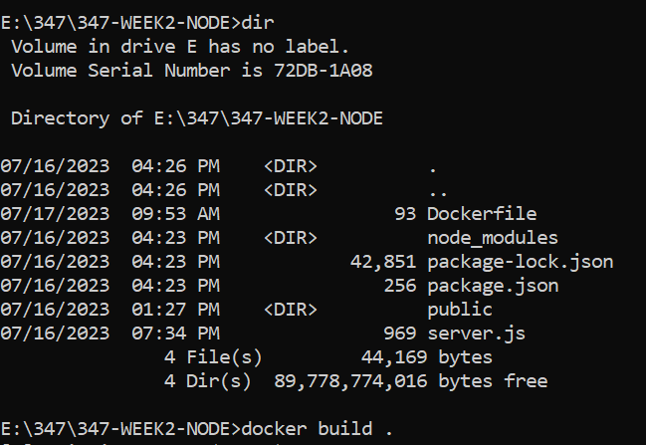
33. Removing Stopped Containers Automatically
--rm

Slide 4
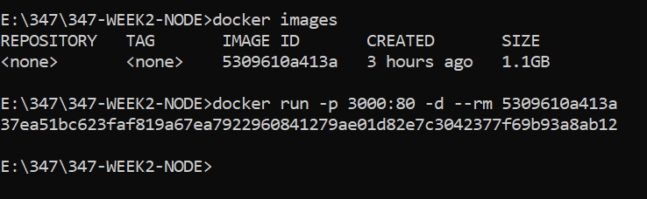
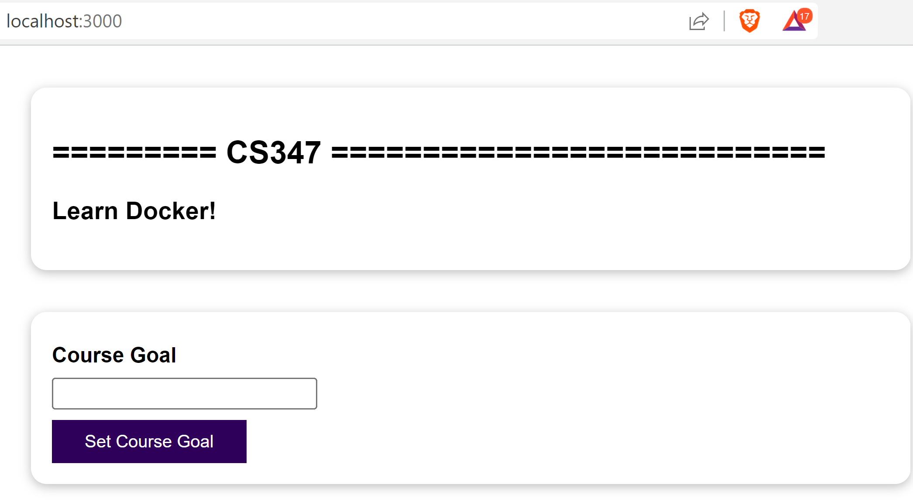

Slide 5
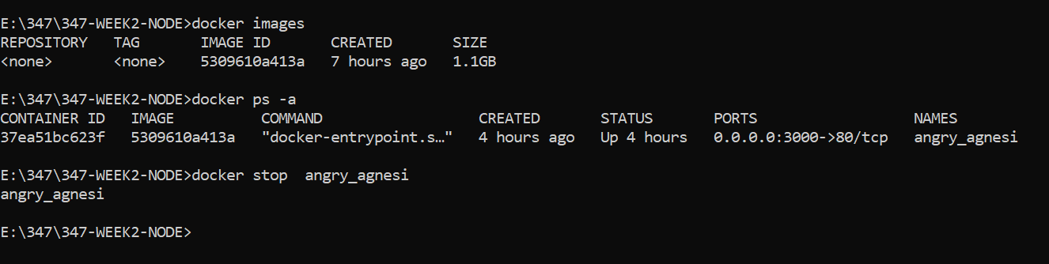
When docker run with –rm flag
stopping container will automatically delete container

Slide 6
E:\347\347-WEEK2-NODE>docker images
REPOSITORY TAG IMAGE ID CREATED SIZE
<none> <none> 5309610a413a 7 hours ago 1.1GB
E:\347\347-WEEK2-NODE>docker ps -a
CONTAINER ID IMAGE COMMAND CREATED STATUS PORTS NAMES
37ea51bc623f 5309610a413a "docker-entrypoint.s…" 4 hours ago Up 4 hours 0.0.0.0:3000->80/tcp angry_agnesi
E:\347\347-WEEK2-NODE>docker stop angry_agnesi
angry_agnesi

Slide 7
34. A Look Behind the Scenes: Inspecting Images
PS E:\347\347-WEEK2-NODE> docker images
REPOSITORY TAG IMAGE ID CREATED SIZE
<none> <none> 5309610a413a 8 hours ago 1.1GB
PS E:\347\347-WEEK2-NODE> docker image inspect 5309610a413a

Slide 8
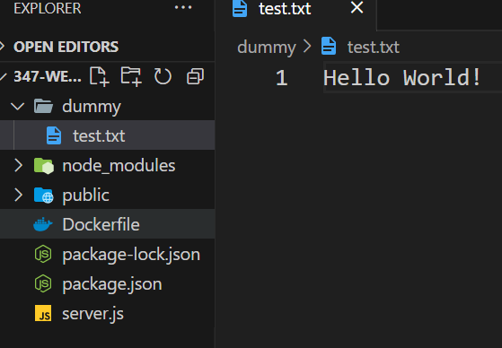
35. Copying Files Into & From A Container
Create folder “dummy”
Create file “test.txt”

Slide 9
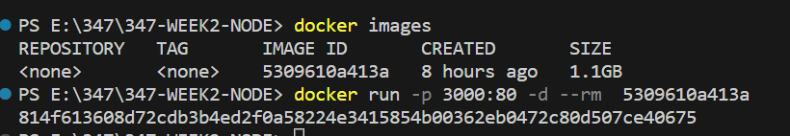
Check whether the containner is running
If not
PS E:\347\347-WEEK2-NODE> docker images
REPOSITORY TAG IMAGE ID CREATED SIZE
<none> <none> 5309610a413a 8 hours ago 1.1GB
PS E:\347\347-WEEK2-NODE> docker run -p 3000:80 -d --rm 5309610a413a
814f613608d72cdb3b4ed2f0a58224e3415854b00362eb0472c80d507ce40675

Slide 10
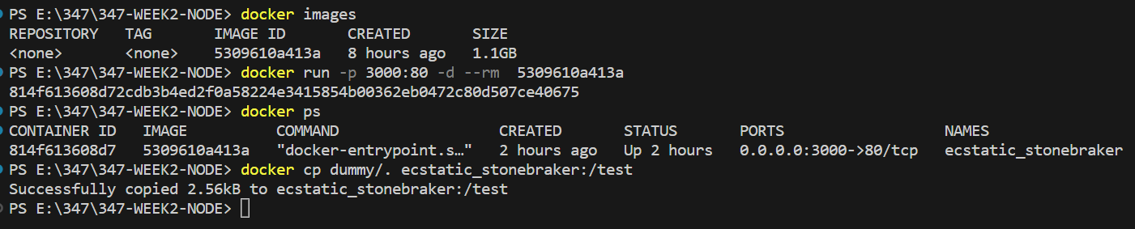

Slide 11
PS E:\347\347-WEEK2-NODE> docker images
REPOSITORY TAG IMAGE ID CREATED SIZE
<none> <none> 5309610a413a 8 hours ago 1.1GB
PS E:\347\347-WEEK2-NODE> docker run -p 3000:80 -d --rm 5309610a413a
814f613608d72cdb3b4ed2f0a58224e3415854b00362eb0472c80d507ce40675
PS E:\347\347-WEEK2-NODE> docker ps
CONTAINER ID IMAGE COMMAND CREATED STATUS PORTS NAMES
814f613608d7 5309610a413a "docker-entrypoint.s…" 2 hours ago Up 2 hours 0.0.0.0:3000->80/tcp ecstatic_stonebraker
PS E:\347\347-WEEK2-NODE> docker cp dummy/. ecstatic_stonebraker:/test
Successfully copied 2.56kB to ecstatic_stonebraker:/test
PS E:\347\347-WEEK2-NODE>

Slide 12
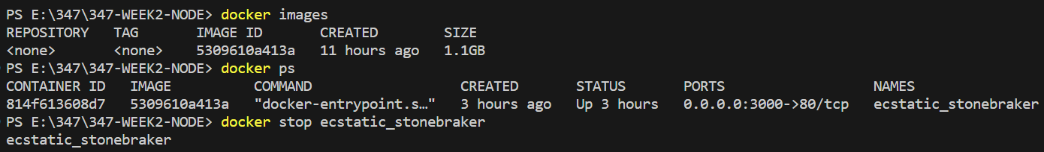
36. Naming & Tagging Containers and Images
PS E:\347\347-WEEK2-NODE> docker images
REPOSITORY TAG IMAGE ID CREATED SIZE
<none> <none> 5309610a413a 11 hours ago 1.1GB
PS E:\347\347-WEEK2-NODE> docker ps
CONTAINER ID IMAGE COMMAND CREATED STATUS PORTS NAMES
814f613608d7 5309610a413a "docker-entrypoint.s…" 3 hours ago Up 3 hours 0.0.0.0:3000->80/tcp ecstatic_stonebraker
PS E:\347\347-WEEK2-NODE> docker stop ecstatic_stonebraker
ecstatic_stonebraker

Slide 13
PS E:\347\347-WEEK2-NODE> docker run -p 3000:80 -d --rm --name goalsapp 5309610a413a
fea92f8cf2545ee79da1a56b8a6531f32d1309087de775ab8275fe6dd9273fd1
PS E:\347\347-WEEK2-NODE> docker ps
CONTAINER ID IMAGE COMMAND CREATED STATUS PORTS NAMES
fea92f8cf254 5309610a413a "docker-entrypoint.s…" 29 seconds ago Up 27 seconds 0.0.0.0:3000->80/tcp goalsapp

Slide 14
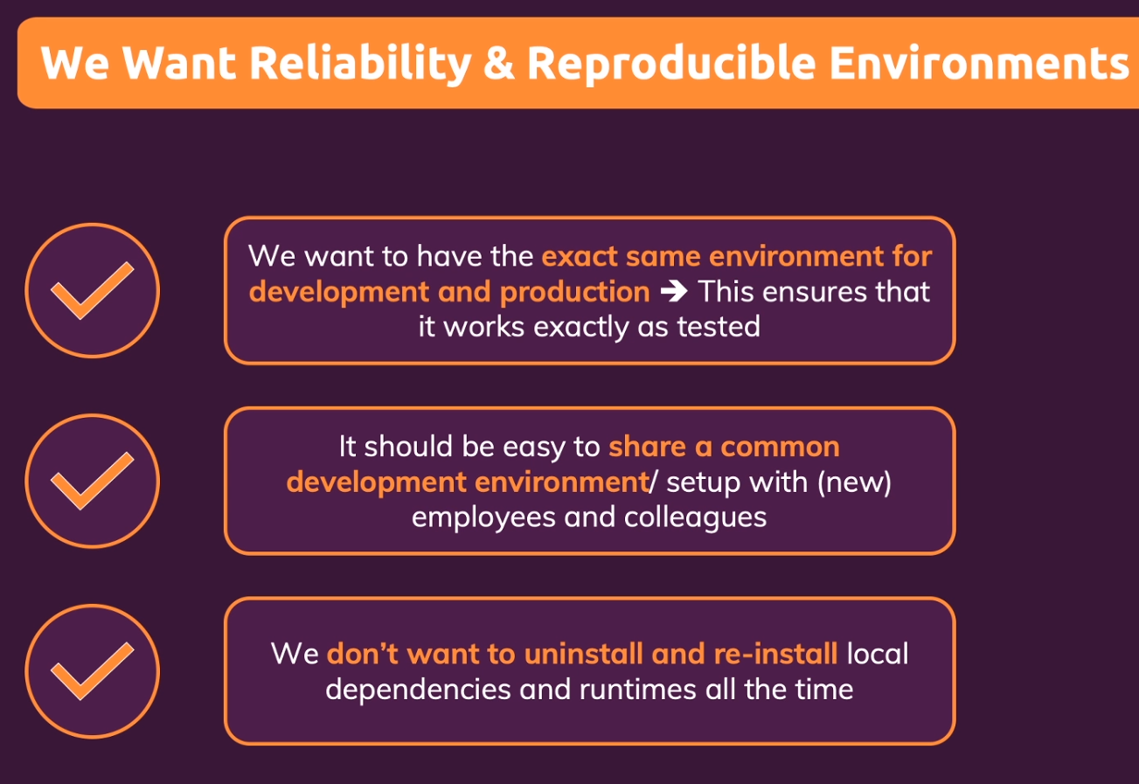
37. Sharing Images - Overview

Slide 15
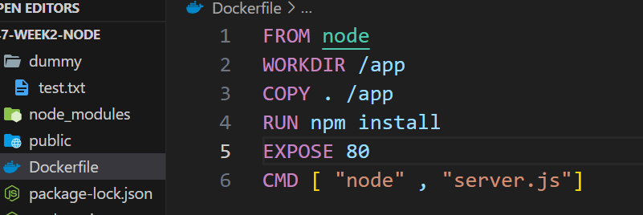
We don’t have to install nodejs in the production server

Slide 16

Share images
Developer team
members
Server
we want to deploy

Slide 17
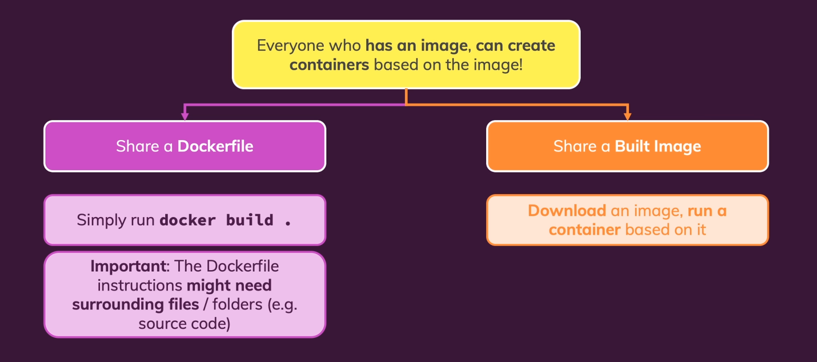
2 methods how to share

Slide 18
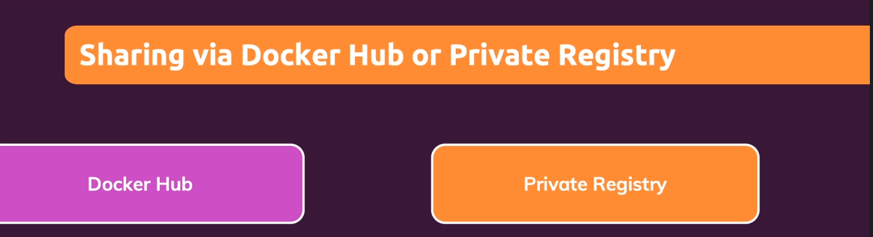
38. Pushing Images to DockerHub

Slide 19

https://www.docker.com/pricing/

Slide 20
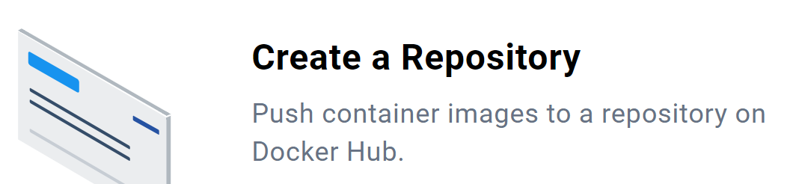

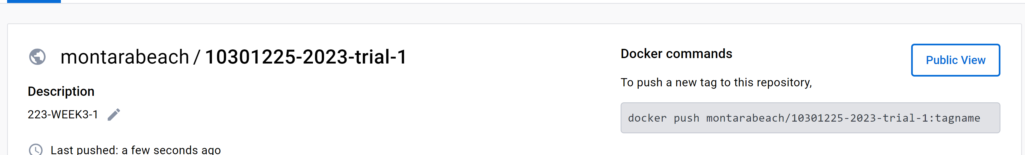
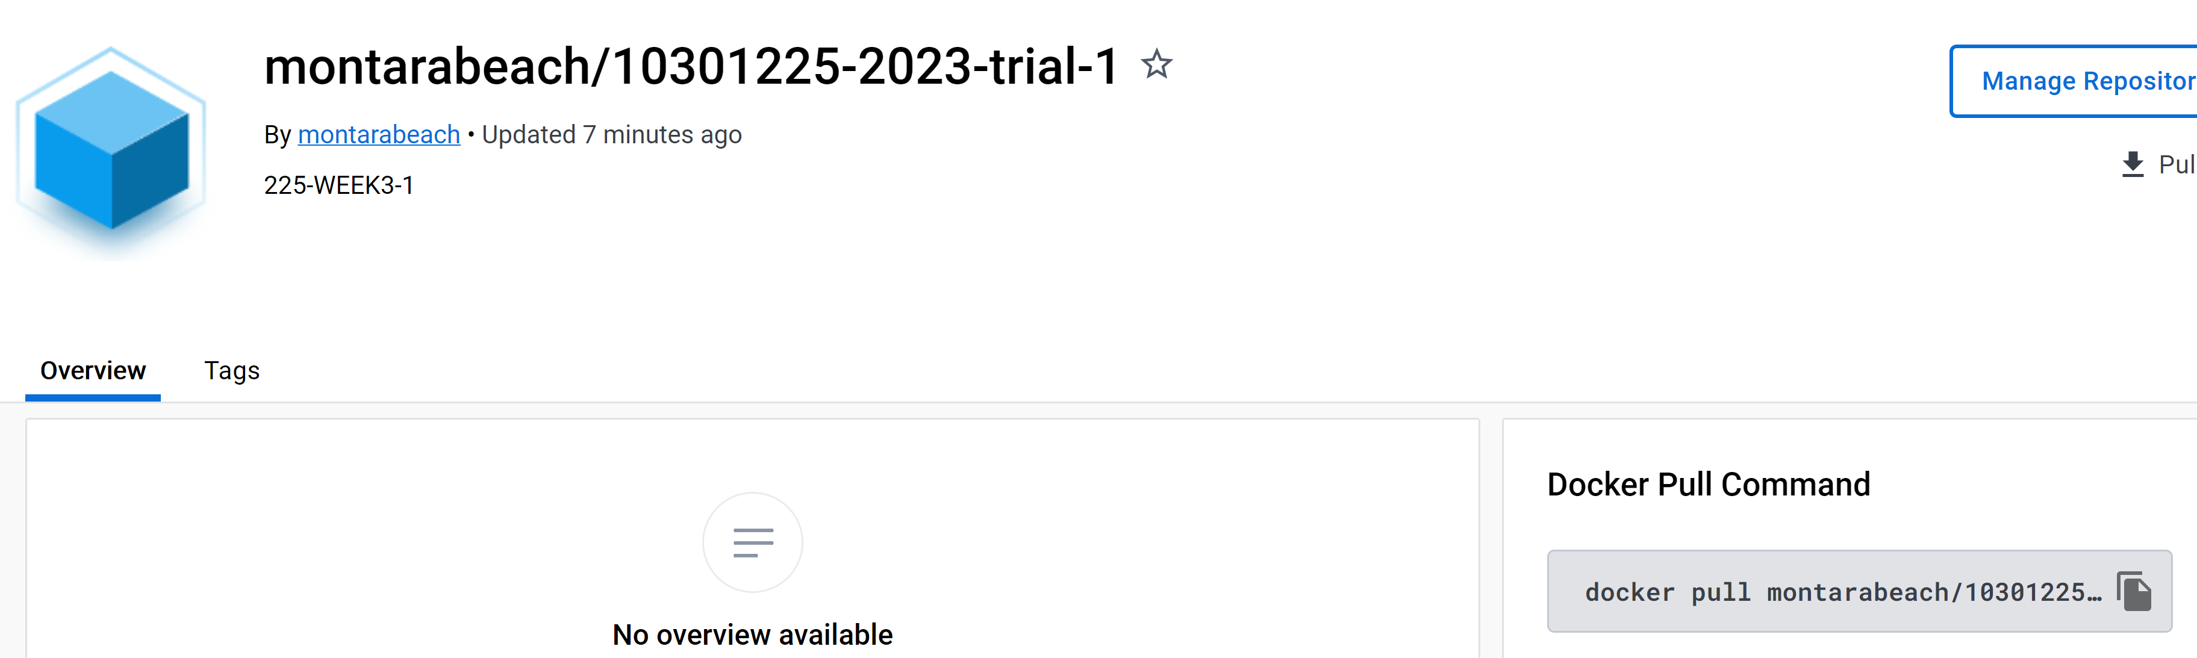
Sign-in to Docker hub
10301225-2023-trial-1
Public

Slide 21
10301225-2023-trial-1-745

Slide 22
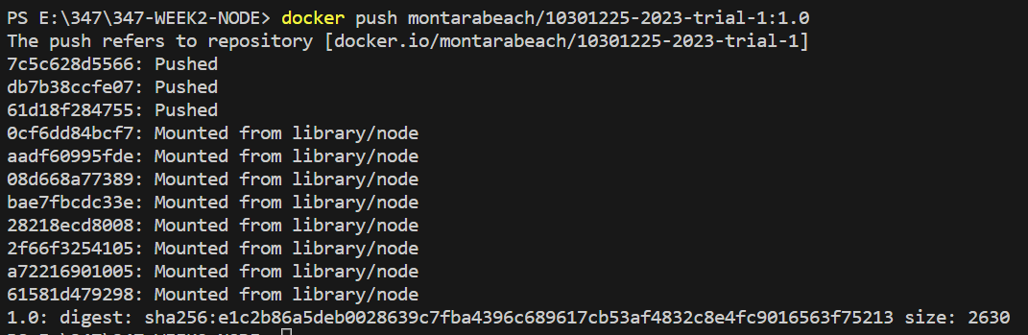
docker build -t montarabeach/10301225-2023-trial-1:1.0 .
docker push montarabeach/10301225-2023-trial-1:1.0

Slide 23
if you cannot push
docker login

Slide 24
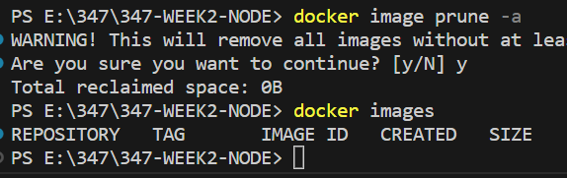
39. Pulling & Using Shared Images

Slide 25
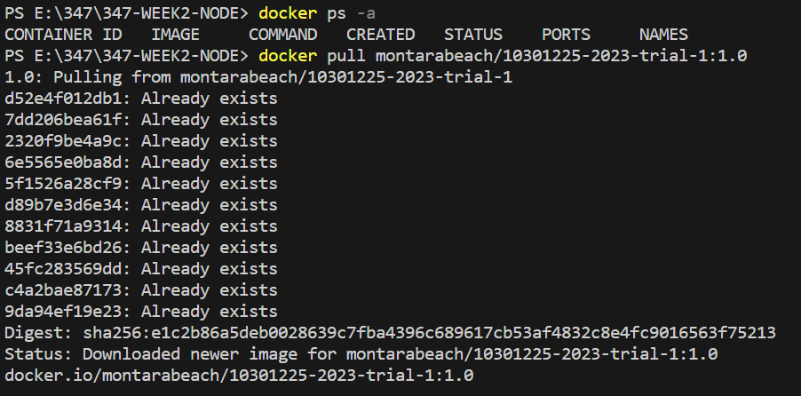
docker pull montarabeach/10301225-2023-trial-1:1.0

Slide 26
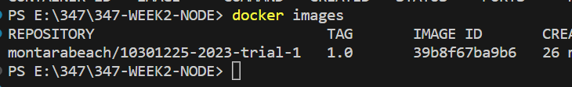
Every one can pull <---- public

Slide 27
docker run -p 3000:80 –d montarabeach/10301225-2023-trial-1:1.0

