Slide 1
347-WEEK2-2

Slide 2
Images contain the code, the setup, the library.
Container runs instance of those images.

Slide 3
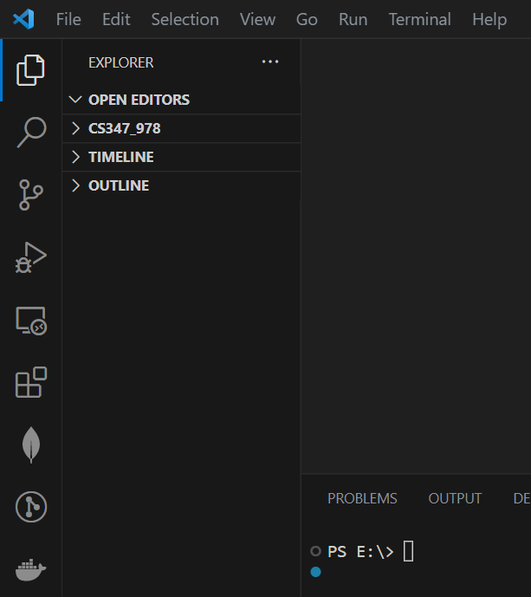
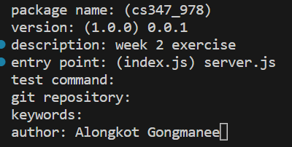
20. Our Goal: A NodeJS App
PS E:\> cd CS347_978
PS E:\CS347_978> npm init

Slide 4
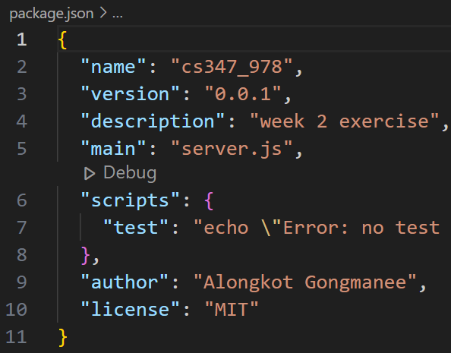
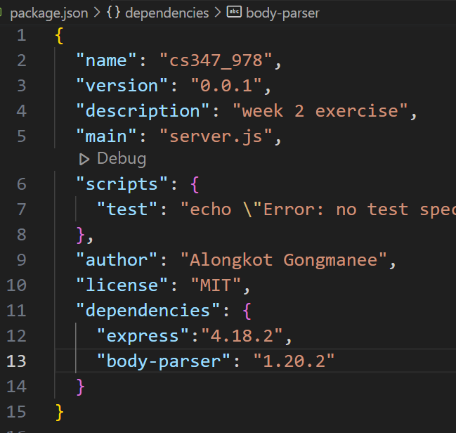
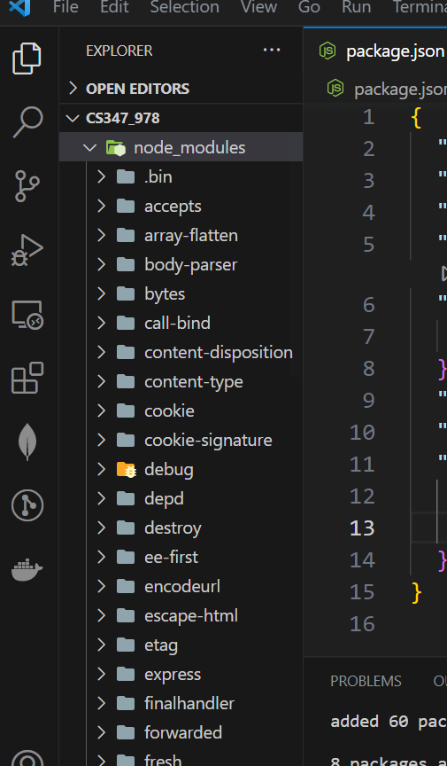
PS E:\CS347_978> npm install
package.json

Slide 5
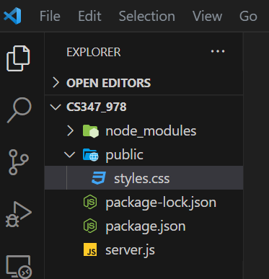
20. Our Goal: A NodeJS App

Slide 6
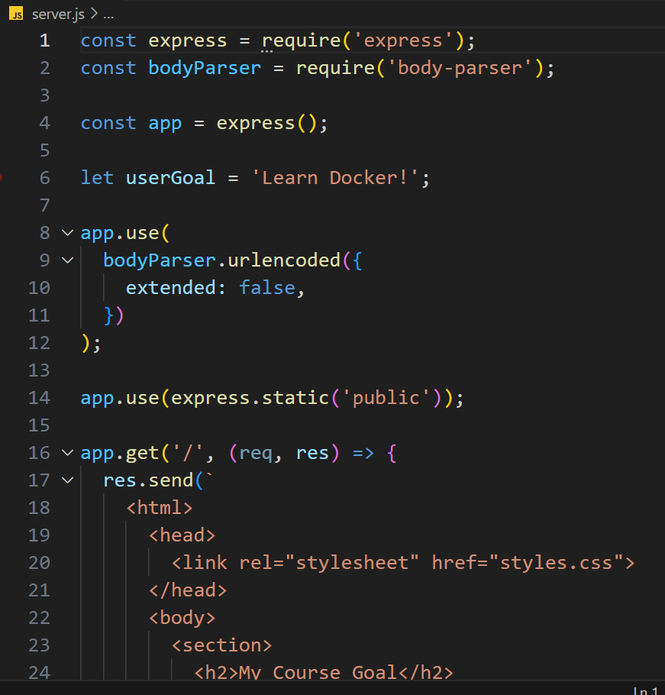
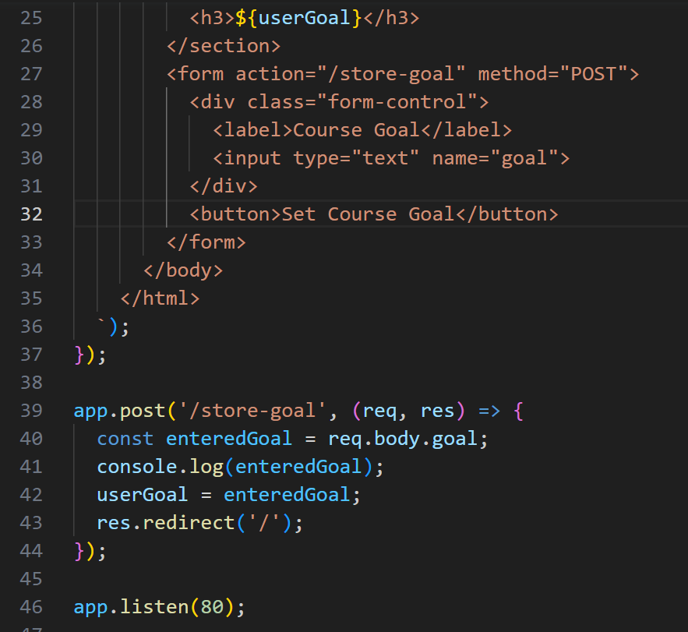
server.js

Slide 7
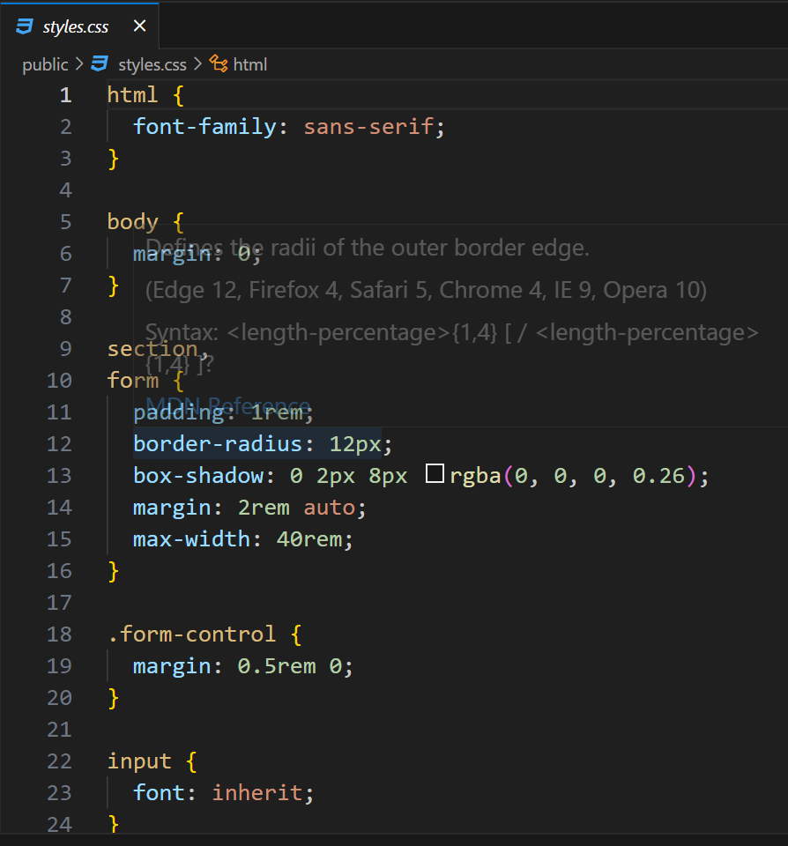
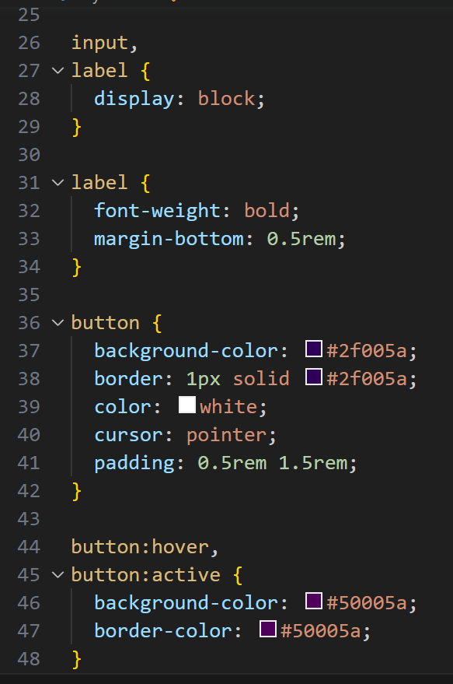

Slide 8
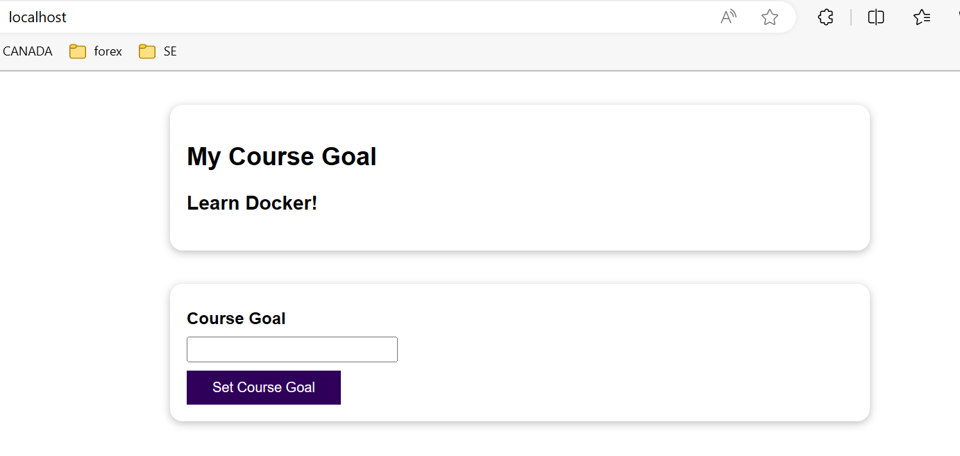
PS E:\CS347_978> node server.js
localhost

Slide 9
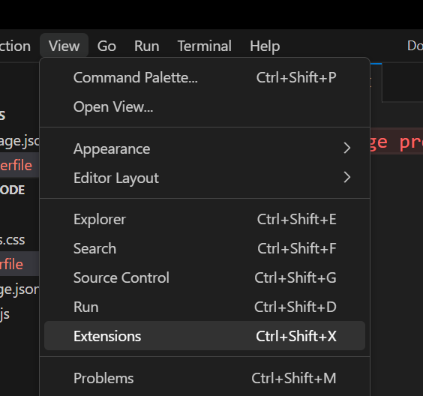
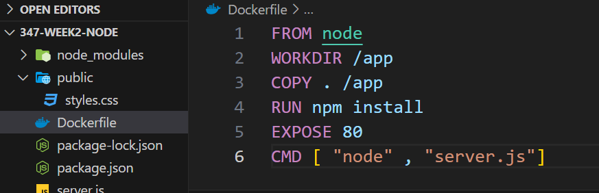
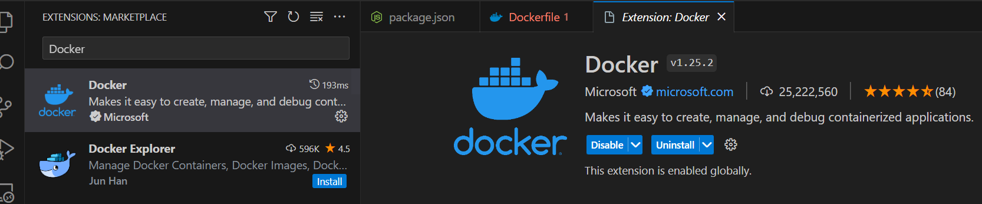
21. Building our own Image with a Dockerfile
1) View – extension - docker
2) Dockerfile

Slide 10
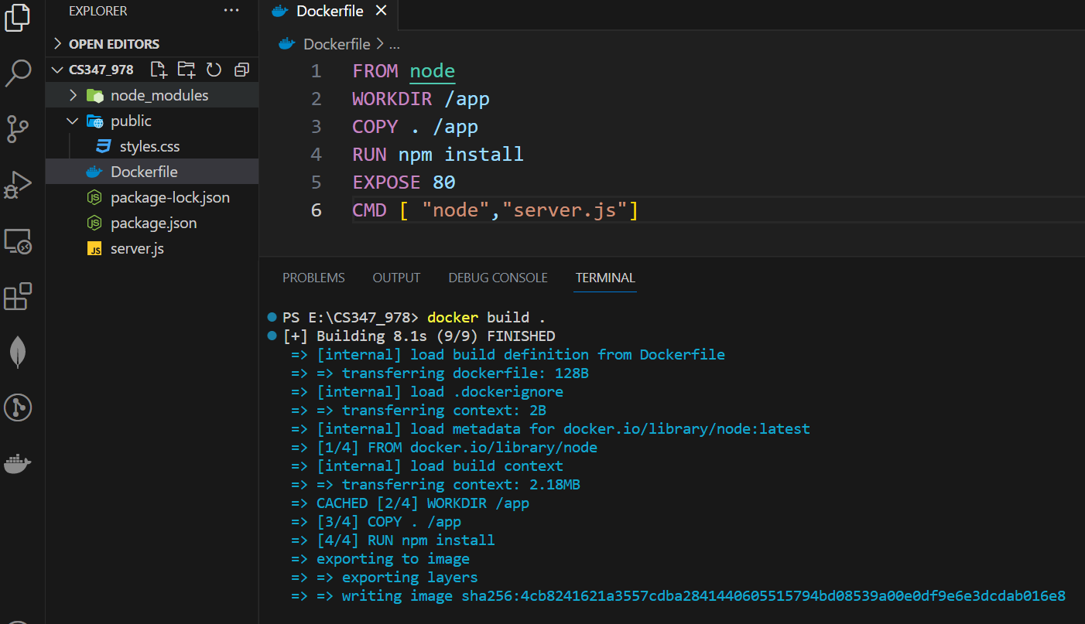
22. Running a Container based on our own Image
docket build .
image
Run

Slide 11
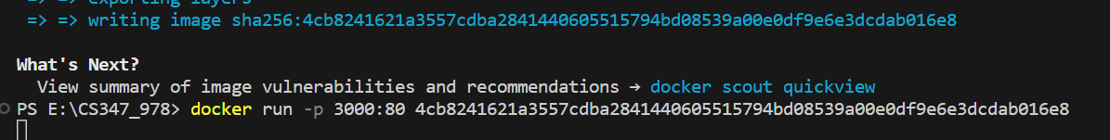
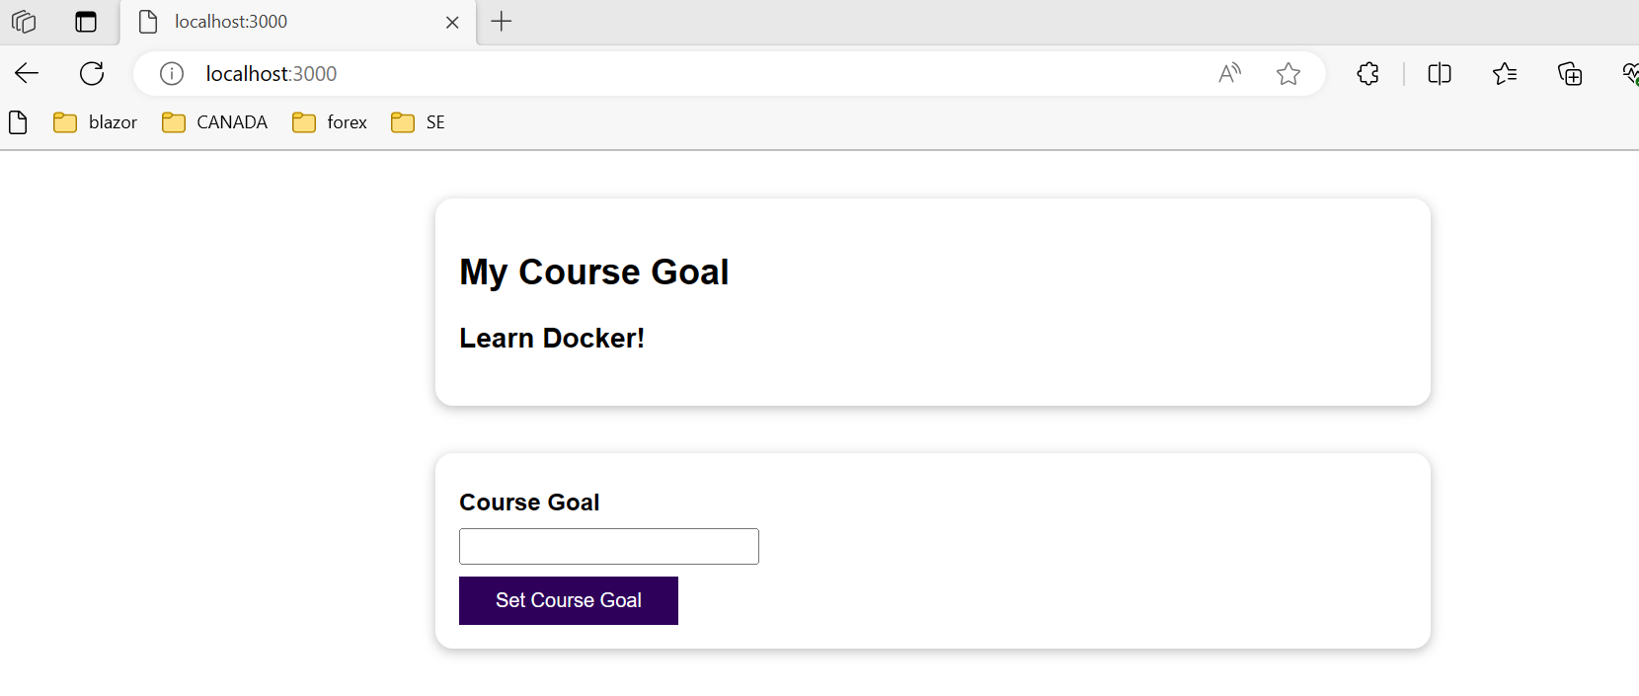

Slide 12
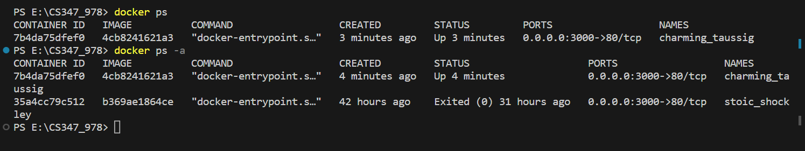
Open another terminal

Slide 13
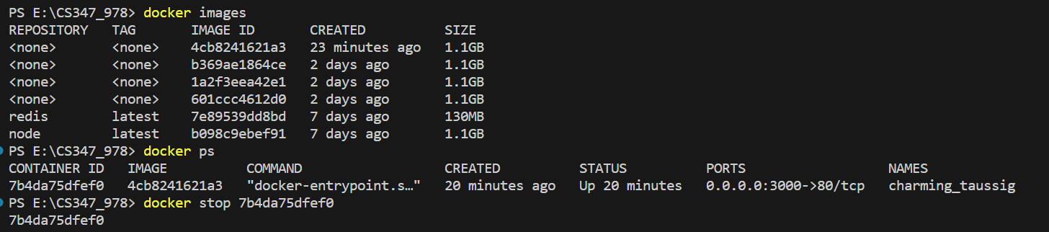
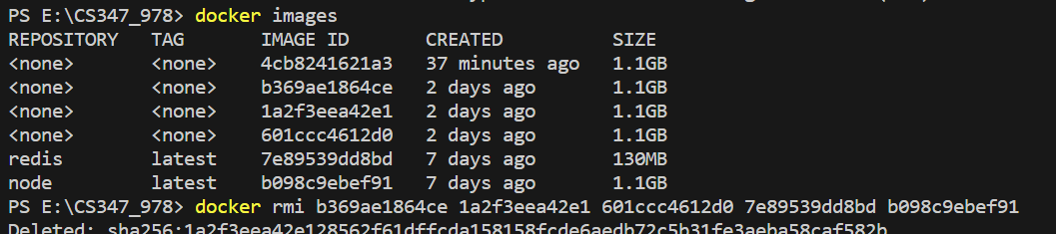
29. Understanding Attached & Detached Containers

Slide 14
1 image รันหรือสตาร์ทได้หลาย containers
container1
run หรือ start
image
run หรือ start
container1
run หรือ start
container1

Slide 15

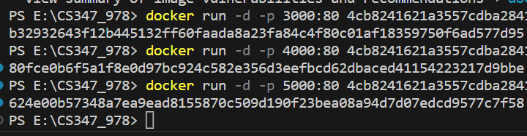
Remove all imges
2) create an image
3) builds 3 new containers in detached mode

Slide 16
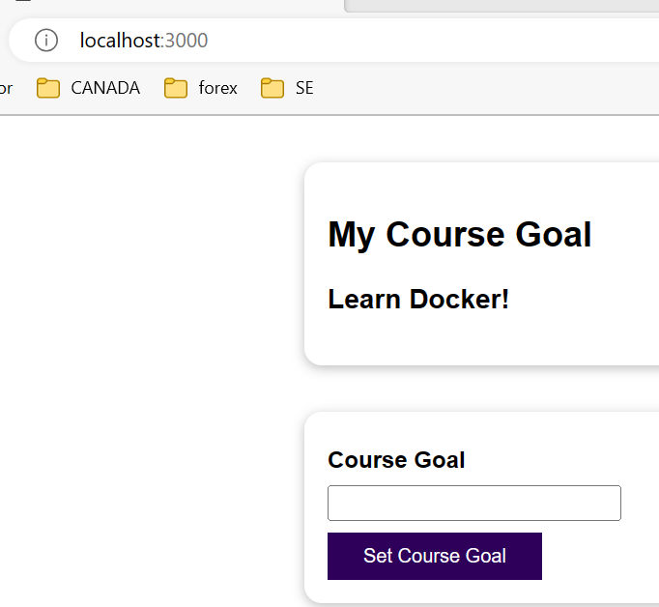
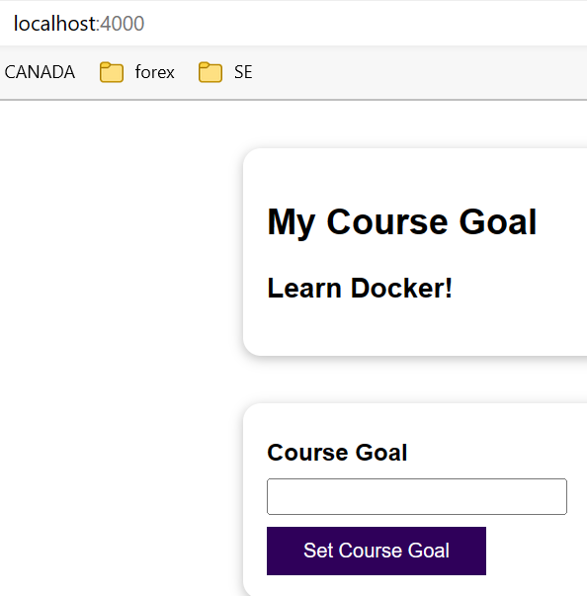
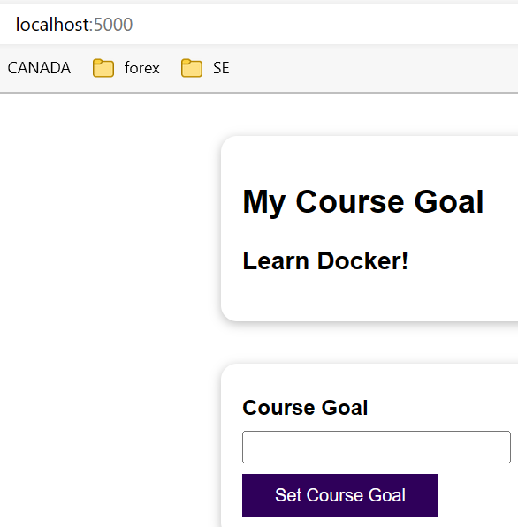
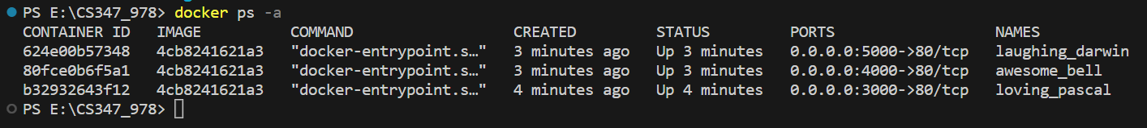
localhost:3000
localhost:4000
localhost:5000
-d is detach mode
-a is attach mode

Slide 17
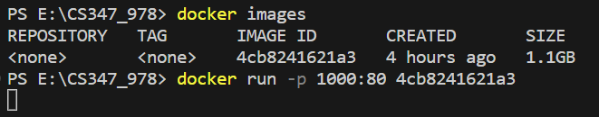
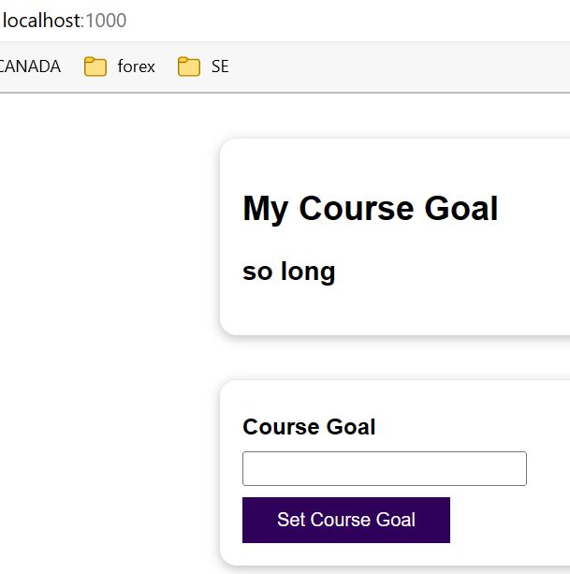
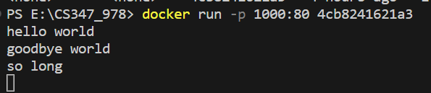
Build an “attached mode” container

Slide 18
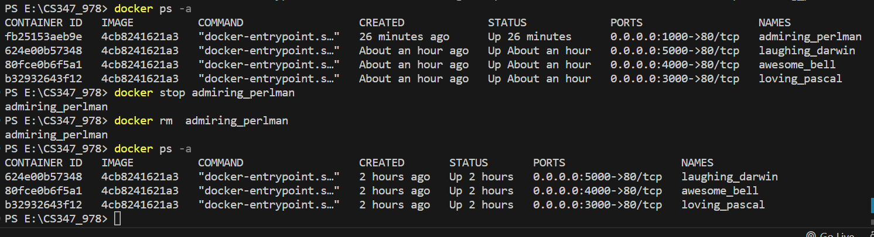
32. Deleting Images & Containers

