Slide 1

http://flic.kr/p/6oP7x7
Version Control with Git

Slide 2
Why track/manage revisions?

Slide 3
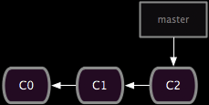
Backup: Undo or refer to old stuff
http://git-scm.com/book/en/Git-Branching-Basic-Branching-and-Merging

Slide 4
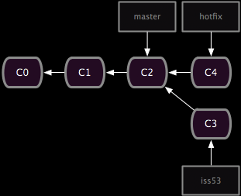
Branch: Maintain old release while working on new
http://git-scm.com/book/en/Git-Branching-Basic-Branching-and-Merging

Slide 5
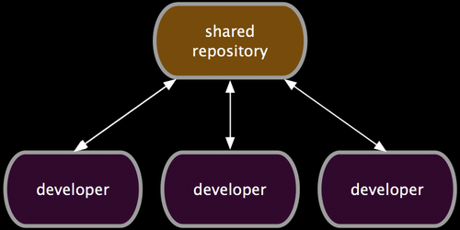
Collaborate: Work in parallel with teammates
http://git-scm.com/book/en/Distributed-Git-Distributed-Workflows

Slide 6
Version Control Systems (VCSs)
Help you track/manage/distribute revisions
Standard in modern development
Examples:
  Revision Control System (RCS)
  Concurrent Versions System (CVS)
  Subversion (SVN)
  Git
older
newer
Our focus

Slide 7


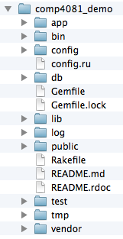
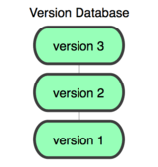
GitHub-User Perspective
You
GitHub
Working Dir
Local
Repos
Remote
Repos

Slide 8
Let’s begin with an example…
You
GitHub

Slide 9
Configure your Git client
(Rails Tutorial 1.3.1)
Install Git
Check config info:
Fix if necessary:
$ git config --list
user.name=Scott Fleming
user.email=Scott.Fleming@memphis.edu
$ git config --global user.name "John Doe"
$ git config --global user.email jdoe@memphis.edu

Slide 10
Log into GitHub and create a repos
(with add README option)
You
GitHub
Remote
Repos

Slide 11
$ git clone https://github.com/sdflem/comp4081_demo.git
You
GitHub
Working Dir
Local
Repos
Remote
Repos

Slide 12
$ rails new comp4081_demo
You
GitHub
Working Dir
Local
Repos
Remote
Repos

Slide 13
$ cd comp4081_demo
$ git add -A
$ git commit –m "Created Rails project skeleton"
You
GitHub
Working Dir
Local
Repos
Remote
Repos

Slide 14
$ git push
You
GitHub
Working Dir
Local
Repos
Remote
Repos

Slide 15
Questions to answer
How organized?
You
GitHub
Working Dir
Local
Repos
Remote
Repos
What operations?

Slide 16
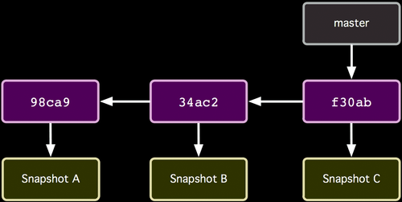
How the repos is organized
http://git-scm.com/book/

Slide 17
How the repos is organized
Commits (from oldest to newest; hashes as commit IDs)
http://git-scm.com/book/

Slide 18
How the repos is organized
Snapshot of all files at each commit
http://git-scm.com/book/

Slide 19
How the repos is organized
Branch (last commit)
http://git-scm.com/book/

Slide 20
How commit works
Before
http://git-scm.com/book/

Slide 21
How commit works
After
http://git-scm.com/book/

Slide 22
Common Workflow
Create temp local branch
Checkout temp branch
Edit/Add/Commit on temp branch
Checkout master branch
Pull to update master branch
Merge temp branch with updated master
Delete temp branch
Push to update server repos
Make changes in local branch
Merge with GitHub repos

Slide 23
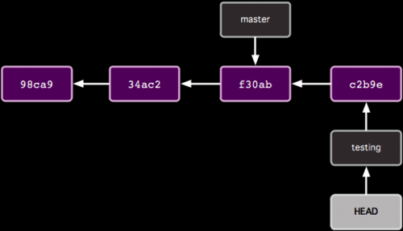
Organization with two branches

Slide 24
Organization with two branches
Last commit of each branch

Slide 25
Organization with two branches
Currently checked out branch

Slide 26
Common Workflow
Create temp local branch
Checkout temp branch
Edit/Add/Commit on temp branch
Checkout master branch
Pull to update master branch
Merge temp branch with updated master
Delete temp branch
Push to update server repos

Slide 27
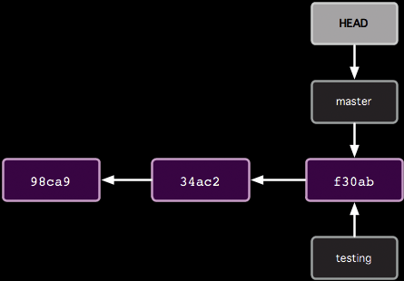
How git branch works
$ git branch testing
Before

Slide 28
How git branch works
$ git branch testing
After

Slide 29
Common Workflow
Create temp local branch
Checkout temp branch
Edit/Add/Commit on temp branch
Checkout master branch
Pull to update master branch
Merge temp branch with updated master
Delete temp branch
Push to update server repos

Slide 30
How git checkout works
$ git checkout testing
Before

Slide 31
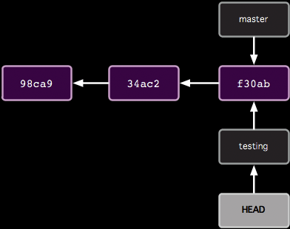
How git checkout works
$ git checkout testing
After

Slide 32
Common Workflow
Create temp local branch
Checkout temp branch
Edit/Add/Commit on temp branch
Checkout master branch
Pull to update master branch
Merge temp branch with updated master
Delete temp branch
Push to update server repos

Slide 33
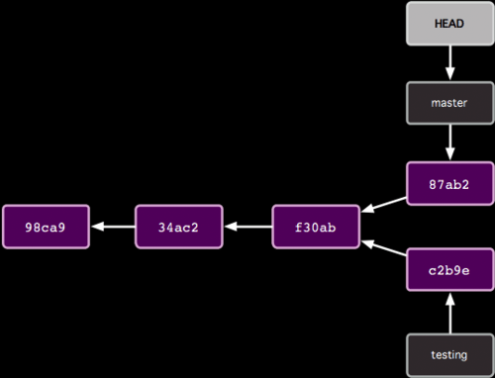
How git commit works with multiple branches
Edit some stuff
$ git add -A
$ git commit –m "blah"
Before

Slide 34
How git commit works with multiple branches
Edit some stuff
$ git add -A
$ git commit –m "blah"
After

Slide 35
Common Workflow
Create temp local branch
Checkout temp branch
Edit/Add/Commit on temp branch
Checkout master branch
Pull to update master branch
Merge temp branch with updated master
Delete temp branch
Push to update server repos

Slide 36
How git checkout works
$ git checkout master
Before

Slide 37
How git checkout works
$ git checkout master
After

Slide 38
Common Workflow
Create temp local branch
Checkout temp branch
Edit/Add/Commit on temp branch
Checkout master branch
Pull to update master branch
Merge temp branch with updated master
Delete temp branch
Push to update server repos

Slide 39
How git pull works
Someone else pushed
$ git pull
Before

Slide 40
How git pull works
Someone else pushed
$ git pull
After

Slide 41
Common Workflow
Create temp local branch
Checkout temp branch
Edit/Add/Commit on temp branch
Checkout master branch
Pull to update master branch
Merge temp branch with updated master
Delete temp branch
Push to update server repos

Slide 42
How git merge works
$ git merge testing
Before

Slide 43
How git merge works
$ git merge testing
e2b92
After

Slide 44
Common Workflow
Create temp local branch
Checkout temp branch
Edit/Add/Commit on temp branch
Checkout master branch
Pull to update master branch
Merge temp branch with updated master
Delete temp branch
Push to update server repos

Slide 45
How to delete branches
$ git branch -d testing
e2b92
Before

Slide 46
How to delete branches
$ git branch -d testing
e2b92
After

Slide 47
Common Workflow
Create temp local branch
Checkout temp branch
Edit/Add/Commit on temp branch
Checkout master branch
Pull to update master branch
Merge temp branch with updated master
Delete temp branch
Push to update server repos

Slide 48
How git push works
$ git push
e2b92
Should update server repos
(if no one else has pushed commits to master branch since last pull)

Slide 49
Tips
git output contains lots of hints
  git status is your friend!
Merging may not be as easy as I showed
  E.g.: Multiple collabs updated same parts of file
  See Pro Git 3.2
Pull before starting temp branch
Team communication important!

Slide 50
Pop Quiz
5 questions
Update diagram in each
  Commit nodes
  Branch nodes
Based on actions of Alice and Bob
  Collaborating via GitHub repo

Slide 51
Start like this
Scott Fleming
SF 1
GitHub
master
11111
master
Alice
11111
Bob

Slide 52
Question 1
Alice:
  $ git clone https://github.com/whatever.git
  $ cd whatever
Bob:
  $ git clone https://github.com/whatever.git
  $ cd whatever
(include the HEAD node)

Slide 53
Question 2
Alice:
  $ git branch myfix
  $ git checkout myfix
(Alternatively)
  $ git checkout -b myfix

Slide 54
Question 3
Alice:
  $ rails generate scaffold User …
  $ git add -A
  $ git commit -m "Added User" # 22222
Bob:
  $ rails generate scaffold Micropost …
  $ git add -A
  $ git commit -m "Added Micropost" # 33333

Slide 55
Question 4
Bob:
  git push

Slide 56
Question 5
Alice:
  git pull

Slide 57
Appendix

Slide 58
What if…
Alice did this:
app/models/micropost.rb
class Micropost < ActiveRecord::Base
validates :content, length: { maximum: 140 }
end
Bob did this:
app/models/micropost.rb
class Micropost < ActiveRecord::Base
validates :content, length: { maximum: 120 }
end

Slide 59
What if Alice did this?
master
33333
$ git checkout master
$ git merge myfix
11111
22222
myfix

Slide 60
$ git merge myfix
Auto-merging app/models/micropost.rb
Automatic merge failed; fix conflict and then commit result.
app/models/micropost.rb
class Micropost < ActiveRecord::Base
<<<<<<< HEAD
validates :content, length: { maximum: 140 }
=======
validates :content, length: { maximum: 120 }
>>>>>>> myfix
end
To resolve:
Manually fix the file; git add and commit

