Slide 1

Heart Watch
Team 16
Kian Soon (A0213510B)
Mahathir (A0213486A)
Shao Qiang (A0213558A)

Slide 2
Business Value
Background
Cardiovascular disease (CVD) is a leading cause of death globally and 17 people in Singapore die from CVD everyday. A doctor has a wide variety of non-invasive and invasive tests at his disposal to diagnose CVD patients. These tests can be expensive and time-consuming for both the patient and the doctor. Therefore, a doctor needs to figure out the most efficient method to predict onset of CVD in his patients.
Proposed solution
A short questionnaire designed from rules derived from a historical dataset of CVD predictors. A doctor will order a single non-invasive test, the Thallium stress test, and few more non-invasive tests as required by the questionnaire. Based on the rules set by our machine learning algorithm, the questionnaire is able to predict the onset of CVD.

Slide 3
Executive summary
There are many factors for diagnosing heart diseases, and faced with many patients, doctors will be overloaded with making diagnoses.
An automatic decision making system can reduce the load of doctors in medical diagnoses.
Decision tree technique is proposed for deriving the best indicative factors, leading to more accurate and timely diagnoses of the potential presence of heart disease in patients.
Patient users may also use this app to get a second opinion, to decide whether to proceed for further checks if they are identified to be high-risk in having heart disease

Slide 4
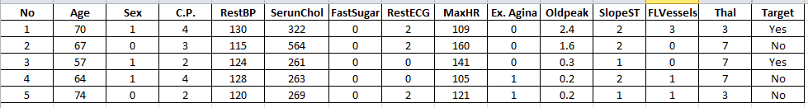
System Design
Dataset
UCI ML Repository Heart Disease Dataset
270 instances / 14 attributes
C.P. (Chest pain): 1- typical angina, 2 - atypical angina, 3 - non-anginal pain,
4 – asymptomatic
Thal (Thallium stress test): 3 – normal blood flow through the coronary arteries ,
6 - fixed defect, 7 - reversable defect
Target (Diagnosis of CVD): Yes ( Presence of Heart Disease),
No (No Presence of Heart Disease)

Slide 5
Project Solution
Decision tree technique will be used to derive the best indicative factors based on the background data from past medical diagnoses of doctors.
270 patients records are used
13 key factors diagnosing CVD are identified for use
Background data will be used to generate both training and testing datasets
Decision tree will be trained to find the best attributes that produce the highest information gain (lowest entropy)

Slide 6
Project Solution
Next, the tree branches will be converted into rules
Rules will be embedded in Rules Engine
A set of questionnaire based on the dataset fields will be deployed in Django
Reasoning System will match the rules against user answers to generate the response (prediction)

Slide 7
Design and Implementation
Background dataset from past heart disease diagnoses
Reasoning System match rules against facts
Embedded rules in Rules Engine
Training: Grow Decision Tree
Rules
System Response (Prediction)
Decision Tree
Extract rules

Slide 8

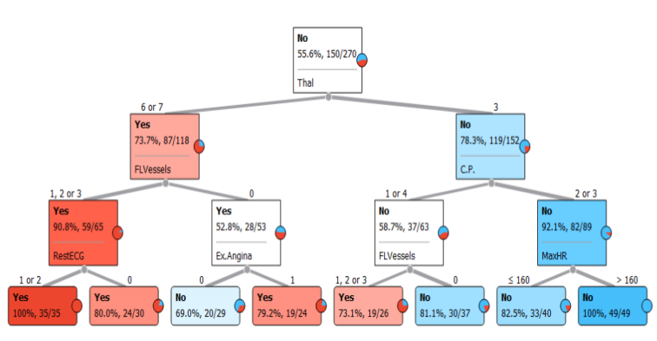



System Architecture
System set-up
Deployment
Orange Data Mining for growing decision-tree
User access
Django Views
Rules written to DB
User interactions and server responses
CrispyForms
Compare user inputs with stored rules
Experta Rules Engine
Django Web Server

Slide 9



System Architecture
Server side
Client side
User access
forms.py
questionaire-01.html
views.py
(Business Logic)
questionaire-02.html
rules.py (Experta)
result.html
Orange, Rattle or Scikit-Learn for Data Mining and Machine Learning for growing decision-tree and conducting cross-validation

Slide 10
Webapp and Tools
Front End: CSS Bootstrap
Back End: Django Framework, Experta
Supporting Tools: Rattle GUI

Slide 11
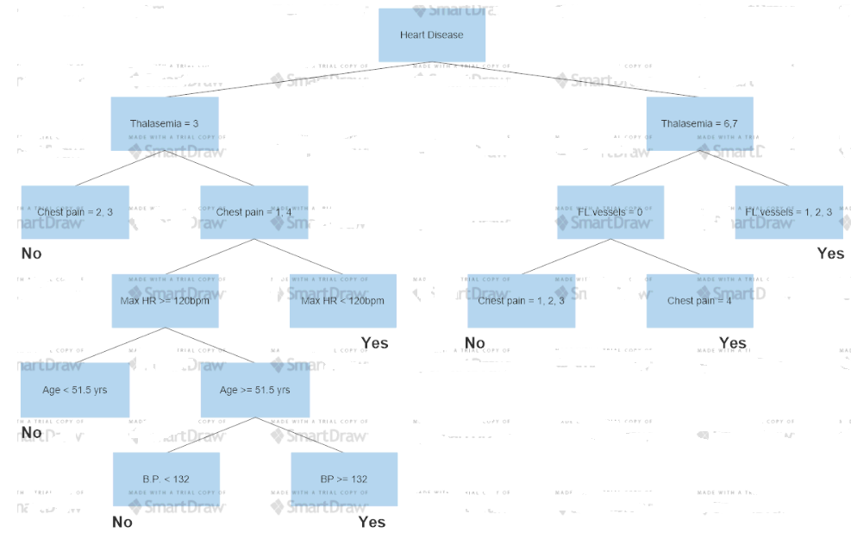
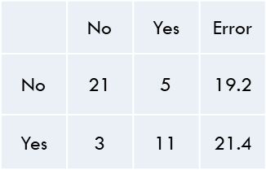
Decision tree generation
Data-mining (Decision tree)
Modelled in R using RATTLE library
Predicted
Actual
Error matrix

Slide 12
Rule Table and Data Output
No | Rules | Probability that Patient has Heart Disease | Diagnosis for Heart Disease
1 | Thal = 3 AND C.P. = 2,3 AND MaxHR >160 | 0% | Negative
2 | Thal = 3 AND C.P. = 2,3 AND MaxHR <= 160 | 17% | Negative
3 | Thal = 3 AND C.P = 1,4 AND FLVessels = 0 | 19% | Negative
4 | Thal = 3 AND C.P = 1,4 AND FLVessels = 1,2,3 | 73% | Positive
5 | Thal = 6,7 AND FLVessels = 0 AND Ex.Angina = 1 | 79% | Positive
6 | Thal = 6,7 AND FLVessels = 0 AND Ex.Angina = 0 | 31% | Negative
7 | Thal = 6,7 AND FLVessels = 1,2,3 AND Rest ECG = 1,2 | 100% | Positive
8 | Thal 6,7 AND FLVessels = 1,2,3 AND Rest ECG = 0 | 80% | Positive
As some of the sample set at the leaf nodes of decision tree are not pure, the app shall report a certain probability of the patient having heart disease

Slide 13
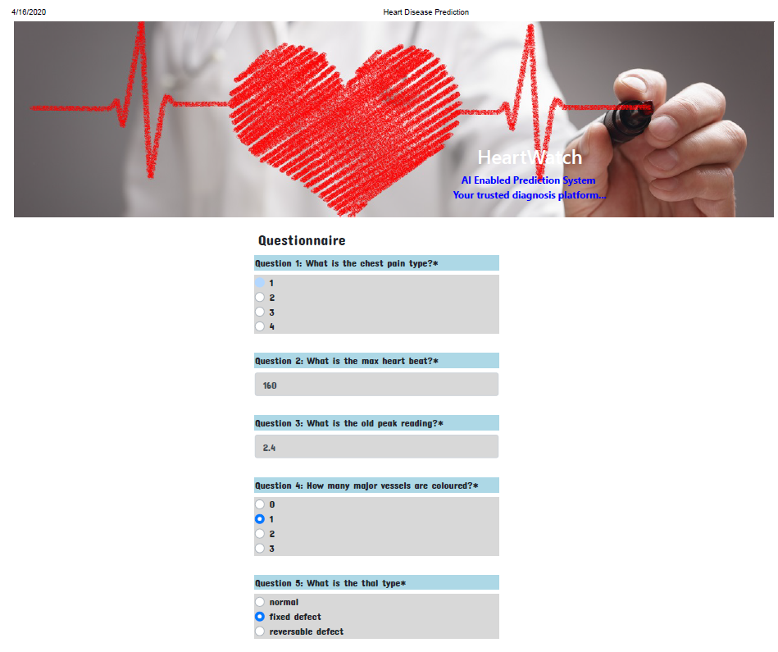
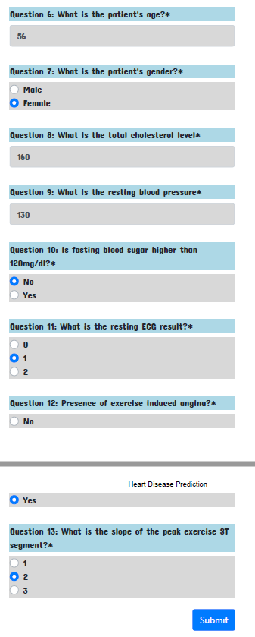
Sample Questionnaire Form 1

Slide 14
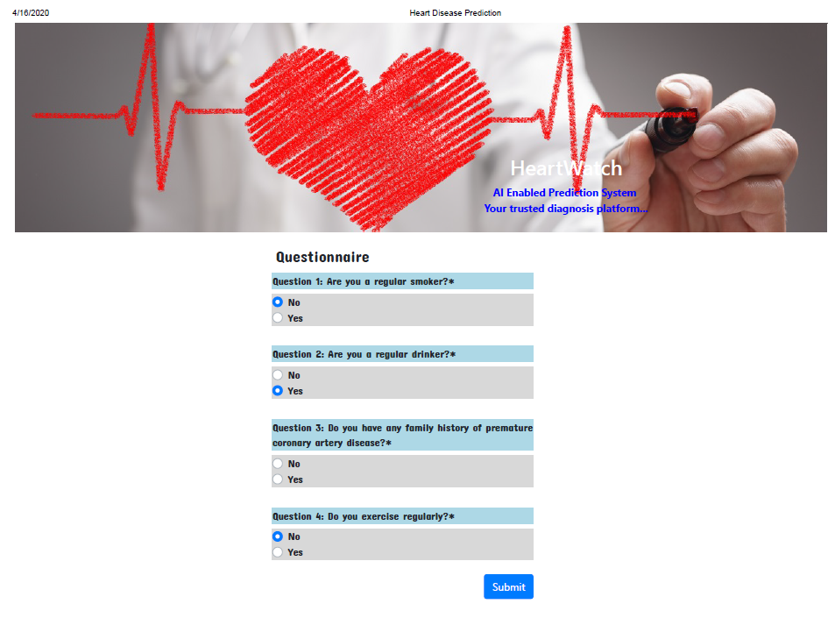
Sample Questionnaire Form 2

Slide 15
Value-ADDS
Domain expert interview (Groundwork)
Questionnaire with GP (Selected questions)
What are the most important signs and symptoms of heart diseases?
What are the current methods used by physicians to determine presence of heart diseases?
Among the factors shown above, which do you think will be the most indicative factors for presence of heart disease? Why is it so?
Are there any other factors which you think can be a good predictor of heart diseases (smoking, alcohol, hereditary etc.)?
Do you know of any similar products in the market? What is your assessment of these products?

Slide 16
Future Enhancement
Automated rules creation
Allow medical professionals to input their own dataset into the program
The program run a script to create the decision tree and generate new rule sets for the reasoning system. The webapp questionnaire will also be updated accordingly.
System will be able to support wider use case (diabetes, depression etc) and not just limited to heart disease prediction

