Slide 1


VIDEO COMPRESSION
Group 24
  Aman Kumar (MT24012)
  Hardik Jain (MT24037)
  Suhail Saifi (MT24097)

Slide 2

Introduction
Video processing and analysis have become an urgent task, as a huge amount of videos (e.g., YouTube, Hulu) are uploaded online every day. The extraction of representative key frames from videos is important in video processing and analysis since it greatly reduces computing resources and time.
We evaluate our method on two datasets (i.e., AlitaBattleAngel.mkv and AvengersEndgme.mkv), and the experimental results consistently demonstrate that our strategy achieves competitive performance and efficiency compared with the state-of-the-art approaches
Keywords: Video compression, motion compensation, K-means clustering, PSNR, residual encoding.

Slide 3

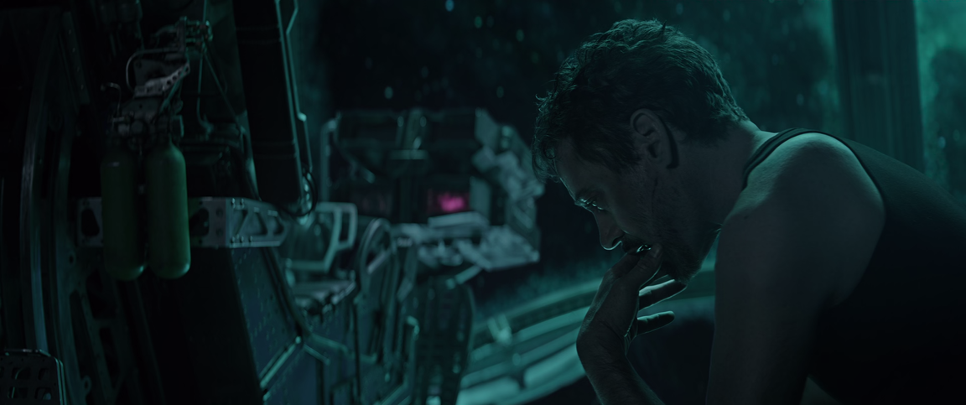
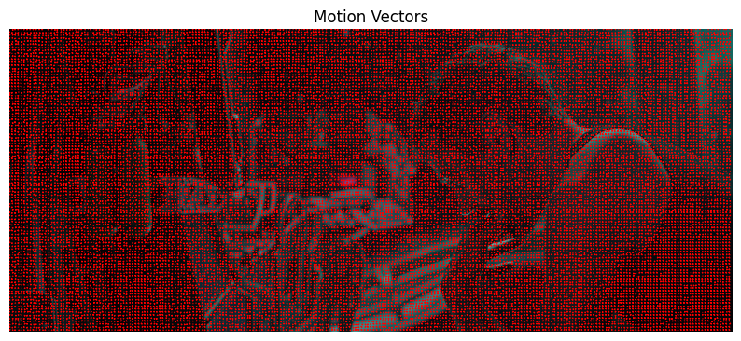
In our EDA focuses on motion vector analysis, frame difference analysis, optical flow analysis, frame brightness, and RGB color difference.
EDA
OriginalFrame 0000
Motion Vector Analysis
Motion vectors are calculated by comparing blocks between frames, seeking the most similar area within a defined search window. This Sum of Absolute Differences (SAD) approach helps determine the displacement of blocks between frames, visualized as arrows over the original frame.

Slide 4
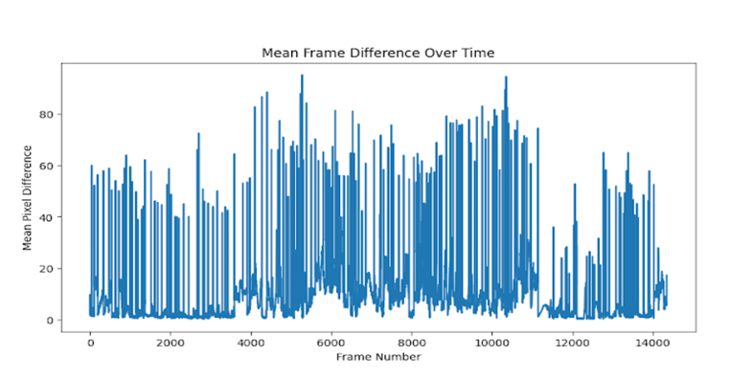

In our EDA focuses on motion vector analysis, frame difference analysis, optical flow analysis, frame brightness, and Histograms of Oriented Gradients.
EDA
Frame Difference Analysis
It is identifying stability and recognizing scenes with abrupt changes. In the Frame Difference Analysis, we utilized OpenCV to calculate the absolute differences between consecutive frames, revealing variations in pixel intensity. This information is vital for unsupervised learning tasks, especially in event detection.
Histograms of Oriented Gradients
HOG play a crucial role in object recognition and scene understanding within computer vision. Incorporating HOG in our analysis involved utilizing the scikit image library, specifically the HOG function, which extracts features representing object structure and edges. Peaks in the HOG features signify the presence of objects or alterations in their shapes, while stability indicates consistent structures over frames.

Slide 5
Methodology
Approach 1
Video Compression
  Block Division and Preprocessing
  Color Clustering for Enhanced Representation
  Motion Estimation for Inter-frame Dynamics
  Data Encoding for Efficient Storage
Video Decompression
  Initialization and Frame Preparation
  Simulated Frame by Frame Decompression
Approach 2
Video Compression
  Frames are Resized to Resolution (1280*720)
  Divided into Clusters of 8*8 Pixels
  Motion Vectors are tracked between 2 frames
  Compressed Data is saved
  The process is repeated for all frames.
  Total Data are saved as a .pkl files
Video Decompression
  All the Data is read from .pkl file
  Reconstruct Each Block using Cluster information or use Motion Vector to predict cluster movement

Slide 6
Result and Analysis
We observed convincing results from both approaches. In the first approach, which employed a color clustering using K means, followed by a block motion estimation function, the SNR value for AlitaBattleAngel.mkv was 16dB for 47 frames and for AvengersEndgme.mkv was 30dB for 47 frames reduced to around 9dB as frame count increased. In the second approach, despite the SNR value being lower, at 15dB for 30 frames and 3dB for 719 frames, the output video was much more robust compared to the first one.

Slide 7
Conclusion
Based on the methodology and subsequent results, the project demonstrated the efficacy of classical machine learning techniques in video compression. The use of motion prediction and redundancy identification led to a notable improvement in compression efficiency without sacrificing video quality.
This project contributes valuable insights and methodologies that could inform future innovations in video processing and compression, potentially leading to more advanced systems that blend classical machine learning with emerging technologies.

Slide 8
THANK YOU

