Slide 1
SI 618 – Week 12
Instructor: Ceren Budak
Some slides from: Yuhang Wang and Kevyn Collins-Thompson

Slide 2
Clustering as an exploratory data analysis tool
Data understanding
Finding underlying factors, groups, structure
Data navigation
Web search and browsing
Data reduction
Clustering creates a new nominal level variable that can be used in any further analysis.
In one-dimension, a good way to quantize real-valued variables into k non-uniform buckets
Data smoothing
Infer missing attributes from cluster neighbors

Slide 3
Cluster analysis finds ‘interesting’ groups of objects based on similarity
What typically makes a ‘good’ clustering?
Members are highly similar to each other
Minimize within-cluster distances
Well-separated from other clusters
Maximize between-cluster distances
Inter-cluster distances are maximized
Intra-cluster distances are minimized
Notes:
Ask who is familiar with clustering
Sometimes clusters referred to as ‘groups’.

Slide 4
Summary: Conducting Cluster Analysis
Formulate the Problem
Select a Distance Measure
Select a Clustering Procedure
Decide on the Number of Clusters
Interpret and Profile Clusters
Assess the Validity of Clustering

Slide 5
Clustering arises naturally in many fields
Health
DNA gene expression
Cluster cancer variants into treatment groups, based on immunomarkers of cell samples
Medical imaging
Find likely tumors
Business
Market segments
Web site visitors
Social network analysis
Find communities
Information Retrieval:
Search results clustered by similarity, event or topic
Personalization for groups of similar users
Speech understanding
Convert waveforms into one of k categories (known as Vector Quantization)

Slide 6
Clustering can be ambiguous: What is the ‘best’ clustering here?
How many clusters?
Six Clusters
Two Clusters
Four Clusters

Slide 7
What algorithms are used to find clusters? Answer: huge range of approaches
Assigning objects to clusters
‘Hard’ (partitional) each object belongs to exactly 1 cluster
‘Soft’ : each object can belong to multiple clusters
Hierarchical vs non-hierarchical
A set of nested clusters organized as a tree
By far most widely-used fall into two types:
Hierarchical: agglomerative, top-down, etc.
Partitional: k-means, etc.
Notes:
Other types:
Spectral
Information-theoretic
Combinatorial optimization
Probabilistic generative models

Slide 8
Hierarchical Clustering
Produces a set of nested clusters organized as a hierarchical tree
Can be visualized as a dendrogram
A tree like diagram that records the sequences of merges or splits

Slide 9
Strengths of Hierarchical Clustering
Do not have to assume any particular number of clusters
Any desired number of clusters can be obtained by ‘cutting’ the dendrogram at the proper level
They may correspond to meaningful taxonomies
Example in biological sciences (e.g., animal kingdom, substructures within an institution)

Slide 10
Hierarchical clustering
Bottom-up (‘Agglomerative’)
Start with each point being in its own cluster
At each step
Merge the most similar pair of clusters based on a cost function
Continue until you have k clusters, or everything is in one big cluster
Top-down (‘Divisive’)
Start with all points in a single big cluster
At each step:
Split the cluster into two smaller clusters based on a cost function
Continue until you have k clusters, or each point is in its own cluster

Slide 11
Agglomerative (bottom-up) Clustering: Starting Situation
Start with clusters of individual points and a proximity matrix of object-to-object distances
p1
p2
p3
p4
p5
. . .
p1
p2
p3
p4
p5
.
.
.
Proximity Matrix

Slide 12
Agglomerative Clustering Algorithm
More popular hierarchical clustering technique
Basic algorithm is straightforward
Compute the proximity matrix
Let each data point be a cluster
Repeat
Merge the two closest clusters
Update the proximity matrix
Until only a single cluster remains
Key operation: computation of the proximity of two clusters. The cost function.
Different approaches to defining the distance between clusters distinguish the different algorithms

Slide 13
Agglomerative (bottom-up) Clustering: Starting Situation
Start with clusters of individual points and a proximity matrix of object-to-object distances
p1
p2
p3
p4
p5
. . .
p1
p2
p3
p4
p5
.
.
.
Proximity Matrix

Slide 14
Intermediate Situation
After some merging steps, we have some clusters
C1
C2
C3
C4
C5
C1
C3
C2
C4
C3
C4
C5
C1
Proximity Matrix
C2
C5

Slide 15
Intermediate Situation
We want to merge the two closest clusters (C2 and C5) and update the proximity matrix.
C1
C2
C3
C4
C5
C1
C2
C3
C3
C4
C4
C5
C1
Proximity Matrix
C2
C5

Slide 16
After Merging
The question is “How do we update the proximity matrix?”
C1
C2 + C5
C3
C4
C1
?
C3
C2 + C5
? ? ? ?
C4
C3
?
C4
?
C1
Proximity Matrix
C2 U C5

Slide 17
How to Define Inter-Cluster Similarity
p1
p2
p3
p4
p5
. . .
p1
Similarity?
p2
p3
p4
p5
MIN
MAX
Group Average
Distance Between Centroids
Other methods driven by an objective function
Ward’s Method uses squared error
.
.
.
Proximity Matrix

Slide 18
How to Define Inter-Cluster Similarity
p1
p2
p3
p4
p5
. . .
p1
p2
p3
p4
p5
MIN
MAX
Group Average
Distance Between Centroids
Other methods driven by an objective function
Ward’s Method uses squared error
.
.
.
Proximity Matrix

Slide 19
How to Define Inter-Cluster Similarity
p1
p2
p3
p4
p5
. . .
p1
p2
p3
p4
p5
MIN
MAX
Group Average
Distance Between Centroids
Other methods driven by an objective function
Ward’s Method uses squared error
.
.
.
Proximity Matrix

Slide 20
How to Define Inter-Cluster Similarity
p1
p2
p3
p4
p5
. . .
p1
p2
p3
p4
p5
MIN
MAX
Group Average
Distance Between Centroids
Other methods driven by an objective function
Ward’s Method uses squared error
.
.
.
Proximity Matrix

Slide 21
How to Define Inter-Cluster Similarity
p1
p2
p3
p4
p5
. . .
p1
×
×
p2
p3
p4
p5
MIN
MAX
Group Average
Distance Between Centroids
Other methods driven by an objective function
Ward’s Method uses squared error
.
.
.
Proximity Matrix

Slide 22
Cost functions for bottom-up (agglomerative) clustering
Single linkage
Minimum distance between clusters
Complete linkage
Max distance between clusters
Average linkage
Average distance between clusters

Slide 23
Cluster Similarity: MIN or Single Linkage
Similarity of two clusters is based on the two most similar (closest) points in the different clusters
Determined by one pair of points, i.e., by one link in the proximity graph.
1
2
3
4
5

Slide 24
Hierarchical Clustering: MIN
5
1
3
5
2
1
2
3
6
4
4
Nested Clusters
Dendrogram

Slide 25
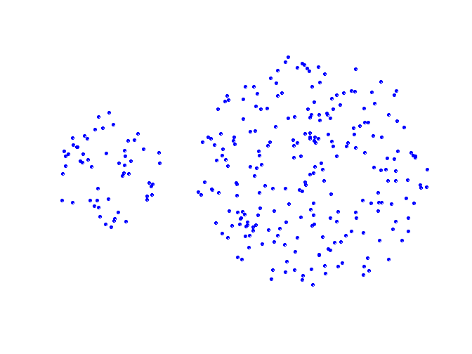
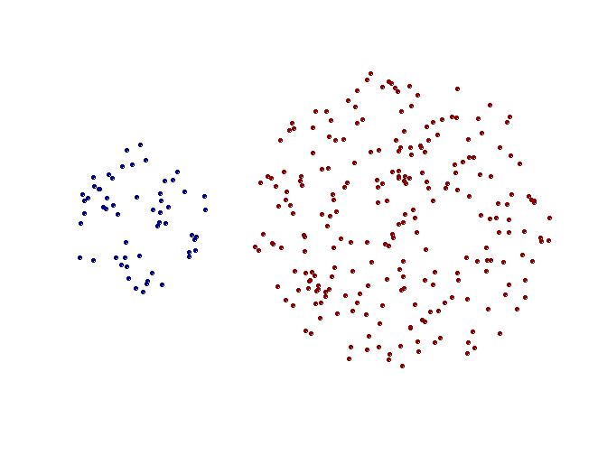
Strength of MIN
Original Points
Two Clusters
Can handle non-elliptical shapes

Slide 26
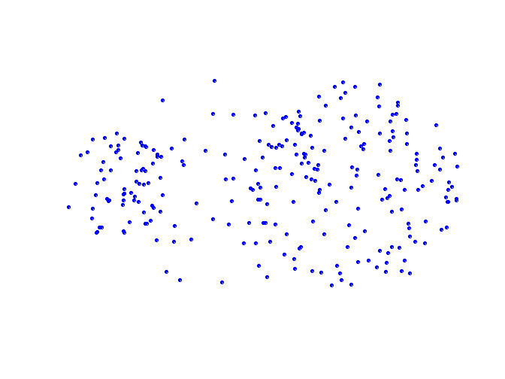
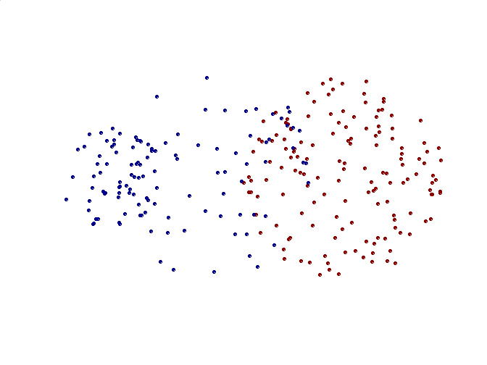
Limitations of MIN
Original Points
Two Clusters
Sensitive to noise and outliers
It produces long, elongated clusters

Slide 27
Cluster Similarity: MAX or Complete Linkage
Similarity of two clusters is based on the two least similar (most distant) points in the different clusters
1
2
3
4
5

Slide 28
Hierarchical Clustering: MAX
1
2
5
2
Let’s finish the clustering and create a dendrogram together
3
6
1
4
Nested Clusters

Slide 29
Hierarchical Clustering: MAX
1
2
5
2
Which communities should be merged next? Respond at PollEv.com/cerenbudak421
3
6
1
4
Nested Clusters

Slide 30
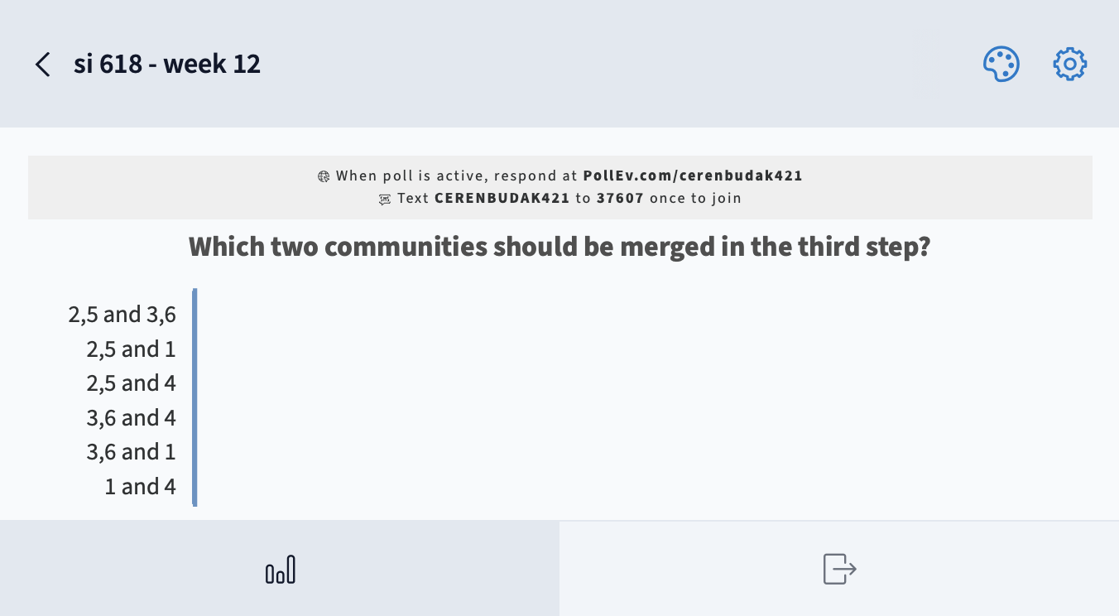

Slide 31
Hierarchical Clustering: MAX
4
1
2
5
5
2
3
6
3
1
4
Nested Clusters
Dendrogram

Slide 32
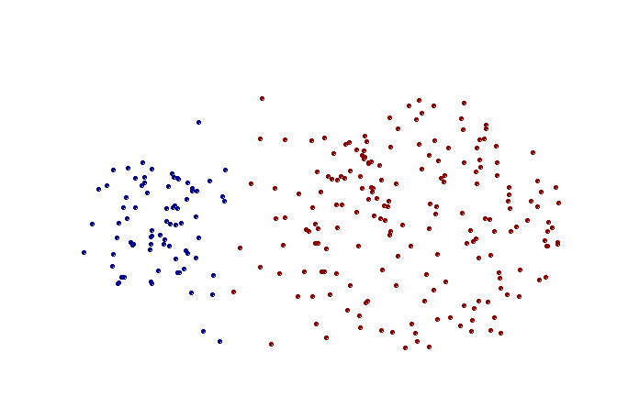
Strength of MAX
Original Points
Two Clusters
More balanced clusters (with equal diameter)
Less susceptible to noise

Slide 33
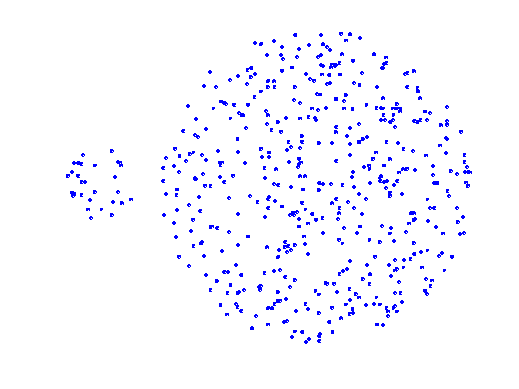
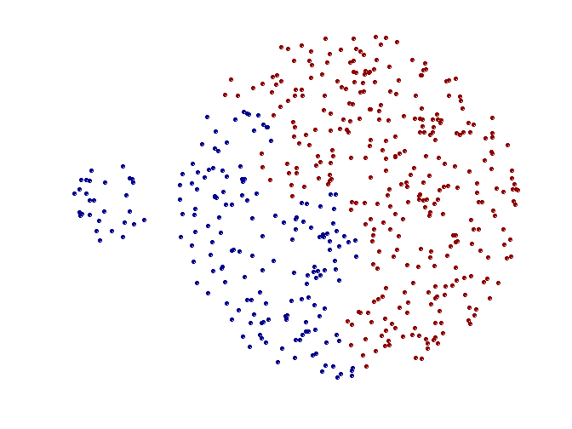
Limitations of MAX
Original Points
Two Clusters
Tends to break large clusters
All clusters tend to have the same diameter – small clusters are merged with larger ones

Slide 34
Cluster Similarity: Group Average
Proximity of two clusters is the average of pairwise proximity between points in the two clusters.
1
2
3
4
5

Slide 35
Hierarchical Clustering: Group Average
1
2
5
2
Let’s finish the clustering and create a dendrogram
3
6
1
4
Nested Clusters

Slide 36
Hierarchical Clustering: Group Average
1
2
5
2
Which communities should be merged next? Respond at PollEv.com/cerenbudak421
3
6
1
4

Slide 37
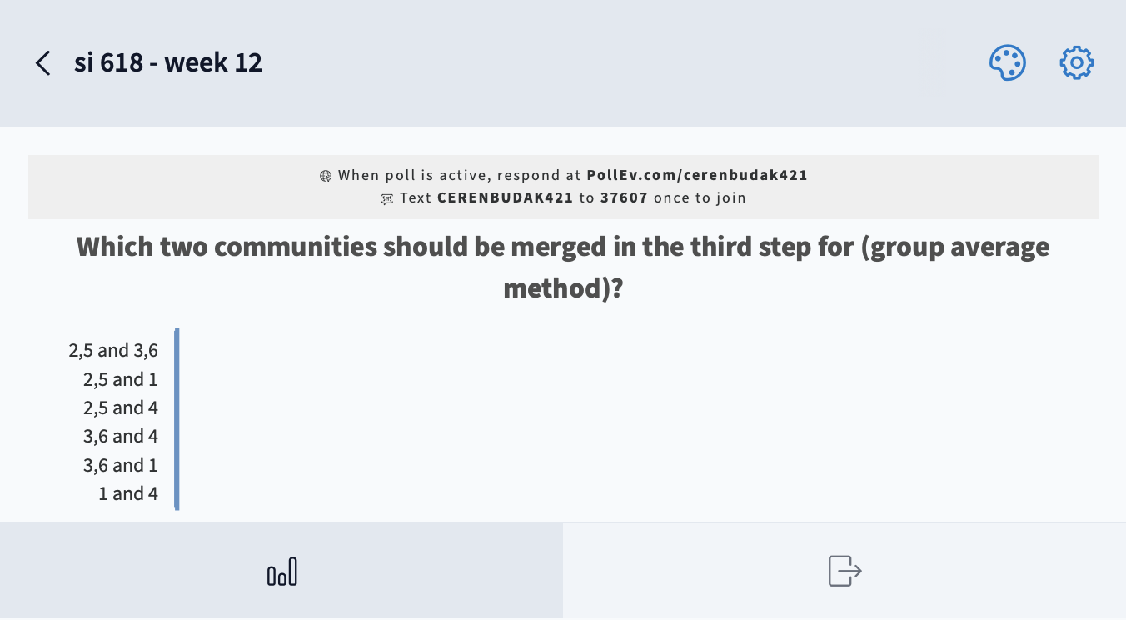

Slide 38
Hierarchical Clustering: Group Average
5
4
1
2
5
2
3
6
1
4
3
Nested Clusters
Dendrogram

Slide 39
Hierarchical Clustering: Group Average
Compromise between Single and Complete Link
Strengths
Less susceptible to noise and outliers
Limitations
Biased towards globular clusters

Slide 40
Distance between two clusters
Centroid distance between clusters C_{i} and C_{j} is the distance between the centroid r_{i} of C_{i} and the centroid r_{j} of C_{j}

Slide 41
Ward’s method (1963)
Ward’s distance between clusters C_{i} and C_{j} is the difference between the total within cluster sum of squares for the two clusters separately, and the within cluster sum of squares resulting from merging the two clusters in cluster C_{ij}
r_{i}: centroid of C_{i}
r_{j}: centroid of C_{j}
r_{ij}: centroid of C_{ij}

Slide 42
Ward’s distance for clusters
Similar to group average and centroid distance
Less susceptible to noise and outliers
Biased towards globular clusters
Hierarchical analogue of k-means

Slide 43
Hierarchical Clustering: Comparison
5
1
4
1
3
2
5
5
5
2
1
MIN
2
MAX
2
3
6
3
3
6
1
4
4
4
5
5
1
4
1
2
2
5
2
Ward’s Method
5
2
3
6
Group Average
3
3
6
4
1
1
4
4
3

Slide 44
Which type of hierarchical clustering to use?
Different methods have different strengths and weaknesses.
Ward's method tends to give equal sized clusters
Single linkage (nearest neighbor) tends to make long strings into a cluster.
Top-down is sensitive to early errors: bad first choice can wreck the entire process
Bottom-up can’t see the whole dataset

Slide 45
Time for some coding…

Slide 46
Two major clustering algorithms
Hierarchical
K-means
General questions:
How many clusters is best?
How can we assess and visualize cluster quality?
How can we visualize clusters?

Slide 47
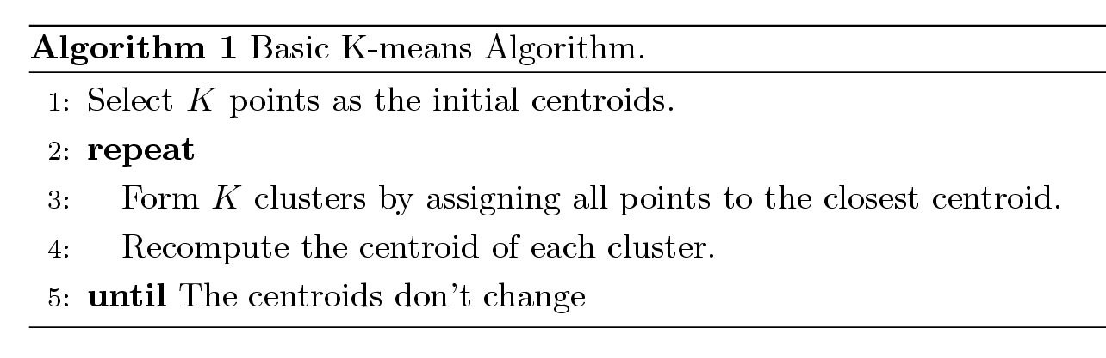
K-means: the other massively popular clustering method.. and very different in nature
Partitional clustering approach
Each cluster associated with a centroid (centerpoint)
Each point is assigned to the cluster with the closest centroid
Number of clusters, K, must be specified in advance
The basic algorithm is very simple
http://stat.ethz.ch/R-manual/R-devel/library/stats/html/kmeans.html

Slide 48
The k-means algorithm (k = 3)

Slide 49
K-means is a special case of model-based clustering
Assume data generated from k probability distributions
Goal: find the distribution parameters
Algorithm: Expectation Maximization (EM)
Output: Distribution parameters and an assignment of points to clusters

Slide 50
K-means Clustering – Details
Different initializations can result in different solutions
Initial centroids are often chosen randomly.
Clusters produced vary from one run to another.
So multiple runs are sometimes done
Centroid is typically the mean of the points in the cluster.
K-medoid: center must be an actual datapoint. Useful when mean of a feature is not defined or available
‘Closeness’ is measured by Euclidean distance, cosine similarity, correlation, etc.
K-means will converge for common similarity measures mentioned above.
Most convergence happens in the first few iterations.
Often the stopping condition is changed to ‘Until relatively few points change clusters’
Complexity is O( n * K * I * d )
n = number of points, K = number of clusters, I = number of iterations, d = number of attributes

Slide 51
Two different K-means Clusterings
Original Points
Optimal Clustering?
No.
Optimal Clustering

Slide 52
Importance of Choosing Initial Centroids

Slide 53
Importance of Choosing Initial Centroids …

Slide 54
Importance of Choosing Initial Centroids …

Slide 55
Trying to find good optimal k-means clustering
Idea 1: Be careful about where you start
Place first center on randomly chosen datapoint
Place second centroid on datapoint as far as possible from first center (or soft probabilistic version thereof)
Place j-th center on datapoint that’s as far as possible from centers 1 thru j - 1
Idea 2: Do many runs of k-means
Each from a different random start configuration
Many heuristics around
Notes:
1. Known as kmeans++. Arthur and Vassilvitskii. Requires k passes over data, efficient approximations exist.

Slide 56
Limitations of K-means
K-means has problems when clusters are of differing
Sizes
Densities
Non-globular shapes
K-means has problems when the data contains outliers.

Slide 57
When should you use k-means vs hierarchical approach?
Do you need to easily interpret the clusters?
Do you know the right k?
Hierarchal clustering is the sort that you might apply when there is a "tree" structure to the data (e.g. living things).
K-means clustering does not assume a tree structure.
If you have only two or three dimensions (or can sensibly reduce your data by factor analysis) you can plot it and see what sort of relationships you have. Are you looking for nice spherical clusters, or are long chains more suitable?
k-means prefers solutions where clusters are of similar size
very different cluster sizes, shapes, densities can confuse it
complex cluster geometry, or outliers
need to specify and test for good k choice
Can combine the two approaches, e.g.
Try several hierarchical methods and see which gives the most interpretable clusters.
Use k-means (with the hierarchical cluster centroids as starting points) to clean up the hierarchical cluster.

Slide 58
More time for coding

Slide 59
More info on how to choose the number of clusters…

Slide 60
How many clusters?
Theoretical, conceptual or practical issues may suggest a certain number of clusters
Hierarchical clustering:
Distance threshold at which clusters are combined
K-means and other non-hierarchical
Educated Guess
Rule of thumb
Elbow method
Silhoutte method

Slide 61
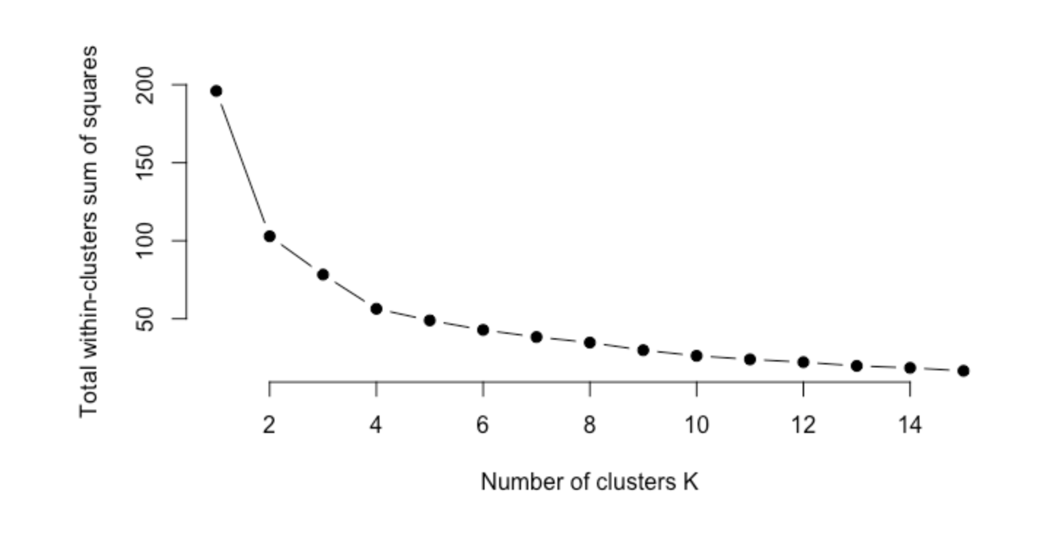
Elbow method
We can use the total intra-cluster variation (known as total within-cluster variation or total within-cluster sum of square) to quantify how good a clustering technique is doing in identifying clusters.
This is also the percentage of variance explained by the use of the clusters.
How can we use this to choose the right k? How about:
What can be a problem here?
Answer: It is monotonically non-increasing. There is a trade-off here
Plot #clusters vs. total within sum of squares
Elbow/sharp bend shows point at which adding more clusters helps reduce distortion measure less and less
i
i
where W(C_i) is the within-cluster sum of square for cluster i
Notes:
Knee point: the point with the maximum curvature

Slide 62
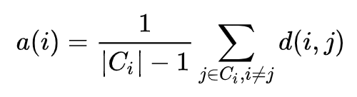
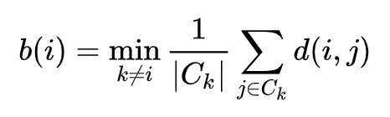
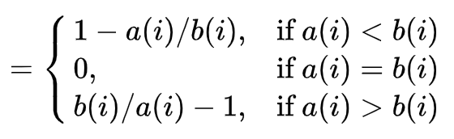
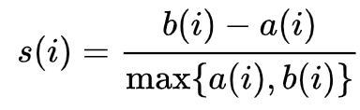
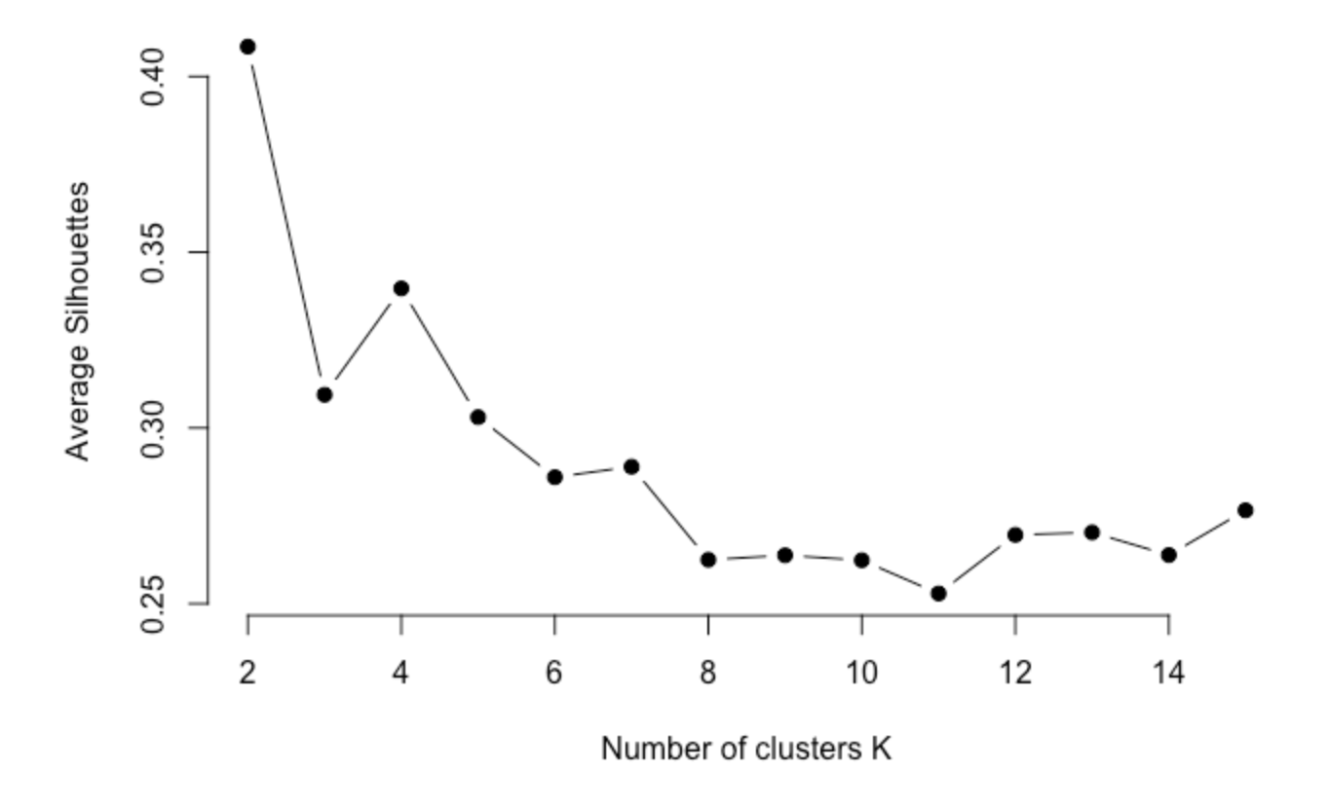
Silhouette Method
Elbow only looks at within cluster quality. Using the silhouette method, you can define quality w.r.t. how well points match their assigned cluster (cohesion) compared to other clusters (separation).
Fit to current cluster for data point i:
Fit to other clusters:
Silhouette of i:
The optimal number of clusters k is the one that maximizes the average silhouette over all data points.
Elbow and silhouette methods do not always give the same answer!

Slide 63
How do we know if we’ve found good quality clusters?
Compare cluster stability across:
Different distance measures
Different clustering methods
Different 50/50 random data splits
Different variable/features deletions
Different data orderings (non-hierarchical)
“Good” clusterings (if they exist) are generally stable and robust to perturbations in methods or data

Slide 64
Class Exercise
Please think about what you learned in this class and reflect on ways you can use it in your project.
Fill out the following form: https://forms.gle/cCXsEGiT7Ph6Xc1u6

