Slide 1
SI 618 BeautifulSoup, APIs, and Databases
Instructor: Ceren Budak

Slide 2
Data Gathering

Slide 3
Data Gathering
Fetching Web content: urllib3 or urllib.request
Parsing Web content: beautifulsoup
HTML
XML
Web services

Slide 4
Python module for fetching Web resources: urllib3
from urllib.request import urlopen
response = urlopen('https://nytimes.com')
html_doc = response.read()
Or
import urllib3
http = urllib3.PoolManager()
response = http.request(‘GET’, 'https://nytimes.com')
html_doc = response.data
Status codes
response.code == 200 Success
response.code == 401 Authentication required
response.code == 403 Request forbidden
response.code == 404 Page not found
response.code in 300-range are redirects, but default handlers process those and you won't see them unless you do special things.

Slide 5
Other urllib3 methods
response = urlopen(‘https://www.theguardian.com’)
response.geturl()
The actual URL fetched (may redirect from what you requested)
>>> response.geturl()
'http://www.theguardian.com/us'
response.info()
An instance of httplib.HTTPMessage describing the page fetched.
>>> print(response.info())
Connection: close Content-Length: 1189562 Content-Type: text/html; charset=UTF-8 ETag: W/"hash-2607354950244242700” …

Slide 6
Parsing structured content

Slide 7
Beautiful Soup is a powerful, widely-used parsing module
A Python module that wraps existing HTML, XML parsers
Installation (anaconda already has this so you most likely will not need it):
pip3 install beautifulsoup4
After parsing a page, you can do things like this:
Find all the links on the page
Find all the links of class externalLink
Find all the links whose urls match "foo.com"
Find the table heading that's got bold text, then get that text
Reference: http://www.crummy.com/software/BeautifulSoup/

Slide 8
A word about HTML parsing
HTML looks simple enough: it must be really easy to parse Web pages, right?
Wrong! It's surprisingly difficult.
Reason #1: Many Web pages are malformed. Part of the hardest part of parsing is to find and fix these..
BeautifulSoup("<a><b /></a>")
# <html><head></head><body><a><b></b></a></body></html>
Reason #2: Some Web pages are technically valid, but auto-generated HTML that breaks the parser's worst-case assumptions
<a href="./foo/../foo/../[681 times]/baz">bar</a>

Slide 9
Beautiful Soup Example
To parse a document, pass it into the BeautifulSoup constructor.
You can pass in a string or an open filehandle:
from bs4 import BeautifulSoup
soup = BeautifulSoup(open("index.html"))
soup = BeautifulSoup("<html>data</html>")
First, the document is converted to Unicode: HTML entities are converted to Unicode characters
BeautifulSoup("Sacr&eacute; bleu!")
<html><head></head><body>Sacré bleu!</body></html>
Beautiful Soup then parses the document using the best available parser. It will use an HTML parser unless you specifically tell it to use an XML parser. (See Parsing XML.) It turns a complex HTML document into a complex tree of Python objects
You can manipulate, e.g. change tag names
Then optionally save a new file

Slide 10
BeautifulSoup tag tree: A graphical example of simple HTML
<html><head><title>The Dormouse's story</title></head>
<body>
<p class="title"><b>The Dormouse's story</b></p>
<p class="story">Once upon a time there were three little sisters; and their names were
<a href="http://example.com/elsie" class="sister" id="link1">Elsie</a>,
<a href="http://example.com/lacie" class="sister" id="link2">Lacie</a> and
<a href="http://example.com/tillie" class="sister" id="link3">Tillie</a>;
and they lived at the bottom of a well.</p>
<p class="story">...</p>
</body></html>
I am breaking the string into lines for readability. Assume that they were all on one line
tag
string
<head>
<title>
The Dormouse's story
<html>
<p>
<b>
The Dormouse's story
<body>
<p>
Once upon a time there were three little sisters; and their names were
<a>
Elsie
,
<a>
Lacie
and
<a>
Tillie
; and they lived at the bottom of a well.
<p>
…
Source: http://www.crummy.com/software/BeautifulSoup/bs4/doc/

Slide 11
Navigating the parse tree
Use tag name to get the first tag by that name
soup.head
soup.title
soup.a
These return tag objects.
If a tag's child is a string, use .string
soup.title.string 'The Dormouse's story'
You can zoom in like this:
soup.body.b
Getting a tag's direct children: .contents and .children
head_tag = soup.head
head_tag.contents
[<title>The Dormouse's story</title>]
title_tag = head_tag.contents[0]
title_tag
# <title>The Dormouse's story</title>
title_tag.contents
# [“The Dormouse's story”]
for child in title_tag.children:
print(child)
The Dormouse's story
for child in head_tag.descendants: # recursively iterate
print(child)
<title>The Dormouse's story</title>
The Dormouse's story
<head>
<title>
The Dormouse's story
<html>
<p>
<b>
The Dormouse's story
<body>
<p>
Once upon a time there were three little sisters; and their names were
<a>
Elsie
,
<a>
Lacie
and
<a>
Tillie
; and they lived at the bottom of a well.
<p>
…

Slide 12
Poll:Quick and easy test
<html><head><title>The Dormouse's story</title></head>
<body><p class="title"><b>The Dormouse's story</b></p>
<p class="story">Once upon a time there were three little sisters; and their names were <a href="http://example.com/elsie" class="sister" id="link1">Elsie</a>, <a href="http://example.com/lacie" class="sister" id="link2">Lacie</a> and
<a href="http://example.com/tillie" class="sister" id="link3">Tillie</a>; and they lived at the bottom of a well.</p><p class="story">...</p></body></html>
<head>
<title>
The Dormouse's story
<html>
<p>
<b>
The Dormouse's story
<body>
<p>
Once upon a time there were three little sisters; and their names were
<a>
Elsie
,
<a>
Lacie
and
<a>
Tillie
; and they lived at the bottom of a well.
<p>
…
What is soup.body.contents[1].contents[2]?
u’Elsie’
‘, ’
u'Once upon a time there were three little sisters; and their names were’
<b>The Dormouse's story</b>
Go to PollEv.com/cerenbudak421

Slide 13
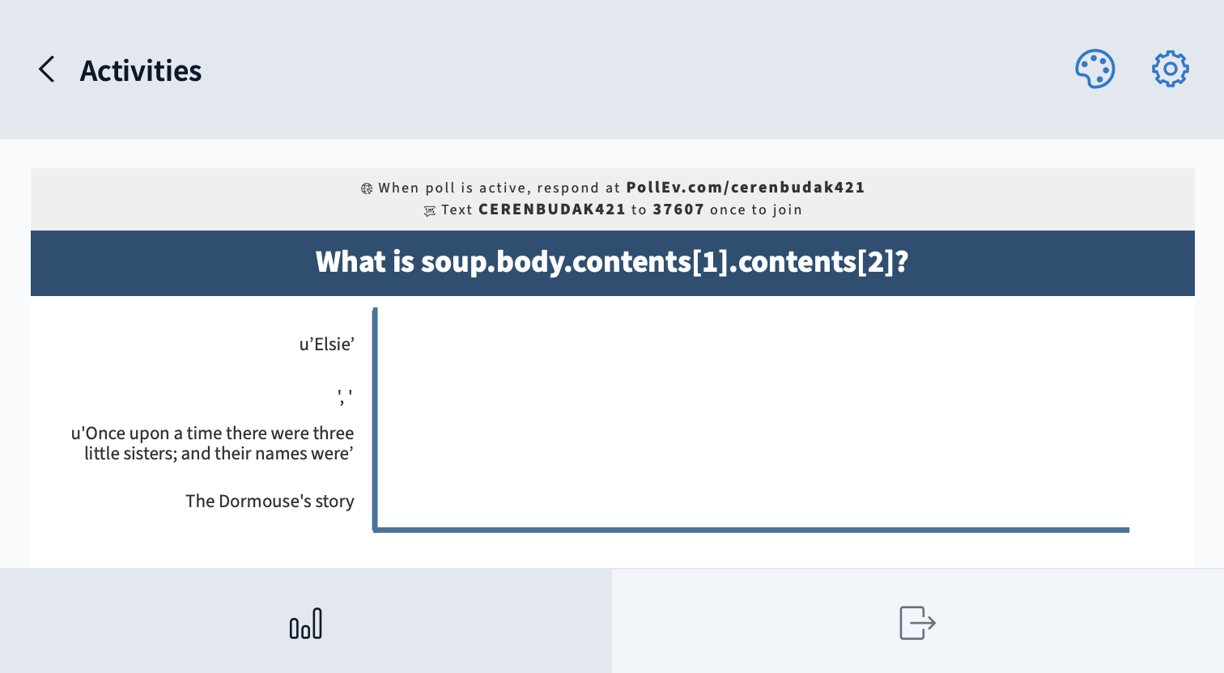

Slide 14
Searching and filtering the parse tree

Slide 15
Searching and filtering the tree: find_all method
find_all(tag_name, attributes, recursive, text, limit, **kwargs)
Returns a ResultSet object: a list of tags and strings
tag_name argument:
soup.find_all('a')
movie_table = soup.find_all('table')[0]
for row in movie_table.find_all('tr’):
…
soup.find_all(["a", "b"]) finds all 'a' AND all 'b' tags
Custom name functions
def has_class_but_no_id(tag):
return tag.has_attr('class')
and not tag.has_attr('id')
Pass this function into find_all() and you’ll pick up all the <p> tags:
soup.find_all(has_class_but_no_id)
# [<p class="title"><b>The Dormouse's story</b></p>,
# <p class="story">Once upon a time there were...</p>,
# <p class="story">...</p>]
In general, find_all looks through all tag descendants and returns
the ones that match your filter conditions.
<html><head><title>The Dormouse's story</title></head>
<body>
<p class="title"><b>The Dormouse's story</b></p>
<p class="story">Once upon a time there were three little sisters; and their names
<a href="http://example.com/elsie" class="sister" id="link1">Elsie</a>,
<a href="http://example.com/lacie" class="sister" id="link2">Lacie</a> and
<a href="http://example.com/tillie" class="sister" id="link3">Tillie</a>;
and they lived at the bottom of a well.</p>
<p class="story">...</p>

Slide 16
Searching and filtering the tree: find_all method
find_all(tag_name, attributes, recursive,
text, limit,**kwargs)
attributes argument:
Any unrecognized argument will be turned into a filter on that tag attribute:
soup.find_all(href="elsie")
# [<a class="sister" href="http://example.com/elsie" id="link1">Elsie</a>]
text argument:
soup.find_all("a", text="Elsie")
# [<a href="http://example.com/elsie" class="sister" id="link1">Elsie</a>]
limit argument:
soup.find_all("a", limit=2)
# [<a class="sister" href="http://example.com/elsie" id="link1">Elsie</a>,
# <a class="sister" href="http://example.com/lacie" id="link2">Lacie</a>]
Good for large documents where you only need a few results
recursive argument:
Search direct children only: recursive=False
<html><head><title>The Dormouse's story</title></head>
<body>
<p class="title"><b>The Dormouse's story</b></p>
<p class="story">Once upon a time there were three little sisters; and their names
<a href="http://example.com/elsie" class="sister" id="link1">Elsie</a>,
<a href="http://example.com/lacie" class="sister" id="link2">Lacie</a> and
<a href="http://example.com/tillie" class="sister" id="link3">Tillie</a>;
and they lived at the bottom of a well.</p>
<p class="story">...</p>

Slide 17
You can filter the tree with regular expressions (remember those?)
import re
for tag in soup.find_all(re.compile("^b")):
print(tag.name)
# body
# b
for tag in soup.find_all(re.compile("t")):
print(tag.name)
# html
# title
<html><head><title>The Dormouse's story</title></head>
<body>
<p class="title"><b>The Dormouse's story</b></p>
<p class="story">Once upon a time there were three little sisters; and their names
<a href="http://example.com/elsie" class="sister" id="link1">Elsie</a>,
<a href="http://example.com/lacie" class="sister" id="link2">Lacie</a> and
<a href="http://example.com/tillie" class="sister" id="link3">Tillie</a>;
and they lived at the bottom of a well.</p>
<p class="story">...</p>
Source: http://www.crummy.com/software/BeautifulSoup/bs4/doc/

Slide 18
Manipulating HTML: tags
soup = BeautifulSoup('<b class="boldest">Very bold</b>')
tag = soup.b
tag.name = "blockquote"
tag.string = "Extremely Bold"
tag['class'] = 'verybold'
tag['id'] = 1
tag
# <blockquote class="verybold" id="1">Extremely bold</blockquote>
del tag['class']
del tag['id']
tag
# <blockquote>Extremely bold</blockquote>
Source: http://www.crummy.com/software/BeautifulSoup/bs4/doc/

Slide 19
find_all exercises for the reader
"Find all the links on the page"
"Find all the links of class externalLink"
"Find all the links whose urls match "foo.com"
"Find the table heading that's got bold text, then get that text"

Slide 20
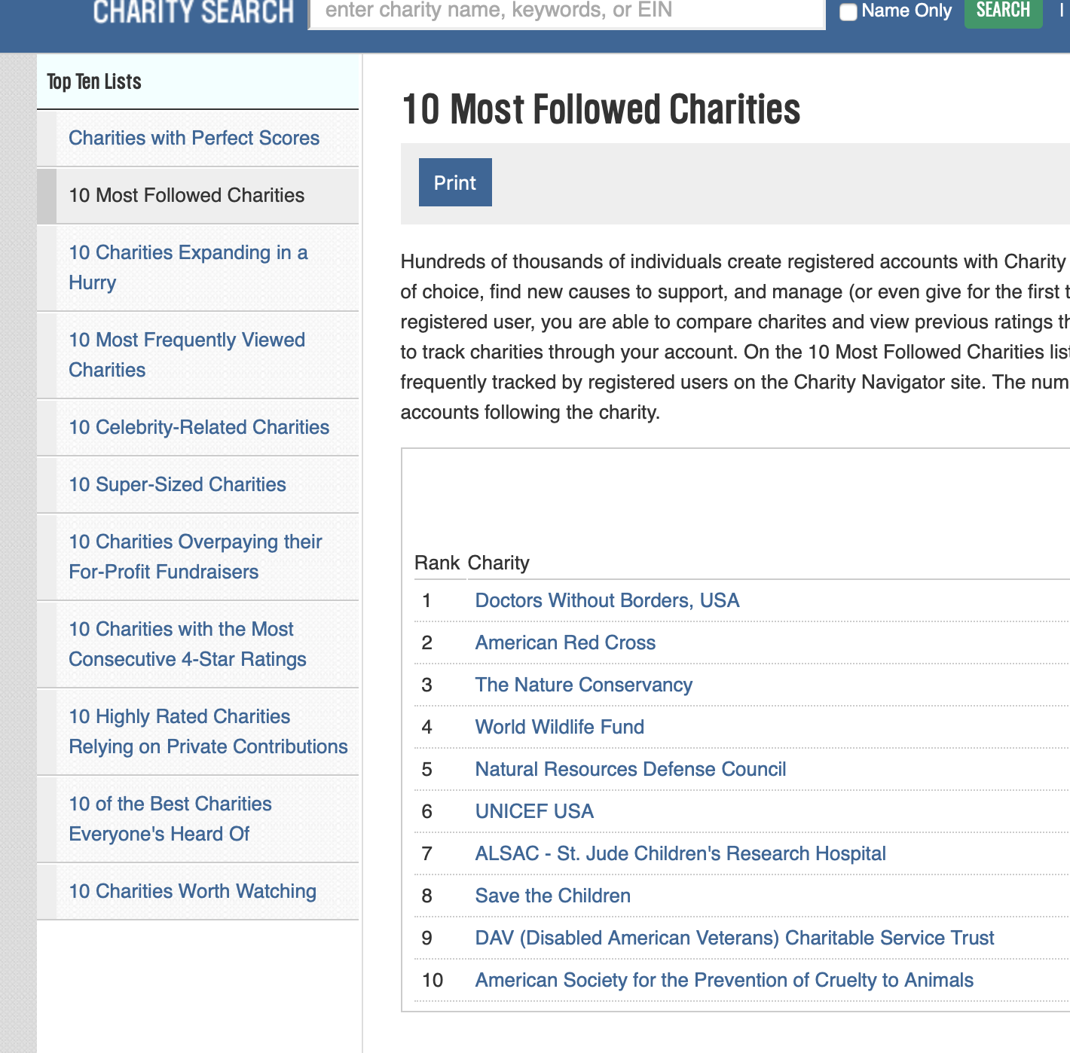
Fetching and parsing together
You can combine your knowledge of fetching and parsing content to study non-profit organizations. Lets try this together…
from urllib.request import urlopen
response = urlopen('https://www.charitynavigator.org/index.cfm?bay=topten.detail&listid=148')
html_doc = response.read()
soup = BeautifulSoup(html_doc)
tbl = soup.find_all('table')[0]
for link in tbl.find_all('a'):
print (link.text)

Slide 21
XML

Slide 22
Beyond Web pages: XML Facts
eXtensible Markup Language
Separation of data and its presentation
in contrast to HTML
Simple tag-based file format
Applications
Heavy-duty web services
Document archiving
Information exchange between applications
XML databases
Web feeds: RSS feeds, Atom feeds, etc.
http://en.wikipedia.org/wiki/XML

Slide 23
Example XML
<?xml version="1.0" encoding="ISO-8859-1"?> <note> <to>Tove</to> <from>Jani</from> <heading>Reminder</heading> <body>Don't forget me this weekend!</body> </note>
http://www.w3schools.com/xml/xml_tree.asp

Slide 24
Root Node
<?xml version="1.0" encoding="ISO-8859-1"?> <note> <to>Tove</to> <from>Jani</from> <heading>Reminder</heading> <body>Don't forget me this weekend!</body> </note>

Slide 25
Child nodes
<?xml version="1.0" encoding="ISO-8859-1"?> <note> <to>Tove</to> <from>Jani</from> <heading>Reminder</heading> <body>Don't forget me this weekend!</body> </note>

Slide 26
Attributes
<?xml version="1.0" encoding="ISO-8859-1"?> <note date="10/01/2008">
<to>Tove</to> <from>Jani</from> <heading>Reminder</heading> <body>Don't forget me this weekend!</body> </note>
date = attribute name
"10/01/2008"= attribute value

Slide 27
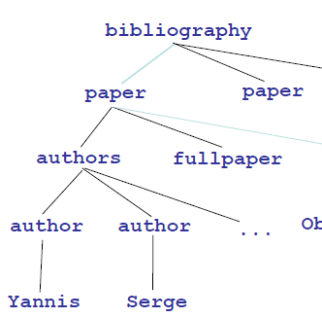
Tree Structure
<bibliography>
<paper >
<authors>
<author>Yannis</author>
<author>Serge</author>
...
</authors>
<fullpaper>Object Fusion</fullpaper>
...
</paper>
</bibliography>

Slide 28
XML parsing in Python
BeautifulSoup(markup,"xml")
Must install the lxml parser first (pip install lxml)
Again, if using Anaconda, you do not need to take this step.
Various other modules can be used:
xml.etree.ElementTree - provides a lightweight Pythonic API that is easy to work with

Slide 29
Alternate Python XML parsing
Default XML support in python
import xml.etree.ElementTree as elementtree
Install ElementTree toolkit:
http://effbot.org/downloads/#elementtree
This will install the elementtree package
Useful documentation of elements, etc.:
Element Type: http://effbot.org/zone/element.htm
Element has: tag, attributes, text, child elements
dom = elementtree.parse('senate-lobbying-2013_1_1_1.xml')
root = dom.getroot()
for node in root:
print (node.tag)

Slide 30
XML tag clouds!

Slide 31
XML government lobbying data sample See senate-lobbying-2013_1_1_1.xml in lectures/week3
<?xml version='1.0' encoding='UTF-16'?>
<PublicFilings>
<Filing ID="306B3144-3E4F-48CF-98F1-C6BF455B6A6B“ Year="2012" Received="2013-01-01T00:58:03.067" Amount="15000" Period="4th Quarter (Oct 1 - Dec 31)">
<Registrant RegistrantID="6848" RegistrantName="Marshall Brachman" />
<Client ClientName="ADAMS COUNTY COLORADO" ClientID="12"
<Lobbyists>
<Lobbyist LobbyistName="BRACHMAN, MARSHALL A" />
</Lobbyists>
<GovernmentEntities>
<GovernmentEntity GovEntityName="SENATE" />
<GovernmentEntity GovEntityName="Federal Aviation Administration (FAA)" />
<GovernmentEntity GovEntityName="HOUSE OF REPRESENTATIVES" />
</GovernmentEntities>
<Issues>
<Issue Code="BUDGET/APPROPRIATIONS" SpecificIssue="DERA funding regarding Rocky Mountain Arsenal&#xA;DoD Appropriations for the above&#xA;TTHUD funding for railroad grade separation&#xA;funding for contract tower program and commercial flight program" />
<Issue Code="DEFENSE" SpecificIssue="DERA funding regarding Rocky Mountain Arsenal&#xA;DoD Authorization" />
<Issue Code="NATURAL RESOURCES" SpecificIssue="land trade issues regarding the Rocky Mountain Arsenal NWP" />
</Issues>
</Filing>

Slide 32
Tag Clouds with wordcloud
from wordcloud import WordCloud
import matplotlib.pyplot as plt
YOUR_TEXT = "A tag cloud is a visual representation for text data, typically\ used to depict keyword metadata on websites, or to visualize free form text."
wc = WordCloud().generate(YOUR_TEXT )
wc.to_file(”yourfile.png")
May need to limit input length to a representative sample of text if module is too slow.
Need to install wordcloud and image packages

Slide 33
Example: Creating tag cloud from lobbying data
<Issue Code="DEFENSE"
SpecificIssue="DERA funding regarding Rocky Mountain Arsenal&#xA;
DoD Authorization" />
from wordcloud import WordCloud
import xml.etree.ElementTree as elementtree
allText = ""
dom = elementtree.parse('senate-lobbying-2013_1_1_1.xml')
#retrieve the first xml tag (<tag>data</tag>) that the parser finds with name tagName:
filinglist = dom.getroot()
for filing in filinglist:
issues = list(filing.iter('Issues'))
if len(issues) > 0:
issuelist = issues[0].iter('Issue')
for i in issuelist:
allText = allText + ' ' + i.attrib.get('SpecificIssue')
wordcloud = WordCloud().generate(allText)
img = wordcloud.to_image()
img.save("senate-wordcloud.png")

Slide 34


Slide 35
Web APIs

Slide 36
An acronym you should know: Representational State Transfer (REST) APIs
Uniform client–server interface
Uniform interface separates clients from servers.
Clients are not concerned with data storage (portability)
Servers are not concerned with the user interface (simplicity, scalability)
Stateless
No client context being stored on the server between requests.
Each client request has all information necessary to service the request
Cacheable
Clients can cache responses.
Responses define themselves as cacheable or not, to prevent clients reusing stale data
Layered system
A client can't tell if the connection is direct or indirect
Code on demand (optional)
Servers can temporarily extend functionality of a client by the transfer of executable code.
e.g. Javascript
Most HTTP-based Web services (and certainly the simple ones) are REST APIs
http://en.wikipedia.org/wiki/Representational_state_transfer

Slide 37
Content Types used by Web Services
Mainly two types:
JSON-based
Facebook, Twitter, Yelp, most Google web services
XML-based
Some Bing, Google web services, eBay
Most Web Services are JSON-based now
Some provide both JSON and XML format APIs
Industry has been moving away from XML to JSON:
XML is overkill
XML is not easy to work with

Slide 38
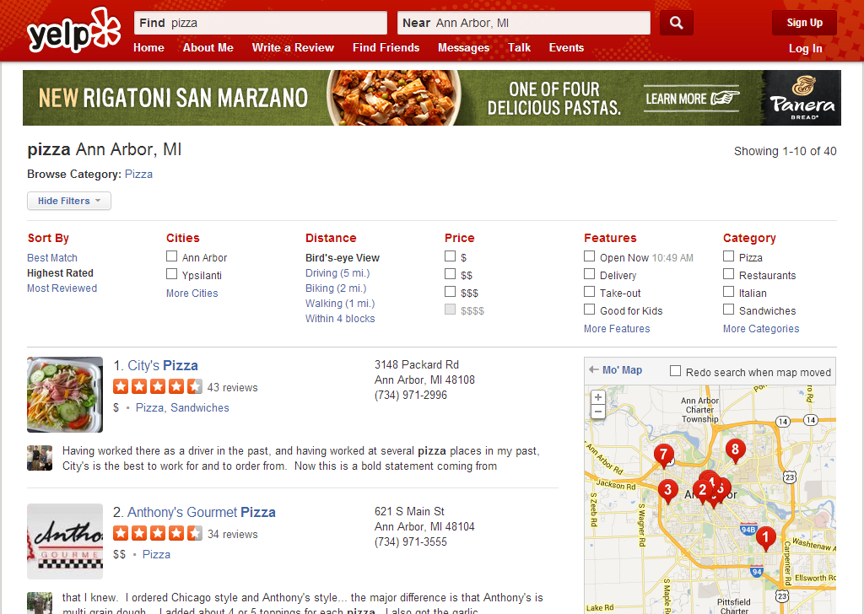
Yelp API
JSON based
Documentation: https://www.yelp.com/developers
Needs authentication
Example code in Files/Lectures/week3:
APIExercises Jupiter notebook

Slide 39
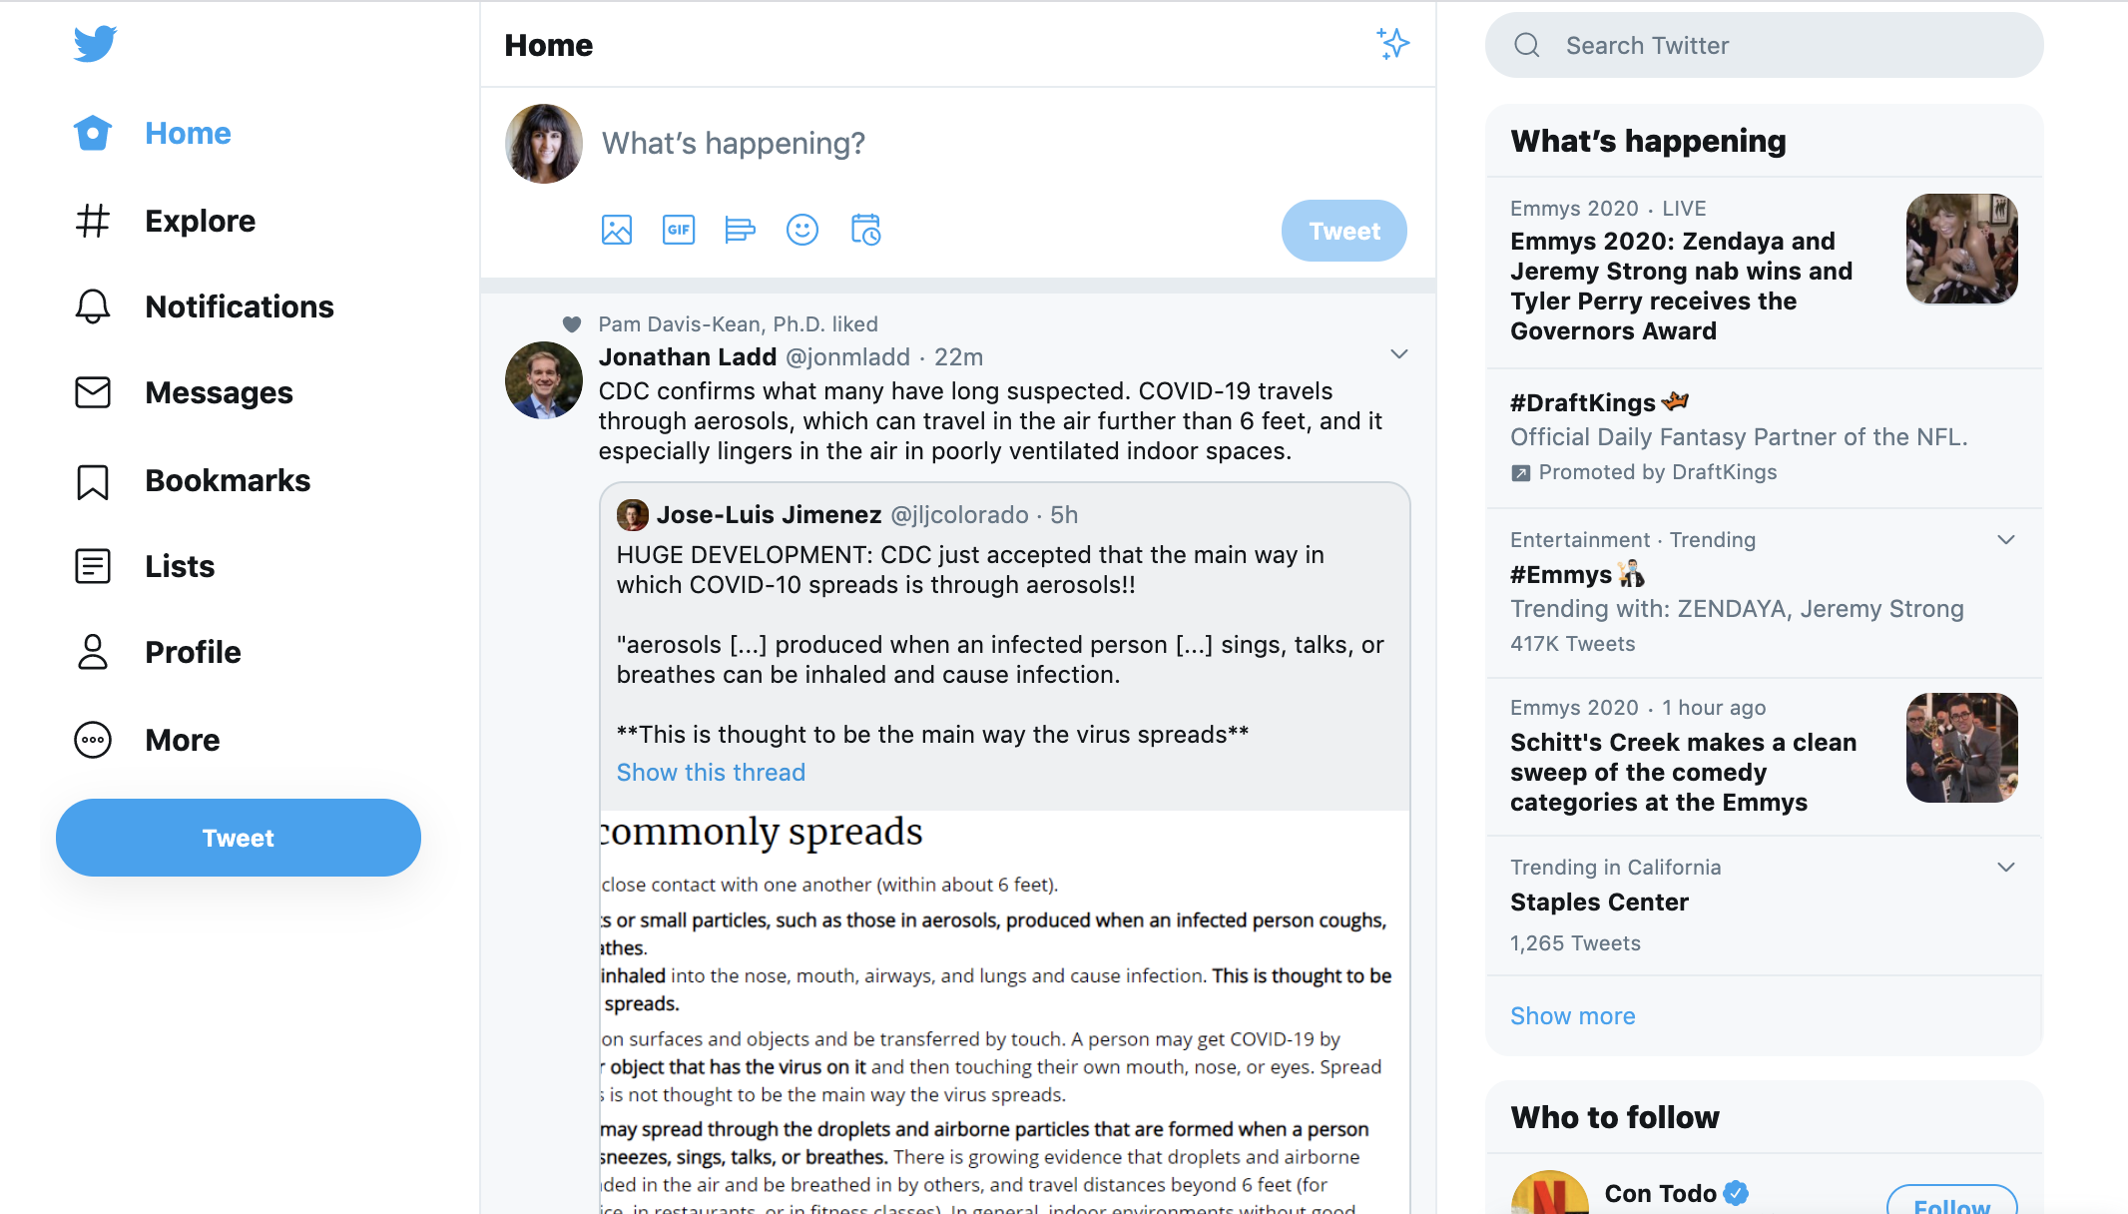
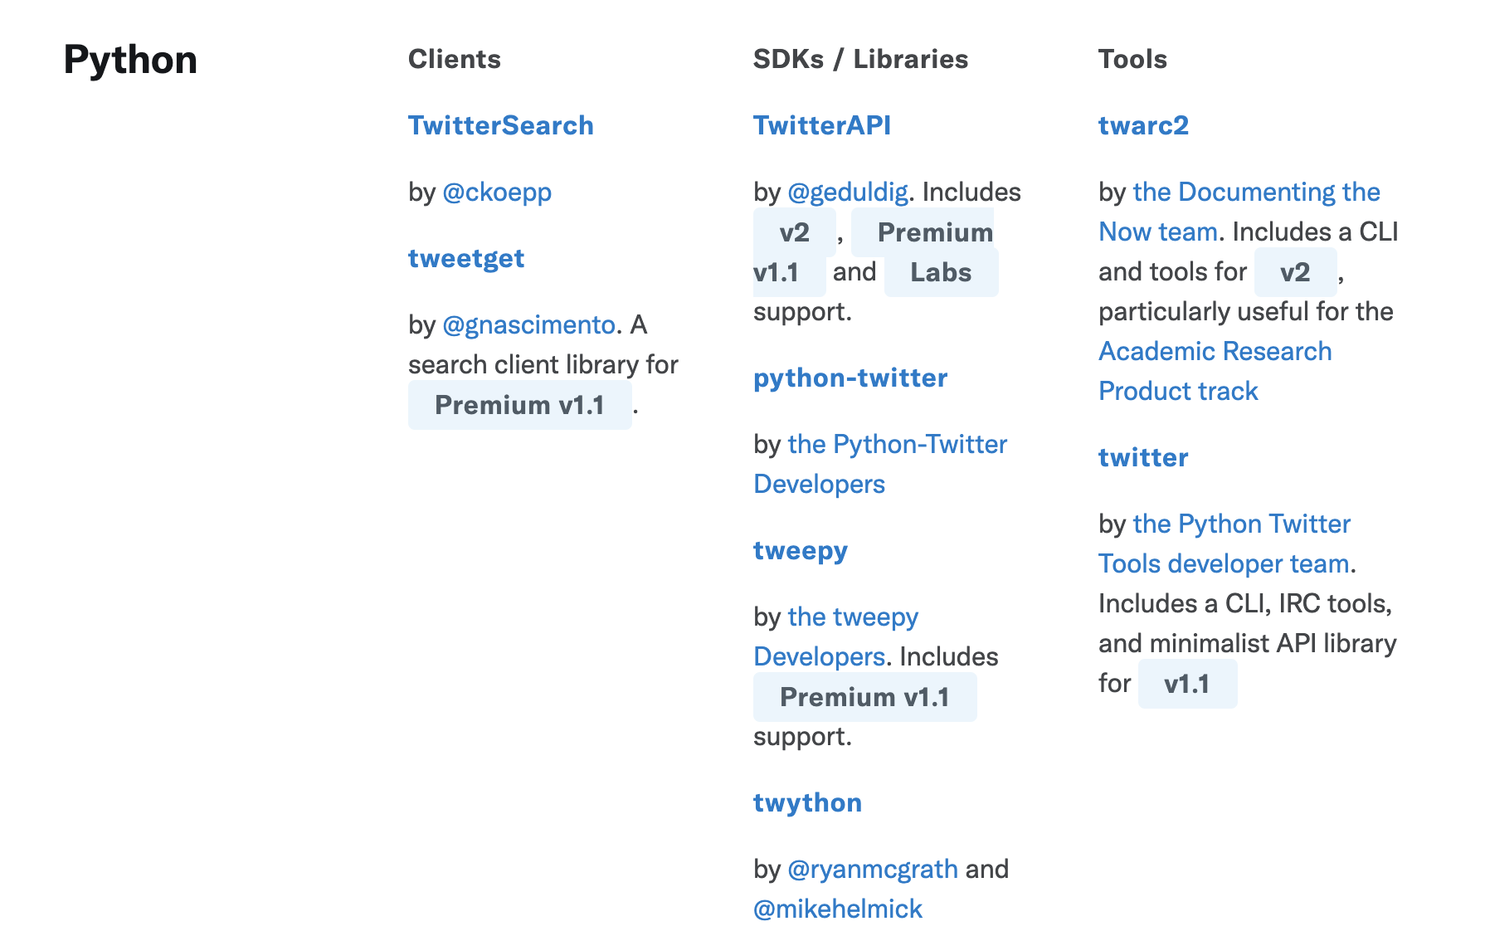
Twitter API
JSON based
Documentation: https://developer.twitter.com/
Twitter API also needs authentication.
There are many python libraries (tweepy example on Canvas!)
Need to register a developer app – an involved process that can take some time to get approved.

Slide 40
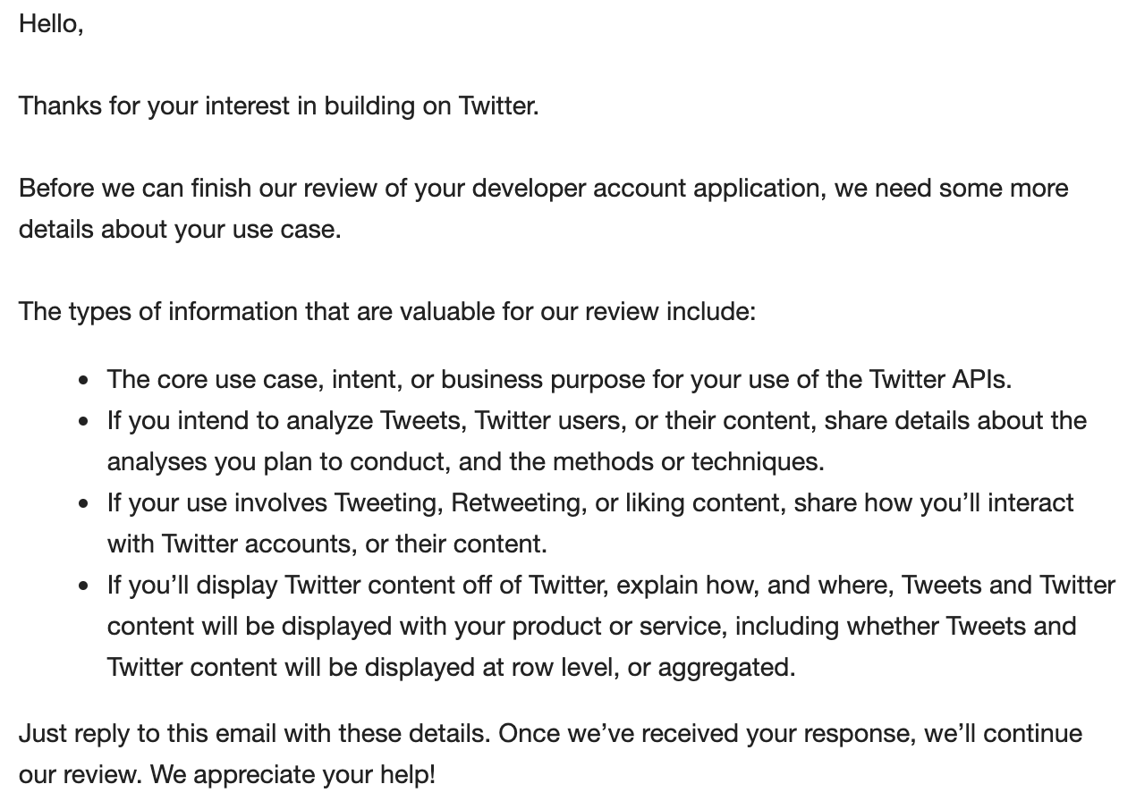
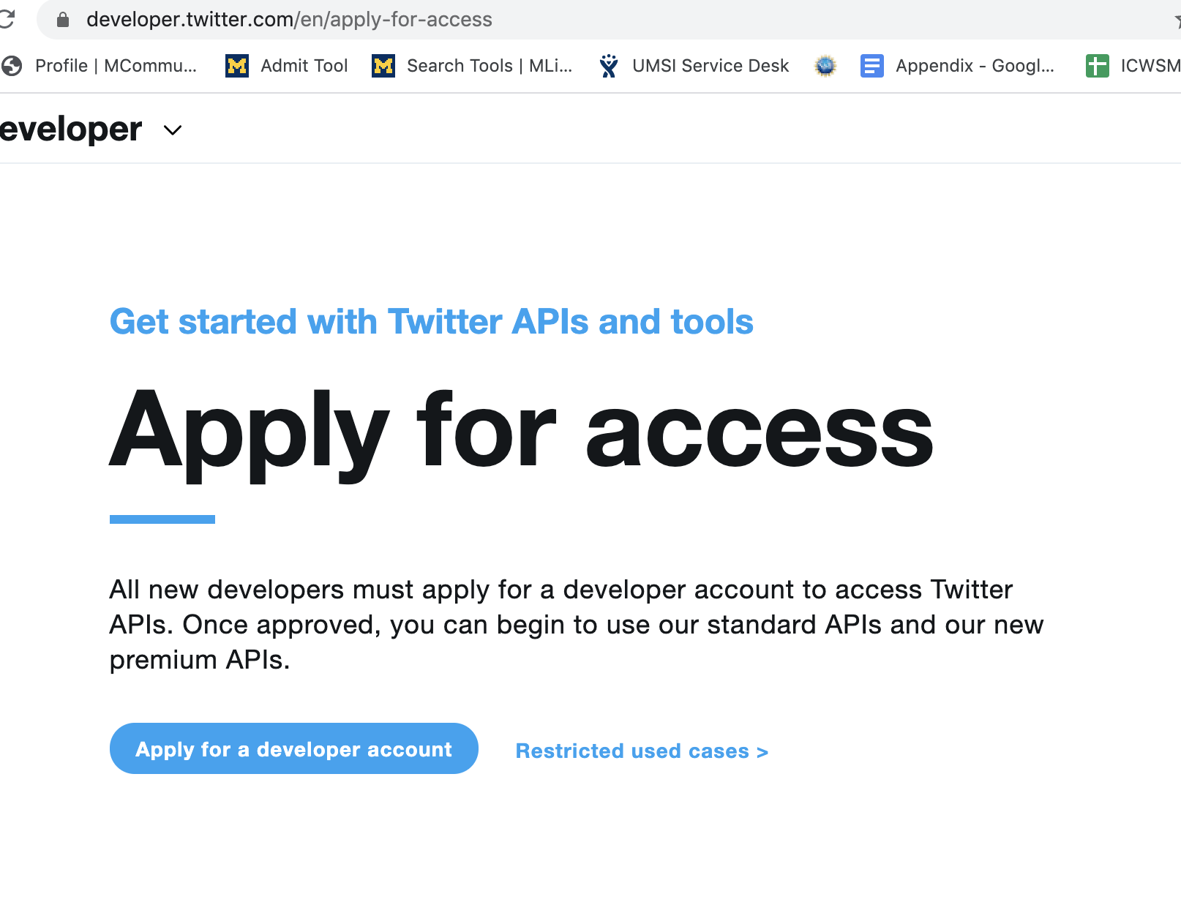
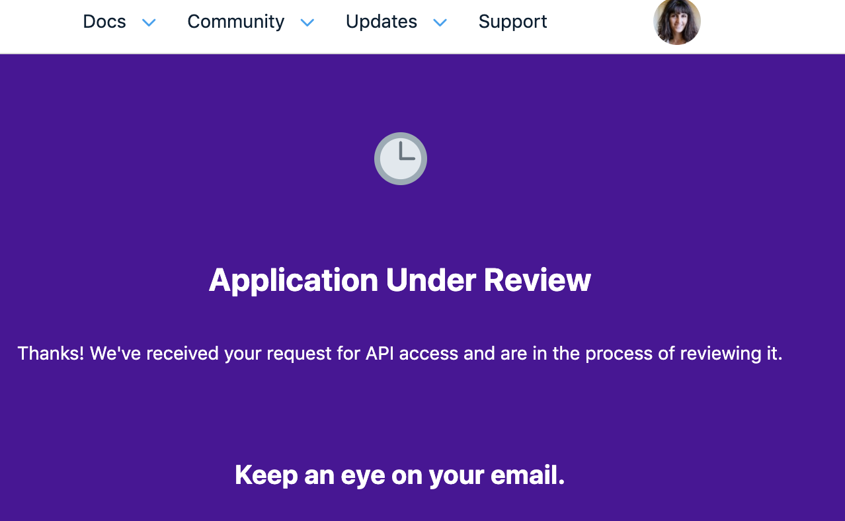
Twitter API
It takes a while to get access.
Note that our university has agreement with Twitter. If you want to use Twitter data for your projects, best option might be to talk to me. You will need to write a short project description that we will send to ARC-TS for approval

Slide 41
Resources
Chapter 12, 13, Severance
HTTP tutorial
http://www.jmarshall.com/easy/http/
Urllib3
https://docs.python.org/3/library/urllib.html
Review of HTML elements
http://www.w3schools.com/html/html_elements.asp
BeautifulSoup
http://www.crummy.com/software/BeautifulSoup/bs4/doc/
json module tutorial:
http://www.doughellmann.com/PyMOTW/json/

Slide 42
Data Processing

Slide 43
Data Processing
Relational Databases and SQL

Slide 44
What is a database? And why are they fascinating and exciting?
A collection of information organized to permit efficient retrieval
Phone book
U.S. Census data
Bibliographic databases
Full-text index
Customer records database
We're going to talk about relational databases
That capture, well, relationships between records

Slide 45
The basic unit of a database is a record
Each record consists of fields of different types
Rows = records, columns = fields
A collection of records forms a table.
Each table record typically has a special value called a primary key that uniquely identifies the record
The primary key can be used to connect to records in other tables
"Students" table
ID | Name | Phone | Grade | Program
2403 | Fred Smith | 1-712-555-2321 | 92 | HCI
9832 | Ana Prinz | 1-657-555-9231 | 84 | HCI
9932 | Andrea Martin | 1-432-213-9990 | 99 | IAR
Fields: ID (integer), Name (string), Phone (phone #), Grade (real), Program (string)

Slide 46
Why use a database?
Capture relationships between entities
Songs, Artists, Albums, …
Large data sets where only some variables are needed per access
SQL queries, caching
Large data set sharing across users
Data federation across DBs
Fast query lookup, little other processing
Indexing
Multiple, simultaneous updates to data
Transaction support: ACID (more on that later…)
On-going data evolution
Journaling, archiving
Web interfaces to data (especially dynamic)
Consistent data query/retrieval model, external schemas

Slide 47
Relational Databases
Popular relational database management systems (RDBMS)
SQLite (open source)
MySQL (open source)
PostgreSQL (open source)
SQL/Server (Microsoft, proprietary)
Oracle (proprietary)
Sybase (proprietary, now part of SAP)
Limitations of RDBMS
Limited abilities with unstructured data (text)
Relationships may not fit into the table paradigm well
e.g. entity-relationship graphs
Gets expensive (software & hardware) when you have hundreds of terabytes of data
Fixed schema, difficult to add columns

Slide 48
ACID
A very important concept that separates relational databases than other popular solutions like NoSQL
Atomicity. In a transaction involving two or more discrete pieces of information, either all of the pieces are committed or none are.
Consistency. A transaction either creates a new and valid state of data, or, if any failure occurs, returns all data to its state before the transaction was started.
Isolation. A transaction in process and not yet committed must remain isolated from any other transaction.
Durability. Committed data is saved by the system such that, even in the event of a failure and system restart, the data is available in its correct state.

Slide 49
Other revolutionary database technologies
'NoSQL'
Cassandra
HBase
MongoDB
SQL on Hadoop:
Apache Hive
Cloudera Impala
Cloud based solutions:
Amazon Redshift
Fast but no ACID support
Added ACID support

Slide 50
How is data in a relational database accessed? Most popular: Structured Query Language (SQL)
Structured Query Language is known as:
Its acronym, SQL, or
SEQUEL, the name of the original version of SQL
SEQUEL was developed by IBM in the mid-1970s.
Supported by all major database systems
Various SQL dialects used for large-scale computation frameworks
e.g. HiveQL, Cloudera Impala, Microsoft SCOPE
A great SQL tutorial is at http://www.w3schools.com/sql/default.asp

Slide 51
The parts of an example SQL SELECT statement
SELECT [Columns] FROM [TABLES] WHERE [Filter condition] ORDER BY [Sort column(s)]

Slide 52
SQL syntax is English-like
"Students" table
SELECT fields: what columns will be retrieved?
FROM tables: which table contains the column data?
ID | Name | Phone | Grade | Program
2403 | Fred Smith | 1-712-555-2321 | 92 | HCI
9832 | Ana Prinz | 1-657-555-9231 | 84 | HCI
9932 | Andrea Martin | 1-432-213-9990 | 99 | IAR
SELECT ID, Grade FROM Students;
ID | Grade
2403 | 92
9832 | 84
9932 | 99

Slide 53
DISTINCT
"Students" table
Eliminating duplicate rows on the output…
SELECT DISTINCT Program FROM Students;
ID | Name | Phone | Grade | Program
2403 | Fred Smith | 1-712-555-2321 | 92 | HCI
9832 | Ana Prinz | 1-657-555-9231 | 84 | HCI
9932 | Andrea Martin | 1-432-213-9990 | 99 | IAR
Program
HCI
IAR

Slide 54
WHERE Clause
ID | Name | Phone | Grade | Program
2403 | Fred Smith | 1-712-555-2321 | 92 | HCI
9832 | Ana Prinz | 1-657-555-9231 | 84 | HCI
9932 | Andrea Martin | 1-432-213-9990 | 99 | IAR
Reducing the output based on specified conditions …
SELECT Name FROM Students WHERE Grade >= 90.0;
Name
Fred Smith
Andrea Martin

Slide 55
Comparison Operators
Equals: =
Not equals: <>
Greater than: >
Greater than or equal: >=
Less than: <
Less than or equal: <=
Within a list of values: IN (e.g. WHERE State IN (“PA”, “MI”, “CA”);)
Logical: NOT
Within a range: BETWEEN (e.g. WHERE ID BETWEEN 1000 AND 9000;)
Notes:
But beware: Different databases define BETWEEN inconsistently: some define endpoints as inclusive, some exclusive, and some [inclusive, exclusive)

Slide 56
Wildcards and LIKE
The LIKE keyword is used in place of the = sign when you use wildcard characters.
The underscore character (_) is a single character substitution
The percent character(%) is a multi-character substitution
SELECT Name FROM Students
WHERE Name LIKE “A%”;
Name
Ana Prinz
Andrea Martin

Slide 57
NULL Means Nothing
"Students" table
A NULL character means that nothing has been entered.
SELECT ID, Name FROM Student WHERE Program IS NULL;
ID | Name | Phone | Grade | Program
2403 | Fred Smith | 1-712-555-2321 | 92 | HCI
9832 | Dana Prinz | 1-657-555-9231 | 84
9932 | Andrea Martin | 1-432-213-9990 | 99 | IAR
ID | Name
9832 | Dana Prinz

Slide 58
ORDER BY Clause
SELECT Name
FROM Students
ORDER BY Name DESC; # DESC = descending order
Results: Zack, Terry, Patrick, Melissa, April
SELECT Name
FROM Students
ORDER BY Name;
Results: April, Melissa, Patrick, Terry, Zack

Slide 59
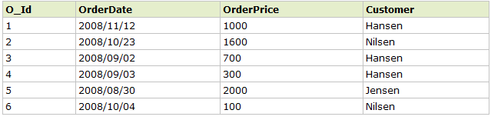

Grouping/Aggregation Functions
SELECT Customer, SUM(OrderPrice) FROM Orders GROUP BY Customer
http://www.w3schools.com/sql/sql_groupby.asp

Slide 60
The HAVING clause
SELECT Customer, SUM(OrderPrice) as OrderSum FROM Orders GROUP BY Customer HAVING OrderSum >= 2000
Customer | OrderSum
Hansen | 2000
Jensen | 2000
http://www.w3schools.com/sql/sql_having.asp

Slide 61
Difference Between Having and Where
A WHERE clause is used to filter records from a result. The filter occurs before any groupings are made.
A HAVING clause is used to filter values from a group.
And you can combine the two:
SELECT SalesOrderID,
SUM(UnitPrice * OrderQty) AS TotalPrice
FROM Sales.SalesOrderDetail
WHERE SalesOrderID > 50000
GROUP BY SalesOrderID
HAVING SUM(UnitPrice * OrderQty) > 10000
First “where” is applied to remove sales orders with id <=50K
Next, groups with total revenue of <=10K are filtered out

Slide 62
Aggregation Functions
Counting number of rows COUNT
Adding the values in a column SUM
Averaging the values in a column AVG
Finding the maximum value in a column MAX
Finding the minimum value in a column MIN

Slide 63
Examples
SELECT Count(*)
FROM Students
WHERE Program = “HCI”;
SELECT Sum(Amount)
FROM SalesReceipt;
SELECT Max(Grade)
FROM Assignments;

Slide 64
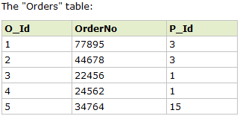
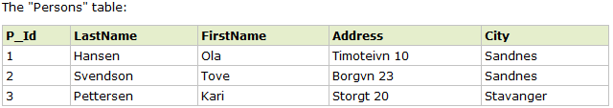
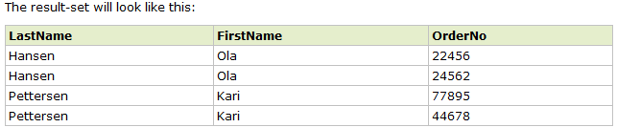
(INNER) JOIN
SELECT Persons.LastName, Persons.FirstName, Orders.OrderNo FROM Person JOIN Orders ON (Persons.P_Id=Orders.P_Id) ORDER BY Persons.LastName

Slide 65
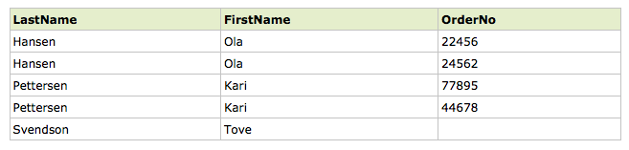
LEFT (OUTER) JOIN
SELECT Persons.LastName, Persons.FirstName, Orders.OrderNo FROM Person LEFT OUTER JOIN Orders ON (Persons.P_Id=Orders.P_Id) ORDER BY Persons.LastName
http://www.w3ctutorial.com/sql-advanced/sql_join_left

Slide 66
Question
In the previous example, what kind of SQL query can we write to find customers with no orders?

Slide 67
Python database support: sqlite
Python comes “batteries included”
No need to install anything. “import sqlite3”
sqlite3 documentation: https://docs.python.org/3/library/sqlite3.html

Slide 68
What is SQLite?
A self-contained, serverless, zero-configuration, transactional SQL database engine. File-based solution makes it extremely portable
The most widely deployed SQL database engine in the world. [According to http://www.sqlite.org/]
Packaged as a C library
Doesn’t require a separate server process
Allows accessing the database using a nonstandard variant of the SQL query language. Some applications can use SQLite for internal data storage.
Unlike MySQL and PostGres, there is no support for concurrency - > no multi-user support
Reference: http://docs.python.org/2/library/sqlite3.html

Slide 69
Using Sqlite
Create a connection to the database
Create a cursor object and use it to execute SQL commands

Slide 70
Step 1. Using sqlite connection object
import sqlite3
Option 1: Opening/creating a database on disk
conn = sqlite3.connect('/path/to/example.db')
Option 2: Creating a database in memory
Fast transactions on more limited-size datasets
conn = sqlite3.connect(':memory:')

Slide 71
Step 2: Using the sqlite cursor object to write changes to a database
c = conn.cursor()
# Create table
c.execute('CREATE TABLE stocks
(date text, trans text, symbol text, qty real, price real)')
# Insert one row of data
c.execute(“INSERT INTO stocks VALUES ('2006-01-05','BUY','RHAT',100,35.14)”)
# Insert several rows of data
purchases = [('2006-03-28', 'BUY', 'IBM', 1000, 45.00),
('2006-04-05', 'BUY', 'MSFT', 1000, 72.00),
('2006-04-06', 'SELL', 'IBM', 500, 53.00),
]
c.executemany('INSERT INTO stocks VALUES (?,?,?,?,?)', purchases)
# Save (commit) the changes
conn.commit()
# We can also close the connection if we are done with it.
# Just be sure any changes have been committed or they will be lost.
conn.close()
Source: http://docs.python.org/2/library/sqlite3.html

Slide 72
Creating and deleting tables and records
Creating a table
CREATE TABLE customer(C_CUSTKEY INT, C_NAME TEXT)
cur.executemany("INSERT INTO customer VALUES(?, ?, ?, ?, ?, ?, ?, ?)", lot)
Deleting a table
DROP TABLE IF EXISTS customer
SQL Datatypes (sqlite 3)
NULL. The value is a NULL value.
INTEGER. A signed integer, stored in 1, 2, 3, 4, 6, or 8 bytes depending on the magnitude of the value.
REAL. Floating point value, stored as an 8-byte IEEE floating point number.
TEXT. The value is a text string, stored using the database encoding (UTF-8, UTF-16BE or UTF-16LE). Default is UTF-8 for slite3 in python.
BLOB. The value is a blob of data, stored exactly as it was input.

Slide 73
Retrieving data with SELECT statements in sqlite
Use the cursor as an iterator
results = c.execute('SELECT * FROM stocks ORDER BY price')
for row in results:
print (row)
Call results.fetchone()to retrieve a single matching row. Once executed, results will no longer contain the first row.
Call results.fetchall()to retrieve a list of the matching rows.

Slide 74
Other Python Packages for Database Connection
MySQLdb
MySQLdb is an interface to the popular MySQL database server for Python.
https://pypi.python.org/pypi/MySQL-python
cx_Oracle
Python interface to Oracle database
http://pypi.python.org/pypi/cx_Oracle

