Slide 1
SI 618: Week 5
Large-scale distributed computation
Fall 2022
Ceren Budak

Slide 2
Before we start
Let’s take a moment to get Great Lakes accounts (will be needed starting next week). Please fill out the form: https://arc.umich.edu/login-request

Slide 3
What is big data?
Volume
Velocity
Variety

Slide 4
What is big data?
Volume
  Dramatic reduction in cost:
  Terabytes (1,000 Gigabytes) to Petabytes (1,000 Terabytes)
  Challenges and opportunities
$100,000 per GB in 1980
<$0.1 per GB in 2022
Notes:
Terabytes – 10¹²
Petabytes – 10¹⁵

Slide 5
What is big data?
Velocity
  Data are not just large but also being produced (and need to be processed) in fast pace
    Consider ads for instance. The moment you visit a site or google a query, the best ads to serve need to be decided
  Growing exponentially
  Both incoming and outgoing

Slide 6
What is big data?
Variety
  You already learned about RDBMs. What do you need to store and process data in such management systems?
    Schema
  In real world scenarios we deal with various sources of data. Three types:
    Structured data : Relational data.
    Semi Structured data : XML data.
    Unstructured data : Word, PDF, Text, Media Logs.
Examples:
Ancestry.com claims approximately 600 TB of genealogical data with the inclusion of US Census data from 1790 to 1930.
The Hubble Space Telescope has collected more than 45 terabytes of data in its first 20 years of observations.
Internet Archive: Collections of digitized materials, including web sites, software applications/games, music, movies/videos, moving images, and nearly three million public-domain books. As of May 2014, its collection topped 15 petabytes.

Slide 7
5Vs > 3Vs
Big data was originally described through the 3Vs described in earlier slides. But why stop there ☺
5Vs: Volume, Velocity, Variety
  Value: Quantity != Quality. Data != Insights. Extracting value from big data is challenging
  Veracity: Just how accurate is this data?

Slide 8
What is big data?
Big data involves the data produced by different devices and applications. Given below are some of examples:
Social Media Data : Social media such as Facebook and Twitter hold information and the views posted by millions of people across the globe.
Stock Exchange Data : The stock exchange data holds information about the ‘buy’ and ‘sell’ decisions made on a share of different companies made by the customers.
Power Grid Data : The power grid data holds information consumed by a particular node with respect to a base station.
Transport Data : Transport data includes model, capacity, distance and availability of a vehicle.
Search Engine Data : Search engines retrieve lots of data from different databases.

Slide 9
Two aspects we will cover
Programming paradigm. Examples:
  Serial Programming
  Multithreading
  MapReduce
  Spark
  Etc.
Storage and processing systems underlying. Examples:
  HDFS
We will first focus on the programming paradigm, ignoring the underlying support for it. We will return to this later.

Slide 10
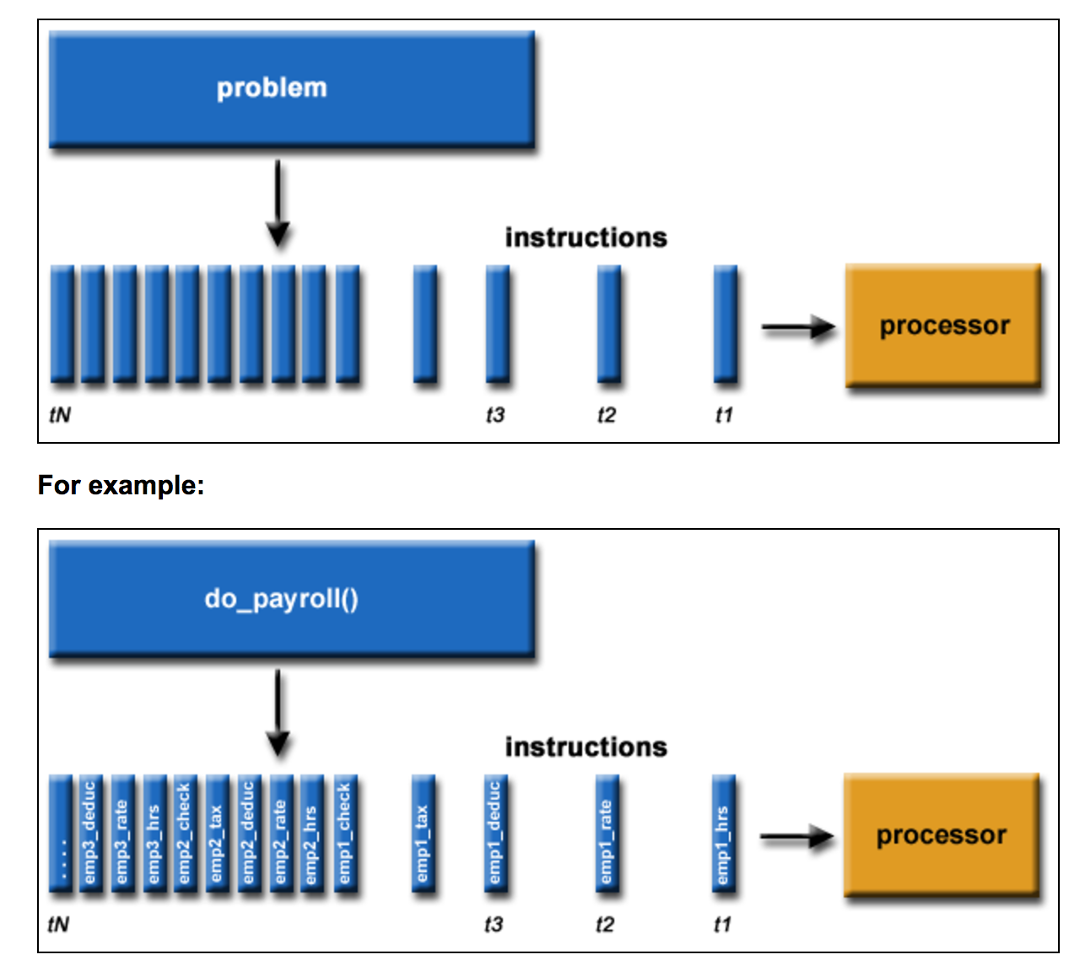
Serial Programming
Traditionally, software has been written for serial computation:
  A problem is broken into a discrete series of instructions
  Instructions are executed sequentially one after another
  Executed on a single processor
  Only one instruction may execute at any moment in time
https://hpc.llnl.gov/documentation/tutorials/introduction-parallel-computing-tutorial

Slide 11
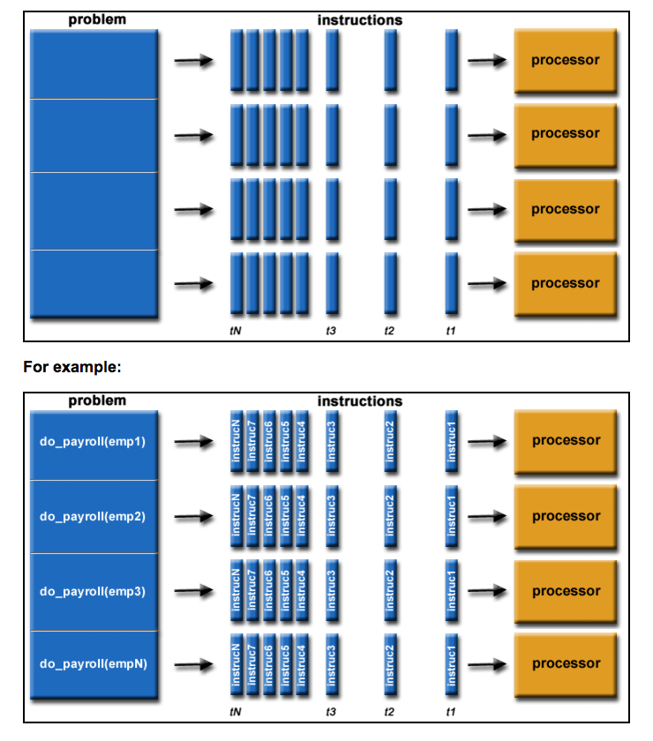
Parallel Programming
In the simplest sense, parallel computing is the simultaneous use of multiple compute resources to solve a computational problem:
  A problem is broken into discrete parts that can be solved concurrently
  Each part is further broken down to a series of instructions
  Instructions from each part execute simultaneously on different processors
  An overall control/coordination mechanism is employed
Python solutions: https://wiki.python.org/moin/ParallelProcessing
https://hpc.llnl.gov/documentation/tutorials/introduction-parallel-computing-tutorial

Slide 12
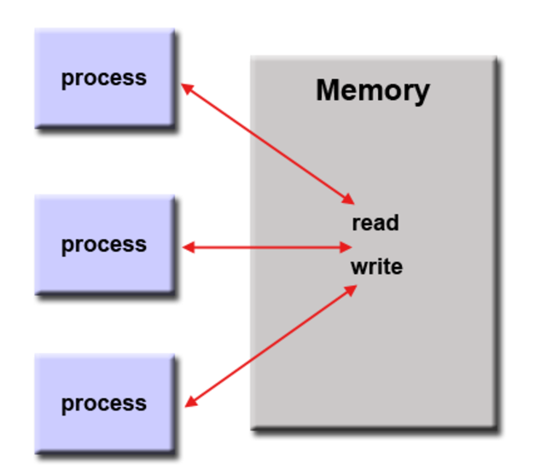
Parallel Programming Models 1 – Shared Memory Model
Processes/tasks share a common address space, which they read and write to asynchronously.
Mechanisms such as locks/semaphores are used to control access to the shared memory, resolve contentions and to prevent race conditions and deadlocks. => can be very hard!

Slide 13
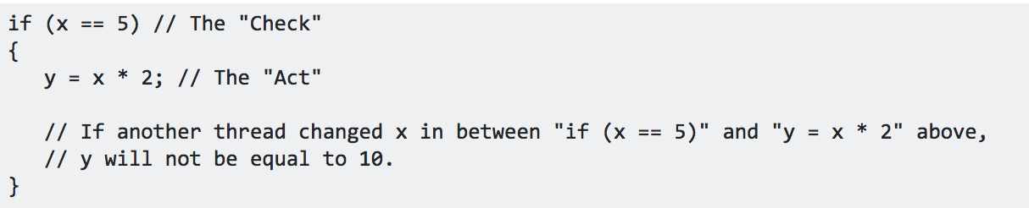
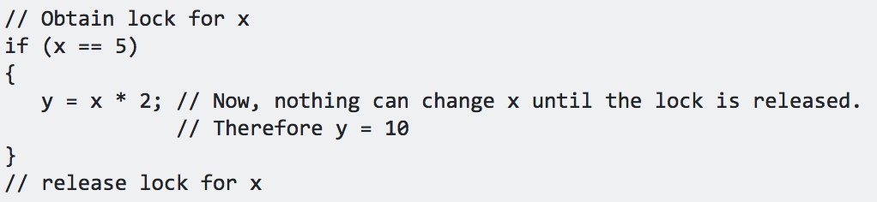
Parallel Programming Models 1 – Shared Memory Model
Processes/tasks share a common address space, which they read and write to asynchronously.
Mechanisms such as locks/semaphores are used to control access to the shared memory, resolve contentions and to prevent race conditions and deadlocks. => can be very hard!
Race condition:

Slide 14
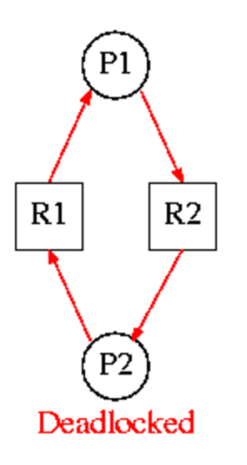
Parallel Programming Models 1 – Shared Memory Model
Processes/tasks share a common address space, which they read and write to asynchronously.
Mechanisms such as locks/semaphores are used to control access to the shared memory, resolve contentions and to prevent race conditions and deadlocks. => can be very hard!
Deadlock:
  Resource R1 and resource R2 are used by process P1 and process P2
    P1 starts to use R1.
    P1 and P2 try to start using R2
    P2 'wins' and gets R2 first
    Now P2 needs to use R1
    R1 is locked by P1, which is waiting for R2

Slide 15
Parallel Programming Models 1 – Shared Memory Model
Processes/tasks share a common address space, which they read and write to asynchronously.
Mechanisms such as locks/semaphores are used to control access to the shared memory, resolve contentions and to prevent race conditions and deadlocks. => can be very hard!
An advantage for programmers: there is no need to specify explicitly the communication of data between tasks.
Disadvantage: difficult to understand and manage data locality
  Keeping data local to the process that works on it conserves memory accesses, cache refreshes and bus traffic that occurs when multiple processes use the same data. Very hard in this model.
On distributed memory machines, memory is physically distributed across a network of machines, but made global through specialized hardware and software. Eg.: http://en.wikipedia.org/wiki/SHMEM.
https://hpc.llnl.gov/documentation/tutorials/introduction-parallel-computing-tutorial

Slide 16
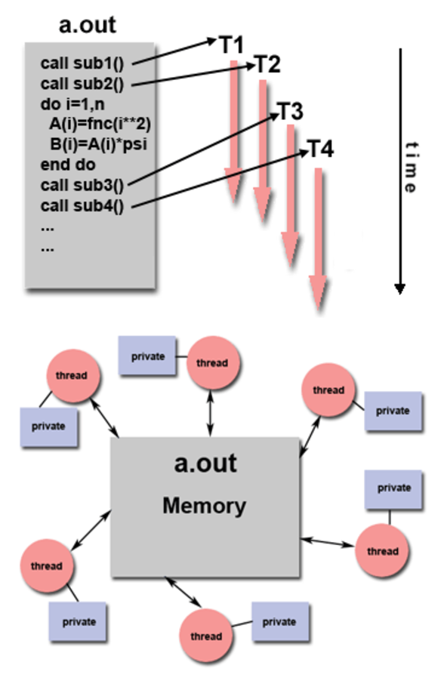
Parallel Programming Models 2 – Threads Model
A type of shared memory programming.
A single "heavy weight" process can have multiple "light weight", concurrent execution paths.
Any thread can execute any subroutine at the same time as other threads.
Threads communicate with each other through global memory (updating address locations). Synchronization constructs needed to ensure that more than one thread is not updating the same global address at any time.
Programmer is responsible for determining the parallelism
Multiple Python libraries:
  https://www.tutorialspoint.com/python/python_multithreading.htm
  https://chriskiehl.com/article/parallelism-in-one-line
https://hpc.llnl.gov/documentation/tutorials/introduction-parallel-computing-tutorial
Notes:
For example:
a.out is scheduled to run by the native operating system. a.out loads and acquires all of the necessary system and user resources to run.
a.out performs some serial work, and then creates threads that can be scheduled and run by the operating system concurrently.
Each thread has local data, but also, shares the entire resources of a.out.
a.out remains present to provide the necessary shared resources until the application has completed.

Slide 17
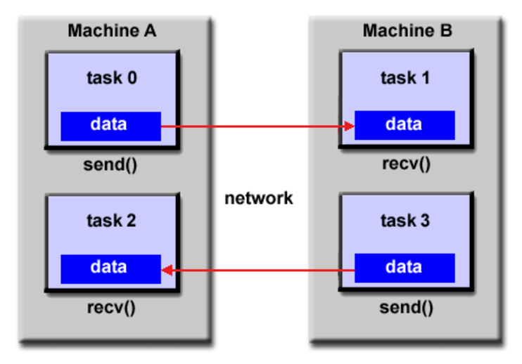
Parallel Programming Models 3 -Distributed Memory/Message Passing Model
Tasks that use their own local memory during computation. Multiple tasks can reside on the same physical machine and/or across different machines.
  Tasks exchange data through communications by sending and receiving messages.
  Data transfer usually requires cooperative operations to be performed by each process. For example, a send operation must have a matching receive operation.
Historically, a variety of message passing libraries have been available since the 1980s. These implementations differed substantially from each other making it difficult for programmers to develop portable applications.
Message Passing Interface (MPI) is the "de facto" industry standard for message passing, replacing virtually all other message passing implementations used for production work.
MPI tutorial: https://hpc-tutorials.llnl.gov/mpi/
https://hpc.llnl.gov/documentation/tutorials/introduction-parallel-computing-tutorial
Notes:
For example:
a.out is scheduled to run by the native operating system. a.out loads and acquires all of the necessary system and user resources to run.
a.out performs some serial work, and then creates threads that can be scheduled and run by the operating system concurrently.
Each thread has local data, but also, shares the entire resources of a.out.
a.out remains present to provide the necessary shared resources until the application has completed.

Slide 18
Parallel Computing Models
And many more…
What are the challenges?
    Computers must communicate and coordinate
    Load balancing
    Network and disk optimization
    How to recover from computer failure (1000 CPU = 1 per day)
    How to optimize? Debug?
    Data locality
All left to the programmer and need to be figured out for each new task!
Google realized that finding a large number of programmers skilled in such complex tasks was hard. So they went back to one of the foundations of computer science and create a simple programming language that abstracts all these messy details away.

Slide 19
Parallel Computing Models – MapReduce
A simple programming model that applies to many large-scale computing problems
Hide messy details in MapReduce runtime library:
  automatic parallelization
  load balancing
  network and disk transfer optimization
  handling of machine failures
  robustness
  improvements to core library benefit all users of library!

Slide 20
A better solution: Divide and conquer
A technique we use everyday!
  Split the task in sub-tasks
  Put resources to handle subtasks in parallel
  Combine the results
  This is a simple example of distributed computing
  We are distributing the workload across different CPUs

Slide 21
Divide and conquer
Word count as an example:
and 2
are 2
hareesh 2
mengyan 2
618 1
at 1
experienced 1
gsis 1
python 1
Hareesh and Mengyan are 618 GSIs
Mengyan and Hareesh are experienced at Python
Notes:
Get student’s algorithm
What if each document has 500 words

Slide 22
Divide and conquer
Conceptual model 1
hareesh 1
and 1
mengyan 1
are 1
618 1
gsis 1
and 2
are 2
hareesh 2
mengyan 2
618 1
at 1
experienced 1
gsis 1
python 1
Hareesh and Mengyan are 618 GSIs
1
mengyan 1
and 1
hareesh 1
are 1
experienced 1
at 1
python 1
Mengyan and Hareesh are experienced at Python
2
Notes:
How are you going to put results together?

Slide 23
Divide and conquer
Conceptual model 2: words get "clustered" to particular CPUs
and 1
are 1
618 1
gsis 1
and 1
are 1
experienced 1
at 1
and 2
are 2
618 1
gsis 1
experienced 1
at 1
hareesh 1
and 1
mengyan 1
are 1
618 1
gsis 1
Hareesh and Mengyan are 618 GSIs
1
and 2
are 2
hareesh 2
mengyan 2
618 1
at 1
experienced 1
gsis 1
python 1
3
mengyan 1
and 1
hareesh 1
are 1
experienced 1
at 1
python 1
hareesh 1
mengyan 1
mengyan 1
hareesh 1
python 1
Mengyan and Hareesh are experienced at Python
hareesh 2
mengyan 2
python 1
2

Slide 24
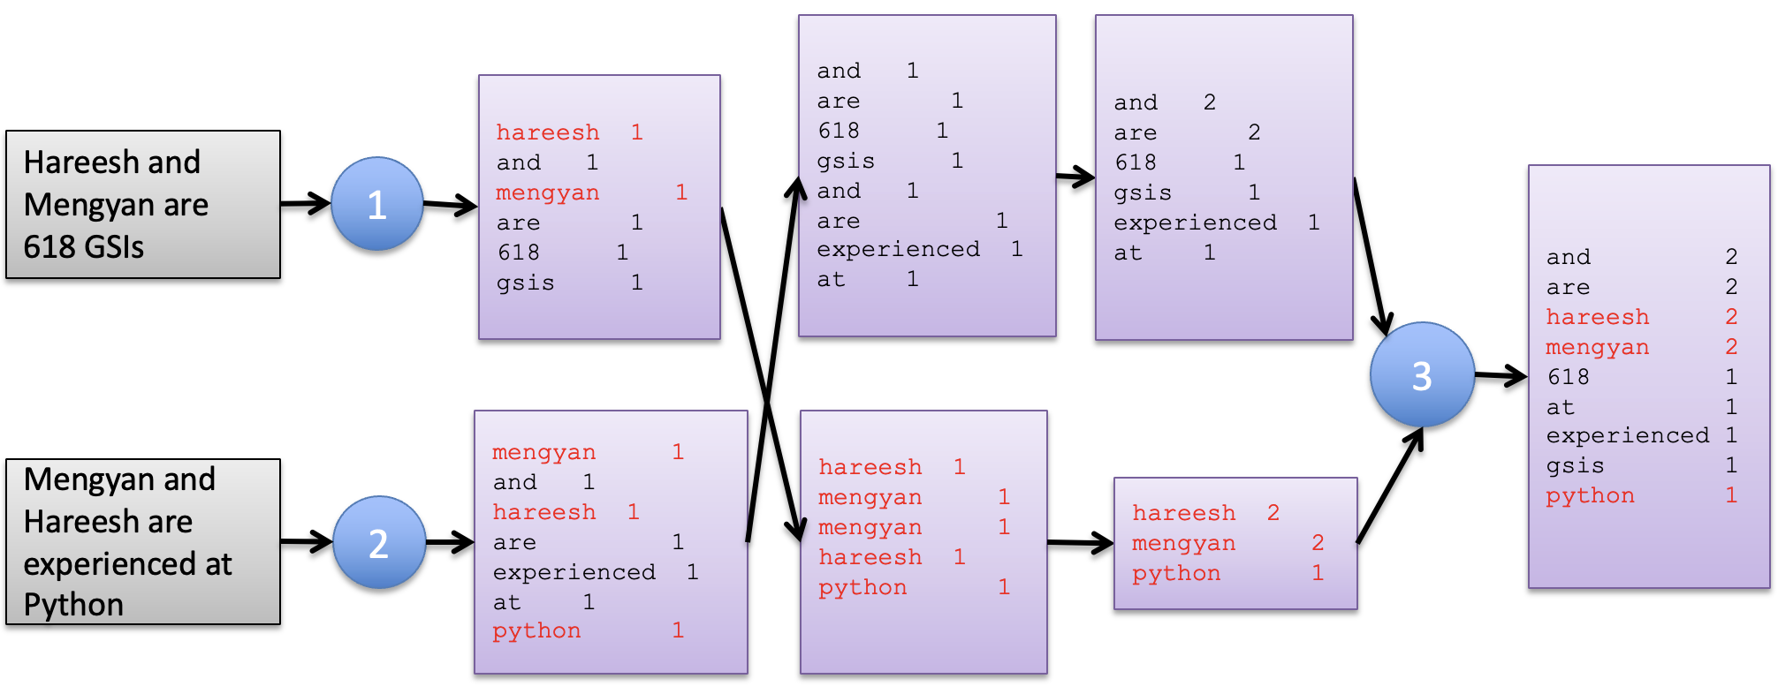
A typical MapReduce problem
This framework is the same for all problems:
We just change Map and Reduce steps to fit the problem
Read a bunch of data (set of records)
Map: for each record,
  Extract something you care about.
Sort and group the extracted records
Reduce: For all groups:
  Summarize, filter, transform, aggregate
  Collapse the group into a result row
Write out the results

Slide 25
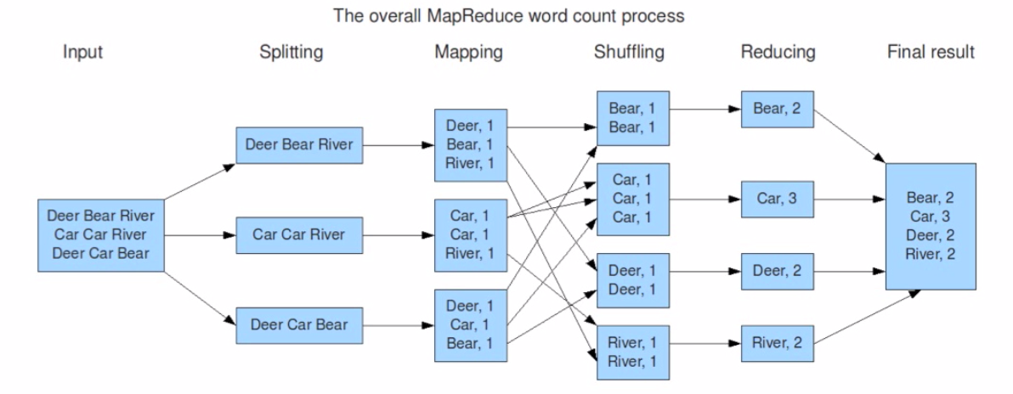
MapReduce – Word Count
Copy data between nodes based on the keys
Slide from Basic Introduction to Apache Hadoop
http://www.youtube.com/watch?v=OoEpfb6yga8

Slide 26
Assumptions of MapReduce
The task can be broken into multiple pieces
Pieces can be processed in parallel with minimal communication between pieces
Results of each piece can be combined in the end to produce final result

Slide 27
Two views of MapReduce programming
Step-level view
  You supply the mapper and reducer functions
  Python MRJob (Lab)
Table-level view
  Load -> Transforms -> Dump
  High-level table operations like SQL
    Group records, compute aggregate function
  Can still define custom mappers, reducers if needed
  Hadoop + PySpark (coming up)

Slide 28
MRJob
Different backends possible
  Test on your local machine
  Or Run on a Hadoop cluster
  Or use Amazon Elastic MapReduce
Base class: MRJob
  You create your own subclass inheriting from MRJob with your desired mapper and reducer methods
  You must define at least one of:
    mapper, reducer, combiner
Install package "mrjob"
Documentation: https://mrjob.readthedocs.io/en/latest/guides/quickstart.html

Slide 29
You plug in a mapper and reducer: MRJob framework does the rest
Mapper
  Goal: Break input line into a set of key, value pairs
  Input: single line from text file
  Output:
  zero or more (key, value) pairs
Reducer
  Goal: Take all (key, value) pairs with the same key, and compute an aggregate function over those values
  Input: a key and a list of all values seen for that key
  Output:
  zero or more (key, value) pairs
  Most typically, the values are from an aggregation function over value_list, e.g. sum(value-list)
The MRJob framework takes care of the rest:
  Sorting the mapper output. Invoking reduce tasks
  Assembling reduce outputs into final result
  Scheduling, monitoring all tasks, re-starting failed tasks

Slide 30
A basic MRJob Map-Reduce program
#!/usr/bin/python
from mrjob.job import MRJob
import re
class MRWordFrequencyCount(MRJob):
### input: self, in_key, in_value
def mapper(self, _, line):
yield "chars", len(line)
yield "words", len(line.split())
yield "lines", 1
### input: self, in_key from mapper, in_value from mapper
def reducer(self, key, values):
yield key, sum(values)
if __name__ == '__main__':
MRWordFrequencyCount.run()

Slide 31
Mapper example: "To be or not to be"
def mapper(self, _, line):
yield "chars", len(line)
yield "words", len(line.split())
yield "lines", 1
Input: "To be or not to be”
Output: ("chars", 18), ("words", 6), ("lines", 1)
Input: "That is the question”
Output: ("chars", 20), ("words", 4), ("lines", 1)

Slide 32
Reducer example: "To be or not to be"
def reducer(self, key, values):
yield key, sum(values)
Input: "chars": [18, 20]
Output: ("chars", 38)
Input: "words" : [6, 4]
Output: ("words", 10)
Input: ”lines" : [1, 1]
Output: (”lines", 2)

Slide 33
The output of all mappers is sorted by key, then given to the reducer
Mappers
Reducer
Sort
By
Key
Input: "chars": [18, 20]
Output: ("chars", 38)
Input: "words" : [6, 4]
Output: ("words", 10)
…
Input: "To be or not to be"
Output:
("chars", 18), ("words", 6), ("lines", 1)
Input: "That is the question"
Output:
("chars", 20), ("words", 4), ("lines", 1)
chars
words
lines
What should this be?
Respond at PollEv.com/cerenbudak421
Note: It should be something like:
Input: …. Output: …
Please include both in one line

Slide 34
The output of all mappers is sorted by key, then given to the reducer
Mappers
Reducer
Sort
By
Key
Input: "chars": [18, 20]
Output: ("chars", 38)
Input: "words" : [6, 4]
Output: ("words", 10)
…
Input: "To be or not to be"
Output:
("chars", 18), ("words", 6), ("lines", 1)
Input: "That is the question"
Output:
("chars", 20), ("words", 4), ("lines", 1)
chars
words
lines
("chars", 38), ("words", 10), ("lines", 2)

Slide 35
Example: MRJob program for counting characters, words, and lines
#!/usr/bin/python
from mrjob.job import MRJob
class MRWordFrequencyCount(MRJob):
# mapper: key _ is always None and ignored
def mapper(self, _, line):
yield "chars", len(line)
yield "words", len(line.split())
yield "lines", 1
def reducer(self, key, values):
yield key, sum(values)
if __name__ == '__main__':
MRWordFrequencyCount.run()
Splitting & Mapping
Shuffling & Reducing
$ python word_count.py my_file.txt
[…a bunch of log output…]
"chars" 3654
"lines" 123
"words" 417

Slide 36
MRJob: protocols
By default, we use one protocol for reading input, one internal protocol for communication between steps, and one protocol for final output (which is usually the same as the internal protocol). Protocols can be controlled by setting INPUT_PROTOCOL, INTERNAL_PROTOCOL, and OUTPUT_PROTOCOL in the mrjob.conf file
class MyMRJob(mrjob.job.MRJob):
# these are the defaults
INPUT_PROTOCOL = mrjob.protocol.RawValueProtocol
INTERNAL_PROTOCOL = mrjob.protocol.JSONProtocol
OUTPUT_PROTOCOL = mrjob.protocol.JSONProtocol

Slide 37
Questions
Is using a reducer always necessary?
  No, if there are no sorting or grouping tasks
  Example: change all words into upper case
Shuffle seems like it passes a lot of data around!
How can we reduce that?
  Add a combiner after mapping

Slide 38
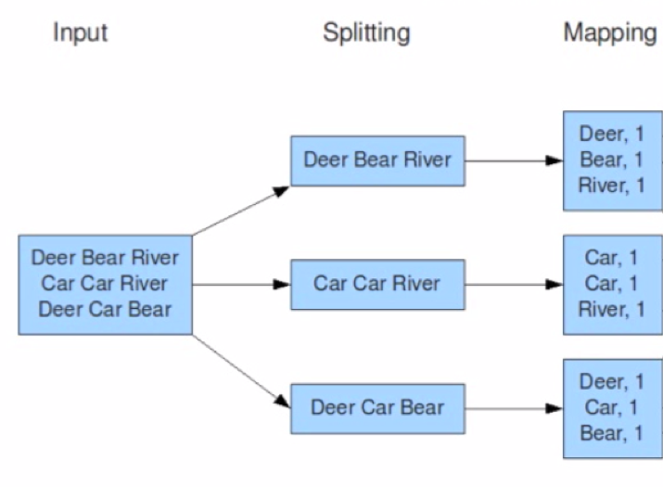
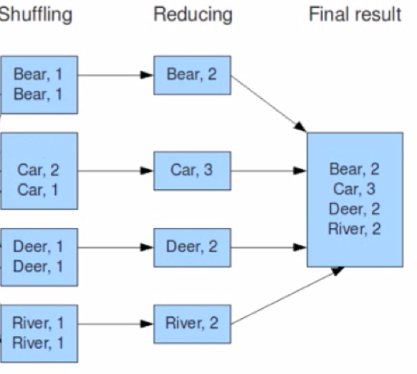
MapReduce – Word Count
Combining
Deer, 1
Bear, 1
River, 1
Car, 2
River, 1
Deer, 1
Car, 1
Bear, 1
Slide from Basic Introduction to Apache Hadoop
http://www.youtube.com/watch?v=OoEpfb6yga8
Notes:
If your algorithm involves computing aggregates of any sort, chances are you can use a Combiner in order to perform some kind of initial aggregation before the data hits the reducer. The MapReduce framework runs combiners intelligently in order to reduce the amount of data that has to be written to disk and transfered over the network in between the Map and Reduce stages of computation.

Slide 39
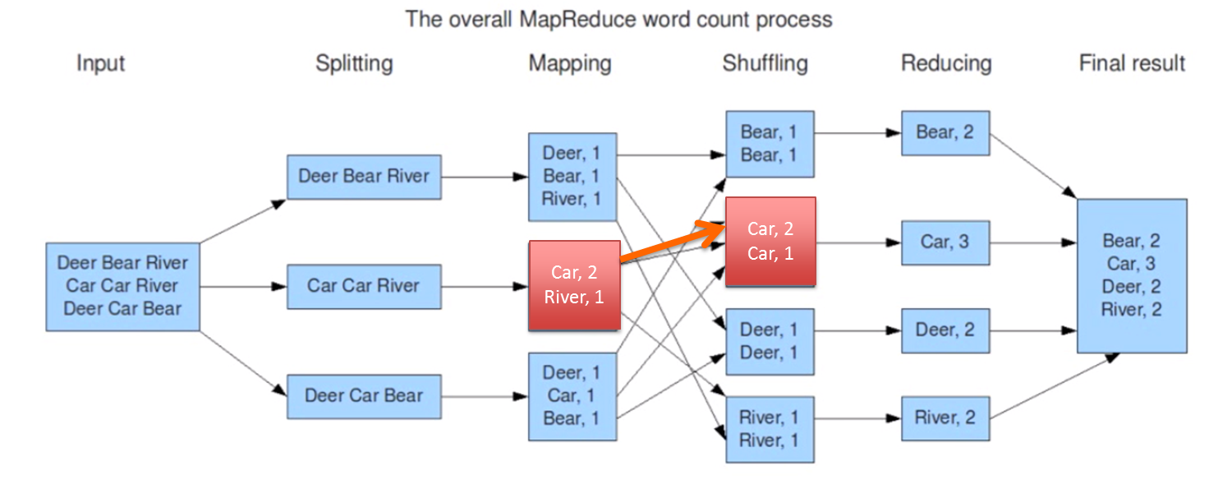
Adding a combiner can increase efficiency
Run immediately after each mapper
Used to decrease total data transfer
Input: key, and a subset of values for that key
Output: zero or more (key, value) pairs
Example:
  mapper: splits line into words
    "the", 1
    "wheels", 1
    "of", 1
    "the ", 1 ...
  combiner: sums word counts over mapper output
    "the", 2
    "wheels", ..
  reducer: sums words counts over combiner outputs

Slide 40
MapReduce
MapReduce has proven to be a remarkably-useful abstraction
Greatly simplifies large-scale computations
Fun to use: focus on problem, let library deal with messy details
  Many thousands of parallel programs written by hundreds of different programmers in last few years
  Many had no prior parallel or distributed programming experience
Source: http://static.googleusercontent.com/media/research.google.com/en/us/pubs/archive/32721.pdf

Slide 41
Implications for Multi-Core Processors
Multi-core processors require parallelism, but many programmers are uncomfortable writing parallel programs
MapReduce provides an easy-to-understand programming model for a very diverse set of computing problems
  users don’t need to be parallel programming experts
  system automatically adapts to number of cores & machines available
Optimizations useful even in single machine, multi-core environment
  locality, load balancing, status monitoring, robustness,...
Source: http://static.googleusercontent.com/media/research.google.com/en/us/pubs/archive/32721.pdf

Slide 42
When should we use MapReduce?
Good MapReduce scenarios?
  Data can be trivially partitioned in parallel
  Few/no dependencies between the pieces
  Results can be trivially recombined
  Have lots of parallel CPUs w/ good bandwidth
  Processing speed matters
  e.g. feature extraction
Bad MapReduce scenarios?
  Lots of dependencies between data elements
    e.g. need similarity between every pair of tweets
  Instead, use graph (network)-based computation:
    Spark, GraphLab and other graph-based or more flexible frameworks
    Order of magnitude speedup over MapReduce in such cases

Slide 43
Projects
Proposals are due October 6. Here is a brief summary of what you need to do:
  (20 points) Summarize and motivate your proposed project.
  (20 points) Choose and describe (at least) two different datasets.
  (20 points) Describe how you might manipulate and join the two datasets.
  (30 points) Describe at least three large-scale computation tasks you will perform to gain insights from the datasets (e.g. mrjob, spark, and sparksql). Each task should result in one meaningful analysis.
  (10 points) Describe at least one visualization you might create that highlights insights you hope to gain.
You can see that I am asking you to use at least two datasets? Why?
Think of a topic you are passionate about and for which you can use data to address important questions

Slide 44
Projects
Think of a topic you are passionate about and for which you can use data to address important questions
Keep in mind the UMSI mission/goals:
  Learning and research that deeply engage pressing social issues
  Public and scholarly impact
  Effective stewardship of public and donor resources
  Pursuit, integration, and respect of diverse intellectual perspectives
  Being intellectually adventurous and creative
  Public access to information
  Civility and respect in public discourse
  Public undergraduate and graduate education as a path for increased social and economic mobility, in particular for student populations historically underrepresented in higher education
  Passion and engagement
  Work-life balance
  Diversity, equity, and inclusion

Slide 45
Projects
Think of a topic you are passionate about and for which you can use data to address important questions
Say you are passionate about understanding racial justice. You can find relevant data in various sources (e.g., openpolicing.stanford.edu/data) and combine with other datasets, e.g., social media
Or say that topic is food. You can find relevant data there too. (e.g., foodnetwork.com, flavornet.com)
And so much more… Check out example projects from the previous years.
The point is to find your calling, find your questions, and ask questions if you are stuck
And make sure you use large-scale computation techniques (mrjob or spark, which we will earn about next)
The assignment on canvas lists many helpful links for ideas

