Slide 1
Extra Slides
Hadoop/HDFS

Slide 2

Hadoop Framework
A software framework for distributed computing
Take 100 'commodity' machines that don't share memory or disk storage
Turn commodity machines into a cluster
Redundant and Reliable
Powerful and Scalable
Cost-effective
Java-based APIs to Hadoop services
But calling these directly is tedious and error-prone so people use programming languages like spark to perform Hadoop jobs
Notes:
Commodity does not mean consumer-class, but just not specialized enterprise machines

Slide 3
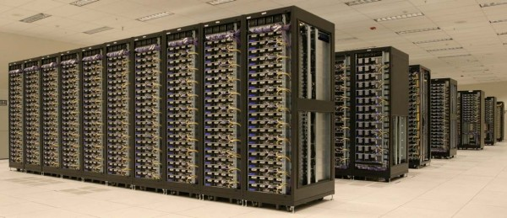
Hadoop Framework
Major components
MapReduce (algorithm)
A programming model for large-scale data processing
Hadoop Distributed File System (data storage)
Stores and aggregates data on cluster machines
Hardware Architecture
Networked machines
Cluster of machines running Hadoop at Yahoo! (Source: Yahoo!) via
http://www.michael-noll.com/tutorials/running-hadoop-on-ubuntu-linux-multi-node-cluster/

Slide 4
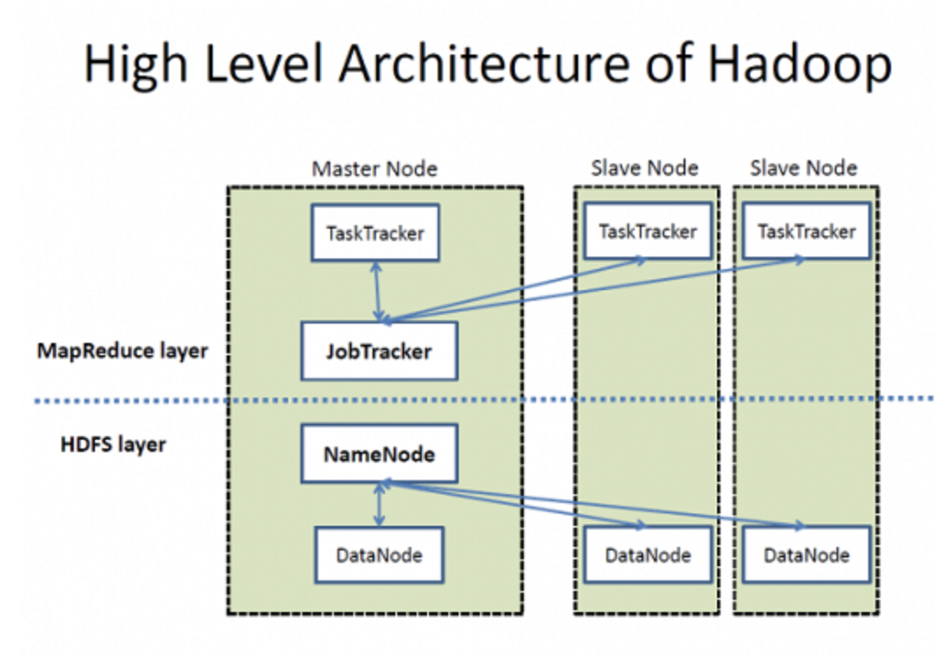
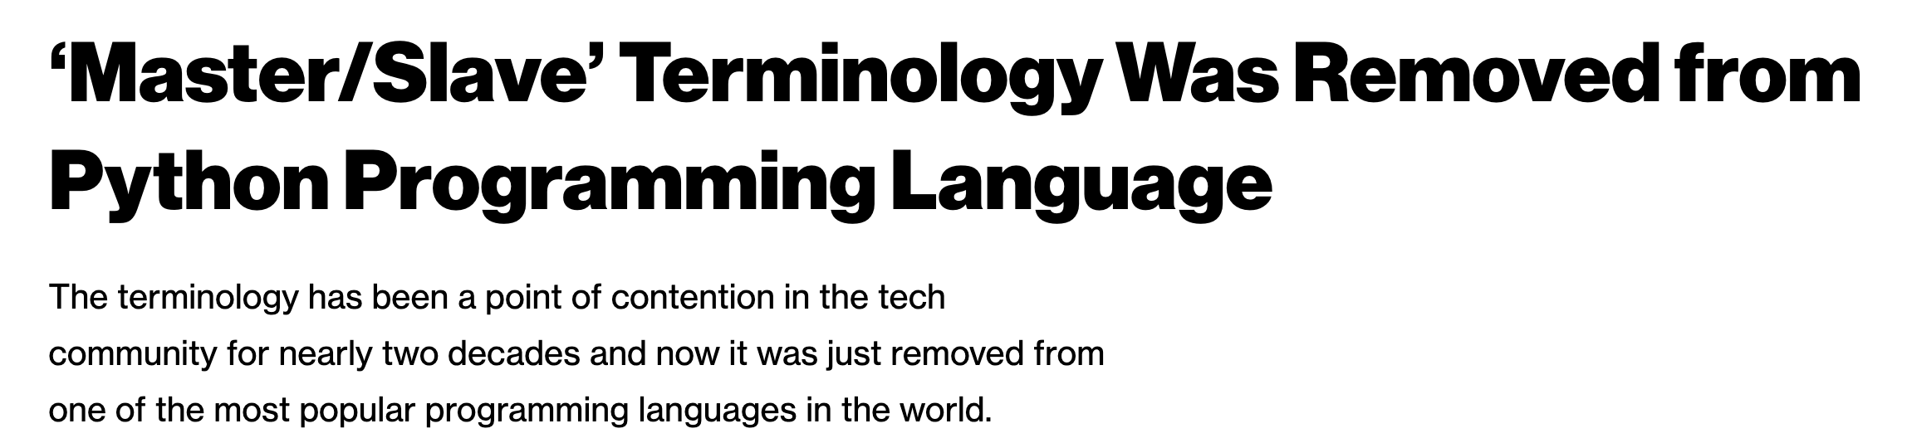
High Level Overview
Warning: The high level summary I will show right now includes unacceptable language.
It is important for us to acknowledge the current state and highlight the fact that such terminology being considered acceptable is perhaps a function of the diversity of the teams/computer science
There are efforts to change things, though.
Coordinator Node
Worker Nodes
I will focus on the HDFS aspect. For more on YARN (Job scheduling):
https://hadoop.apache.org/docs/current/hadoop-yarn/hadoop-yarn-site/YARN.html

Slide 5
Hadoop Distributed File System (HDFS)
Also need a mechanism to support the process at the data level.
HDFS is designed to be…
Scalable in storage and I/O bandwidth
Highly fault-tolerant (check periodically)
Optimized for commodity machines
Typical Settings:
Save a file into blocks (128MB)
Replicate 3 times
Notes:
http://www.youtube.com/watch?v=1_ly9dZnmWc

Slide 6
Hadoop Distributed File System (HDFS)
Name node keeps track of where these chunks are. Name node also has a simple webpage that lists some basic details.
Single point of availability failure (which is why systems generally replicate and have two name nodes)
Client
Name Node
Data Node
Data Node
Data Node
Responsible for actual read and write
Notes:
Secondary name node is not a demon. It pull the metadata from master name node and save it as a file image, then feed back to the master node fro persistence.

Slide 7
Hadoop MapReduce
In large configurations, there might be multiple racks with multiple nodes.
Name node is rack-aware (what if an entire rack goes down? We need to be resilient to this case)
Job Tracker
Name Node
Name Node2
1
1
1
1
What happens if rack 1 goes offline?

Slide 8
Hadoop MapReduce
In large configurations, there might be multiple racks with multiple nodes.
Name node is rack-aware (what if an entire rack goes down? We need to be resilient to this case)
Job Tracker
Name Node
Name Node2
1
1
1
1
What happens if rack 1 goes offline?

Slide 9
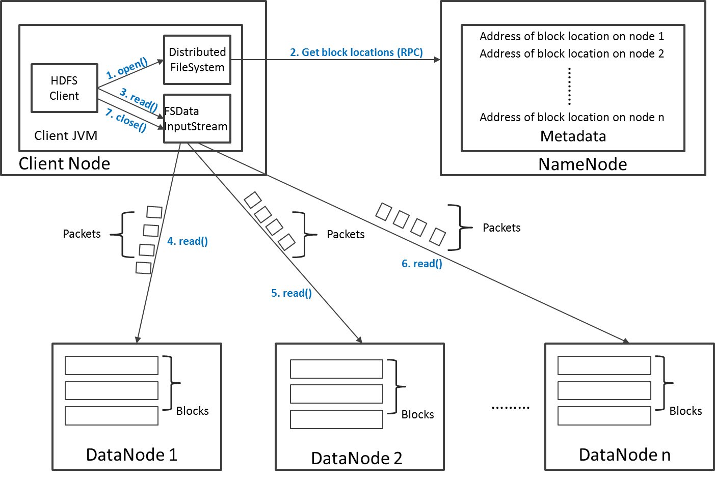
Read Operation in HDFS
Say that the client is looking for a block that is replicated on three datanodes. Namenode gives a sorted listed of datanodes to contact. Client will contact the second datanode only if it does not receive a response from the first
Why does the client go to the name node only to get the list and communicate with the data nodes directly? We don’t want name node to be a single point of failure

Slide 10
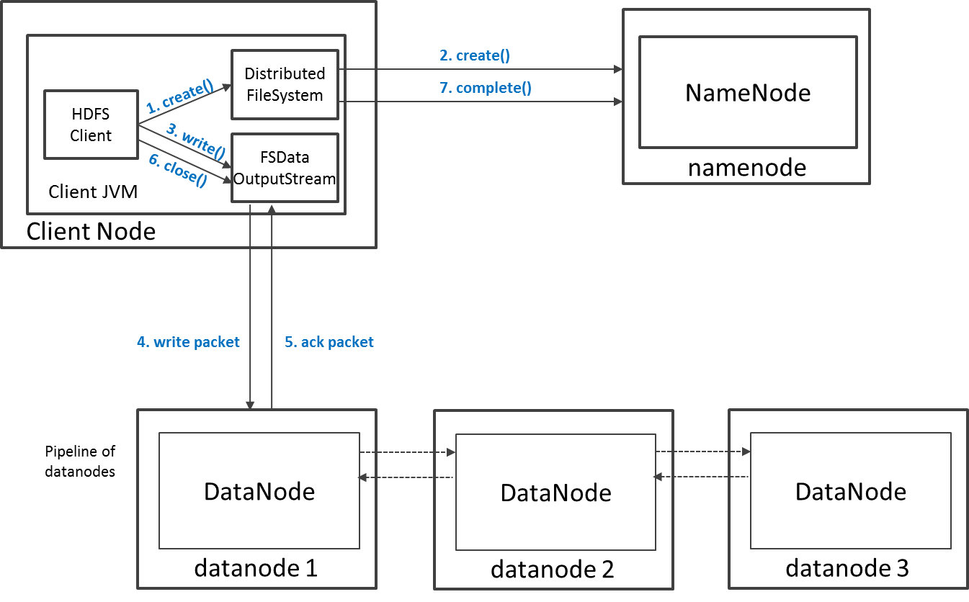
Write Operation in HDFS
Say your replication is 3, two of those are generally saved on two different datanodes on the same rack? Why?

