Slide 1
SI 618: Large-scale distributed computation 3
Fall 2022
Instructor: Ceren Budak

Slide 2
Spark Components
Spark SQL (SQL)
Spark Streaming
(real-time)
GraphX
(graph)
MLlib
(machine learning)
Spark SQL(SQL on Spark)
Spark Streaming (stream processing)
GraphX (graph processing)
MLlib (machine learning library)
…
Spark Core

Slide 3
Spark vs. SQL
Two Paradigms
MapReduce
+ parallelism abstractions make it easy to run distributed computation
+ flexible, complete programming language
-programmer responsible for optimizations
-difficult/inefficient for many queries (join)
SQL
+ Easy for certain operations like filter, join
+ Optimizations built-in
+ Simple, declarative query statements
-must perform ETL on data
-doesn't scale well
-hard to perform iteration, row-by-row
Notes:
ETL: extract, transform, load

Slide 4
SparkSQL
What is Spark SQL?
Tries to allow users to have the advantages of both without the disadvantages of either
Make it easier to construct a “pipeline” or mix of SQL queries fed into procedural constructs, similar to FlumeJava or DryadLINQ
Transforms SQL operations into RDD operations
Data can be loaded from HDFS
Stores data in memory
Supports both relational and Spark-style queries
Provides a configurable optimization engine

Slide 5
SparkContext: Entry point to SQL functionality
The entry point into all SQL functionality in Spark is the SQLContext class. To create a basic instance, all we need is a SparkContext reference.
from pyspark.sql import SQLContext
sqlContext = SQLContext(sc)

Slide 6
Datasets and DataFrames
A Dataset is a distributed collection of data
A Dataset can be constructed from JVM objects and then manipulated using functional transformations (map, flatMap, etc.)
The Dataset API is available in Scala and Java
A DataFrame is a Dataset organized into named columns
It is conceptually equivalent to a table in a relational database or a data frame in R/Python, but with richer optimizations
An abstraction for selecting, filtering, aggregating and plotting structured data

Slide 7
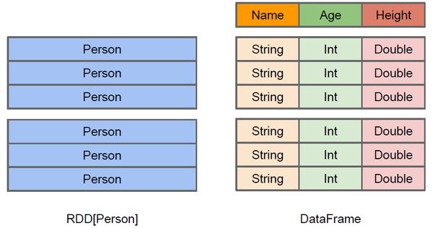
Difference between DataFrame and RDD
DataFrame more like a traditional database of two-dimensional form, in addition to data, but also to grasp the structural information of the data, that is, schema
RDD[Person] although with Person for type parameters, but the Spark framework itself does not understand internal structure of Person class
DataFrame has provided a detailed structural information, making Spark SQL aware of what columns are included in the dataset (the name and type of each column). Thus Spark SQL query optimizer can target optimization

Slide 8
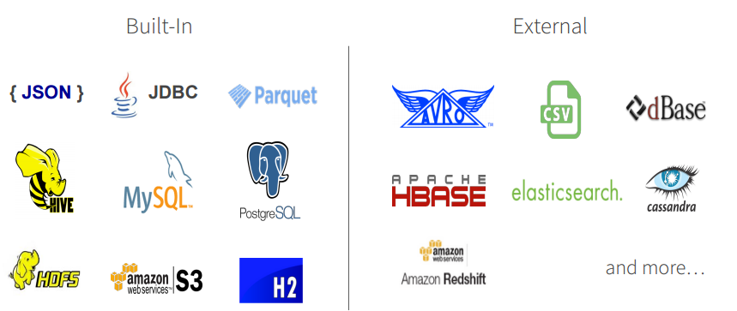
DataFrame Data Sources
Spark SQL’s Data Source API can read and write DataFrames using a variety of formats.
E.g., structured data files, tables in Hive, external databases, or existing RDDs
DataFrames can be created from RDDs, or loaded from data file: https://spark.apache.org/docs/1.3.0/sql-programming-guide.html
DataFrame operations: https://spark.apache.org/docs/1.3.0/api/python/pyspark.sql.html#pyspark.sql.DataFrame

Slide 9
DataFrames
Can embed relational style queries
Allows use of things like loop constructs and conditionals surrounding SQL-style queries
Can access, name, and use intermediate results of those queries
Spark-style lazy-eval allows optimization
Immediate error detection and response despite lazy-evaluation

Slide 10
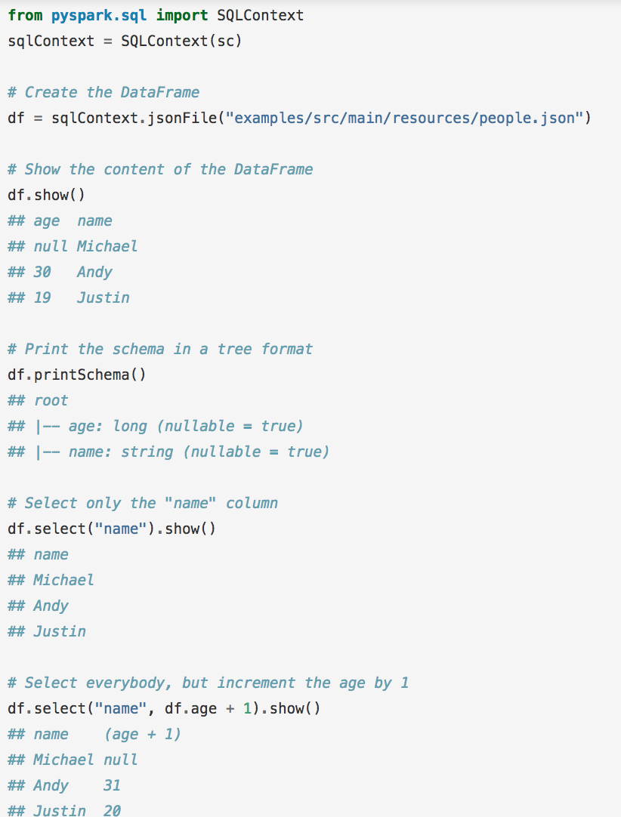
Spark SQL
sqlContext.read.json

Slide 11
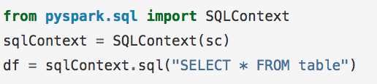
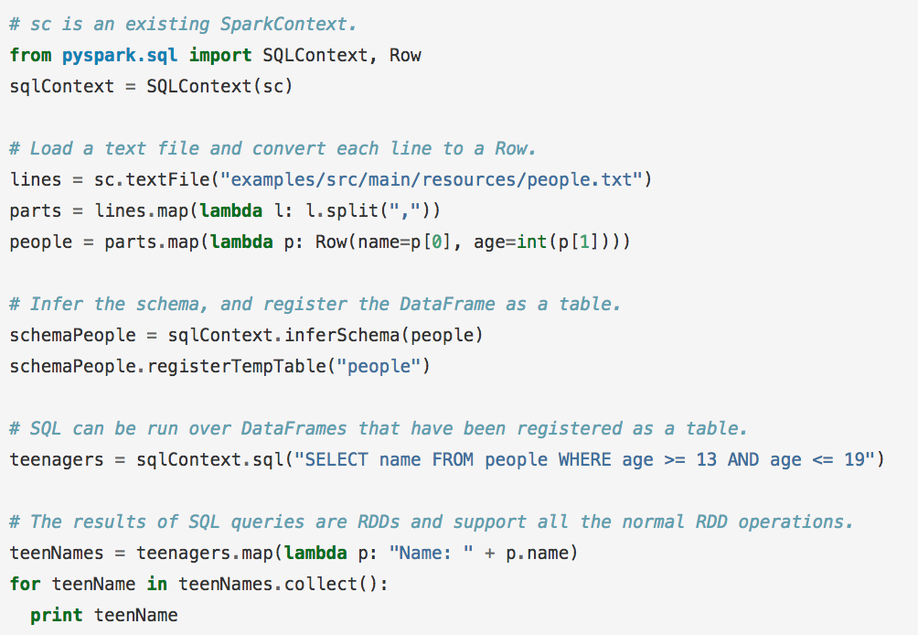
Spark SQL
Can infer a schema from semi-structured data (neat!)
Passes over data, finds the most specific but sufficient Spark SQL data-type that covers all instances of a field
Find all instances of field, find largest matching data type, and set that as the “type” of that column

Slide 12
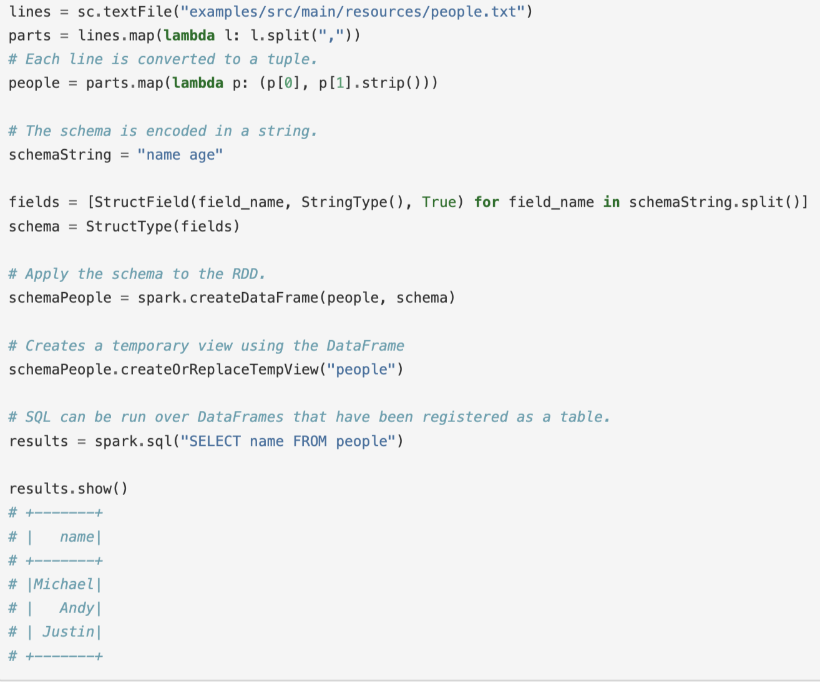
What is this third parameter? Check out StructField
You can also programmatically set the schema

Slide 13
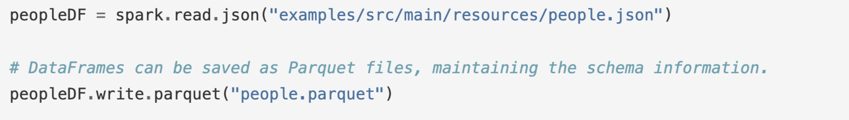
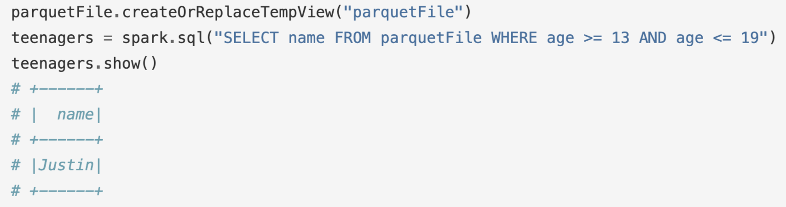
Parquet Files
Data can be saved as Parquet files to keep the schema
You can read parquet files as:
Parquet files can also be used to create a temporary view and then used in SQL statements.

Slide 14
Resources: Spark Documentation
https://spark.apache.org/docs/latest/quick-start.html
https://spark.apache.org/docs/latest/programming-guide.html
https://spark.apache.org/docs/latest/api/python/index.html

Slide 15


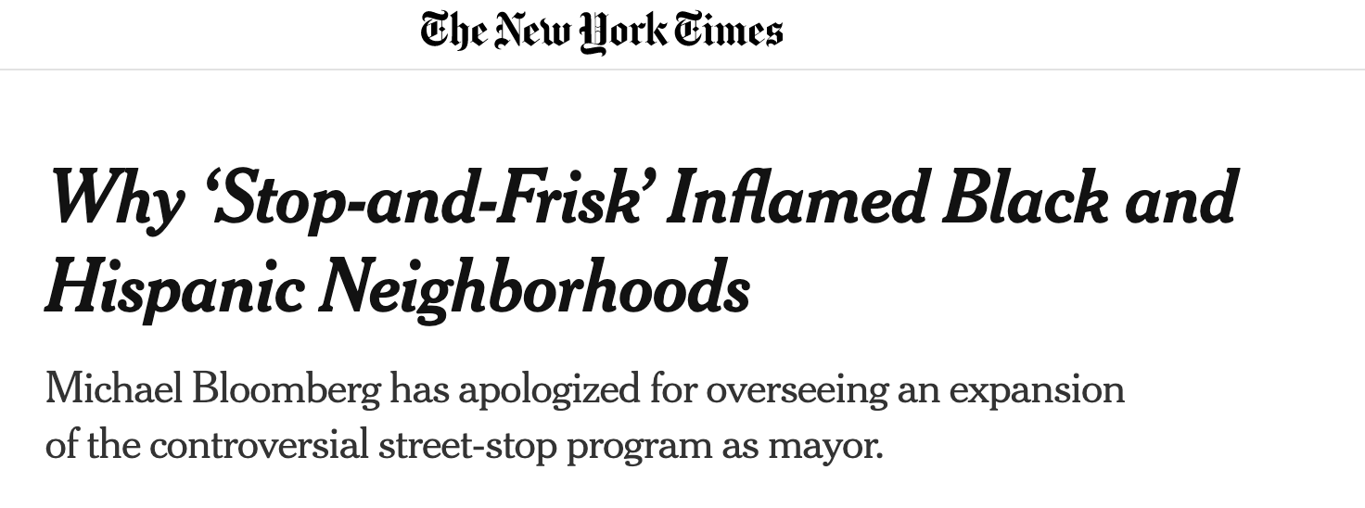
Now lets go through a SparkSQL example
Let’s delve into data about the NYC Stop-and-Frisk program
What is stop-and frisk? The practice of temporarily detaining, questioning, and at times searching civilians on the street. The police must have a reasonable suspicion that a crime has been, is being, or is about to be committed by the suspect.

Slide 16
Mid-point Check in
Want to understand how you are doing and what I can do to better support you.
Please fill out the form: https://forms.gle/LDS7SWwKwym2f7QS9
We will take 10 minutes to do this now.

Slide 17
Distributed File Systems
So far we have focused on the programming aspects of distributed computation.
Now, we will go over an overview of a popular file system: HDFS

Slide 18
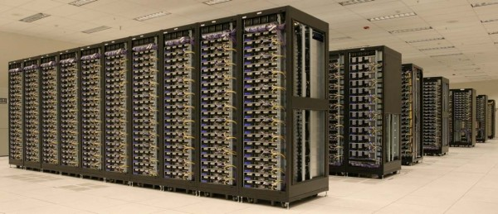
Hadoop Framework
Major components
MapReduce (algorithm)
A programming model for large-scale data processing
Hadoop Distributed File System (data storage)
Stores and aggregates data on cluster machines
Hardware Architecture
Networked machines
Cluster of machines running Hadoop at Yahoo! (Source: Yahoo!) via
http://www.michael-noll.com/tutorials/running-hadoop-on-ubuntu-linux-multi-node-cluster/

Slide 19
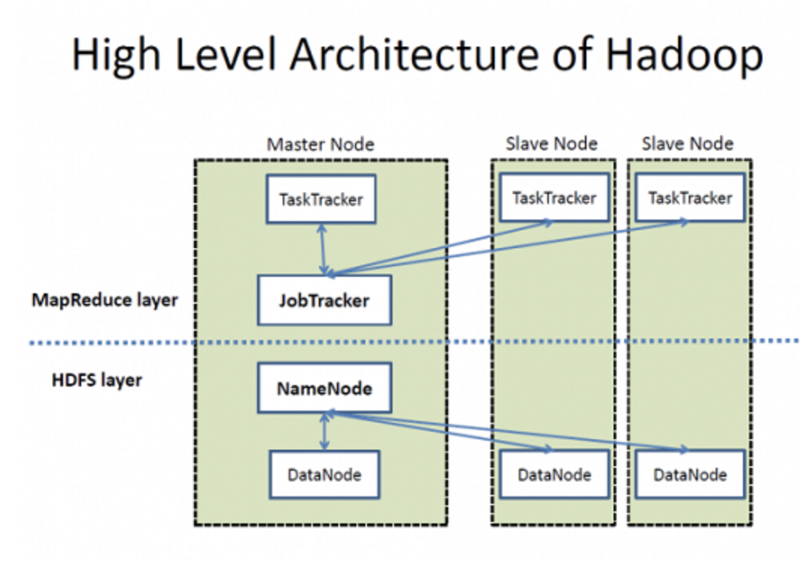
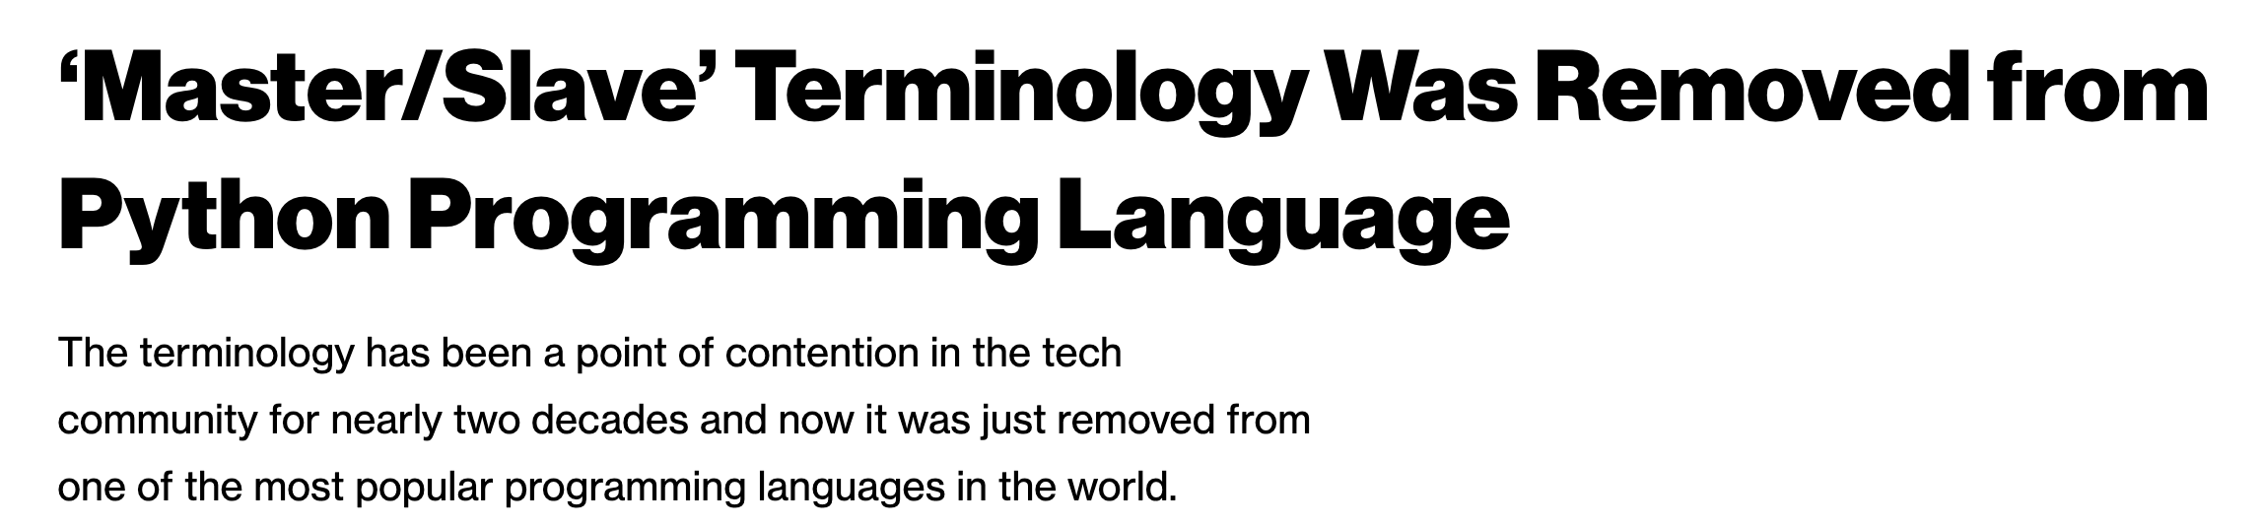
High Level Overview
Warning: The high level summary I will show right now includes unacceptable language.
It is important for us to acknowledge the current state and highlight the fact that such terminology being considered acceptable is perhaps a function of the diversity of the teams/computer science
There are efforts to change things, though.
Coordinator Node
Worker Nodes
I will focus on the HDFS aspect. For more on YARN (Job scheduling):
https://hadoop.apache.org/docs/current/hadoop-yarn/hadoop-yarn-site/YARN.html

Slide 20
Hadoop Distributed File System (HDFS)
Also need a mechanism to support the process at the data level.
HDFS is designed to be…
Scalable in storage and I/O bandwidth
Highly fault-tolerant (check periodically)
Optimized for commodity machines
Typical Settings:
Save a file into blocks (128MB)
Replicate 3 times
Notes:
http://www.youtube.com/watch?v=1_ly9dZnmWc

Slide 21
Hadoop Distributed File System (HDFS)
Name node keeps track of where these chunks are. Name node also has a simple webpage that lists some basic details.
Single point of availability failure (which is why systems generally replicate and have two name nodes)
Client
Name Node
Data Node
Data Node
Data Node
Responsible for actual read and write
Notes:
Secondary name node is not a demon. It pull the metadata from master name node and save it as a file image, then feed back to the master node fro persistence.

Slide 22
Hadoop MapReduce
In large configurations, there might be multiple racks with multiple nodes.
Name node is rack-aware (what if an entire rack goes down? We need to be resilient to this case)
Job Tracker
Name Node
Name Node2
1
1
1
1
What happens if rack 1 goes offline?

Slide 23
Hadoop MapReduce
In large configurations, there might be multiple racks with multiple nodes.
Name node is rack-aware (what if an entire rack goes down? We need to be resilient to this case)
Job Tracker
Name Node
Name Node2
1
1
1
1
What happens if rack 1 goes offline?

Slide 24
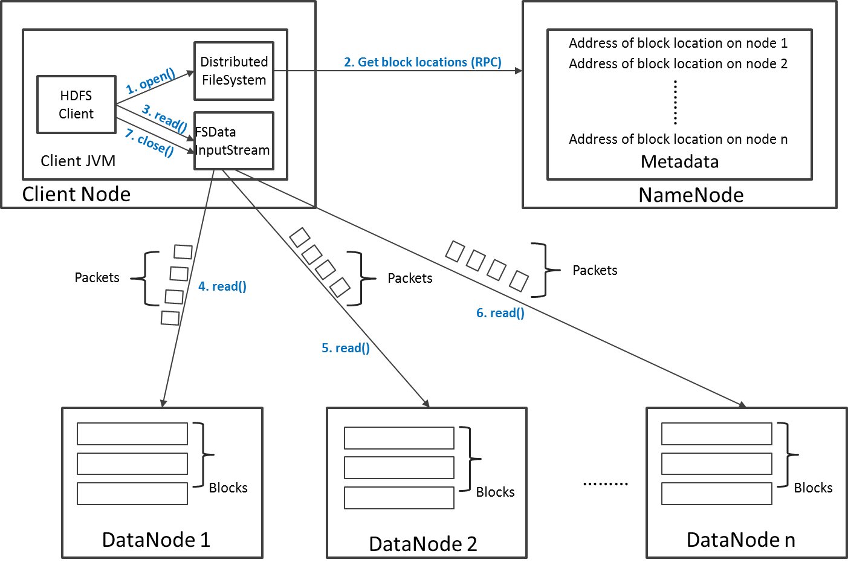
Read Operation in HDFS
Say that the client is looking for a block that is replicated on three datanodes. Namenode gives a sorted listed of datanodes to contact. Client will contact the second datanode only if it does not receive a response from the first
Why does the client go to the name node only to get the list and communicate with the data nodes directly? We don’t want name node to be a single point of failure

Slide 25
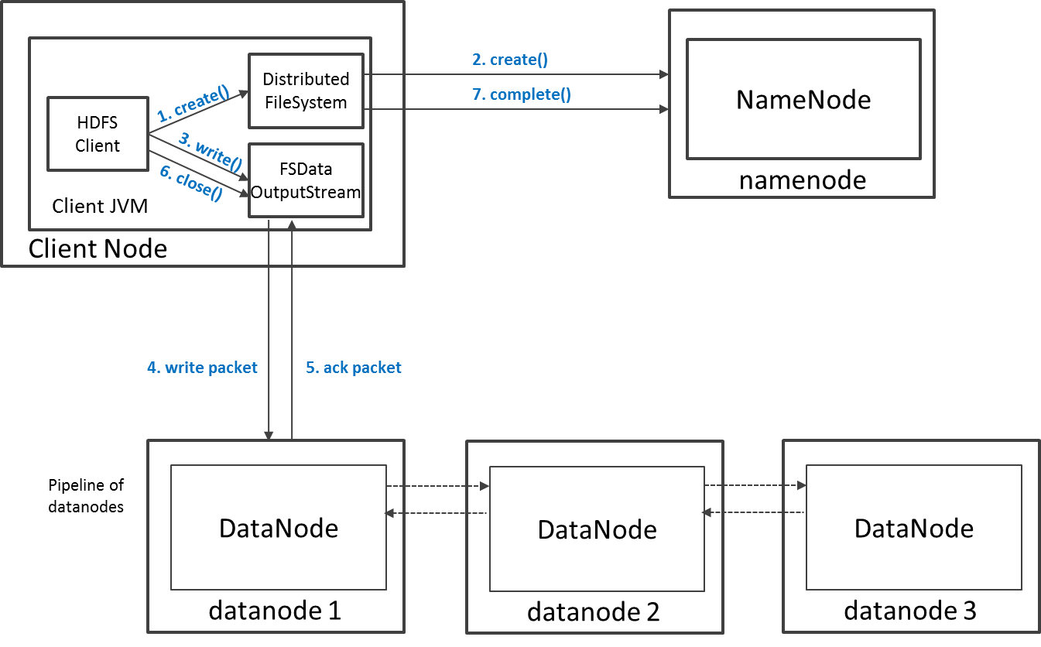
Write Operation in HDFS
Say your replication is 3, two of those are generally saved on two different datanodes on the same rack? Why?

