Slide 1

Thermoeconomics and Energy Modelling
AY 2022-2023
Project Work – Final presentation
Seyed Kian Jafarinejad 215413
Virginia Fiameni 223022
Andrea Giudici 233469
Paola Latini 225984
Giuseppe Mastrangelo 226528
Group 21 Zambia

Slide 2
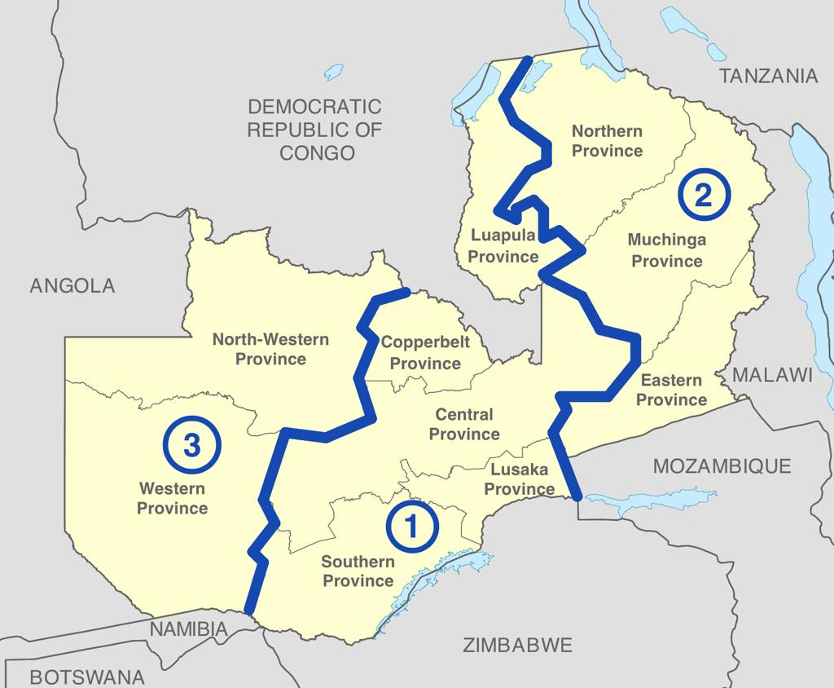

ZAMBIA
GDP of 24,09 billion 2015 USD
Population of 19,38 million
Sub-Saharan Country with no overlook to the sea
Large availability of water basins
Highly urbanized central region with high access to electricity and higher power capacity.
Western and Eastern regions manly rural highly depending on Central region energy export
No grid connection exclusively between region 2 and 3

Slide 3
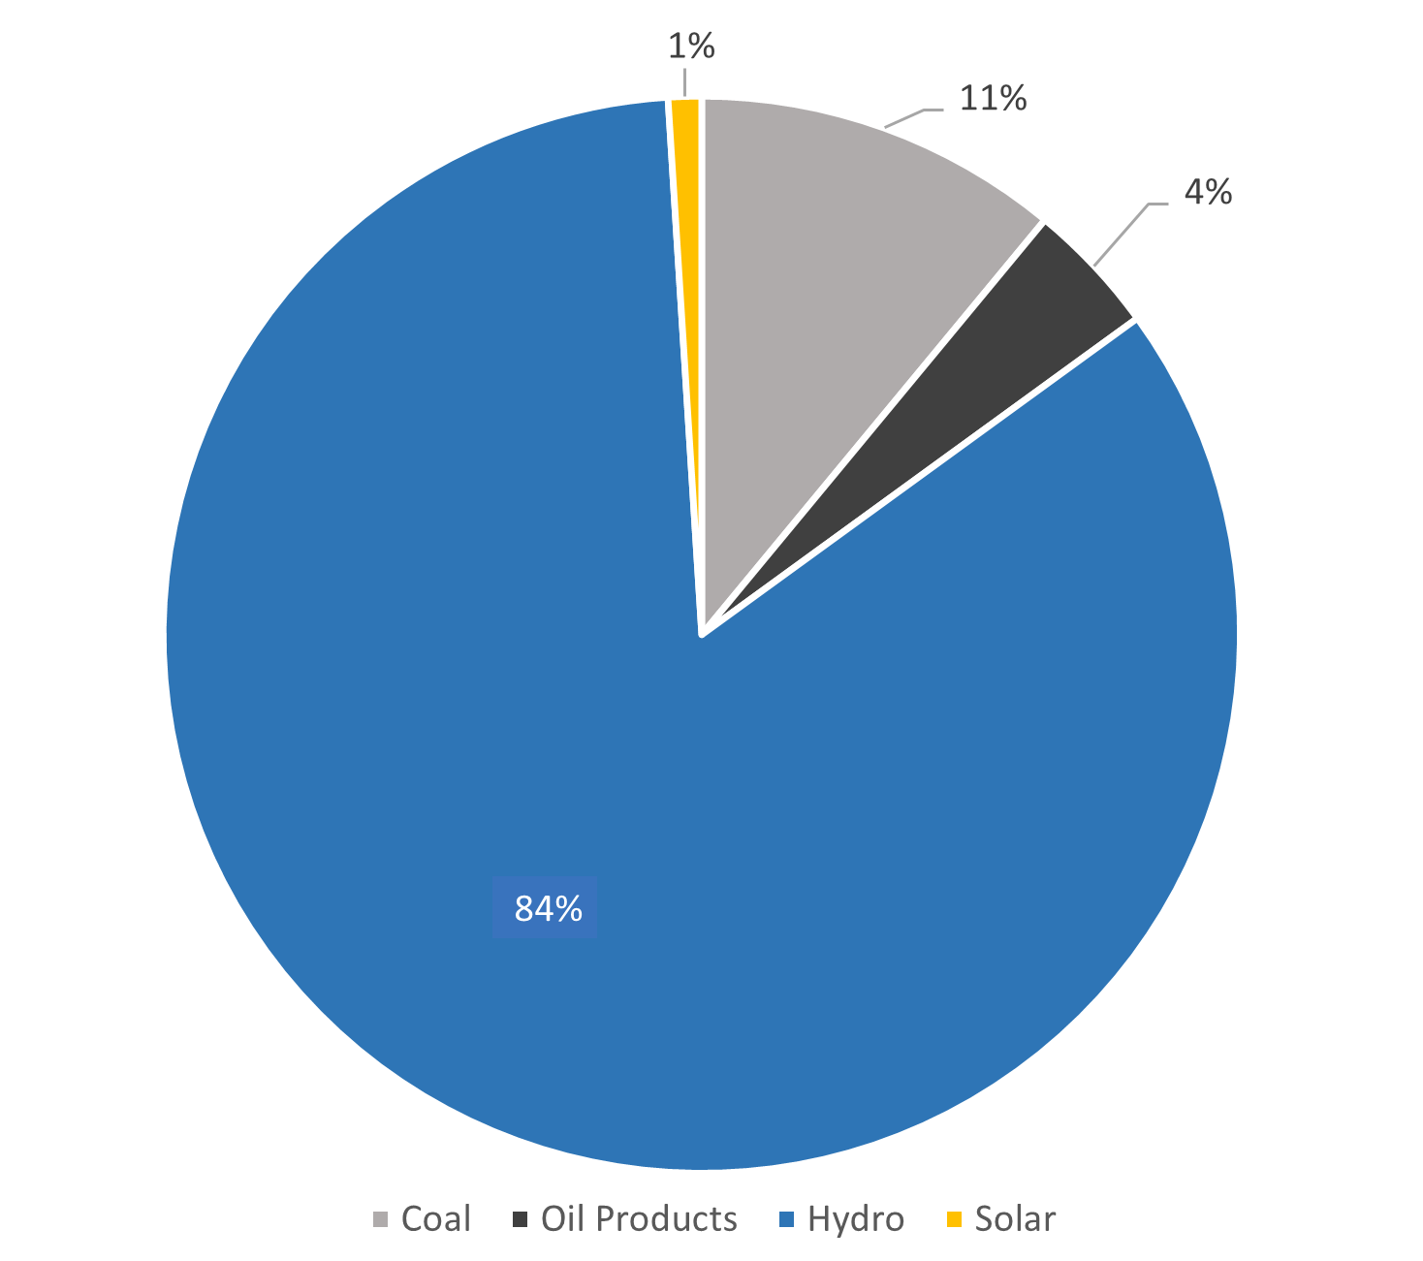
Electricity Share by source
Hydroelectric power plants accounting for most of the domestic electricity supply
High renewable share
Potential availability issue
Diesel, HFO and Coal still present to guarantee acceptable reliability of the energy sector
Abundant solar irradiation exploitable by new solar power plants

Slide 4
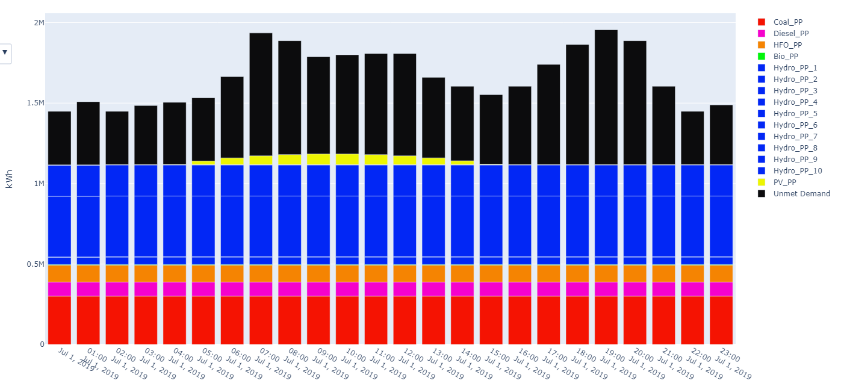
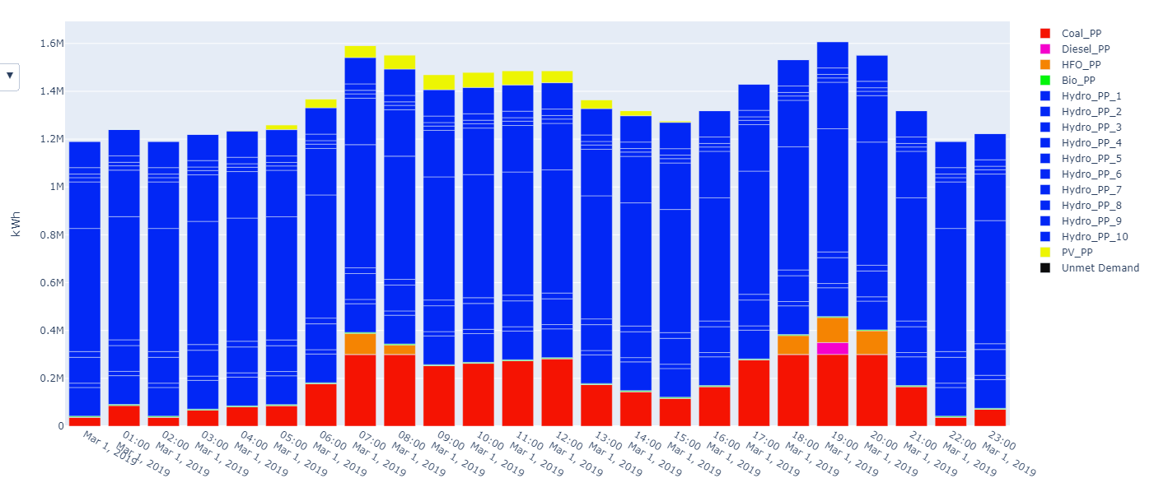
Weaknesses
Unmet demand
Operation hourly production march 2019
Operation hourly production june 2019
Due to population growht this issue is expected to worsen whitout any intervention
Poor distribution infranstructures and limited efficiency of the line negatively contribute
The demand is not always met troughout the year

Slide 5
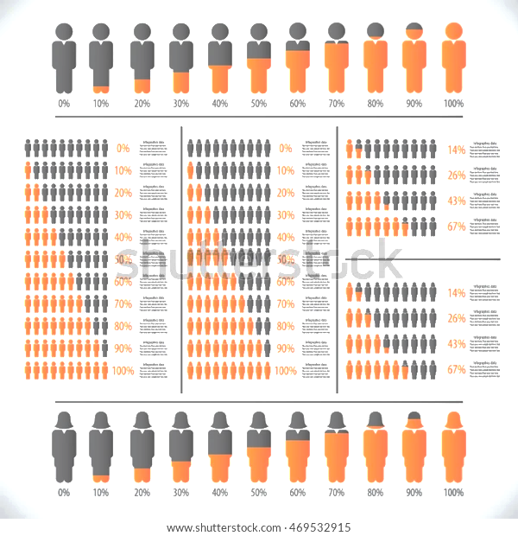
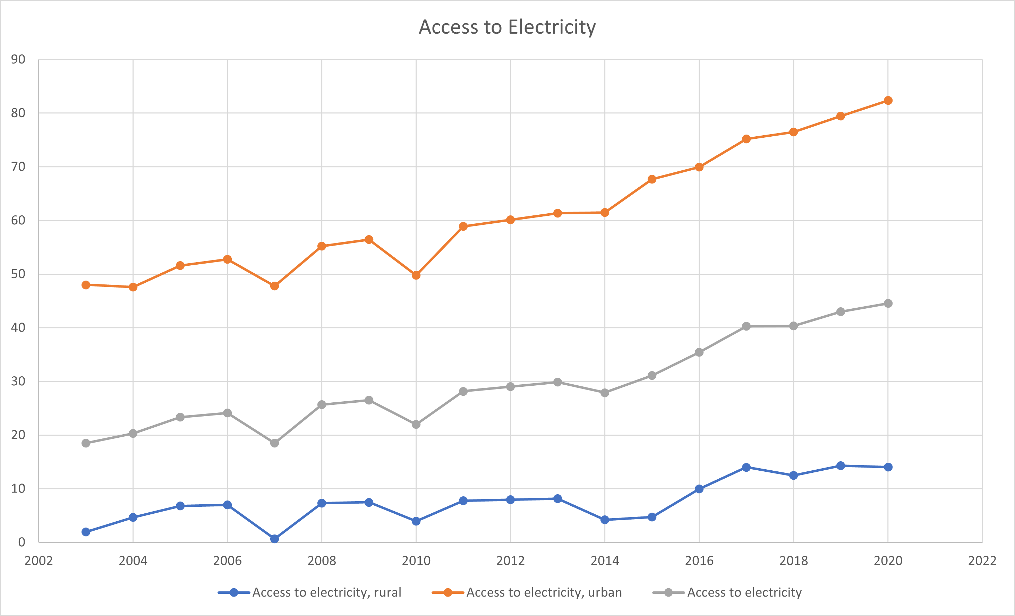

Weaknesses
Access to electricity
Rural
Urban
High difference between urban and rural area
Policy states the will to reach 51% of access to electricty in rural areas by 2030
Very costly new line extension projects

Slide 6
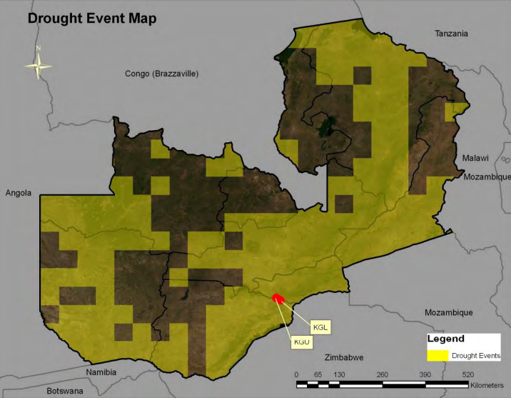
Weaknesses
High Hydro Share
84% of the electricity production is generated with hydro
Withouth hydro power plants the share of renewables in the energy mix drops dramatically
Poor reliability due to increase of drought events and climate change
Environmental and Social issues linked to the accessibility to water for other porpouses (agricolture)
Access to the resource shared between neighbouring countries (Batoka Gorge North, shared with Zimbabwe)
Drought event from 1982 to 2010

Slide 7
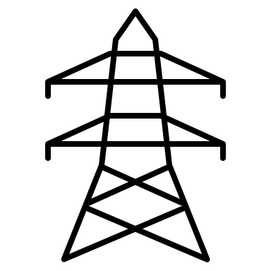




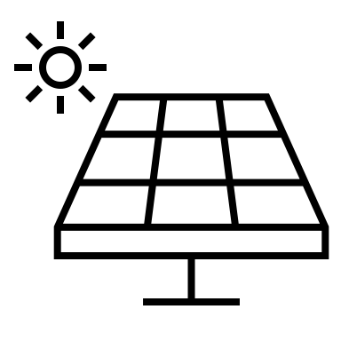
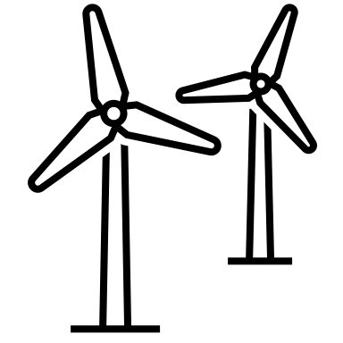
Policies
2019
2030
Meet the national demand by 2030 and be a net exporter of electricity
Improve the share of Solar and Wind power production, and minimize the use of hydro power
Keep the CO2 emissions below the 25% of its value in 2010
Improve the rural access to electricity to 51% by 2030

Slide 8
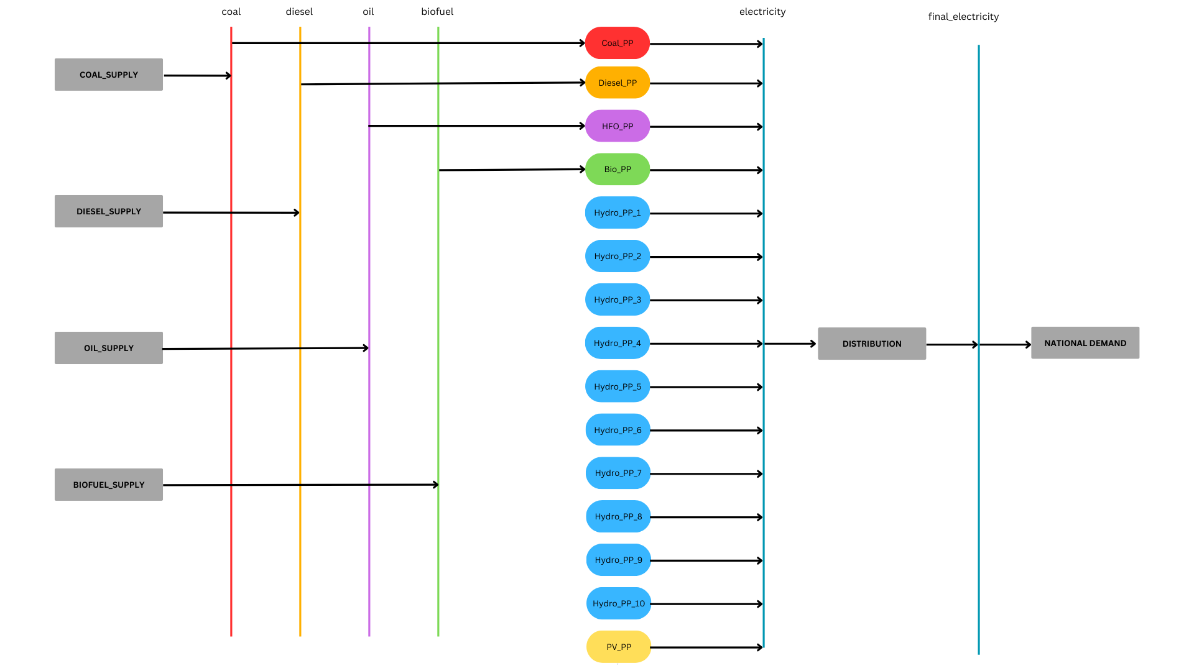
Starting point

Slide 9
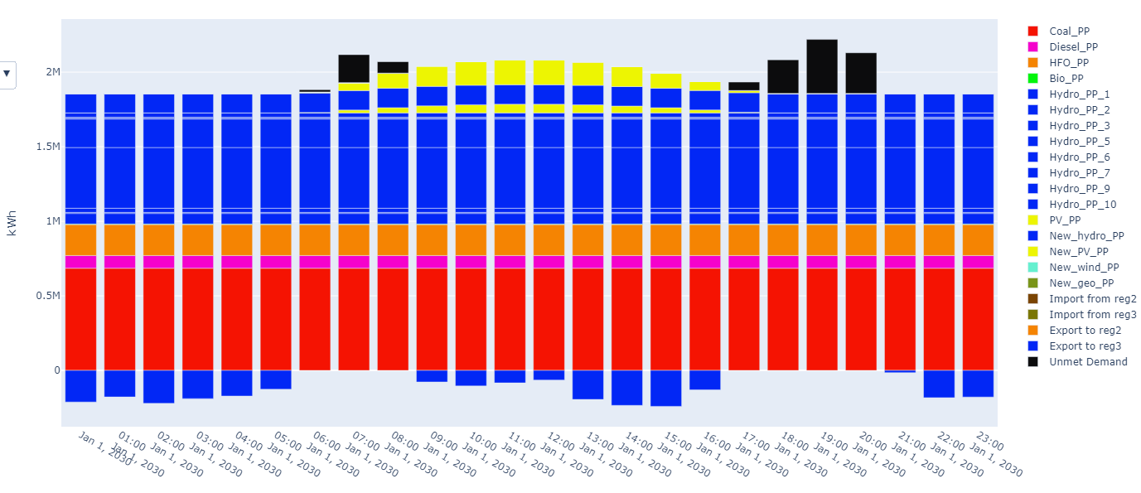
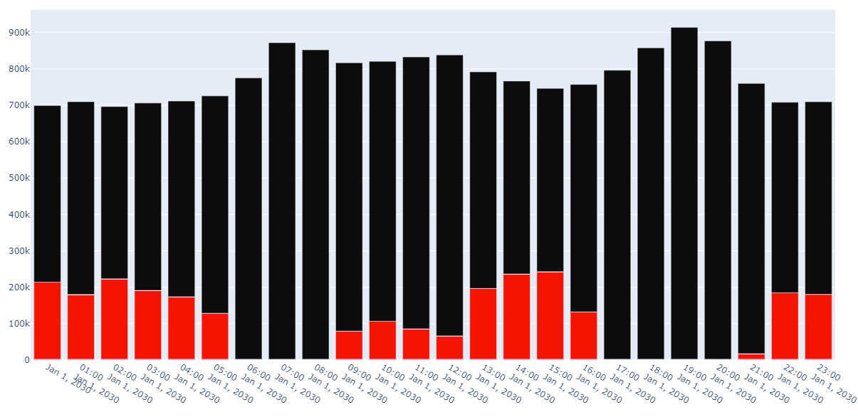
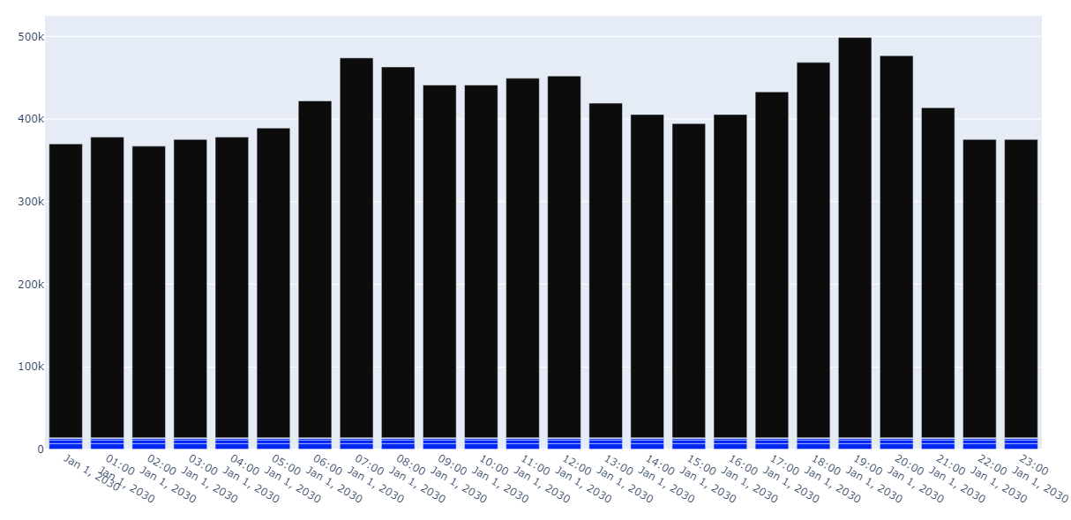
Business as Usual
hourly production 2030, central region
NPC: 11,90 B$
ASSUMPTIONS:
The trends of capacity installed growing with the same rate of the last 10 years
Max_totalcap
Demand projection coherent with population growth and growing access to electricity
No new technology installed where it was not already present
CONCLUSION
Demand growing at faster rate than installed capacity leading to unmet demand
Necessity to install new capacity and new technologies also in region 2 and 3
HFO and Coal plants have been built despite the increase of the emissions
hourly production 2030, western region
hourly production 2030, eastern region

Slide 10
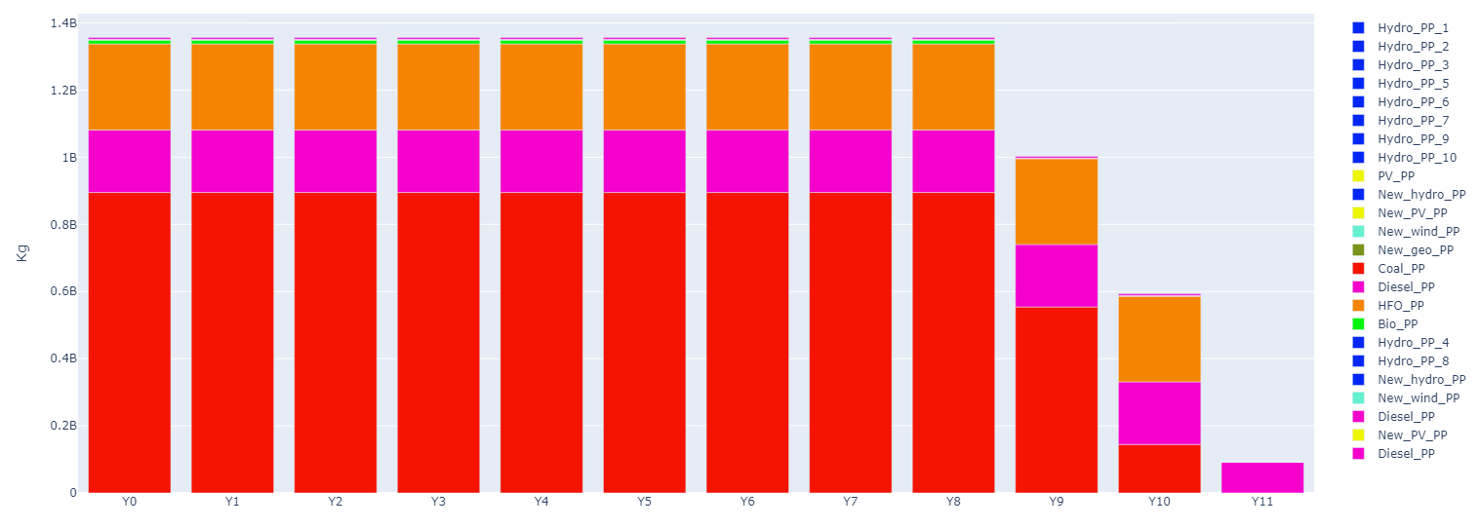
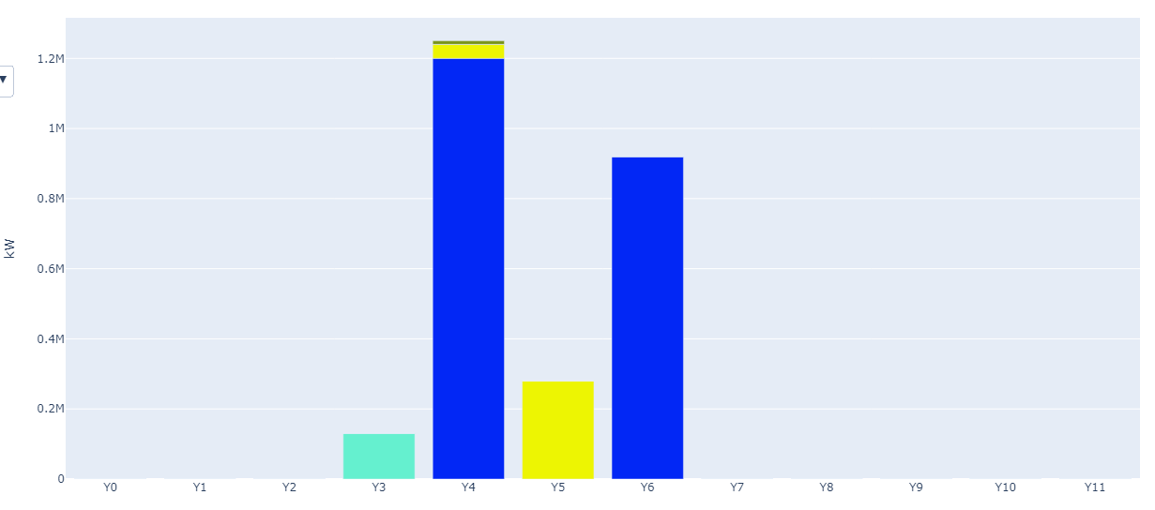
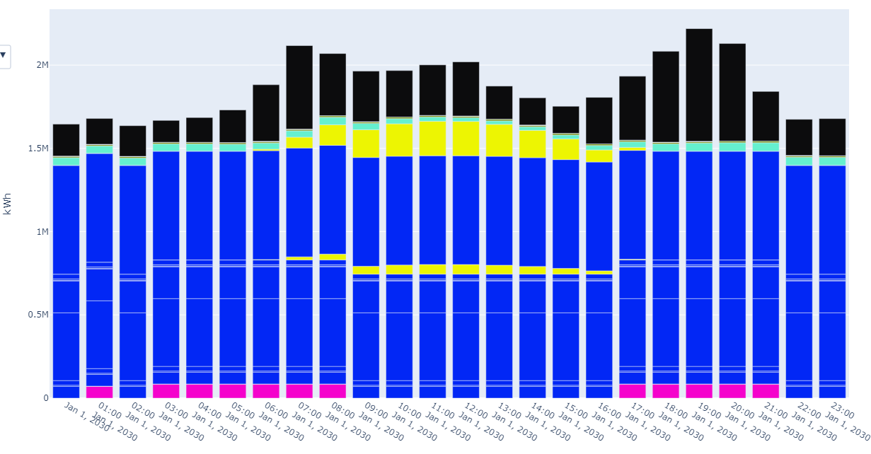
Stated Policies Scenario
CO2 emission,central region
NPC: 16,73 B$
ASSUMPTIONS:
Installation of power plants belonging to already committed policies
Max_total_cap
CO2 cap defined by Zambia to adhere to Paris agreement
Global_emission_cap_annual
CONCLUSION:
Production from fossils fuels start declining after 2027
All the new capacity installed is all renewables
Unmet demand still present in all the regions
Residual capacity of fossil fuels power plants compensate the variability of non dispatchable res during the day
New capacity installed, region 1
Hourly production 2030 ,central region

Slide 11
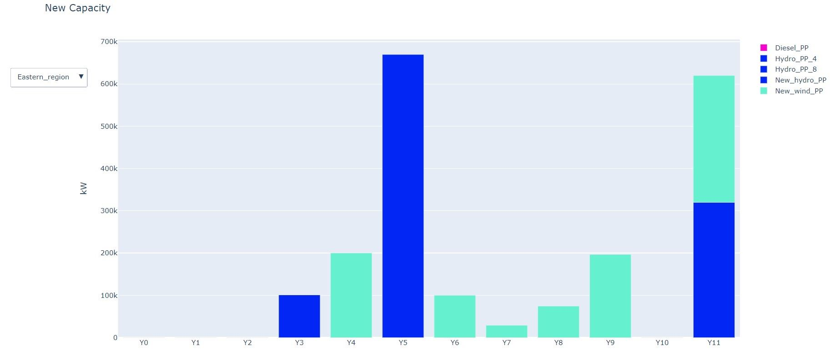
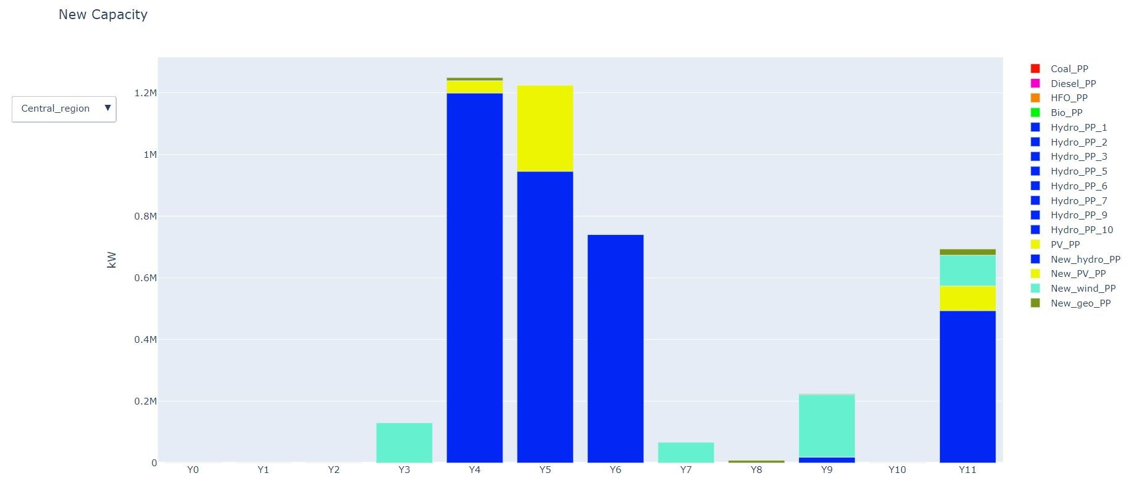
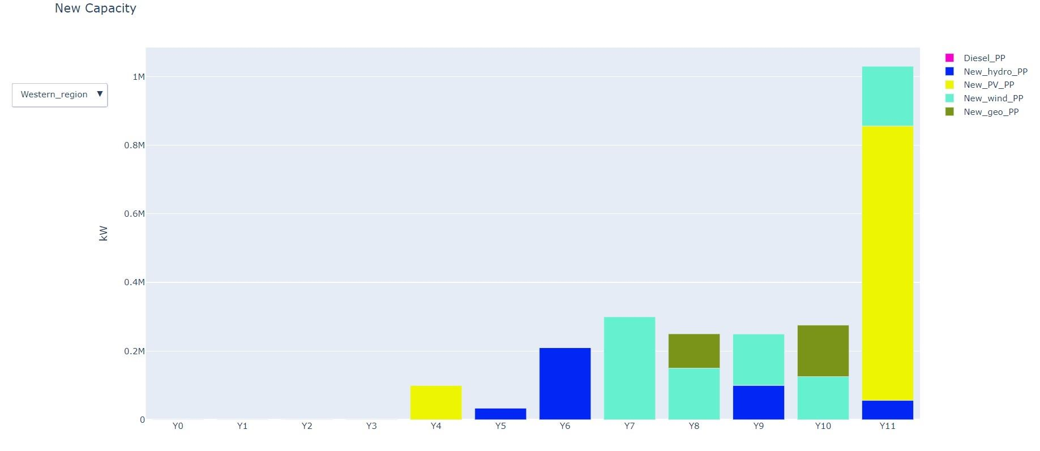
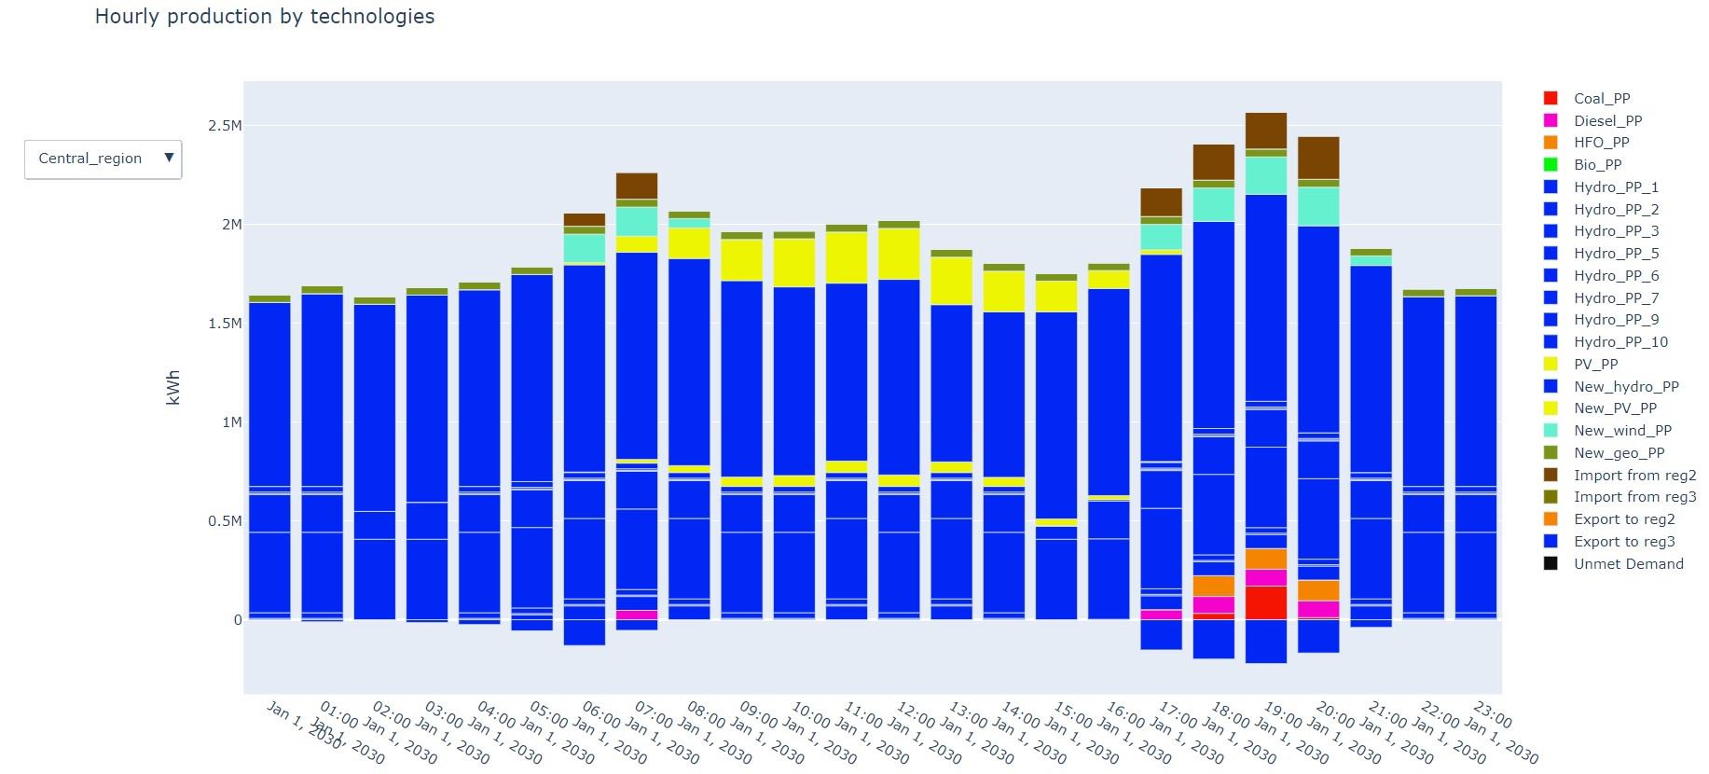
Announced pledges scenario
NPC: 28,83 B$
ASSUMPTIONS:
Installation of power plants belonging to committed and non committed policies
Installation of additional capacity to meet the demand and become net exporter by 2030
CO2 cap defined by Zambia to adhere to Paris agreement Global_emission_cap_annual
Region 2 and 3 prioritize the installation on RES
Geothermal limited due to low geo potential in Zambia Max_total_cap
CONCLUSION:
All the goals of the STEPS scenario are still met
Unrealistic amount of installed capacity to meet the demand
High renewables share in the energy mix exposes to reliability issues

Slide 12
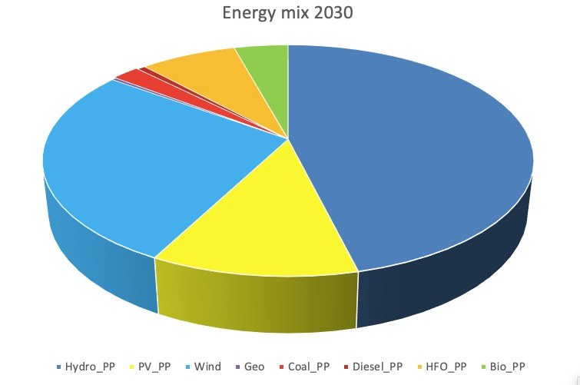
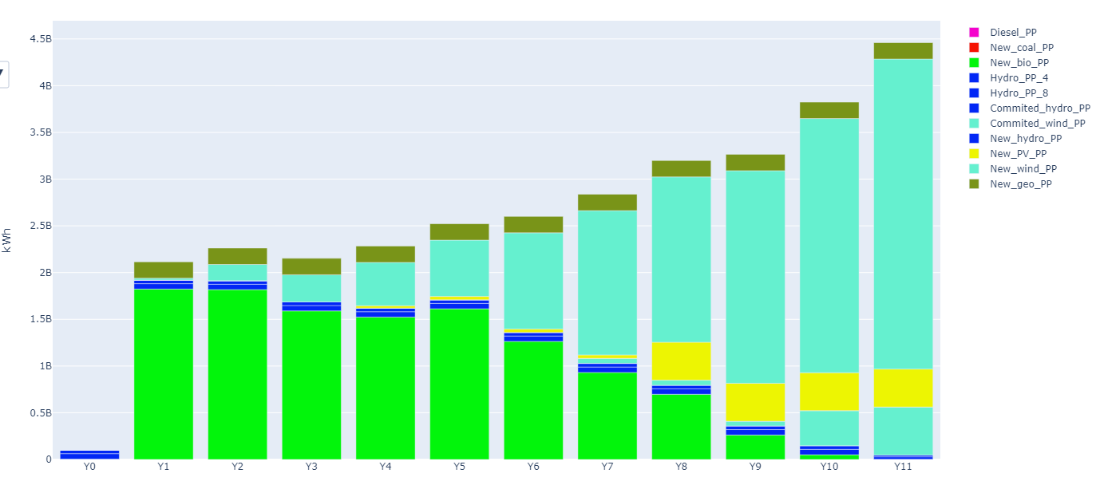
Diversification
NPC: 24,43 B$
ASSUMPTIONS:
Reduction of Hydro share down to 50% by 2030
Renewable_tech_share
Land usage employed as a limit for new PV_PP installation
Max_land_usage
Installation of additional capacity to meet the demand and become net exporter by 2030
CONCLUSION:
More equilibrated and reliable energy mix
Shift from relying predominantly on Bio to a greater share of Wind and solar by 2030
Demand issue solved trough new installations and internal energy exchange
Production by technology, eastern region

Slide 13
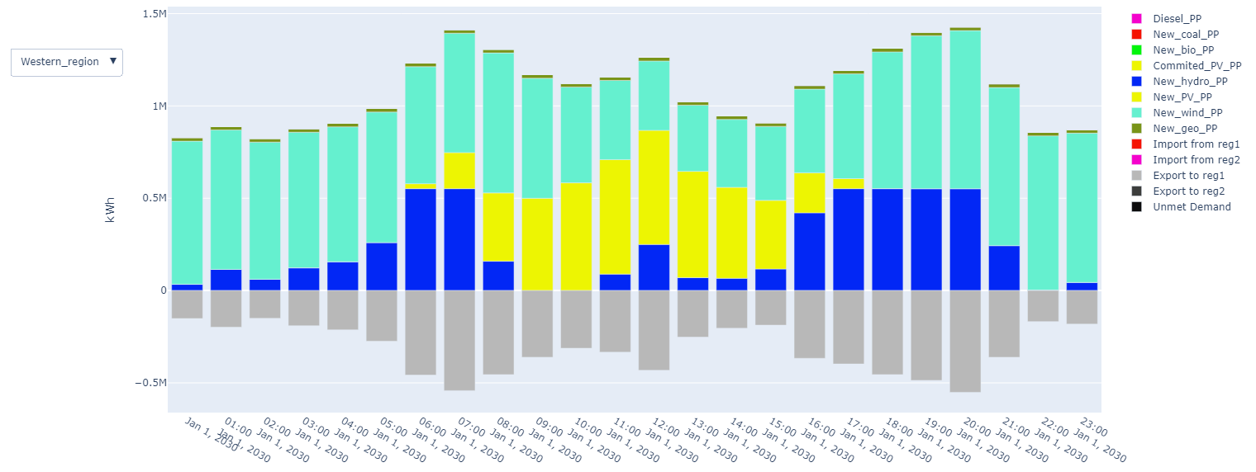
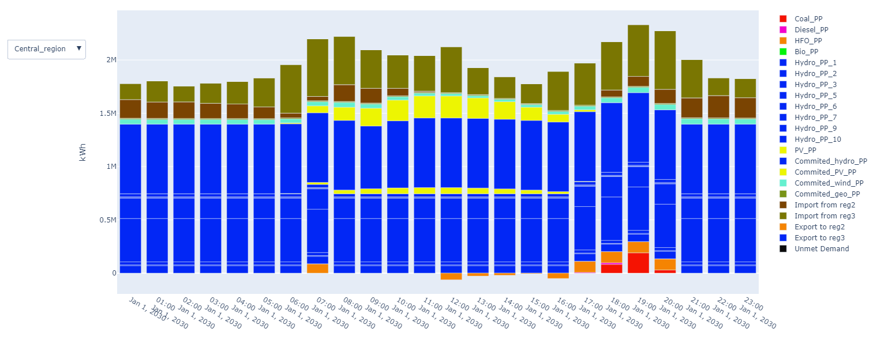
The the new installed wind plants cover the lack of production of PV
Hydro share in central region still accounts for the majority of the production
Central Region begins to import from easter and western ones

Slide 14
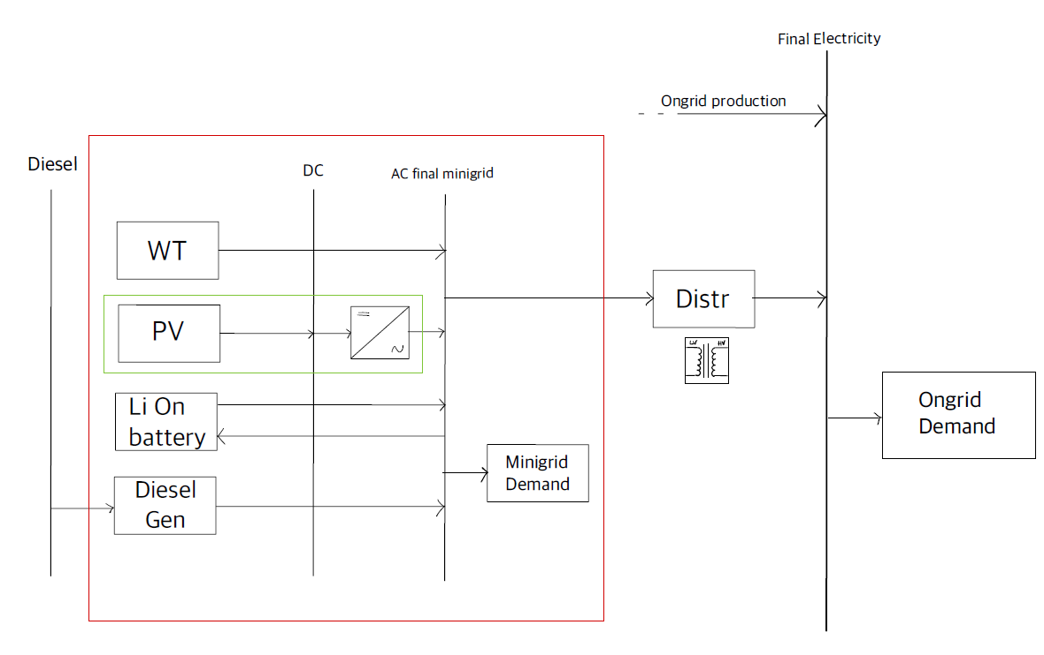
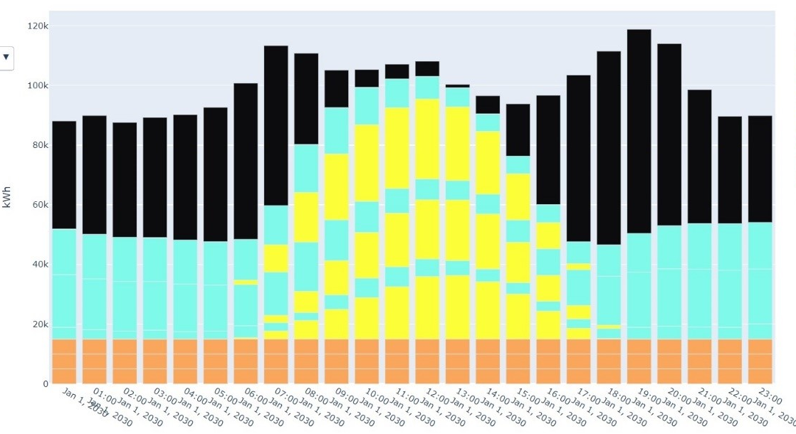
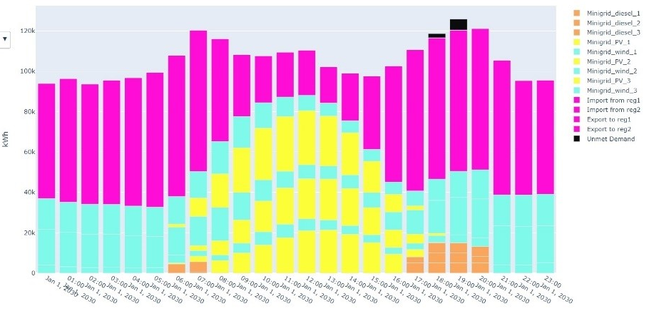
Minigrid
NPC: 33,58 B$
ASSUMPTIONS:
Additional demand due to rural area improved access to electricity
Additional rural demand equally distributed between eastern and western region
Installation of 3 minigrid islands on each eastern and western region
Minigrid connected to the main grid
CONCLUSION:
By installing these mini grids (isolated) we see noticable improvements in access to electricity.
By connecting these islands to the main grid, we reach the ultimate goal of improving the access to electricity to 51%.

Slide 15

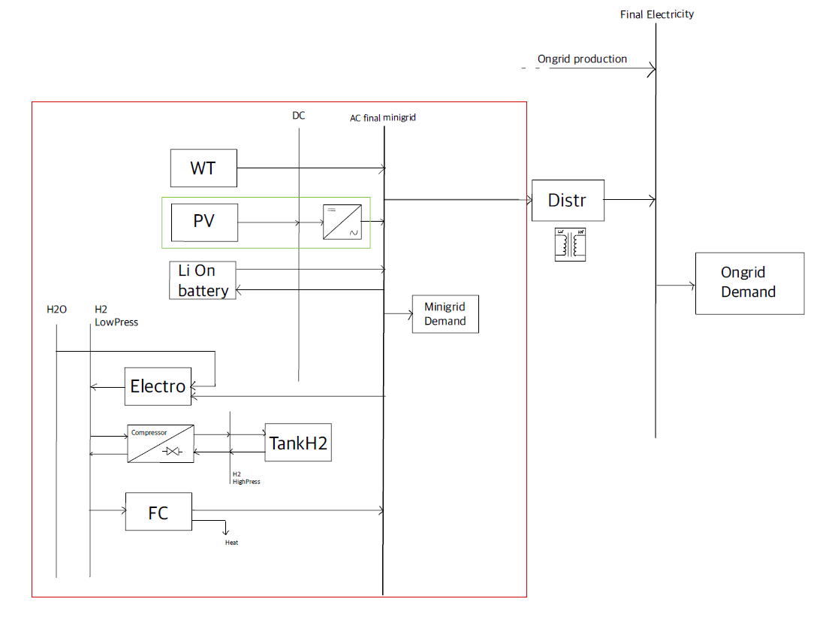
HRES Minigrid
Using Electrolyzer instead of Dieasel Engine
No CO2 emissions
Solving the problem of unmet demand and poor access to electricity , while connecting to the main grid
Issues with usage and desalinization of water
Difficult to store and manage hydrogen

Slide 16
Conclusion
Unmet demand
Implementing the committed policies and already-paid power plants, while promoting the use of renewable sources
Hydro share
Prioritizing PV, Wind & geothermal as main sources of energy for the new capacity added in the energy sector
CO2 emissions
Replacing coal, diesel & bio power plants gradually by wind & PV power plants
Rural access to electricity
Introducing Mini grid islands with the possibility of connecting them to the main grid, for reliability
Finally, suggesting HRES mini grid islands for keeping the CO2 emissions even lower

Slide 17
Thank you for your attention

