Slide 1

Data’s Metamorphosis
{
Algorithms for detecting change points in data
Chris Natoli, Cody Buntain, and Miroslav Zivkovic
OSDC PIRE Fellowship 2014

Slide 2
Change points
What are they?

Slide 3


Slide 4


Change Point

Slide 5

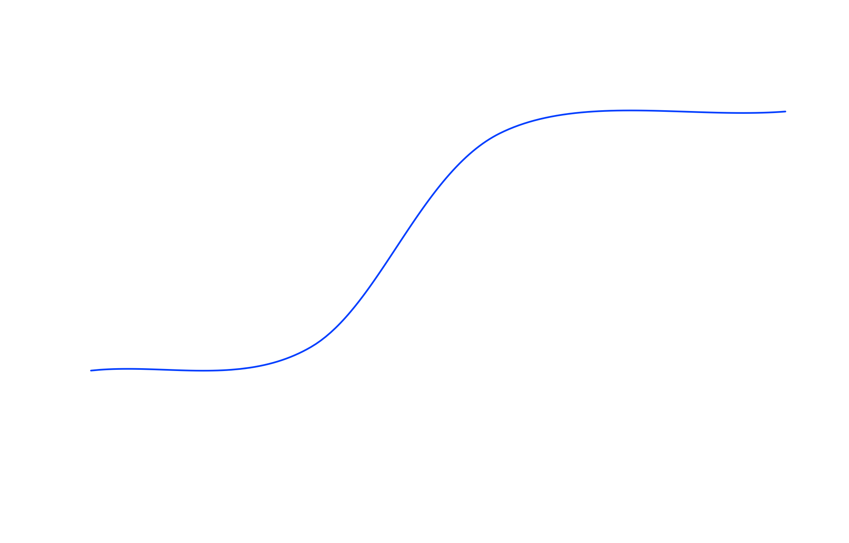
{

Slide 6

Other Applications
Economics

Slide 7
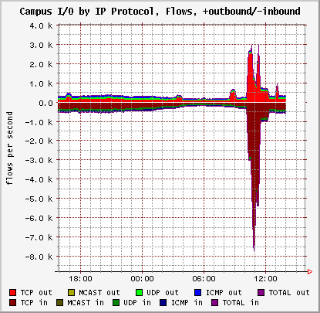
Other Applications
Cyber security

Slide 8
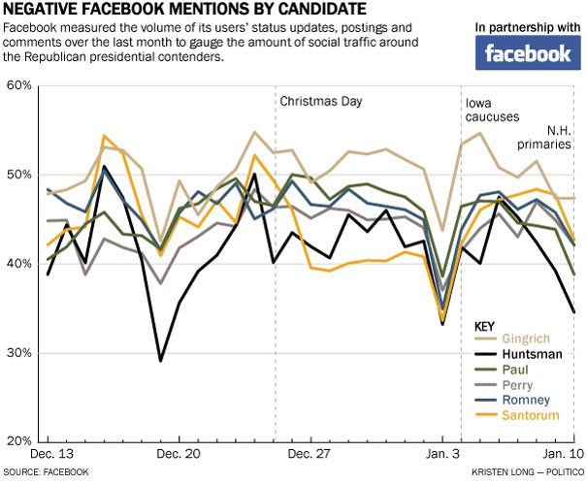
Other Applications
Sentiment in Social Media

Slide 9
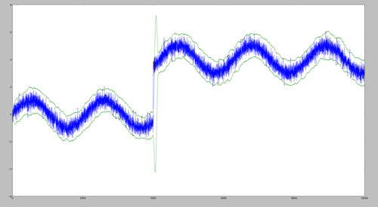
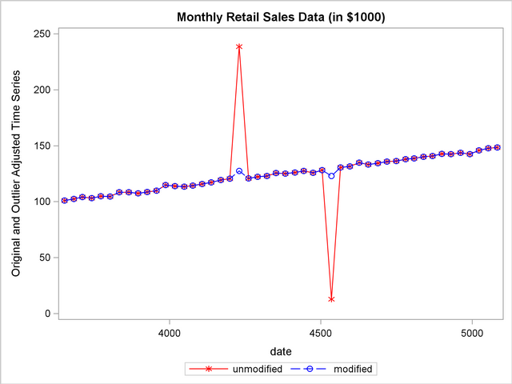
Versus Outlier Detection
Outliers
Change Point
Duration!

Slide 10
Algorithms
How do you find change points?

Slide 11
Many algorithmic methods
Offline Approaches
Likelihood-ratio tests
Cumulative sum of squares
Online Approaches
Support vector machines
Density ratios

Slide 12
Likelihood-Ratio Test

Slide 13
Likelihood-Ratio Test
Null model:
No change point in the data
Alternative model:
For some potential change point at time h

Slide 14
Likelihood-Ratio Test
Find h_{max} that maximizes LRT_{stat}
If LRT_{max} exceeds some critical value at h_{max}, a change point occurs at h_{max}
If change point is found, split data at h and re-run algorithm on 1≤j<h and h<j≤n

Slide 15
CUSUM

Slide 16
SVM Change Detection

Slide 17
Density Ratios

Slide 18
Algorithm Performance
How do they compare?

Slide 19
Real Data Applications
What can we learn?

