Slide 1
Lab1 fork() and exec ()
CSI3131 Operating Systems

Slide 2
Fork()
Fork is a system call used for creating a new process.
The new process is referred to as child (of the calling process).
The calling process here is the parent process.
The child process is a copy of the calling process except for the return values. The process id is also different between child and parent.
And once it is created, both processes will keep running what’s left in the codes.

Slide 3
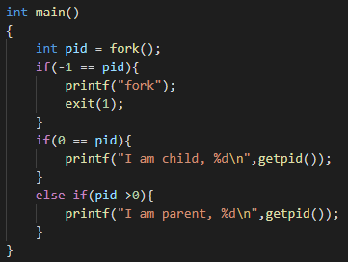
Return value of fork()
fork() takes no parameter and will return an integer.
If an error occurred return negative value
If it’s in child process, return 0
If it’s in parent process, return positive value which is the id of the child process
Try the codes here and observe the output.
(getpid() will get the current process id of the process.)

Slide 4
How many hello world will be in the output?
int main()
{
fork();
printf("Hello world!\n");
return 0;
}
int main()
{
fork();
fork();
printf("Hello world!\n");
return 0;
}
Hello world!
Hello world!
Hello world!
Hello world!
Hello world!
Hello world!

Slide 5
When fork() is called
Hello world!
Parent
int main()
{
fork();
fork();
printf("Hello world!\n");
return 0;
}
First fork()
Second fork()
Hello world!
Child
Second fork()
Hello world!
Hello world!
Child
Child

Slide 6
What is exec* ?
exec is a functionality of an operating system that runs an executable file in the context of an already existing process, replacing the previous executable.
When “exec()” call ?
No new process create.
Replace the data segment and code segment of current process.
Process ID remain same.
Calling process data and code is gone .
Cannot return to the caller .

Slide 7
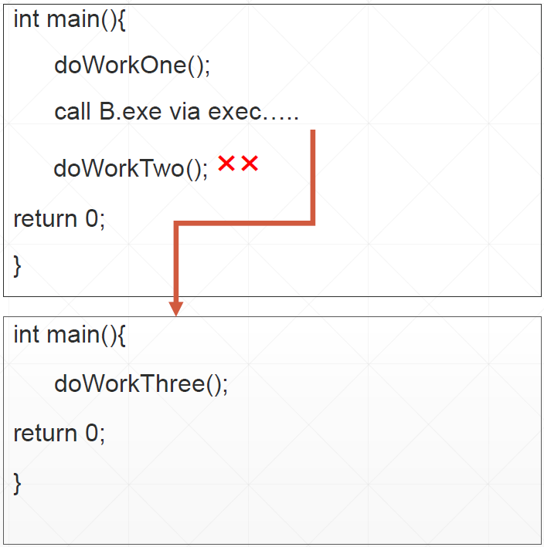
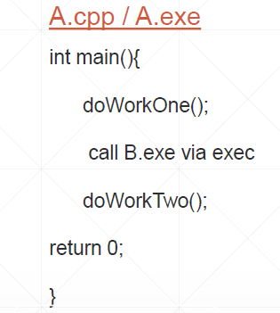
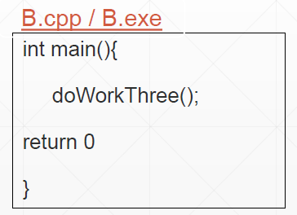
How exec works ?

Slide 8
The available exec functions along with their function parameters are given below:
int execl(const char *path, const char *arg, …, NULL);
int execlp(const char *file, const char *arg, …, NULL );
int execv(const char *path, char *const argv[]);
int execvp(const char *file, char *const argv[]);
int execle(const char *path, const char *arg, …, NULL, char * const envp[] );
int execve(const char *file, char *const argv[], char *const envp[]);
Notes:
The exec function families are defined in the header unistd.h. So, you must use this header on the C program where you want to use these functions. “ l ” is specified as a list of arguments.
“ v “ is specified as a vector (array of character pointers).
“ e “ environment is specified as an array of character pointers.
“ p “ user's PATH is searched for command, and command can be a shell program

Slide 9
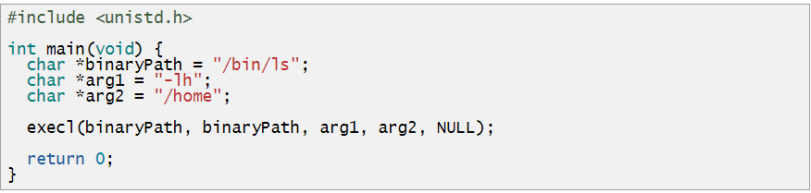
execl() System Function:
In execl() system function takes the path of the executable binary file (i.e. /bin/ls) as the first and second argument. Then, the arguments (i.e. -lh, /home) that you want to pass to the executable followed by NULL. Then execl() system function runs the command and prints the output. If any error occurs, then execl() returns -1. Otherwise, it returns nothing.
Syntax :
Example of the execl() system function:
Run ls -lh /home command using execl() system function.

Slide 10
Thank you !
Questions ?

