Slide 1
CSI 3131
Operating systems
Fadi Malek
malek@uottawa.ca
1

Slide 2
Course objectives
Know the basic concepts of operating systems.
Define and prove the need for operating systems.
Understand the functionalities of an operating system.
2

Slide 3
Plan
Introduction
Definition of operating systems
Main features:
Process management
Memory management
File management system
3

Slide 4
Introduction
Windows
Mac
Unix
FreeBSD
Solaris
Linux
Debian
...
4

Slide 5
Introduction
Computer
System
Software
Hardware
Systems Software
Application Software
Program development and execution tools
Operating Systems
5
Notes:
Every computer system consists of software, hardware and firmware. Software is put on top of the hardware.
Hardware is made up of CPU, memory (RAM) and I/O devices (peripherals)
A few layers that go on top of the hardware:
Operating system: programs that set the hardware, closest to the hardware
Application programs on top of the OS, that are in charge of taking care of the functions that are built-in, such as MS Apps, or software that you “install” not build.
User programs on top of the application programs, that use the application programs to create new data, such as computer games
These layers are the software portion of the computer system.
Application software is any software that is not inherently used by the operating system
Application software: MS Apps for example
Systems software: compilers, User-interfaces

Slide 6
Definition of operating systems
Intermediary between the computer and the applications / users.
Computer: a set of resources (physical + logical)
Physical resources : CPU, memory, peripherals
Logical resources : files, processes
6
Notes:
System Software: System Software is the type of software which is the interface between application software and system. Low level languages are used to write the system software. System Software maintains the system resources and gives the path for application software to run. An important thing is that without system software, system can not run. It is a general purpose software.
Application Software: Application Software is the type of software that runs as per user request. It runs on the platform which is provided by system software. High level languages are used to write the application software. Its a specific purpose software.
The main difference between System Software and Application Software is that without system software, system can not run on the other hand without application software, system always runs.

Slide 7
Definition of OS
Provide a simplified access interface to resources.
Manage the efficient and equitable sharing of resources.
Ensure access control to resources.
The OS is a resource manager that implements a virtual machine.
7
Notes:
Hardware resources are under the OS, whereas the software is above the OS. These resources need to be accessed without difficulty.

Slide 8
Process management
A process is a running program.
Problem: A processor can only execute one instruction at a time.
Goal : Share one (or more) processor between different programs (processes).
8
Notes:
A process is a program in execution which then forms the basis of all computation. The process is not as same as program code but a lot more than it. A process is an 'active' entity as opposed to the program which is considered to be a 'passive' entity.
Consider 2 process loaded into the system, but only 1 CPU is available. A such, the sharing of processor is important here for computations.

Slide 9
Process management
Resources not available
Running
Waiting
Processor available
Interruption
Resources available
Ready
New
Terminated
Waiting line
9
Notes:
Depending on the process, the states change based on the circumstances of the system.
New: The new process is created when a specific program calls from secondary memory/hard disk to primary memory/RAM
Ready: In a ready state, the process should be loaded into the primary memory, which is ready for execution.
Waiting: The process is waiting for the allocation of CPU time and other resources for execution.
Executing/Running: The process is an execution state.
Blocked: It is a time interval when a process is waiting for an event like I/O operations to complete.
Suspended: Suspended state defines the time when a process is ready for execution but has not been placed in the ready queue by OS.
Terminated: Terminated state specifies the time when a process is terminated

Slide 10
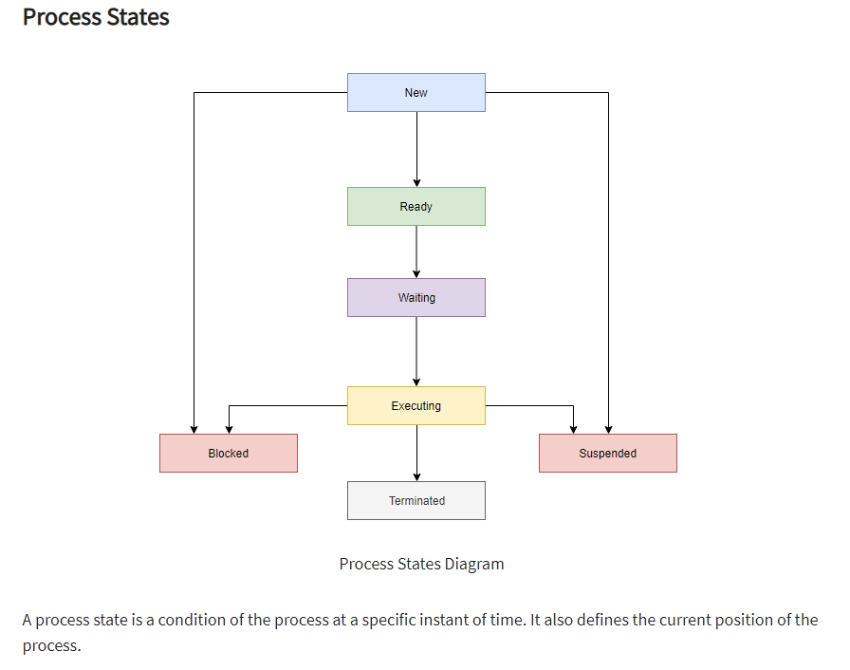

Slide 11
Process management
Scheduling Types
No Preemption
With Preemption
FIFO
SJF
Round Robin
Priority
Notes:
In the ready state, the OS will have to manage or schedule which processes are to be allocated for the CPU.

Slide 12
File management system
A file is a logical storage unit for information.
File attributes:
Name, size, type, protection, date, owner, ...
File operations:
Creation, Write / Read, Delete,
Concatenation (Append) ...

Slide 13
File management system
File Type: executable, command, text, ...
Some OS support and recognize file type, others don't.
Examples:
Windows uses the file name suffixes:.exe,
.bat,.txt,.com...
Unix does not support file typing.

Slide 14
File management system
Goal :
organize files
Several organizations:
single level directory
two-level directory structure
tree organization (Unix, Ms-Dos)
Operations:
navigation, listing, ...

Slide 15
Memory management
Allow memory sharing.
Allocate memory blocks to different tasks.
Protect used memory spaces
Optimize the amount of available memory.
Goal: Organize the memory as well as possible to get
the maximum performance?

Slide 16
Memory management
Monoprogramming
Multiprogramming
P 12 MB
P1 6 MB | P2 2 MB | P3 4 MB
Available memory
10 MB
Available memory 10 MB
Physical memory is expensive.
Secondary memory (disks, extended memory, ...) inexpensive.
Use secondary memory "as" RAM memory.

Slide 17
Memory management: Virtual memory
Provide an address space independent of that of physical memory.
Ability to run programs larger than physical memory.
Address space > physical space
Ease of the implementation of multiprogramming.

Slide 18
Memory management: Virtual memory
Principle:
If a program A wants to run when there is no more space
in memory ??
Swap a piece of another program to secondary memory and replace it with a piece of A.
A program is divided into pieces which we call pages, of fixed size.
Memory is divided into pages of the same size.

Slide 19










Memory management
Virtual address space
Disk
0
1
3
Physical memory
X
0
0
1
X
2
1
n-1
X
N-1
X
Frame
page
Pagination

Slide 20
Pagination algorithms
Many algorithms:
FIFO - First In First Out: chronological order of loading;
LRU - Least Recently Used : chronological order of use;
LFU - Least Frequently Used ;
Random : randomly ;
...
Notes:
Or page replacement algorithms

