Slide 1
CSI3131 Module 1 - Introduction / Overview of OS
Reading: Chapter 1 and 2 (Silberchatz)
Goal:
Do a quick overview of the organization of computers - processor (CPU), memory, and input / output, architecture and general operations.
Introduce the operating system to understand its role and main functions
1

Slide 2
Organization
Computer system
Operating system
2

Slide 3
Device Controllers
Bus
Memory
CPU
Hardware
Organization
Computer system
Operating system
3
Notes:
Hardware = CPU + Memory + Device Controllers + the components held by the bus

Slide 4
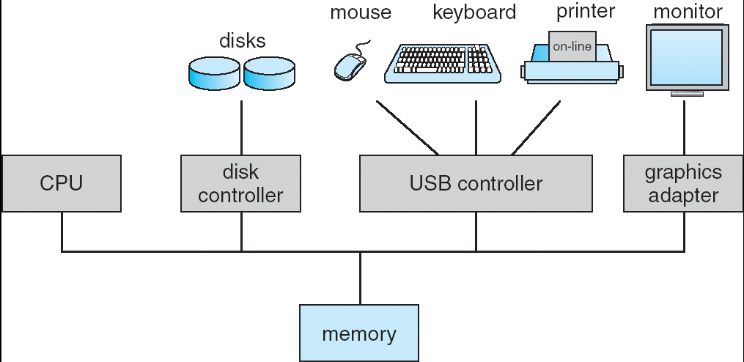
Main hardware
Processor (CPU)
Main memory (real memory, RAM)
Contains code and data
I/O Modules (I/O Controllers, I/O Processors ...)
hardware (with registers: I/O ports) for data transport between CPUs and peripherals such as:
secondary memory (e.g. hard disks)
keyboard, screen ...
Communication equipment
Interconnection (ie: Bus)
for communication between processor (s), memory and I/O modules
4
Notes:
CPU: to execute the programs that are loaded in memory prior to execution
I/O Modules: Transfer data between the devices and the CPU and/or memory. We need those devices because the speed is very slow compared to the CPU and memory. We need them as an alternative way to transfer data instead of directly sending to CPU and then to memory. The data from the disks into these controllers and then into CPU and/or memory. All of these components are connected via a bus.
Disk controller: a processor (has registers (data, status)), has an interface to the disk and to the bus, its purpose is to allow the transfer of information/data from the disk into the disk controller buffer, and then sent to CPU or main memory. Transfer the data from the device into those data registers there, where bus data are buffered in the data registers (ports)

Slide 5
Device Controllers
Bus
Memory
CPU
Hardware
Memory
Structure
Organization
Secondary Memory
Main Memory
Computer system
Operating system
5

Slide 6
Memory structure
Main memory
Accessible directly by the CPU
A program must be in main memory to be executed
by the CPU
Main memory is not large enough to hold all programs and data
The main memory is volatile - its content changes
on loss of power or on restart.
Secondary memory
Contains large amounts of data / files, permanently.
Access to Virtual memory when needed.
In general, a hierarchy exists for memory devices which varies according to speed, cost, size and volatility.
6
Notes:
No program can be executed while on the disk, it has to be brought to the main memory to be recognised and executed.

Slide 7
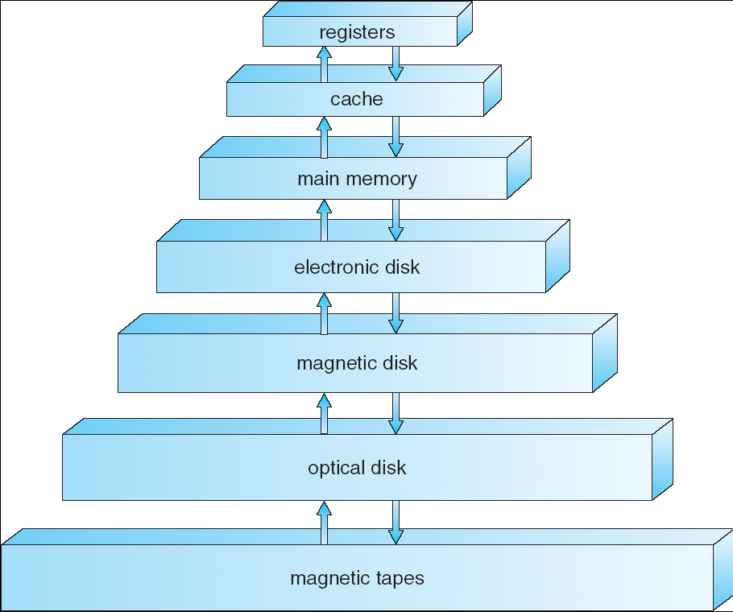
Hierarchy of memory devices
7
Notes:
The CPU needs to access the data that is on the register. It is much faster to access that is in the register rather than in the magnetic disks. Speed increases upwards, while capacity decreases, and this relationship works in reverse as well.
In terms of speed, it is about accessing the data and transferring of data. Once the data is in the registers, it is very fast to access them by the CPU (being closest to the CPU), and thus much faster to transfer, rather than from main memory to registers and then CPU, thus more time-consuming. Same for the disks, where from there it must go to the controllers, and the CPU.

Slide 8

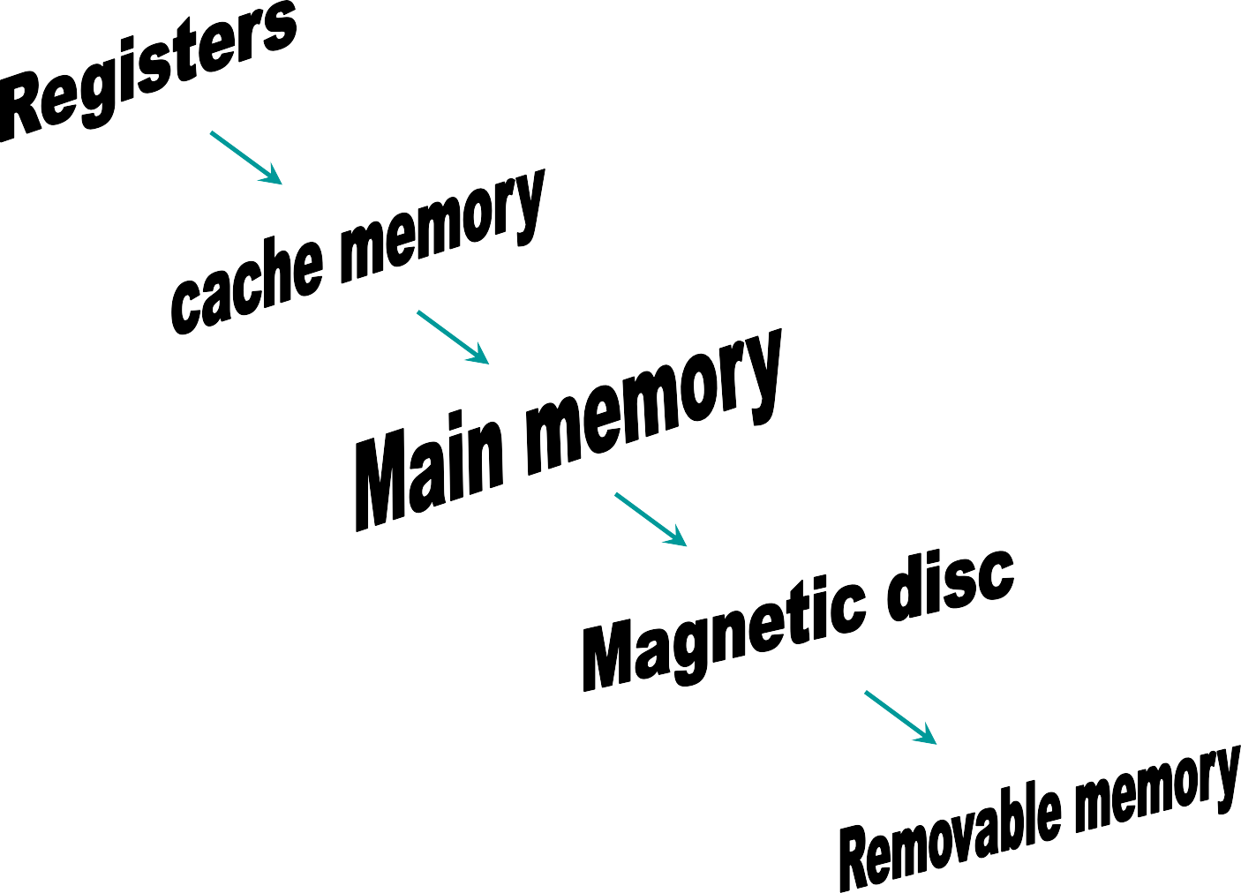

Hierarchical organization of memory
8
Notes:
In terms of cost, buying a disk is much less than buying a main memory. Cost goes down from top of arrow (Registers) to the head of arrow (Removable memory)

Slide 9
Device Controllers
Bus
Memory
CPU
Hardware
Interrupt
driven
I/O
Structure
Direct
I/O
Memory
Structure
Organization
DMA
Secondary Memory
Main
Memory
Computer system
Operating system
9

Slide 10
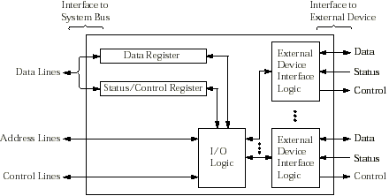
Structure of the I/O controller
Bus data are buffered in the “data register” (I/O ports)
The “Status / Control” register contains:
information on the status of the I/O operation
the control information coming from the CPU
The “I/O logic” circuit interacts with the CPU via the bus.
Contains logic specific to the interface of each device
10
Notes:
Sole purpose is to transfer data from and to main memory or the main CPU via a bus.

Slide 11
CPU Registers (fast memory on cpu)
Control & Status Registers
Generally not available to user programs
some used by CPU to control its operation
some used by OS to control program execution
User-visible Registers
available to system (OS) and user programs
holds data, addresses, and some condition codes
11

Slide 12
Examples of Control & Status Registers
Program Counter (PC)
Contains the address of the next instruction to be fetched
Instruction Register (IR)
Contains the instruction most recently fetched
Program Status Word (PSW)
A register or group of registers containing:
condition codes and status info bits
Interrupt enable/disable bit
Supervisor(OS)/user mode bit
12
Notes:
Recall:
PC contains the address of the next instruction to be fetched.
After instructions is read from the main memory, it goes into IR and then it is decoded to recognize the type of function and action.
PSW: The program status word (PSW) is a register that performs the function of a status register and program counter, and sometimes more. It keeps track of the current state of the system.

Slide 13
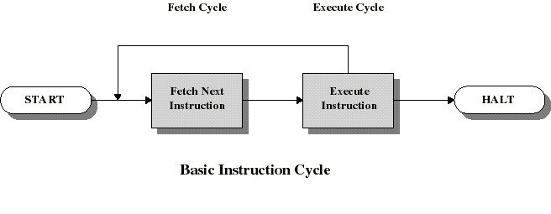
The Basic Instruction Cycle
The CPU fetches the next instruction (with operands) from
memory.
Then the CPU executes the instruction
Program counter (PC) holds address of the instruction to be fetched next
Program counter is automatically incremented after each fetch
13
Notes:
Every time the CPU must follow this cycle for fetching instructions,
FETCH → DECODE → EXECUTE
So on and so forth, until HALT (another instruction once reached, the program stops)

Slide 14
Communication techniques for I/O
3 techniques are possible:
Direct I/O (most inefficient way)
Does not use interrupts. CPU must wait after each I/O operation
I/O triggered by interrupts
The CPU can execute code during the I/O operation: the CPU is interrupted when the operation is complete.
Direct memory access (DMA)
A block of data is transferred directly to / from
memory without going through the CPU
Notes:
Example:
For Direct I/O, every time the system wants to enter a character or send a character, it must wait for the already in process action to complete before continuing.
Device → CPU → Memory
The interrupt-based I/O method controls the data transfer activity to and from connected I/O devices. It allows the CPU to continue to process other work instead and will be interrupted only when it receives an input signal from an I/O device. For example, if you strike a key on a keyboard, the interrupt I/O will send a signal to the CPU that it needs to pause from its current task and carry out the request from the keyboard stroke.
There is also the programmed I/O method , which controls the transfer of data between connected devices and the computer. Each I/O device connected to the computer is continually checked for inputs. Once it receives an input signal from a device, it carries out that request until it no longer receives an input signal. Let's say you want to print a document. When you select print on your computer, the request is sent through the central processing unit (CPU) and the communication signal is acknowledged and sent out to the printer.
Device → Memory
Direct Memory Access (DMA) I/O
The name itself explains what the direct memory access I/O method does. It directly transfers blocks of data between the memory and I/O devices without having to involve the CPU. If the CPU was involved, it would slow down the computer. When an input signal is received from an I/O device that requires access to memory, the DMA will receive the necessary information required to make that transfer, allowing the CPU to continue with its other tasks. For example, if you need to transfer pictures from a camera plugged into a USB port on your computer, instead of the CPU processing this request, the signal will be sent to the DMA, which will handle it.

Slide 15
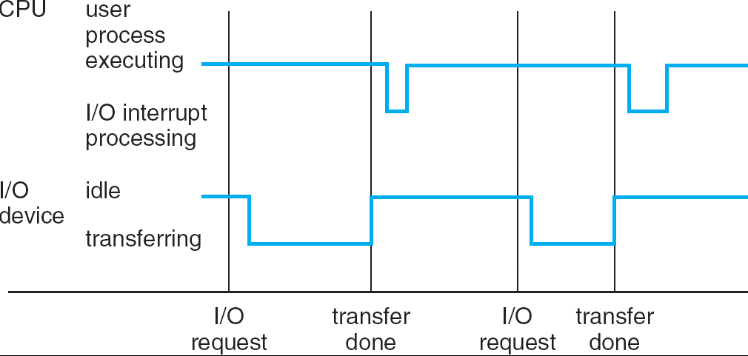




I/O Interrupt
Notes:
I/O request: Transfer of the data by the device

Slide 16
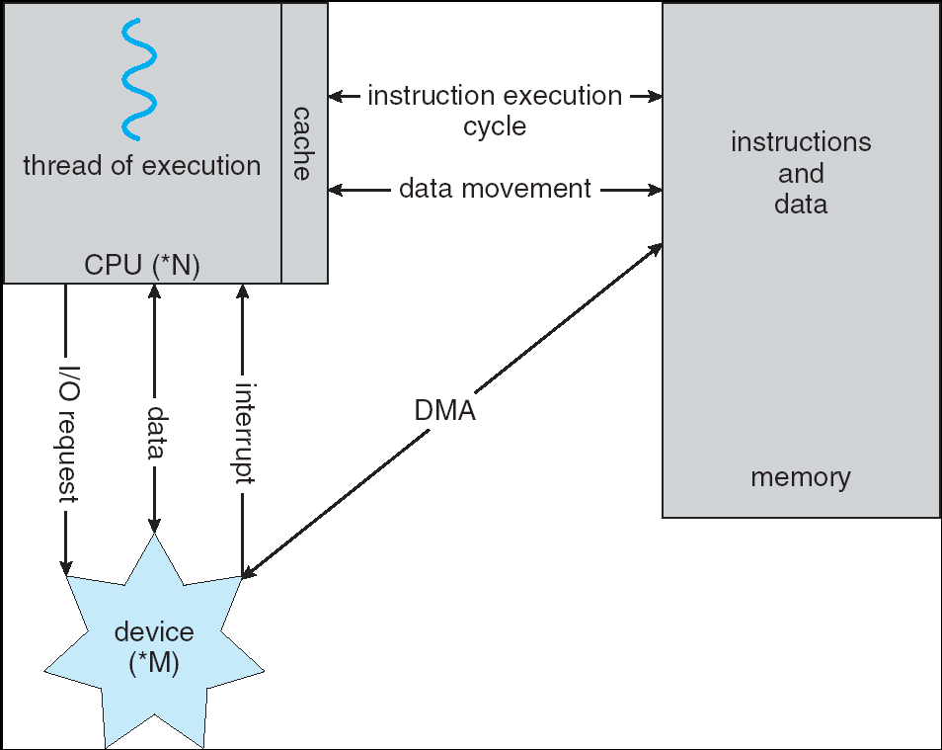
Modern computer operation

Slide 17
Device Controllers
Bus
Memory
CPU
Hardware
By
interruption
I/O
Structure
Direct
I/O
One *
processor
Multi
processor
Architecture
Memory
Structure
DMA
Secondary Memory
Clusters
Organization
Main
Memory
Computer system
Operating system

Slide 18
Computer systems architecture
Systems with a single processor
From PDA (cellphones) to central computer
Almost all have special-purpose processors (ie controllers) for graphics, I/O
This is not considered to be multi-processor
Multiprocessor systems
Increased processing throughout
Economy of scale
Increased reliability
Asymmetric multiprocessing
Each processor is given a specific task
Symmetric multiprocessing (most common)
All processors perform all OS tasks
Clusters, distributed systems
Notes:
Advantages of having multiple CPUs (the processors are independent of each other) → 8-core, 10-core as example:
Able to execute multiple programs simultaneously (at the same time), while the CPU in a single processor is shared among the processes.
Economy of scale means it is cheaper to maintain several CPUs in one machine than several machines and each having one CPU.
Increased reliability allows for covering of one CPU when damaged, and this can be done in multiple CPU systems (although execution decreases in quality, but still functioning). This cannot be done in single processor systems, where the machine will just shut down.
Multiprocessing is the use of two or more central processing units within a single computer system
Asymmetric multiprocessing: not all of the multiple interconnected central processing units are treated equally. For example, a system might allow only one CPU to execute operating system code or might allow only one CPU to perform I/O operations. Asymmetric Multiprocessing system is a multiprocessor computer system where not all of the multiple interconnected central processing units (CPUs) are treated equally. In asymmetric multiprocessing, only a master processor runs the tasks of the operating system. No longer used anymore.
Symmetric Multiprocessing:
It involves a multiprocessor computer hardware and software architecture where two or more identical processors are connected to a single, shared main memory, have full access to all input and output devices, In other words, Symmetric Multiprocessing is a type of multiprocessing where each processor is self-scheduling.
Clusters:
A cluster has three basic elements—a collection of individual computers, a network connecting those computers, and software that enables a computer to share work among the other computers via the network. A cluster is a set of loosely or tightly connected computers working together as a unified computing resource that can create the illusion of being one machine. Cluster systems are created when two or more computer systems are merged. Basically, they have an independent computer but have common storage and the systems work together.
Distributed systems:
Complete separate systems, with nothing in common, can run the same function/application to handle different requests from different users from different regions.

Slide 19
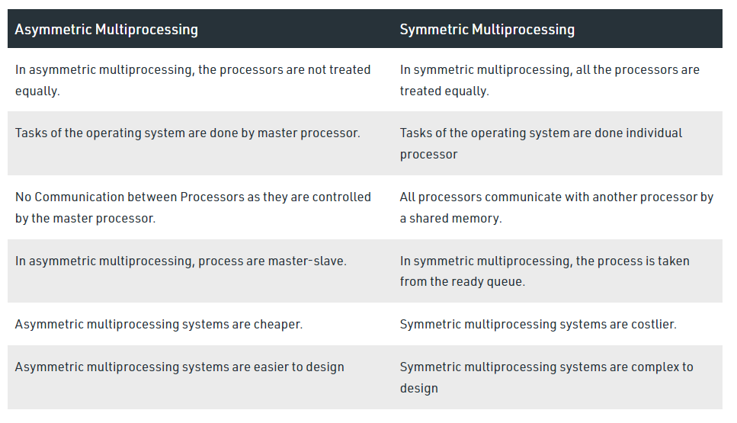

Slide 20
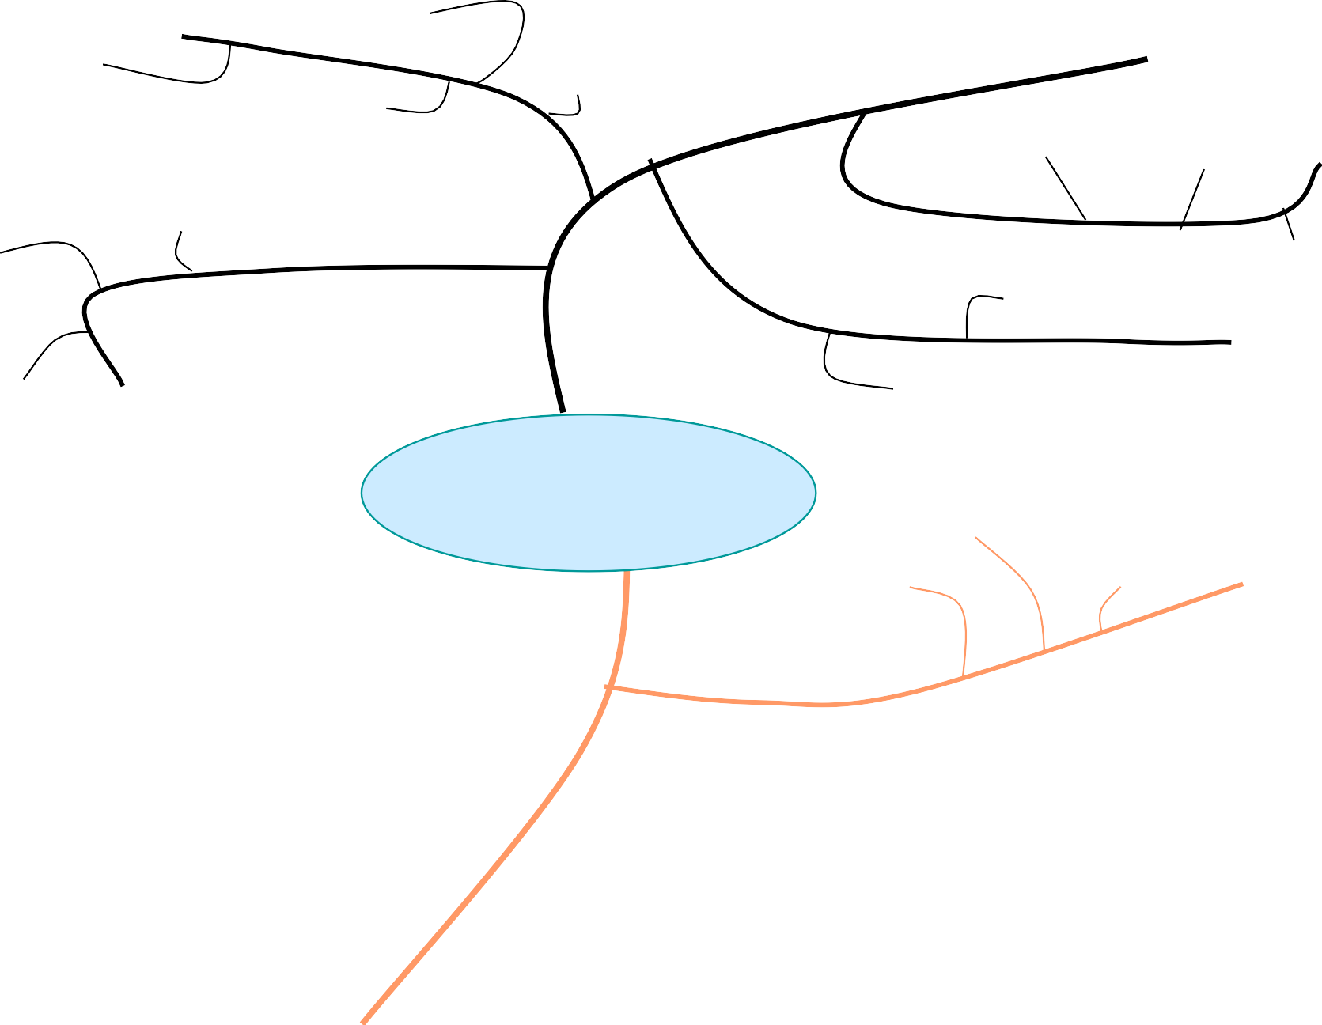
Device Controllers
Bus
Memory
CPU
Hardware
interrupt
I/O
Structure
Direct
I/O
One *
processor
Multi
processor
Architecture
Memory
Structure
DMA
Secondary Memory
Clusters
Organization
Main
Memory
Computer System
User Interfac
Services What
is it?
GUI or CLI
Operating System
User
View

Slide 21
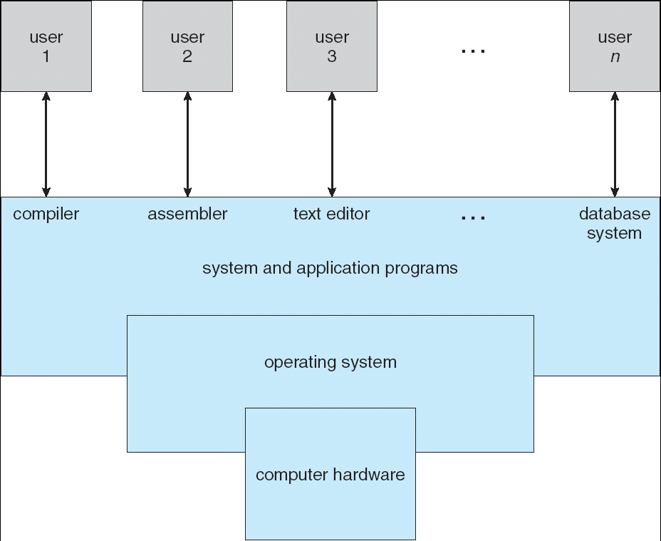
Abstract view of the components of a computer system

Slide 22
User View of the computer
This is my system, only I use it (consider a laptop)
i.e, desktop system with one user monopolizing its resources
OS maximizes the work or play user is performing.
OS designed mostly for ease of use, not resource utilisation.
Handheld systems – usability + low hardware demand
This is the big dedicated computer, I'm lucky to have CPU time
i.e Mainframe or minicomputer
The OS is designed to maximize the use of resources (CPU, memory, I/O)
Computer sharing
ie workstations connected to a network of servers
Dedicated and shared resources
OS balances individual needs with resource utilization needs
What? There is a computer inside.
Embedded systems designed to run with minimal intervention
Notes:
Need to know for design of operating systems, where the intent of the usage is for single or multiple users. Thus, do we need to maximise the efficiency of the system, or instead usability (easy to use, easy to learn) and not much resource utilization.
The difference between dedicated computers and computer sharing is that dedicated computers are OS dedicated to multiple people whereas computer sharing are OS dedicated for multiple computers.
An embedded operating system is a specialized operating system (OS) designed to perform a specific task for a device that is not a computer. The main job of an embedded OS is to run the code that allows the device to do its job.

Slide 23
What do operating systems do?
Write a sentence or two that summarizes the role of the OS.
OS is the program most involved with hardware
Hardware abstraction (hides the details to the user)
The OS allocates resources
Manage all resources
Deal with conflicting demands for efficient and fair use of resources
OS is a control program
Controls the execution of programs (ie processes) to
avoid errors and misuse of the computer.
Notes:
Analogy:
OS to Computer Systems is like government to countries
A country has several resources: people, water, land.
In order to manage/allocate/protect the resources, a government is needed.
As such, the resources of computer systems (CPU, memory, peripherals, files) need to be managed and protected by OS, allocated to users.
Hardware abstraction is kind of like how we don’t see how the computer connects our laptop with an external keyboard or monitor

Slide 24
The definition of the Operating System
So what is an operating system?
No universal definition accepted
“Everything the supplier delivers when ordering
an OS” is a good approximation
But this varies a lot.
“The program that runs all the time” is the one
used in this course
This is the (Kernel)
Any other program is a system program (delivered
with the OS) or an application program.
What does “run all the time” mean? When I play Tetris, Tetris is executed by CPU - right?
Notes:
For example, in Windows, Internet Explorer (or MS Edge) is supplied with the OS, rather than be essential to it functionality.
In UNIX, it comes with programs such as CP (copy from file1 to file2). It is a system program, where the Kernel is the OS itself.

Slide 25
Operating System
Two main functions:
Is a program that controls the execution of application programs
OS must relinquish control to user programs and regain it safely and efficiently
Tells the CPU when to execute other programs
Is an interface between the user and hardware
Masks the details of the hardware to application programs
Hence OS must deal with hardware details
25
Notes:
User Programs
A computer program written by the person who uses it or by personnel of the organization that will use it. Also known as roll your own; user-written code.
Application Programs
These programs perform a particular function directly for the users. Some of the common application programs include Email, web browsers, gaming software, word processors, graphics software, media player etc.
All of these programs provide an application to the end users, so they are known as application programs. For example: a web browser is used to find information while a gaming software is used to play games.
The requests for service and application communication systems used in an application by a programmer is known as an application program interface (API).
System Programs
The system programs are used to program the operating system software. While application programs provide software that is used directly by the user, system programs provide software that are used by other systems such as SaaS applications, computational science applications etc.
The attributes of system programming are −
Using system programming, a programmer can make assumptions about the hardware of the system that the program runs on.
A low level programming language is used in system programming normally. This is so that the programs can operate in low resource environments easily.
Most system programs are created to have a low runtime overhead. These programs may have small runtime library.
Some parts of the system programs may be directly written in assembly language by the programmers.
A debugger cannot be used on system programs mostly. This problem can be solved by running the programs in a simulated environment.
Some examples of system programs are operating system, networking system, web site server, data backup server etc.

Slide 26
Kernel?
The Kernel is the fundamental part of an OS. It is a piece of software responsible for providing secure access of the machine's hardware to various computer programs.
Since there are many programs, and access to the hardware is limited, the kernel is also responsible for deciding when and how long a program should be able to make use of a piece of hardware.
Accessing the hardware directly could also be very complex, so kernels usually implement a set of hardware abstractions. These abstractions are a way of hiding the complexity, and providing a clean and uniform interface to the underlying hardware, which makes it easier on application programmers.
26
Notes:
any program that does not run immediately is a user or application program, and the OS consists of a kernel and ANY application that runs immediately
Kernel, scheduler and innit are essential parts of the OS which need to be running all the time.
Kernel = main loop while the system programs are functions that COULD be called in the main loop but don't have to be. depends on the task at hand
The OS comprises of the Kernel, the important component driving the OS, and system programs and application programs that start running once the machine is turned on.
Some programs are only running when needed, and thus if they are removed, the OS would still function, these are the system programs. Application programs are installed programs, and user programs are user defined and user made. Even some system programs can be installed again as an application program, but are still considered system programs

Slide 27
System Programs
Are part of the operating system
Anything not in the kernel, but shipped with the OS
All depends on the OS and the supplier
Can provide multiple system services, ie UNIX commands (CLI) are system programs for performing system tasks.
Much of the user's perspective on OS is defined by system programs, not directly by system calls to the kernel.

Slide 28
Systems/Applications Programs
System programs (also called utility programs) provide an environment for program development and execution. Services:
File management - ie copy, rm, ls, mkdir
Status information - ie ps, who, regedit
Editing files - editors
Programming language support - ie cc, javac
Programme loading and execution - loaders, debuggers
Communications - ssh, ftp
Application programs - browsers, electronic pages, games

Slide 29
Operating Systems Services
Input / Output operations
Hardware access is through the kernel for the running program
Communications
Communication between programs of the same computer or with those of other computers
Can be done with shared memory or message passing
Error Detection
Detection
Hardware errors (internal or external): memory, failure of
an I/O device
Software errors: overflows, prohibition of access to a memory slot
Inability for OS to satisfy request
Reaction: just report the error to the application, or try the operation again, or suspend the application
Notes:
OS services provide I/O operations, communication and error detection

Slide 30
Services to ensure efficiency and proper functioning
Resource allocation and management
Required to serve multiple users and multiple programs
Some resources have their specific management
code:
CPU, main memory, file system
Others are managed via a general code - I/O
Accounting
Statistics on the use of resources by users
Protection and security
Prevent intruders (unauthorized users) from accessing the system
Prevent users from accessing resources that are not intended for them
Notes:
Running several process on the same system, governed by one CPU, it is the OS that commands the CPU to change focus from one process to another → Resource allocation and management
Detecting if memory is full, how much space is utilized, how much is left → Accounting

Slide 31
User interface - CLI
Command Line Interface (CLI) allows command entry
directly from the keyboard
The command interpreter is a program that reads commands typed by the user
Often referred to as the "shell" (UNIX terminology)
The execution of a command is done one of two ways
The interpreter executes the command
Programming instructions allow the interpreter to execute "shell" programs
The command is used to start a separate program (eg
a system program)
Notes:
DOS (Disk Operating System) → early Windows computers, did not have GUI.
The CLI provides a shell where commands can be inserted/entered, where the shell will interpret these commands and execute them.

Slide 32
User interface - GUI
User-friendly interface that represents a desktop surface
With mouse, keyboard, and monitor
Icons represent files, programs, actions, etc.
Invented at Xerox PARC
Many systems include CLI and GUI interfaces.
Microsoft Windows is GUI with a CLI “command” shell
Apple Mac OS X contains the “Aqua” GUI interface and a
UNIX kernel and therefore the “shell”
Solaris and Linux are CLI with optional GUI interfaces (Java Desktop, KDE)
Which interface do you prefer? (True hacker would
never use GUI)
CLI benefits: easier to execute complex commands.
Notes:
System programmers mainly prefer CLI, while GUI has been shown to provide easier learning for beginners

Slide 33
OS interfaces
CLI and GUI - interfaces for the user
What are the other interfaces of the operating system?
Interface for programs that run on the computer and request services from the OS
The system call interface
Hardware interface
Interrupts, drivers device controllers
Notes:
Users interact with the OS via CLI or GUI. When programs are also involved in the system, the system call interface contains a library of functions where it provides them whenever a program call is needed.
API (application programming interface) → a library of functions or services which is a set of definitions and protocols for building and integrating application software.

Slide 34
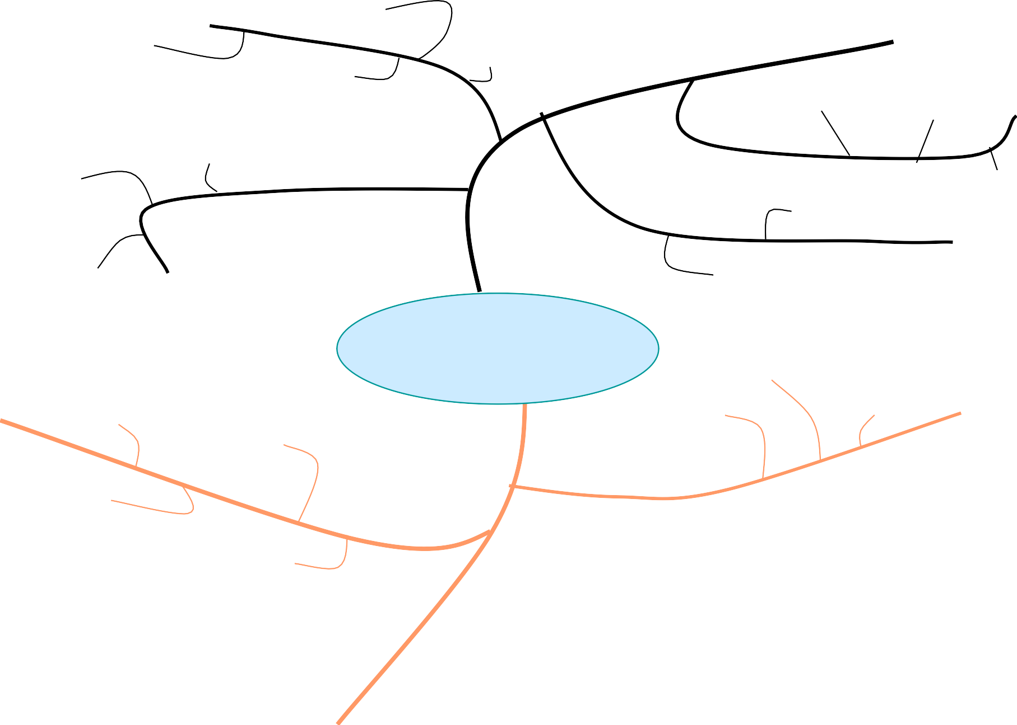
Device Controllers
Bus
Memory
CPU
Hardware
interrupt
I/O
Structure
Direct
I/O
One *
processor
Multi
processor
Architecture
Memory
Structure
DMA
Secondary Memory
Clusters
Organization
Main
Memory
Computer System
Operating
User Interfac
I/O
Management
Services What is it?
GUI or CLI
Process
Management System
Operation
Dual
Mode
Memory
Management
User View

Slide 35
Operating-System Operations
The OS works on the basis of interrupts
Interrupts come from hardware AND software
Mouse click, divide by zero, OS service request
Timer interruption (process time finished), memory access error (process wants to modify another one or the OS).
Some operations will have to be done only by a reliable program.
Access hardware, memory management registers.
An evil user program could damage other processes, steal the system, ...
Solution: operation in dual mode.
Notes:
Cannot let user programs allocate space in memory or directly access the hardware or modify registers, only the OS can do those tasks. As such, the OS must distinguish between operations that can only be done by the OS itself (or a reliable program), or done by the user program. Thus, OS have dual mode operation to supplement that,
When an operation that is invalid is called, the CPU delivers ISR (interrupt service routine) that will handle this type of interruption (terminate the program, prompt with an error message, etc.)

Slide 36
User mode and kernel mode
Dual mode operation allows the OS to protect itself and other components
User mode and kernel mode (or supervision)
Bit mode is found in the hardware
Distinguish the mode (user or kernel)
Some instructions are privileged
Call to OS changes the mode to kernel and the
return of the call changes it to user mode.
Notes:
A computer operates either in user mode or kernel mode. The difference between User Mode and Kernel Mode is that user mode is the restricted mode in which the applications are running and kernel mode is the privileged mode which the computer enters when accessing hardware resources.
When some programs are executing some instructions, those instructions can be done in user mode if they are simple enough to not trigger or access any hardware. If an instruction were to access hardware, or allocate space in memory, the program cannot run in user mode any more. Must be done in kernel mode, since we need a program from the OS to perform the designated instruction (need a reliable program to execute this instruction, otherwise, damages can be done to the resources). Hence, a distinguishment is needed for user mode and kernel mode operations, as well as knowing to protect itself, and other components from any damage that can be caused by the user programs.
The bit found in the register is set to 0 or 1 to determine whether we are in user mode or kernel mode

Slide 37
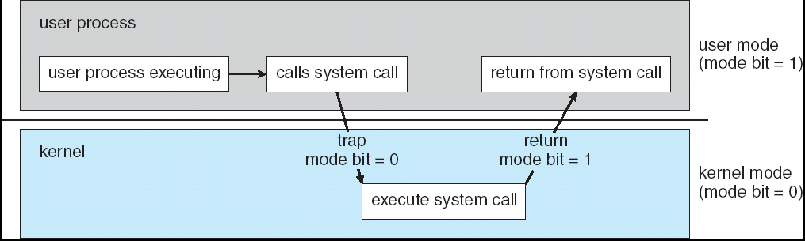
Transition from user mode to kernel mode
A timer prevents processes from taking over the system
An interruption after a period of time
OS decrements a counter
When the counter is zero, change process or end process.
Configure before giving control to the process to regain control or terminate the program.
Notes:
A user process is running. When this process hits an instruction of type system call (requiring the services of the OS, as an interruption), and since mode bit is set to 1 (since we are in user mode), the system call forces the mode bit to change from 1 to 0, to go in the kernel mode. Once finished, the mode bit is switched back, and the process exits kernel, back to user mode. Notice we are “trapping” the mode bit in the kernel, and returning this same bit into user mode.

Slide 38
System Calls
The interface that offers OS services to programs
Process control:
to run a program.
File management:
create / open / read / write a file, list a directory.
Device management:
request / release of a device
Information management:
time management, process attributes and files
Communication:
open / close a connection, send / receive messages
Notes:
API is the acronym for Application Programming Interface, which is a software intermediary that allows two applications to talk to each other.
open() and fork() are like system APIs that only the OS implement because they require the kernel mode and access hardware. To keep things simple, the OS only wants 1 implementation to make it easier to manage

Slide 39
System Call (continued)
Normally written with high level programming language (eg C) (such as open, write, read…) .
Implemented with software interrupt (called from user
program by invoking trap instruction
The software interrupt changes the mode bit to kernel mode and calls the appropriate subroutine according to an array of system calls and the interrupt number
Linux example: http://docs.cs.up.ac.za/programming/asm/derick_tut/syscalls
.html
At the end of the subroutine, the mode returns to user mode and values are returned to the calling program.

Slide 40
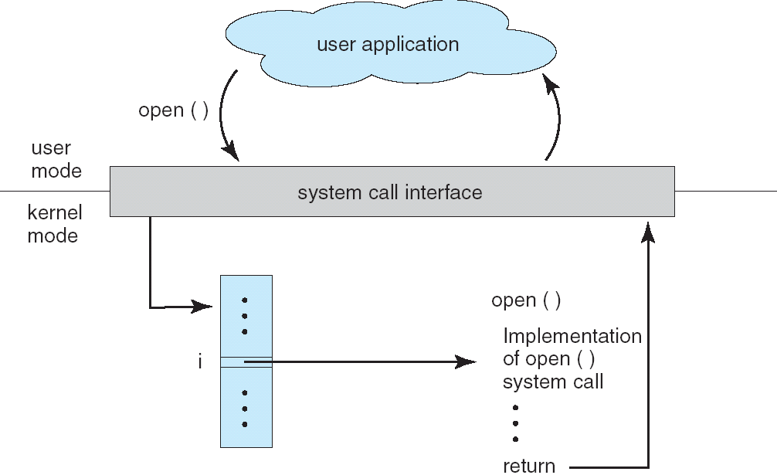
System Calls API
Notes:
APIs let your product or service communicate with other products and services without having to know how they’re implemented.
When you use an application on your mobile phone, the application connects to the Internet and sends data to a server. The server then retrieves that data, interprets it, performs the necessary actions and sends it back to your phone. The application then interprets that data and presents you with the information you wanted in a readable way. This is what an API is - all of this happens via API.
An API is a library that contains functions that preform a task that the user doesn't want to implement. So for example you can have a math API that has a log() function. There are many math APIs out there because those functions are not implementation specific. there can be different ways to implement the log() function. open() and fork() are specific examples from the system API

Slide 41
How to access system calls
Often accessed through programs with an application programming interface (API) and not directly via system call use.
Common APIs:
Win32 for Windows
POSIX API for POSIX systems
UNIX, Linux and MAC OS X
Java API for Java Virtual Machine (JVM)
The calling program does not know anything about the implementation of the system call.
Simply obeys API standards: parameters to provide, return
values, and desired operation
The OS interface details are hidden behind the API.
Managed by the API library (set of functions supplied with the compiler)
Possible to use system calls directly

Slide 42
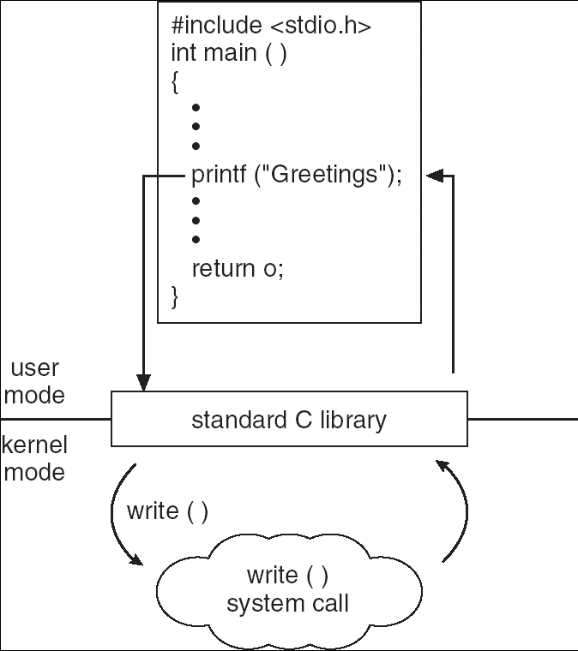
Example of the standard API in C
The printf () function which makes a write() system call
Notes:
printf() is a C function (exits within the C library) makes a system call to write() where this is an OS function

Slide 43
Main operations of an Operating System (OS)
Process management
A process with a thread has a single program counter
The OS manages the resources required by the processes
CPU, memory, I/O, files
Initialization data
The OS manages the activities of the processes: creation
and destruction, interactions between processes, etc.
Memory management
Memory management determines which process and when it occupies memory to optimize CPU usage and the computer's response to users
Secondary memory management
The OS provides a uniform and logical view of the information stored in secondary memory
File system, mass storage
The I/O subsystem
A role of the OS is to hide the various peculiarities of the user's devices

Slide 44

Device Controllers
Bus
Memory
CPU
Hardware
interrupt
I/O
Structure
Direct
I/O
One *
processor
Multi
processor
Architecture
Memory
Structure
DMA
Secondary Memory
Clusters
Organization
Main
Memory
Computer System
Operating
User Interfac
I/O
Management
Services What is it?
GUI or CLI
Process
Management System
Operation
Dual
Mode
Memory
Management
User View
Virtual
Machine
Design
Structure
Questions
Different Flavors
Micro
kernel
Layer
43
Modules

Slide 45
Design and realization of OS
The design of the OS is mainly affected by the choice of material and type of system
Batch, time-shared (ie. Round Robin), one-user, multi-user, distributed (different environments?), real-time (more complex, cannot afford to fail during an operation) vs general use (home, university, minimal impact on surrounding)
User needs versus system needs
User needs - easy to use, easy to learn, reliable, and fast
System requirements - easy to design, simple to build and maintain (easy/simple to modify/change in the future), as well as flexible, reliable, error-free, and efficient.
A balance between user needs and system needs is required.
Implementation
Traditionally in assembler
Today, especially in C, with small sections in assembler
(drivers, manipulation of registers)
Notes:
What is the purpose of the OS when designing them?
Batch mode: Batch processing system works as an operating system. Batch processing system means to grab all types of programs and data in the batch form then proceed to process. Main motive of using batch processing system is to decrease the set up time while submitting the similar jobs to CPU
A time shared operating system uses CPU scheduling and multi-programming to provide each with a small portion of a shared computer at once. Each user has at least one separate program in memory. A program loaded into memory and executes, it performs a short period of time either before completion or to complete I/O.
An operating system that allows a single user to perform only one task at a time is called a Single-User Single-Tasking Operating System. Functions like printing a document, downloading images, etc., can be performed only one at a time. Examples include MS-DOS, Palm OS, etc.
A multi-user operating system is an operating system that permits several users to access a single system running to a single operating system. These systems are frequently quite complex, and they must manage the tasks that the various users connected to them require. For the multi-user aspect, the OS must provides the resources to protect the user from other users as well as others. One of the most important security features of a multi-user operating system is account separation. The ability of each user to have their own private work and storage space within the system is vital for the protection of file integrity and content privacy.

Slide 46
System structure
Internal structure of OS vary
Since needs/requirements vary
Simple hardware, simple functions
Simple monolithic structure
More resources and complex functions
Layered Structure
MS-DOS and traditional UNIX are monolithic OS which use a layered structure.
Even more resources and functions, with a focus on flexible and
elegant design
Micro-Kernel structure (MACH, QNX, Windows NT)
Flexibility and efficiency
Modular structure (Solaris, Windows NT)

Slide 47
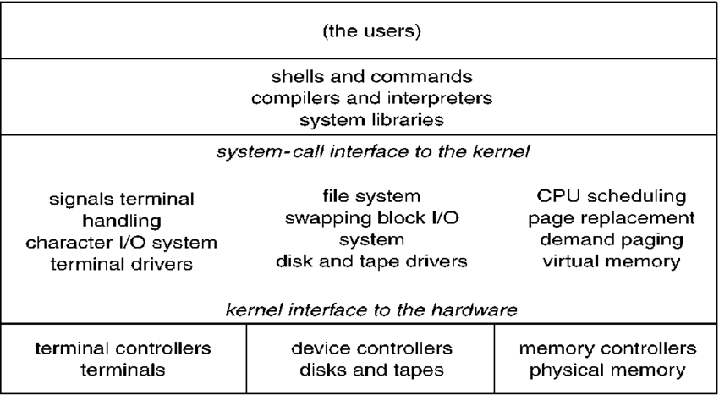
UNIX structure: few layers

Slide 48
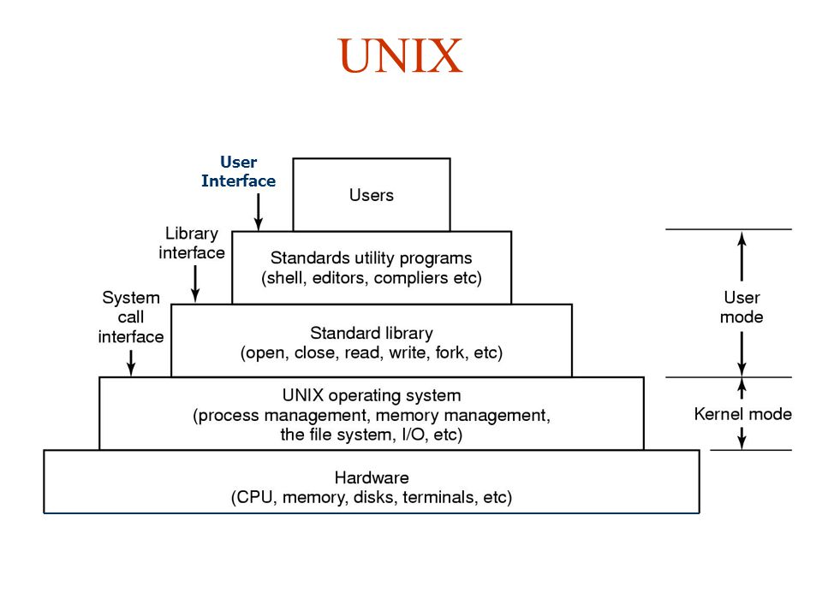

Slide 49
Virtual machines: the problem and the solution
How to allow different OS to run on a single physical machine?
Not easy, because each OS requires direct access to the hardware
SOLUTION: A program that creates a layer that makes several physical machines available virtual
On each we can run a different OS
Notes:
A single physical machine → HOST
Contains different virtual machines where each can run a different OS. Each of these virtual machines share the hardware of the physical machine.

Slide 50
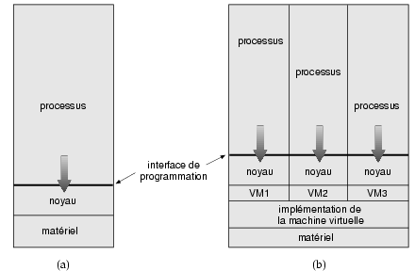
System model
A single real machine and single kernel
Several virtual machines and several kernels
Notes:
noyau <-> kernel
materiel <-> hypervisor
Each virtual machine uses the hardware resources (CPU, RAM, disks) that are provided by the OS from the physical machine. They do not have their own processors, they use the ones provided by the OS of physical machine.

Slide 51
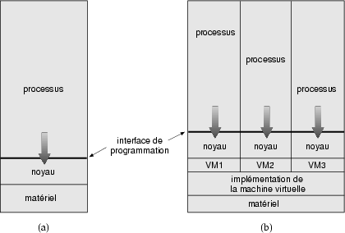
Operation
The VM system allows unprivileged instructions to execute normally
System calls are executed by the VM system and the results are passed to the virtual machine on which the process is running

Slide 52
Advantages
Each virtual machine can use a different OS!
In theory, we can build virtual machines on virtual machines!
Complete protection, because virtual machines are completely isolated from each other
A new OS can be developed on a virtual machine without disturbing others

Slide 53
Implementations
The concept of VM is widely used to allow running one OS on another
Eg. SUN, Apple, Linux allow Windows to run on their platform,
They must provide Windows with an environment that Windows recognizes as its usual Intel environment.

Slide 54
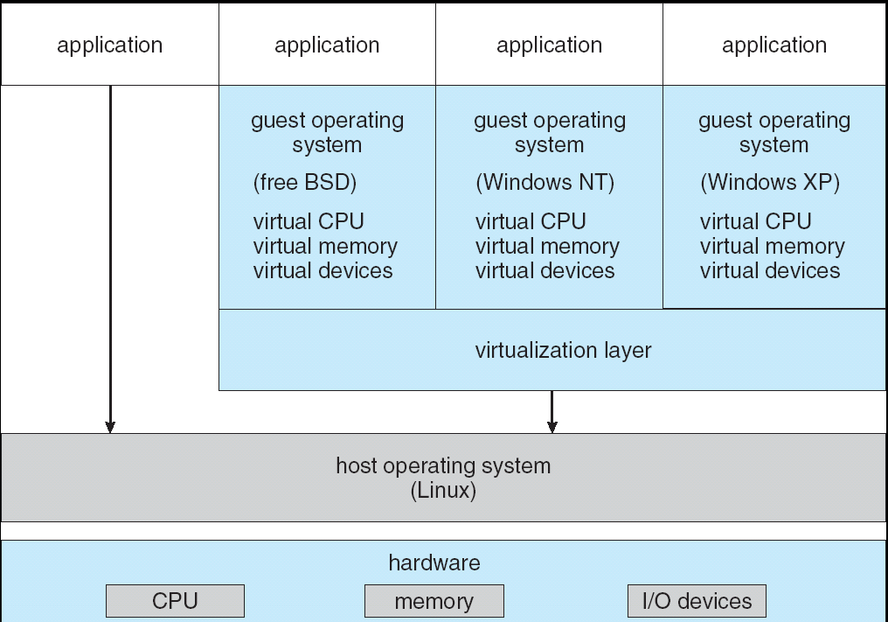
VMWARE on Linux

Slide 55
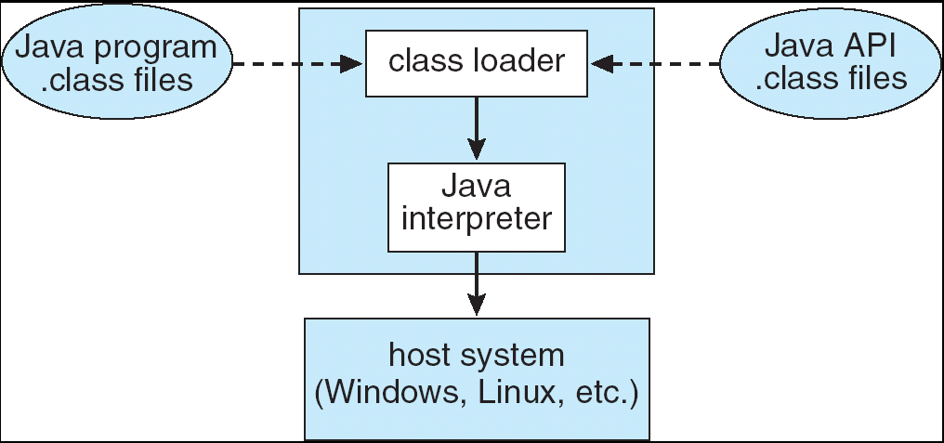
Java Virtual Machine

Slide 56
We do not cover these concepts
Distributed system
Embedded real-time systems
Multimedia systems
Hand held Computers
Peer to peer
WEB operating system
Fall 2008

Slide 57
Device Controllers
Bus
Memory
CPU
Hardware
interrupt
I/O
Structure
Direct
I/O
One *
processor
Multi
processor
Architecture
Memory
Structure
DMA
Secondary Memory
Clusters
Organization
Main
Memory
Computer System
Operating
User Interfac
I/O
Management
Services What is it?
GUI or CLI
Process
Management System
Operation
Dual
Mode
Memory
Management
User View
Virtual
Machine
Design
Structure
Questions
Different Flavors
Micro
kernel
Layer
55
Modules

