Slide 1





Chapter 10 (Silberschatz)
Chap. 10
1

Slide 2



Important concepts of Module 10
Operation and structure of disk drives
Calculating the execution time of a sequence of operations
Different scheduling algorithms
Operation, efficiency
Management of swap space
Unix
RAID - error resistant drives
Chap. 10
2
Notes:
When processes make requests to disks, such as I/O requests
Execution time is calculated by the time it takes to handle the request
RAID = redundant array of independent disks → how we organize and add redundancy to guard for errors

Slide 3
Magnetic disks
Rigid platters covered with magnetic recording material
disk surface divided into tracks (tracks) which are divided into sectors
the disk controller determines the logical interaction between the drive and the computer
Chap. 10
3

Slide 4
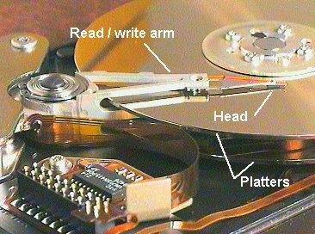
So, how does a disk look inside?
4

Slide 5
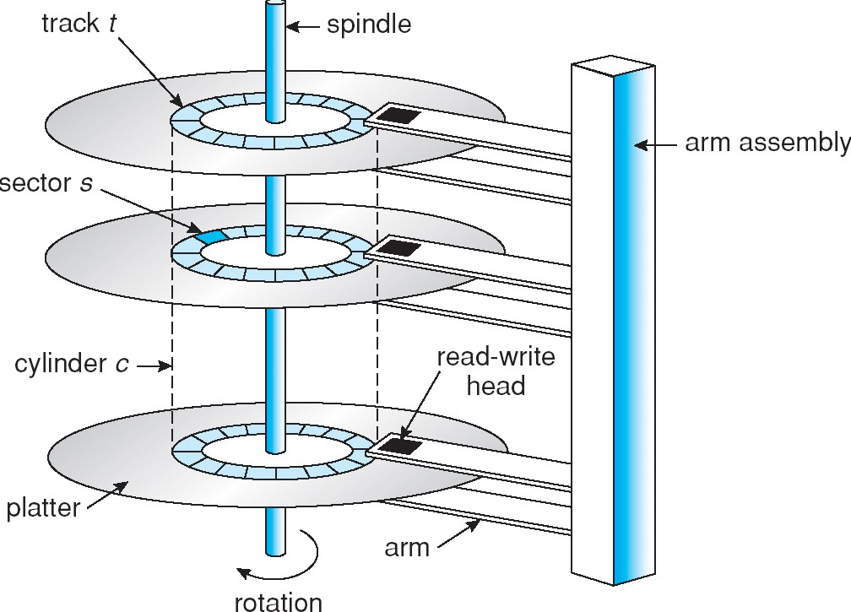
The insides of a hard drive!
5
Notes:
Several platters where each platter on its surface has a magnetic layer, where the information will be recorded on the material of itself on the disk. Each platter is divided into tracks (one large circle → platter, many smaller circles inside of it → tracks).
Every track is divided into sectors. These platters while stacked together, they rotate around the spindle.
All platters that are divided into the same number of tracks formulate a cylinder (a set of tracks formed from different platters). Cylinder c means all the tracks of that number associated to them (track c from the platters) form cylinder c.
The arm assembly has two arms on the platters where at those ends is what allows for information to be read from and written to the disk. Notice the length of the arms, as they would need to adjust their position to reach all the tracks or cylinders on the platter → seek time: time taken for the arm to move back and forth to position on top of the tracks. The platter can also be rotated for the hand to access a specific sector of the track → rotation time: time taken to position the read-write head on the specific sector. (there is also the read-write time → time taken to read from or write to a disk from the track)

Slide 6
Electronic Disks
Today, more and more other types of memory are treated like hard disks, but are completely electronic
For example, flash memory (memory sticks)
These devices do not contain seek time, rotational latency, etc.
6

Slide 7
Disk scheduling
Problem: Goal is optimal use of hardware Reduced total time of I/O requests
given a queue of I/O disk requests, in what order should they be executed?
Chap. 10
7
Notes:
As known, processes make requests. In the context of disks, let’s say many processes make requests to the cylinders. A sequence of requests just like a reference string. How do we determine which of the requests is to be done first?

Slide 8


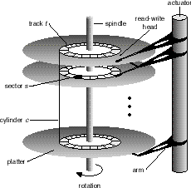
Parameters to consider
seek time (positioning time):
the time taken for the disk drive to
position itself on the desired cylinder
Rotation latency time
the time taken by the disk drive who is on the correct cylinder to position yourself on the desired sector
Reading time
time needed to read the track
Seek time is normally the most important, so it is the one that we will seek to minimize
Chap. 10
8
Notes:
Seek time → position the arms on specific track (usually larger than the others, so we want to minimize it)
Rotation time → position the arms on the right sector

Slide 9

Disk I/O Queue
In a multiprogrammed system with virtual memory, there will normally be a queue for the disk drive
Shall study different methods using an I/O waiting queue containing requests:
98, 183, 37, 122, 14, 124, 65, 67
Each number represents a cylinder number. Must also known the starting cylinder: 53
What order of requests will minimize the total seek time (movement of head to cylinders).
Simple hypothesis: moving 1 cylinder takes 1 time unit.
9
Notes:
The requests are put into a queue, and each request is represented by the cylinder number.
The starting cylinder is necessary here → 53 → where the head of the arm is initially found. It is also important that the head is moving upwards or downwards the cylinder numbers (reaching larger than cylinder 53, or reaching the smaller numbers)

Slide 10
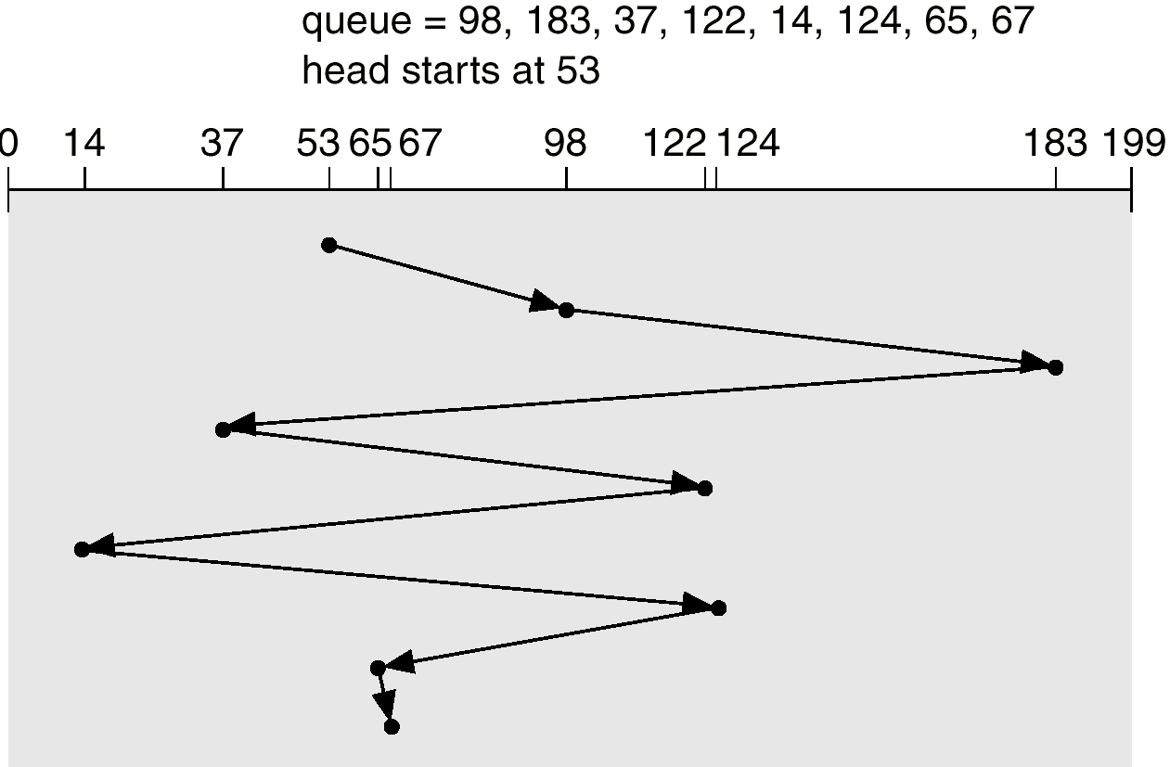
First Come First Served: FCFS
rotation axis
45
85
146
85
108
110
59
2
Total movement: 640 cylinders = (98-53) + (183-98) + ... Average: 640/8 = 80
Chap. 10
Notes:
Cylinder 0 is the external cylinder whereas cylinder 199 is the internal cylinder.
The unit times from cylinder to cylinder is written above the transitions (cost of one cylinder to the next (consecutively) is one unit of time)
Average is found by the total movement divided by the number count of cylinders to access in the queue.

Slide 11
SSTF: Shortest Seek Time First
Selects the request with the minimum seek time from the current head position
Can be seen as a form of SJF scheduling Clearly better than the previous one
But not necessarily optimal! (see manual) Can cause famine/starvation
Chap. 10
Notes:
How can it cause famine?
While receiving requests, if they are close to the starting head cylinder, then the further ones may be ignored for a while before being serviced (but it will eventually be serviced)

Slide 12
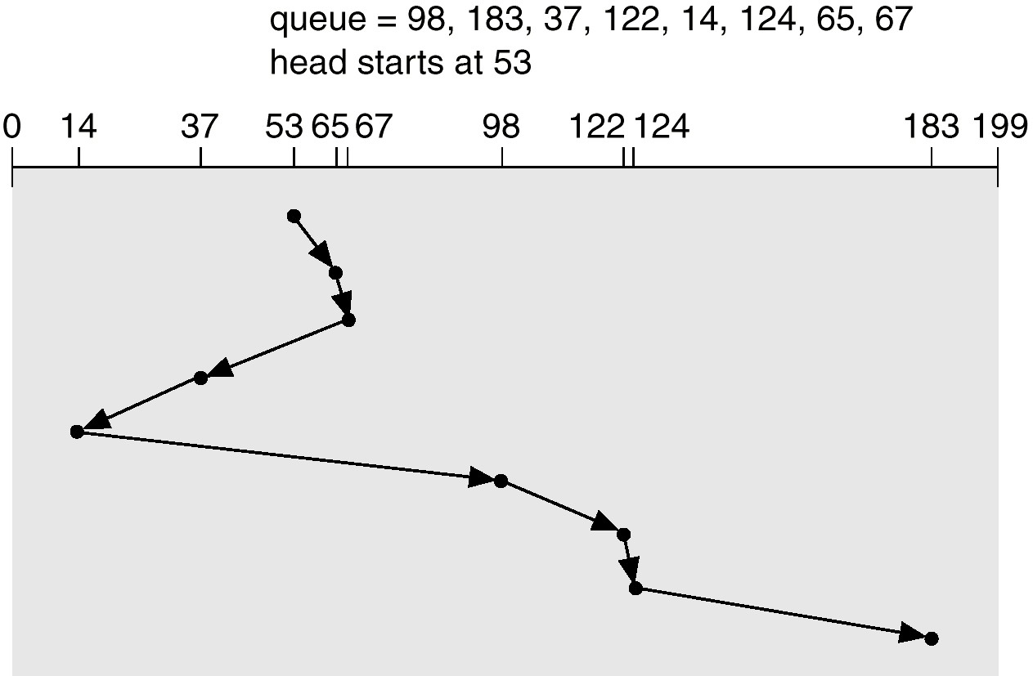
SSTF: Shorter served
Total movement: 236 cylinders (640 for the previous one)
Average: 236/8 = 29.5 (80 for the previous one)
Chap. 10
Notes:
Whichever cylinder that is closer to the current cylinder in which the arm is positioned at is the next cylinder to transition to.

Slide 13
SCAN
Goal: Avoid starvation, while still being efficient
Idea:
The disk arm starts at one end of the disk, and moves toward the other end, servicing requests until it gets to the other end of the disk, where the head movement is reversed and servicing continues.
Starvation is avoided, because we scan the whole disk Performance should also be reasonably good, as zig-
zagging is avoided (i.e. queue: 1,200,2,199,3,198,4,197; requests will be serviced in one pass)
Also called the elevator algorithm.
Problems
Not much work to do when reversing directions, since requests will have accumulated at the other end of the disk.
Waste time moving to the end of the disk when have serviced the last request.
13
Notes:
Like an elevator system, it will service all the requests it passes while reaching to a destination floor. This is established by the direction of the transitions.
All scan algorithms have a “direction” involved with them.

Slide 14
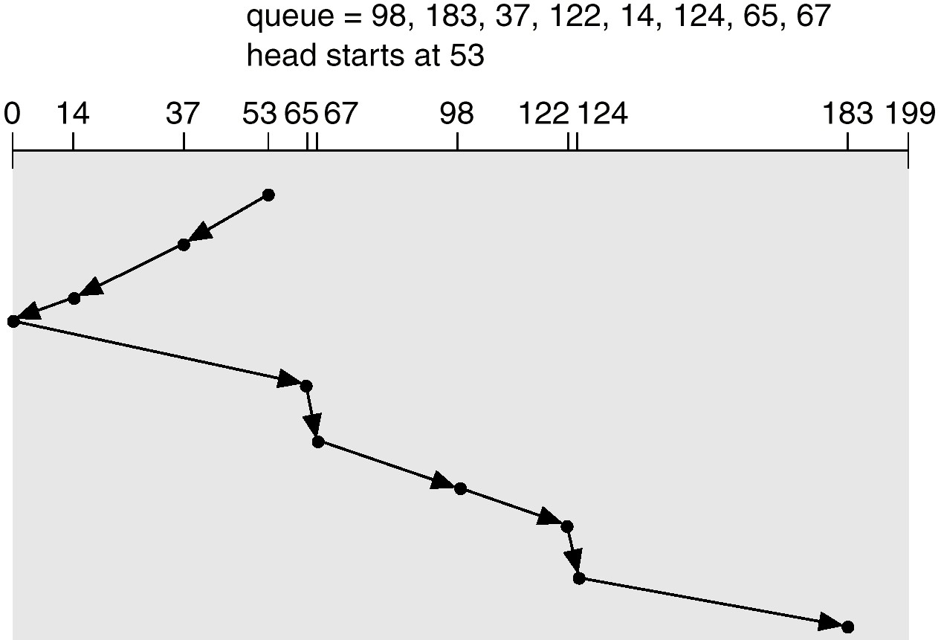
SCAN: the elevator
direction
Total movement: 236 cylinders Average: 236/8 = 29.5 (29.5 for SSTF)
Chap. 10

Slide 15
C-SCAN
Fast return to the start (cylinder 0) of the disc instead of reversing the direction
Assumption: the return mechanism is much faster than the time to visit the cylinders
C-LOOK (Scan)
Same idea, but instead of going back to cylinder 0, going back to the first cylinder that has a query
Chap. 10
Notes:
The C-Scan only scans and services requests in one direction, returning from one to the other with the assumption that when the return is done, the transition is quite fast.
For C-LOOK, the algorithm gets to look ahead in the queue sequence to see which cylinder is the last one to service in the direction that it transitions. Once established, it returns to the other end of spectrum, and then starts transitions with the primary direction it went before.

Slide 16
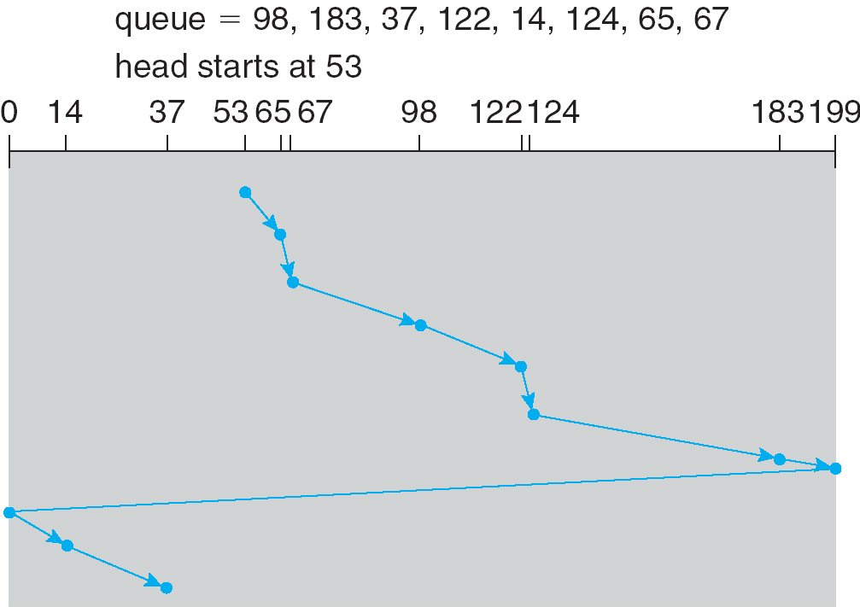
C-SCAN (Cont.)
16
Notes:
For the example, the direction of the scan is →.

Slide 17
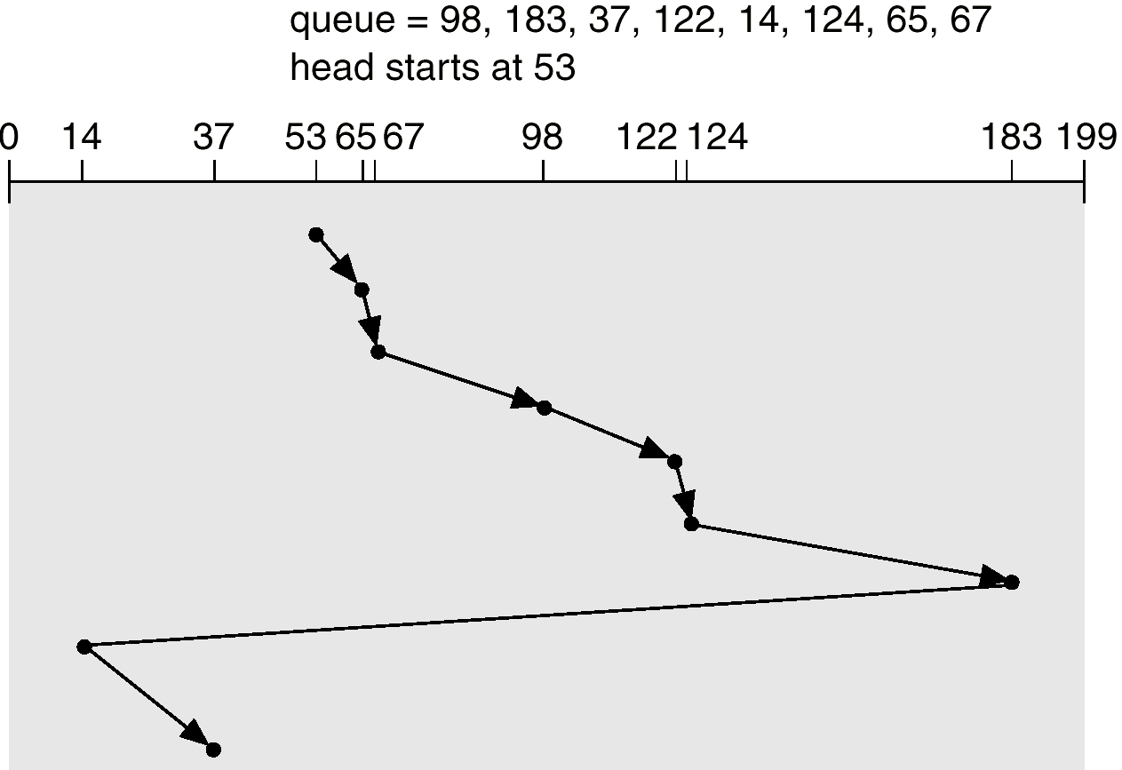
C-LOOK
direction →
return: 169 (??)
Time units travelled is 153 without considering the return (19.1 on average) (26 for SCAN)
BUT 322 with return (40.25 on average). Normally the return will be quick so the actual cost will be between them
18

Slide 18
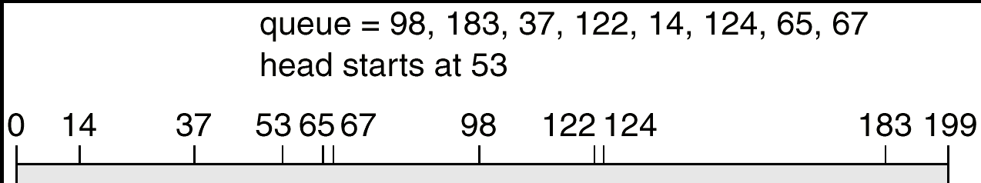
C-LOOK with opposite initial direction
direction
Return 169
Very similar results:
Time units travelled is 157 without considering the return, 326 with the return
Chap. 10

Slide 19
C(ircular)-SCAN
First problem with SCAN:
Not much work to do when reversing directions, since requests will have accumulated at the other end of the disk.
Idea:
The head moves from one end of the disk to the other,
servicing requests as it goes.
When it reaches the other end, however, it immediately returns to the beginning of the disk, without servicing any requests on the return trip.
The return trip is relatively fast, as it does not need to
accelerate/decelerate for each request
Treats the cylinders as a circular list that wraps around from the last cylinder to the first one.
19

Slide 20


Comparison
If the queue often contains very few items, the FCFS algorithm should be preferred (simplicity)
Otherwise, SSTF or SCAN or C-SCAN? In practice, it is necessary to take into consideration:
Actual travel time and time to go back to start File and directory organization
The directories are on disk too ...
The average length of the queue
The incoming flow of requests
Chap. 10
Notes:
FCFS is the worst in terms of producing the largest travelled time units

Slide 21
Disk Management
Low-level formatting, or physical formatting divide the disk into sectors the controller can read initialize each sector (header, trailer)
Comes from factory
Partitioning
logically partition the disk into one or more groups of cylinders, each of them having its own FS.
Set the boot partition
Logical formatting or “making a file system”
Write the FS data on disk
i.e. write FAT, the root directory, inodes, …
21
Notes:
Every time a disk is involved, or is needed for use, it needs to be formatted, such as be divided into partitions or tracks, and then divide them into sectors, which are separated into blocs of headers and trailers. This physical formatting is performed by the vendor from the factory.
Some OS say that 1 bloc = 1 sector or many blocs = 1 sector.
The logical formatting is to construct the file system, a structure to use to organize the files and the directories.

Slide 22
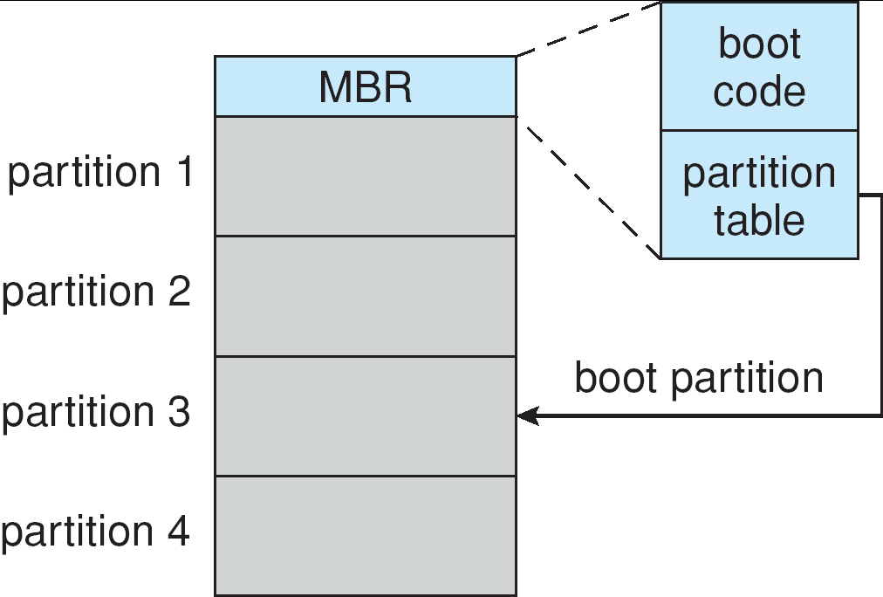
Booting from a Disk in Windows 2000
22
Notes:
MBR → master boot record to boot the OS that tracks the basic constraints that contain scalable boot code and partition tables.

Slide 23

Bad Block Management
There are tens and hundreds of millions of blocks on a HD Bad blocks do happen
What to do about them?
Have some spare blocks and when you detect a bad
block, use the spare block instead
i.e. the HD has nominally 100 blocks, but was fabricated with 110, 0..99 are used, 100-109 are spare
If block 50 fails, the HD controller (after being told by the OS)
will use block 100 to store the logical block 50
But that messes up the efficiency of the disc scheduling algorithms!
Don’t panic! Just have spare blocks in each cylinder
(sector sparing) or use sector slipping
23
Notes:
On every disk, there could be block that cannot be read → bad blocks
OS provides some tools to repair them (if it can) → if so, then use spare blocks instead for compensation

Slide 24
Swap-Space Management
Swap-space — Virtual memory uses disk
space as an extension of main memory
Where is the swap-space on the disk?
As a part of the normal file system (not recommended)
good: Simple, flexible, bad: SsssLOoooWwww
in a separate disk partition (recommended)
Using its own, optimized algorithms and structures
i.e. fragmentation not such a big problem – on boot starts anew, but really want fast sequential access
Good: faster
Bad: might waste space
24
Notes:
In the virtual memory, set up a space on the disk as a swap-space to reside the virtual memory (as an extension of the physical memory). The system administrator sets this up, letting the OS know what it is and its location on the disk for it to use.
As part of the normal file system, you create the swap-space after creating the file system. This is not efficient, because since the organization of the file system already takes time, you are now also treating the swap space like a system file, thus this is also treated in the same manner as before, hence not efficient, creating overhead. Every time to access the file, the system would need to go through the directory to find the file (inefficient)
Hence, as a separate disk partition, and thus, being independent, the schedulers that use the swap space do not need to do the access of directory steps.

Slide 25
Swap-Space Management
When to allocate space in the swap space?
When the process starts/the virtual page is created
When the page is replaced
What to remember?
Kernel uses swap maps to track swap- space use.
25

Slide 26
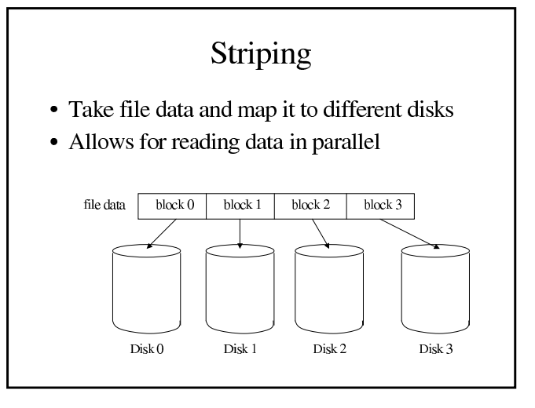
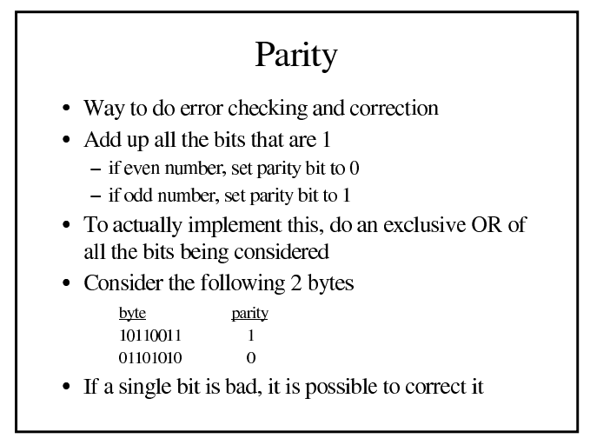
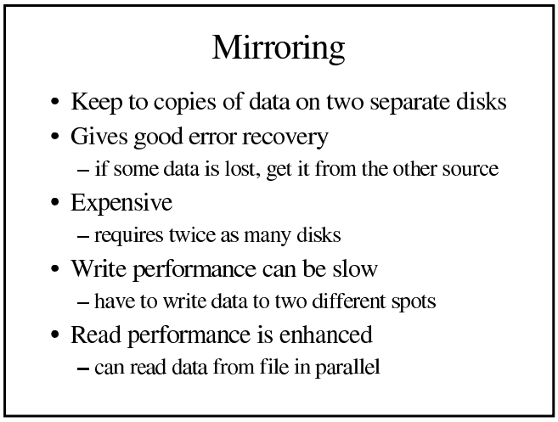

Slide 27
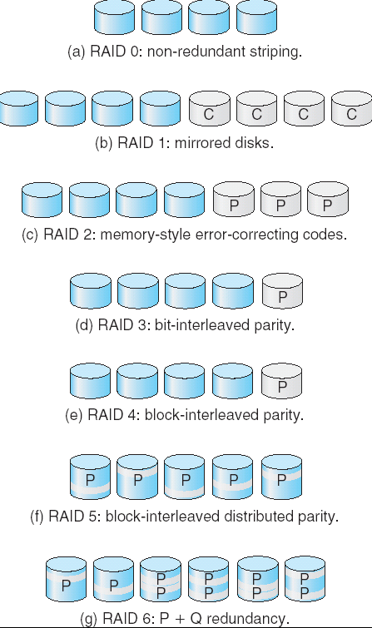
RAID Levels
Striping: reading multiple disks in parallel
Bit interleaving Block interleaving
Redundancy: redundant data to cover data in case of disk failure
duplicate data (mirror disks)
Parity or correction codes
Examples: The six RAID levels store 4 data disks
Main one used (major/most) → RAID 5
Chap. 10
Notes:
Recall: RAID → redundant array of independent disks
A computer system can be supplied with many disks, as a computer system can require it for capacity (storage) or redundancy (in case one fails)
In parallel means that you can read from or write to an array of disks in parallel.
Bit interleaving is involving a single bit for the striping, and block interleaving is involving a block of bits.
RAID 0 → non-redundant striping → when a disk is lost, all the information is lost with it. RAID level 0 refers to disk arrays with striping at the level of blocks but without any redundancy (such as mirroring or parity bits). Performance boost for read and write operations. Space is not wasted as the entire volume of the individual disks are used up to store unique data. There is no redundancy/duplication of data. If one of the disks fails, the entire data is lost.
Redundancy is introduced.
RAID 1 → mirrored disks → mirroring means that an exact duplication of data will be inputted into other disks once a disk has been modified. As such, if a disk fails and thus lost, the other disk can replace it and recover the information from this new mirrored disk. Data can be recovered in case of disk failure. Increased performance for read operation. Slow write performance and space is wasted by duplicating data which increases the cost per unit memory. Need to as if double the capacity of the system where one disk is for storage and the other for mirroring in case of disk failure.
Another way of accomplishing redundancy is parity, where when blocks of bits are written to one disk, and other blocks are written to another, a third disk can be used to track the even-parity of these disks. As in counting the number of 1s throughout these blocks determines the parity where, if the count is odd, a 0 is given, a 1 is given if the count is even (For checking odd-parity, 1 is given for count is odd, 0 is given if the count is even). To demonstrate:
Disk 1 Disk 2 Disk 3 (parity)
0 0 0
0 1 1
1 0 1
1 1 0
With this, if one of the disks are lost, it can be recovered with the help of the other available disks and reconstruct once a new disk arrives. If two of the disks fail, well then this method fails. The chance is slim for losing multiple disks, but losing one a time is easier to handle.
Correction codes work similarly to parity, where a function is used to calculate the information on the third disk, and use this to recover the lost disks.

Slide 28
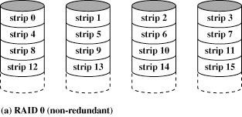
RAID: Redundant Array of Independent Disks
Stallings
By distributing the data on different disks, it is likely that a big read can be done in parallel (instead of reading strip0 and strip1 in sequence, this organization allows them to be read at the same time)
Chap. 10

Slide 29
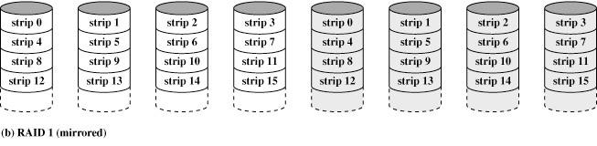
Redundancy in RAID
Stallings
Duplicate data to increase parallelism and remedy data
loss (expensive but used in practice)
Chap. 10

Slide 30
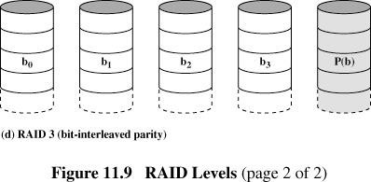
RAID: Error correction by parity
Stallings
Parity bits for data recorded on one disk are saved to another disk
Chap. 10

Slide 31
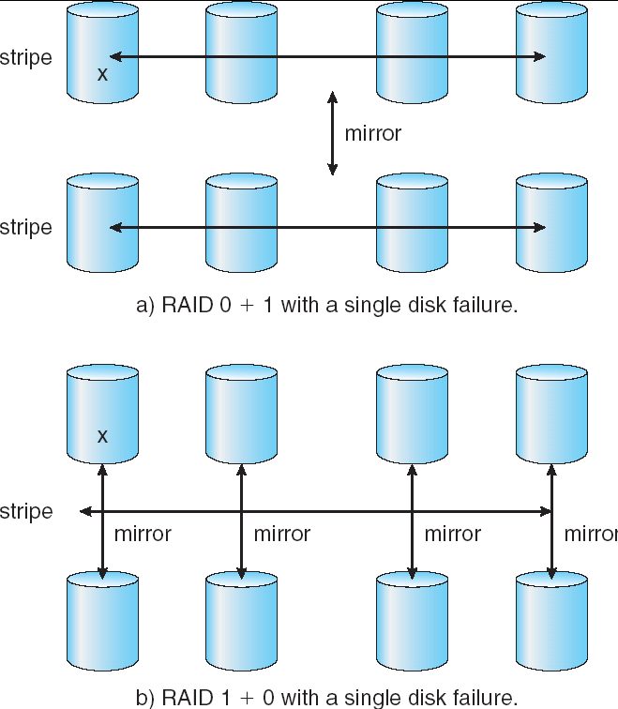
RAID (0 + 1) and (1 + 0)
Chap. 10

