Slide 1









The process
CSI3131 - Module 2 - Processes
Reading: Chapter 3 (Silberchatz) Goal:
1

Slide 2




Important concepts of Module 2 - Process
The process - to run a program
States and process state transitions
Process Control Block Process switching
PCB saving, reloading
Process queues and PCBs
Short, medium and long term schedulers Operations with processes
Creation, termination, hierarchy
Communication between processes
2

Slide 3
Process and terminology
(also called job, task, user program)
Process concept: a program in execution
Has memory resources, peripherals, etc.
Process scheduling
Process operations
Example of process creation and termination
Cooperating processes (communication between processes)
3
Notes:
When a program is written and saved onto a disk, it is not a process yet. Once a program is loaded into memory, it becomes a process, and it requires space (takes space in memory), CPU in order to execute, and resources (peripherals to open files, reserves for devices)

Slide 4
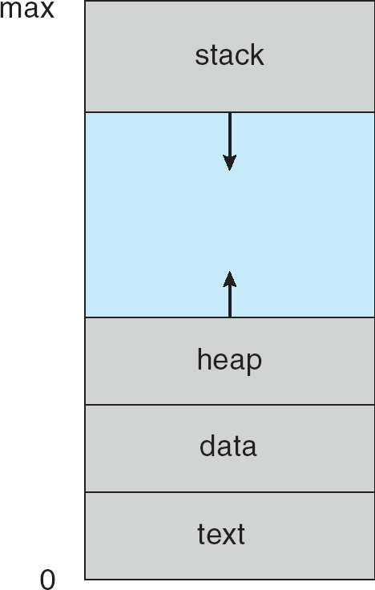
Process runs a program
Text - code to run
Data
Heap
Stack
4
Notes:
Text is essentially the code, comprising the instructions, hence any program is a sequence of instructions. This includes the current activity represented by the value of Program Counter and the contents of the processor's registers.
Data is the component the program operates on, and contains the global and static variables.
Stack is needed when parameters are passed for the program to function. It contains the temporary data such as method/function parameters, return address and local variables.
Heap is used for dynamic memory allocations, where this is dynamically allocated memory to a process during its run time.

Slide 5
process state is IMPORTANT
As a process executes, it changes state
new: the process has just been created
Execution - running: the process is being executed by the CPU
waiting: the process is waiting for an event (e.g. the end of an I / O operation)
ready: the process is waiting to be executed by the CPU
terminated: end of execution
5
Notes:
When a program is loaded into the memory and it becomes a process, it goes through different stages, and changes states based on the situation
New − When a new process is created, it enters into the new state. Then it tries to load into RAM.
Execution / Running − The processes that are running on the CPU are in running state. If the process is running in its critical section, then other processes need to wait in the ready state.
Ready − The processes that are loaded on RAM and waiting for CPU are in ready state. Not waiting for resources, but rather waiting for the CPU.
Waiting / Blocked − All processes that are leaving the CPU and moving to the waiting state are in the blocked state. When the CPU becomes free, processes from the blocked state again move to the ready state, and from ready to Running state. For example, it is waiting for resources (I/O resources let’s say) once transferring/reading from/writing to a file
Exit / Terminated − A process that is terminated from CPU and RAM is in the terminate state. Once the process is done executing, it becomes terminated.

Slide 6
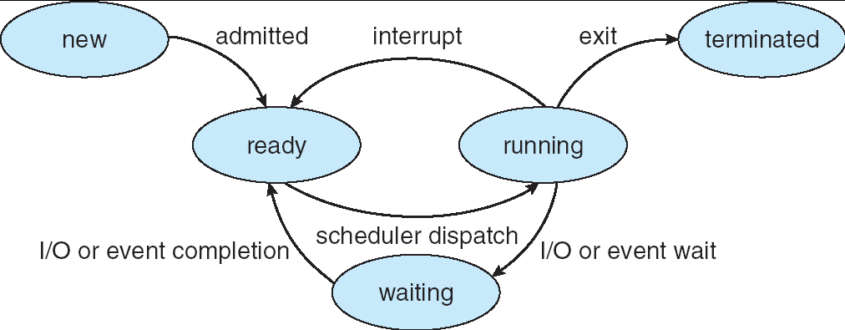
State transition diagram of a process
6
Notes:
The process executes when it changes state. The state of a process is defined by the current activity of the process. It is important to know that only one process can be running on any processor at any instant. Many processes may be ready and waiting.
Transitions:
Once a program is loaded into the RAM (memory), it becomes a process in its New state. Once it has finished being created and associating all the data structures and parameters that the process will need, the process goes into the Ready state, waiting for the CPU to call it.
How would the process be allowed to be called upon by the CPU? The scheduler (part of the OS) decides which process (there can be many in the Ready state) and selects one of them, and assigns the CPU to that particular process. Thus, once a process is selected, that process transitions into the Running state, where it can now be executed by the CPU.
Once in the Running state, 3 things could happen:
A process can finish executing all of its instructions, and thus the process terminates, which means the process exits the CPU into its Terminated state.
The process could issue an I/O request (for example, the process wants to read from/write to a file), doing a I/O operation, which may or may not be satisfied right away. There could be several requests to the disk, and these requests are handled by the I/O controller. Thus, the process transitions into the Waiting state, for the I/O request to complete. Once the I/O operation is completed, the process goes back to the Ready state, and thus becoming ready again to be called upon by the CPU and be executed by the CPU. When the process is in waiting, it goes to ready state when the condition is satisfied instead of going to running again. In addition, It goes to ready because it needs to wait for the CPU again.
The process could be interrupted for some reason. For example, in time-sharing systems, several processes can be in the memory. While the CPU is executing one of the processes, to give a chance to the other processes (to be executed), depending on the scheduler, the process can be interrupted by the time allotted for it to be running. After the time allotted is done, the CPU must change process priority, and the original process is now in the Ready state. Like a cycle, the scheduler may select the process again, and the CPU will execute that process again. The scheduler can also decide upon the priority level of processes and decide the next process to be associated to the CPU, rather than just allow time for processes to be in execution.
Note: It is possible for an interrupt to cause a program to terminate

Slide 7
Transitions between processes
Ready → Running
When the CPU scheduler chooses a process for execution
Running → Ready
Result of an interruption caused by a process independent event
This interrupt must be treated, so the current process loses the CPU
Important case: the process has exhausted its time interval (timer)
7

Slide 8
Transitions between processes
Running → Waiting
When a process requests a service from the OS that the OS cannot immediately offer
(interruption caused by the process itself)
access to a resource not yet available
initiate I/O: must wait for the result
needs response from another process
Waiting → Ready
when the expected event occurs
8

Slide 9
The need to replace (swapping)
Until now, all processes were (at least partially) in memory (RAM)
Even with virtual memory, the OS cannot keep too many processes in memory without deteriorating performance
Sometimes the OS must suspend some processes, ie: transfer them to disk. So 2 other states:
Waiting Suspended: blocked/waiting processes
transferred to disk
Ready Suspended: ready processes transferred to disk
9
Notes:
There could be other states as well, aside from the aforementioned.
In general, the CPU changes processes depending on the algorithm the scheduler is running on to decide the next process. To make use of the virtual memory, some space in the RAM needs to become available, since it has limited capacity. Often, using the secondary memory, to augment the memory of the RAM, to have more processes running at a time.
Another way to free up space in the RAM, some processes are swapped out of the RAM, and transferred into a disk. This is especially done for processes in the Ready or even the Waiting state, where they are not being executed at the moment, and can be swapped and then brought back later on.

Slide 10
New transitions
Waiting -> Waiting Suspended
Preferred choice by the OS to free memory
Waiting Suspended -> Ready Suspended
When the expected event occurs (status info is available to the OS)
Ready Suspended -> Ready
when there is no more process ready (in memory)
Ready -> Ready Suspended (rare)
We must free some memory but there are no more blocked processes in memory
10

Slide 11
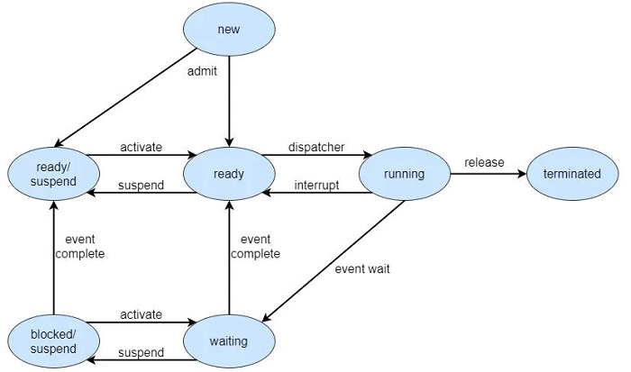
A 7-state process model
Notes:
The states present in seven state models are as follows −
New − Contains the processes that are newly coming for execution.
Ready − Contains the processes that are present in main memory and available for execution.
Running − Contains the process that is running or executing.
Terminated − Contains the processes that complete its execution.
Waiting − Contains the processes that are present in main memory and awaiting an event to occur.
From Waiting to Waiting Suspend and then back to Waiting is because perhaps the I/O or event has not been completed yet, hence the request must be completed first before being called upon by the CPU.
Waiting Suspend − It contains the process present in secondary memory and awaits an event to occur.
Cannot go straight to the Ready state because the I/O request must be completed first before being ready for any execution. In addition, the process needs to be in the RAM to be associated to the CPU, where in suspend states, it is not in the RAM.
Ready Suspend − Contains the processes that are present in secondary memory but is available for execution as soon as it is loaded into main memory.
Either of the suspend states allows for freeing up space in the RAM.

Slide 12
Saving process information
In multiprogramming, a process is running on the CPU intermittently
Whenever a process takes over the CPU (transition ready → execution) it must resume it in the same situation where it left it (same content of CPU registers, etc.)
So when a process exits the execution state, it is necessary to save its essential information, which will have to be recovered when it returns to this state.
12
Notes:
What happens when we switch the CPU from one process to another:
Consider the CPU executing process P1, and P2 is waiting in the RAM. Once the CPU changes to executing on P2, some work needs to be done. Direct change is avoided because P1 could be left in an unstable state. For example, in a process doing a simple addition, P1 cannot be interrupted while doing ADD operation, without saving some information. Because after changing to P2, we need to come back to P1 and continue where we left off, and save all the values of the registers.

Slide 13
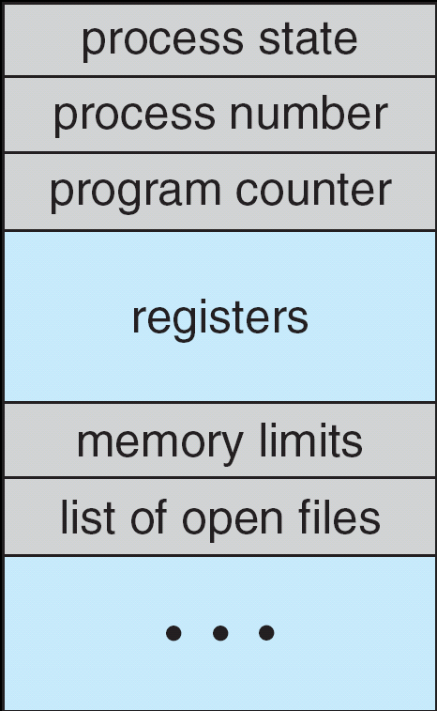
CPU Registers
13
Notes:
The content is saved in a data structure called the PCB:
For each process there is a Process Control Block, PCB, which stores the following (types of) process-specific information. Thus, P1 → PCB1, P2 → PCB2,…
Thus, any information that needs to be saved of a process, will be saved in the PCB of that process. The following are the type of information that needs to be saved.
The PCB contains a pointer that is directed to the next PCB (like linked list)
Process State - Running, waiting, and the others aforementioned.
Process ID/number, and parent process ID → the process identifier
CPU registers and Program Counter - These need to be saved and restored when swapping processes in and out of the CPU. The program counter will tell us which instruction will be executed next. In addition, save the current values of the registers like the AC.
CPU-Scheduling information - Such as priority information and pointers to scheduling queues.
Memory-Management information / Memory Limits - E.g. page tables or segment tables. Where was the program located in memory from address to address
Accounting information - user and kernel CPU time consumed, account numbers, limits, etc.
I/O Status information / List of Open files - Devices allocated, open file tables, etc.

Slide 14
Process Control Block (PCB)
IMPORTANT
pointer: the PCBs are arranged in linked lists (to see)
process state: ready, running, waiting ...
program counter: the process must resume at the next instruction
other CPU registers
memory limits
Memory management
Opened files
etc., see. textbook
14

Slide 15
Process switching
Also called context switching
When the CPU switches from executing a process 0 when running a process 1, it is necessary to
update the PCB of 0 (Save content of P0 in PCB0)
save the PCB of 0
take back the PCB from 1, which had been saved before (populate the registers with this information)
reset CPU registers, instruction counter etc. in the same situation which is described in the PCB of 1
15

Slide 16
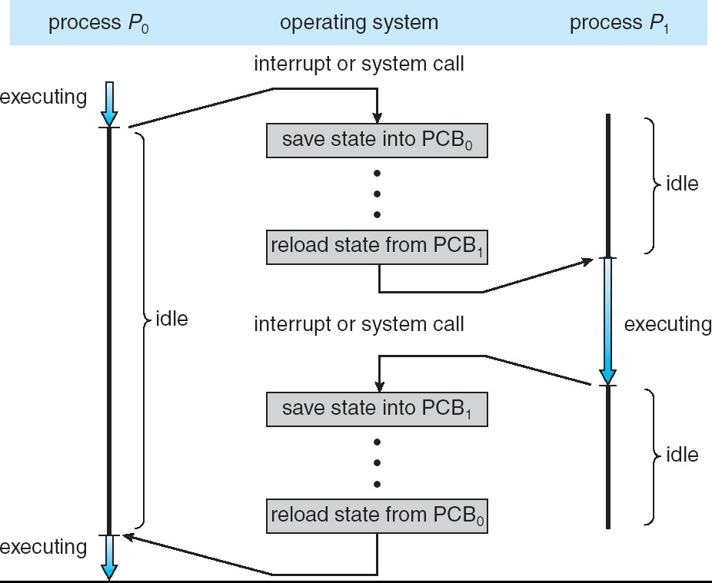
Processor switching (context switching)
It is possible that much time passes before returning to Process 0, and that many other processes execute during this time
16
Notes:
A computer processor is described as idle when it is not being used by any program. Every program or task that runs on a computer system occupies a certain amount of processing time on the CPU. If the CPU has completed all tasks it is idle. Modern processors use idle time to save power.
Process P zero was executing at some point, then it gets interrupted. To save the state into PCB zero we reload the state from PCB one after it. Process one was idle up until we finished loading the state from PCB one so P one now can start executing while P zero is idle. If we need to switch back from the one back to zero, we need to do the same thing, as in we need to save the state into PCB one, we need to reload the state from PCB zero, and then we start executing P zero while P one becomes idle again.
What if PCB1 was completed and it wasn’t interrupted → it would follow the same steps, where PCB0 is reloaded anyways

Slide 17
The PCB is not the only information to save ... (the textbook is not clear here)
It is also necessary to save the state of the program data (Slide 14)
This is normally done by keeping the 'program image in primary or secondary memory
The PCB will point to this image
17
Notes:
Program data is not the same as program text (or code or image)

Slide 18
Process and terminology
(also called job, task, user program)
Process concept: a program in execution
Has memory resources, peripherals, etc.
Process scheduling
Process operations
Example of process creation and termination
Cooperating processes (communication between processes)
18

Slide 19
Scheduling of processes
What's this?
Selecting the next process to run on the CPU
Why?
Multiprogramming - to achieve good system use
Time sharing - To allow a good response time
How? 'Or' What?
In detail in Module 4 (Chapter 5 of the text)
Now introduce the fundamentals of scheduling
Already introduced first: process switching
19
Notes:
The scheduler is a program and part of the OS
Multiprogramming: Maximise the usage of the resources, such as CPU and memory
Time-sharing allows all processes to be operated on by the CPU, and for practicality, and this is where the swapping mechanism comes in

Slide 20
Waiting Queues IMPORTANT
Computer resources are often limited compared to the processes that require them.
Each resource has its own queue of pending processes
By changing state, processes move from one queue to another
Ready Queue: processes in ready state = ready (for CPU)
Waiting queue: Queues associated with each I / O unit (Not for CPU)
etc.
20
Notes:
Waiting queues are required because resources are limited, and several processes are in “ready queue” to be executed.
CPU is a resource, each peripheral is also a resource (ie. disk, magnetic tape)
When they are in the waiting states, those processes are placed in the waiting queue associated with that I/O or event request, for example the disk
Every resource has its own queue associated with it, not every state has one.
Interrupted processes have to go to the back of the queue before resuming.
OS itself would be running as the kernel processes keeps on running for OS task. Thus, if the ready queue isn't empty, then obviously the processes are still in the ready state and to be executed, so the running queue also can't be empty.
Resources contain or have queues associated with them and those queues have processes in one of these states

Slide 21
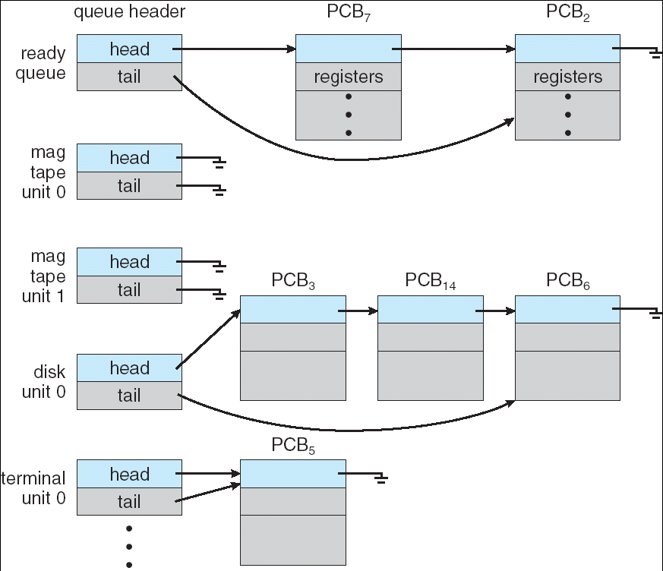
Ready Queue And Various I/O Device Queues
21
Notes:
The CPU scheduler goes around the ready queue, allocating the CPU to each process for a time interval of up to 1-time quantum. To implement Round Robin scheduling, we keep the ready queue as a FIFO queue of processes. A ready queue or run queue is used in computer scheduling. Modern computers are capable of running many different programs or processes at the same time. However, the CPU is only capable of handling one process at a time. Processes that are ready for the CPU are kept in a queue for "ready" processes.

Slide 22
ready → 7 →  2 magtape0 →
magtape1 →
disk0 → 3 → 14 → 6
term0 → 5
22
Notes:
The queues associated to the resources on the LHS of arrow pointing to the next process to be executed, and that pointing to the next process (if any). If no process number on the RHS, then no processes are waiting in that queue.

Slide 23
PCBs are not moved in memory to be put in the different queues:
it's the pointers that change.
term. unit 0
ready
. . .
PCB2 | PCB3 | PCB4 | PCB5 | PCB6 | PCB7
. . .
PCB14
disk unit 0
23

Slide 24
Schedulers
Programs that manage the use of computer resources
Three types of schedulers:
Short term (most important) = process scheduler: select which process should execute the transition ready → execution
Long term = job scheduler: select which processes can execute the transition new → ready (event admitted) (from spool jobs to ready queue) (for batch processing system, batch)
medium term: we will see (timesharing systems)
24
Notes:
In older systems (batch-processing systems), submit job (processes) as New processes, and then get admitted into Ready
The Medium scheduler selects which of the processes to go into the Ready queue of the RAM from the disk compartment
Long Term Scheduler
Long term scheduler is also known as a job scheduler. This scheduler regulates the program and select process from the queue and loads them into memory for execution. It also regulates the degree of multi-programing.
However, the main goal of this type of scheduler is to offer a balanced mix of jobs, like Processor, I/O jobs., that allows managing multiprogramming.
Medium Term Scheduler
Medium-term scheduling is an important part of swapping. It enables you to handle the swapped out-processes. In this scheduler, a running process can become suspended, which makes an I/O request.
A running process can become suspended if it makes an I/O request. A suspended process cannot make any progress towards completion. In order to remove the process from memory and make space for other processes, the suspended process should be moved to secondary storage.
Short Term Scheduler
Short term scheduling is also known as CPU scheduler. The main goal of this scheduler is to boost the system performance according to set criteria. This helps you to select from a group of processes that are ready to execute and allocates CPU to one of them. The dispatcher gives control of the CPU to the process selected by the short term scheduler.

Slide 25
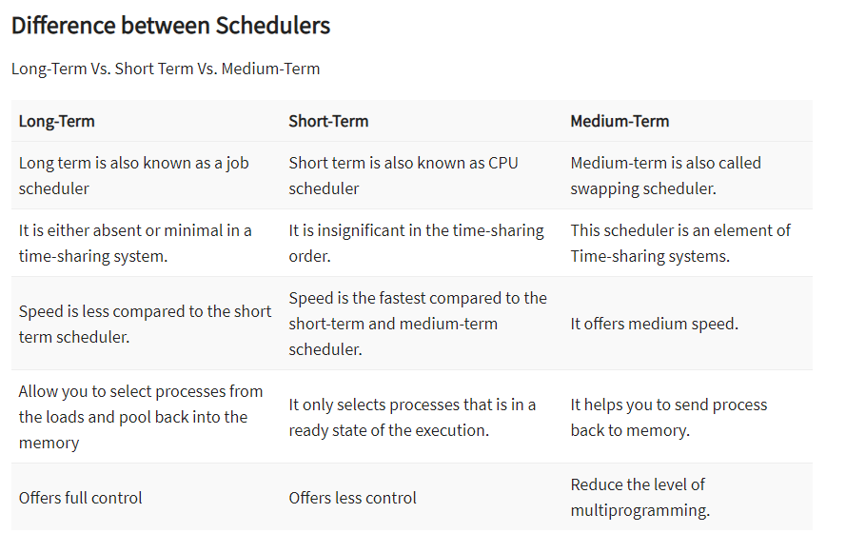
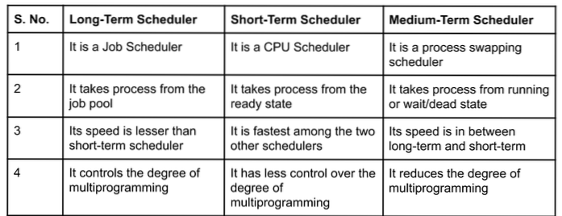
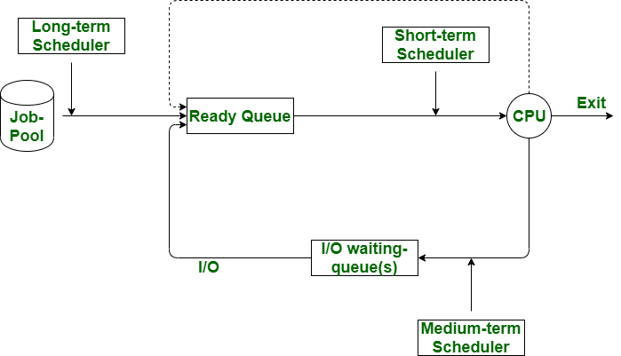

Slide 26
Schedulers
Long-term scheduler (or job scheduler)
selects which new processes should be brought into the memory; new → ready (and into the ready queue from a job spool queue) (used in batch systems)
Short-term scheduler (or CPU scheduler)
selects which ready process should be executed
next; ready → running
Which of these schedulers must execute really fast, and which one can be slow? Why?
Short-term scheduler is invoked very frequently (milliseconds) ⇒ (must be fast)
Long-term scheduler is invoked very infrequently
(seconds) ⇒ (may be slow)
Notes:
Medium scheduler is only applied when the processes are transferred to the disks

Slide 27
Schedulers (Cont.)
Processes differ in their resource utilization:
I/O-bound process – spends more time doing I/O (writing/reading from disk) than computations (arithmetic, logical ops), many short CPU bursts
CPU-bound process – spends more time doing computations; few very long CPU bursts
The long-term scheduler controls the degree of multiprogramming
the goal is to efficiently use the computer resources
ideally, chooses a mix of I/O bound and CPU- bound processes
but difficult to know beforehand
Notes:
Consider having many processes that are I/O bound, and one CPU bound process. If this last process is not let in, while the others are the one being executed (since not needed with CPU), then the CPU becomes Idle, while the disk is very busy, which is not a good trait for multiprogramming (have all resources utilized).
It is better to have a mix of I/O bound and CPU bound processes rather than only one kind of one type (or a more dominant type)

Slide 28
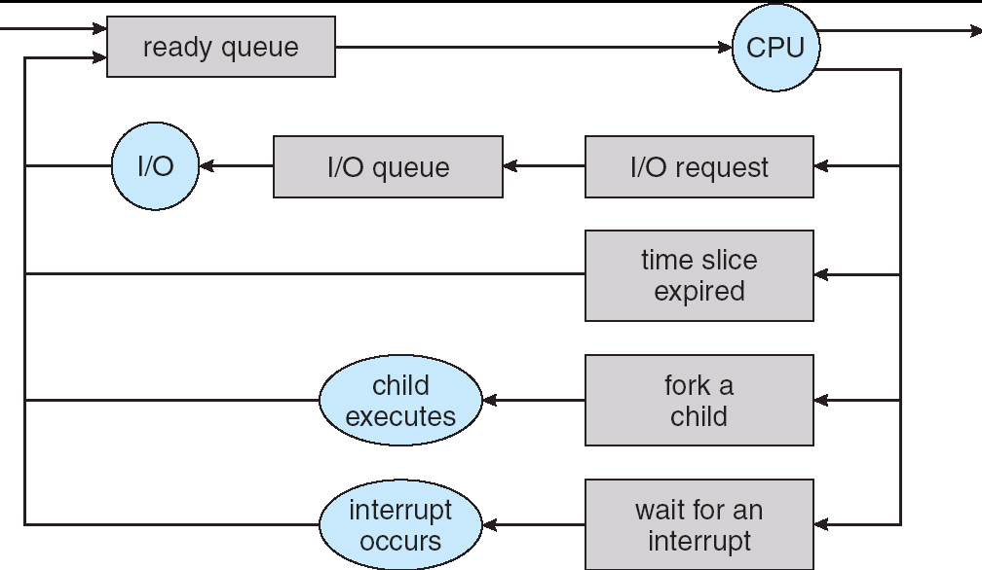
Process Scheduling (Short Term)

Slide 29
Medium-term scheduler
Lack of resources can sometimes force the OS to suspend processes
they will be more in competition with others for resources
they will be resumed later when the resources become available
These processes are removed from main memory and placed in secondary memory, to be resumed later.
`swap out`,` swap in`, back and forth
29

Slide 30
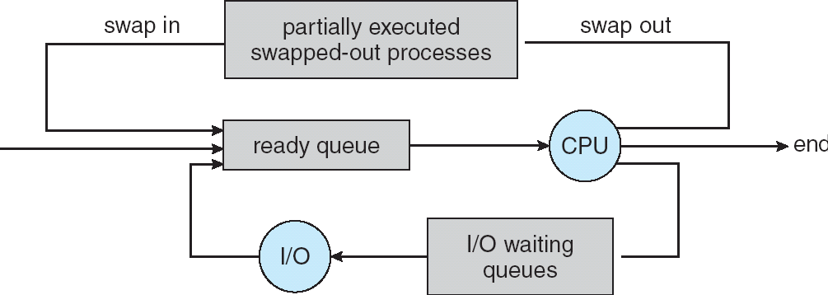
short and medium term Schedulers
short
Medium
short
30

Slide 31
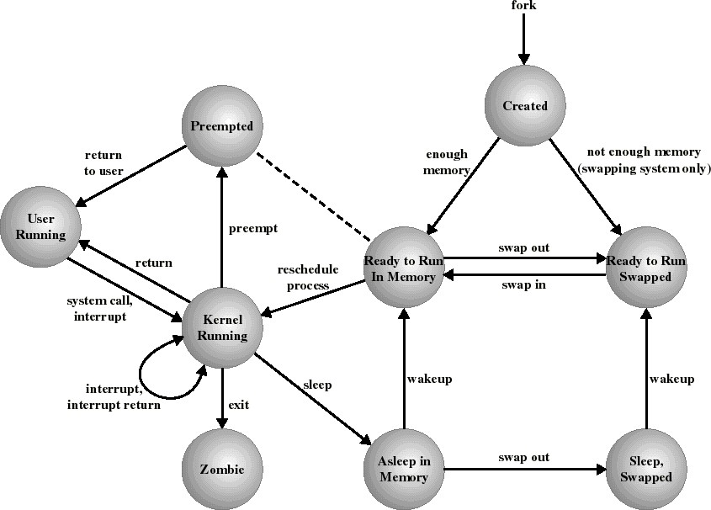
Process States in UNIX SVR4 (Stallings) An example of a state transition diagram for a real OS
Kernel, user mode = monitor, user mode
31

Slide 32
Context Switch
What?
Assigning the CPU from one process to another
How?
We have already seen that
Save the CPU state to the PCB of the current
process
Load the CPU with the information from the PCB of the new process
Set the program counter to the PC of the new
process
Additional work as well (accounting, …)
Comments:
Can be quite a lot of work - pure overhead, as no
process is executing at that time
Context switch time is dependent on hardware support (and OS smartness)
31
Notes:
Context Switch time is the time when the content of a process is saved into its PCB before the CPU is associated with another process and reloading the content of this new process from its PCB.
A Context switch (time) is a time spent between two processes (i.e., bringing a waiting process into execution and sending an executing process into a waiting for state). This happens in multitasking

Slide 33
Process and terminology
(also called job, task, user program)
Process concept: a program in execution
Has memory resources, peripherals, etc.
Process scheduling
Process operations
Example of process creation and termination
Cooperating processes (communication between processes)
32

Slide 34
Process Creation
So, where do all processes come from?
Parent process create children processes, which, in turn
create other processes, forming a tree of processes
Usually, several properties can be specified at child creation time:
How do the parent and child share resources? They can …
Share all resources
Share subset of parent’s resources
No sharing
Does the parent run concurrently with the child? They can …
Yes, execute concurrently
No, parent waits until the child terminates
Address space
Child duplicate of parent
Child has a program loaded into it
Notes:
P → P1 → P11, P12
→ P2 → P21, P22
→ P3
Image is the actual program that is “inherited” to the child from the parent
A process image is an image of a process taken when memory is allocated to it before execution. This happens because, when multitasking, the kernel needs to re-enter the process where it left off. If the process were to be changed in the middle of execution, bad things could happen so the operating system makes a read-only version of the process and uses that during execution.
So the process image is just a process's allocated space in virtual memory. Therefore, both the process and process image can contain exactly the same components (program code, program data, stack, PCB). The only difference is that the process image is read only (in other words, not editable) whereas the process can be changed at any point. It is read only because during multi-tasking, the kernel needs to exit and re-enter the instructions in the process when it is its turn to access the CPU. If the process is changed while another process is running, when the scheduler comes back to the process in question, it will crash because the process is now different.

Slide 35
Process Creation (Cont.)
UNIX example:
fork() system call creates new process with the duplicate address space of the parent
no shared memory (or image), but a copy
copy-on-write used to avoid excessive cost
returns child’s pid to the parent, returns 0 to the new child process
the parent may call wait() to wait until the child terminates
exec(…) system call used after a fork() to replace the process’ memory space with a new program
Notes:
When a process P creates the child process C, the child process will not share the image with P. The image of C will initially be a copy of P, hence it is created for C. Same image and same code of P is duplicated for C.
So, instruction P_id = fork() is in both P and C. The P_id of P will contain the process ID of the child, while in C, P_id of C is 0
The parent process can run concurrently with the child process, or wait for the child process to terminate, and then run.
The child process can have its own image instead, and to do that, it has to use the exec() system call to replace the image of the child with another program (image)

Slide 36
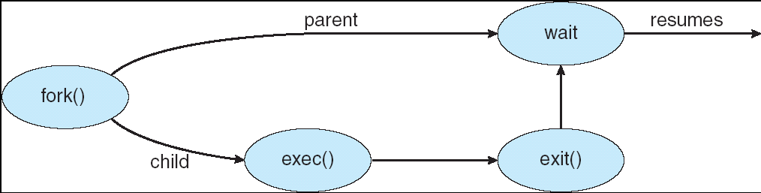
UNIX: fork(), exec(), exit() & wait()
Notes:
Fork() creates a new child process and both the parent and child being execution of the code after the fork() line
reminder that the child is a copy of the parent and the code is the same but has a different location in memory
the child continues after the fork statement, just like the parent
same image means same source code and same values in the variables
The order of execution for the processes are not controlled by you, it is controlled by the scheduler. Thus, it is possible that the child process is printed on the screen before the parent process

Slide 37
C Program Forking Separate Process
#include <stdio.h> #include <unistd.h>
int main(int argc, char *argv[]) { int pid;
pid = fork(); if (pid < 0) {
/* fork another process */
/* error occurred */
 |  | fprintf(stderr, "Fork Failed");
 |  | exit(-1);
} | else | if (pid == 0) { /* child process */
 |  | execlp("/bin/ls","ls", NULL);
} | else | { /* parent process, will wait for the
child to complete */ wait(NULL);
printf("Child Complete"); exit(0);
}
36
}
Notes:
Stdio → standard input/output → package for primary operations (read, write)
Unistd → unix standard
pid = fork(); → create the process for child c, where c contains int pid (duplicated process from parent)
fork() → creates a new process, and duplicates the image
if pid is negative, then an error occurred where the fork was not successful (due to not enough memory space, or it was interrupted), otherwise, the fork has worked
If fork worked, then pid is either 0 or > 0
If pid == 0, then we are working with the child process
Otherwise, parent process in action
pid of the child is 21 (for example). the value of the VARIABLE pid in the child is 0. The actual pid is a value, because that is was the CPU uses to id the processes. BUT the variable pid is 0 after it is created by the parent.
the only difference between P and C at the beginning of the fork process is the value of pid. P gets the pid of the C created, C gets 0 because fork didn't actually run in it but a value had to be given to the pid variable
the fork() function returns the 0 value just so a parent and child can be differentiated

Slide 38
Fork example
int pid, a = 2, b = 4;
pid = fork(); /* fork another process */ if (pid < 0) exit(-1); /* fork failed */ else if (pid == 0) { /* child process */
a = 3; printf(“%d\n”, a+b);
} else {
wait();
b = 1;
printf(“%d\n”, a+b); exit(0);
}
What would be the output printed?
7
3
Notes:
format output:
%d int (signed decimal integer)
%u unsigned decimal integer
%f floating point values (fixed notation) - float, double
%e floating point values (exponential notation)
%s string
%c character
It is used when you are trying to print a variable, its how you add it into the string so it prints a message
Notice the wait() → this means the parent process must wait until the child process completes its commands, and then it will execute (hence 7 will always appear before 3)

Slide 39
Fork example
int pid, a = 2, b=4;
pid = fork(); /* fork another process */ if (pid < 0) exit(-1); /* fork failed */ else if (pid == 0) { /* child process */
a = 3; printf(“%d\n”, a+b);
} else {
b = 1;
wait();
printf(“%d\n”, a+b);
}
What would be the output printed?
7
3
Notes:
No difference in writing wait() after assigning b to 1, because the parent must wait still until the child process completes its commands

Slide 40
Fork example
int pid, a = 2, b=4;
pid = fork();
*/
if (pid < 0)
/* fork another process
exit(-1); /* fork failed */
else if (pid == 0) { /* child process */
a = 3; printf(“%d\n”, a+b);
} else {
b = 1;
printf(“%d\n”, a+b);
wait();
}
What would be the output printed?
7 | or | 3
3 |  | 7
Notes:
This time, it depends on the scheduler, thus both output styles are possible, as if the processes are fighting for which process reaches a = 3 first
For the case when 3 is printed first, and then wait() is reached, since no child process is happening, then it will return and exit the program
Wait(NULL) means the parent must wait for any child to complete their process

Slide 41
Understanding fork()
Before fork After fork
After child executes a=3
Parent process
page table
Parent process page table
Parent process
page table
*
*
*
a: 2
b: 4
a: 2
b: 4
a: 2
b: 4
*
*
*
*
Child process
page table
Child process
page table
*
*
*
*
a: 3
b: 4
*
*
*

Slide 42
Process Creation (Cont.)
Windows:
CreateProcess(…)
Similar to fork() immediately followed by exec()
Discussion
fork() very convenient for passing data/parameters from the parent to the child
all code can be conveniently at one place
direct process creation more efficient when you really just want to launch a new program

Slide 43
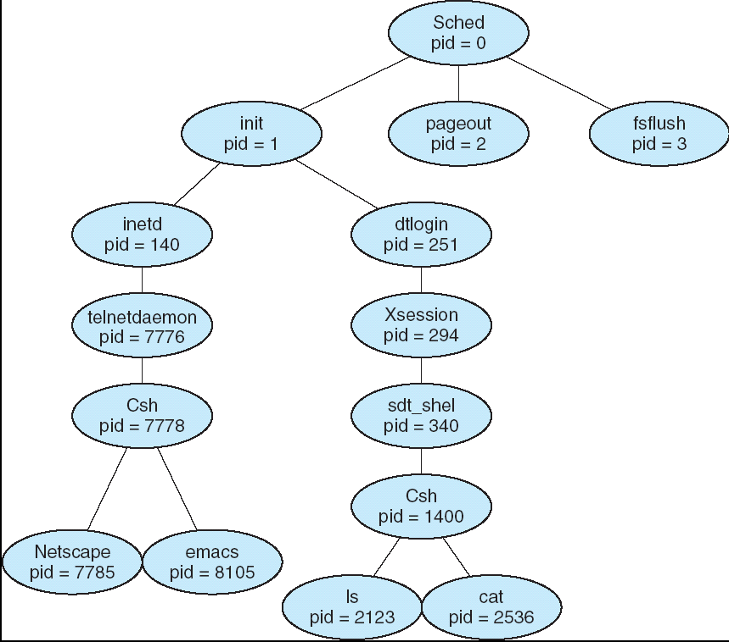
Example of a process tree (Solaris)
42

Slide 44
Process Termination
How do processes terminate?
Process executes last statement and asks the operating system to delete it (by making exit() system call)
Abnormal termination
Division by zero, memory access violation, …
Another process asks the OS to terminate it
Usually only a parent might terminate its children
To prevent user’s terminating each other’s processes
Windows: TerminateProcess(…)
UNIX: kill(processID, signal)

Slide 45
Process Termination
What should the OS do?
Release resources held by the process
When a process has terminated, but not all of its resources has been released, it is in state terminated (zombie) → can create memory leaks
Process’ exit state might be sent to its parent
The parent indicates interest by executing wait()
system call
What to do when a process having children is exiting?
Some OSs (VMS) do not allow children to continue
All children terminated - cascading termination
Other find a parent process for the orphan processes

Slide 46
Time for questions
Process states
Can a process move from waiting state to running
state? No, from waiting must first ready then running
From ready state to waiting state? no, only running to waiting
PCB
Does PCB contain program’s active (running) time? No
How is the PCB used in context switches?
CPU scheduling
What is the difference between long term and medium term scheduler?
A process (in Unix) has executed wait() system call. In which queue it is located?
What happens if there is no process in the ready
queue? CPU goes into IDLE
45
Notes:
When the CPU changes from a process to another, the information/progress of the current process must be saved into its PCB, before changing to the other process. Before running this other process, the CPU must take the data/information from this new PCB and the start executing

Slide 47
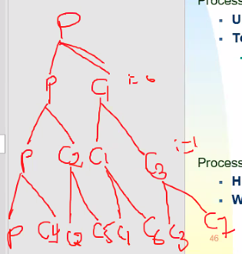
Other questions!
Process creation
Understand fork(), exec(), wait()
Test if you really understand them
So, how many processes are created in this code fragment?
for(i=0; i<3; i++) fork();
8 processes exist the end (including the very first parent process)
Process termination
How/when.
What should the OS do?
46

Slide 48
Process and terminology
(also called job, task, user program)
Process concept: a program in execution
Has memory resources, peripherals, etc.
Process scheduling
Process operations
Example of process creation and termination
Cooperating processes (communication between processes)
47

Slide 49
Cooperating Processes
Independent processes cannot affect or be affected by the
execution of other processes
Cooperating processes can affect or be affected by the execution of other processes
Advantages of process cooperation
Information sharing
Computation speed-up (parallel processing)
Modularity
Nature of the problem may request it
Convenience
So, we really want Inter-Process Communication (IPC)
Notes:
Affect means no process can change the data of another process, no sharing of messages nor data

Slide 50
Interprocess Communication (IPC)
Mechanisms for processes to communicate and to synchronize their actions
So, how can processes communicate?
Fundamental models of IPC
Through shared memory
Using message passing
Examples of IPC mechanisms
signals
pipes & sockets
semaphores …

Slide 51
Shared Memory
By default, address spaces of processes are disjoint
To protect from unwanted interference
The OS has to allow one process to access (a precisely specified) part of the address space of another process
One process makes a system call to create a shared
memory region
Other process makes system call to map this shared memory region into its address space
Special precaution is needed in accessing the data in the shared memory, it is way too easy to get into inconsistent state
We will talk about this extensively in Chapter 6

Slide 52
Message Passing
Two basic operations:
send(destination (process), message)
receive(source (process), message)
If processes wish to communicate, they need to establish a
communication link between them
figure out what destination and source to use
There are many variants of how send() and receive()
behave
Direct or indirect communication
Synchronous or asynchronous communication
Automatic or explicit buffering

Slide 53
Direct Communication
Processes must name each other explicitly (send/receive a specific message):
send (P, message) – send a message to process P
receive(Q, message) – receive a message from process Q
Properties of the communication link
Links are established automatically, exactly one link for each pair of communicating processes
The link may be unidirectional (one process sends), but is usually bi-directional (both processes send) but one at a time

Slide 54
Indirect Communication
Messages are sent and received to/from mailboxes (also referred to as ports)
Each mailbox has unique id
Processes can communicate only if they share a mailbox
Basic primitives:
send(A, message) – send a message to mailbox A receive(A, message) – receive a message from mailbox A
Operations
create a new mailbox
send and receive messages through mailbox
destroy a mailbox
Notes:
Consider processes P and Q, where P wants to communicate with Q.
P can send a message to be stored in the mailbox, and then Q can receive it
The process first has to create the mailbox and then it can start actually inserting messages and then the other process can actually read those messages there.

Slide 55
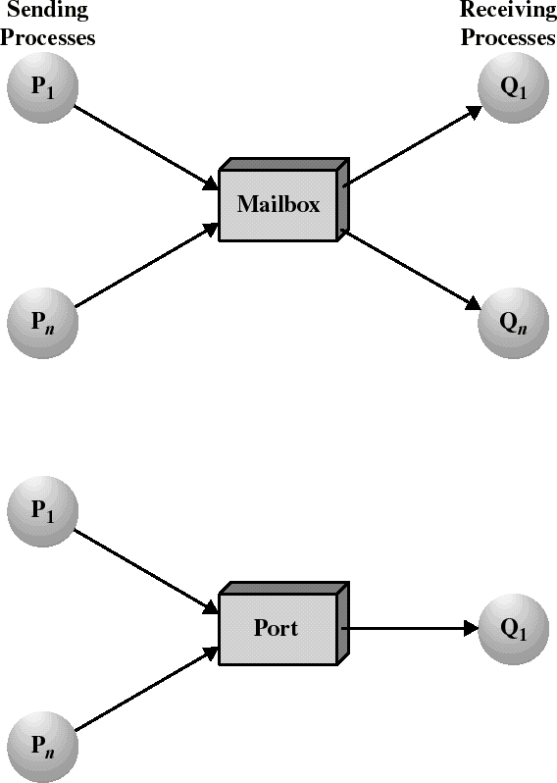
Indirect Communication
Notes:
P → : this means process sending message
→ P : this means process is receiving the message

Slide 56
Indirect Communication
Mailbox sharing
P₁, P₂, and P₃ share mailbox A
P₁, sends; P₂ and P₃ receive
Who gets the message?
Solutions
Allow a link to be associated with at most two processes
Allow only one process at a time to execute a receive
operation
Allow the system to select arbitrarily the receiver. Sender is notified who the receiver was.

Slide 57
Blocking Message Passing
Also called synchronous message passing (like pipes)
sender waits until the receiver receives the message
receiver waits until the sender sends the message
advantages:
inherently synchronizes the sender with the receiver
single copying sufficient
disadvantages:
possible deadlock problem
Notes:
Synchronous means processes need to wait until the other has sent or received the message
Deadlock means that consider when 2 mailboxes are shared between 2 processes, where process P has sent to mailbox A a message, waiting on process Q to receive, while at the same time, Q has sent a message to mailbox B, waiting on Process P to receive/read that message. P and Q are waiting for each other in order to continue their execution, but they cannot -> deadlock

Slide 58
Synchronous Message Passing
send() before corresponding receive()
request
send()
sender suspended
back data
recv()
receive() before corresponding send()
recv()
receiver suspended
send()

Slide 59
Non-Blocking Message Passing
Also called asynchronous message passing
Non-blocking send: the sender continues before the delivery of the message (the sender will not wait for the receiver, and the process does not get blocked)
Non-blocking receive: check whether there is a message available, return immediately (even if empty, Q receives the message from the mailbox, not waiting until non-empty)

Slide 60
Buffering
With blocking direct communication, no buffering is needed – the message stays in the sender’s buffer until it is copied into the receiver’s buffer
With non-blocking communication, the sender might reuse the buffer,
therefore the message is copied to a system buffer,
and from there to the receiver’s buffer
If the system buffer becomes full, the sender would still be suspended
Notes:
if the buffer is full, we should block the access of process P to send the message, since it is still a blocking

Slide 61
Examples of IPC Mechanisms
Pipes
Sockets
Remote Procedure Calls
Remote Method Invocation (Java)
Higher-level concepts
Implemented either using shared memory (between processes on the same computer) or message passing (between different computers)

Slide 62
Pipes – a few facts
Each UNIX/Linux process is created with 3 open files:
0: standard input
1: standard output
2: standard error
Often attached to a terminal
Synchronous message passing
Can redirect to a file
command > file
Process
0 1 2
. . .
Kernel
Notes:
Pipe: When two processes are communicating through a shared memory
Every pipe has 2 ends: 0 and 1
Pipe will read the process from end 0 and write to the pipe from end 1
When opening a file, the file handler of Windows creates a descriptor table, and the open command assigns a number to point to that file from the descriptor table
Every process that gets created has a descriptor table created with it, lines of file descriptors
Used for in order to define the characteristics of the various memory areas used during program execution, including the base address, the size, and access privileges like executability and writability.
Keyboard: standard input
Monitor: standard output and error
The next numbers in the descriptor table, the smallest ones are assigned to the open files that the programs open

Slide 63
Pipes - communication
What is it?
A unidirectional
channel
One write end (1)
One read end (0)
Process
Process
0
1
2
. . .
0
1
2
. . .
Kernel
Why?
The UNIX/Linux pipes allows linking of processes to obtain complex functions from simple commands
who | sort
Notes:
When two processes want to communicate, and there is a pipe between them, the pipe is created by one of the processes:
After P creates the pipe,
P will read from 0, and write to 1, whereas Q also reads from the same pipe from descriptor 0 and writes to descriptor 1
Who → who will create the pipe
| → the pipe symbol
Sort → the other process receiving the message from Who
grep → from the output of the left side, find the keyword “” and filter to the right side

Slide 64
Pipes – how?
System call: pipe(int fd[2])
Create a pipe with two file descriptors:
fd[0] – reference/point to the read end
fd[1] – reference/point to the write end.
Process 0 1 2 3 4 . . .
Kernel
Process 0 1 2 3 4 . . .
Kernel
/* Array for storing 2 file descriptors */
int fd[2];
/* creation of a pipe */ int ret = pipe(fd);
if (ret == -1) { /* error */ perror("pipe");
exit(1);
}
(before)
(after)
pipe
Notes:
File descriptor <-> fd

Slide 65
Unix Pipes
So, what did we get?
fd[0] is a file descriptor for the read end of the pipe
read(pipes[0], dataBuf, count) would read count bytes from the pipe into the dataBuf character array
fd[1] is a file descriptor for the write end of the pipe
write(pipes[1], dataBuf, count) would write count bytes from
the dataBuf character array into the pipe
Nice, but we want to communicate between different processes, and pipe() gives both endpoints to the process calling pipe()
Too bad, we are allowed to talk only with ourselves :-(
Wait! Can we talk at least within the family?
Notes:
When the ends are closed, remember that when forked, only one processes is affected, not the child ones

Slide 66
Unix Pipes
Note:
When parent calls fork(), the child gets the parent’s open file descriptors.
That includes the pipe endpoints!
If the child calls exec() to run another program, the new open files are preserved.
So, how do we make the parent talk to its child:
The parent creates pipe
Calls fork() to create child
The parent closes the read end of the pipe and writes
to the write end
The child closes the write end of the pipe and reads from the read end
Can we have the communication in the opposite way?
6▪5

Slide 67
Unix Pipes
int fd[2], pid, ret; ret = pipe(fd);
if (ret == -1) return PIPE_FAILED; pid = fork();
if (pid == -1) return FORK_FAILED; if (pid == 0) { /* child */
close(fd[1]);
while(…) {
read(fd[0], …);
…
}
} else { /* parent */ close(fd[0]); while(…) {
write(fd[1], …);
…
}
}

Slide 68
After Spawning New Child Process
Parent Process Child Process 0 1 2 3 4 . . . 0 1 2 3 4 . . .
Kernel
 |  |  |  | pipe

Slide 69
After Closing Unused Ends of Pipe
Parent Process Child Process 0 1 2 3 4 . . . 0 1 2 3 4 . . .
Kernel
 |  |  |  | pipe

Slide 70
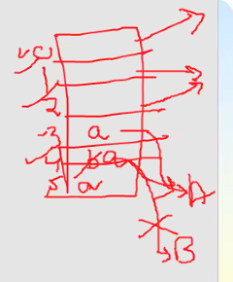
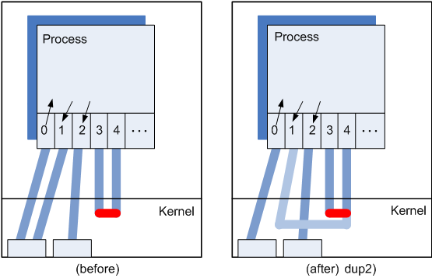

Pipes – attaching to 0 and 1
System call: dup2(fdSrc,fdDst)
Creates a copy of fdSrc to fdDst
If fdDst is open, it is first closed
To attach a pipe to the standard output, dup2(fd[1],1)
Note
fd 4 still refers to the pipe
It is possible to have multiple references to the ends of the pipe, including from other processes
Notes:
dup → duplicate
fd2 = dup(fd1) → duplicate the content of the file descriptor source into the minimum descriptor line
Duplicating the content for the descriptor line into another descriptor line
dup2 creates a copy of descriptor (source) to description (destination)

Slide 71
Unix Pipes
Nice, nice, but we would like 2-way communication
2 pipes can be used
Gotcha’s:
Each pipe is implemented using a fixed-size system buffer
If the buffer becomes full, the writer is blocked until the reader
reads enough
If the buffer is empty, the reader is blocked until the data is written
What happens if both processes start by reading from pipes?
Deadlock, of course!
Similar with writing when the pipe becomes full
When working with several pipes, one has to be extra careful to avoid deadlock

Slide 72
Unix Named Pipes
But we can still communicate only between related processes.
Solution: Named pipes
Creating a named pipe (using mkfifo() system call) creates the corresponding file in the pipe file system
Opening that file for reading returns a file descriptor to the read end of the pipe
Opening that file for writing returns the write end of the pipe
Notes:
A physical file on disk is created by mkfifo(), in which a name can be given to this pipe

Slide 73
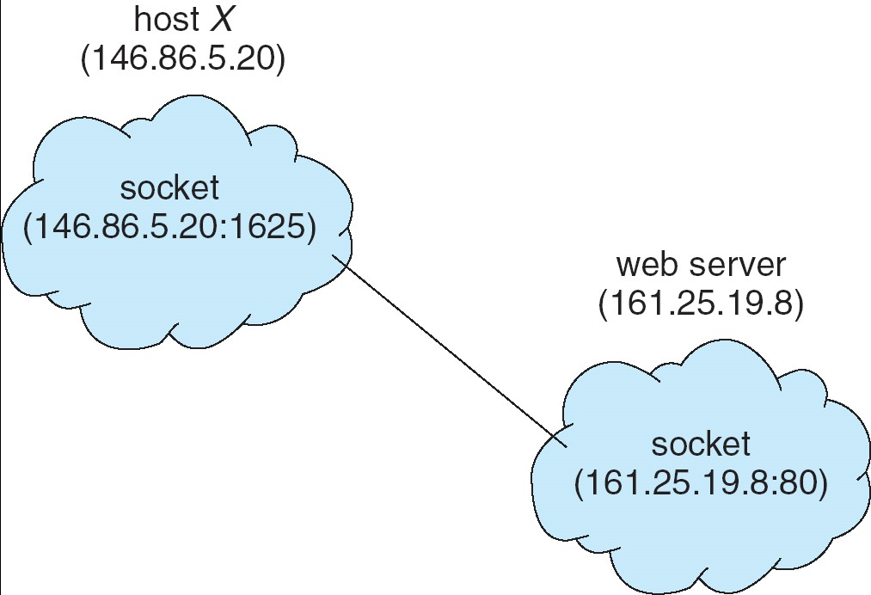
Sockets
A socket is defined as an endpoint for
communication
Concatenation of IP address and port
The socket 161.25.19.8:1625 refers to port 1625 on host 161.25.19.8
Communication link corresponds to a pair of sockets
Notes:
Socket is like port, the endpoints for communication between two hosts. Processes on these different hosts communicate through these sockets. Specifying the IP address of the hosts allows for the ports or sockets to recognize each other and communicate

Slide 74
Remote Procedure Calls - RPC
Is it possible to make calls to other computers?
Must therefore exchange parameters and return values (possibly multiple data) between computers
Problem - different computers often have different
formats for data representation
Solution - external representation of data
Support to find the desired server and procedure
Replacement Element (Stub): hides communication details between client and server
At the client, the "stub":
Discover the server
Convert parameters (marchalling)
At the server, the "stub":
Receive the message and extract the converted parameters
Execute the procedure on the server
Uses ports to identify servers that can answer various calls - example - file system (NFS from SUN)
73
Notes:
Example of Client-Server communication where Client issues a remote procedure call to the server for the server to do something.
At the beginning, the server is simulated with a stub, which is like calling a server (or calling a function), putting all the logic in the stub as if the server is being communicated with. Parameters can be passed as well (called marchalling)
Client can send a message to the server with parameters, the server will receive the message, and then perform with those parameters

Slide 75
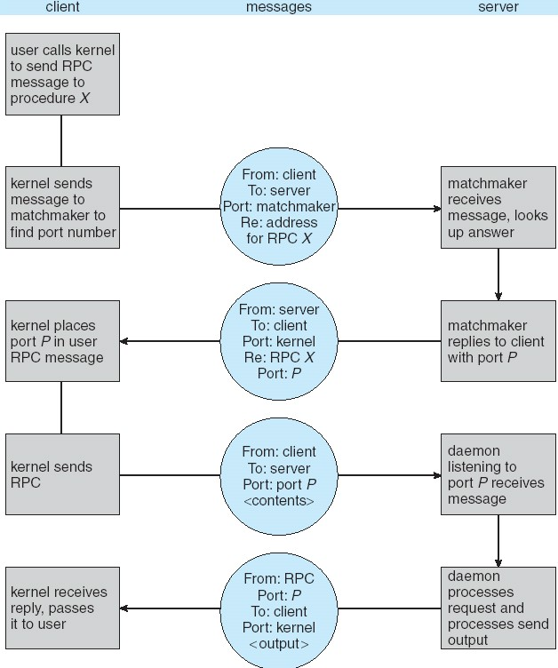
Execution of RPC
Notes:
Another example of RPC is that consider being on host A and want to execute a command on host B. From host A, you can execute a command that is associating the IP address of host B, in a particular directory. Server A is issuing the command locally, where the command is sent to server B, and will be executed on server B, which then the result will be sent back to server A and be displayed on server A

Slide 76
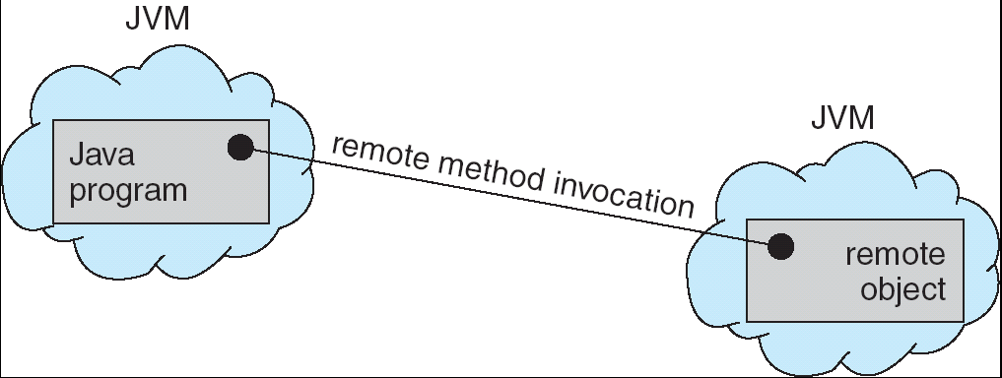
Remote Method Invocation
Remote Method Invocation (RMI) is a Java mechanism similar to RPCs.
RMI allows a Java program on one machine to invoke a method on a remote object.

Slide 77
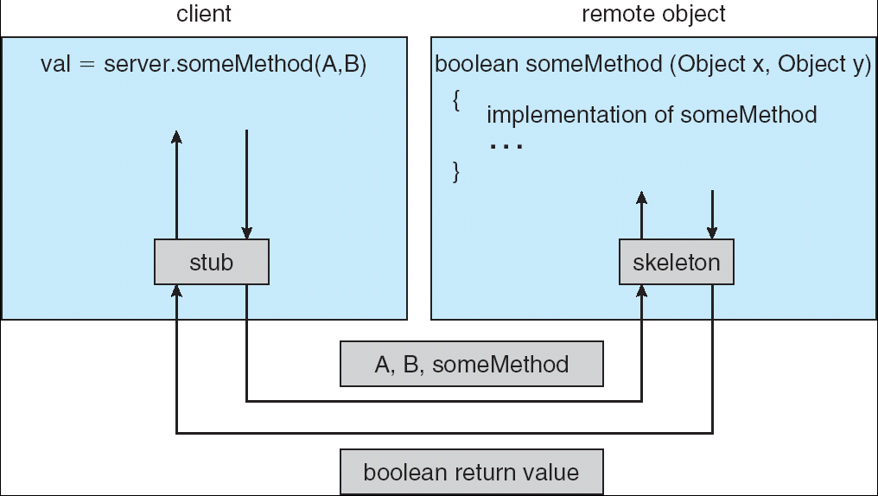
Parameter conversion
Local parameters: copy with "object serialization" technique
Remote parameters: use reference
77
Notes:
Client calls a method from the server with parameters A and B through the stub, which is then sent to the server, and that method on the server will be executed.

Slide 78
Important concepts of Module 2
Process
Creation, termination, hierarchy
States and process state transitions
Process Control Block PCB
Process switching
PCB saving, reloading
Process queues and PCBs
Short, medium and long term schedulers
Communicating processes
IPC communication
Pipes, Sockets, RPC, RMI
78

