Slide 1
Module 3 - Threads
Reading: Chapter 4 (Silberschatz)
Goal:
Understanding the concept of threads and its relationship to the process
Understand how the operating systems manage and use the threads.
1

Slide 2
Topics
The execution thread in the processes
Multi-thread versus single thread (the thread)
User level threads and kernel level threads
The challenges of "Threading"
Examples of threads
2

Slide 3
Characteristics of processes
Resource ownership unit - a process has:
an addressable virtual space containing the process image
other resources (files, I / O units ...)
Execution unit (dispatching) - a process is executed along a path among several programs
execution nested among the execution of several processes
the process has an execution state and a priority for scheduling
The instruction counter pointing to the next instruction
Comprises the scheduling unit
Several threads create several execution units, but share the same resource ownership unit
3
Notes:
Consider the amount of tabs open in a Google Chrome window, those can be considered threads, where they are not loaded multiple times in memory. The idea of a thread is that a process is loaded only once, where this process will have several threads of execution. A process can be running multiple threads where each thread executes the same commands, but at different instructions. Each thread will have its own block (similar to a process control block, PCB) called TCB. The program counter data is something that needs to be stored into the PCB of the associated process, and as such, the threads will also have its own program counter, where TCBs would need to store that data for later

Slide 4
Process
Owns its memory, files, resources, etc.
Protected access to memory, files, resources of other processes
4
Notes:
Processes cannot access other processes' memory in principle. In practice the underlying operating system usually offers this mechanism to privileged processes.

Slide 5
Process characteristics
These 2 characteristics are perceived as independent by some OS
The execution unit is usually denoted by execution thread
The unit of resource ownership is usually referred to as process
5

Slide 6
Resource ownership unit
Process image
BCP
Identification Structures data
State of processor Ordonnan.
Memory user
Coded execution
Related to the following components of the process image
The part of the PCB which contains identification and resource structures
Memory containing the execution code
Memory containing global
data
Battery
Battery user
Battery
core
Data
global
6
Notes:
These resources can be shared between different threads, since they are all a part of the process

Slide 7
Execution unit
Process image
BCP
Identification Structures data
State of processor Ordonnan.
Memory user
Coded execution
Related to the following components of the process image
PCB
Processor state
Scheduling structure
Stack
Battery
Battery user
Battery
core
Data
global
7
Notes:
But each thread has its own execution unit, where each has its own PCB (scheduling information and processor state), thus a process has many execution units.
Contains the things that changed between threads, which means the scheduling information will also change. Same goes for the state transition of the thread and the registers

Slide 8
Topics
The execution thread in the processes
Multi-thread versus single thread (the thread)
User level threads and kernel level threads
The challenges of "Threading"
Examples of threads

Slide 9
Threads = lightweight processes
A thread is a subdivision of a process
A control thread in a process
The different threads of a process share addressable space and resources of a process
when a thread modifies a variable (not local), all other threads see the modification (since the data is shared)
a file opened by one thread is accessible to other threads (of the same process), since the files are shared among several threads
Notes:
Dividing a process to do different instructions at the same time or not
A thread can declare its own local variables
A thread is a unique execution of a process, so it does a certain sequence of instructions that other threads might not do. So it needs to remember what it did so if we switch between threads, we remember where we are. Just like a process, threads have an image and that image is loaded into the memory and it's being executed.

Slide 10
Example
The MS-Word process involves several threads:
Interacting with the keyboard
Arrangement of characters on the page
Regular backup of work done
Spell check
Etc.
These threads share all the same document
Notes:
Performing multiple different tasks at the same time, without having to load MS Word again in the memory

Slide 11
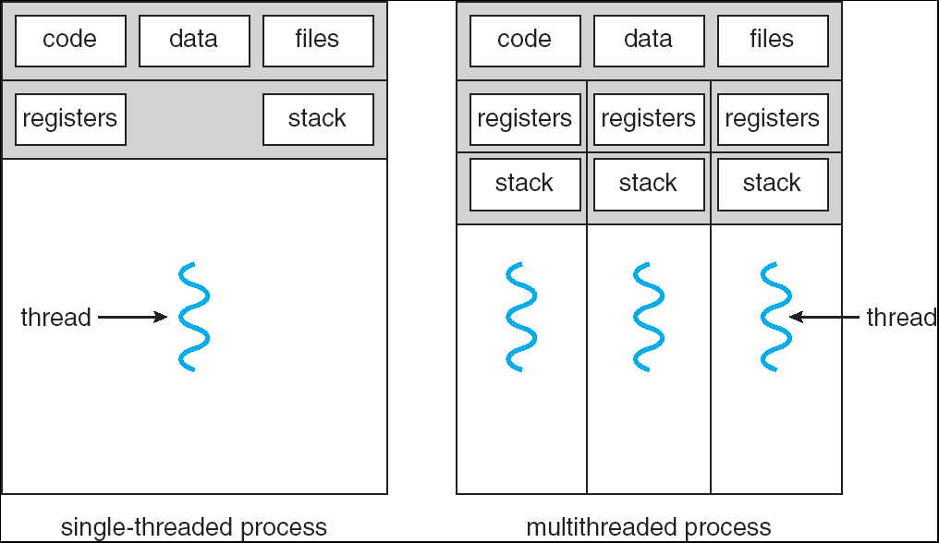
Single and multi-threaded processes
Notes:
Notice that between the two types, every process has its own process image/code, global data (resources and files), and then registers (instruction counters), and the stack. In a multithreaded process, the code, data and files are shared amongst each other, while each thread has its own register and stack.
To achieve multithreaded process, by creating a separate execution unit for every thread, and the execution unit contains the thread control block for every thread, which changes from thread to another, but the image and global data remains the same.

Slide 12
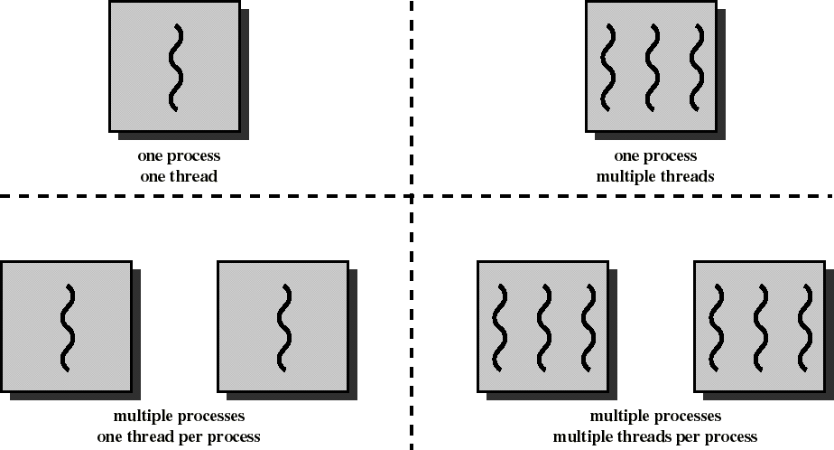
Threads and processes [Stallings]

Slide 13
Thread
Has an execution status (ready, blocked, etc.)
Has a scheduler
Has its stack and a private space for local variables
Has access to the addressable space, files and resources of the process to which it belongs
In common with the other threads of the same process
Notes:
process => all the instructions
Threads => a unique sequence of those instructions
Consider a java or C program, where the main thread is running the entire program, whereas there could be other threads running some of the methods within that program

Slide 14
Why threads
Responsiveness: a process can be subdivided into several threads, e.g. one dedicated to interacting with users, the other dedicated to processing data
One can run as long as the other is blocked
Use of multiprocessors: threads can run in parallel on different CPUs
Notes:
When working with a single processor, same as switching between processes, the threads would need to be switched among each other too. However, it is less expensive to switch between threads than to switch between processes.
When comparing processes and threads, we can also analyze the context switch cost. Whenever it is needed to switch between two processes, we must invalidate the TLB cache which can be a slow operation. When we switch between two threads, on the other hand, it is not needed to invalidate the TLB because all threads share the same address space, and thus have the same contents in the cache. Thus the cost of switching between threads is much smaller than the cost of switching between processes.
Threads in a same process share the memory and resource. Switching processes requires OS to process more information. But no need to exchange memory or data during thread creation and switching. If there is ULTs, switching does not require kernel to get involved.
TLB: Translation lookaside buffer
A translation lookaside buffer is a memory cache that stores the recent translations of virtual memory to physical memory. It is used to reduce the time taken to access a user memory location. It can be called an address-translation cache. It is a part of the chip's memory-management unit.

Slide 15
Switching between threads is less
expensive than switching between processes
A process has memory, files, other resources
Changing from one process to another involves saving and restoring the state of it all.
Switch from one thread to another in the same process is much simpler, involves saving CPU registers, stack, and little else
Notes:
Saving information for switching between threads is less than saving information for switching between processes.

Slide 16
Communication is also less expensive
between threads than between processes.
Since threads share their memory,
communication between threads in the same process is more efficient than communication between processes

Slide 17
Creation is less expensive
Creating and terminating new threads in an existing process is also less expensive than creating a process, due to executing different tasks and procedure within the same process.

Slide 18
Kernel and user threads
Where to implement the threads:
In user libraries
user-controlled
POSIX Pthreads, Java threads, Win32 threads
In the kernel of the OS:
kernel controlled
Windows XP / 2000, Solaris, Linux, True64 UNIX, Mac OS X
Mixed solutions
Solaris 2, Windows 2000 / NT
Notes:
Past programming languages did not provide a way to execute or create several threads, and did not have libraries to do that, unlike modern times. Now you can create threads without calling the OS. Just need to invoke the libraries provided by that programming language → user threads as they are implemented within user libraries (libraries provided/supplied by the language you are using to write the user programs)
Or threads can be created within or by the OS → kernel controlled

Slide 19
User and kernel threads (kernel)
user threads: supported by user libraries or programming language
efficient because operations on threads do not request system calls (invoke function provided by library)
disadvantage: the kernel is not able to distinguish between state of process and state of threads in the process (cannot supervise/see the threads, only the process that contains those threads)
blocking a thread implies blocking the process
kernel threads: directly supported by the OS kernel
(WIN NT, Solaris)
the kernel is able to directly manage the states of the threads
It can assign different threads to different CPUs
Notes:
Kernel thread should be blocked in general

Slide 20
Mixed solutions: user and kernel threads
Relationship between user threads and kernel threads
many to one
one by one
many to many (2 models)
We must take into consideration several levels:
Process
User thread
Kernel thread
Processor (CPU)

Slide 21
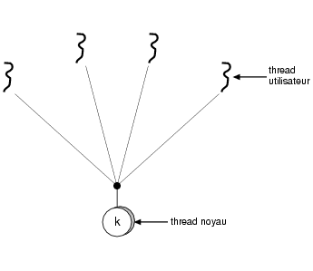
Multiple user threads for a kernel thread:
the user controls the threads (one to many)
OS does not know user threads, only the kernel thread
v. advantages and disadvantages mentioned before
Examples
Solaris Green Threads
GNU Portable Threads
Notes:
Scheduling in this case can only be controlled upon the kernel thread done by the OS, not the user ones.
If a user thread issues a blocking system call, the kernel thread which controls that user thread gets blocked, which in turn, all the threads (user) are blocked as well
when you have the one to many, the kernel thread will have shared resources that all the user threads will use. So if you block it, all its resources are also blocked. No one can do anything until its released

Slide 22
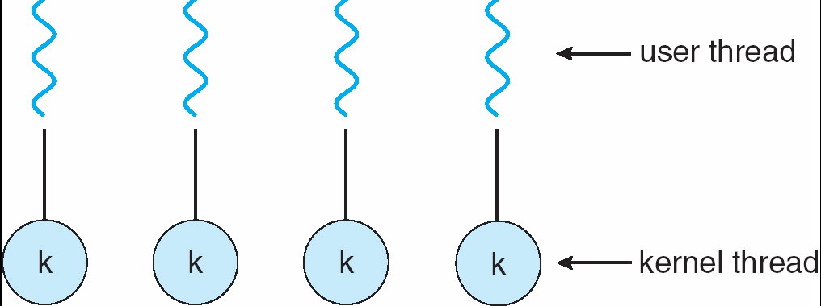
One to one: the OS controls the threads
Thread utilisateur
Thread noyau
Operations on threads are system calls
Allows another thread to run when a thread
executes a blocking system call
Win NT, XP, OS / 2
Linux, Solaris 9
Notes:
Every user thread has a kernel thread associated with it.
One advantage is that the user threads can be scheduled in the same way the processes are scheduled, and same goes for the threads (when scheduling the kernel threads, you are also scheduling the user threads). If a thread issues a system call, the other threads are not impacted and can continue to function. The OS can schedule another thread to run instead.
This cannot be done in one to many.

Slide 23
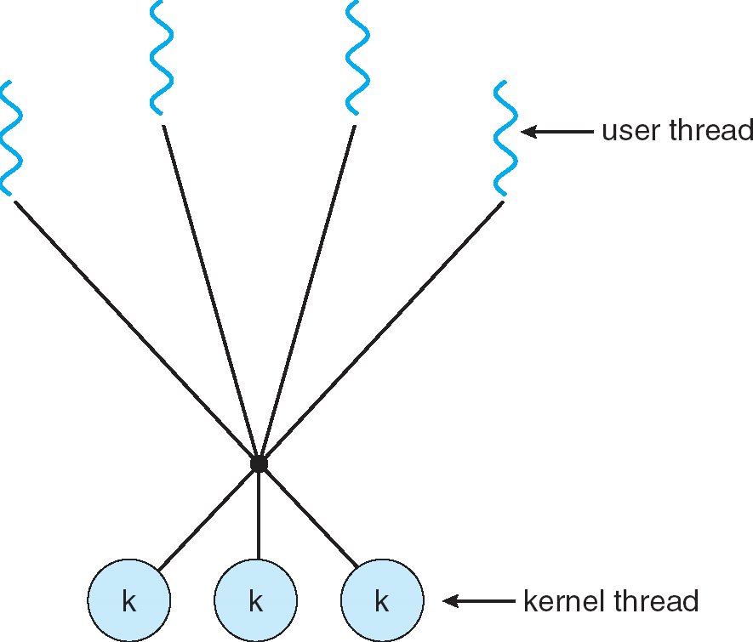
Many to many: mixed solution (M: M - many to many)
Uses both user threads and kernel threads
Flexibility for the user to use the technique he prefers
If a user thread blocks, its kernel thread can be assigned to another
If more. UCT are available, plus. kernel threads can run at the same time
Some versions of Unix, including Solaris before version 9
Windows NT / 2000 with the ThreadFiber package

Slide 24
Multithreads and monothreads
MS-DOS supports a single-threaded user process
UNIX SVR4 supports multiple single- threaded processes
Solaris, Widows NT, XP and OS2 support multiple multithreaded processes

Slide 25
Topics
The execution thread in the processes
Multi-thread versus single thread (the thread)
User level threads and kernel level threads
The challenges of "Threading"
Examples of threads

Slide 26
Threading challenges
How beautiful it is to have children, but what are the practical consequences?
Challenges:
Semantics of system calls fork () and exec()
Cancelling threads
A group of threads (pools)
Thread-specific data
Scheduling

Slide 27
Fork () and exec () semantics
Does fork () copy only the calling thread or all the threads?
Often two versions available (as in either copying only or all threads are possible)
What does exec() do?
It replaces the address space, so all threads are replaced
Notes:
Recall that fork() duplicates the image process into a child process.

Slide 28
Cancellation of thread
The termination of the thread before it is finished.
Two general approaches:
Asynchronous cancellation which ends the child immediately (not recommended)
May leave shared data in a bad state
Some resources are not released.
Deferred cancellation
Use a flag that the child checks to see if it should cancel its execution (if about to terminate, it tries to release and save all the resources/information of that thread)
Gives a smooth ending
Notes:
Thread cancellation allows a thread to terminate the execution of any other thread in the process. The target thread (the one being cancelled) can keep cancellation requests pending and can perform application-specific cleanup when it acts upon the cancellation notice.
The pthreads cancellation feature permits either asynchronous or deferred termination of a thread. Asynchronous cancellation can occur at any time; deferred cancellation can occur only at defined points. Deferred cancellation is the default type.
Regarding Asynchronous cancellation:
Incorrectly using threads that asynchronously cancel may result in silent corruption, resource leaks, and, in the worst case, unpredictable interactions.
The reason for this is that it is usually difficult or impossible to guarantee that the recipient of an asynchronous cancellation request will not be in a critical section. If a thread should die in the middle of a critical section, this will almost certainly cause your program to misbehave.

Slide 29
Wire groupings (Thread Pools)
A server process can service its requests by creating a thread for each request
Thread creation takes time
No control over the number of threads, which can increase the load on the system.
Solution
Let's create a number of threads waiting for work
Advantages:
The creation time only takes place at the beginning of
the creation of the group of children
The number of running threads is limited by the size of the group
Notes:
Thread definition (basic): when a server wants to serve many requests from different clients. Normally, the server creates a thread for each client. Some systems, rather than wait for the request and then create the thread, they instead create the threads ahead of time, so that when the requests come in, they can be handled ASAP. Since thread creation takes time, if not created ahead of time, some delay can occur.
There is no control over the amount of the threads that need to be created, but by creating them ahead of time, it determines how many requests can be handled at a time, to not overload the system. It has no control because there is no limit to the number of request that could be sent to the server. It will just constantly make them. However if you do pooling, you make a sent number of threads at the beginning and that's the number of threads you can have at one time

Slide 30
thread-specific data
Allows each thread to have a private copy of data
Useful when the control of the creation of the thread is limited (ie in a group of threads).
Notes:
Every thread has access to the data of the process, were they contain thread-specific data, in a particular data structure.

Slide 31
Topics
The execution thread in the processes
Multi-thread versus single thread (the thread)
User level threads and kernel level threads
The challenges of "Threading"
Examples of threads

Slide 32
Examples of thread libraries
Pthreads
Win32
Java threads

Slide 33
Pthreads
A POSIX standard (IEEE 1003.1c) of an API for the creation and synchronization of threads
The API specifies the behavior of the thread library (its realization depends on the developer)
Common in UNIX operating systems (Solaris, Linux, Mac OS X)
Typical functions:
pthread_create (& threadid, & attr, start_routine, arg)
pthread_exit (status)
pthread_join (threadid, status)
pthread_attr_init (& attr)
Notes:
How to create a thread using these system calls, pthread_create to create a thread, terminate a thread, how we can actually wait for a thread and then how we can assign attributes to the to the thread and such.

Slide 35
Programming exercise with threads
Goal: Write a matrix multiplication program with several threads, to
take advantage of several CPUs.
Program for multiplication with single thread of matrix A and B of order nxn
for (i = 0; i <n; i ++)
for (j = 0; j <n; j ++) { C [i, j] = 0;
for (k = 0; k <n; k ++)
C [i, j] + = A [i, k] * B [k, j];
}
To make our life easier:
We have 6 CPUs and n is a multiple of 6
How to start? Ideas?

Slide 36
Matrix multiplication with multi-threads
Idea:
creation of 6 threads
each thread solves 1/6 of matrix C
Main thread → wait for the end of the 6 threads
matrix C can now be used
Thread 0
Thread 1
Thread 2
Thread 3
Thread 4
Thread 5
Notes:
Note: the threads need to initialize the values in that row to a value, before calculating the actual result

Slide 37
Let's go!
pthread_t tid [6]; pthread_attr_t attr; int i;
pthread_init_attr (& attr);
for (i = 0; i <6; i ++) / * creation of work threads * /
pthread_create (& tid [i], & attr, worker, & i);
for (i = 0; i < 6; i++)
finished * /
pthread_join (tid [i], NULL);
/ * let's wait until all are
/ * matrix C can now be used * /
...
Notes:
worker → the function needed to be executed by the thread

Slide 38
Let's go!
void *worker (void * param)
{
int i, j, k;
int id = * ((int *) param); / * interpret the param
as pointer to an integer * / int low = id * n / 6;
int high = (id + 1) * n / 6;
for (i = low; i <high; i ++) for (j = 0; j <n; j ++)
{
C [i, j] = 0;
for (k = 0; k <n; k ++)
C [i, j] = A [i, k] * B [k, j];
}
pthread_exit (0);
}
Notes:
Each thread would receive a different parameter

Slide 39
Let's go!
Does it work?
Do we need to pass A, B, C and n as a parameter?
no, they are in shared memory, we are good
Have the IDs been passed?
not really, pointers all receive the same address.
int id[6];
.
.
for (i = 0; i <6; i ++) / * create the working threads * / {
id [i] = i;
pthread_create (& tid [i], & attr, worker, & id [i]);
}
Now does it work?
should, ...
Notes:
The & i in slide 37 passes the same address, when it should pass the address of the elements of the id array ( id[6] = {0, 1, 2, 3, 4, 5} )

Slide 40
Win32 thread API
// create a thread
ThreadHandle = CreateThread ( NULL, // default security attributes 0, // default stack size
Summation, // function to execute
& Param, // parameter to thread function 0, // default creation flags
& ThreadId); // returns the thread ID
if (ThreadHandle! = NULL) { WaitForSingleObject (ThreadHandle, INFINITE); CloseHandle (ThreadHandle);
printf ("sum =% d \ n", Sum);
}
Notes:
Note to test these, for compilation, you must do:
cc –lpthread filename.c

Slide 41
Java Threads
Java threads are created with a call to the start () method of a class that
Extends the Thread class, or
Uses the Runnable interface:
public interface Runnable
{
public abstract void run ();
}
Java threads are an important part of the Java language which offers a feature rich API.

Slide 42
Extend the Thread class
class Worker1 extends Thread
{
public void run () {
System.out.println ("I Am a Worker Thread");
}
}
public class First
{
public static void main (String args []) {
Worker1 runner = new Worker1 ();
runner.start ();
System.out.println ("I Am The Main Thread");
}
}

Slide 43
The Runnable interface
class Worker2 implements Runnable
{
public void run () {
System.out.println ("I Am a Worker Thread");
}
}
public class Second
{
public static void main (String args []) { Runnable runner = new Worker2 (); Thread thrd = new Thread (runner); thrd.start ();
System.out.println ("I Am The Main Thread");
}
}

Slide 44
Attach Threads
class JoinableWorker implements Runnable
{
public void run () {
System.out.println ("Worker working");
}
}
public class JoinExample
{
public static void main (String [] args) {
Thread task = new Thread (new JoinableWorker ()); task.start ();
try{task.join (); }
catch (InterruptedException ie) {}
System.out.println ("Worker done");
}
}

Slide 45
Thread cancellation
Thread thrd = new Thread (new InterruptibleThread ()); Thrd.start ();
. . .
// now interrupt it
Thrd.interrupt ();

Slide 46
Examples of I/O Thread Implementation
Windows XP
Linux
Java

Slide 47
Windows XP Threads
One to one model
Each thread contains
A thread identifier (id)
A set of registers
Different user and kernel stacks
Private data memory
The set of registers, stacks, and private memory form the context of the thread
The main data structures of a thread include:
ETHREAD (executive thread block)
KTHREAD (kernel thread block)
TEB (thread environment block)
Notes:
One to one means every user thread has a kernel thread associated with it

Slide 48
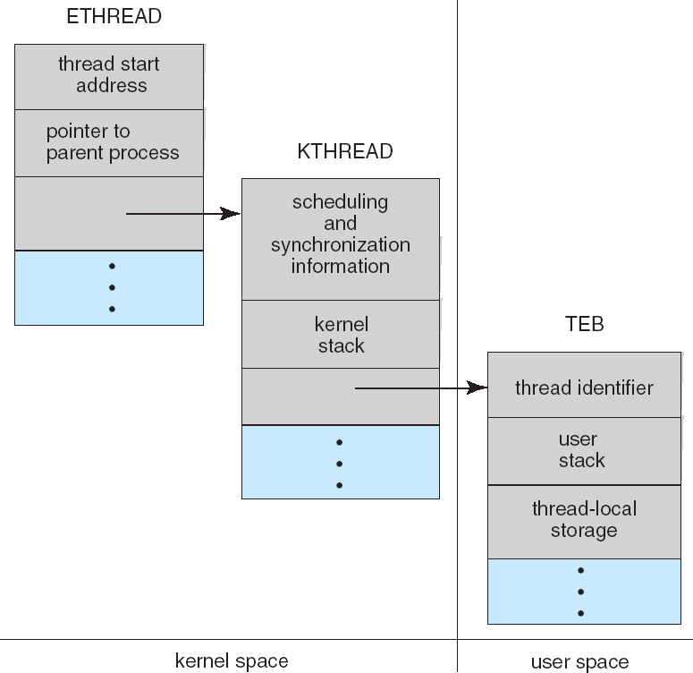
Windows XP Threads

Slide 49
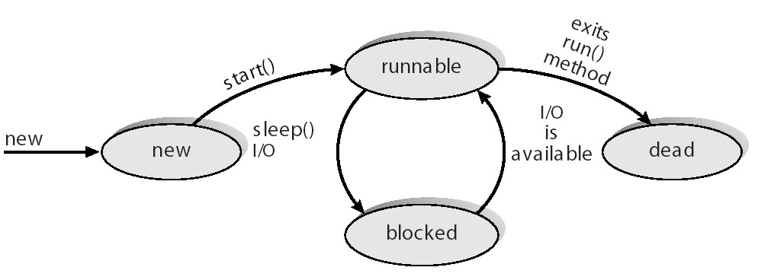
Java threads are managed by the JVM

Slide 50
The producer - consumer problem
A classic problem in the study of communicating processes
a process producer produces data (e.g. records from a file) for a process consumer
a print program produces characters - consumed by a
printer
an assembler produces object modules which will be consumed by the loader
Requires a buffer to store produced items (waiting to be consumed)

Slide 51
Communication buffers
Prod
Prod
1 deal
1 deal | 1 deal | 1 deal
Cons
Cons
If the buffer is of length 1, the producer and consumer must necessarily go at the same speed
Longer length buffers allow some independence. Eg. on the right the consumer was slower

Slide 52
The bounded buffer (bounded buffer)
a fundamental data structure in OS
in: 1st pos.
free
b[0]
b[1]
b[0] | b[1] | b[2] | b[3] | b[4] | b[5] | b[6] | b[7]
b[7]
b[2]
or
b[6]
b[3]
in: 1st pos. free
out: 1st pos. full
b[5]
b[4]
out: 1st pos. full
The bounded buffer is in the memory shared between consumer
and user
blue: full, white: free

Slide 53
The producer - consumer problem
public class Factory
{
public Factory () {
// first create the message buffer
MessageQueue mailBox = new MessageQueue ();
// now create the producer and consumer threads
Thread producerThread = new Thread (new Producer (mailBox));
Thread consumerThread = new Thread (new Consumer (mailBox));
producerThread.start (); consumerThread.start ();
}
public static void main (String args []) { Factory server = new Factory ();
}
}

Slide 54
Producer thread
class Producer implements Runnable
{
private MessageQueue mbox;
public Producer (MessageQueue mbox) {
this.mbox = mbox;
}
public void run () {
Message date;
while (true) { SleepUtilities.nap (); message = new Dated();
System.out.println ("Producer produced" + message);
// produce an item & enter it into the buffer mbox.send (message);
}
}
}

Slide 55
Consumer thread
class Consumer implements Runnable
{
private MessageQueue mbox;
public Consumer (MessageQueue mbox) {
this.mbox = mbox;
}
public void run () {
Message date;
while (true) { SleepUtilities.nap ();
// consume an item from the buffer
System.out.println ("Consumer wants to consume.");
message = (Date) mbox.receive (); yew (message! = null)
System.out.println ("Consumer consumed" + message);
}
}
}
55

