Slide 1



Module 4 - Process scheduling
Reading: Chapter 6 (Silberschatz)
Ch. 6
1

Slide 2


Module overview
Basic concepts Scheduling criteria Scheduling algorithms Multiprocessor scheduling Algorithm evaluation
Ch. 6

Slide 3
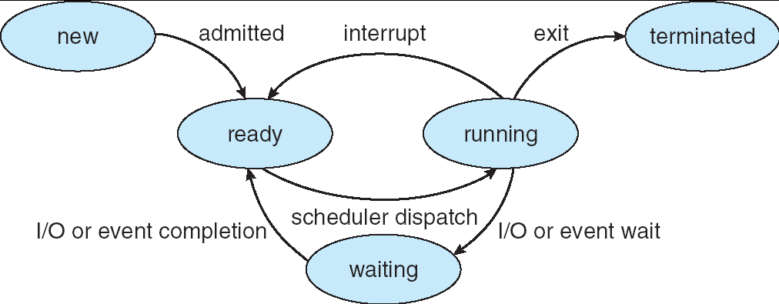
State transition diagram of a process
Ch. 6
Notes:
Recall when a process is waiting for the CPU to be executed, they are in the “Ready” state. In order to determine which process is chosen, the scheduler dispatch is called to decide which process is to be executed by the CPU, which then the process changes state as such.

Slide 4
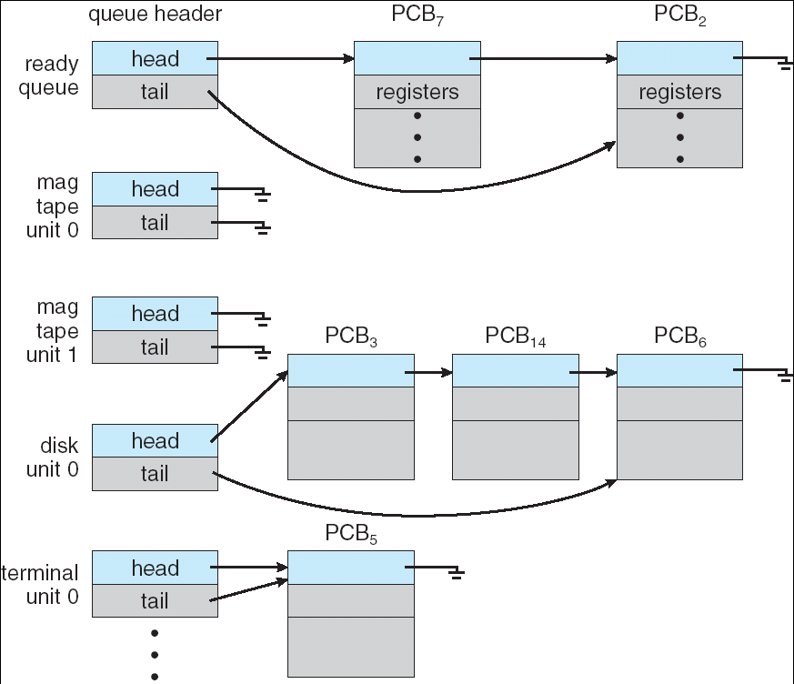
Process queues for scheduling
Ready queue
We will assume that the first process in a queue is the one that uses the
resource: here, proc7 executes
Ch. 6
Notes:
Several queues where the processes have to reside in, with the main one being the ready queue containing all the processes that are ready for the CPU. Other than the CPU and its ready queue, there are also queue for devices, which operate the same way. Notice the headers pointing to the PCBs,

Slide 5


Basic concepts
Multiprogramming is designed to achieve maximum use of resources, especially the CPU
The CPU scheduler is the part of the OS that decides which process in the ready queue gets the CPU when it becomes free
should aim for optimal use of the CPU
CPU is the most valuable resource in a computer, so we are talking about it
However, the principles that we will see also apply to the scheduling of other resources (I / O units, etc.).
Must understand process behavior
To make the right scheduling decision
Ch. 6
Notes:
Due to limited amount of resources available in a system, the maximum usage needs to be implemented for the betterment of the system which then the scheduler needs to be efficient for in its function.

Slide 6
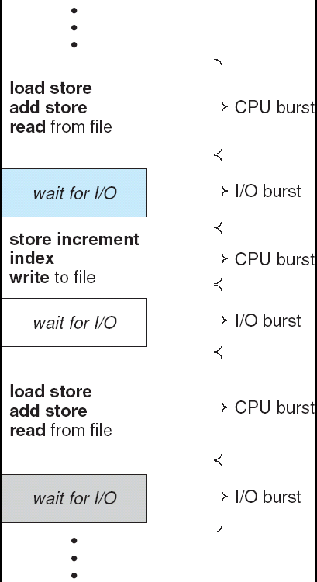

The cycles of a process
CPU and I / O cycles (bursts): the execution of a process consists of execution sequences on CPUs and I / O waits
Ch. 6
Notes:
The CPU burst is where the computational instructions occur, hence the CPU is solely involved, but then there are times where an I/O instruction is necessary, where then the I/O bursts occur.
Not all processes have I/O bursts, which means they are CPU-based processes, but in general, most processes will have both types of bursts.

Slide 7


When to invoke the scheduler
The scheduler must make its decision every time the executing process is interrupted, i.e.
a process presents itself as new or finished an executing process becomes stuck waiting a process changes from running to ready
a process changes from waiting to ready
in conclusion, any event in a system causes an interruption of the CPU and the intervention of the scheduler, who will have to make a decision about which process or thread will have the CPU after
Preemption: we have preemption in the last two cases if we remove
the CPU from a process that had it and can continue to use it
In the first two cases, there is no preemption
Several problems to resolve in the case of preemption
Ch. 6
Notes:
Every time the process is interrupted, then the CPU is interrupted.
FYI: any of the 5 process changes will mean the scheduler’s invocation
Preemeption can occur when a more higher priority process in the “Ready” states sort of triggers a process from the “running” state to then stop the execution and switch
preemption means has it run before and was interrupted during its execution. When we have a new process it hasn't started running yet, its starting for the first time. In other words it doesn't have a PCB

Slide 8

Dispatcher
The code of the OS that gives control to the process chosen by the scheduler. It must be concerned with:
change context change to user mode
restart the chosen process (pick up the progress from the instruction counter)
Dispatcher latency
the time required to perform the duties of the dispatcher
it is often overlooked, it must be assumed that it is small compared to the length of a cycle
Ch. 6
Notes:
Dispatcher allows to switch from one process to another by doing some work →
Change context (save info of P1 into PCB1, and then load PCB2 of P2 into CPU)
Change to user mode
Restart the chosen process
But these actions take time →

Slide 9
Scheduling criteria
There will normally be several processes in the ready queue
When CPU becomes available, which one to choose?
The general idea is to make the choice in the interest of the efficient use of the machine
But the latter can be judged according to different criteria ...
Ch. 6

Slide 10

Scheduling criteria
Main reason for scheduling
Percentage of use: keep CPUs and I / O modules busy
Time-sharing systems?
Response time (for interactive systems): the time between a request and the response
Servers?
Throughput: number of processes that complete in the unit of time
Batch processing systems?
Turnaround time: the time taken by the process from its
arrival to its end.
Loaded systems?
Waiting time: waiting in ready queue (sum of all time spent in ready queue)
Ch. 6
Notes:
Different CPU scheduling algorithms have different properties and the choice of a particular algorithm depends on the various factors. Many criteria have been suggested for comparing CPU scheduling algorithms.
The criteria include the following:
CPU utilisation – The main objective of any CPU scheduling algorithm is to keep the CPU as busy as possible. Theoretically, CPU utilisation can range from 0 to 100 but in a real-time system, it varies from 40 to 90 percent depending on the load upon the system.
Throughput – A measure of the work done by CPU is the number of processes being executed and completed per unit time. This is called throughput. The throughput may vary depending upon the length or duration of processes.
Turnaround time – For a particular process, an important criteria is how long it takes to execute that process. The time elapsed from the time of submission of a process to the time of completion is known as the turnaround time. Turn-around time is the sum of times spent waiting to get into memory, waiting in ready queue, executing in CPU, and waiting for I/O.
Waiting time – A scheduling algorithm does not affect the time required to complete the process once it starts execution. It only affects the waiting time of a process i.e. time spent by a process waiting in the ready queue.
Response time – In an interactive system, turn-around time is not the best criteria. A process may produce some output fairly early and continue computing new results while previous results are being output to the user. Thus another criteria is the time taken from submission of the process of request until the first response is produced. This measure is called response time.

Slide 11
Scheduling criteria: maximize / minimize
To maximize
CPU use: percentage of use (how much the CPU is kept busy)
Throughput: number of processes that complete in the unit of time
To minimize
Response time (for interactive systems): the time between a request and the response (cannot wait forever to get a response)
Turnaround time: completion time minus arrival time
Waiting time: waiting in ready queue
Ch. 6
Notes:
if we're prioritizing 100% utilization on the CPU, then there would be some hardware limitations that the software would have to manage, constantly sending processes to the CPU could make it to get overheated and then actually decrease the efficiency at the CPU can operate. For this course, we are assuming to ignore all external factors such as “overheating”. In reality, this would not be the responsibility of the scheduler to manage this overloading of processes.

Slide 12
Scheduling Criteria Example
P₁ P₂ P₃ P₄ Process arrival
P₁ | P₂ | P₃ | P₄ | P₁ | P₂
Time
0 4 5 7 10,11,12
CPU utilization:
100% (is the CPU ever NOT busy?)
Throughput :
4/24 (in the total amount of time, how many processes have been completed? → #processes / total time)
Turnaround time (P₃, P₂):
P₃: 5 (time finished - time entered (arrow down))
P₂: 20
Waiting time (P₂): (better for processes that start execution AGAIN)
P₂: 13 (time finished – time started2) + (time started1 – time arrived)
Response time (P₃, P₂):
P₃: 3 (time started – time arrived)
P₂: 1
20 22 24
12
Notes:
A GANTT chart

Slide 13
Now let's take a look at several scheduling
methods and see how they behave against these criteria.
we will study specific cases
the study of the general case would require recourse to probabilistic or simulation techniques
Ch. 6

Slide 14
First come, first served (First come, first serve, FCFS)
Note, no preemption Example: Process | Cycle time
P1 | 24
P2 | 3
P3 | 3
If the processes arrive at time 0 in the order: P1, P2, P3 The Gantt chart is:
P₁ | P₂ | P₃
0 24
Waiting time for P1 = 0; P2 = 24; P3 = 27
Average waiting time: (0 + 24 + 27) / 3 = 17
27
30
Notes:
Cycle Time <-> CPU burst time

Slide 15
First come, first served
CPU utilisation = 100% Throughput = 3/30 = 0.1
3 processes completed in 30 units of time
Average Turnaround time: (24 {P1: 24-0} + 27{P2: 27-0} + 30{P3: 30-0}) / 3 = 27
P₁ | P₂ | P₃
0
24
27
30
Ch. 6

Slide 16

FCFS scheduling (continued)
If the same processes arrive at 0 but in order
P₂ , P₃ , P₁ .
The Gantt chart is:
P₂ | P₃ | P₁
0 3 6 30
Waiting time for P₁ = 6 P₂ = 0 P₃ = 3 Average waiting time: (6 + 0 + 3) / 3 = 3 Much better!
So for this technique, the average wait time can vary greatly
Exercise: also calculate the average rotation time, throughput, etc.
Ch. 6
Notes:
Average rotation time <-> average turnaround time:
P1: turnaround time is 30 – 0 = 30
P2: 3 – 0 = 0
P3: 6 – 0 = 0
Thus, average turnaround time is (30 + 3 + 6) / 3 = 13
Throughput is 3/30

Slide 17
Take into account the arrival time!
If the processes arrive at different times, subtract the arrival times
Exercise: repeat the calculations if:
P2 arrives at time 0 P1 arrives at time 2 P3 arrives at time 5
Ch. 6
Notes:
Waiting times:
P2: 0
P1: 1
P3: 27 – 5 = 22
Average waiting time is (22 + 1 + 0)/3 = 23/3 ≈ 7.7
Average turnaround time:
P2: turnaround time is 3 – 0 = 3
P1: 27 – 2 = 25
P3: 30 - 5 = 25
Thus, average turnaround time is (3 + 25 +25)/3 = 53/3 ≈ 17.7
Throughput: 3/30

Slide 18
Convoy Effect with the FCFS
Consider a single CPU bound process and many I/O bound processes (fairly normal situation).
The I/O bound processes wait for the CPU: I/O under utilized (*).
The CPU bound process requests I/O: the other processes rapidly complete CPU bursts and go back to I/O: CPU under utilized.
CPU bound process finishes I/O, and so do the other processes: back to *
Solutions?
18
Notes:
Convoy Effect is phenomenon associated with the First Come First Serve (FCFS) algorithm, in which the whole Operating System slows down due to few slow processes.
FCFS algorithm is non-preemptive in nature, that is, once CPU time has been allocated to a process, other processes can get CPU time only after the current process has finished. This property of FCFS scheduling leads to the situation called Convoy Effect.
Suppose there is one CPU intensive (large burst time) process in the ready queue, and several other processes with relatively less burst times but are Input/Output (I/O) bound (Need I/O operations frequently).
Steps are as following below:
The I/O bound processes are first allocated CPU time. As they are less CPU intensive, they quickly get executed and go to I/O queues.
Now, the CPU intensive process is allocated CPU time. As its burst time is high, it takes time to complete.
While the CPU intensive process is being executed, the I/O bound processes complete their I/O operations and are moved back to ready queue.
However, the I/O bound processes are made to wait as the CPU intensive process still hasn’t finished. This leads to I/O devices being idle.
When the CPU intensive process gets over, it is sent to the I/O queue so that it can access an I/O device.
Meanwhile, the I/O bound processes get their required CPU time and move back to I/O queue.
However, they are made to wait because the CPU intensive process is still accessing an I/O device. As a result, the CPU is sitting idle now.
Hence in Convoy Effect, one slow process slows down the performance of the entire set of processes, and leads to wastage of CPU time and other devices.
To avoid Convoy Effect, preemptive scheduling algorithms like Round Robin Scheduling can be used – as the smaller processes don’t have to wait much for CPU time – making their execution faster and leading to less resources sitting idle.

Slide 19

FCFS Scheduling Discussion
Is it simple and easy to program?
Yes!
Can we find other benefits?
It costs little time to make scheduling decision
Does it provide low waiting time?
Not at all, can be quite awful
Does it provide good CPU utilization?
No – the convoy effect
OK, forget about it.
Now, let’s try to reduce the average waiting time
Idea: It is better to execute ready processes with short CPU bursts
19

Slide 20


The shortest process starts first
Shorter First = Shortest Job First (SJF)
Optimal in principle in terms of average waiting time
(see the last example)
But how do we know
20
Ch. 6
Notes:
The process with the smallest CPU bursts

Slide 21
Shortest-Job-First (SJR) Scheduling
Associate with each process the length of its next CPU burst. Use these lengths to schedule the process with the shortest time
Two schemes:
nonpreemptive – once CPU has been given to the process it cannot be preempted until it completes its CPU burst
preemptive – if a new process arrives with CPU burst length less than remaining time of current executing process, preempt (CPU is taken from the running process, and given to the new process). This scheme is also know as the
Shortest-Remaining-Time-First (SRTF)
Just call it preemptive SJF
Preemptive SJF is optimal – gives minimum average waiting
time for a given set of processes
Moving a process with short CPU burst in front of a process with longer CPU burst reduces average waiting time
21
Notes:
The creator of the OS decides which approach the scheduler uses
The term dispatch latency describes the amount of time it takes for a system to respond to a request for a process to begin operation. With a scheduler written specifically to honor application priorities, real-time applications can be developed with a bounded dispatch latency. The overall application response time is composed of the interrupt response time, the dispatch latency, and the time it takes the application itself to determine its response.

Slide 22
Example of Non-Preemptive SJF
Process | Arrival Time | Burst Time
P₁ | 0.0 | 7
P₂ | 2.0 | 4
P₃ | 4.0 | 1
P₄ | 5.0 | 4
SJF (non-preemptive)
P₁ P₃
3 7 8
P₂
P₄
0
12
16
P₂ arr.
P₃ arr. P₄ arr
Average waiting time = (0 + 6 + 3 + 7)/4 = 4
22
Notes:
The first process arriving at 0, the CPU takes it since it is the only process available. After a process (P1 here) is completed, the scheduler decides which process takes the shortest time to complete, hence taking P3 after.
A process that is I/O based, its CPU burst time can be 0 (or a small number)

Slide 23
Example of Preemptive SJF
Process Arrival Time | Burst Time
P₁ 0.0 | 7 (5) (5) (5) → 0
P₂ 2.0 | 4 (2) (0)
P₃ 4.0 | 1 (0)
P₄ 5.0 | (_) 4 (4) (0)
SJF (preemptive)
P₁
P₂
P₃
P₂
P₄
P₁
0
_{P} 2
4 5 7
11 16
₂ arr.
P₃ arr.
P₄ arr.
Average waiting time = (9 + 1 + 0 + 2)/4 = 3
23
Notes:
Recall: pre-emption means taking away the CPU from one process, and giving it charge to another process
There can be moments where a tie would occur between bursts times of the process, and as such, the implementation needs to be clear in which process needs to take priority when something like this occurs (time break is broken via who arrived first, it goes back to FCFS)

Slide 24

Small technical detail with SJF
How do we know the length of the next CPU burst?
If you know that, you probably know also tomorrow’s stock market prices…
You will be rich and won’t need to waste time in CSI3131 class
So, we can only estimate it
Any idea how to estimate the length of the next CPU burst?
Probably similar as the previous bursts from this process
Makes sense to give more weight to the more recent bursts, not just straightforward averaging
Use exponential averaging
24
Notes:
Not possible to predict the length of the next CPU bursts. We can estimate based on previous CPU bursts

Slide 25
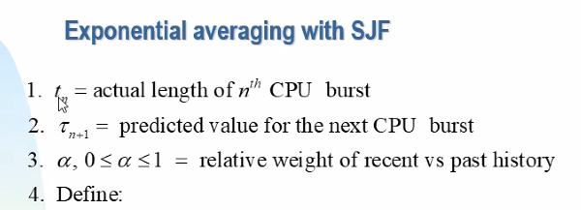
τ _{n+1} = α t_{n} + (1− α )τ _{n}
τ _{n+1} = α t_{n} + (1− α )αt_{n−1} + (1− α )² αt_{n−2} +…
+ (1− α )^{i} αt_{n−i} +…+ (1− α )^{n} t₁
25
Notes:
T1 = tau1 (unless stated otherwise in the question)
T_n is known, since those are the times of the previous CPU bursts
Smoothening factor (α) – It controls the relative weight of recent and past history in our prediction.
If α = 0, Τ^{n+1} = Τ^{n} i.e. no change in value of initial predicted burst time.
If α = 1, Τ^{n+1} = t^{n} i.e. predicted Burst-Time of new process will always change according to actual Burst-time of n^{th} process.
If α = 1/2, recent and past history are equally weighted.
https://www.geeksforgeeks.org/shortest-job-first-cpu-scheduling-with-predicted-burst-time/

Slide 26
The shortest first SJF: review
Difficulty estimating the length in advance (only theoretical)
Long processes will suffer from famine when there is a constant supply of short processes (they are never the shortest in comparisons, thus never get to run by the CPU)
Preemption is required for timeshared environments
A long process can monopolize the CPU if it is the first to enter the system and it does not do I / O
There is an implicit assignment of priorities: preferences for shorter jobs
26
Ch. 6
Notes:
Priority based algorithm based on the job length (“shortest” job first)

Slide 27

SJF Discussion
Does it ensure low average waiting time?
Yes, it was designed that way
As long as our burst-length predictions more-or-less work
Does it provide low response time?
Not necessarily, if there is a steady stream of short CPU bursts, the longer bursts will not be scheduled
This is called starvation
A process is blocked forever, always overtaken by other processes (well, or at least while the system is busy)
Let’s see Priority Scheduling.
27

Slide 28



Priority Scheduling
A priority number (usually integer) is associated with each process On some systems (Windows), the higher number has higher priority On others (Unix) , the smaller number has higher priority
The CPU is allocated to the process with the highest priority
Can be preemptive or non-preemptive
but usually you want to preempt low-priority process when a high priority process becomes ready
Priority can be explicit
Assigned by the sysadmin/programmer, often for political reasons
Professor jobs are of higher priority
But also for technical reasons
This device has to be serviced really fast, otherwise the vital data will be lost (real-time processing)
Priority can also be implicit (computed by the OS)
SJF can be seen as priority scheduling where priority is the predicted next CPU burst time
28
Notes:
Similar to SJF, but here we are specifically or explicitly assigning priorities to the processes with a number (with meaning).
The priority scheduling will favour those processes with higher priority than the others, and will give those to the CPU instead. Preemption can play a role depending on the circumstances, either allow it to switch contexts, or let the current process be completed.
Explicit priority means that it can be assigned by you (for whatever reason)
Implicit priority can also be done, such as SJF
If the priority is the same, then the algorithm goes back to FCFS to break the tie
While processes are in the queue, the burst time is not a factor in priority, if a process has a low priority number, then its burst time can be any amount.

Slide 29
Priority Scheduling Discussion
Good properties
Professor jobs will be scheduled before student jobs Allows support of real-time processing
Bad properties
Professor jobs will be scheduled before student jobs
OK, give me something else
starvation – low priority processes may never execute
How to resolve the starvation problem?
aging – keep increasing the priority of a process that has not
been scheduled for a long time until reaching a number that allows it to be executed.
What to do with the processes of the same priority level?
FCFS, or
Might as well add preemption = Round Robin
29
Notes:
Benefits one kind of jobs, while bringing a disadvantage to the other kind

Slide 30
Round-Robin (RR)
Most used in practice
Each process is allocated a quantum of time (e.g. 10-100 millisecs.) To run
(book terminology: time slice)
If it runs for an integer quantum without other interruptions, it is interrupted by the timer and the CPU is given to another process
The interrupted process becomes ready again (at the end of the queue)
Preemptive method
The ready queue is a circle (including RR)
 | P[0] | P[1]
P[7] |  |  | P[2]
P[6] |  |  | P[3]
 | P[5] | P[4]
Ch. 6
Notes:
A FIFO circular queue containing different processes, with each allocating a slice of time. The CPU burst for the current process only runs for the given allowed time, thus the burst time may not finish (until returning to that process later on) → hence a preemptive method
Works on a FCFS approach

Slide 31
Round-Robin performance
If there is a process in the ready queue and the quantum is q, then each process receives 1 / n of the CPU time in units of max duration of q
If q large ⇒ FCFS
If q small ... we will see
Ch. 6
Notes:
Consider having 3 processes, with each allocated for q seconds. Thus, in the period of 3q seconds, with each process allocating q seconds, this means that each process will get q/3q = 1/3 of the CPU time
When q is large, the processes are computed in FCFS approach since each process will not need the entire allocated quantum time, thus whichever process comes in first will be executed.
Too many context switches or interruptions between processes due to low q time, it is not ideal and could slow down the system. The overhead (In computers, overhead refers to the processing time required by system software, which includes the operating system and any utility that supports application programs.) caused by the dispatcher (dispatcher latency) can slow the system down.
Optimal quantum time is usually in between the largest and shortest CPU bursts

Slide 32
Example: RR Quantum = 20
Process
Cycle (CPU Burst)
P₁ | 53 (33) (13) (0) (0)
P₂ | 17 (0) (0) (0) (0)
P₃ | 68 (48) (28) (8) (0)
P₄ | 24 (4) (0) (0) (0)
P₁ | P₂ | P₃ | P₄ | P₁ | P₃ | P₄ | P₁ | P₃ | P₃
0 20 37 57 77 97 117 121 134 154 162
Normally,
higher turnaround time than SJF
but average waiting time is better than FCFS
Ch. 6
Notes:
Notice the cycle for P2 is 17, thus it finishes at 37, and now the sequence of time uses q by 20 from there. The quantum is allowing the process to run in that allocated time, but the process does not have to use all of it, since in this case, the process has less CPU burst time.
Assumption, all processes arrive at time 0 in the order given above. Each line separating the P_n is an interruption

Slide 33
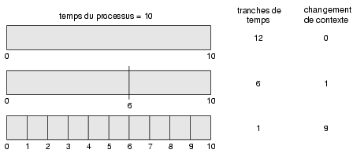
A small quantum increases # context switches (OS time)
(Time quantum)
(# Context Switch)
(Process Time)
Ch. 6

Slide 34
Example to see the importance of a good choice of quantum (to be developed as an exercise)
Three cycles:
A, B, C, all of 10
Try with:
q = 1
q = 10
In this second case, the round-robin works as FCFS and the average rotation time is better
Ch. 6

Slide 35
Algorithms we have seen so far
First Come First Serve
simple, little overhead, but poor properties
Shortest Job First
needs to know CPU burst times exponential averaging of the past
Priority Scheduling
This is actually a class of algorithms
Round Robin
FCFS with preemption
35

Slide 36
Scheduling exercises
Consider three processes P1, P2, P3 Burst times for P1: 14,12,17
Burst times for P2: 2,2,2,3,2,2,2,3,2,2,2,3,2,2,2,3
Burst times for P3: 6,3,8,2,1,3,4,1,2,9,7
All three arrive at time 0, in order P1, P2, P3
Each CPU burst is followed by an I/O operation taking 6 time units
Let’s simulate the scheduling algorithms
FCFS
Round Robin (quantum=5)
Non-preemptive SJF or Preemptive SJF (your choice)
Round robin (quantum=5) with Priority scheduling, priorities are P2=P3>P1
36

Slide 37
Multilevel Queue
Idea: Partition the ready queue into several
queues, and handle each queue separately.
Example:
foreground queue (interactive processes) background (batch processes)
Each queue might have its own scheduling algorithm
foreground – RR (for low response time)
background – FCFS (for simplicity and low context- switch overhead)
37

Slide 38
Multilevel Queue
How to schedule from among the queues (allocate CPU time for foreground and background)?
Fixed priority scheduling
i.e. the processes from foreground queue get the CPU, the background processes get the CPU only if the foreground queue is empty
Possibility of starvation.
Time slice – each queue gets a certain amount of CPU time which it can schedule amongst its processes
i.e., 80% to foreground queue, 20% to background queue
not necessarily optimal
38
Notes:
Processes do not move from one queue to another

Slide 39
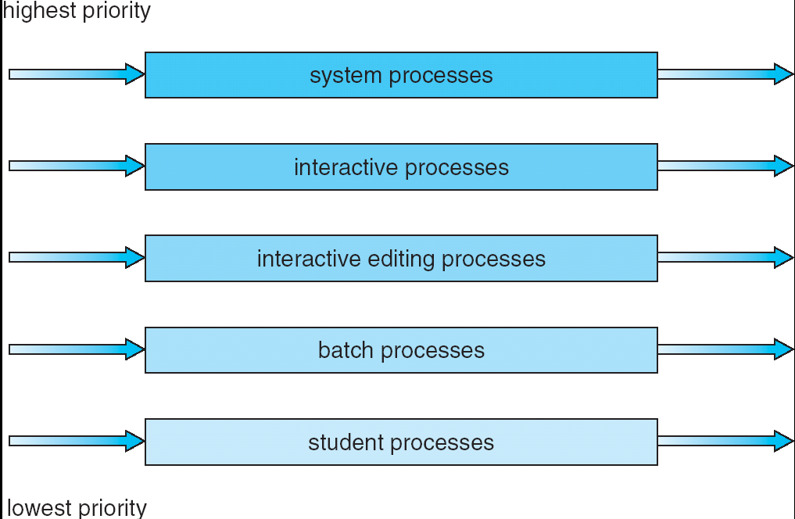
Multilevel Queue Scheduling
39

Slide 40

Multilevel Feedback Queue
Idea:
Use multilevel queues
A process can move up and down queue hierarchy (to avoid starvation)
Why would a process move to a lower priority queue?
It is using too much CPU time
Why would a process move to a higher priority queue?
Has been starved of CPU for long time A way to implement aging
40
Notes:
Tend to prioritize short CPU burst processes.

Slide 41
Multilevel Feedback Queue
Multilevel-feedback-queue scheduler defined by the following parameters:
number of queues
scheduling algorithms for each queue
method used to determine when to upgrade a process
method used to determine when to demote a process
method used to determine which queue a process will enter when that process needs service
This algorithm is the most general one
It can be adapted to specific systems
But it is also the most complex algorithm
41
Notes:
Although advantageous to use Multilevel Feedback Queue, but the increased complexity means more parameters need to be established. Thus, some operating systems need to predetermine these parameters

Slide 42
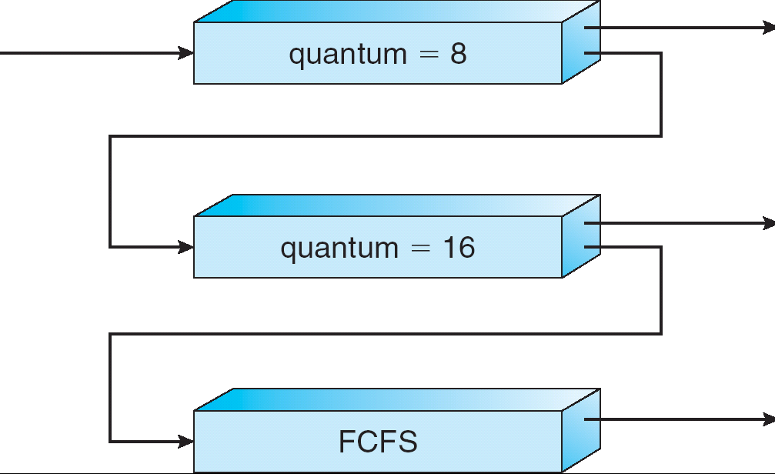
Example of Multilevel Feedback Queue
Scheduler selects processes in Q0 first (highest priority)
If Q0 is empty, the processes from Q1 are selected.
If both Q0 and Q1 are empty, processes from Q2 are selected
If a process arrives in a higher priority queue when another from a lower priority queue is running, the running process will be preempted, to allow the arriving process to run.
Q0
When a process exhausts its quantum in either Q0 or Q1, it is preempted and moved to the lower priority queue.
Q1
Q2
42
Notes:
Consider the example above:
Q0 → RR with q=8
Q1 → RR with q=16
Q2 → FCFS
When a process comes in, it will be put in Q0. If this process needs more than q=8, it will move to another queue, with an increased quantum time, in this case Q1. If it needs more than that again, then will move to Q2. This way, short CPU burst processes will finish in Q0, and longer ones will finish in the later queues. A priority is established with this structure.

Slide 43
Example of Multilevel Feedback Queue
Scheduling example
A new job enters queue Q₀ which is served FCFS. When it
gains CPU, job receives 8 milliseconds.
If it does not finish in 8 milliseconds, job is preempted and moved to queue Q₁ and served again FCFS to receive another 16 additional milliseconds.
If it still does not complete, it is preempted and moved to queue Q₂.
Q0
Q1
Q2
43

Slide 44
Multilevel Feedback Queue Discussion
Exact properties depend on the parameters
Flexible enough to accommodate most requirements The convoy example:
One process with long CPU burst time
Several I/O bound processes with short CPU burst time
Even if the all processes start at the same level, the CPU-intensive process will be soon demoted to a low priority queue
The I/O bound processes will remain at high priority and
will be swiftly serviced, keeping the I/O devices busy
44
Notes:
Longer CPU burst processes will end up in the later queues with the FCFS approach, while the I/O bound shorter CPU bursts will finish executing in the earlier queues.

Slide 45
In practice...
The methods we have seen are all used in practice (except pure SJF which is impossible (to determine the length of the next CPU burst))
Sophisticated OS provide the system manager with a library of methods, which it can choose and combine as needed after observing the behavior of the system. Most used one is the RR in practice.
Ch. 6

Slide 46
Also…
Our study of scheduling methods is theoretical, does not consider in detail all the problems that arise in CPU scheduling.
Eg. CPU schedulers cannot give the CPU to a process for all the time it needs
Because in practice, the CPU will often be interrupted by
some external event before the end of its cycle.
Also, this study does not consider the execution times of the scheduler at all.
Ch. 6

Slide 47

Summary of scheduling algorithms
First come, first served (FCFS)
simple, low system time (overhead), low quality
Shortest Job First (SJF)
Must know processing times (not practical)
Must predict using the exponential mean of the past
Scheduling with priority
A class of algorithms
Round-Robin
FCFS with preemption
Multilevel Queues
Possible to use different algorithms with each queue
Multilevel Feedback Queues
Combines several techniques
Ch. 6
Notes:
Not all algorithms suffer from starvation, such as the Round Robin approach

Slide 48
Overview of advanced scheduling topics
- Scheduling with several identical CPUs (multiple-processor scheduling) - Evaluation model
Ch. 6

Slide 49
Multiple-Processor Scheduling
Good news:
With multiple CPUs, we can share the load We can also share the OS overhead
Bad news:
We are expected to efficiently share the load
Managing the OS structures gets more complicated
The scheduling gets more complex
49
Notes:
Sharing the load by scheduling the different processes on each CPU separately → load balancing
The problem with this is that how can we treat all the CPUs equally so that not one or more processors are overused.

Slide 50
Multiple-Processor Scheduling - Approaches
We assume homogeneous (alike) processors
i.e. all processors have the same functionality
Still, the scheduler (and possibly the whole OS) might be run on a single CPU
Asymmetric multiprocessing (ASMP) – only one CPU accesses the system data structures and makes scheduling decisions (master CPU and slave CPUs)
alleviates the need for data sharing but might become bottleneck
Symmetric multiprocessing (SMP) – each CPU is self-scheduling
Either from a common ready queue, or from a private ready queue
Care must be taken when CPUs access common data
structures
Virtually all modern operating systems support SMP including Windows XP, Solaris, Linux, Mac OS X.
50
Notes:
The master CPU in asymmetric multiprocessing is the one that distributes the work among the slave CPUs.
In SMP, each process is scheduled on any of the CPUs because all of them (the CPUs) are considered equivalent. Then, this brings two scenarios:
Each CPU can have its own ready queue, OR
All of them can pull from one common ready queue

Slide 51
SMP Scheduling Issues
Processor Affinity
When process runs on a physical CPU, cache memory is
updated with content of the process
If the process is moved to another CPU, benefits of caching is lost.
SMP systems try to keep processes running on the same physical CPU – known as processor affinity
Load Balancing
Required when each CPU has its own (private) Ready Queue
Push migration: a task is run periodically to redistribute load among CPUs (their ready queue)
Pull migration: An idle CPU (i.e. with an empty ready
queue), will pull processes from other CPUs
Linux supports both techniques
Can counteract the benefits of processor affinity, since it moves processes from one CPU to another
51
Notes:
One problem is that a process may be executed upon multiple CPUs, when there is only one queue. There is some data on the cache of CPU1, and then switching to CPU2, we need to invalidate the cache of CPU1, and repopulate the cache on CPU2, which results in work. To avoid this, Processor Affinity is used, allowing the process to run all the time on the same processor.
Load balancing allow all processors to have its own private ready queue. But then how does the OS guarantee that the processor is not overloaded, while others are in IDLE? Load balancing will allow all processors to be equally loaded/worked, which then means no overloaded processors. This is done with 2 techniques:
Push migration: when a task notices a queue is empty of a CPU or has less processes than the others, it will push processes into that queue.
Pull migration: an IDLE CPU with an empty ready queue, will go and pull processes from other the CPU queues, and bring them into its own.

Slide 52
Evaluation methods and comparison of algorithms
Deterministic modeling
Queuing models Simulation
Ch. 6

Slide 53
Deterministic modeling
Essentially, what we have already done by studying the behavior of several algorithms on several examples
Ch. 6
Notes:
This evaluation method takes a predetermined workload and evaluates each algorithm using that workload.
Take processes, and look at their arrival time, their CPU burst, and their average waiting time with regards to each algorithm, and thus compare them by the end. → a theoretical evaluation

Slide 54
Use of queuing theory
Analytical method based on probability theory
Simplified model: in particular, the OS times are ignored
However, it makes estimates possible
Ch. 6
Notes:
For each system, we look at the arrival rate (using some distribution e.g. Poisson, Normal) of the processes. As they arrive at the system at a certain rate, they come into the system, and then enter the ready queue. Let length n represent the number of processes found in the queue at a certain time. So, we know the arrival rate, and n for processes waiting in the queue. Now we need to know the waiting time in the queue.

Slide 55
Queuing theory: Little's formula
An important result:
n = λ × W
n: average length of the queue
λ : process arrival rate in queue
W: average waiting time in the queue
Eg.
λ if processes arrive 3 per sec.
W and they stay in the queue for 2 seconds
n the average queue length will be ??? 3p/s x 2s=6p
Exercise: Solve also for λ and W
Observe that for n to be stable, λ × W must be stable
If n must remain 6 and λ goes up to 4, what must be W?
Ch. 6
Notes:
p for # processes

Slide 56
Simulation
Build a (simplified...) model of the sequence of events in the OS
Assign a duration of time to each event Assume a certain sequence of external events (e.g. arrival of process, etc.)
Run the model for this sequence to get stats
Ch. 6
Notes:
Run each algorithm on the system, and then find the response time for each process as our parameter, such as analysing the arrival time of processes, and compare the response time for each algorithm, looking for the minimum response time.

Slide 57
Important points in this chapter
Ready Queue for CPU Scheduling criteria Scheduling algorithms
FCFS: simple, not optimal
SJF: optimal, difficult implementation
exponential averaging
Priorities
Round-Robin: selection of the quantum
Algorithm evaluation, queuing theory,
Little's formula
Ch. 6

