Slide 1




Chapter 6 (Silberchatz)
1
Notes:
Why synchronize processes?
If several processes are waiting for the CPU to execute, and interruptions may occur to processes for context switching, process synchronization can help in making the procedure smoother. Synchronization allows for sharing of data, which can prevent in a situation where a process can read from a region of memory (RAM), while another writes to that same region, altering the data and using data we did not want.
Check out example about a++ / a-- from lecture June 7
If no synchronization is done and that no control can be done over the processes, then the final value of a can be 3, 4, or 5. While the correct answer should be 4, where process1 finishes before process2 or vice versa. Depending on the algorithm, the scheduler then decides which process to be evaluated first, and if any interruptions need to be made.

Slide 2
Problems with concurrency = parallelism
Concurrent threads (or even processes) must sometimes share data (files or common memory) and resources
We are therefore talking about cooperative tasks
If access is not controlled, the result of program execution may depend on interleaving order of the execution of the instructions (non-determinism).
A program may give different and sometimes undesirable results from time to time
2

Slide 3

An example
Two threads execute this same procedure and share the same database
They can be interrupted anywhere
The result of concurrent execution of P1 and P2 depends on the order of their interlacing
Mr. X asks for a plane reservation
Database says seat A is available
Seat A is assigned to X and marked occupied
3
Notes:
Two agencies having access to the same database may result in error, where one agency assigning the same seat to one customer can take time, which then can be misleading to the other agency assigning the same seat to another customer. This is an issue of concurrency.

Slide 4



Overview of a possible execution
P1
(Interruption)
Mr. Leblanc requests a plane reservation
P2
or delay
Mr. Guy requests a
plane reservation
Database says 30A seat is available
Database says 30A seat is available
Seat 30A is assigned to Guy and marked occupied
Seat 30A is assigned to Leblanc and marked occupied
4

Slide 5
Two operations in parallel on a shared variable a (b is private at each process)
P1 P2
b = a
interruption
b = a b ++ a = b
b++
a = b
Suppose a is 0 at the start
P1 is working on old value of a so the end result will be a = 1. Will be a = 2 if the two tasks are executed one after the other. If a was saved when P1 is interrupted, it could not be shared with P2 (there would be two a while we want only one)
5

Slide 6
3rd example
Thread P1
Thread P2
static char a;
static char a;
void echo ()
{
cin >> a;
void echo ()
{
cin >> a; cost << a;
}
cost << a;
}
If the var a is shared, the first a is deleted, If it is private, the display order is reversed

Slide 7


Other examples
Threads that work simultaneously on a matrix, eg. one to update it, the other to extract statistics from it
Problem that affects the program of bounded buffer, v. textbook
When several threads are executing in parallel, we cannot make any assumptions about the execution speed of the threads, nor their interleaving.
May be different each time the program is run

Slide 8

Critical Section
Part of a program whose execution must not intertwine with other programs
Once a task enters it, it must be allowed to complete this section without allowing other tasks to play on the same data.
Notes:
The issue with concurrency is that both processes are modifying/accessing shared memory at the same time, while it should be accessed by one process at a time. This is the critical section, where a shared piece of memory is being operated upon at two different spots. A process must finish its instructions, before another process can execute its instructions, using the same data.

Slide 9

The problem of the critical section
When a thread handles a shared data (or resource), we say
that it is in a critical section (CS) (associated with this data)
The problem of the critical section is to find an algorithm of mutual exclusion of threads in running their CSs so that the result of their actions do not depend of interleaving order their execution (with one or more processors)
The execution of critical sections must be mutually exclusive: at any moment, a single thread can execute an CS for a given var (even when there are multiple processors)
This can be achieved by placing special instructions in the entry and exit sections
For simplicity, henceforth we assume that there is only one
CS in a program.
Notes:
Once a process enters the critical section, it must have mutual exclusion, meaning no other process is allowed to interact with/be executing the section.
CS is the segment dealing with the shared data, whereas RS is the segment executing other things, not involving shared variables

Slide 10
Program structure
Each thread must therefore request permission before
entering a critical section (CS)
The section of code that performs this query is the entry section (necessary, along with the exit section)
The critical section is normally followed by a exit section The code that remains is the remaining section (RS): non- critical
repeat
entry section critical section exit section remaining section
forever
Notes:
Every program should follow the above structure.

Slide 11
Application
Mr. X asks for a plane reservation
Entry section
Database says seat A is available
Critical
section
Seat A is assigned to X and
marked occupied
Exit section
Notes:
Entry section: some instruction needs to be executed to ensure no other process can interrupt the current function, by entering the critical section
Exit section: now the green light can be given for any process to enter the critical section.

Slide 12


Criteria necessary for valid solutions
Mutual exclusion:
At any time, at most one thread can be in a critical
section (CS) for a given variable
Progress:
no deadlock (Chap 7)
if a thread requests to enter a critical section at a time when no other thread requests it, it should be able to enter it
No interference (like process interruptions):
If a thread stops in its remaining section, this should not affect other threads
But we assume that a thread which enters a critical
section will leave it.
Bounded waiting:
no thread eternally prevented from reaching its CS (no
starvation)
Notes:
No deadlock, meaning a solution using the 2 processes if caught in a deadlock, no progress is made (the solution cannot result in a deadlock). Cannot have a situation where one program cannot enter its CS, while the other ALSO cannot enter its CS
Every process has its own critical section, where in the 2nd Progress point, if a process enters its critical section, while no other process has entered their critical section, then there is no way for that primary process to be interrupted.
Cannot design the solution that allows the processes to enter the critical sections and finish their instructions be allowed to enter them again (as many times as it wants/can), while preventing other processes to enter their CS. Must design to favour all processes/threads, not just one.
Any valid solution must follow the 3 red points above: progress needs to be made, while processes are executing in mutual exclusion with bounded waiting.

Slide 13



Types of solutions
Software solutions
algorithms who’s correctness does not rely on any other assumptions
Peterson’s algorithm
Hardware solutions
rely on some special machine instructions testAndSet, xchng
OS provided solutions
higher level primitives (implemented usually using the hw solutions) provided for convenience by the OS/library/language
semaphores, monitors
All solutions are based on atomic access to main memory: memory at a specific address can only be affected by one instruction at a time, an thus one thread/process at a time.
More generally, all solutions are based on the existence of atomic instructions, that operate as basic CSs.
Atomicity = indivisibility
Module 5
13
Notes:
Software solutions are the most difficult to implement
Hardware solutions are the most expensive to execute
OS provided solutions are the optimal ones
Atomic means they are not divisible. Example is a++ is not atomic → LDA a, INC, STA a (3 atomic instructions)

Slide 14


Software solutions
(not practical, but interesting to understand the problem)
We first consider 2 threads
Algorithms 1 and 2 are not valid
Show the difficulty of the problem
Algorithm 3 is valid (Peterson's algorithm)
Notation
Let's start with 2 threads: T0 and T1
When we discuss the task Ti, Tj will always denote the other task (i != j)

Slide 15
Algorithm 1: threads give each other the turn
The shared variable turn is initialized to 0 or 1
The CS of Ti is performed iff
turn = i
Ti is busy waiting if Tj is in
Thread Ti: repeat
while(turn!= i) {}; CS
turn = j;
CS.
Works for mutual exclusion! No starvation (only 1 thread
in turn according to turn).
But the criterion of progress is not satisfied because the execution of the CSs must strictly alternate
RS
forever
Do nothing
Ex 1: T0 has a long RS and T1 has a short RS. If turn == 0, T0 enters its CS and then its RS (turn == 1). T1 enters its CS and then its RS (turn == 0), and tries to enter its CS: refused! it must wait for T0 to give it the turn.
Notes:
Ti and Tj both have a critical section → how to prevent them to enter their critical sections at the same time
Solution of algorithm 1: use of a common variable (called “turn”)
For thread Ti
Entry section: while turn is not equal to i → do nothing
CS
Exit section: turn = j
For thread Tj
Entry section: while turn is not equal to j → do nothing
CS
Exit section: turn = i

Slide 16
initialization of turn to 0 or 1
Thread T0: repeat
while (turn!= 0){}; CS
turn = 1; RS
forever
Thread T1: repeat
while(turn!=1){}; CS
turn = 0; RS
forever
Algorithm 1 overview
Ex 2: Generalization to n threads: each time, before a thread can enter its critical section, it must wait until all the others have had this chance!
Notes:
0 and 1 are integers in the body of the threads
Mutual exclusion is satisfied, because initially, turn = 0, where CS of T0 is entered, while CS of T1 cannot be entered.
When T0 finishes its CS, then its exit section sets turn to 1. After the “do nothing” of T1, the loop is repeated, where then turn is now 1, so its CS is now executed.
Busy waiting refers to the while loop that thread needs to check whether the condition is satisfied or not.
By forcing the alternation on the solution design, progress criteria cannot be followed since the RS of T0 is preventing T1 to enter its CS

Slide 17
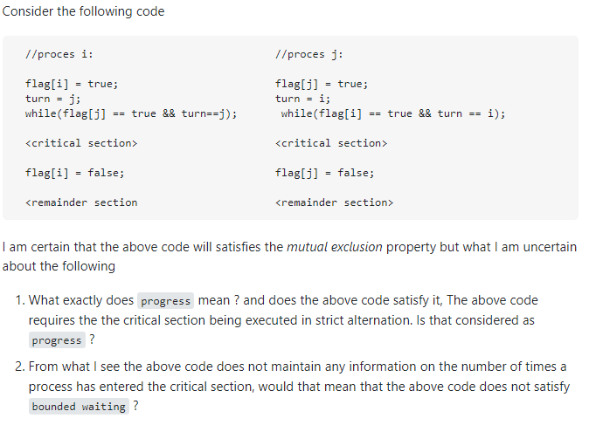
Notes:
Progress means that the process will eventually do some work - an example of where this may not be the case is when a low-priority thread might be pre-empted and rolled back by high-priority threads. Once your processes reach their critical section they won't be pre-empted, so they'll make progress. Progress of the processes mean that the processes don't enter in a deadlock situation and hence, their execution continues independently! Actually, at any moment of time, only one of the process i or process j will be executing its critical section code and hence, the consistency will be maintained! SO, Progress of both processes are being talked and met successfully in the given code.
Bounded waiting means that the process will eventually gain control of the processor - an example of where this may not be the case is when another process has a non-terminating loop in a critical section with no possibility of the thread being interrupted. Your code has bounded waiting IF the critical sections terminate AND the remainder section will not re-invoke the process's critical section (otherwise a process might keep running its critical section without the other process ever gaining control of the processor).
Next, this particular code is for processes which are intended to run only for once and hence, they won't be reaching their critical section code again. It is for single execution of process.
Bounded waiting says that a bound must exist on the number of times that other processes are allowed to enter their critical sections after a process has made a request to enter its critical section and before that request is granted.
This particular piece of code has nothing to do with bounded waiting and is for trivial cases where processes execute for once only!
property of mutual exclusion is preserved if even if they were in the while loop.

Slide 18



Algorithm 2 or the excess of courtesy ...
A Boolean variable per
Thread: flag [0] and flag [1]
Ti signals that he wants to execute his CS by: flag [i] = true
But he does not enter if the
other is also interested!
Mutual exclusion ok Progress ok
Absence of famine not satisfied:
Consider the sequence:
T0: flag [0] = true T1: flag [1] = true
Thread Ti:
repeat
flag [i] = true; while(flag[j]==true){}; CS
flag[i] = false; RS
forever
do nothing
Each thread will wait indefinitely to execute its CS: we have a starvation
Module 5
17
Notes:
Each process uses a flag (array of size 2) and they are shared between the processes.
The first flag means that the thread wants to enter its CS, but if the second flag is also true, then CS cannot be entered, otherwise it can enter. Thus, after each setting of flag, the flag of the other process is checked to see if the current thread enter its CS.
3 criteria is needed to be met for a valid solution, but here, starvation is not satisfied.
No progress does not mean there is a deadlock, progress means that if one thread does not want to enter its CS, this aspect should not prevent other threads from entering their CS.

Slide 19
After you sir
After you sir
Thread T0:
repeat
flag [0] = true;
while (flag [1] == true)
{};
CS
flag [0] = false;
RS
forever
Thread T1:
repeat
flag [1] = true;
while (flag [0] == true)
{};
CS
flag [1] = false;
RS
forever
Algorithm 2 overview
T0: flag [0] = true T1: flag [1] = true deadlock!
Module 5
18
Notes:
Mutual exclusion: if process T0 is in its CS, then flag1 != true, while flag0 == true. And if T1 wants to enter its CS, then its flag must be true, which means flag0 must be false, which is impossible since T0 is in its CS. Thus both threads cannot be in their CS at the same time.
Progress: if T0 does not want to enter its CS, can T1 enter its CS instead? If T0 is doing its RS, then flag0 is false, where then for T1, flag1 is set to true, and the following condition is also true (as in flag0 is indeed false), thus T1 enters its CS. Thus progress can be made.
Bounded waiting (starvation): if both threads want to enter their CS at the same time, as in flag0 is set to true, and flag1 is set to true, well then the following conditions in their while checks whether the opposite flag is true or false, and since they are true, the program restarts its iteration, checking again and again whether the flag has changed or not. And this continues forever for both since none of them change their flags. Starvation occurs when the condition of the while loop is kept on executing, and thus if both flags are true, then the while keeps on occurring.

Slide 20

So, neither Algorithm 1, nor Algorithm 2 work. What do we do? Use the ideas from both of them!
Use the flag i to indicate willingness to enter CS
But use turn to let the other task enter the CS
Task T0:
Task T1: while(true)
{
flag[1] = true;
// T1 wants in
turn = 0;
// T1 gives a chance to T0
while
(flag[0]==true&&turn==0){}
Critical section flag[1] = false;
// T1 wants out
Remainder Section
}
while(true)
{
flag[0] = true;
// T0 wants in
turn = 1;
// T0 gives a chance to T1
while
(flag[1]==true&&turn==1){}
Critical Section flag[0] = false;
// T0 wants out
Remainder Section
}
20
Notes:
Notice both threads have a flag array set to true indicating that they want to enter their CS.
This time, the turn variable are opposites of each other in the threads,
To falsify the inner while loops, one of the conditions must be false, and because of that, the CS of the thread can be entered.
Remember, the threads are not running concurrently, rather running side by side on the same processor (at the same time), where the CPU will handle one thread one at a time, depending on the flags.
The static variable turn allows for breaking the deadlock, since it can be set to 0 or 1, and thus one of the while conditions will be false, and never true for both (since the same variable is being used in both pieces of code)
The complexity of this solution is supplied by the sensitivity of the variables, as in the right values are needed to be given to the variables in order for the solution to work.

Slide 21


Lets see if it works …
Does it ensure mutual exclusion?
Yes, a task enters CS only if it is its turn when both want in.
Does it satisfy bounded waiting?
Yes, when a task is in its RS, the other task can enter its CS (flag of other task is false).
Ok, that was the easy part, lets go the crucial question:
Does it satisfy the progress requirement?
A task will enter CS if and only if it is its turn OR the other task does not want to enter CS
OK, so if the other task does not want to enter, I can go
in, great
But that was the easy part. What if both want to enter?
21
Notes:
Mutual exclusion: when one thread is in its CS, the other thread cannot be in their CS.
Bounded waiting: When a thread is in its RS, the other thread is not prevented from entering its CS.

Slide 22

Algorithm 3
Discussing progress requirement for Algorithm 3… What happens if both tasks want to enter?
Both will set their respective flags to true Both will set turn to the opposite value
Wait! Only one of them (the second one, for example T1) will really succeed in this, as turn can take only one value
This means T0 will enter the CS!
And after T0 exits it, it will set its flag to false and T1 will
enter CS.
Nonsense! There must be a way they block each other. Perhaps they start staggered…
22

Slide 23
Task T0:
Task T1:
SC
flag[0] = false;
// T0 wants out
RS
flag[0] = true;
// T0 wants in
turn = 1;
// T0 gives a chance to T1
// but T1 cancels this action
while
(flag[1]==true&&turn=1){};
// test false, enter Section Critique
flag[0] = false
flag[1] = true;
// T1 wants in
turn = 0;
// T1 gives a chance to T0
while
(flag[0]==true&&turn=0){};
// test true, must wait
23

Slide 24

Task Ti: while(true)
{
flag[i]=true;
turn=j;
// I want in
// but I let the other in
while (flag[j]==true && turn==j){} ;
Critical section
flag[i]=false; // I no longer want in
Remainder section
}
Let’s construct a situation where both tasks are blocked…
So, lets assume T0 is blocked.
The only possible place is in the while loop, therefore flag[1] is true and turn = 1.
However, if turn=1, then T1 cannot be blocked.
It might actually work!
It indeed works, the algorithm is called Peterson’s algorithm
24

Slide 25
A few additional ideas
A solution to the Critical Section Problem (CSP) is robust relative to tasks failing in the RS.
But, if a task fails in the CS, the other task shall be blocked.
The Peterson algorithm can be generalised to more than 2 tasks
But, there exists other more elegant algorithms – the banker’s algorithm
For tasks with shared variable to work properly, all threads involved must use the same synchronization algorithm
A common protocol
25

Slide 26
Critique of software solutions
Difficult to program! And to understand!
The solutions that we will see from now on are all based on the existence of specialized instructions, which facilitate the work.
Threads that require entry into their CS are busy waiting; thus consuming CPU time → wasted time
For long critical sections, it would be better to block the
threads/processes that must wait ...
Notes:
Need to carefully analyse the different scenarios (consider the different parameters to satisfy the 3 criteria for the validity of the solution) to understand the problem, and then to code the solution. And imagine programming on several processes, difficulty increases. In addition, generalizing algorithm 3 to n threads, more parameters and conditions are needed to be considered.

Slide 27

Hardware solutions: disabling interrupts
On a uniprocessor: mutual exclusion is preserved but the efficiency deteriorates: when in CS it is impossible to interlace execution with other threads in an RS
Loss of interruptions On a multiprocessor:
mutual exclusion is not
preserved
A solution that is generally not acceptable
Process Pi: repeat
disable interrupt critical section enable interrupt remaining section
forever
Notes:
Recall the a++ example, where in synchronization, different outputs can be yielded, since different processes are entering their CS, and modifying the same variable. To prevent this, we disable the interrupts in the region before/prior entering the CS of the program, and then enable again after finishing the CS. This way, the process at hand finishes its CS without interruption, before switching to another process.

Slide 28
Hardware solutions: specialized machine instructions
Normal: While one thread or process is accessing a memory address, no other can access the same address at the same time
Extension: machine instructions executing many actions (e.g. read and write) on the same memory slot atomically (indivisible)
An atomic instruction can only be executed by one thread at a time (even in the presence of several processors)

Slide 29
The test-and-set statement
An algorithm using testset for Mutual Exclusion:
Shared variable b is initialized to 0
It is the 1st Pi which sets
b to 1 which enters CS
A C ++ version of test-
and-set:
bool testset (int & i)
{
if (i == 0) { i = 1;
return true;
} else {
return false;
}
Pi task:
while testset (b) == false {};
CS // enter when true
b = 0;
RS
}
Atomic Instruction!
Notes:
The testset method is the hardware instruction acting as the interrupt disabler. It is executed without any interruptions (hence an atomic instruction)
Any change made to the variable i will be affected in the calling function as well, hence it being a reference variable. As such, it is the value of b that changes in the calling function (Pi task).
To start, P0 with b = 0 initially, gets testset(0) to return true with b changed to 1, and true != false, then CS is entered for P0.
While in doing so, can P1 enter its CS? testset(1) returns false since 1 != 0, and thus the condition is satisfied thus P1 does nothing (does not enter its CS). Until P0 leaves its CS, which then sets b to 0, then P1 restarts its program (due to while loop)

Slide 30


The test-and-set (cont.) Statement
Mutual exclusion is ensured: if Ti enters CS, the other Tj is busy waiting (CPU time is wasted)
Problem: still uses busy waiting
Can easily provide mutual exclusion but requires more complex algorithms to satisfy other requirements of the critical section problem
When Ti leaves CS, the selection of Tj which will enter CS is arbitrary: no limit on waiting: Possibility of starvation

Slide 31
'Exchange' instruction
Some CPUs (eg x86 family) offer an xchg (a, b) instruction which interchanges the contents of a and b atomically.
But xchg (a, b) suffers from the same shortcomings as test-and-set

Slide 32
Using xchg for mutual exclusion (Stallings)
The shared variable b is
initialized to 0
Each Ti owns a local variable k The Ti that can enter its CS is the one that finds b=0
The Ti excludes all others by
assigning 1 to b
When the CS is occupied, both k and b will have the value 1 in tasks trying to enter its CS.
But k is 0 in the task that has
entered its CS.
usage:
Task Ti:
while
{
k = 1
while k!=0 xchg(k,b); Critical Section xchg(k,b);
Remainder Section
}
Swap(a, b): { /* xchg(a, b) */
int v;
v = a;
a = b;
b = v;
}
31
Notes:
The swap method can be interrupted at any point if the interrupt before it is not disabled. Although the method itself is not atomic (many instructions at hand), we force it to be atomic by disabling the interrupt, and then enabling it after, when necessary.
Consider P0 and P1, where b = 0 is shared;
Both have a local variable k = 1
While P0 is executing, k != 0 is true, thus the exchange occurs. So b = 1 and k = 0. So k is checked again, where k == 0 now, thus CS is entered. For P1, k = 1, and b = 1, and the condition becomes true thus the exchange occurs, but since the values are the same, the values don’t change after the exchange, hence P1 is stuck in this loop, doing busy waiting (P1 will not enter its CS), until P0 swaps again k and b where b is back to 0 and k is back 1, where P0 enters its RS, and P1 can now enter its CS.
The xchg instruction has to be done atomically

Slide 33
Solutions based on instructions provided by the OS (system calls)
The solutions seen so far are difficult to program and lead to bad code.
We would also like it to be easier to avoid common mistakes, like deadlocks, starvation, etc.
Need for higher level instruction
The methods that we will see from now on use powerful instructions, which are implemented by calls to the OS (system calls)
Module 5

Slide 34
Semaphores
A semaphore S is an integer which, except for Initialization, is accessible only by these 2 operations which are atomic and mutually exclusive:
wait (S) signal (S)
It is shared between all the processes that are
interested in the same critical section
The semaphores will be presented in two stages:
semaphores which are busy waiting (use CPU time)
semaphores that use waiting queues
A distinction is also made between counter and binary semaphores, but the latter are less powerful (see book).
Module 5

Slide 35
Spinlocks Unix: Semaphores busy waiting
(busy waiting)
The easiest way to set up
semaphores.
Useful for situations where the wait is short, or there are a lot of CPUs
S is an integer initialized to a positive value, so that a first thread can enter the CS
When S > 0, up to n threads can enter
When S <= 0, you have to wait for S + 1 signals (other threads) to enter
wait (S):
while S <= 0 {}; S--;
Wait if no. threads that can enter
= 0 or negative
signal (S):
S ++;
Increase the number of threads that
can enter by 1
Module 5
Notes:
Consider int S = 1;
Imagine P0 and P1 both have:
Wait(S);
CS
Signal(S)
When P0 is happening:
Wait(s) → S = 1 > 0 → S-- → S = 0
CS → This occurs now
Now P1 might occur, where now S (the shared variable) is now 0
Wait(S) → S = 0 <= 0 → busy waiting → cannot enter its CS
Signal(s) from P0 occurs, which means S++ -> S = 1, so now P1 can go into its CS

Slide 36
Atomicity
Wait: The test-decrement sequence is atomic, but not the loop!
V
Signal is atomic.
S <= 0
F
Reminder: atomic sections cannot be executed simultaneously by different threads
S - -
atomic
(this can be achieved using one of the previous mechanisms)
CS
Module 5

Slide 37
Atomicity and interruptibility
CS
S ++
other thr.
interruptible
V
S <= 0
F
S - -
atomic
CS
The loop is not atomic to allow another thread to interrupt the wait coming out of the CS
Module 5
Notes:
The wait(S) and signal(S) are atomic and not interruptible,

Slide 38
Use of semaphores for critical sections
For n threads Initialize S to 1
Then only 1 thread can be in its CS
To allow k threads to execute CS, initialize S to k
Thread Ti: repeat
wait (S); CS
signal (S); RS
forever
Module 5

Slide 39
Initializes S to >= 1
Thread T1: repeat wait (S); CS
signal (S); RS
forever
Thread T2: repeat
wait (S); CS
signal (S); RS
forever
Semaphores: global view
Can be easily generalized to more. threads
Module 5

Slide 40
Using semaphores for thread synchronization
We have 2 threads: T1 and T2
S1 statement in T1 must be executed before S2 statement in T2
Define a semaphore S Initialize S to 0
Correct synchronization when T1 contains:
S1;
signal (S);
and that T2 contains:
wait (S);
S2;
Module 5
Notes:
Consider two threads T1 and T2, where both have a bunch of statements followed by S1 and S2:
No control over the order of execution of the threads, yet we want S1 to always occur before S2:
Initialize a semaphore S shared between T1 and T2 to 0, then in T1, Signal(S) needs to be inserted after S1, and Wait(S) needs to be inserted before S2 in T2. By doing this, we make sure S1 is executed before S2.
While the threads are running, the wait(S) in T2 is stuck due to S = 0, and as such after some time, when T1 is running, S1 gets to execute before S2, and when S1 is done, signal(S) changes the value of S (S = 1), thus now wait(S) can overcome its condition, thus S2 can now execute.
S# → CS#

Slide 41

Deadlock and starvation with semaphores
Starvation: a thread can never manage to execute because it never tests the semaphore at the right time
Deadlock: Suppose S and Q initialized to 1
T0
wait (S)
T1
wait (Q)
wait (Q)
wait (S)
Module 5
Notes:
Consider T0 and T1 as threads using shared semaphores S and Q;
Both initialized to 1;
Suppose T0 executes first (due to gap between T1 and its wait(Q))
Wait(S) → S =1 → 0, and as such T0 proceeds. Now let T0 be interrupted, and we switch to T1, which then wait(Q) occurs, which makes Q = 0. Now, either T1 continues until hitting wait(S), or T0 continues until hitting wait(Q). Either way can lead to deadlock.
Once T1 reaches wait(S), S is equal to 0, which then the method is caught in busy waiting. Same result for T0 after reaching wait(Q) where Q = 0, thus both threads cannot proceed, hence we have starvation.

Slide 42

Semaphores: observations
wait (S):
while S <= 0 {};
S--;
When S >= 0:
The number of threads that can run wait (S) without
becoming blocked = S
S threads can enter the CS
note power compared to mechanisms already seen
in solutions where S can be >1 it will be necessary to have a 2nd
sem. to let them enter one at a time (excl. mutual)
When S becomes > 1, the thread that enters the CS first is the first to test S (random choice)
this will no longer be true in the next solution
When S < 0: the number of threads waiting on S is
= | S | (need S + 1 signal to awaken the other threads that have been waiting)
- Not applicable for semaphores busy waiting
Module 5

Slide 43
How to avoid busy waiting and random choice in semaphores
When a thread has to wait for a semaphore to become greater than 0, it is put into a queue of threads that wait on the same semaphore.
The queues can be (FIFO), with priorities, etc. The OS controls the order in which threads enter their CS.
wait and signal are calls to the OS like calls to I / O operations.
There is a queue for each semaphore just as there
is a queue for each I/O unit.
Module 5
Notes:
Instead of allowing a thread to go in busy waiting after a wait(S) call, we instead associate a queue to the semaphore. Treat the semaphore like an I/O resource. Similar to an OS dealing with processes in the waiting queue, the process or thread is put in the queue associated with the S.

Slide 44
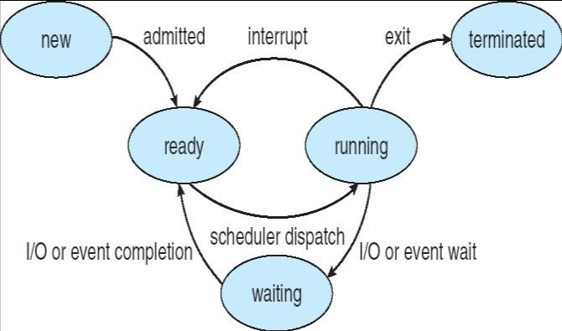
Semaphores without busy waiting
A semaphore S becomes a data structure:
A value
A waiting list L
A thread having to wait for a semaphore S, is blocked and added the waiting line S.L semaphore (see blocked state = waiting chap 3).
signal (S) removes (according to a fair policy, ex: FIFO) a thread of S.L and places it on the list of ready threads.
Module 5
Notes:
Struct semaphore
int value
semaph L
/*
S.value is the value of the semaphore
S.L is the queue associated with the semaphore
*/

Slide 45
Implementation
(the boxes represent non-interruptible sequences)
wait(S):
S. value--;
if S. value < 0
{ // CS busy
add this thread to S.L; block // thread put in wait state
}
signal(S):
S.value ++;
if S. value ≤ 0 {{ // threads are waiting
remove a process P from S.L;
wakeup(P)
// chosen thread becomes ready
}
S.value must be initialized to a non-negative value (application dependent, see examples)
Module 5
Notes:
Block as in block the process in the first segment

Slide 46
Wait and signal themselves contain CSs!
The operations wait and signal must be executed atomically (only one thread at a time)
In a system with only 1 CPU, this can be achieved by disabling interrupts when a thread is performing these operations.
Normally, we have to use one of the mechanisms seen before (special instructions, Peterson's algorithm, etc.)
The busy wait in this case will not be too
expensive because wait and signal are brief
Module 5
Notes:
Wait and Signal cannot be interrupted once it is being executed.

Slide 47
Classic synchronization problems
Bounded buffer (producer-consumer) Writers - Readers
The philosophers eating
Module 5

Slide 48
The producer - consumer problem
A classic problem in the study of communicating threads
a thread producer produces data (e.g. records in a file) for a thread consumer
Module 5
Notes:
Data inserted into a file for the consumer to consume

Slide 49
Communication buffers
Prod
Prod
1 data
1 data | 1 data | 1 data
Cons
Cons
If the buffer is of length 1, the producer and consumer must necessarily go at the same speed
Longer length buffers allow some independence. Eg. on the
right the consumer was slower
Module 5
48
Notes:
The producer can produce single messages at a time, or many messages and put them in the buffer before the consumer consumes the messages.

Slide 50
The bounded buffer (bounded buffer)
a fundamental data structure in OS
in: 1st pos.
free
b[0]
b[1]
b[0] | b[1] | b[2] | b[3] | b[4] | b[5] | b[6] | b[7]
b[7]
b[2]
or
b[6]
b[3]
in: 1st pos. free
out: 1st pos. full
b[5]
b[4]
out: 1st pos. full
blue: full, white: free
The bounded buffer is in the memory shared between consumer
and user
Notes:
in the producer and consumer example, we need to check the available spot first, then acquire access to the buffer, which is what the wait(e) line does (producer waits for free spot) and the wait(N) (consumer waits for data to be in buffer)
In points to the next free slot, and out points to the next (or first slot that is full)
The buffer is usually a circular buffer, thus it circles back to the first slot by the end.

Slide 51
Problem of sync between threads for the bounded buffer
Since the producer and the consumer are independent threads, problems could occur allowing concurrent access to the buffer
Semaphores can solve this problem
Notes:
Accessing the same buffer (write and read to same buffer), need to make the producer and consumer synchronized, and thus the same semaphores need to be utilized

Slide 52
Semaphores: reminder.
Let S be a semaphore on a CS
it is associated with a queue
S positive: S threads can enter CS
S zero: no thread can enter, no thread waiting S negative: | S | thread in queue
Wait (S): S - -
if after S >= 0, thread can enter CS if S < 0, thread is queued
Signal (S): S ++
if after S <= 0, there were threads waiting, and a thread is
awakened
Indivisibility = atomicity of these ops
Notes:
Recall:
Wait(S) and signal(S) being atomic (as in executed atomically) means no interruptions can occur WHILE these methods are being executed. Must completely finish without interruptions. And to achieve this atomicity (or indivisibility), we disable the interrupt before these methods (so before wait(s) and enable it afterwards (as in after signal(S))

Slide 53
Solution with semaphores
A semaphore S for mutual exclusion on access to the buffer
The following semaphores do not do Mutual Exclusion
A semaphore N to synchronize producer and consumer on the number of consumable items in the buffer
A semaphore E to synchronize producer and consumer on the number of free slots
Notes:
Consider a buffer with size n,
Every time a producer puts a message in the buffer, it has to access the buffer, and thus we need mutual exclusion for S so that only one of producer and consumer has access to the buffer. (Indicates when which is done accessing the buffer)
E controls the number of empty slot and N to control how many full slots are present in the buffer.

Slide 54
P / C solution: bounded circular buffer of dimension k
Initialization:S.count | = | 1; | // | mut. | excl.
N.count | = | 0; | // | full | slots
E.count = k; // empty slots
append (v): b[in] = v; in++ mod k;
Producer: repeat produce v; wait (E);
Consumer: repeat
wait (N);
wait (S);
wait (S);
w =take();
take ():
w = b[out]; out++ mod k; return w;
append(v);
signal(S);
signal(E); consume(w); forever
signal (S); signal (N);
forever
Critical sections
Module 5
53
Notes:
S → mutual exclusion to provide access to buffer
N → number of full slots of the buffer
E → number of empty slots of the buffer
S, initially set to 1, allows for switching between producer and consumer, so gives access to one when the other is done, but not both.
N, initially set to 0, since no full slots at the beginning.
E control the # empty slots → size of buffer == k
Producer produces a message, call it v, now we want to write/put it in the buffer. Before putting it there, we need to make sure an empty slot is available. By checking E (wait(E)), since initially it is k, then the producer will not wait/be blocked (k > 0), thus it proceeds to wait(S), to access buffer. S is 1 > 0, then it can access, so then append(v) is executed, to put message into the buffer. Now the producer no longer needs access to the buffer, so signal(S) is executed. Then, N needs to be incremented (via signal(N)) since one slot was filled up.
Now for consumer:
Wait(N) → if N = 0, well it will be stuck, continue to check. Otherwise, N > 0, no waiting. Then wait(S), if S <= 0, then consumer must wait, otherwise, consumer can access the buffer. Then it can take the message via w = take(), and then signal(E) to increment E again since slot has been cleared out. After, it can consume the message.
Append(v): put message v in the array at position in, the increment in mod k (since it is circular array)
Take(): out points to the first full slot, thus at that position, it is copied to w, and then out is incremented mod k, then return w.
The wait method is a complex function, and needs to finish with no interruption, hence its atomicity.

Slide 55
Important points to study
possible problems by interchanging the instructions on the semaphores
or by changing their initialization
Generalization in case of more producers and consumers

Slide 56
Important concepts in this part of Chap 6
The problem of the critical section Interlacing and atomicity Starvation and deadlock issues Software solutions
Hardware instructions
Busy or queued semaphores How the different solutions work
The example of the bounded buffer

Slide 57

Some examples
Classic synchronization problems Readers - Writers
The philosophers eating Monitors

Slide 58
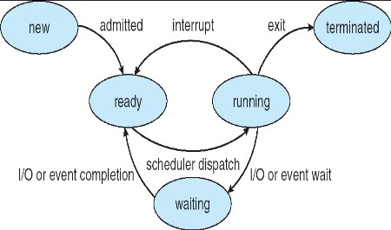
Semaphores: reminder
(the boxes represent non-interruptible sequences)
wait(S):
S. value--;
if S. value < 0 // CS busy
{
add this thread to S.L; block // thread put in wait state
}
signal(S):
S. value ++;
if S. value ≤ 0 {{ // threads are waiting
remove a process P from SL;
wakeup(P)
// chosen thread becomes ready
}
S.value must be initialized to a non-negative value (application dependent, see examples)

Slide 59
Semaphores: reminder.
Let S be a semaphore on a CS
it is associated with a queue
S positive: S thread can enter CS
S zero: no thread can enter, no thread waiting S negative: | S | thread in queue
Wait (S): S - -
if after S> = 0, thread can enter CS if S <0, thread is queued
Signal (S): S ++
if after S <= 0, there were threads waiting, and a thread is
transferred to a ready queue
Indivisibility = atomicity of wait and signal

Slide 60
Problem of readers - writers
Multiple threads can access a database
To read or write there
Writers should be in sync with each other and with readers
a thread must be prevented from reading while writing
two Writers must be prevented from writing simultaneously
Readers can access it simultaneously
Notes:
Consider many writers and readers are present, where a database is being modified by said readers and writers. As such, synchronization is necessary between them. Cannot allow writers to write at the same time, and writing to be done while reading is being done.
What if no writers were there, then no synchronization is needed if only readers are present.

Slide 61
A solution (does not exclude starvation)
Variable readcount: number of threads reading the database Semaphore mutex: protects the CS where readcount is updated
Semaphore wrt: provide mutual exclusion between Writers and readers
Writers should wait on wrt
for each other, or
and also the end of all readings (a reader is there)
Readers should
wait on wrt when there are writers who write
block writers on wrt when there are readers who read restart writers when no one is reading

Slide 62
Input and Writers
Input: two semaphores and one variable
mutex, wrt: semaphore (init. 1); readcount: integer (init. 0); (no readers in the beginning)
Writer
wait (wrt);
. . .
// write
. . .
signal (wrt);
Notes:
Wait to get the lock (as in to open it) before accessing the database, write the necessary, and then signal the lock back on

Slide 63
The readers
wait (mutex);
readcount++;
if readcount == 1 then wait (wrt);
signal (mutex);
The first reader in a group might have to wait on wrt, they should also block writers. When he enters, the following will be able to enter freely
// CS: read
wait (mutex);
readcount--;
if readcount == 0 then signal (wrt); signal (mutex):
Last outgoing reader must allow writers access
Notes:
Every time a CS is in action, a lock needs to be obtained, that allows it to enter the CS, and once done, the lock is released by signal(mutex). Mutex is the semaphore associated with updating the readcount (that is shared)
Imagine the first reader comes in (where mutex is initialized to 1), no waiting occurs, thus readcount is now 1. Now, what if another reader comes in, since the value of mutex is 0, the reader would have to wait. Even if there was a writer (wrt) initially, then then first reader would wait on the writer rather in the beginning, while the second reader would need to wait on mutex (mutex went from 1 to 0)
rc → readocunt
mutex and wrt are semaphores that are initialized to 1. Also, rc is a variable that is initialized to 0. The mutex semaphore ensures mutual exclusion and wrt handles the writing mechanism and is common to the reader and writer process code.
The variable rc denotes the number of readers accessing the object. As soon as rc becomes 1, wait operation is used on wrt. This means that a writer cannot access the object anymore. After the read operation is done, rc is decremented. When rc becomes 0, signal operation is used on wrt. So a writer can access the object now.

Slide 64
Observations
The 1st reader that enters the CS blocks the writers (wait (wrt)), the last reader (releases the lock) restarts them (signal (wrt))
If 1 Writer is in the CS, 1 reader waits on wrt, the others on mutex
a signal (wrt) can run a reader or a writer

Slide 65

The Dining Philosophers Problem
5 philosophers think, eat,
think, eat, think ….
In the center a bowl of rice. Only 5 chopsticks available.
Require 2 chopsticks for eating: 1 from left, 1 from right
A classical synchronization
problem
Illustrates the difficulty of allocating resources among process without deadlock and starvation
64

Slide 66
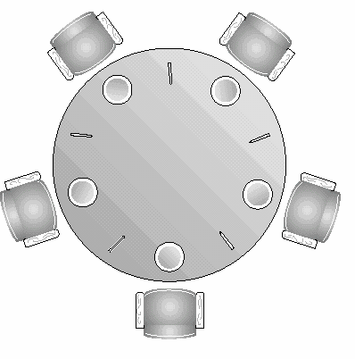




The Dining Philosophers Problem
Each philosopher is a process
Process Pi:
One semaphore per chopstick:
So that two philosophers cannot grab the same chopstick simultaneously
semaphore chopst[5];
Initialization:
chopst[i].value=1 for i = 0 to 4
while(true)
{
think(); wait(chopst[i]);
wait(chopst[(i+1)%5]); eat(); signal(chopst[i+1)%5]); signal(chopst[i]);
}
Does it work?
What happens if each philosopher starts by
picking his left chopstick?
Deadlock! Poor philosophers, they should know better…
65
Notes:
To eat, chopstick from left, then from right.
To finish eating, signal right chopstick, and then left.
Each philosopher is treated as a process, and a semaphore is declared for each chopstick. Since there are 5, then an array for that is created, each with a value of 1. When a philosopher is not eating, it is thinking → cycle of think, eat, think, eat
Wait for chopsticks → pick them up
Signalling chopsticks → releasing them
A deadlock may occur:
Imagine if all philosophers were thinking and then decided to eat. Thus each requires 2 chopsticks at the same time, where each pick up the left chopstick at the same time. As such, then the right chopstick cannot be picked up by any of them, for any of them. Thus, the process cannot proceed.
All the four starting philosophers (P0, P1, P2, and P3) should pick the left chopstick and then the right chopstick, whereas the last philosopher P4 should pick the right chopstick and then the left chopstick. This will force P4 to hold his right chopstick first since the right chopstick of P4 is C0, which is already held by philosopher P0 and its value is set to 0, i.e C0 is already 0, because of which P4 will get trapped into an infinite loop and chopstick C4 remains vacant. Hence philosopher P3 has both left C3 and right C4 chopstick available, therefore it will start eating and will put down its both chopsticks once finishes and let others eat which removes the problem of deadlock.

Slide 67
The Dining Philosophers Problem
A solution: allow only 4 philosophers at a time to try to eat
Then 1 philosopher can always eat when the other 3 are holding 1 chopstick
Hence, we can use another semaphore T that would limit at 4 the number of philosophers trying to take a chopstick
How to initialize T.count?
T.value = 4
Process Pi:
while(true)
{
think();
wait(T);
wait(chopst[i]);
wait(chopst[(i+1)%5]); eat(); signal(chopst[(i+1)%5]); signal(chopst[i]); signal(T);
}
66
Notes:
Treat as if only 4 bowls left, while same number of chopsticks are present.

Slide 68
Advantage of semaphores
(compared to previous solutions)
Only one shared variable per critical section
only two operations: wait, signal
more localized control (only with the previous ones)
easy extension in case of more. threads possibility of bringing in more. threads both in a critical section
management of queues by the OS: starvation avoided if the OS is fair (eg FIFO queues)
Notes:
Advantage of semaphore is that it allows to protect the shared variable. Every time a process wants to modify or access the semaphore for modification, wait needs to be called first, and the signal after finishing the modification.

Slide 69
Problem with semaphores: programming difficulty
wait and signal are scattered among several threads, but they must match
See. bounded buffer program
Usage must be correct in all threads
A single “bad” thread can cause an entire collection of threads to fail (e.g. forgot to signal) Consider the case of a thread that has
waits and signals in loops and tests ...
Notes:
Forgetting a wait or signal, or even misplacing them will lead to a problem.
Misuse of threads can lead to huge problem.

Slide 70

Monitors: another solution
Constructions (in high-level language) which provide functionality equivalent to semaphores but easier to control
Available in:
Concurrent Pascal, Modula-3 ...
synchronized method in Java (simplified monitors)
Notes:
Instead of letting the programmer insert the wait and signal, allow a programming language to do it for us → a joint solution/effort between OS and compiler.
Monitors in Operating System
Monitors are used for process synchronization. With the help of programming languages, we can use a monitor to achieve mutual exclusion among the processes. In other words, monitors are defined as the construct of programming language, which helps in controlling shared data access. The Monitor is a module or package which encapsulates shared data structure, procedures, and the synchronization between the concurrent procedure invocations.
Although, procedures outside the monitor but in the same class can be called without any prevention of the processes.

Slide 71
Monitor
Is a module containing: one or more procedures an initialization sequence local variables
Characteristics:
local variables accessible only by using a monitor procedure
a thread enters the monitor by invoking one of its procedures
only one thread can execute in the monitor at any moment (but more threads can be waiting in the monitor)
Notes:
Consider shared data pieces A and B, and processes P1 and P2 who want to access A and B. Remember, two processes cannot access the same piece of data at the same time (problems would occur). So, to allow that without causing problems, a monitor can contain that data/resource, and whenever a process wants to access the resource, it has to go through this module (monitor). To access the resources, the processes call the procedures within the module. The monitor would allow only one process to enter the monitor at a time (it is prevented by the monitor)
So the local variables (data/resource), these are the data that needs to be accessed by the outside world and the monitor has to protect those variables, protecting them by using monitor procedures by making the external processes call these methods or these procedures to access the local data here.
The module contains resources for the processes to access, and they call a procedure to access the module.
Every monitor has a lock associated with it, where only one thread will be within the monitor at a time.
Single or multiple procedures can be associated for one local variable, such as putMessage and getMessage for a buffer from a producer and consumer perspective.

Slide 72

Monitor
It alone ensures mutual exclusion: no need to explicitly program it
We ensure the protection of shared data by placing it in the monitor
The monitor locks the shared data when a thread
enters it
Thread synchronization is performed by using conditional variables which represent conditions after which a thread might wait before executing in the monitor
Notes:
Synchronization is done inside and outside the monitor, which are maintained by conditional variables.
For example, a producer-consumer processes are trying to access the monitor, where the buffer variable to be accessed is empty. Then this empty is used as a conditional, where the consumer would need to check that if the buffer is empty, what can it do based on that.
There is a queue associated with the conditional variable, where the process consumer is located inside it. Before being blocked by the monitor, it will release the lock, for the producer to access the monitor.
Blockage of processes are required outside the monitor since one process is already inside the monitor (the others are put in the queue associated with the monitor) and a block can be done inside where the process inside the monitor is inserted to queue associated with a conditional variable.
External synchronization happens when multiple threads want to access the monitor at the same time, whereas only one can do that at a time. As such, the rest will be put in the queue associated with the monitor. Until the first thread leaves the monitor, it releases the lock, and allow the next thread in line of the queue to access the monitor. A monitor lock is the mechanism handling this action.
Internal synchronization must be provided with conditional variables. Consider a buffer (an array) in the monitor, with procedures to access the buffer (putMessage, getMessage). A producer and consumer process outside the monitor trying to access the buffer. If the consumer wants to access and calls getMessage, it must first check if the buffer is empty. If it is, then the buffer must use a conditional variable (call it empty). The producer would not be able to access (prevented) and rather it is put inside a queue outside the monitor. Since the consumer wants get a message it must wait until the buffer is non-empty, so it waits by being placed in the queue associated with the conditional variable. As such, it would be blocked from access, but before this, it releases the lock of the monitor to producer, so now producer can access the monitor while the consumer is waiting. Now the producer is inside, and can now call putMessage to a put a message inside the buffer. After doing so, it has to release a signal to wake up the consumer, and then leave the monitor, releasing the lock to the consumer.

Slide 73
General structure of the monitor (Java style)
monitor monitor-name
{// vars declarations
public entry p1 (...) {method code p1} public entry p2 (...) {method code p2}
. . .
}
The only way to manipulate the internal vars of the monitor is to call one of the input methods

Slide 74
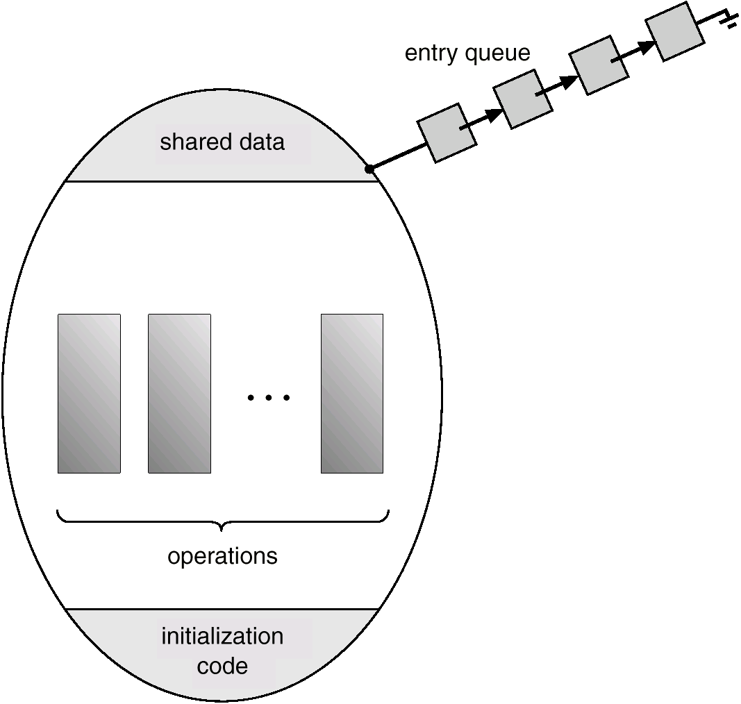
Notes:
Only one process can be inside the monitor, where the other processes are in the entry queue outside the monitor.

Slide 75
Conditional variables (do not exist in Java)
are local to the monitor (accessible only within the monitor)
can be accessed and changed only by two functions:
x.wait() blocks execution of the calling process/thread on condition (variable) x
the process/thread can resume execution only if another process/thread executes x.signal()
x.signal() resume execution of some process/thread blocked on condition (variable) x.
If several such process exists: choose any one (first is preferred)
If no such process exists: do nothing (no effect)
75
Notes:
Let x be the conditional variable:
Consumer calling the x.wait would cause the consumer to block the execution of the called procedure, and then be put in the queue associated with x. Only can resume after being released by another process (signal from producer) by x.signal from consumer.

Slide 76
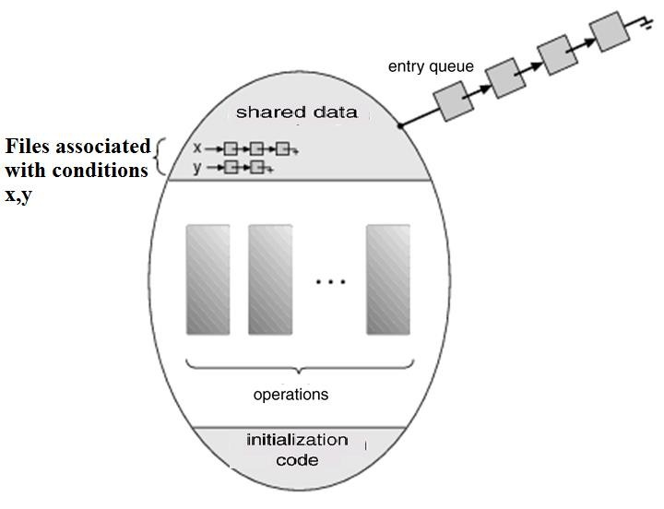
Monitor with Conditional Variables
In a bank, there is a main line, but once you enter you could be made to wait in a chair until the teller is available
76

Slide 77
A Problem with signal()
Say a thread/process P executes x.signal() and frees a thread/process Q,
Now, 2 threads/processes that want to execute, P and Q – not allowed
Two possible solutions:
Signal and Wait
P waits until Q leaves the monitor (e.g. in a special queue – urgent – see Stallings).
Signal and Continue
P continues its execution and Q waits until P leaves the monitor
77
Notes:
If there are no processes that need to be awaken, then the signal call will have no effect

Slide 78
Back to the Dining Philosophers Problem
5 philosophers think, eat, think, eat, think ….
In the center a bowl of rice.
Only 5 chopsticks available.
Require 2 chopsticks for eating.
A classical synchronization. problem
78

Slide 79
Dinning Philosophers: A Monitor
Define the monitor « dp » (dining philosophers) Shared variables: each philosopher has its own state that can be: (thinking, hungry, eating)
philosopher i can only have state[i] = eating if its neighbors are not eating
Conditional variables: each philosopher has a
condition self
the philosopher i can wait on self [ i ] if it wants to eat but cannot obtain 2 chopsticks
Four functions
pickup(i) – philosopher i wants to pick up chopsticks putdown(i) – philosopher i puts down his/her chopsticks test(i) – test the state of philosopher i Initialization_code() - initialization
79

Slide 80
Philosopher i executes the loop:
while(true)
{
dp.pickup(i) eat dp.putdown(i)
}
80
Notes:
Every philosopher has the given structure, and every time a philosopher wants to eat, has to call the pickup method from the monitor dp. When successful, then the eat method can be called, and then putdown method is called by the dp.
Monitor:
pickup(i)
Putdown(i)
Test(i)
State[]
Self[]

Slide 81
A philosopher eats
void test(int i)
{
if ( (state[(i + 4) % 5] != EATING) && (state[i] == HUNGRY) && (state[(i + 1) % 5] != EATING) )
{
state[i] = EATING; self[i].signal();
}
A philosopher eats if his/her neighbors do not eat and he/she is hungry.
When the philosopher starts eating, a signal allows the
philosopher to leave the semaphore.
No change in state occurs if tests fail.
}
81
Notes:
If the conditions fail, it means one (or both) of the neighbours are eating. However, if the neighbours are not eating, no reason for the main i to not be eating.
The self.signal line is not a release of sorts, it is for waking up the other philosohpers

Slide 82
Pickup Chopsticks
void pickUp(int i)
{
state[i] = HUNGRY; test(i);
if (state[i] != EATING)
self[i].wait();
}
Philosopher tries to start eating by doing a test. If it comes out of test not eating, must wait – blocs until the execution of self[i] signal()
82
Notes:
Slide shows the code for philosopher calling pickup(i):
Change the state of i to hungry
Test(i) → test the neighbours around philosopher I
Then, checking the state of i, where if eating, then do nothing. Otherwise, need to wait, which is checked by putDown method

Slide 83
Put down Chopsticks
void putDown(int i)
{
state[i] = THINKING;
// test the two neighbors
test((i + 4) % 5);
test((i + 1) % 5);
}
Once eating is done, a philosopher tries to get his/her neighbors eating using test.
83

Slide 84
Relationship between monitors and other mechanisms
The monitors are implemented using semaphores or other mechanisms already seen
It is also possible to set up semaphores using monitors!
See text

Slide 85
The problem of CS in practice ...
Real systems make available several mechanisms which can be used to achieve the most efficient solution in different situations (must be aware of the complexities of synchronization)

Slide 86
Important concepts in Chapter 6
Critical sections: why
Difficulty of the synch problem on CS
Good and bad solutions
Atomic access to memory Pure software solutions
Hardware solution: test-and-set
Solutions by system calls:
Semaphores, monitors, operation
Typical problems: bounded buffer, reader- writers, philosophers

