Slide 1



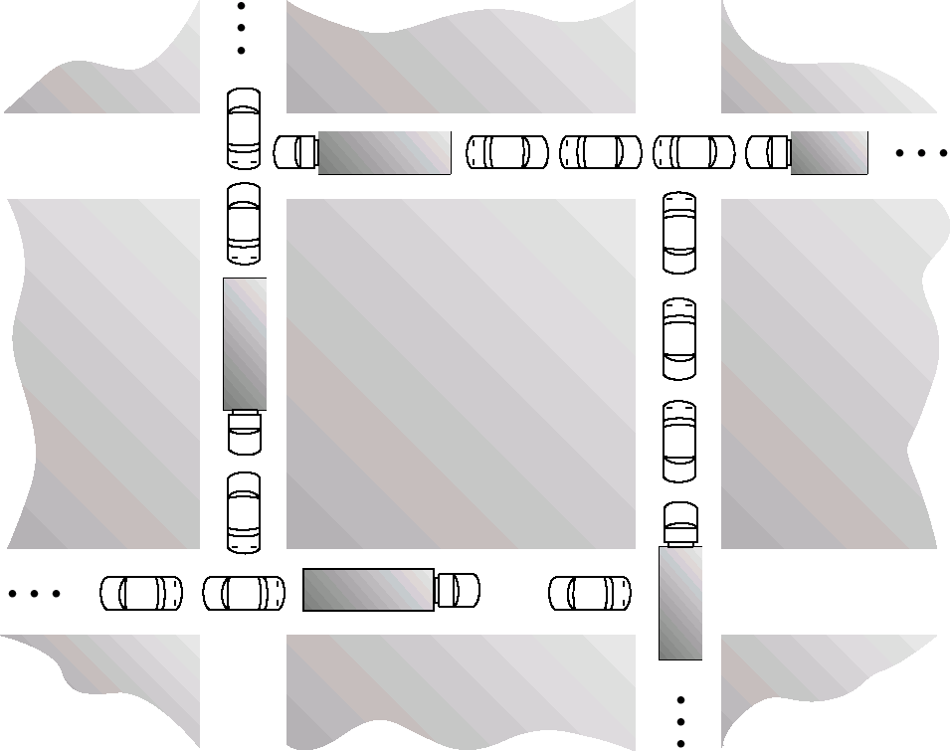

Chapter 7 (Silberchatz)
Module 6
1

Slide 2



Deadlocks: important concepts
The deadlock problem Characterization: the 4 conditions
Resource allocation graphs Safe sequences
Methods of dealing with deadlocks
Prevent deadlocks Avoid deadlocks
Safe and unsafe states
Detect deadlocks
Recover from deadlock
Module 6
2

Slide 3



Example 1
Two processes coexist in a system, which has 2 telephone
lines. only
Process 1 needs
a phone line to get started
the previous line, and an additional one, to finish
Process 2 is the same Deadlock scenario:
process 1 request 1 line
process 2 requests 1 line: both lines are engaged
deadlock! no proc can complete
unless one of the process can be suspended
or can go back
Observe that deadlock is not inevitable, e.g. if 1 completes before the start of 2
When does it become inevitable?
Module 6
3
Notes:
When processes are running and require resources, the process puts a lock on that resource, so that no other process can use it.

Slide 4
Example 2
Semaphores
P₀
wait (A);
wait (B);
P₁
wait(B) wait(A)
Deadlock Scenario: initialization of A and B to 1 P0 executes wait (A), A = 0 P1 executes wait (B), B = 0 P0 and P1 cannot go further
What happens instead if P0 fully executes before P1?
Module 6
4
Notes:
Recall that in semaphores, P0 cannot use B since P1 is using it, and vice versa for A

Slide 5


Definition (Tanenbaum)
A set of blocked processes each holding a resource and waiting to acquire a resource held by another process in the set
A resource can be a signal, a message, a semaphore, etc.
Interesting example: deadlock between readers or writers on a database ???
Module 6
5
Notes:
Processes become blocked because they hold some resources, but need other resources which are held by other processes → deadlock situation.

Slide 6
System Model
Resource types R₁, R₂, . . ., R_{m}
CPU cycles, memory space, I/O devices
Each resource type R_{i} has W_{i} instances.
2 printers, three hard drives, etc.
Each process utilizes a resource as follows (using
system calls):
request use release
Deadlock example
Three processes each hold a CD drive. Each process requires a 2nd drive.
Multithreaded programs are good candidates for deadlock
Threads share many resources.
6
Notes:
Structure of resource usage: Need to be requested for acquirement, once acquired the resource, it can be used, and once done using, it can be released.
For the example given, the deadlock originates from the 2nd drive being used by all processes, when it cannot be shared simultaneously

Slide 7






Deadlock characterization
Deadlock requires the simultaneous presence of 4 conditions
(necessary conditions)
Mutual exclusion: the system has non-shareable resources (only 1 process at a time can use the resource, no sharing simultaneously)
E.g .: CPU, memory area, peripheral, but also semaphores, monitors, critical sections
Hold and wait: a process holding a non shareable resource and is
waiting to acquire additional resources held by other processes.
No preemption: a resource can be released only voluntarily by the process holding it, after that process has completed its task.
Circular wait: there is a process cycle such that each process to complete must use an unshareable resource which is used by the next, and which the next will keep until terminated
When the first 3 conditions exist, the circular wait is an indication of a deadlock.
The first 3 conditions do not imply necessarily a deadlock, since the circular wait may not occur.
Module 6
7
Notes:
A resource cannot be used at the same time by multiple processes. Shared for access, not for usage
Printers: 2 processes cannot use a printer to print at the same time. Although shared for access, but not for function. That is one at a time.
Exemption: if a file is used for reading between multiple processes, then the file can be a shared resource, and used simultaneously. However, if writing is involved, with reading or writing again, then sharing is not allowed.
Consider 2 processes and 2 printers, and both processes need both printers. Where P1 is using printer1 and wants to use printer2. If printer2 is assigned to P2, then P1 must hold onto printer1, and wait for printer2. If P1 does not need printer1, then printer1 will be released and the assigned to P2.
Continuing from the example, since printer2 is held by P2, and printer1 is held by P1, even if P1 has higher priority than P2, printer2 cannot be released by P2, until the task is done.
A process waits for a resource of another process, and this process waits for the resource that a third process is using, and the cycle goes on.

Slide 8
Circular wait - none let go - no process can complete so deadlock
P4
P0
P3
P2 P1
Finally, each process must hold a resource that the next will not let go → deadlock
Module 6
8

Slide 9
Exercise
Think about this example where cars are in a deadlock situation on a bridge and see how the different conditions are met.
See also the example on page 1.
Module 6
Notes:
Cars need to go back and let the other car go first. The middle (bridge) can only hold one car at a time

Slide 10

Exercise
Consider a system in which each process needs only one resource throughout its existence
Deadlock, is it possible?
Module 6
Notes:
The hold and wait condition cannot be satisfied, thus no deadlock occurs.
Even if P1 uses R1, and P2 uses R2 while wanting R1, it can just wait until P1 finishes.
If all the process only need one resource, one of them will be running before the others. Let’s say P1 will run before others. It will use that resource, finish, then release it for others. Whichever process is faster, will be assigned to the resource, and same action will happen.
There is a wait, but no hold. Since nothing is stopping P1 from using the resource, then it WILL finish the task and P2 will just have to wait for P1 to finish. Then P3 will just wait for P2 to finish. There is no hold, just a wait that will eventually end. In this case it executes sequentially, just waiting for the P before him to finish using the R

Slide 11
Resource-Allocation Graphs
A set of vertices V and a set of edges E V is partitioned into:
P = {P₁, P₂,…, P_{n}}, the set which consists of all the process in the system
R = {R₁, R₂,…, R_{m}}, the set which consists of all types of resources in the system
Request edge - directed edge P_{i} → R_{k}
Assignment edge - directed edge R_{i} → P_{k}
Module 6
Notes:
A vertex can be a process type or resource type
Directed from process to resource: request edge
Directed from resource to a process: assignment edge

Slide 12
Resource-Allocation Graph (Cont.)
Process
Resource Type with 4 instances
Request Edge: P_{i} requests instance of R_{j}
P_{i}
R_{j}
Assignment Edge: P_{i} is holding an instance of R_{j}
P_{i}
R_{j}
12
Notes:
Resource type (example: printer) → has instances in it (here: 4 printers in this resource)
Any instance satisfies the process that requests the instance of the resource

Slide 13
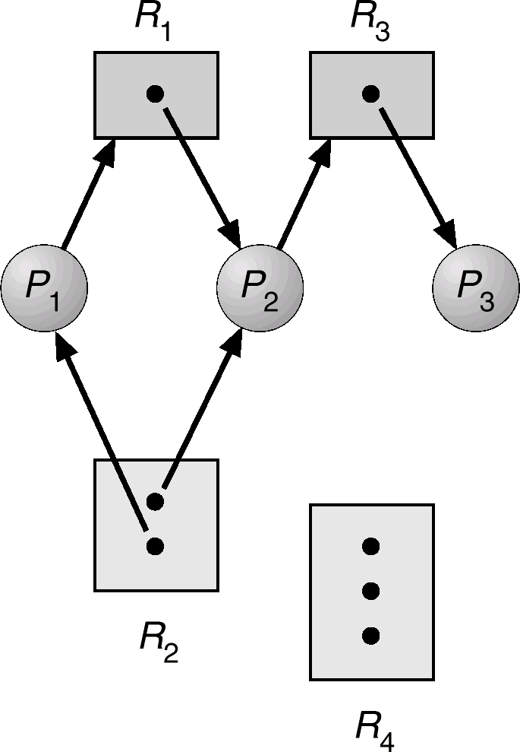
Example of a Resource Allocation Graph
P1 waiting
P3 not waiting
P2 waiting
Is there a deadlock?
Module 6
Notes:
To prove that there is no deadlock in a Resource Allocation Graph
Need to find a safe sequence (termination sequence → a sequence by which the process finishes)
Resource held on by a process → resource required by a process
P3 will finish first since it is not waiting for any other resource. Once done, then the instance of R3 is released (free), thus P2 can acquire it. After P2 is done, R3 is released, as well as the instance of R2.
Safe sequence: <P3, P2, P1>
No pre-emption is like P1 cannot forcefully get R1 since it is held by P2. Cannot allow P1 to get R1 since it is held by P2.
Hold and wait means P1 must hold onto R2 instance while wait for R1 instance

Slide 14
Using these graphs
We assume the existence of the first 3 conditions
Mutual Excl., hold and wait, no preemption
To show that there is no deadlock, we must show that there is no cycle (otherwise, circular wait), because there is a process which can terminate without waiting for any other, and then the others can terminate immediately
<P₃, P₂, P₁> is a process termination sequence: all can finish in this order
Module 6
Notes:
It also depends on the number of instances available in each resource.
Only one sequence is enough to find whether a graph can be proven that there is no deadlock.

Slide 15
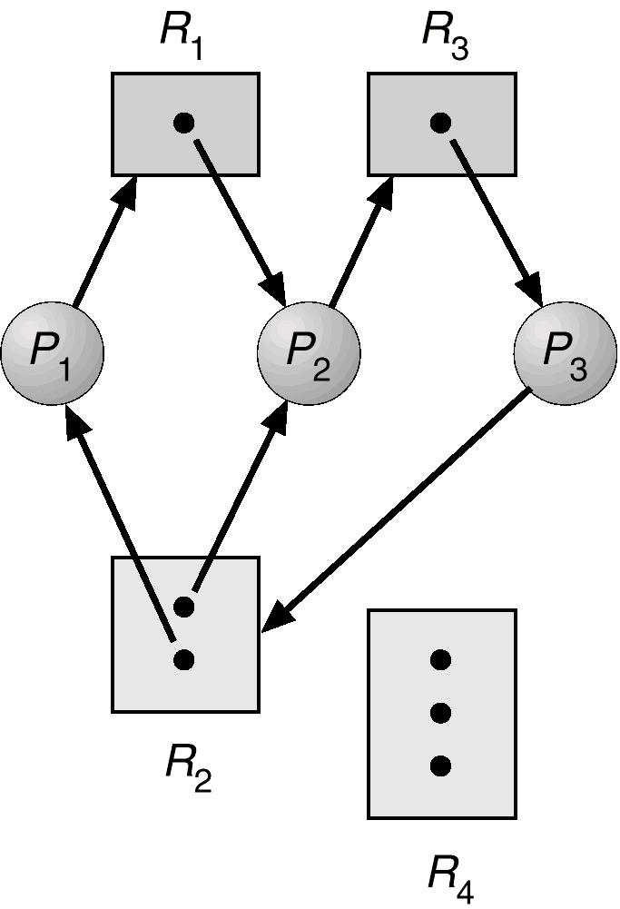
Resource allocation graph with deadlock
Cycles:
P1 → R1 → P2 → R3 → P3
→ R2 → P1
P2 → R3 → P3 → R2 → P2
no process can terminate
no possible way out
Module 6
Notes:
A graph without a cycle → no deadlock
A graph with a cycle → may or may not have a deadlock

Slide 16
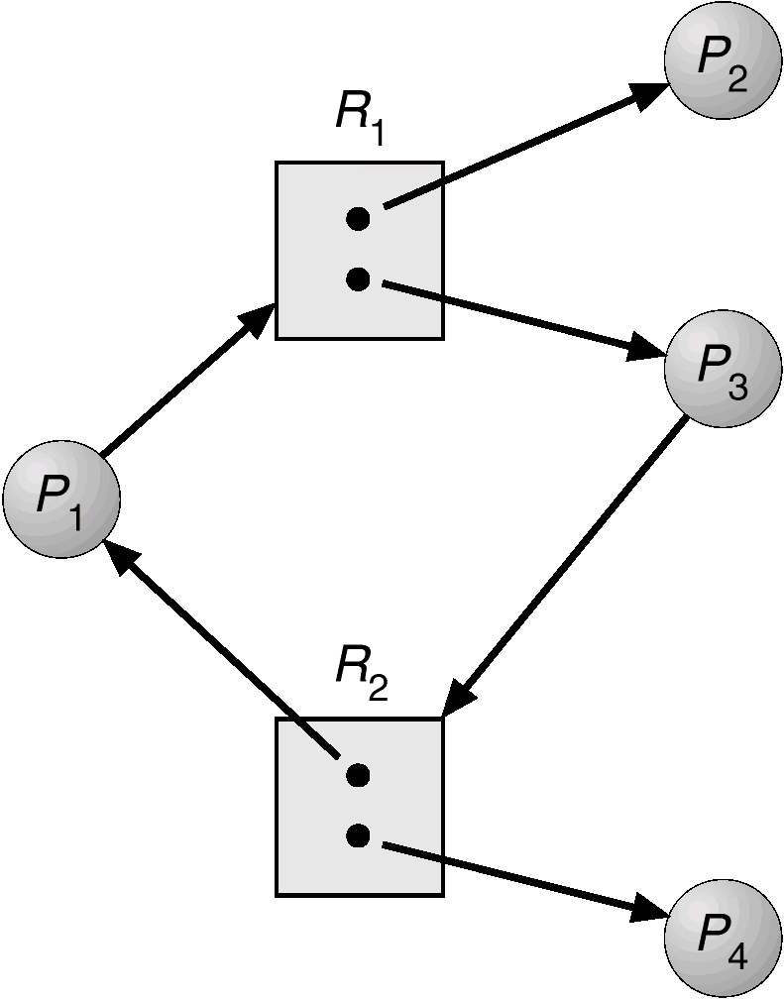
Resource allocation graph with cycle, but no deadlock (Why?)
Circular wait, but resources may become available
Module 6
Notes:
<P2, P1, P3>
No deadlock: P4 would finish first which then a instance of R2 is released (same for P2 releasing an R1 instance). As such, then P3 can then finish (or P1 finish), and continuing this, deadlock is broken.

Slide 17

Basic Facts
The cycles in the resource allocation graph do not necessarily signal a circular wait
If there are no cycles in the graph, no deadlock If there are cycles:
If only one resource per type, deadlock
(Why?!) → all are holding an instance while waiting for another
If several resources per type, possible deadlock
The question must be asked: is there a process that can terminate and if so, what other processes can terminate as a result?
Module 6
Notes:
Regarding the first point if there are cycles:
Holding one resource and requesting another resource while being held by another process, hence the deadlock that is created.

Slide 18
Termination hypothesis
A process which has all the resources it needs, it uses them for a finite time, then it frees them
We say the process ends, but it could also continue, no matter what.
Module 6
Notes:
A process terminating here means that it is done with the resources (no longer requiring them), while still running.

Slide 19
Difference between request and wait
In reality, a process that requests a resource does not necessarily have to stop immediately while waiting for it to be given to it ...
However if the resource is not given to it, it will have to stop at some point.
So in the deadlock analysis we make the assumption that a process stops when it requests a resource, if this request is not satisfied immediately
Module 6
Notes:
When a process requests a resource, and the resource cannot be given to the process, the process will thus be blocked from it.

Slide 20

Methods for handling deadlock
Prevent: design the system in such a way that deadlock is not possible
difficult, very restrictive suitable for critical systems
Avoid: deadlocks are possible, but are avoided
(avoidance)
Detect and recover: Allow deadlocks, recover after
Ignore the problem and pretend that deadlocks never occur in the system.
Used by most operating systems, including UNIX/Windows
Module 6
Notes:
Ensure that the system will never enter a deadlock state
Allow the system to enter a deadlock state and then recover
Ignore the problem and pretend that deadlocks never occur in the system; used by most operating systems, including UNIX
Restrain the ways request can be made

Slide 21

Deadlock Prevention: prevent at least one of the four conditions that lead to deadlock
Mutual exclusion: reduce as much as possible the use of shared resources and critical sections (almost impossible).
Hold and wait: a process that requests new resources cannot hold up other processes (ask for all resources at once).
No pre-emption: If a process asks for resources and cannot obtain them, it is suspended and its resources already held are released.
Circular wait: define an request ordering for resources, a process must ask for resources in this order (e.g. always ask for the printer before the tape drive) (see section 7.4.4 in the textbook for more details).
21
Notes:
If shareable resources are present, then mutual exclusion cannot happen. In some cases, deadlock can be mitigated by making resources more shareable. For example, using a reader/writer lock instead of a mutex can make deadlock less likely (since many readers can share the read lock). Using a lock-free data structure is another way to allow multiple threads to access a data structure simultaneously (without blocking).
However, many resources are inherently non-shareable (e.g. printers: can't print two documents simultaneously!). Mutual exclusion is a good condition to break if you can, but often you can't.
If a process needs multiple resources, then call/request all of them at the same time initially, to be allocated for that process, instead of it holding onto a resource and wait for another. If allowed to have all of them, then acquire them and use them, and once done with them, release them all in the end
While P1 has R1 and needs R2, but R2 is held by P2, then P1 can be suspended locked (since it cannot proceed), releasing the resources held by it as well, becoming available for other processes.
Define a mathematical function f, that maps each resource to N (assigns every resource a number)
R = {R1, R2, R3} → f(R1) = 2, f(R2) = 4, f(R3) = 6
To define a request ordering for the resources:
Now, if a process needs R1 and R2, it must request in order with R1, then R2. As such, if all processes ask for resources in this order, then circular wait cannot happen. Proof by contradiction can be used to prove why it does not happen.
If P1 requests R1, where P2 is holding it, and P2 requests R2, that is held on by P3. P3 requests R3, that is held on P1.
f(R1) < f(R2) < f(R3) < f(R1) → this is impossible (f(R1) < f(R1) is not valid)

Slide 22
Deadlock Avoidance
Requires that the system has some additional a priori
information available.
Simplest and most useful model requires that each process declare the maximum number of resources of each type that it may need.
The deadlock-avoidance algorithm dynamically examines the resource-allocation state to ensure that there can never be a circular-wait condition.
Resource-allocation state is defined by the number of available and allocated resources, and the maximum demands of the processes.
22
Notes:
Consider a set of processes are present and we know the amount of instances per resource type.
In the set of resources R, by a vector representation: R = [5 4 2] where R → [R1 R2 R3] (each entry defines the maximum number of instances per resource type
Assume that each process declares the maximum number of instances that it may need during its execution/lifetime.
R1 R2 R3
P1 2 1 1
P2 3 0 2
P3 1 1 1
P4 0 2 1
The algorithm will use another matrix to show how many of these instances have been allocated to these processes, at some point in time t. To examine that the system will always find a way out, using a termination sequence.

Slide 23
Safe State
When a process requests an available resource, the system must decide if immediate allocation leaves the system in a safe state.
What is a safe state?!
System is in safe state if there exists a
safe sequence of all processes.
23
Notes:
The system cannot really allow immediately to release the resource once a process requests it.
Consider: P1, P2, P3
If a termination sequence can be found such as <P2, P3, P1>, then they are in safe state

Slide 24
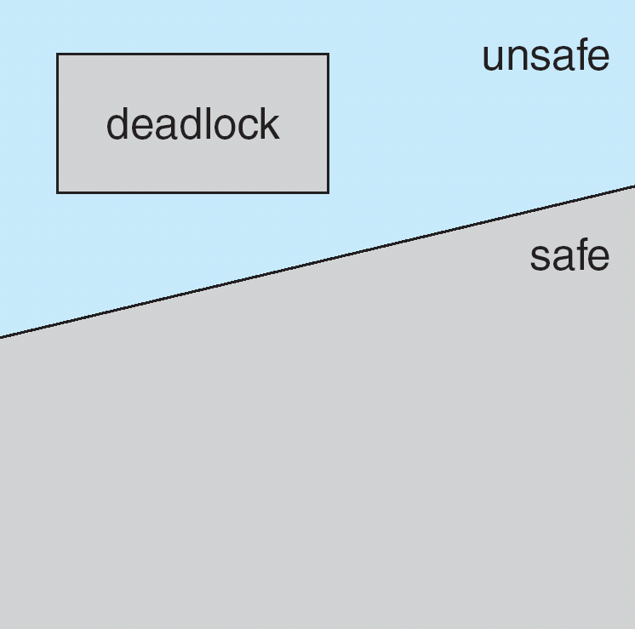
Basic Facts
If a system is in safe state ⇒ no deadlock possible (i.e. the system can exit without deadlocks (all processes will finish one after another)
If a system is in unsafe state ⇒
possibility of deadlock.
Avoidance ⇒ ensure that a system will never enter an unsafe state (i.e Do not allocate a resource to a process if the resulting state is not safe.
24
Notes:
The algorithm must be careful while allocating resources to processes. Although it can still release resources, the system can still be in an unsafe state.

Slide 25

Safe Sequence
Safe sequence is a sequence witnessing that we can run all processes to completion
P₁ is the process that can be run to completion using
only the available resources
P₂ is the process that can be completed when P1 completes and releases its resources… Sequence <P₁, P₂, …, P_{n}> is safe if for each P_{i}, the
resources that P_{i} can still request can be satisfied by
currently available resources + resources held by all the P_{j} that were released, with j < i.
If P_{i} resource needs are not immediately available, then P_{i} can wait until all P_{j} have finished.
When P_{j} is finished, P_{i} can obtain needed resources,
execute, return allocated resources, and terminate.
When P_{i} terminates, P_{i+1} can obtain its needed resources, and so on.
25
Notes:
Recall: safe sequence
All processes can finish or terminate one after another at some point.

Slide 26

Safe Sequence
A sequence of processes <P₁, P₂,…, P_{n}> is safe if for each Pi, the resources that P_{i} can still request can be met by currently available resources + resources used by the P_{j} that precede them (i.e P_{j}, with j < i).
When P_{i} succeeds, P_{i} + 1 can get the resources it needs, and terminate, so:
<P₁, P₂,…, P_{n}> is a process termination sequence or a safe sequence: all can end in this order
Module 6
26

Slide 27
Resource-Allocation Graph Algorithm
First consider the simpler case of one-instance resources
Note: in such case, a cycle in the Resource-
Allocation graph implies deadlock
Lets introduce claim edges:
Claim edge P_{i} → R_{j} indicates that process P_{j} may
request resource R_{j}; represented by a dashed line.
Claim edge is converted to request edge when a process requests a resource.
When a resource is released by a process, assignment
edge reconverts to a claim edge (process may request it back)
Resources must be claimed a priori in the system.
The algorithm: if satisfying request creates a cycle
in the modified R-A graph (including claim edges), reject the request
27
Notes:
A new type of edge: claim edge
Directed from process to resource, where a process may request a resource (not definite, as in it has not requested it yet) during its execution (some time in the future)

Slide 28
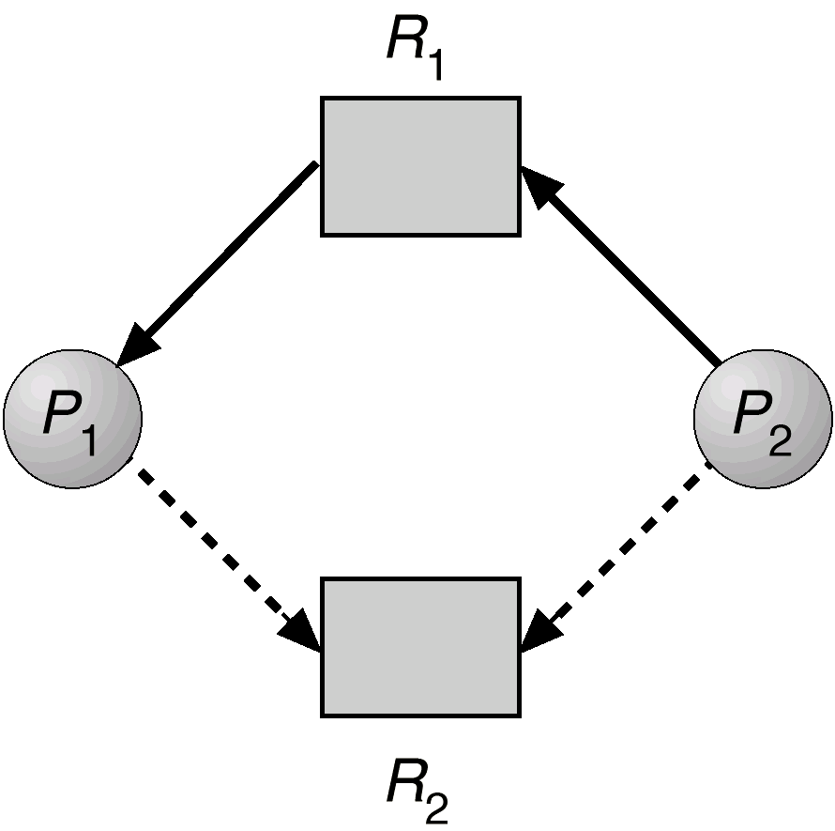






Resource allocation graph with a claim edge
Continuous line: current request; dashes: possible request in the future
Module 6
28
Notes:
AE: assignment edge
RE: request edge
CE: claim edge
A safe state graph, no deadlock (yet), where P2 has not requested R2 (yet)

Slide 29
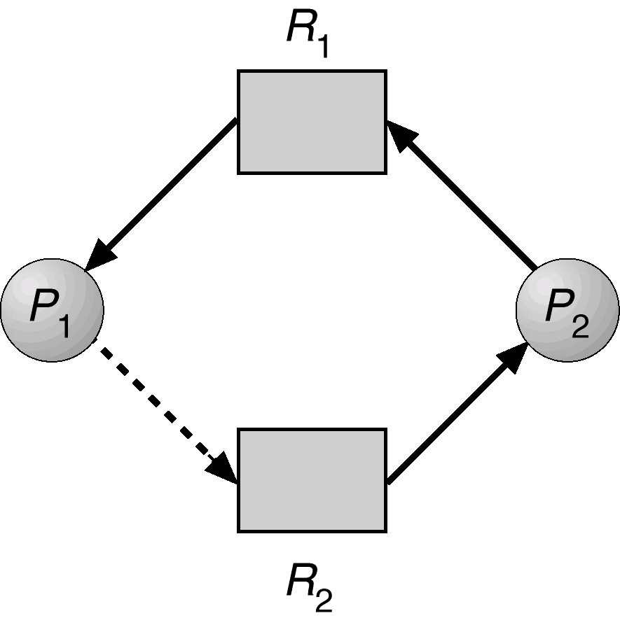
Unsafe State In Resource-Allocation Graph
If P1 requests R2, the latter cannot be given to it, because this can cause a cycle in the graph: P1 req R2,
Notes:
If P1 requests R2, then we will have a cycle (circular wait). As such, R2 cannot be given to P2 as a result.

Slide 30
Refusal to allocate a resource: the banker's algorithm
Processes are like customers who want to borrow money (resources) from the bank ...
A banker shouldn't lend money if he can't meet the needs of all his clients
At all times the state of the system is defined by the values of R(i), C(j, i) for any type i and process j, and by other values of vectors and matrices.
Notes:
The prevention algorithm can be modelled by a banking scenario:
The tellers cannot give all the money to the customers, thus they need to ensure that when giving away money, not all of the money is given away at once, this way, there is still money left for other customers.

Slide 31
The banker's algorithm
We also need to know the quantity allocated A(j, i) from resources of type i to process j
The total amount of type i resource available is
given by: V (i) = R (i) - Σ_{_k} A (k, i) (smallest to largest # process)
N (j, i) is the quantity of resources i needed by process j to complete its task: N (j, i) = C (j, i) - A (j, i)
To decide whether the request should be granted, the banker's algorithm tests whether this allocation will lead the system into a safe state:
grant the request if the state is safe otherwise refuse the request
Notes:
How to avoid deadlocks:
**Note it does not make sense for max instances to be less than what is allocated → not possible (error)
Recall, maximum number of instances of resources each process can take
C = Max
R1 R2 R3
P1 2 2 2
P2 3 2 1
P3 4 1 3
P4 2 3 1
R = [6, 5, 3] <-> [R1, R2, R3]
Matrix Allocated:
At a certain time, how many resources are allocated to a certain process
Consider T = t1
R1 R2 R3
P1 2 2 1
P2 1 1 2
P3 1 1 0
P4 1 0 0
V = [1, 1, 1] <-> remaining instances [R1, R2, R3]
A(j, i) = 1 → means there is one instance from resource type i for process j
Matrix N for Need: at time T = t1
Safe state?? → to prove whether this is in a deadlock or safe state
Using the vector V, can we use the remaining instances to fill in for matrix N
R1 R2 R3
P1 0 0 1 checkmark
P2 2 1 1 x
P3 2 0 3 x
P4 1 3 1 x
If P1 can finish, then its resources are released, thus V:
V=[3, 3, 2]
R1 R2 R3
P1 0 0 1 finished
P2 2 1 1 checkmark
P3 2 0 3 checkmark
P4 1 3 1 checkmark
And so, the remaining processes can also finish in a termination sequence. Notice that once all the resources are released, it should equal the R vector.

Slide 32

The banker's algorithm
A state is safe iff there is a sequence {P1..Pn} where each Pi is allocated all the resources it needs to complete
ie: we can still run all processes until terminated from a safe state

Slide 33



The banker's algorithm
Q (j, i) is the resource quantity i requested by process j during a request.
To determine whether this request should be granted, we use the banker's algorithm:
If Q (j, i) <= N (j, i) for all i then continue. Otherwise report the error (amount claimed exceeded).
If Q (j, i) <= V (i) for all i then continue. Otherwise wait (resource not yet available)
Pretend that the request is granted and determine the new state:
Notes:
The process is requesting more than it needs, which does not make sense, regarding the first point of algorithm.

Slide 34
The banker's algorithm
V (i) = V (i) - Q (j, i) for all i
A (j, i) = A (j, i) + Q (j, i) for all i
N (j, i) = N (j, i) - Q (j, i) for all i
If the resulting state is conservative, then grant the request. Otherwise the process j must wait for its request Q (j, i); restore the previous state.
The safety algorithm is the part that determines if a state is safe
Initialization:
all processes are “unfinished”
the work vector first contains the available resources: W (i) = V (i); for all i;
Notes:
W for the available matrix of instances

Slide 35
The banker's algorithm
REPEAT: Choose an “unfinished” process j such that N (j, i) <= W (i) for all i.
If such j does not exist, goto EXIT Otherwise: “terminate” this process and
recover all its resources: W (i) = W (i) + A (j, i) for all i. Then goto REPEAT
EXIT: If all processes have “terminated” then this state is safe. Otherwise it is unsafe.

Slide 36

Banker's algorithm: example
We have 3 types of resources with the following quantities:
R(1) = 9, R(2) = 3, R(3) = 6
and 4 processes with the initial state (T = t0):
Claimed |  |  |  | Allocated |  |  | Available
R1 R2 R3 |  |  |  | R1 R2 R3 |  |  | R1 R2 R3
P1 | 3 | 2 | 2 | 1 | 0 | 0 | 1 | 1 | 2
P2 | 6 | 1 | 3 | 5 | 1 | 1
P3 | 3 | 1 | 4 | 2 | 1 | 1
P4 | 4 | 2 | 2 | 0 | 0 | 2
Suppose the request of P2 is Q = (1,0,1). Should it be granted?
Notes:
R = [9, 3, 6]
Claimed matrix means what is the maximum number resources that can be allocated for each process.
For granting the request, the system must be checked to see if it is in a safe state → the Need matrix: N = C - A
R1 R2 R3
P1 2 2 2 x
P2 1 0 2 checkmark → after release, V = [6, 2, 3,]
P3 1 0 3 x
P4 4 2 0 x
With the current V, the remaining processes can finish in a safe sequence. Now to grant the request:
R1 R2 R3
P1 2 2 2 x → checkmark after release of P2
P2 0 0 1 checkmark → V = [6, 2, 3]
P3 1 0 3 x → checkmark after release of P2
P4 4 2 0 x → checkmark after release of P2
Now, V = [0, 1, 1]
Thus, since the system remains in a safe state, the request can be granted

Slide 37
Banker's algorithm: example
resulting state would be:
Claimed R1 R2 R3
Allocated R1 R2 R3
Available R1 R2 R3
P1 | 3 | 2 | 2 | 1 | 0 | 0 | 0 | 1 | 1
P2 | 6 | 1 | 3 | 6 | 1 | 2
P3 | 3 | 1 | 4 | 2 | 1 | 1
P4 | 4 | 2 | 2 | 0 | 0 | 2
This state is safe with the sequence {P2, P1, P3, P4}. After P2 we have W = (6,2,3) which allows all other processes to terminate. The request is therefore granted

Slide 38
Banker's algorithm: example
However if, from the initial state, P1 requires Q = (1,0,1). The resulting state would be:
Claimed |  |  |  | Allocated |  |  | Available
R1 R2 R3 |  |  |  | R1 R2 R3 |  |  | R1 R2 R3
P1 | 3 | 2 | 2 | 2 | 0 | 1 | 0 | 1 | 1
P2 | 6 | 1 | 3 | 5 | 1 | 1
P3 | 3 | 1 | 4 | 2 | 1 | 1
P4 | 4 | 2 | 2 | 0 | 0 | 2
This state is not safe because, to complete, each process requires a unit of R1. The request is refused: P1 is blocked.
Notes:
N = C – A
V = [0, 1, 1]
R1 R2 R3
P1 1 2 1 x
P2 1 0 2 x
P3 1 0 3 x
P4 4 2 0 x
As such, if we were to satisfy the request for P1, then the system will be put into an unsafe state, which will lead to a deadlock. As such, the request should be refused and P1 should be blocked. P1 has to wait until the resources become available (P2, P3, or P4 finish and release their resources)

Slide 39

Banker's algorithm: comments
A safe state is without a deadlock. But a unsafe state does not necessarily contain a deadlock.
Ex: P1 from the previous unsafe state could temporarily release a unit from R1 and R3 and thus return to a safe state
so it is possible that some processes have to wait without it being necessary
sub-optimal use of resources
All the algorithms used to avoid deadlock assume that each process is independent: without synchronization constraint

Slide 40
Deadlock detection
The system is allowed to enter a deadlock state
Deadlock is detected
We recover from deadlock
Notes:
If we allow a system to enter a deadlock situation, how do we recover from it?

Slide 41
Difference between wait and deadlock
It is difficult to detect if there is indeed a deadlock in the system
We could see that a number of processes are waiting for resources
this is normal! (but uncertain regarding the length of waiting)
To know that there is a deadlock, you must know that no process in a group has a chance to receive the resource
because there is a circular wait!
This implies an additional analysis, which few OS bother to do ...

Slide 42
Deadlock detection method for one resource by type
Essentially, the method already described Build a resource allocation graph and see if there is a way all processes can terminate
In the case of one resource by type, the algorithm looks for cycles in the graph (order algorithm n², if n = number of vertices)
More difficult in the case of several resources by type
Notes:
Consider the resource allocation graph, and then need to reduce it to a wait-for graph
but this reduction of graph can only be done when there is 1 instance per resource type, as such, when there is more, a modified version of the banker’s algorithm is used.

Slide 43
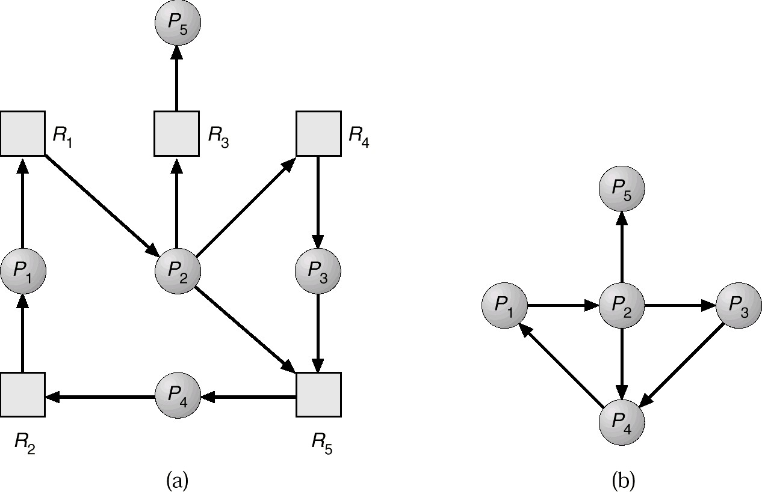
Notes:
Since P1 only waits for R1, while R1 is assigned to P2, then essentially P1 waits for P2. Same approach for the other processes. Hence the reduction of the resource allocation graph.
Recall, if there is a cycle, then a deadlock exists.

Slide 44
A deadlock detection algorithm
Use the previous matrices and vectors for resource allocation
Mark each process not involved in a deadlock. Initially all processes are unmarked (possibly involved). Then perform:
Mark each process j for which: A (j, i) = 0 for all i. (since they cannot be involved)
Initialize the working vector: W (i) = V (i) for all i REPEAT: Choose an unmarked process j such that Q (j, i) <= W (i) for all i. Stop if such j does not exist.
If such a j exists: mark the process j and do
W (i) = W (i) + A (j, i) for all i. Goto REPEAT
At the end: every unmarked process is involved in a dealock

Slide 45

Deadlock detection: comments
Process j is not involved in a deadlock when Q (j, i) <= W (i) for all i.
We are then optimistic and assume that process j will not require more resources to complete its task
It will then free all its resources. Then: W (i) = W (i) + A (j, i) for all i
If this assumption is incorrect, deadlock could arise later.
This deadlock will be detected the next time the detection algorithm is invoked.

Slide 46
Deadlock detection: example
Request
R1 R2 R3 R4 R5
Allocated
R1 R2 R3 R4 R5
Available
R1 R2 R3 R4 R5
P1 | 0 | 1 | 0 | 0 | 1 | 1 | 0 | 1 | 1 | 0 | 0 | 0 | 0 | 0 | 1
P2 | 0 | 0 | 1 | 0 | 1 | 1 | 1 | 0 | 0 | 0
P3 | 0 | 0 | 0 | 0 | 1 | 0 | 0 | 0 | 1 | 0
P4 | 1 | 0 | 1 | 0 | 1 | 0 | 0 | 0 | 0 | 0
Mark P4 because it has no allocated resources Make W = (0,0,0,0,1)
The request of P3 <= W. Then mark P3 and do W = W + (0,0,0,1,0) = (0,0,0,1,1)
The algorithm ends. P1 and P2 are involved in a deadlock
Notes:
At the moment, only P3 can terminate, as its R5 can be supplied by the available R5. Thus, the remaining V = [0, 0, 0, 1, 1]
Even with this release, the other processes cannot terminate, and thus the system is in a deadlock situation.
Matrix Request is similar to Matrix Need

Slide 47
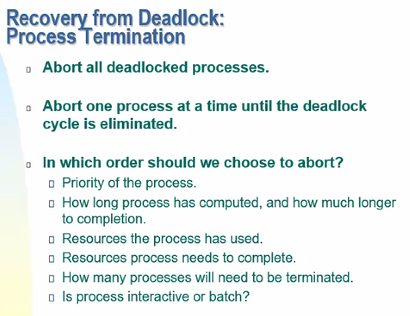
Notes:
First approach: Very harsh solution to abort/kill all processes, one after another, not at the same time.
Killing a process means deleting the process and its data that was involved with it.
1. Process Termination: To eliminate the deadlock, we can simply kill one or more processes. For this, we use two methods:
(a). Abort all the Deadlocked Processes: Aborting all the processes will certainly break the deadlock, but with a great expense. The deadlocked processes may have computed for a long time and the result of those partial computations must be discarded and there is a probability to recalculate them later.
(b). Abort one process at a time until deadlock is eliminated: Abort one deadlocked process at a time, until deadlock cycle is eliminated from the system. Due to this method, there may be considerable overhead, because after aborting each process, we have to run deadlock detection algorithm to check whether any processes are still deadlocked.

Slide 48
Recover deadlocks
Terminate all processes in deadlock
Terminate one process at a time, hoping to eliminate the deadlock cycle
In what order: different criteria:
priority
need for resources: past, future
how long has i trun, how long does it still need etc.

Slide 49
Recovery: resource preemption
Minimize the cost of selecting the victim Rollback: return to a safe state
need to regularly establish and keep 'checkpoints' kinds of snapshots of the current state of the process
Starvation possible if a process is always selected
Notes:
2. Resource Preemption: To eliminate deadlocks using resource preemption, we preempt some resources from processes and give those resources to other processes. This method will raise three issues –
(a). Selecting a victim: We must determine which resources and which processes are to be preempted and also the order to minimize the cost.
(b). Rollback: We must determine what should be done with the process from which resources are preempted. One simple idea is total rollback. That means abort the process and restart it.
(c). Starvation: In a system, it may happen that same process is always picked as a victim. As a result, that process will never complete its designated task. This situation is called Starvation and must be avoided. One solution is that a process must be picked as a victim only a finite number of times.

Slide 50
Combination of approaches
Combine the different approaches, if possible, taking into account practical constraints
prevent avoid detect
use the most appropriate techniques for each resource class
Notes:
Another approach is to combine the different approaches, in order to get rid of the deadlock.

Slide 51
Importance of deadlock problem
Deadlock is almost ignored in the design of today's systems
With the exception of critical systems
If this is true, the user will see a system failure or a process failure
In the high concurrent systems of the future, it will become more and more important to prevent it and avoid it.
Notes:
In most of the systems, deadlock happens rarely. So, why to apply so many detection and recovery techniques or why to apply some method to prevent deadlock? As these processes of deadlock prevention are costly, so, the Operating System assumes that the deadlock is never going to happen. It simply ignores the deadlock. This is the most widely used methods of deadlock handling.
We have to compromise between correctness and performance. In the above three methods, the correctness is good but the performance of the system is low because the CPU has to check for deadlock after a regular interval. But if we ignore the deadlock then there might be cases where deadlock can happen but that is rare of the rarest case. We can simply restart the system and get rid of deadlock if some deadlock happens in our system. But at the same time, you will lose your data that is not being saved.
So, you have to think that you want correctness or performance. If you want performance, then your system should ignore deadlock otherwise you can apply some deadlock prevention technique. It totally depends on the need of the situation. If your system is dealing with some very very important data and you can't lose that if deadlock happens then you should definitely go for deadlock prevention.
Depending on the system environment, you cannot just reboot the system to solve the issue.

Slide 52
Deadlocks: important concepts
Characterization: the 4 conditions Resource allocation graphs
Safe sequences
Safe and unsafe states Prevent deadlocks Avoid deadlocks Detect deadlocks Recover from deadlock

