Slide 1

Module 7 Memory Management
Silberschatz: Chapter 8
1
Notes:
How to allocate space to programs in memory, and need to maximise this property to incorporate as many programs as possible, and be available to be executed by the CPU.

Slide 2
In this module we will see that, to optimize the use of memory, the programs are scattered in memory according to different methods:
Pagination, segmentation
2

Slide 3




Memory management: objectives
Main memory usage optimization = RAM
The greatest possible number of active processes must be kept there, in order to optimize the operation of the system in multiprogramming
keep the system as busy as possible, especially the CPU
adapt to user memory needs
dynamic allocation as needed
3

Slide 4
Memory management: concepts in this chapter
Physical address and logical address
physical memory and logical memory
Contiguous allowance
partitions
Segmentation Paging
Combined segmentation and pagination
4
Notes:
Consider a program with many lines of instructions, with each line associated with an address. Each of those addresses are a logical address, where the collection of them comprise the logical memory.

Slide 5
Application of these concepts
Not all of the concepts in this chapter are actually used as is in today’s main memory management.
However, many are found in the field of auxiliary memory management, especially disks
5

Slide 6


Memory / Physical and logical addresses
Physical memory:
the main memory RAM of the machine
Physical addresses: the addresses of this memory Logic memory: the address space of a program Logical addresses: the addresses in this space
These concepts must be separated because normally, the programs are loaded from time to time in different memory positions.
So physical address ≠ logical address
6
Notes:
Logical address n could be mapped to physical address m (m could equal n) but need to be aware that the two are not the same in concept and practice.
Logical Address is generated by CPU while a program is running. The logical address is virtual address as it does not exist physically, therefore, it is also known as Virtual Address. This address is used as a reference to access the physical memory location by CPU. The term Logical Address Space is used for the set of all logical addresses generated by a program’s perspective. The hardware device called Memory-Management Unit is used for mapping logical address to its corresponding physical address.
Physical Address identifies a physical location of required data in a memory. The user never directly deals with the physical address but can access by its corresponding logical address. The user program generates the logical address and thinks that the program is running in this logical address but the program needs physical memory for its execution, therefore, the logical address must be mapped to the physical address by MMU before they are used. The term Physical Address Space is used for all physical addresses corresponding to the logical addresses in a Logical address space.

Slide 7
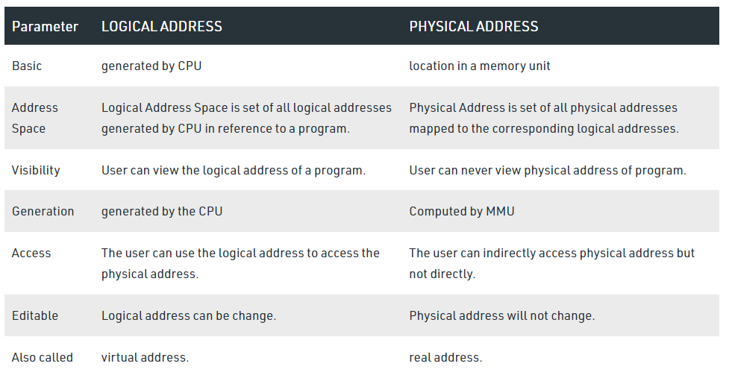
Notes:
Differences Between Logical and Physical Address in Operating System
The basic difference between Logical and physical address is that Logical address is generated by CPU in perspective of a program whereas the physical address is a location that exists in the memory unit.
Logical Address Space is the set of all logical addresses generated by CPU for a program whereas the set of all physical address mapped to corresponding logical addresses is called Physical Address Space.
The logical address does not exist physically in the memory whereas physical address is a location in the memory that can be accessed physically.
Identical logical addresses are generated by Compile-time and Load time address binding methods whereas they differs from each other in run-time address binding method.
The logical address is generated by the CPU while the program is running whereas the physical address is computed by the Memory Management Unit (MMU).

Slide 8
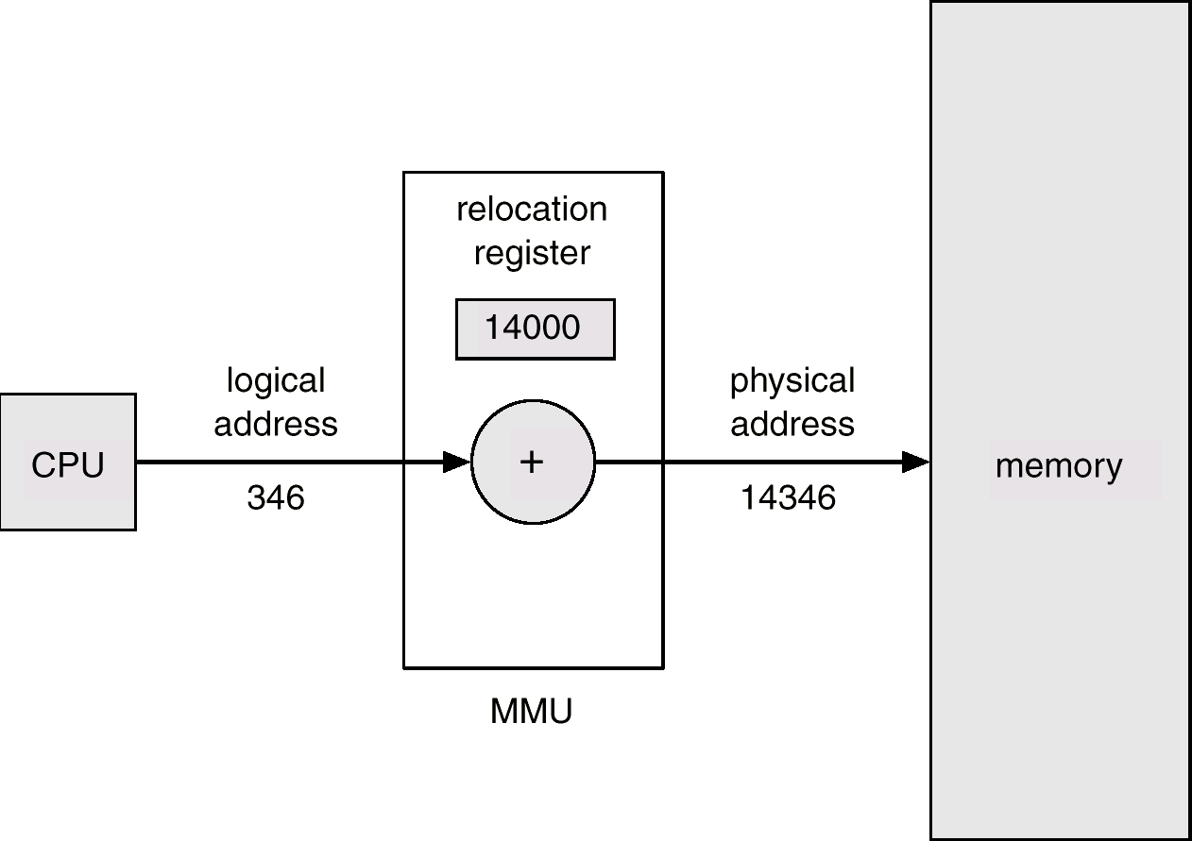
Logical address translation → physical address
MMU: memory management unit translation unit for addresses
(memory management unit)
8

Slide 9
Definition of logical addresses
a logical address is an address at a location in a program
compared to the program itself only
independent of the program position in physical memory
9

Slide 10

User view
Normally we have several types of addressing eg. the programmer's addresses (symbolic names) are translated at compile time into logical addresses
these addresses are translated into physical addresses after loading the program into memory by the address translation unit (MMU)
Given the wide variety of hardware and software, it is
impossible to give more precise definitions.
10

Slide 11
Binding logical and physical addresses (instructions and data)
The binding from logical addresses to physical addresses can be performed at different times:
Compilation: when the physical address is known at the time of compilation (rare)
e.g. parts of the OS
Loading (into memory): prior to execution, when the physical address where the program is loaded is known, the logical addresses can be translated (rare today)
Runtime: normally, physical addresses are not known
until runtime
e.g. dynamic allocation (virtual memory → programs are swapped in and out of the memory)
11
Notes:
In early OS (Example: DOS) it was done at compilation time, where the physical addresses become known
For the runtime;
When a program is made up of several modules, not all need to be loaded within memory to function, thanks to the virtual memory. By loading the main module (for example), the other modules do not need to be loaded as well. When this main module calls a method/function in which exists within the other modules, then the other modules will be brought into memory.

Slide 12
Two basic concepts
Loading. The program, or part of it, is loaded into physical memory, ready to run.
Static or dynamic
Linking (linking occurs when a part of the code makes calls to another module to resolve the reference) of the different parts of a program to make it an executable entity.
To resolve the references between different modules must be translated
static (before execution): link different modules and produce an executable that contains all the functions of the modules
dynamic (on request during execution): instead of linking all, the non-main modules are compiled and put into DLL, and when executing main, it needs the other modules, where the linking then occurs.
Parts in the program = modules = segments =
subprograms = objects, etc.
12
Notes:
Static: load the program prior to execution
Dynamic: load parts of the program as needed during execution
Consider a program made up of modules, where each module contains a different purpose: main, function1, etc. each module can be compiled separately
Linking allows to combine all these modules into an executable file.
Invoking the cc program will be compiling them solely creates object modules (file.obj), and then links them, as in it combines the different parts of a program (creating a reference between the modules)
Static linking is the process of copying all library modules used in the program into the final executable image. In contrast, dynamic linking is the process of loading the external shared libraries into the program and then binds those shared libraries dynamically to the program. Thus, this is the main difference between static linking and dynamic linking.
Dynamic linking can reduce total resource consumption (if more than one process shares the same library (including the version in "the same", of course)). I believe this is the argument that drives its presence in most environments. Here "resources" include disk space, RAM, and cache space. Of course, if your dynamic linker is insufficiently flexible there is a risk of DLL hell.
Dynamic linking means that bug fixes and upgrades to libraries propagate to improve your product without requiring you to ship anything.
Plugins always call for dynamic linking.
Static linking, means that you can know the code will run in very limited environments (early in the boot process, or in rescue mode).
Static linking can make binaries easier to distribute to diverse user environments (at the cost of sending a larger and more resource-hungry program).
Static linking may allow slightly faster startup times, but this depends to some degree on both the size and complexity of your program and on the details of the OS's loading strategy.

Slide 13
Loading aspects
Find free memory for a loaded module: contiguous or not
Translate the addresses of the program and make the connections in relation to the addresses where the module is loaded
13
Notes:
Loading is to find free space in memory and put modules in those spaces.
Contiguous means that all parts of the program follow each other
Contiguous allocation means you load the modules as a whole (where modules follow each other), whereas for non-Contiguous allocation is where the modules can be loaded at different locations

Slide 14


0
Alloc. from mem.
JUMP 328
Other
programs
JUMP 10328
500K
Logic memory
Physical Memory
14
Notes:
Logic memory, containing an address space from 0 to 500k

Slide 15
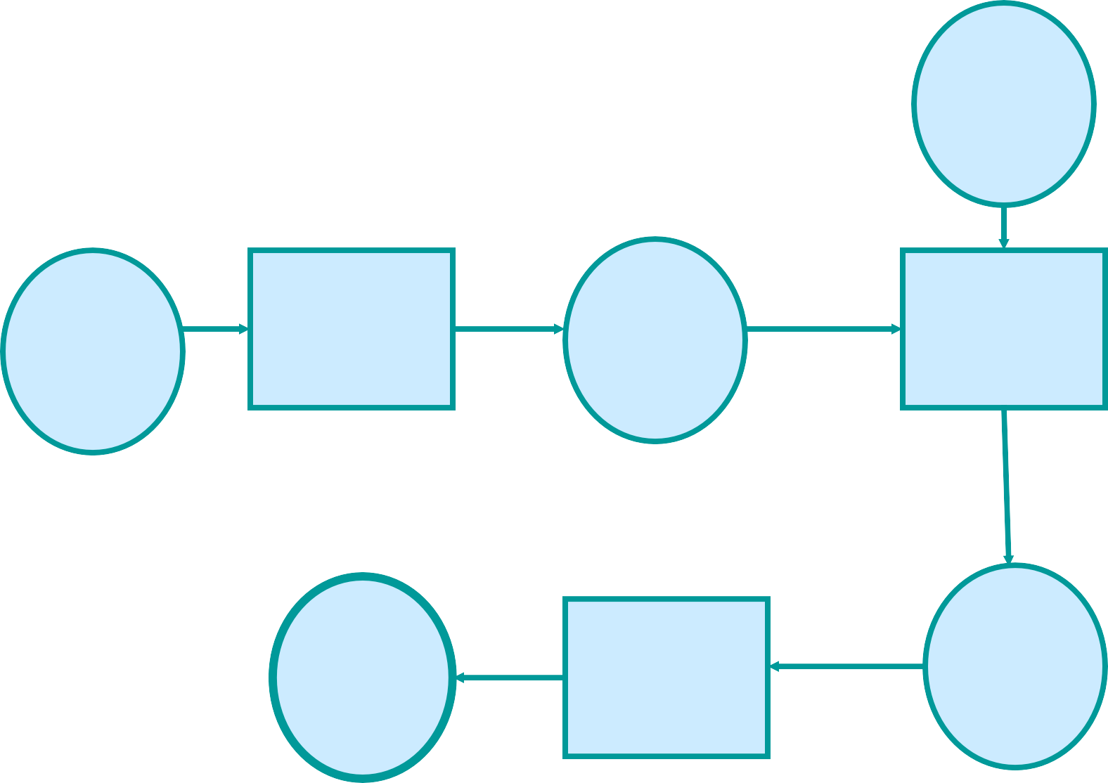
Binding and loading
See fig. more complete in book
Other Mods (Libraries)
Source Progr.
Compiler
Modules Object
Linker
Executable
Progr.
Linked
Modules
Loader
NB: we assume that all the modules are known at the beginning Often this is not the case → dynamic loading
15
Notes:
When you have a source program, you invoke the compiler to produce a module object and then you invoke the linker, and this will link this module object with other libraries and then you produce what is called a module with all linked together, and then load the program (the executable program) into main memory

Slide 16

Loading and dynamic binding
A running process may need different program modules at
different times
Static loading can therefore be inefficient
It is better to load modules on demand (i.e. dynamically)
dll, dynamically linked libraries
In a program which may need to load modules dynamically, at the beginning these are represented by stubs which indicate how to get to the modules (e.g. where it is: disk, www, other ...)
At its 1st execution. the stub causes the module to be loaded into memory and it’s linked with the rest of the program
dynamic binding
Successive invocations of the module must not pass through this, we will know the address in memory
16
Notes:
The inefficiency of static loading is because of the time taken for linking all the modules together and then produce a large executable file, which then if space is limited in memory, the entire program may not be able to be loaded. Thus, it is better to link the modules dynamically.
A big executable file is to be produced where the modules are all compacted together in static loading, where it may not be compiled accurately, hence inefficient.
Stub hides the function details, but rather show the function signature (parameters and their amount, return value). This is then replaced by the actual function when dynamically linked

Slide 17

Logical address translation → physical
In early systems, a program was always read at the same
memory addresses
Multiprogramming and dynamic allocation created the need to read a program in different positions
In the beginning, this was done by the loader which changed
the addresses before launching the execution.
Today this is done by the MMU as the progress is executed This does not cause increased execution time, as the MMU acts in parallel with other CPU functions.
Eg. the MMU can prepare the address of an instruction at the same time as the CPU executes the previous instruction
17
Notes:
Memory management unit is the component that performs the translation from logical address to physical address

Slide 18
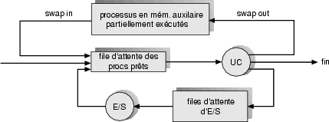
Program swapping
A program, or part of a program, can be temporarily removed from memory to allow the execution of other programs (chap. 4)
it is put in secondary memory, normal disk
18
Notes:
Recall the medium scheduler

Slide 19
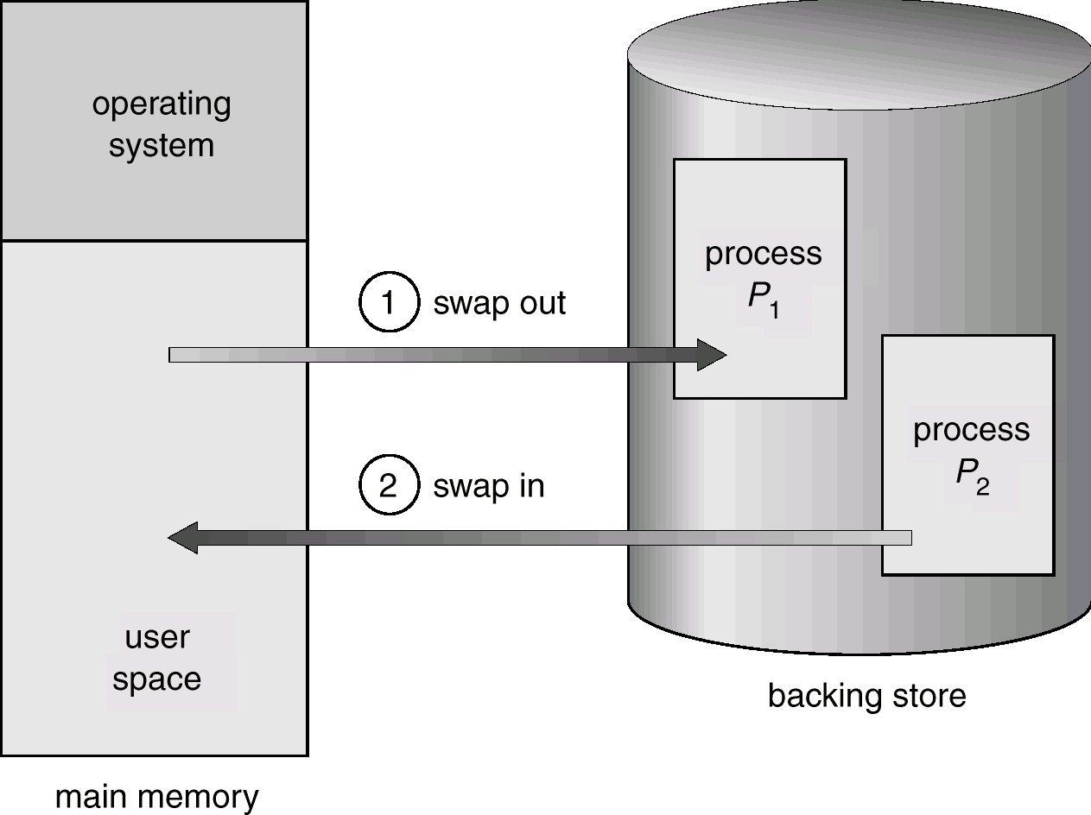
Program swapping
19
Notes:
Process P1 can be swapped out to make room for process P2 to be executed, and in the future, P1 can also return again by being swapped with another program (one that needs to wait or is terminated)

Slide 20
Contiguous memory allocation
We have several programs to run
We can load them into memory one after the other the place where a program is read is only known when loading
Material/Hardware requirements: translation/location registers and bounds registers
20
Notes:
Contiguous memory allocation means that programs are loaded in partitions, one after another, and to achieve this, translation (gives the base address of where the program or partition starts) and bound (gives the limit/length of the partition) registers are required. These information of the registers are available to the system, and MMU are aware of them.
Contiguous memory allocation is a classical memory allocation model. Here, a system assigns consecutive memory blocks (that is, memory blocks having consecutive addresses) to a process.
Contiguous memory allocation is one of the oldest memory allocation methods. Here’s how it works: when a process needs to execute, memory is requested by the process. The size of the process is compared with the amount of contiguous main memory available to execute the process.
If sufficient contiguous memory is found, the memory is allocated and the process starts its execution. Otherwise, the process is added to a queue of waiting processes until sufficient free contiguous memory is available.

Slide 21
Contiguous memory allocation
OS
progr. 1
progr. 2
available
progr. 3
Here we have 4 partitions for programs - each is read in a single memory area
21

Slide 22




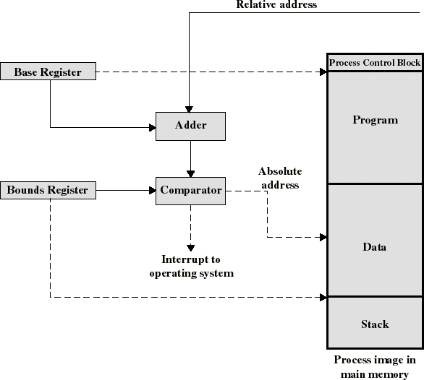
logical address
base address of the partition where the progr. in exec. is located
limit address of the partition where the progr. in exec. is located
Module 7
21
Notes:
how does the memory management unit translate addresses:
When MMU is presented with a relative (logical) address, it looks at the base register (has value of 1000 for example) with bound register (value of 1100 for example, thus the limit/bound is 100). To translate a logical address of 50, it starts in the base register, the adder adds the 1000 (now 1050) and the address will go to that location in that partitions from 1000-1100. Then the comparator compares the address value with the bound, where if it becomes more than the bound, then an interrupt occurs, where if less, then it goes through and becomes the physical address.

Slide 23
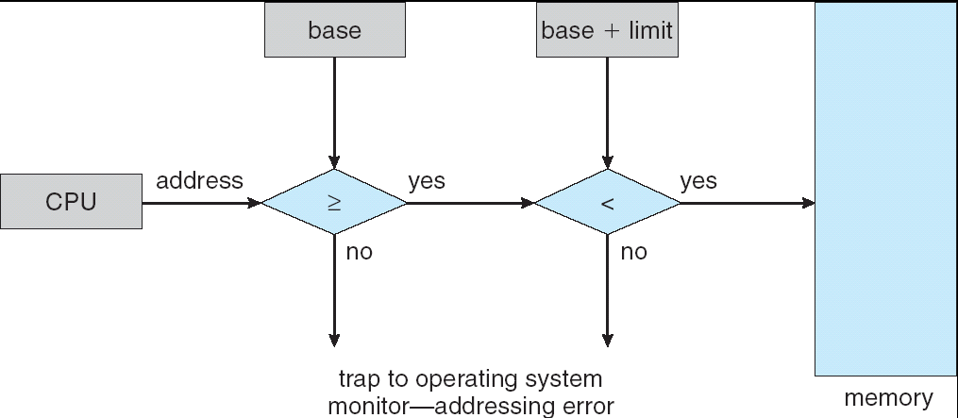
Bound registers and translation in MMU
base address of the partition where the progr. in exec. is located
logical address
limit address of the
partition where the progress
Module 7
in exec. is located
22
Notes:
Every physical address must be between the base and the base + limit values.
In our example, base is 1000 and base + limit is 1100. If the logical address value becomes (after adder computation) larger than the bound + limit or smaller than the base, a trap to OS occurs to address the error. Otherwise, as in if it is less than base + limit or larger or equal than base only, then it is translated and can be accessed in the memory.

Slide 24
Fragmentation: unused memory
A major problem in contiguous allocation: There is enough space to run a program, but it is non-contiguously fragmented
external: unused space is Between partitions internal: unused space is in the partitions
Module 7
23
Notes:
Fragmentation is a problem in which arises from memory allocation. It means that when the memory is being divided for allocating programs, certain holes may appear in memory that cannot really be used → fragmented memory.
Consider a partition segment in main memory, where programs are to be loaded. Each partition has 4 MBs of space. If a program does not fully allocate the partition, then there is unused space in the partitions (internal), whereas if a program cannot even fit in a partition, the there is unused space between the partitions (external), unless merged with other partitions that are also empty.

Slide 25
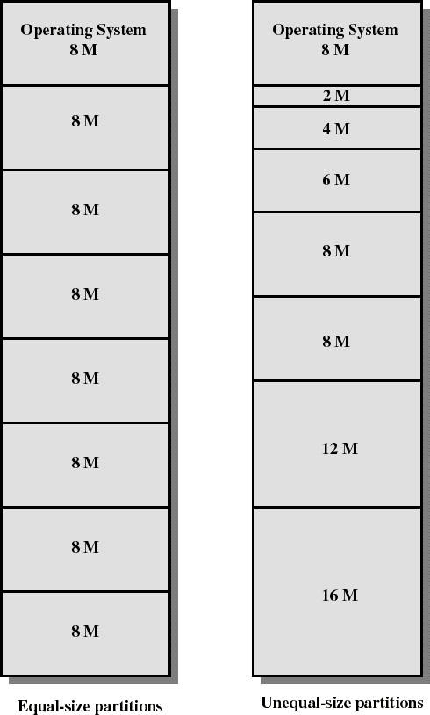
Fixed partitions
Main memory subdivided into distinct regions: partitions
Partitions are either the same size or unequal sizes
Any progr. can be allocated to a partition that is large enough
(Stallings)
Module 7
24
Notes:
When dividing into partitions of equal sizes, large enough programs can be allocated, where each partition can be left with some amount of space (internal fragmentation). To solve this, one can design unequal sized partitions, which thus internal fragmentation would not occur (might not occur)

Slide 26
Fixed partitions
Simple, but ...
Inefficient memory usage: Any program, no matter how small, must occupy an entire partition. There is internal fragmentation.
Partitions of unequal sizes alleviate these problems but they remain there ...

Slide 27
Dynamic partitions
Partitions in varying numbers and sizes Each process is allocated exactly the required memory size
Probably unused holes will form in the memory: this is the external fragmentation
Notes:
Instead of using fixed partitions, in equal or unequal sizes, why not use dynamic partitions:
Treat the memory as one large partition, and then start allocating space to every process as much space as it needs. However, this technique will suffer from external fragmentation.

Slide 28
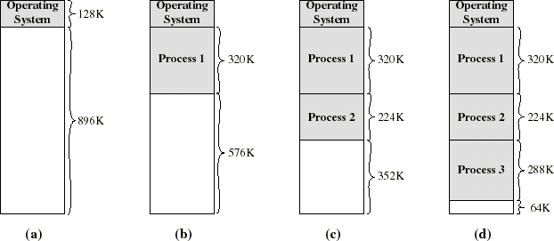
Dynamic partitions: example (Stallings)
(d) There is 64K hole after loading 3 processes: not enough space for other process
If all processes get stuck (e.g. waiting for an event), P2 can be swapped out and P4 = 128K can be loaded.
Notes:
Suppose a memory with one partition of size 896K. The first process to join is 320K, which is accepted and loaded. Next process is 224K, and can also be accepted and thus loaded. Same for process 3 with 288K, leaving the memory with 64K of space. Now imagine that at some point, these processes may be suspended, and thus swapped out for a new process. For example, process 2 gets suspended, and thus gets swapped out, freeing up space.

Slide 29
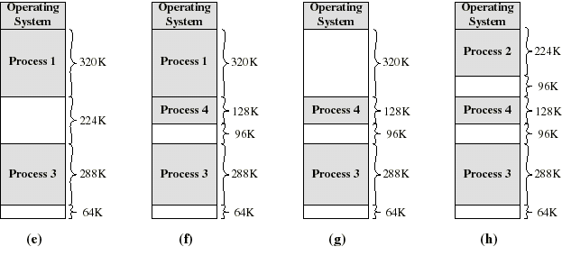

Dynamic partitions: example (Stallings)
(e-f) Process 2 is suspended, Process 4 is loaded. A hole of 224-128 = 96K is created (external fragmentation)
(g-h) P1 ends or it is suspended, P2 is put back in its place: producing another hole of 320-224 = 96K ...
We have 3 small holes and probably unused. 96 + 96 + 64 = 256K external
fragmentation
_{Module 7}COMPRESSION to make a single hole of 256K
28
Notes:
The 3 unused holes of partitions, if they can be compacted, then a new partition is created, large enough for a process (or more) to be loaded

Slide 30
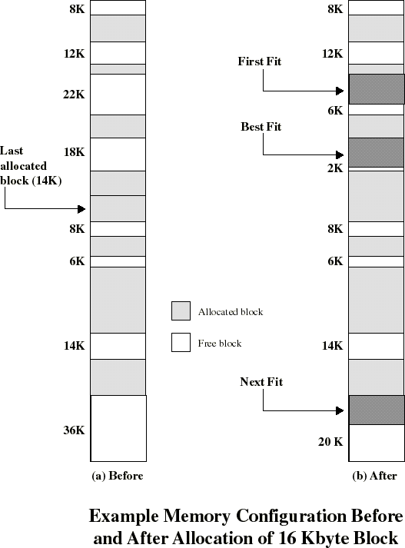
Placement Algorithm in dynamic allocation
to decide the location of the next process
Goal: reduce compression usage (takes time...)
Possible choices: “Best-fit”: choose the smallest hole
“First-fit”: choose 1st hole from the beginning
“Next-fit”: choose 1st hole
from the last placement
(Stallings)
Notes:
As all algorithms scans the partitions to look for the next available space for allocation:
Best-fit looks for the smallest unused hole to be allocated the incoming process (that closely matches the space needed with the process)
First-fit looks for the first space that meets the size requirement for the incoming process
Next-fit looks for the first space after the last placement (as in the previous fit that was last allocated) where a pointer is established for reference. This means the next search/scan of available partition is done from this new reference rather than from the start.

Slide 31

Placement Algorithms: comments
What is the best?
main criterion: decrease the probability of situations where a process cannot be served, even if there is enough memory ...
The simulation shows that it is not worth using the most complex algorithms (best fit and next fit) ... so first fit
“Best-fit”: look for the smallest possible block: the hole
created is as small as possible
memory will be filled with holes too small to hold a program
Next-fit ”: allocations will often be done at the end of
memory
Notes:
First-fit has been found to be the most efficient one (and simplest one to implement). Some OS may still use the Best fit or Next fit as their algorithms.

Slide 32
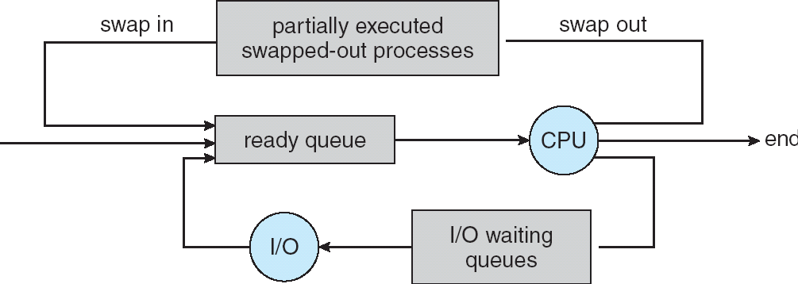
Suspension (see chap 4)
When all the programs in memory are blocked, the OS can suspend one (swap / suspend)
We transfer to the disk one of the blocked processes (thus putting it in suspended state) and replace it with a process ready to be executed
the latter process performs a transition from New or Suspended to Ready state
Notes:
When processes are blocked or suspended, they are swapped out of the memory, get transferred to the disk and then eventually be brought back the ready queue.

Slide 33
Compression (compaction)
A solution for external fragmentation
The programs are moved in memory so as to reduce to 1 single large hole from several small holes available
Performed when a program requesting to be executed does not find a partition large enough, but its size is smaller than the existing external fragmentation
Disadvantages:
program transfer time (it takes time) within memory
need to re-establish all links between addresses of different programs
Hence, inefficient solution
Notes:
Internal fragmentation does not have any solution, since there is unused space within a partition.
For external fragmentation → compression: moving processes around until unused spaces are located next to each other, which then can be merged into one large space for the next process to be loaded

Slide 34

Non-contiguous allowance/allocation
To reduce the need for compression, the next step is to use
the non-contiguous allocation
split a program into chunks and allow separate allocation of each chunk
the pieces are much smaller than the entire program and therefore allow more efficient use of memory
small holes can be used more easily/efficiently
There are two basic techniques for doing this: pagination and segmentation.
segmentation uses program parts that have a logical value (modules)
pagination uses arbitrary parts of the program (breaking up
the program into pages of fixed length).
they can be combined
I find the segmentation to be more natural, so I start with this
one
Notes:
Not all modules would need to be loaded at first, or even one after another. Consider a program made up of several modules (P = M1 + M2 + M3)
For both, the program is divided into segments,
1. Segmentation
Each module has a logical meaning (M1 refers to the main function for example). Instead of loading the program P into memory with its modules one after another, we can load each module at different places of the memory, and in any order (M1, M3, M2 for example). And using the segment table, it tells us where the segments are to be placed, since no order is given, only the logical value is priority in a sense.
2. Paging
In the address space of the program, divide it into logical units of equal size, and the memory is also divided into frames where using paging, allocation occurs. No logical meaning for the pages

Slide 35
Segments are logical parts of the program.
A
JUMP (D, 100)
B
Main Progr.
LOAD (C, 250)
Data
C
D
Sub Progr.
LOAD (B, 50)
Data
4 segments: A, B, C, D
Notes:
Imagine a program with 4 logical parts (called segments)

Slide 36
Segments as memory allocation units
0
3
1
2
0
1
2
3
user space physical memory
Since segments are smaller than entire programs, this technique involves less
fragmentation (which is external in this case)
Notes:
0 → A, 1 → B, 2 → C, 3 → D
The advantage of segmentation is that only parts of the program can be loaded rather than the entirety.
Notice in the physical memory, the modules are not one after another. The “order” of the allocations of the modules is determined by the segment table, where they are tabulated based on the logical value of the modules. The OS scans the available spaces in memory and based on that, it determines where the segments are to be placed, which then are given by the segment table, regardless of the segments functionality.

Slide 37

Mechanism for segmentation
A table contains the starting address of all segments in a process
Each address in a segment is appended to the segment start address by
the MMU
0
3
1
2
Addr of 3
Addr of 2
Addr of 1
Addr of 0
current segment
segment table
physical memory
Notes:
How to do the segmentation and keep track of them:
Segment table: 4 columns
Segment number starting physical address of the segment segment length additional information
S0 0 10
S1 100 20
S2 150 25
S3 50 5
A RAM is divided into physical address segments, where in this case, S0 goes from segment 0 to 9, S1 goes from segment 100 to 119, S2 goes from segment 150 to 174, and S3 goes from segment 50 to 54.

Slide 38

Details
The logical address consists of a pair:
<No of segm, offset>
where offset is the address in the segment
the segment table contains: segment descriptors
base address segment length
Protection info, we'll see ...
In the process PCB there will be a pointer to the memory address of the segment table.
There will also be the number of segments in the process
At the time of context switching, this info will be loaded into the appropriate CPU registers.
Notes:
Recall the strategy used to load processes into memory via segmentation: segment table
Each segment contains some information associated with them in the segment table: segment number, base address (where is the segment located in memory), segment length, additional information.

Slide 39
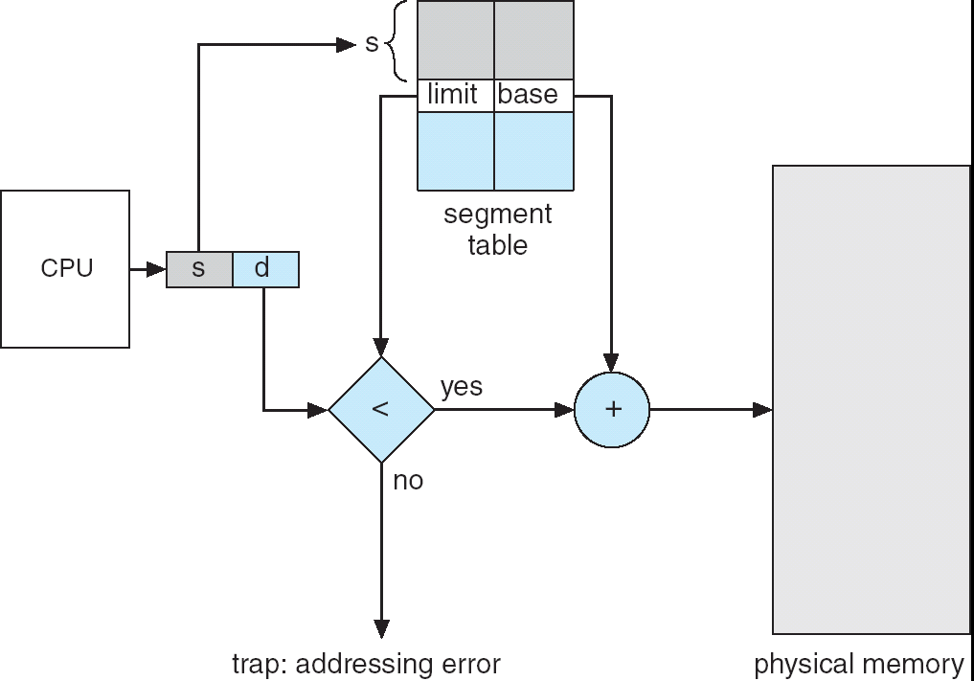
Address translation in segmentation
Notes:
Recall: every segment number has a length, indicated by the limit.
Each segment has a logical address: → <Sn, d> → take the segment number and scan the segment table, and then compare the d value in <S1, d> with the limit. The d value represents where inside the segment is the address to be found and then translated. Comparing the d value with the limit: if d < limit, then no issues and we add by concatenation the base to the segment value (s), if d > limit, then an error is issued for interruption.
S1 has 4 instructions: I1, I2, I3, I4, and for each instruction, you can represent as: I1 <S1, 0>, I2 <S1, 1>, I3 <S1, 2>, I4 <S1, 3>

Slide 40
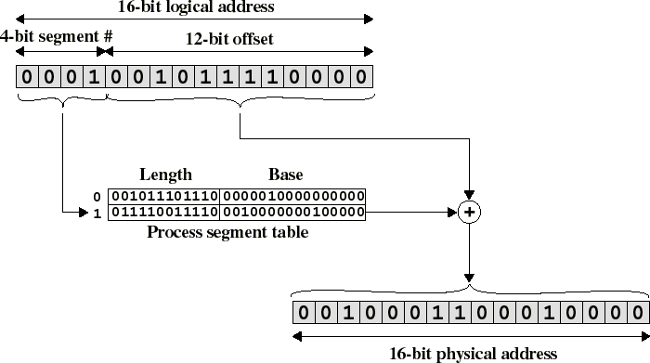
The mechanism in detail (implemented in the hardware)
In the program
Stallings
Final address
Module 7
39
Notes:
16-bit logical address where first 4 bits are for the segment number, and the other 12 bits represent the offset.
4-bit segments means a combination of 2^4 = 16 numbers can be constructed → a process can have up to 16 segments (but it does not have to)
In example on slide, the process where this address needs to be translated only has two segments, and specifically, it is segment 1, with some offset.
Now, use the segment number, and scan the segment table for its limit/length and base.
Then, compare the offset with the length: (offset _ length)
If smaller, take the base address (where the segment is to be found in the segment table) and add (not by concatenation) the offset to it to get the physical address
If larger, then the offset is outside the range, leading to an error for interrupt
The base and offset are never the same size

Slide 41
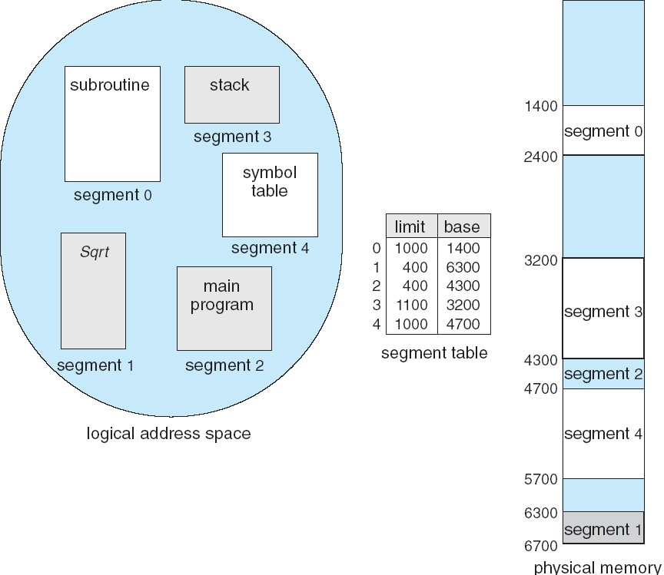
Example of simple segmentation
Notes:
Example:
Segment 0: 1444-2399
Segment 1: 6300-6699
Segment 2: 4300-4499
Segment 3: 3200-4299
Segment 4: 4700-5699

Slide 42
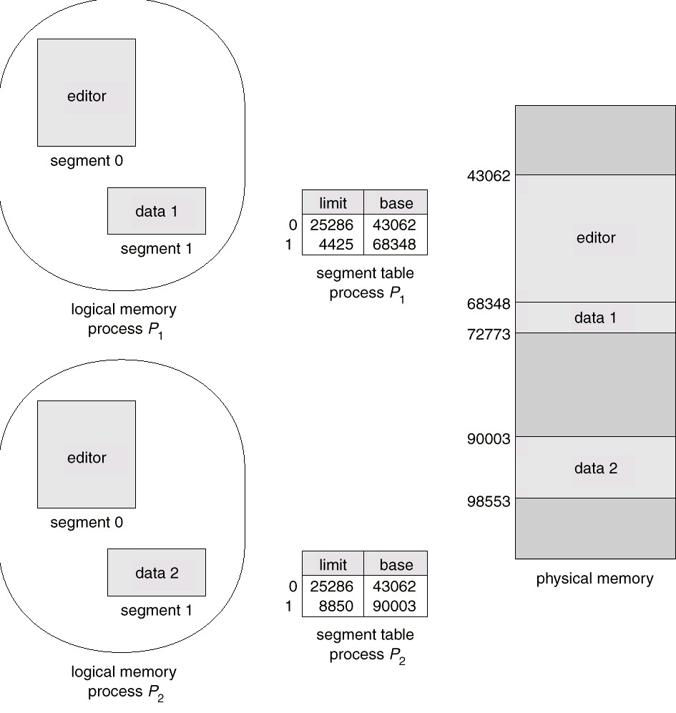
Sharing segments: segment 0 is shared
Eg: DLL used by several users
Notes:
Some processes can share segments, like here, where Data 1 is being modified by the editor in segment 0 where data 2 is also being modified by the same editor (instead of loading the editor twice).

Slide 43
R1
Process1 data
Program
+
Instruction
R2
Process2 data
+
The same instruction, if executed
by process 1, its address is modified by the content of base register 1
by process 2, its address is modified by the content of base register 2
This works even if the instruction is executed by more. CPUs at the same time, if the registers are in different CPUs
Notes:
Notice how the a program is acting upon different registers, where an instruction performs its operations on one register independent from another register, even though it is the same instruction.

Slide 44
Segmentation and protection
Each entry in the segment table can contain protection info:
segment length
user privileges on the segment: read, write, execute
If, when calculating the address, it is found that the user does not have access rights→interruption
this information can therefore vary from user to user, in relation to the same segment!
limit | base | read, write, execute?
Notes:
Another column (which would be a bit to the values) can be added to the segment table to perhaps represent to execute some instructions, for an editor for example.

Slide 45

Simple segmentation assessment
Advantages: The memory allocation unit is
smaller than the whole program
a logical entity known by the programmer segments can change places in memory
protecting and sharing segments is easy (in principle)
Disadvantage: the problem of dynamic partitions:
External fragmentation is not eliminated:
holes in memory, compression?
Another solution is to try to simplify the mechanism by using memory allocation units of equal sizes.
PAGING
Notes:
Advantages notes:
Dividing the program logically into units called segments (main program, subroutine, …).
For changing place in memory, this can happen in swapping out segments, and when putting them back into memory, we would need to change the base in the segment table, and thus the segment would allocate at a different location in memory.

Slide 46
Segmentation versus pagination
The problem with segmentation is that the memory allocation unit (the segment) is of variable length
Paging uses fixed memory allocation units, therefore eliminating this problem
Notes:
No logical division is done with paging, but rather random division.
Consider a program p, that contains a lot of instructions (Instruction0 (I0) <->Instruction99 (I99)). We want to divide the program into the same lengths. Then we want to divide the RAM into frames of the same length of the pages, but not necessarily the same number of frames (usually more frames for “just in case”). Due to using fixed memory allocation units, external fragmentation is solved (but internal remains) where the length of the pages is the same as the frames.
A page can always be loaded into a frame and occupy the frame entirely. Usually, the last page of the process will not allocate the entire frame, thus causing internal fragmentation.

Slide 47

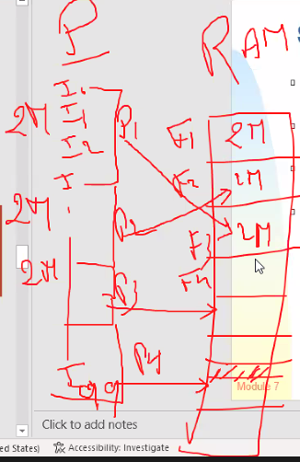
Simple pagination
The memory is partitioned into small pieces of the
same size: the physical pages or 'frames'
Each process is also partitioned into small pieces of the same size called pages (logical)
Logical pages of a process can therefore be assigned
to frames available anywhere in main memory (non-contiguous).
Consequences:
a process can be scattered anywhere in physical memory. fragmentation external is eliminated

Slide 48
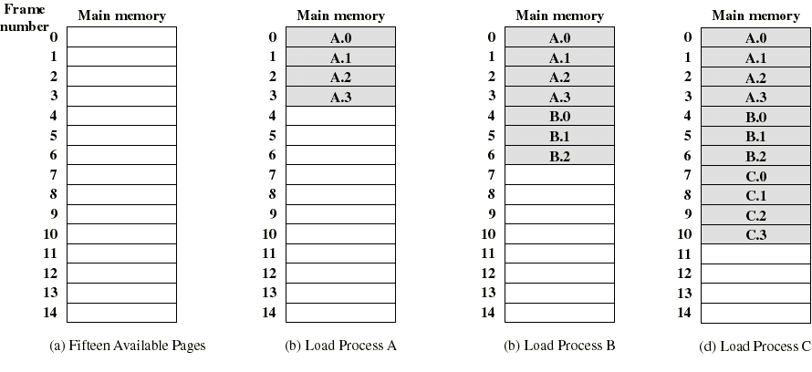
Example of process loading
Suppose process B ends or is suspended
Stallings
Notes:
Consider (a) a RAM divided into 15 frames.
(b) Shows that process A has 4 pages thus we need to have 4 available frames where each is to be allocated to a separate frame.
(c) Same procedure for process B
(d) Same procedure for process C

Slide 49
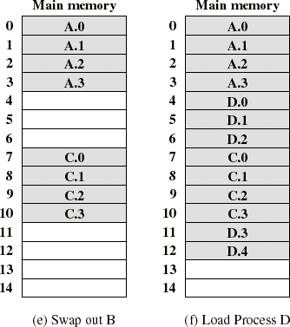
Example of process loading (Stallings)
We can now transfer a program D to memory which requires 5 frames
although there are no 5 contiguous frames available
External fragmentation is limited to the case that the number of available pages is not sufficient to run a waiting program.
Only the last page of a process can suffer from internal fragmentation (avg. 1/2 frame per process)
Notes:
Imagine process B is suspended, and thus needs to be swapped out. While loading process D, notice that contiguous allocation is not followed, which allows to not only get rid of wasted space, but also to have freedom in allocation.
Frame 12 containing D4 is the only page where internal fragmentation can occur, where the page may not be allocating the entire frame, where that extra space cannot be used by any other process.
Waiting program → consider a process is waiting to be loaded into the main memory. External fragmentation disallows the process from being loaded into the main memory because it requires sufficient space, in which the RAM does not provide at that moment.

Slide 50
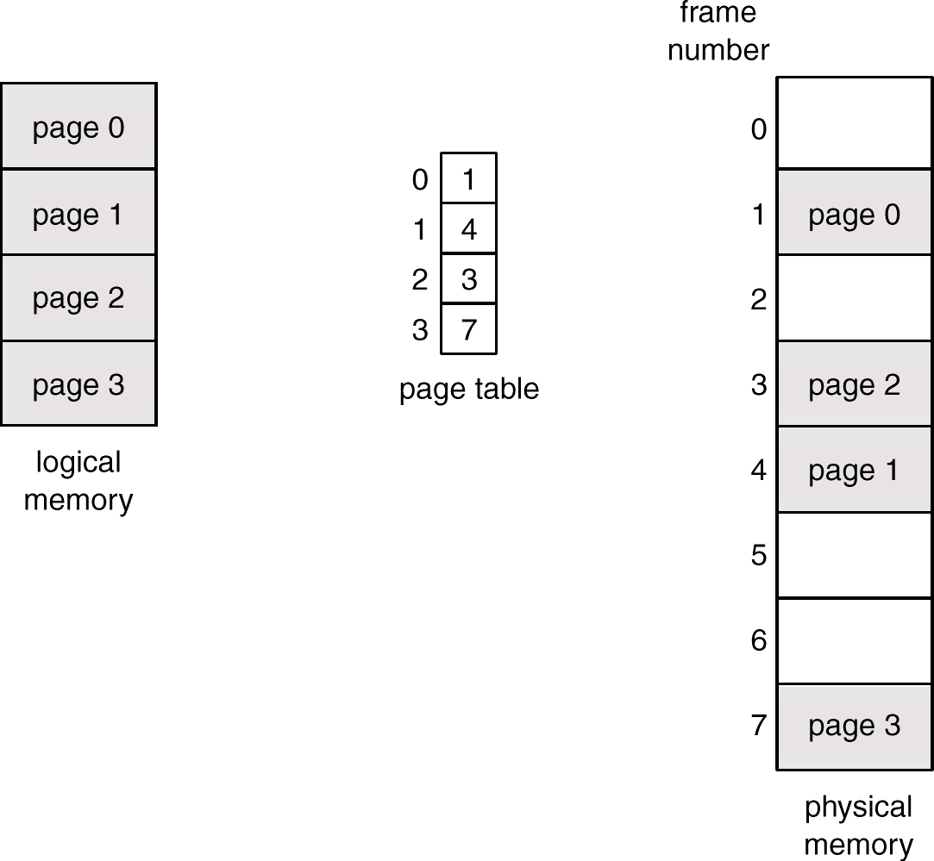
Page tables
Notes:
A page table will tell us where in memory are the pages located, where the main memory is divided into frames. → just like a segment table
Frame size = page size

Slide 51
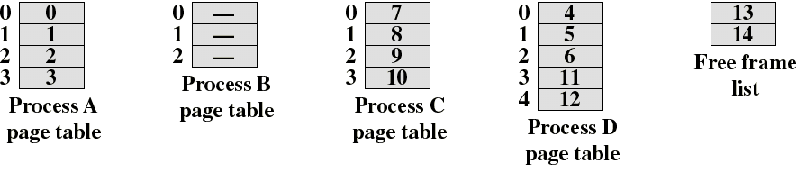
Page tables
The OS must maintain a page table for each process
Each entry in a page table contains the frame number where the corresponding page is physically located
A page table is indexed by the page number in order to
obtain the frame number
A list of available frames is also maintained (free frame list)
Notes:
A free frame list is also necessary to maintain to know which frames are available for allocation for the incoming pages.

Slide 52
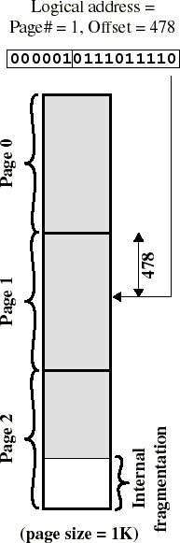


Logical address (pagination)
The logical address is easily translated into a physical address because the page size is a power of 2
Ex: if 16 bits are used for the addresses and the size of a page = 1K: we need 10 bits for the offset, thus leaving 6 bits for the page number
The logical address (n, m) is translated to the physical address (k, m) using n as an index on the page table and replacing it with the address k found
m does not change
Module 7
Stallings
51
Notes:
Consider a program with 16 instructions, where each 4 instructions are located in a page.
<p1, 0> → I1
<p1, 2> → I3
<p2, 0> → I5
<n, m> → n is page number, m is the offset
This is translated to the frame number which corresponds to that page, where the offset stays the same.
<n, m> <-> <k or Fn, m>
<p1, 0> → <F2, 0>
<p1, 2> → <F2, 1>
<p2, 0> → <F1, 0>

Slide 53

Logical address (pagination)
So the pages are invisible to the programmer, compiler or assembler (only relative addresses are used)
Runtime address translation is easily accomplished by hardware:
the logical address (n, m) is translated into a physical address (k, m) by indexing the page table and appending the same offset m to the number of the frame k
A program can be run on different hardware using different page sizes
What changes is the interpretation of the bits by the addressing mechanism

Slide 54
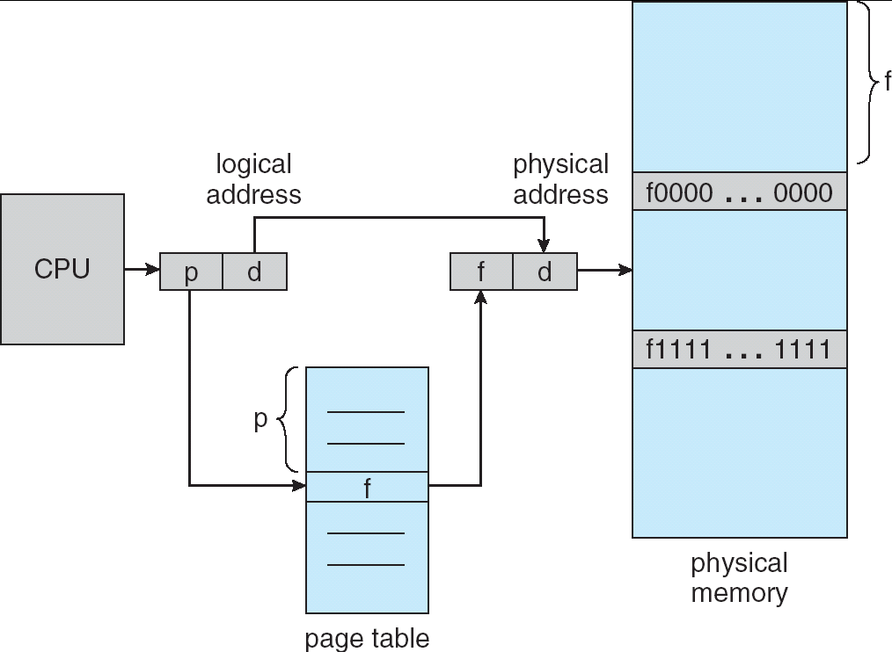
Mechanism: hardware
Notes:
Logical address <p, d> where p is the page number (n) and d is the offset (m), using p as an index to scan the page table to find the frame it has been allocated, take the frame number (fn or k or Fn) and concatenate the d value to this frame number

Slide 55
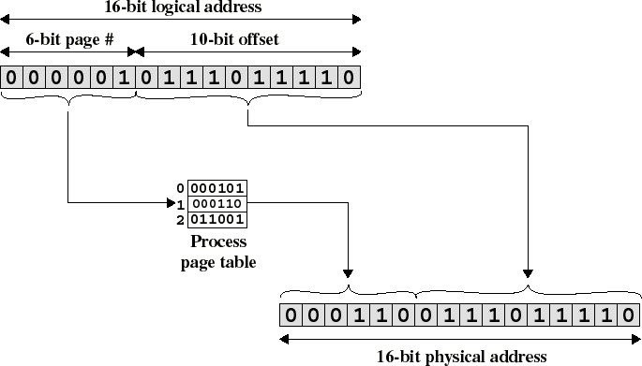
Address translation (logical-physical) for pagination
Stallings
Notes:
6-bit page can have up to 2^6 pages
Recall:
Take the page number (here it is 000001) and scan the page table for that number (in value) to find the frame number (here it is 000110), and then concatenate to the offset from before (here it is 0111011110) to get the physical address 0001100111011110

Slide 56
Translation of addresses: segmentation and pagination
Both in the case of segmentation and in the case of pagination, we add the offset to the segment or page address.
However, in pagination, the page addresses are always multiples of 2, and there are as many 0s on the right as there are bits in the offset ... so the addition can be done by simple concatenation:
11010000 + 1010
=
1101 1010

Slide 57
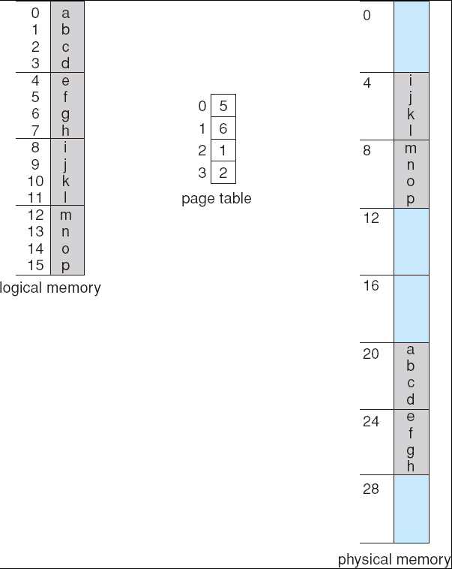
Example of pagination
page0
frame0
page1
frame1
page2
frame2
page3
frame3
frame4
frame5
frame6
frame7

Slide 58
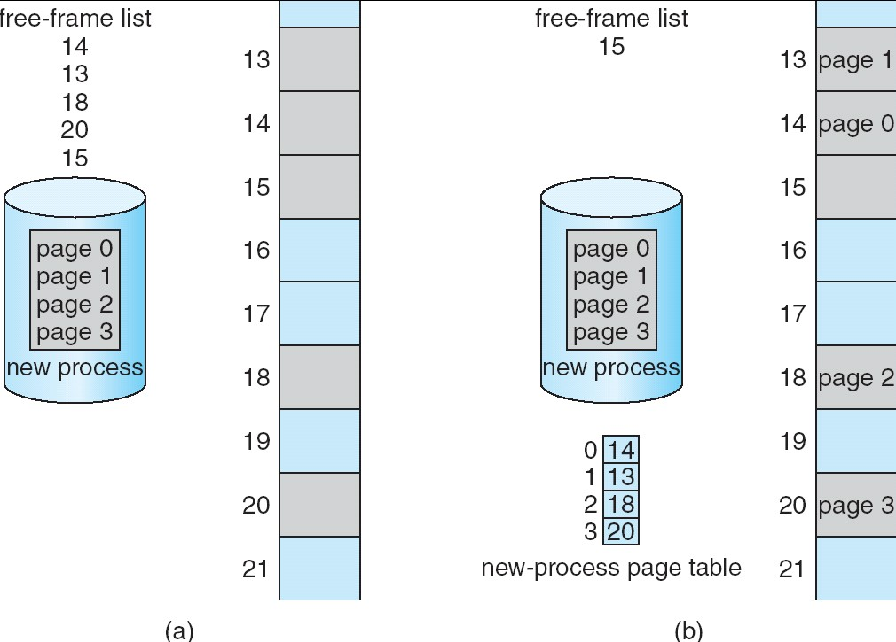
List of free frames
Notes:
Every time a process is being loaded into the main memory via pagination, that list of available frames needs to be checked to validate allocation.

Slide 59
Efficiency issues
Address translation, including page and segment address lookup, is performed by hardware mechanisms
However, if the page table is in main memory, each logical address causes at least 2 references to memory
One to read the entry in the page table The other to read the referenced word
The memory access time is double...
Notes:
For address translation via segmentation or pagination, the segment or page table needs to be consulted. This is done of course to figure out where that page or segment is located in the RAM (by finding the frame or base number). If it happens that the tables are in the RAM, then we need to access the main memory first for the table and then access it again to find the reference from the table.

Slide 60
To improve efficiency
Where to put the page tables (the same ideas also
apply to segment tables)
Solution 1: in CPU registers.
advantage: speed (speed up access/translation by finding the frame number quicker)
disadvantage: insufficient CPU registers present, limited number of pages per process, memory size. logic is limited (problem with capacity)
Solution 2: in main memory
advantage: size of the memory → unlimited logic (logical memory space is unlimited)
disadvantage: previous slide with double access of memory
Solution 3 (mixed): The page tables are in main memory, but the most used addresses are also in CPU registers.

Slide 61
Associative registers
TLB: Translation Lookaside Buffers, or caches addressing
Parallel search for an address:
the sought address is found in the left part of the table in parallel (special equipment)
Translation page → frame
If the requested page has been used recently it will be
found in the associative registers
Quick search
No Page
No Frame
3 | 15
7 | 19
0 | 17
2 | 23
Notes:
To speed up the process for access in case the tables are in the RAM

Slide 62


Associatve Research in TLB
The TLB is a small table of hardware registers where each row contains a pair:
Logical page number, Frame number
The TLB uses equipment from associative memory: simultaneous interrogation of all logical numbers to find the required physical number
Each pair in the TLB is provided with a benchmark as to whether that pair has been used recently. Otherwise, it is replaced by the last pair that we need
Notes:
Access the buffer to find the page number, and then use the referenced frame number to find in the RAM

Slide 63

Translation Lookaside Buffer (TLB)
On receipt of a logical address, the processor examines the TLB cache
If this page entry is there, the frame number is taken from it
Otherwise, the page number indexes the process page table (in memory)
This new page entry is put in the TLB It replaces another not recently used
TLB is emptied when CPU changes process
The first three operations are done by material

Slide 64
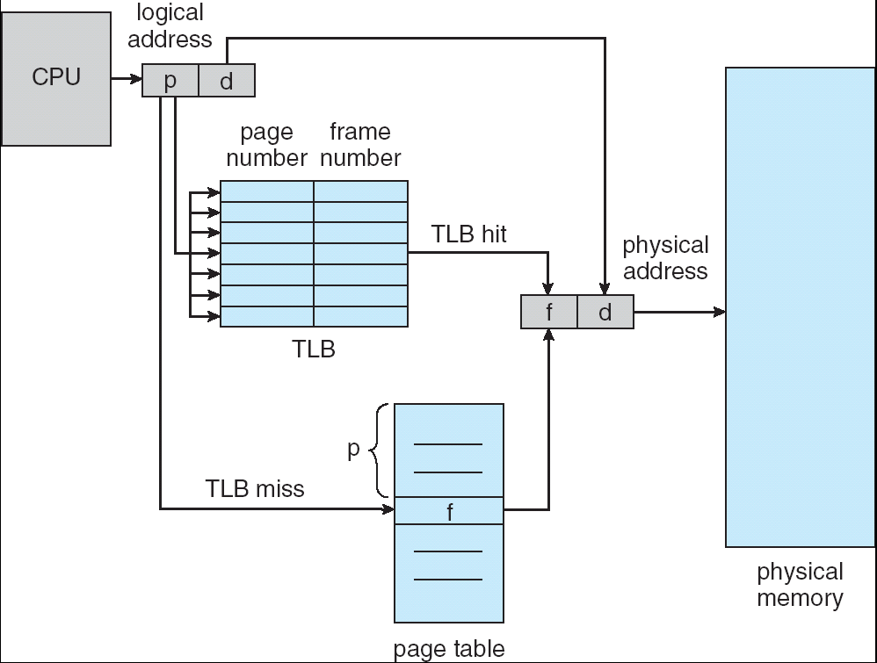
TLB usage diagram
In CPU
In memory
In the case of 'miss', f is found in memory, then it is put in the TLB
Notes:
TLB hit means the page number is found in the TLB, and thus the page number is accessed in the TLB, then its frame number is used to concatenate with the offset of the logical address, and thus put in the physical memory.
TLB miss means the page number is not found in the TLB, thus the frame number needs to be found from the memory. To access the main memory, we use the page number as an index in to the page table (which is in memory) to find the frame number, and then we go back to the TLB to update the page number and frame number (by swapping with an unused page number and frame number), and thus the page number is accessed in the TLB, then its frame number is used to concatenate with the offset of the logical address, and thus put in the physical memory.

Slide 65
Real access time (to memory)
Associative search = ε time units (normally small)
Suppose the memory cycle is 1 microsecond
α = percentage of hits (hit ratio) = percentage of times a page number is found in associative registers
this is related to the number of associative registers available
Effective access time t_{ea}:
t_{ea} = (1 + ε) α + (2 + ε) (1 - α)
= 2 + ε - α
if α is close to 1 and ε is small, this time will be close to 1.
Generalization of the formula taking m as the access time to the main
memory:
t_{ea} = (m + ε) α + (2m + ε) (1- α) = m α + εα + 2m - 2m α + ε - εα =
= 2m + ε -m α
Notes:
Alpha is the percentage for the page number is found on the TLB
1 – alpha is the percentage for the page number is not found on the TLB
Sigma → time taken to search for the page number in the TLB (associative search)
If found, sigma + 1 (alpha %)
Not found, sigma + 1 (searching page table to find frame number) + 1 (searching main memory) (1 – alpha %)

Slide 66
Memory protection
Associates various bits with each page in the page array as in the segment array
E.g. valid-invalid bit indicates valid pages of the process (important in swapping in/out of memory)
To check if an address is valid
With an array of pages having a fixed size: valid- invalid bits
With an array of pages having a variable size (only the valid pages of the process): Compare the page # with the PTLR register (page-table length register)
Notes:
To tell us if a page is in memory (from their frame number) → valid if in (loaded into memory), invalid if not in (not loaded into memory)
For the valid/invalid point:
Consider a process with 4 pages, where only the first two are in the RAM, where the other two are not allocated. Thus the first two are valid due to being loaded into memory, while the other two are invalid.

Slide 67
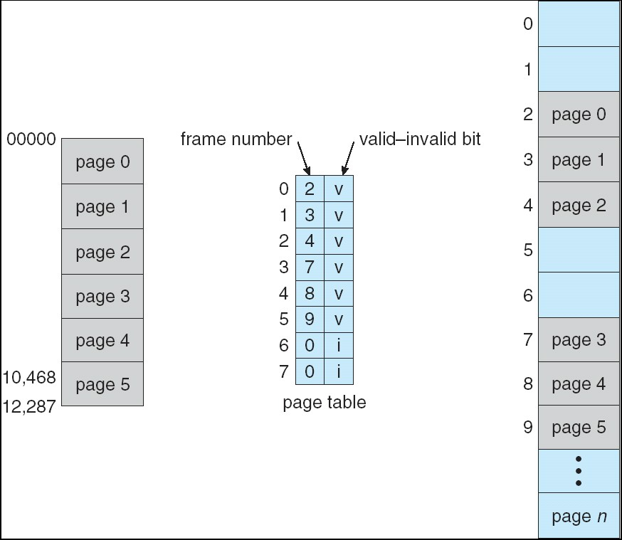
Bit Valid-Invalid (vi) in the page table
Notes:
Notice the invalid pages have 0 for frame number reference

Slide 68
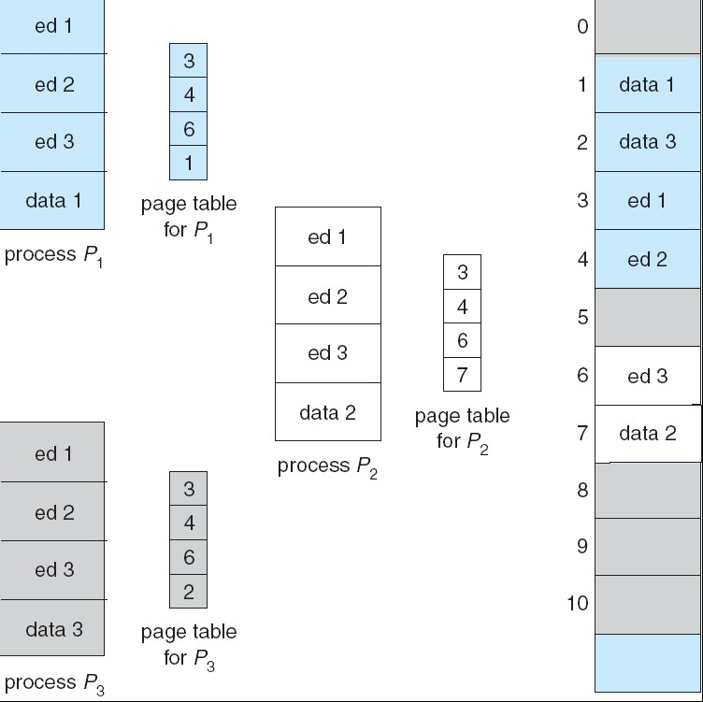
Sharing pages:
3 proc. sharing an editor, on private data for each process
Notes:
Notice the page numbers are the same for the shared editors in the page tables. Of course, the data files have different page numbers

Slide 69
Structure of page tables
How long can an a page table be?
32-bit Addresses, page of 4 kbytes -> 2²⁰ pages = 1M page entries!
Oh my!
Hierarchical page table
Notes:
If the registers are not large enough, then they need to be put into the main memory
4 KB → (2^2) * 2^10 bits = 2^12 bits for the offset
20 for the page sizes → 2^20 combinations for a process → 1 million pages (1 MB) for a process
Recall, each frame in RAM is the same size of page size

Slide 70



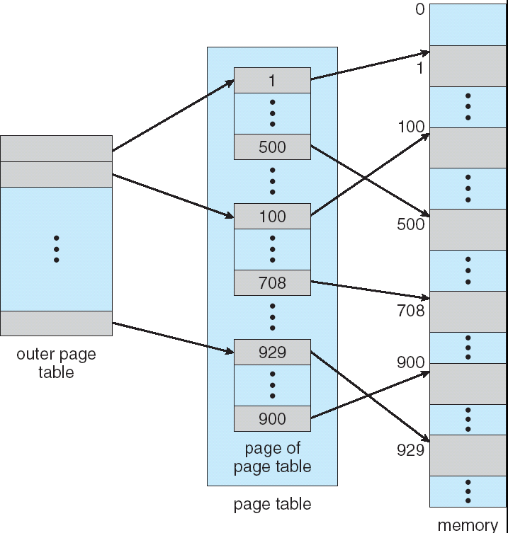
page table of the page table
Notes:
Consider a logical address of 10 bits, where 6 bits are used for the page size, and 4 bits for the page number.
With 4 bits for the page number means up to 2^4 = 16 pages. If not enough size in the registers, then we can divide the 4 bits into pairs of two bits where the first 2 bits from the left give us 4 pointers to a page table where each of those tables have 4 entries, thus giving us 16 entries. An extra table aside from the page table to use as pointer to the page table references.
The advantage is that:
Consider we are asking for a particular address, such as 0010. Well from the 00 on the left, we know which pointer to go to, and the other two bits lets us know which entry in the referenced table is the entry to go with. As such, the other referenced tables will not be accessed, only load the 25% of the tables to access it (4 pages instead of 16 pages), saving a lot of space. So when the page tables are large, we divide the page tables into “inner” page tables, and then load individual pages as shown above, reducing the capacity for loading.

Slide 71
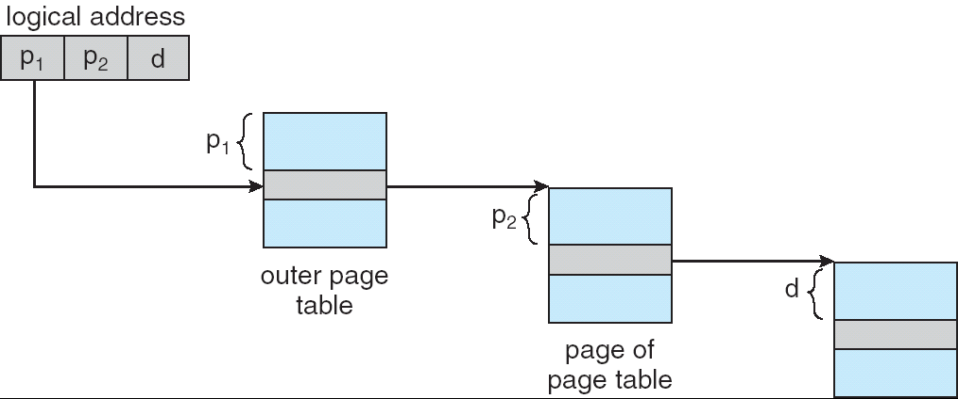
Hierarchical page tables on two levels
The part of the address that belongs to the page number is itself divided into 2
inner
Notes:
Multilevel Paging is a paging scheme that consists of two or more levels of page tables in a hierarchical manner. It is also known as hierarchical paging. The entries of the level 1 page table are pointers to a level 2 page table and entries of the level 2 page tables are pointers to a level 3 page table and so on. The entries of the last level page table store actual frame information. Level 1 contains a single-page table and the address of that table is stored in PTBR (Page Table Base Register).
Why it is required?
If the frame size of the main memory is smaller than the page size and the process cannot fit that way then we divide the pages into further pages, and this concept is known as multilevel paging.

Slide 72
Using Translation Lookaside Buffer
In the case of multi-level paging systems, the use of TLB becomes even more important to avoid multiple memory accesses to calculate a physical address
The most recently used addresses are found directly in the TLB.

Slide 73

Simple Segmentation vs Simple Pagination
Pagination is only concerned with the problem of loading, while Segmentation also targets the problem of connection Segmentation is visible to the programmer but pagination is not
The segment is a logical unit of protection and sharing, while the page is not
So protection and sharing are easier in segmentation Segmentation requires more complex hardware for address translation (addition instead of concatenation)
Segmentation suffers from fragmentation external (dynamic partitions)
Pagination produces fragmentation internal, but not a lot (1/2 frame per program)
Fortunately, segmentation and pagination can be combined
Segmentation does logical division, while pagination does arbitrary/random division

Slide 74
Conclusions on Memory Management
Problems of:
fragmentation (internal and external)
complexity and efficiency of algorithms
Two widely used methods
Paging
Segmentation
Pagination and segmentation issues: size of segment tables and pages pagination of these tables
efficiency provided by Translation Lookaside Buffer
The methods are often used in conjunction, resulting in complex systems (most OS), but mostly pagination is used

Slide 75
Fragmentation recap
Partition fixes: internal fragmentation because partitions cannot be completely used + external fragmentation if there are unused partitions
Dynamic partitions: external fragmentation which leads to the need for compression.
Segmentation without pagination: no internal fragmentation, but external fragmentation due to segments of different lengths, stored contiguously
(as in dynamic partitions)
Pagination: on average, 1/2 frame of internal fragmentation per process

