Slide 1


Module 8 - Virtual memory
Chapter 9 (Silberchatz)
Module 8
1

Slide 2
Module 8: Virtual Memory
Reading: Chapter 9
Objectives:
To describe the benefits of a virtual memory system.
To explain the concepts of demand paging, page-replacement algorithms, and allocation of page frames.
To discuss the principles of working-set model.
2
Notes:
Expanding the main memory by utilizing a secondary storage called the virtual memory.
Recall that in order to execute a process, the entirety of the process does not need to be loaded into memory → demand paging

Slide 3


Virtual memory
Demand paging Performance issues Replacing pages: algorithms Allocation of memory frames Working set
Module 8
3

Slide 4

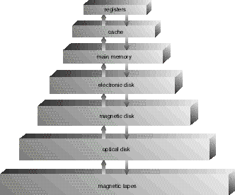
Virtual Memory and Memory Hierarchy
Mechanisms used with virtual memory are similar to those used for cache memory
But for cache memory – implemented in hardware
Cache mechanisms
RAM
(flash)
Mech. virt. memory
4
Notes:
Recall the different memory devices: the hierarchy differentiates the speed of access from top (highest) to bottom (slowest) and storage/capacity from top (smallest) to bottom (largest)

Slide 5


Virtual memory (extension of the RAM)
In order for a program to be executed, it does not have to be all in main memory!
Only the parts that are in execution need to be in main memory
The other parts can be on secondary memory (e.g. disk), ready to be brought into main memory on request
swapping mechanism → demand paging
This makes it possible to run programs much
larger than physical memory.
Achieving a virtual memory that is larger than physical memory.
Module 8
5
Notes:
Using virtual memory to extend the physical memory.
Not all parts of a process need to be loaded into the main memory.
Demand paging is a technique used in virtual memory systems where the pages are brought in the main memory only when referenced or required or demanded by the CPU. Hence, it is also named as lazy swapper because the swapping of pages is done only when required by the CPU. When the essential pages are in the memory, based on the references made, those referenced pages are then brought in, only upon request.
Sometimes, the frames available in the memory cannot allocate the incoming pages, or that no free frames are available. At this point, some swapping of the already allocated pages is necessary (into the disk for example), and be replaced by the new pages → page replacement algorithm

Slide 6




From paging and segmentation to virtual memory
A process consists of pieces (pages or segments) not requiring to occupy a contiguous region of main memory
References to memory are translated to physical addresses during
execution
A process can be moved to different regions of memory, also secondary memory!
Therefore: all the pieces of a process do not need to be in main
memory during execution (only some are needed)
Execution can continue as long as the next instruction (or data) is in a piece found in main memory
The sum of the logical memory of the running processes can therefore exceed the available physical memory.
This is the basic concept of virtual memory
An image of the entire process address space is kept in secondary memory (normal Disk) from where missing pages can be taken if necessary
swapping mechanism
Module 8
6
Notes:
Regarding the exceeding of spaces:
Consider a process with 3 pages, and another process with 4 pages. Now a physical RAM that has 4 frames available. The first process and the second process can be loaded solely and independent from each other with no problem. But then again, not all pages/parts need to be loaded, which then allows for both processes to be loaded partially at the same time. This allows to execute multiple processes without actually loading all the segments of each process.
Sum of logical memory here is 3 + 4, where physical memory is 4

Slide 7
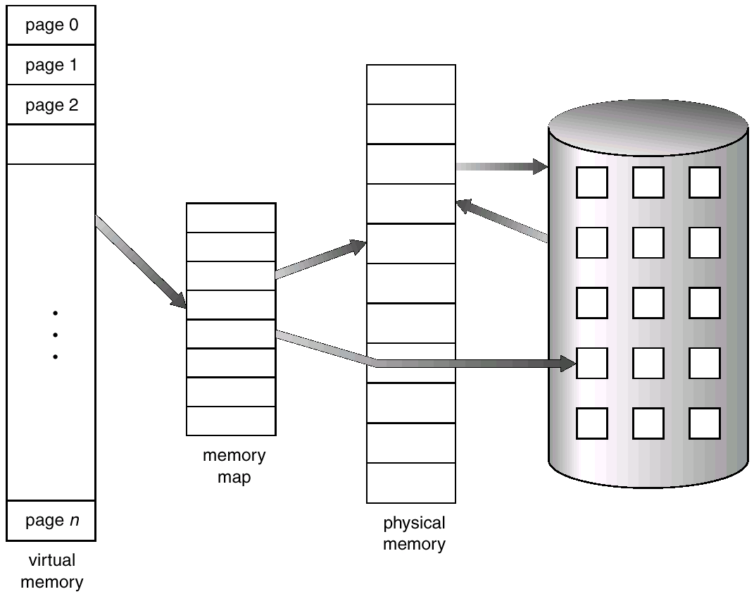
Virtual memory:
result of a mechanism which combines main memory and secondary memory
Table of pages
Module 8
7
Notes:
The virtual memory can contain all the pages of the current processes. As shown, it contains all of the pages for the logical memory, where as the physical memory is smaller in capacity.
The memory map is like a page table to map which pages are in which frames of the physical memory, and if not included, then they are in the disk.

Slide 8
Locality and virtual memory
Principle of locality of references: references to memory by a process tends to be grouped.
Thus: only a few pieces of the process are used during a small period of time (pieces: pages or segments).
There is a good chance of “guessing” which
pieces will be in demand in the near future.
Module 8
8
Notes:
Consider a program running with a set of instructions, separated into pages. As we start with the primary instruction, thus in the first page, at some point, we jump into another page. This means that the instructions are grouped so that some time is spent during one page until it is over, then moving to another, rather jumping from instruction to instruction. This would determine which page is to be loaded next, rather than the next instruction.

Slide 9
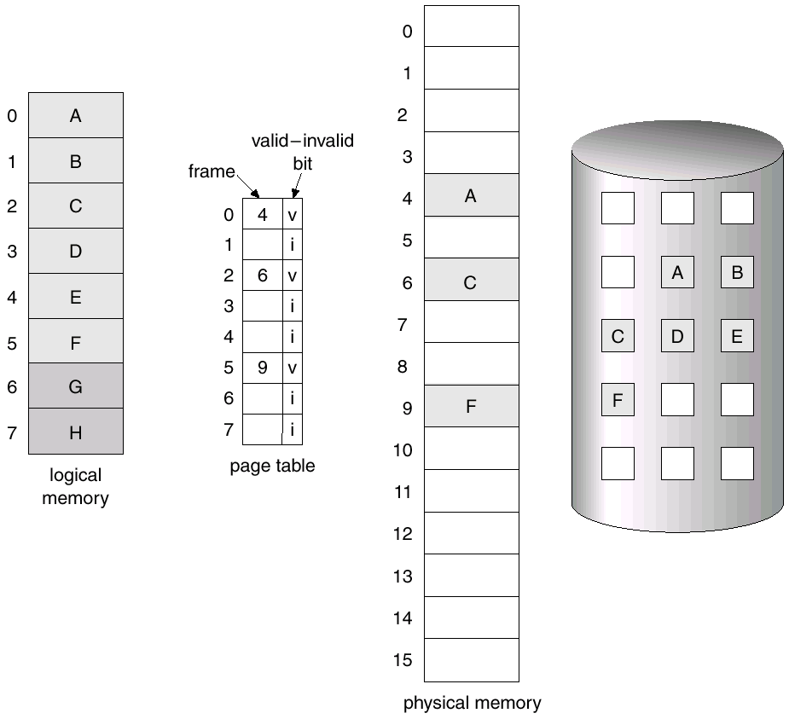
Pages in RAM or on disk
Page A in RAM and
on disk
Page E only on disk
Module 8
9
Notes:
The pages that are valid will be in main memory and have their validity bit set to 1 or v, while the ones that are invalid will be on disk and have their validity bit set to 0 or i.

Slide 10
New page table format (the same idea can be applied to segment tables)
Address of the page | Bit present
bit present
1 if in main memory,
0 if in secondary memory (or disk).
If the page is in main memory,
this is an address of page
in Main memory
otherwise it is a secondary memory address
At the start, bit present = 0 for all pages
Module 8
10

Slide 11
Advantages of Partial Loading
More processes can be maintained in memory for execution
Only a few pieces are loaded for each process.
The user can be happy, since he/she can execute many processes and reference large data structures without worrying about filling main memory.
With many processes in memory, more probable to have a process in the ready state, which increases utilization of the CPU.
Many pages or segments rarely used need not be loaded at all into memory.
It is now possible to execute a set of processes even if their sizes exceed the main memory
It is possible to use more bits in the logical address than the number of bits used for addressing main memory.
Logical address space > physical address space.
Notes:
Or Logical memory can exceed the physical memory in terms of storage.

Slide 12
Virtual Memory: Can Be LARGE!
Ex: 16 bits are required to address physical memory of size 64KB
Using 1KB pages, 10 bits are required for offset.
For the page number of the logical address, it is possible to use more than 6 bits, since not all pages need to be in memory.
Thus the limit of virtual memory is defined by the number of bits that can be reserved for the address
In some architectures, these bits can be included in registers.
Logical memory is thus called virtual memory.
Is maintained in secondary memory → disk
Pieces are brought into main memory only when necessary, on demand.
Notes:
2^offset size is the page size. The other bits attached to offset is the page number where each page number can have 2^offset regarding its page size

Slide 13
Virtual Memory
For better performance, virtual memory is located in a region of the disk not managed by the file system.
Swap memory.
Physical memory is the memory referenced by physical addresses
Found in RAM and the cache.
The translation of the logical address to the physical address is accomplished using the mechanisms studied in the previous module.
Notes:
The virtual memory is not managed by the file system as it would create an overhead, for possible damaging of the region, and users cannot manipulate this region such as renaming files or creating files as one would on a disk.

Slide 14
Virtual memory: the reciprocating mechanism
Table of pages
Module 8
14

Slide 15
Execution of a Process
The OS loads the main memory with some parts of the program (including the starting point)
Each entry in the page table (or segments) has a bit present (set to 1)
which indicates whether the page or segment is in main memory
Resident set is the portion (set of pages) of the process in main memory
An interrupt is generated when the logical address refers to a part which is not in the resident set
page fault
What to do when an address reference falls in a page not in physical memory?
Bring that page into memory
How?
Find it on the disc
Get an empty frame (on RAM)
Read/Bring the page into frame
Set the valid bit to 1 of that page in the page table
Restart the instruction that caused the page fault.
Module 8
15
Notes:
If the bit present is set to 0, then that page or segment is in the virtual memory.
While executing a program, sometimes a reference is made to a page that is not in the RAM → an interrupt is generated that is called a page fault

Slide 16


Demand Paging
Bring a page into memory only when it is needed What does it mean that the page is needed?
Memory address in that page was referenced
Fine, but what do we need to make it work?
For each page we need to know whether it is in memory or swapped on disk
If not, we need to be able to automatically and
transparently bring it there
If it is on disk, where on disk?
Notes:
Only load pages when they are needed/referenced into the main memory

Slide 17
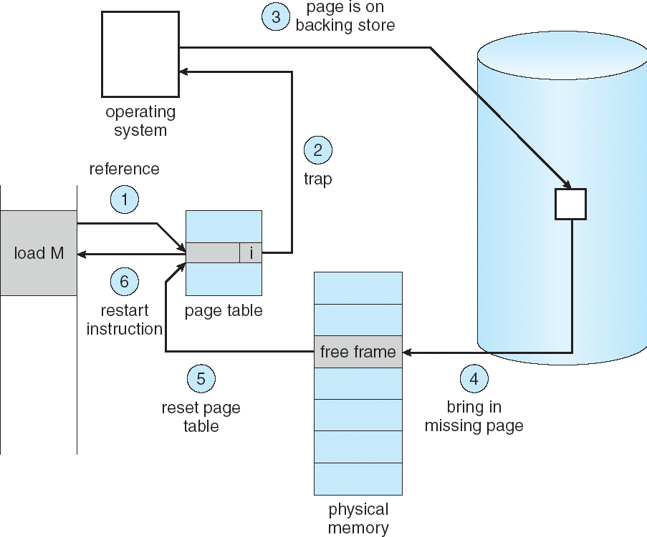
Steps in Handling a Page Fault
Notes:
Consider when load M is an instruction that makes a reference to a page that is not in the RAM. When looking for the page in the page table, its validity bit is set to invalid, and as such, an interrupt is made → page fault. As such, the OS will trap this bit (handling the page fault) and then looks for it in the virtual memory. After finding the page, it scans the page table, looking for a free frame, to situate the incoming page. It brings the page into main memory, resetting the page table (and thus changing the validity of the page in the page table) and the restarting the instruction where the interrupt occurred.

Slide 18


Sequence of Events for a Page Fault
1.
Reference is made to an address of a page not loaded into
main memory.
Trap to the OS – an interruption
If the address is legal (page requested is part of the process image).
Save registers and state of process in the PCB
State is changed to « waiting »
PCB placed in the I/O queue.
If the address is not legal – terminate the process, i.e. fatal error.
Find the position of the page on the disk.
Read the page from the disk into a free memory frame (we suppose that one exists)
Execute the disk operations required to read the page.
2.
3.
4.

Slide 19
Sequence of Events for a Page Fault (cont.)
4. The disk controller completes the transfer and interrupts the CPU.
Note that the process is placed in the Wait state during the I/O operation
5. The OS updates the contents of the page table for the process that caused the page fault
The process becomes ready.
6. At some point, the process will execute
The desire page being in memory, the process re-
executes the instruction that caused the page fault.

Slide 20
Average memory access time
Suppose that:
memory access: 100 nanosecs
paging fault processing time: 25 millisecs = 25,000,000 nanosecs
p: probability of not finding a page in memory (default) Average memory access time:
(1-p) x 100 + p x 25,000,000 → (no page fault + page fault)
Using the same formula we can determine how many faults we can tolerate, if a certain level of performance is desired (see manual).
Eg. with these parameters, if the slowdown due to paging cannot exceed 10%, only 1 paging fault can be tolerated for every 2,500,000 memory accesses.
Module 8
20
Notes:
If the page happens to not be in the main memory, then it will take more time to access the page since now the OS needs to search in the disk after searching in the page table.
paging fault processing time is the time taken to perform the 6 steps shown 2 slides before
To demonstrate:
1st step: reference to page → 2 scenarios
1. page in main memory
1-p → probability of finding the page in RAM
2. page not in RAM
p → probability of not finding the page in RAM

Slide 21
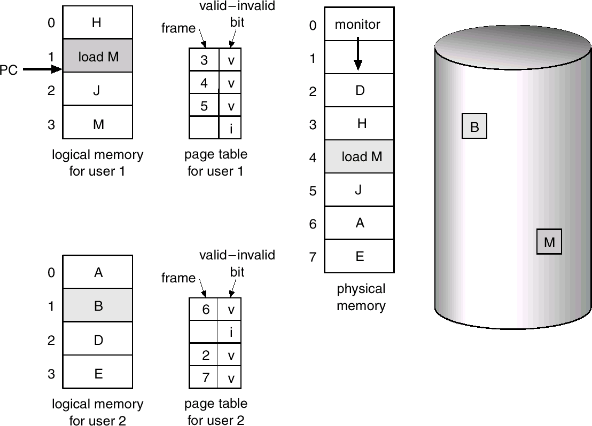
When the RAM is full but we need a page not in RAM
Module 8
21

Slide 22
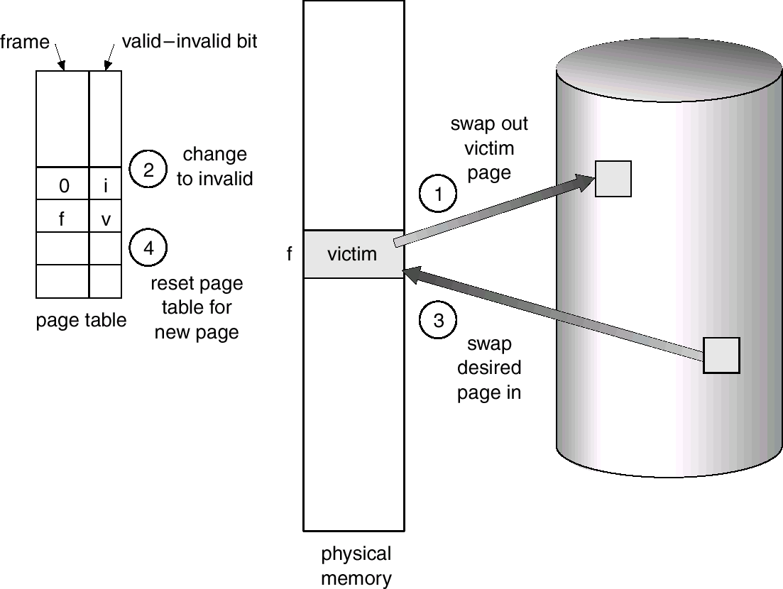
The victim page ...
Module 8
22
Notes:
When the page referenced is not in main memory, and thus need to look for in the disk, now what if there are no frames available in the RAM?
Normally, the frames are divided among the processes, but other circumstances such as this can occur.
Imagine when a process is only allocated limited number of frames in RAM, with each page filling in the frames. Now another page is referenced from the current pages. Now, must find a free frame, but no frames are empty. Thus, we need to steal a frame, as in choose a frame that has already allocated a previous page. This is a different situation, where an algorithm needs to decide which of the currently allocated pages need to be swapped out in order to create space. The page that swapped out is called the victim page (selected by the page replacement algorithm and is the page that is swapped out in order to bring in the desired page into the RAM)

Slide 23
Basic Page Replacement
What if a process requests a new page and there are no free frames in RAM?
It will be necessary to choose a page already in main memory, belonging to the same or to another process, which it is possible to remove from the main memory
the victim!
A memory frame will therefore be made available Obviously, several memory frames cannot be 'victimized':
eg frames containing OS kernel, I/O buffers ...
Module 8
23
Notes:
The frames that belong to the OS or I/O buffers cannot be victimized and thus are not touched by the page replacement algorithms.

Slide 24
Dirty bit
Does the “victim” really need to be written into secondary memory?
Only if it has not changed since it was brought into main memory.
Otherwise its copy on the disk is still correct.
A dirty bit in the page table entry can indicate if the page has changed.
Thus to compute the cost in time of a reference in memory should include the probability that the page is “dirty” and needs to be written to the disk.
24
Notes:
Recall when a process is divided into some pages, and that when one is referenced, one of those currently allocated pages is the victim page.
When a process is loaded, its pages started in the disk, thus a version of the page exists in the secondary memory, as a program resides on the disk. This is useful because swapping out pages takes time, and instead, the referenced page can just override the “victim” page. All pages start off in secondary memory, therefore if they never changed in main memory, we can just use the version that exists in secondary memory.
When a page is modified, we want to save a copy (before the modification) to the disk. Using the Dirty bit, we distinguish pages that have been modified or not.

Slide 25
Page replacement algorithms
Choose the victim so as to minimize the page defect rate
not easy!!!
Page that we won't need in the future? impossible to know!
Page not often used?
Page which has been in memory for a long time ??
etc. we will see...
Module 8
25

Slide 26
Criteria for evaluating algorithms
The algorithms for choosing which pages to replace must be designed so as to minimize page fault rate in the long run
Should try to keep system overhead to a minimum, e.g. updating tables in memory for each memory access.
Try to keep expensive hardware to a minimum.
Module 8
26
Notes:
Same standard is used for identifying page faults for each algorithm
minimize page fault rate = producing minimum number of page faults

Slide 27

Page Replacement Algorithms
Which pages to consider for replacement?
Can we replace kernel pages? No
Not all pages in main memory can be selected for replacement
Some frames are locked (cannot be paged/swapped out):
much of the kernel is held on locked frames as well as key control structures and I/O buffers
OK, which unlocked pages to consider for replacement (using dirty bit)? Only those of the process that has suffered the page fault Consider all unlocked pages
related to the resident set management strategy:
how many page frames are to be allocated to each process?
We will discuss this later
Notes:
Any page that belongs to the OS are not allowed to be replaced
resident set management strategy → How many frames initially are to be allocated to each process → 2 algorithms: Equal allocation and proportional allocation

Slide 28
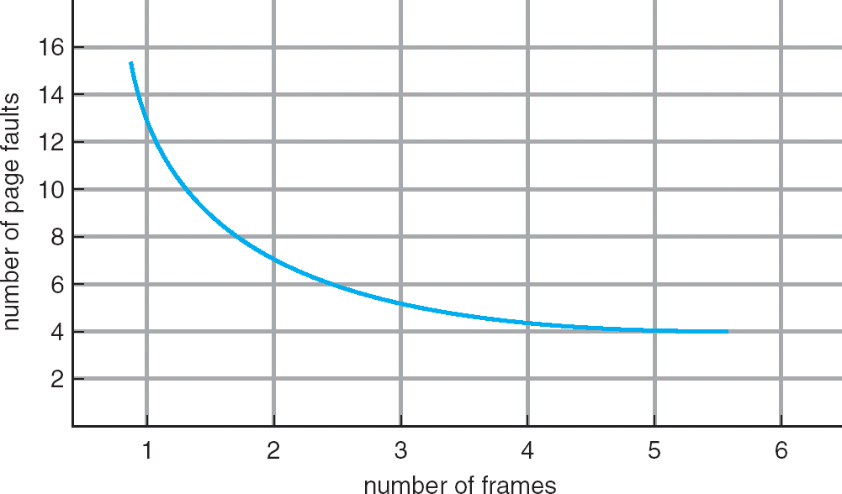
Graph of Page Faults Versus The Number of Frames
More frames we allocate to the process, less page faults will occur
Notes:
The normal behavior of any page replacement algorithms.
The desire is that all pages are in the RAM where then no page faults would or could occur, where this happens when the number of frames increases.

Slide 29
Explanation and evaluation of algorithms
We will explain and evaluate the algorithms using the following page reference strings
2, 3, 2, 1, 5, 2, 4, 5, 3, 2, 5, 2
7, 0, 1, 2, 0, 3, 0, 4, 2, 3, 0, 3, 2, 1, 2, 0, 1, 7, 0, 1
Careful: such sequences are not random.
Remember the locality of reference
The evaluation will be made on the basis of this example, obviously not sufficient to draw general conclusions.
Module 8
29
Notes:
Reference string: the execution order of references of the pages that contain the instructions
Imagine a process with instructions I1, I2, I3, …., In, and they are separated into pages. While executing the process, the instructions are being executed. To keep track of which instructions are being executed, we associate a page number to those instructions with respect to where they are located in the page groups. Example: 1, 1, 2, 2, 2, 3, 3, …, 1 where this reference string are page numbers.
Notice that no consecutive reference numbers are the same number (example above this text line is not accurate, just explanatory → 1, 2, 3, …, 1). If they exist, then it means that page faults have occurred, and the page fault occurs on the first occurrence of the reference. It is only the consecutive duplicates that are removed. Hence since the following duplicated page references would not create page faults, and thus are removed.
A reference string may only contain a portion of the pages to be used in the RAM, as in the maximum number from this sequence does not always mean the maximum number of pages available from the process/program

Slide 30
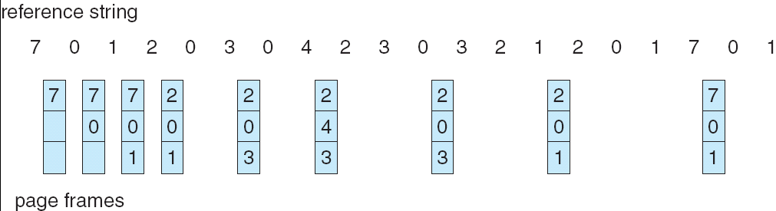
OPT Algorithm
Good news:
There is an optimal algorithm that produces the fewest number of page faults
The optimal algorithm (OPT) selects for replacement the the page that will be referenced the latest (i.e. the page for which the time to the next reference is the longest)
Notes:
Example, assume a process is allowed 3 frames:
Starting with page 7, it causes a page fault, and thus brought into the frame. Same thing for page 0 and 1. When reaching page 2, notice how 7 will be called later than both page 0 and 1, hence it is the one being replaced. Same thing for page 3. Notice 7 replaces 2 by the end. By the end, 9 page faults have been made in OPT.
No page fault for pages if already in the frame.

Slide 31

OPT Algorithm
Bad news:
impossible to implement (need to know the future)
Still useful: serves as a standard to compare with the other algorithms we shall study:
Least recently used (LRU) First-in, first-out (FIFO) Second Chance or Clock Counting algorithms

Slide 32
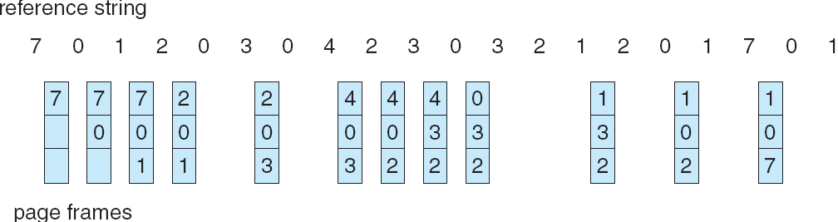
The LRU Algorithm
Least Recently Used/referenced Chronological order of use
Replaces the page that has not been referenced
for the longest time
By the principle of locality, this should be the page least likely to be referenced in the near future
performs nearly as well as the optimal policy
Notes:
Need to scan backwards when choosing for a candidate to replace the pages.
By the end, 12 page faults for this example

Slide 33
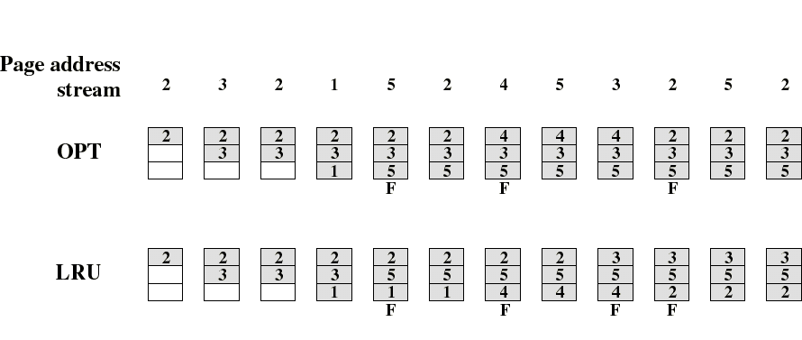
OPT and LRU example
LRU performs nearly as well as OPT:
A 5 page process and there are only 3 physical
pages available.
In this example, OPT causes 3 + 3 faults, LRU 3 + 4.
Notes:
The OPT will always be better than the LRU (maybe sometimes equal in producing # page faults, but never worse)

Slide 34
Note on counting page faults
When the main memory is empty, each new page we bring in is a result of a page fault
For the purpose of comparing the different algorithms, we are not counting these initial page faults
because the number of these is the same for all algorithms
But, in contrast to what is shown in the figures, these initial references are really producing page faults
Notes:
Thus when a free frame is available, a page fault occurs due to referencing page that DNE in the main memory.

Slide 35
Implementation of the LRU Algorithm
What do we need to implement LRU algorithm?
Each page should be tagged (in the page table entry) with the time at each memory reference.
This tag should be updated on every reference
The LRU page is the one with the smallest time value
needs to be searched at each page fault
Can be implemented using a stack (linked list)
Both approaches would require expensive hardware and a great deal of overhead.
Consequently very few computer systems provide sufficient hardware support for true LRU replacement algorithm
Other algorithms are used instead such as LRU
approximations
Notes:
Using the past to predict the future
Every instance the reference is made, the time it was referenced needs to be updated. Thus the page to be replaced is the one that has the shortest timestamp.

Slide 36

The FIFO Algorithm
OPT is impossible, LRU is too costly but possible, let’s try something simple!
Idea: a page which has been in memory for a long
time has had its chance to execute → replace that one
Treats page frames allocated to a process as a circular buffer:
When the buffer is full, the oldest page is replaced.
Hence: first-in, first-out
This is not necessarily the same as the LRU page
“The oldest page” means the page in memory the longest (for LRU, in terms of page reference).
Simple to implement
requires only a pointer that circles through the frames of the process
BUT: A frequently used page is often the oldest, so it will be repeatedly paged out by FIFO
36
Notes:
A sort of order of numbers are associated to the pages that are allocated to the frames, and based on that number, the lower that number, the next page to be replaced. Or, think of looking for the page that has been in the RAM for the longest time.
The page that has been brought into memory first will exit first.
Easiest to implement, but highest in page fault occurrence, where as the LRU, although more costly, more practical in modern times

Slide 37
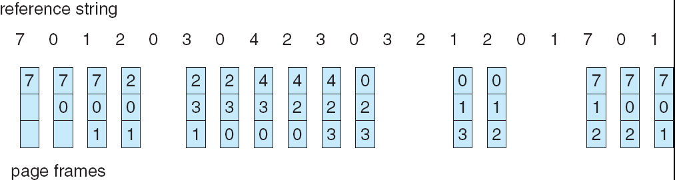
FIFO Example
37

Slide 38

Comparison of FIFO with LRU (Stallings)
Unlike FIFO, LRU recognizes that pages 2 and 5
are used frequently
FIFO's performance is less good:
in this case, LRU = 3 + 4, FIFO = 3 + 6
Module 8
38

Slide 39
Conceptual problem with FIFO
The first pages brought into memory are often useful throughout the execution of a process!
global variables, main program, etc.
Which shows a problem with our way of comparing methods based on a random sequence:
references to pages in a real program will not be really random
Module 8
39
Notes:
And the global variables and the main program are necessary to stay in the RAM, and if they were chosen to be replaced or swapped out, then the CPU will no longer have access to them.

Slide 40

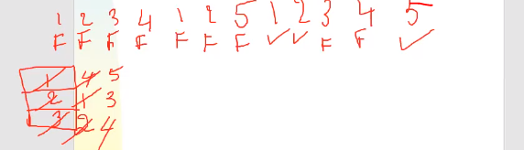
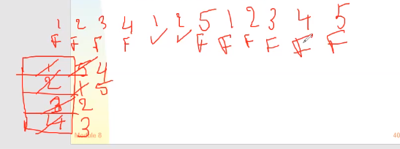
Belady's anomaly
For some algorithms, in some cases it could have more faults with more memory!
E.g., FIFO, but not LRU, OPT, CLOCK
(Ex. referral string 1,2,3,4,1,2,5,1,2,3,4,5)
Module 8
40
Notes:
Recall the graph (slide 28), where as the # of frames increase, the # page faults should decrease, but the FIFO brings in an anomaly
To demonstrate:
Imagine a process with 5 pages working in a 3 frame RAM, and then a 4 frame RAM
F for page fault, N for no page fault
3 Frames: 1 2 3 4 1 2 5 1 2 3 4 5
3 Frames: F F F F F F F N N F F N → 9 page faults
4 Frames: 1 2 3 4 1 2 5 1 2 3 4 5
4 Frames: F F F F N N F F F F F F → 10 page faults
Notice here that the number of frames increased, but the number of page faults increased as well, where the graph indicated the number of page faults would decrease instead → Belady’s anomaly in FIFO

Slide 41
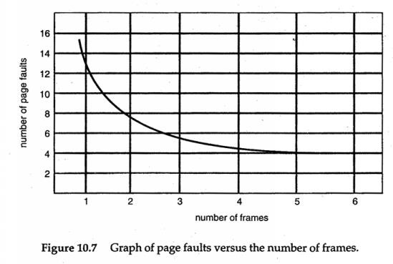
Situation considered normal
Module 8
41

Slide 42
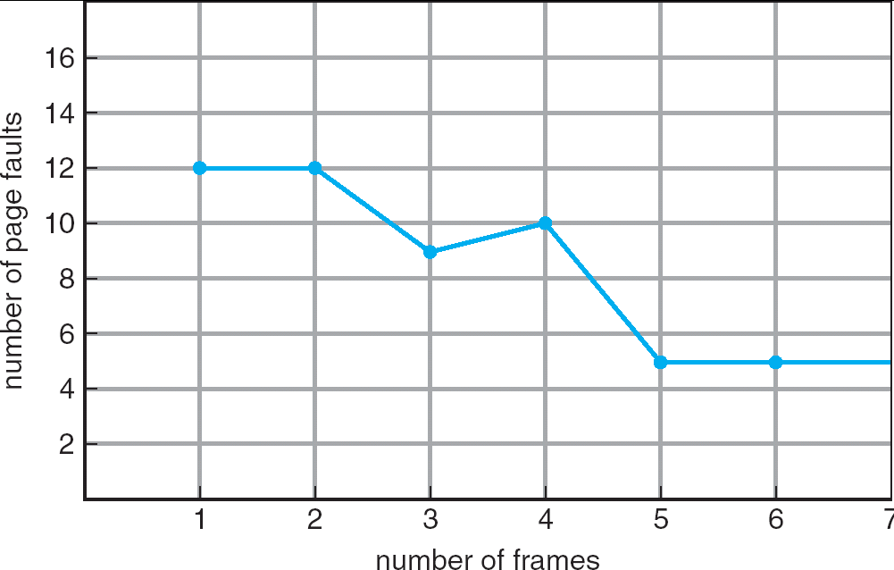
Belady’s Anomaly
Number of page faults does not necessarily decrease with increased number of frames:

Slide 43
Belady’s Anomaly in FIFO Algorithm
Chain of References: 1, 2, 3, 4, 1, 2, 5, 1, 2, 3, 4, 5
3 frames (3 pages can be in memory at a time per process)
1
2
1
2
3
4 5
1 3 9 page faults
3
2 4
4 frames
1
2
1
2
3
4
5 4
1 5 10 page faults
3
2
3
4

Slide 44
Page replacement algorithms
OPT
Impossible to implement
Let’s approximate it with LRU
But LRU is still too costly
Let’s try something simple – FIFO
Does not work well enough
Any further ideas?
Try to approximate the approximation Approximate LRU
Clock algorithm
Counting algorithms

Slide 45

The Clock Algorithm (second chance algorithm)
The set of frames candidate for replacement is considered as a circular buffer (similar to FIFO)
When a page is replaced, a pointer is set to point to the next frame in buffer
A use bit for each frame is set to 1 whenever
a page is first loaded into the frame
the corresponding page is referenced
When it is time to replace a page, the first frame encountered with the use bit set to 0 is replaced.
During the search for replacement, each use bit set to 1 is changed to 0
Gives each page a second chance to prove that it is useful
By not replacing it when considered for the first time
By not replacing if it was referenced after it has been considered at the last page fault
Notes:
In this algorithm, the pages have 2 lives as if, where the clock rotates around searching for those that have only 1 life. The pointer will always point to the frame with 1 life left. If the page already exists in the frames, and is referenced, it gains a life, but if the pointer was pointing to it, the pointer stays on it. If a page is already in the frames, and the pointer is not on that page, then no changes are made. The pointer will point to the next frame that contains a page after each stage (it does not have to contain a page, especially in the early stages)

Slide 46
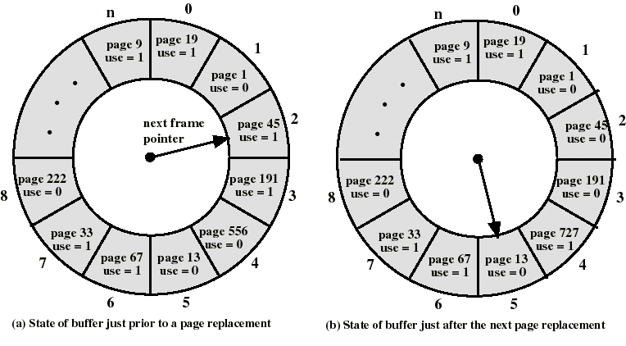
Clock algorithm: an example (Stallings).
Page 727 is loaded in frame 4. The next victim is frame 5, then frame 8, since the use bits are 0.
Module 8
46

Slide 47
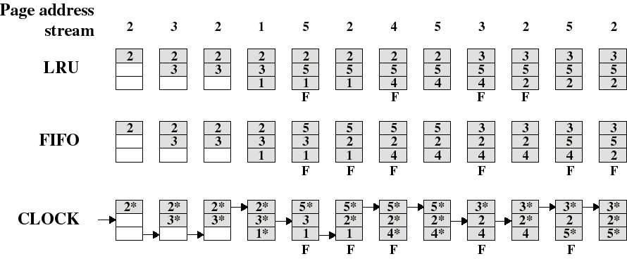
Comparison of Clock with FIFO and LRU
Asterisk indicates that the corresponding use bit is set to 1
Clock protects frequently referenced pages by setting the use bit to 1 at each reference
LRU = 3+4, FIFO = 3+6, Clock = 3+5
Notes:
For the 4th stage, if the next stage was referencing 1 instead of 5 for example, then no changes would be made to the main memory, since page 1 is already in the RAM and thus no need to change anything (even the pointer will not change reference). A change would have been made only if no star was beside that referenced page number, which then due to referencing page 1 again, it gains the start, without changing the pointer position. Even if the pages 2 and 3 had no star, they will not gain any stars beside since the reference was to page 1.
Every time a page enters/is loaded into a frame, it receives 2 lives, and when it is referenced and it is in the frame, also gains a life (unless already has 2 lives, in which case, nothing happens)

Slide 48
Additional Hardware for the CLOCK Algorithm
 | 1
 | 0
 | 0
 | 0
 | 1
Each block of memory has a use bit
When the contents of the bloc has been used, the bit is set to 1 by the hardware.
The OS can examine this
bit
If 0, the page can be replaced
If 1, it sets it to 0.
Memory

Slide 49
Comparison: Clock, FIFO and LRU
Simulations show that clock has almost the same performance as LRU
Variations of the clock are implemented in real systems
When candidate pages for replacement are local to the process that invoked the page fault and the number of frames allocated are fixed, experiments show:
If few (6 to 8) frames are allocated, the number of page faults produced by FIFO is almost double that produced by LRU, and that produced by CLOCK is somewhere in between.
The difference between LRU and CLOCK tends to disappear as (over 12) frames are allocated.
Notes:
LRU seems to be next best thing after the OPT
FIFO is the easiest to implement
CLOCK is more applied in industrial applications

Slide 50
Counting Algorithms
Idea: Keep a counter of the number of references that have been made to each page
LFU Algorithm: replaces page with smallest count
MFU Algorithm: based on the argument that the page with the smallest count was probably just brought in and has yet to be used
Implementation of these algorithms are expensive and rarely used.
Notes:
Another set of algorithms for page replacement algorithms
LFU → least frequently used (use FIFO for tie-breakers)
MFU → most frequently used

Slide 51
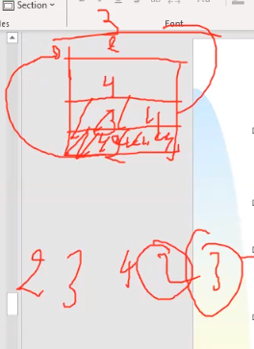
Using a stack
When a page is used, it is put on top of the stack. so the most recently used page is always at the top, the least recently used is still at the bottom
Good implementation of the principle of locality, however ...
The stack must be implemented by hardware, as we cannot tolerate the execution of a program every time a page is used
So not practical as it is implemented by hardware
Module 8
51

Slide 52
Page Buffering
Pages to be replaced are kept in main memory for a while to guard against poorly performing replacement algorithms such as FIFO
Two lists of pointers are maintained: each entry points to a frame selected for replacement
a free page list for frames that have not been modified
since brought in (no need to swap out)
a modified page list for frames that have been modified (need to write them out)
A frame to be replaced has a pointer added to the tail of one of the lists and the present bit is cleared in corresponding page table entry
but the page remains in the same memory frame
Notes:
Recall the page swapping mechanism of demand paging; this has some overhead as the process has to wait for the new page to be allocated into the frame in the RAM, and thus cannot continue execution until the swap is done. Thus, a free frame is found and then the new page is brought in, or the swapping is done. But for replacement, it requires 2 other steps: two lists of pointers.

Slide 53
Page Buffering
At each page fault the two lists are first examined to see if
the needed page is still in main memory
If it is, we just need to set the present bit in the corresponding page table entry (and remove the matching entry in the relevant page list)
If it is not, then the needed page is brought in, it is placed in the frame pointed by the head of the free frame list (overwriting the page that was there)
the head of the free frame list is moved to the next entry
(the frame number in the page table entry could be used to scan the two lists, or each list entry could contain the process id and page number of the occupied frame)
The modified list also serves to write out modified pages in batch (rather than individually)

Slide 54
Frame Allocation
To execute, a process needs a minimal number of memory
frames.
For example, a few instructions may require a number of pages for execution (code, data, stack).
It is easy to see that when a process receives few frames, it will generate an excessive number of page faults and be slowed considerably.
How to ensure that a process is allocate its minimum
Equal allocation: each process has an equal portion of physical memory.
Proportional allocation: each process is allocated according to its size
The criteria should be more related to the pages needed: see working set.
Notes:
If enough frames are not allocated to a process, then many issues, notably page faults, will occur. How does the OS handle these many issues?
For equal allocation, consider allocating 40 frames to the RAM for user processes. And 10 processes come in where each is equally allocating the same number frames, in this case, 4 frames per process.
For proportional allocation, the RAM would allocate a number of frames with respect to the number of pages or size of the incoming processes. This does not means # frames = # pages, but rather proportionally throughout the pages. So for example process 1 has 12 pages, process 2 with 8 pages and process 3 with 4 pages, where process 3 is allocating 2 frames, then process 2 gets 4 frames and process 1 gets 6 frames.

Slide 55
Global or local allocation
global: the `victim` is taken from any process
local: the `victim` is taken from the process that needs the page
Module 8
55
Notes:
Local: processes select victim among allocated frames allocated to them (only from the region of RAM that is allocated for that process entirely)
→ Can lead to under utilization
Global: Select any free frame, even if allocated to another process (where another region of RAM is allocated for another process entirely)
→ Processes lose control over their own page fault rate

Slide 56
Thrashing
If not enough memory is allocated to a process so that it generates many page faults, the process spends it time in the I/O queues.
If this situation is generalized to many processes, the CPU becomes under utilized (IDLE mode).
The OS can help remedy the situation by increasing the level
of multiprogramming
More processes in memory, but then...Less memory per process → More page faults
Disaster: thrashing ← multiprogramming causes it
The system is so busy doing I/O of pages (the swapping), it not longer can complete any useful work.
Notes:
Thrashing occurs when allocating enough memory or frames to a process.
Recall that to handle a page fault, the referenced page needs to be scanned in the page table, and depending on that (based on validity bit), then need to scan the memory for a free frame, or select a victim page for replacement (dirty bit or not), for allocating the new page. While this is happening, which takes time, the CPU is not doing any useful work, rather going into IDLE mode.

Slide 57
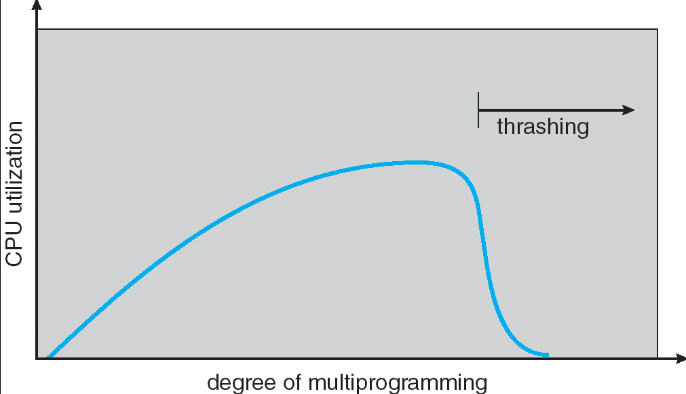
Thrashing
Notes:
As shown, while the degree of multiprogramming increases, the CPU utilization also increases, which is expected as more processes are added into the memory. UP TO A POINT, where if the degree was still increasing, the CPU will become under utilized, as the system will instead spend time performing swapping of pages in the I/O queues → thrashing mode

Slide 58
The reason for the thrashing
Each process needs a certain number (minimum) of pages to run efficiently.
The number of pages that the set of processes needs now exceeds the number of available memory frames
We really need to avoid thrashing! How to do that?
By managing the resident set sizes of processes (initial allocation of frames → 2 ways)
By controlling the degree of multiprogramming → Load control
Module 8
58
Notes:
Load control refers to suspending processes to reduce their count and free up frames to reallocate other pages.

Slide 59
Resident Set Size
The OS must decide how many page frames to allocate to a process
large page fault rate if too few frames are allocated → need to increase # frames
low multiprogramming level if too many frames are allocated, and if the process does not need the extra frames, less processes end up in the memory, as they are rather waiting in the ready queues to be admitted.
Notes:
The resident set is the set of page frames that are used or allocated to a process

Slide 60
Working Set
The working set of a process at a point in execution consists of the set of pages the process requires for execution without too many page faults.

Slide 61
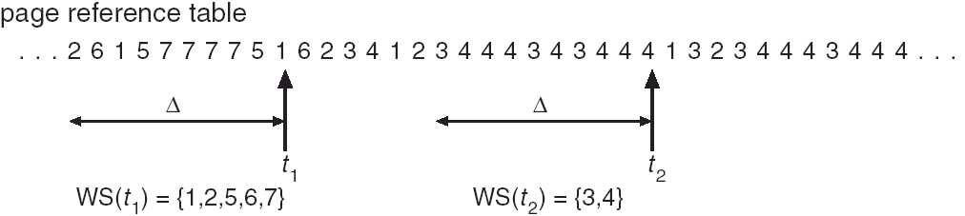
The Working Set Strategy
Is a variable-allocation method with local scope based on the assumption of locality of references
The working set for a process at time t, WS(t), is the set of pages that have been referenced in the last Δ virtual time units
virtual time = time elapsed while the process was in execution (in terms of memory references)
Δ is a window of time
WS(t) is an approximation of the program’s locality
Δ =10 ref.
Δ = 4 would give the same results for t₂!
Notes:
The working set changes from time to time, in the same simulation, where sometimes it is increased, and other times decreased, as shown above.
How many different pages were referenced during that window of time → WS(t_n)
WS(t) is an approximation of the program’s locality: this means that as the program executes, such as spending time to execute the main program (one locality), at some point, the process jumps to another function (another locality). From here, it can either go back to the main program, or another function (thus also changing locality). Making references in this locality or another is the meaning of that statement

Slide 62
The Working Set Strategy
The working set of a process first grows when it starts executing
then stabilizes by the principle of locality
it grows again when the process enters a new locality (transition period)
up to a point where the working set contains pages from two localities
then decreases after a sufficient long time spent in the new locality

Slide 63
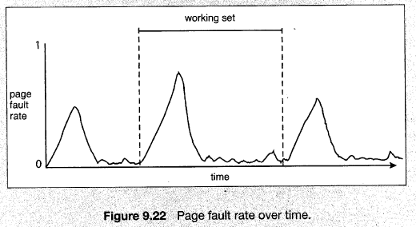
Working Set and Page Faults

Slide 64
The Working Set Strategy
the working set concept suggest the following strategy to determine the resident set size by the OS. The OS:
Monitors the working set for each process (how many page frames it will need)
Periodically removes from the resident set of a process those pages that are not in the working set (apply LRU). **
When the resident set of a process is smaller than its
working set, allocate more frames to the resident set
If not enough free frames are available, suspend the process (until more frames are available); ie: a process may execute only if its working set can be loaded in main memory
Notes:
** From the current resident set, when the new references are made, if one of the pages are not referenced, then by LRU, it is removed from the resident set

Slide 65

The Working Set Strategy
Practical problems with this working set strategy:
measurement of the working set for each process is impractical
necessary to stamp the referenced page with virtual time at every memory reference
necessary to maintain a time-ordered queue of referenced
pages for each process
the optimal value for Δ is unknown and time varying
Any solution?:
rather than monitoring the working set, monitor the page fault rate!
Notes:
The window of time is difficult to consider → how many page references are needed to be considered/determined

Slide 66
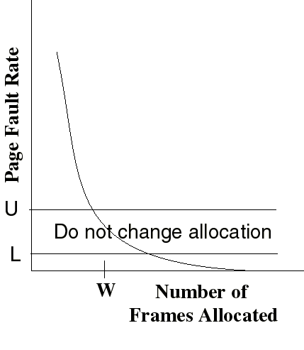
The Page-Fault Frequency Strategy
Define an upper bound U and lower bound L for page fault rates
Allocate more frames to a process if fault rate is higher than U
Allocate less frames if
fault rate is < L
The resident set size should be close to the working set size W
We suspend the process if the PFR > U and no more free frames are available
Notes:
The bounds are determined by the OS based on simulations

Slide 67
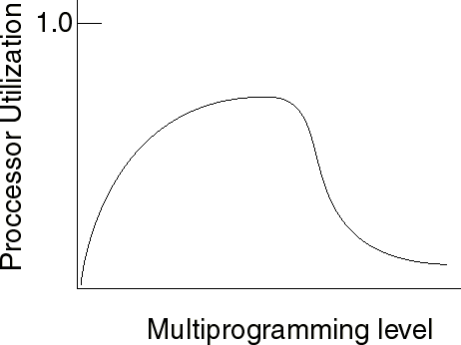
Load Control
Determines the number of processes that will be resident in main memory (ie: the multiprogramming level)
Too few processes: often all processes will be blocked and the processor will be idle
Too many processes: the resident size of each process will be too small and flurries of page faults will result: thrashing

Slide 68
Load Control
A working set or page fault frequency algorithm implicitly incorporates load control
only those processes whose resident set is sufficiently large are allowed to execute
Another approach is to adjust explicitly the multiprogramming level so that the mean time between page faults equals the time to process a page fault
performance studies indicate that this is the point where processor usage is at maximum

Slide 69
Process Suspension
Explicit load control requires that we sometimes swap out (suspend) processes
Possible victim selection criteria:
Faulting process (the process generating many page faults)
this process may not have its working set in main memory
so it will be blocked anyway
Last process activated (the last process brought in)
this process is least likely to have its working set resident
Process with smallest resident set (few page frames)
this process requires the least future effort to reload
Largest process (most allocated frames)
will yield the most free frames

Slide 70
Locking Pages in Memory
Some pages must be locked in memory,
e.g. those containing the OS kernel
It is also essential to lock in memory pages on which there is execution of I/O
This can be achieved with a `lock` bit on the memory frame.
this bit means that this frame cannot be selected as `victim`
Module 8
70
Notes:
Some pages in the main memory need to be locked to prevent from being modified, such as the OS pages, which is done by associating in the page table a lock bit, which is set to 1 if a page needs to be locked (not candidate for replacement), and set to 0 if it does not need to be locked (can be replaced).

Slide 71
Real time systems
With virtual memory, the execution times of a process becomes less predictable
unexpected delays due to pagination
So hard real time systems rarely use virtual memory
Module 8
71
Notes:
They don’t use virtual memory, as it would create an overhead that the real time systems cannot afford to encounter.

Slide 72

Combination of techniques
The real OS use the techniques that we studied in
combination, eg
Linux uses paging (the smallest amount of allocable memory is a page)
other systems use fixed partitions with paging, which can be
done in several ways:
Divide real memory in fixed partitions, assign each partition to one or more processes, then paginate a process in the partition assigned to it
Divide virtual memory in partitions, assign each partition to one or more process, then use the appropriate technique for each process in its partition
Real OS are complex and varied, but the principles explored in this course form the basis.
Module 8
72
Notes:
Some OS use a combination of techniques to allocate frames to processes, such as in Linux, they use dynamic memory allocation (dividing the real memory in fixed partitions) or divide virtual memory in partitions, and start loading processes back into it.

Slide 73
Conclusions 1
It is highly desirable that the user address space can be much larger than the RAM memory address space.
The programmer will therefore be freed from the concern of managing his memory allocation.
however, he should seek to maximize the locality of his process
Virtual memory also allows more processes to be running.
CPU, busier I/O
Module 8
73

Slide 74
Conclusions 2
The problem of deciding the victim page is not easy.
The best algorithms are impossible or difficult to implement
However in practice the FIFO algorithm is acceptable.
Module 8
74

Slide 75
Conclusions 3
Make sure that each process has enough pages in physical memory to run efficiently
risk of thrashing
The working set model expresses the requirements well, however it is difficult to implement
More pragmatic solution, where one decides to give + or - of memory to the processes according to their rate of pagination faults
In order for these memory management mechanisms to be efficient, several types of mechanisms are desirable in the hardware.
Module 8
75

