Slide 1
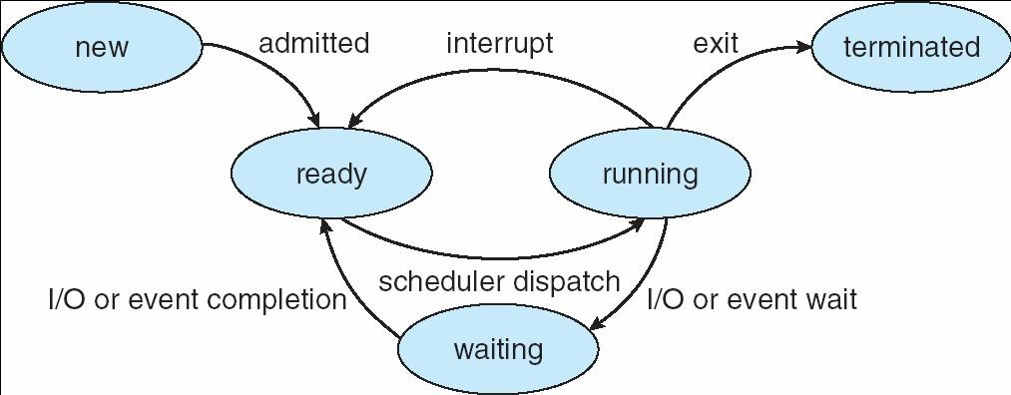
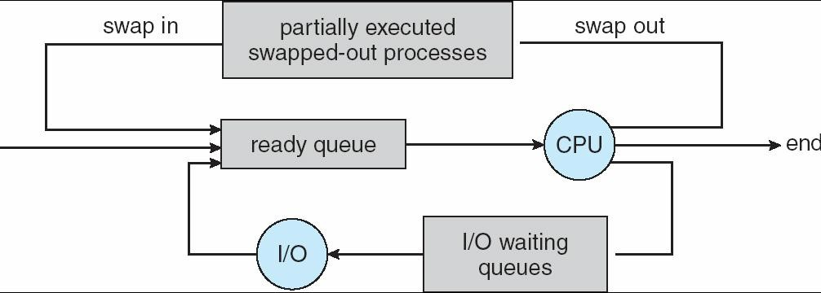
CSI3131 – Operating Systems Tutorial 2 – Summer 2009 Processes - Solution
1. In class, we studied execution of processes by assuming that all processes were in main memory and can be executed when ready. The state diagram in Figure 1 shows how processes move from a running state (i.e. the process’ program is being executed by the CPU) to the ready state (to allow another process to run). The CPU scheduler (short term scheduler) is responsible for managing sharing the CPU among the processes ready for execution, and changing between the states.
Figure 1
Recall that a medium term scheduler was responsible for “swapping out” processes to release memory for the execution of processes as illustrated in Figure 2. The use of such a scheduler increases the number of processes that can be managed by the OS.
Figure 2
Modify the state diagram in Figure 1 to include two additional states that allow the OS to determine when a process has been swapped out. Include appropriate transitions for the new states and describe under what conditions the transitions occur.
Transitions from the ready or waiting state to the terminated state may be possible (these transitions are typically not shown to keep the state diagrams clear). Under what conditions would such transitions occur?
Notes:
In Figure 1, from state “ready” and “waiting”, it can go directly to terminated.
b) Having not enough memory, or perhaps the process is no longer needed, or to save running time, these are when the process moves from “ready” or “waiting” to “terminated”

Slide 2
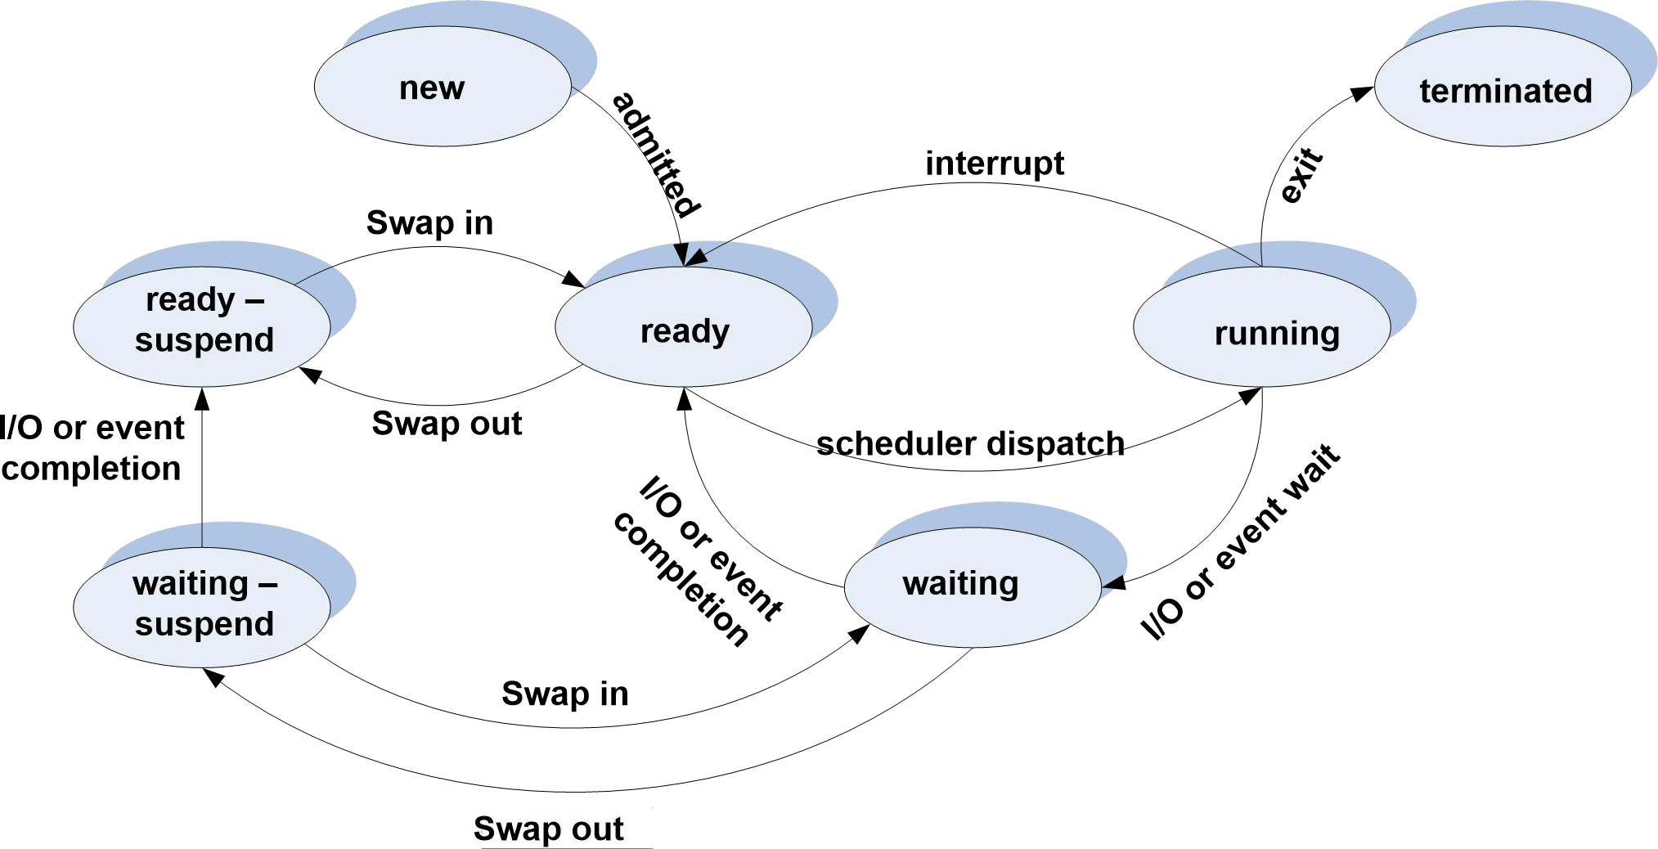
The process 7-state diagram
Requirement for swapping:
The OS can suspend (swap out) processes, i.e. transfer them to disk. Two states are added.
waiting – suspend: block processes have been transferred to the disk
ready – suspend: processes in the ready state have been transferred to the disk.
Note that a process is not swapped out when in the running state
These states are used to reflect the state of the process at the moment it was swapped out.
Note that the state of the process can still change event when it has been swapped out.
New transitions
Two new transitions are used when the process is swapped out :
Waiting --> waiting-suspend
Processes in the waiting state are the preferred choice for swapping out processes to free memory.
Ready --> Ready- suspend (rare)
Processes in the ready state are swapped out only when no processes in the waiting state are available.
Waiting-suspend --> Ready Suspend
Occurs when the expected event has occurred while the process is swapped out.
Ready-Suspend --> Ready
When the process is swapped back in to main memory.
Waiting-Suspend --> Waiting
Can be useful if the OS can determine that the event blocking the process in this state will occur soon and it is a high priority process (than any other process in the ready- suspend state).
The following is a state transitions diagram of a real operating system, the UNIX SVR4 (system V, release 4 – source Stallings)
Notes:
Waiting to Waiting-suspend: Perhaps the process has stayed for too long in the Memory Waiting, and thus to release memory space, it is swapped out. However, the reverse can be more important, where an event is completed (or getting close to) where a process in the “Waiting-suspend” may have more priority than any other in the “Ready” state, that certain process will need to transition to “Waiting” and then to “Ready”
In a multitasking operating system, a situation arises when all the active processes cannot coordinate in the main memory, then a process is swap out from the main memory so that other processes can enter it.

Slide 3
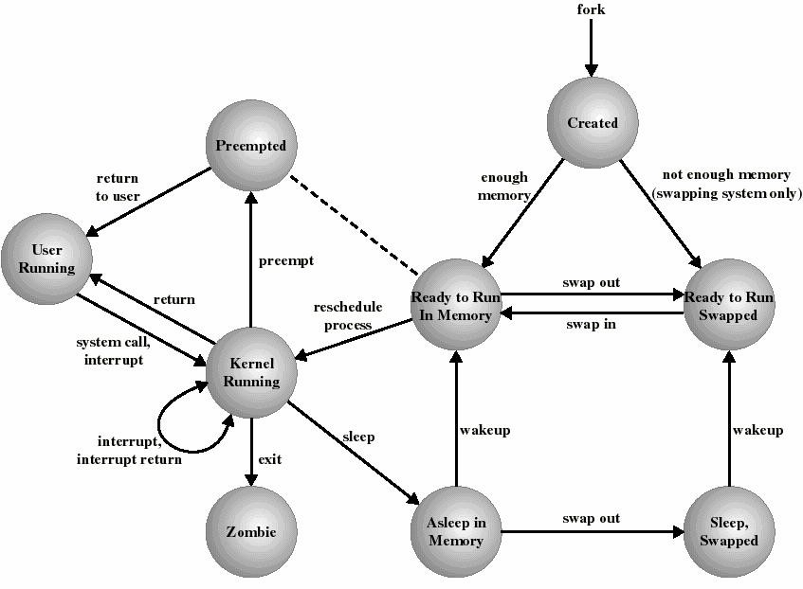
Notes on the UNIX state diagram:
The running state is divided into 2 states, to distinguish when the process is running in the user mode and in the kernel mode. Note that when running in the kernel mode, the process is in fact running OS code. In class, the view was taken that when an interrupt occurs, the OS runs outside the processes. The UNIX state diagram reflects the view that the OS runs in the context of processes. The advantage of this approach is to reduce process switching. When the kernel code has completed and no process switching is required (e.g. the system call was satisfied immediately), then control is simply returned to the user code. Thus the OS is seen as a collection of subprograms run in kernel mode when some interrupt or system trap occurs.
The zombie state corresponds to the terminated state (zombie processes were discussed in class). Asleep in memory corresponds to the waiting state.
Note that when insufficient memory is available to run a process when it is created, it is placed in swap space (on the hard drive).
Note that when dealing with hardware interrupts in kernel mode, the interrupt is serviced and control returned back to the kernel code running at the time of the interrupt
The Preempted state and ready to run in memory state are essentially the same state (as indicated by the dotted line). Processes in either state are placed in the same scheduling queue (the ready queue). When the kernel is ready to return control to the user program, it may decide to preempt the current process in favor of another that is ready and has a higher priority. In this case, the current process is placed in the preempted state.
Notes:
Sleep-swapped <-> Waiting-suspend
Ready to run-Swapped <-> ready-suspend
Pre-emption or preemption in computing is the act of temporarily interrupting a task being carried out by a computer system, without requiring its cooperation, and with the intention of resuming the task at a later time. Such a change is known as a context switch .

Slide 4
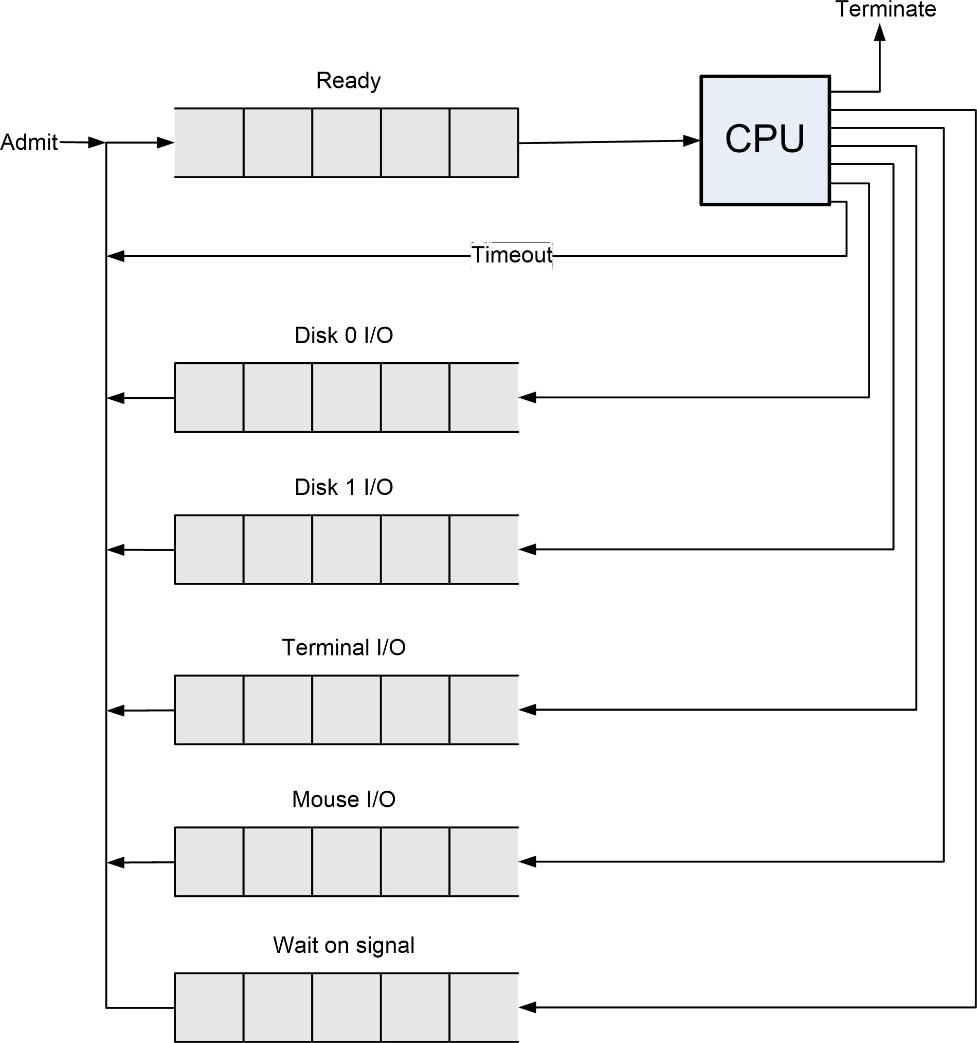
Consider Figure 3 that shows and example of how scheduling queues can be defined for the 5-state diagram from Question 1.
First label each of the transitions (with no label) with the action/event that triggers the action.
Then indicate which transitions and queues are the responsibility of each of the following OS subsystems (that is, determine the scope of each subsystem).
CPU Scheduler (short term scheduler)
File Subsystem (includes a I/O scheduler and device drivers for dealing with the I/O on all devices including the disk): This OS component is responsible for servicing file system requests such as opening files, reading from and writing to files, and closing files; and all input/output with the computer hardware.
IPC subsystem: Responsible for all interprocess communications functions in the OS (including dealing with signals.
Modify Figure 3 to accommodate the new 7-state diagram from Question 1. Include now a medium term scheduler as part of the OS subsystems to complete the Figure.
For each queue, identify the state or states the processes in the queue will (can) have.
Figure 3

Slide 5
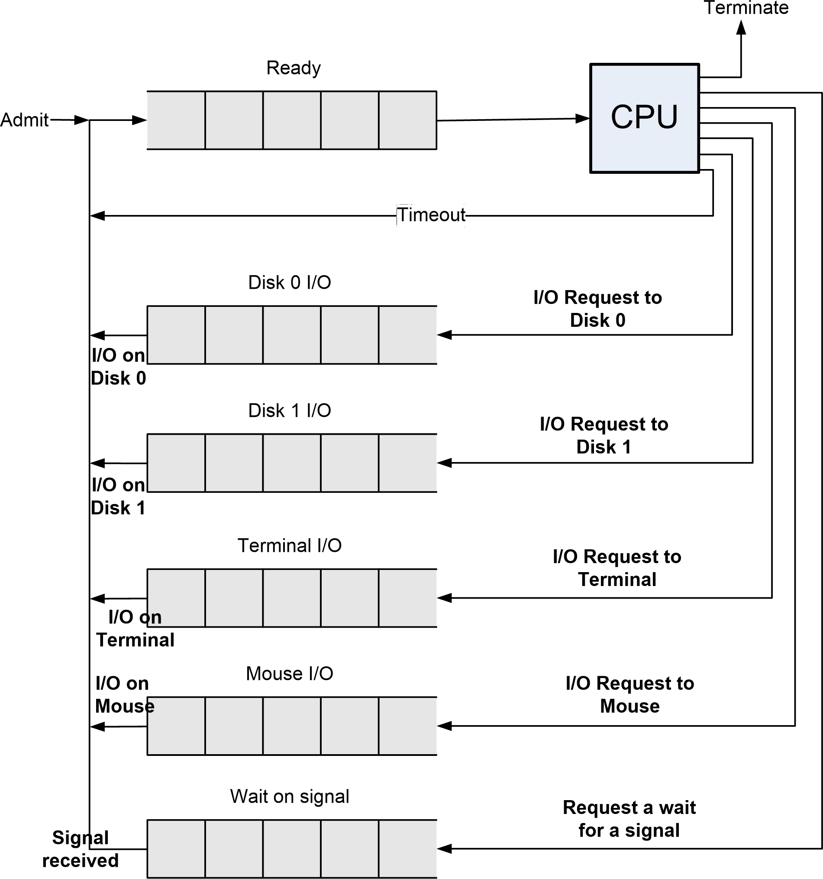
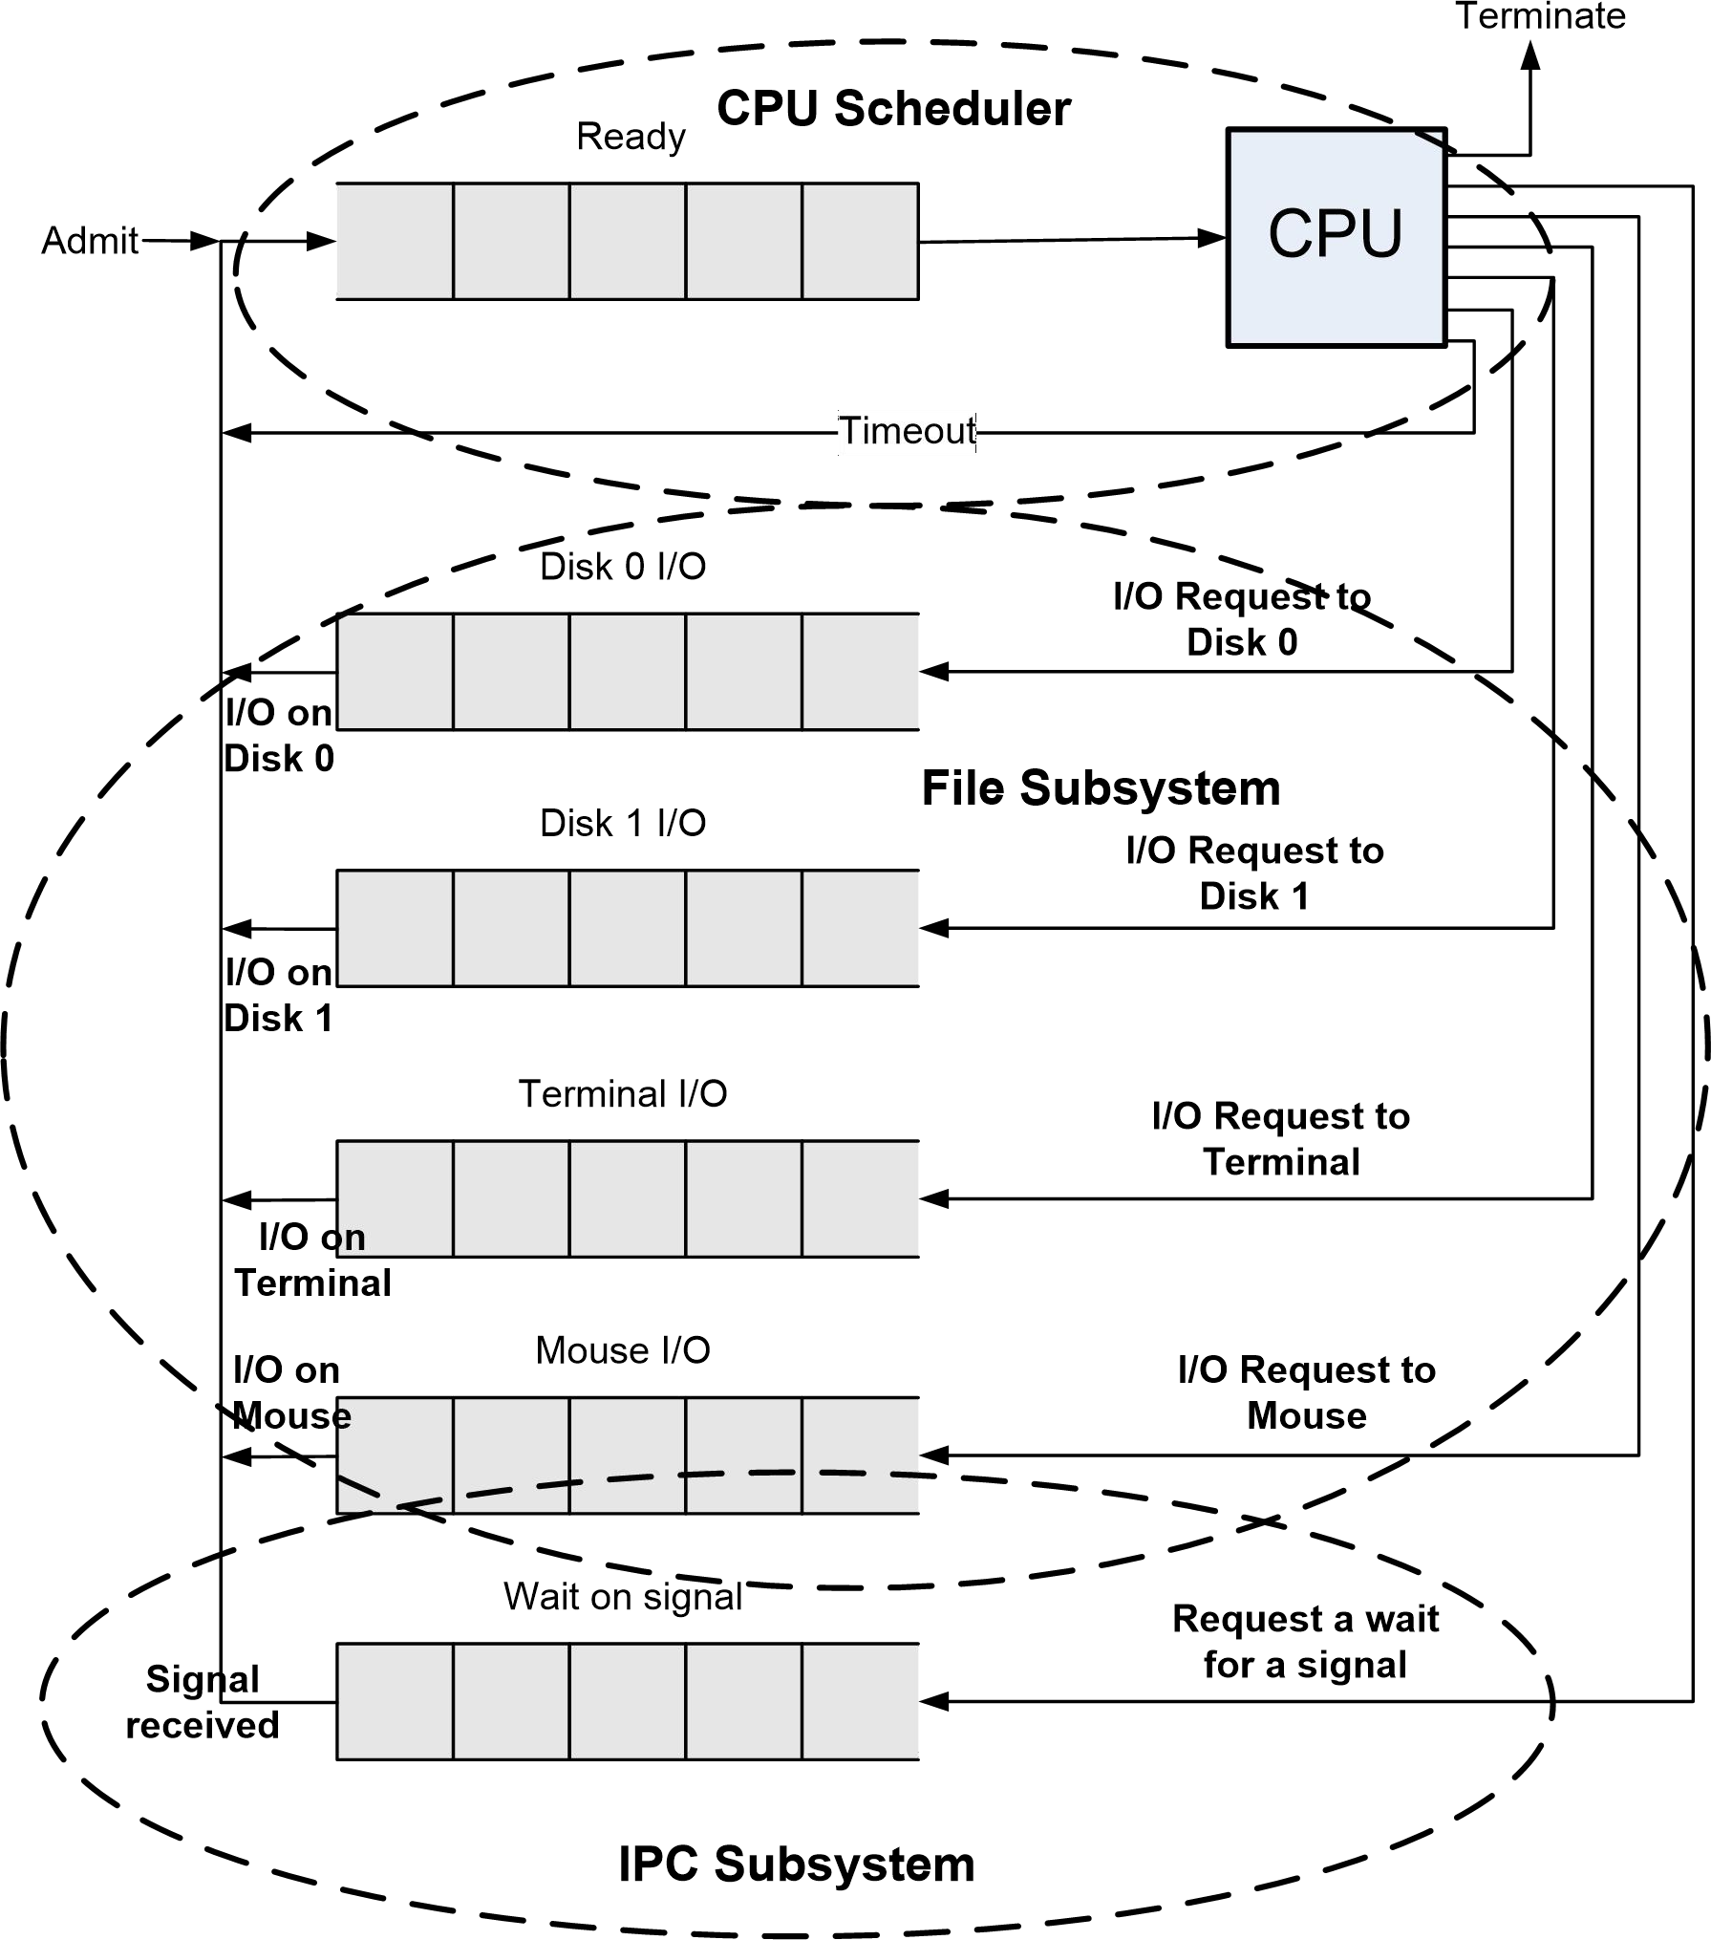
Part a)
Part b)
Notes:
When the I/O request has been provided, from those stations (Disk, Terminal, Mouse, Wait on Signal), it will go to the Ready queue, and wait for execution. Even when a process goes into “timeout”, it will go back to the back of the “Ready” queue, behind the previous allotted process

Slide 6
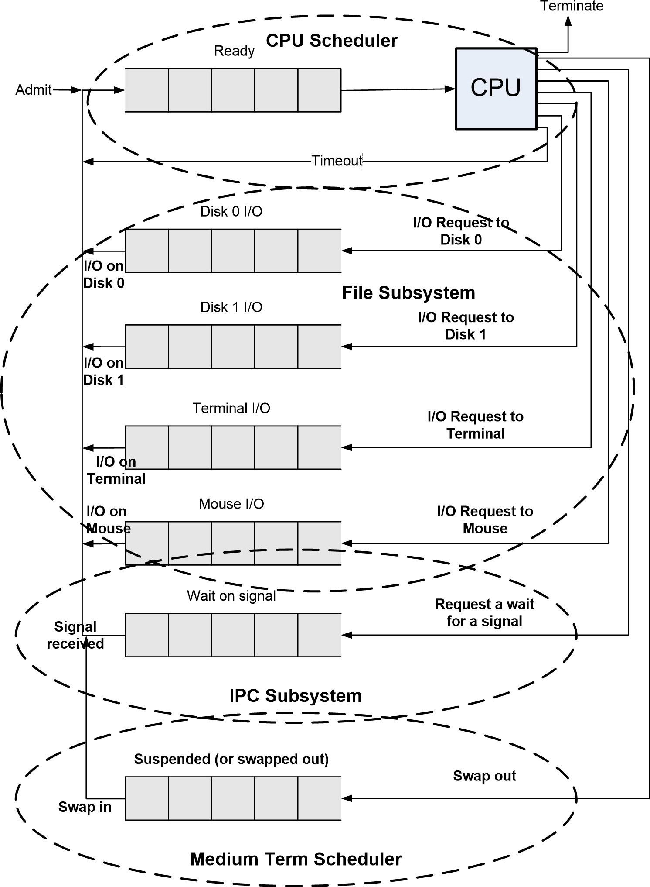
Part c)
Part d)
Queue | State
Ready | Ready
Disk 0 I/O | Waiting
Disk 1 I/O | Waiting
Terminal 0 I/O | Waiting
Mouse I/O | Waiting
Wait on signal | Waiting
Suspended | Waiting/suspend or Ready/suspend
Note that it is acceptable to have two queues instead of the single suspended queue – one queue for each of the states “waiting/suspend” and “ready/suspend”.

Slide 7
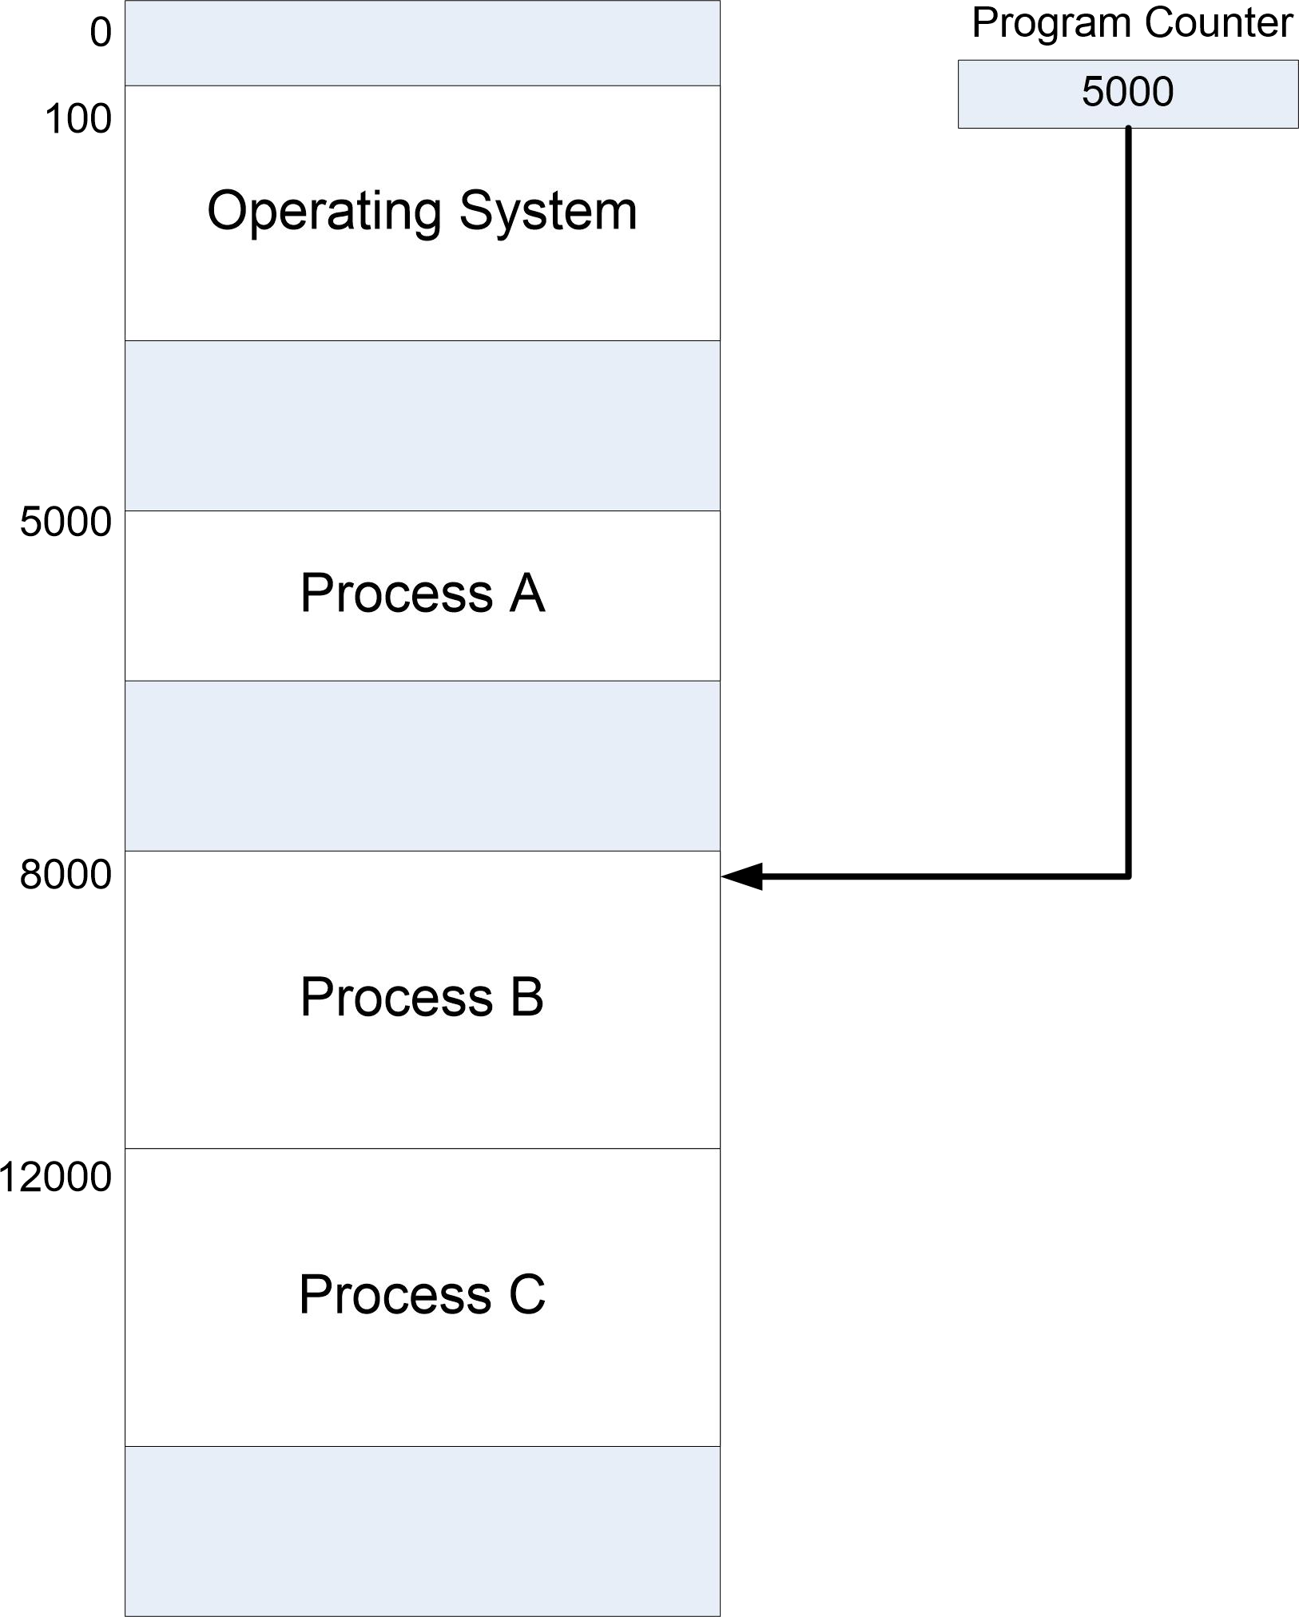
3. Figure 4 is a simplified diagram showing how three processes occupy memory in a running system (assume that all processes are ready for execution). Note that part of the memory has been reserved by the operating system. In this problem, two components of the operating system are run: the short term scheduler (or dispatcher) that selects a process for running on the CPU, and the file system that handles I/O requests.
Figure 4
Table 1
Instruction Cycle | Address | Instruction Cycle | Address | Instruction Cycle | Address | Instruction Cycle | Address
1 | 5000 | 27 | 8002 | 53 | 12058 | 79 | 5022
2 | 5001 | 28 | 8003 | 54 | 12059 | 80 | 5100
3 | 5002 | 29 | 8004 | 55 | 12060 | 81 | 5101
4 | 5000 | 30 | 8005 | 56 | 12100 | 82 | 5102
5 | 5001 | 31 | 8006 | 57 | 12101 | 83 | 300
6 | 5003 | 32 | 400 | 58 | 12102 | 84 | 301
7 | 5004 | 33 | 401 | 59 | 300 | 85 | 302
8 | 5005 | 34 | 402 | 60 | 301 | 86 | 303
9 | 5006 | 35 | 300 | 61 | 302 | 87 | 12103
10 | 5010 | 36 | 301 | 62 | 303 | 88 | 12061
11 | 5011 | 37 | 302 | 63 | 5101 | 89 | 12062
12 | 5012 | 38 | 303 | 64 | 5102 | 90 | 12063
13 | 5010 | 39 | 12000 | 65 | 5103 | 91 | 12074
14 | 5011 | 40 | 12001 | 66 | 5014 | 92 | 12075
15 | 5012 | 41 | 12002 | 67 | 5015 | 93 | 12076
16 | 5010 | 42 | 12003 | 68 | 5015 | 94 | 12077
17 | 5011 | 43 | 12004 | 69 | 5020 | 95 | 12074
18 | 5012 | 44 | 12053 | 70 | 5021 | 96 | 12075
19 | 5013 | 45 | 12054 | 71 | 5022 | 97 | 12076
20 | 5100 | 46 | 12055 | 72 | 5100 | 99 | 12077
21 | 300 | 47 | 12056 | 73 | 5101 | 99 | 12080
22 | 301 | 48 | 12057 | 74 | 5102 | 100 | 12081
23 | 302 | 49 | 12100 | 75 | 5103 | 101 | 12082
24 | 303 | 50 | 12101 | 76 | 5022 | 102 | 12100
25 | 8000 | 51 | 12102 | 77 | 5020 | 103 | 12101
26 | 8001 | 52 | 12103 | 78 | 5021 | 104 | 12102

Slide 8
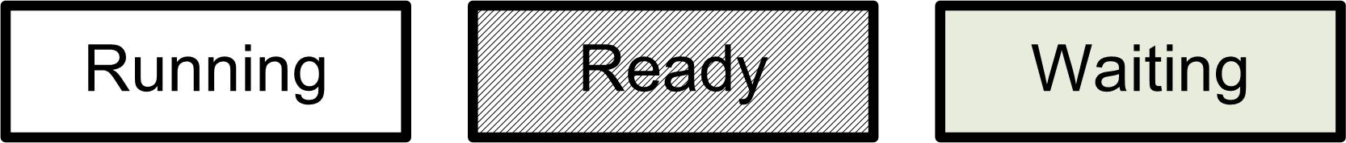
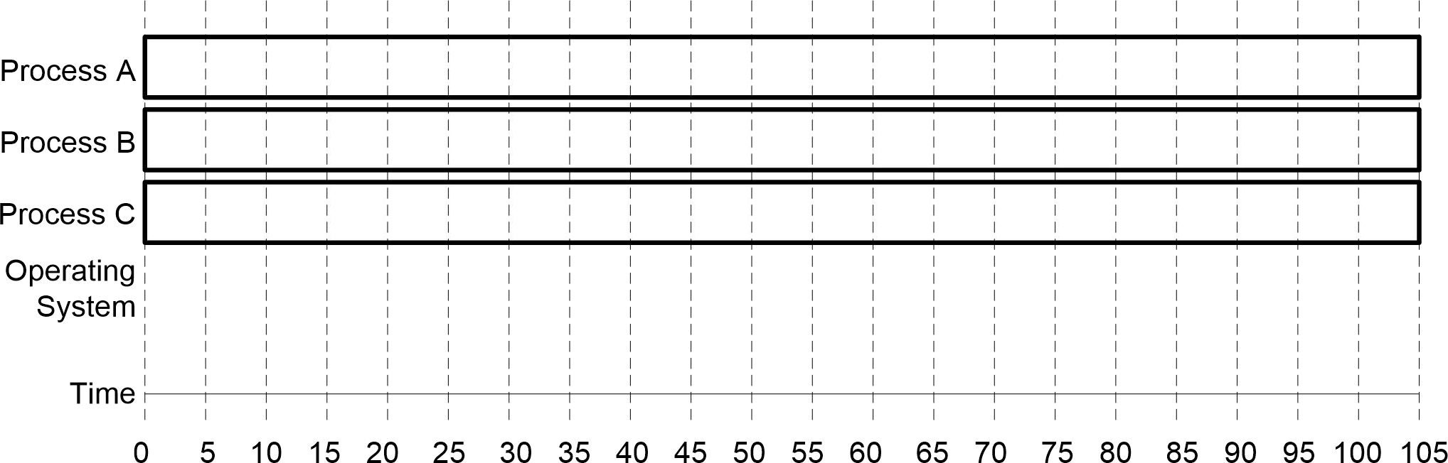
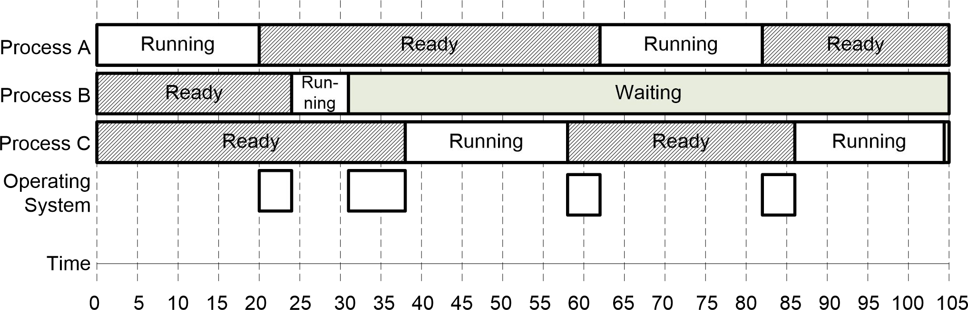
Table 1 gives a picture of the system execution of 104 instructions cycles in the running system. The address of the instructions for each cycle is shown (note that to simplify the example each instruction occupies one single address). Assume that each instruction cycle takes 1 time unit. Note that timeouts and I/O requests occur at the following times:
After cycle 20: Process timeout (the process has exceeded allotted time with the CPU).
After cycle 31: Process requested I/O on hard disk 1
After cycle 58: Process timeout
After cycle 82: Process timeout
Complete Figure 5 to show for each process how its state changes during the system execution. For each process fill in the bar to show its state at different times using the following legend:
For the operating system, indicate the times that its code is running. (To make things simple, assume that the a process moves to the ready or wait states as soon as its execution is terminated, that is, when the OS starts executing; and to the running state when the OS has completed the execution of its code).
Figure 5
Determine the percentage of time that each process and the operating system are running on the CPU. Are these numbers reasonable?
Total running time is 104 time units (see Table 1).
Process a runs for 20 + 20 = 40 time units, thus 40/104 = 38% of the time Process B runs for 7 time units, thus 7/104 = 6.7 % of the time
Process C run for 20 + 18 time units, thus 38/104 = 36% of the time (in fact this should be considered higher as the process has not completed its time allowed with the CPU).
Operating system runs for 4+7+4+4 = 19 time units, thus 18% of the time.

Slide 9
An operating system that runs for 18% of the time is not very well designed (not efficient done by the OS). One would hope to keep the OS share of the execution time under 10%. Note that in a real system, a process (and OS) would run many more instructions than shown in this example.
When a process creates a new process using the fork() operation, which of the following resources is shared between the parent process and the child process?
Stack (stack memory)
Heap (dynamic memory)
Shared memory
Only the shared memory segments are shared between the parent process and the newly forked child process. Copies of the stack and the heap are made for the newly created process.
What will LINE A output to the screen in the program below? Explain your answer.
#include <sys/types.h> #include <stdio.h> #include <unistd.h>
int value=5; int main()
{
pid_t pid;
pid = fork();
if(pid == 0) /* child process */
{
value = value + 15;
}
else if(pid > 0)
{
wait(NULL);
/* parent process */
printf(“PARENT: value = %d\n”,value); /* LINE A */ exit(0);
}
}
The output is:
PARENT: value = 5
The execution of the child does not affect the value of the variable “value” in the parent process since it will have its own copy. From the point when fork is executed, two processes are running the above program each with their own copy of the program (i.e. their own copy of the variable “value”). Given that fork returns the PID of the child in the parent process, the “else” portion of the if statement is executed in the parent. In the child, fork retuns 0 and it is the “if” portion of the if statement that is executed, but the variable “value” is changed only in the child.
Notes:
“Heap” memory, also known as “dynamic” memory, is an alternative to local stack memory. Local memory is quite automatic. Local variables are allocated automatically when a function is called, and they are deallocated automatically when the function exits. Heap memory is different in every way.

Slide 10
6. Examine the following C code for the program stdout2stdin.
int main(int argc, char *argv[])
{
char *pgrm1; char *pgrm2; int p1to2fd[2]; int p2to1fd[2]; int pid;
/*pointer to first program */
/*pointer to second program */
/* pipe from prc1 to prc2 */
/* pipe from prc2 to prc1 */
if(argc != 3)
{
printf("Usage: stdout2stdin <pgrm1> <pgrm2> \n"); exit(1);
}
/* get programs */ pgrm1 = argv[1]; pgrm2 = argv[2];
/* create the pipes */ pipe(p1to2fd); pipe(p2to1fd);
/* Complete first diagram when program is at this point */
/* create process 1 */ pid = fork();
if(pid == 0)
{
dup2(p1to2fd[1], 1);
dup2(p2to1fd[0], 0); close(p1to2fd[0]); close(p1to2fd[1]); close(p2to1fd[0]); close(p2to1fd[1]); execlp(pgrm1, pgrm1, NULL);
}
/* Complete second diagram when program is at this point */
/* create process 2 */ pid = fork();
if(pid == 0)
{
dup2(p2to1fd[1], 1);
dup2(p1to2fd[0], 0); close(p1to2fd[0]); close(p1to2fd[1]); close(p2to1fd[0]); close(p2to1fd[1]); execlp(pgrm2, pgrm2, NULL);
}
}
/* Complete third diagram when program has terminated */
Complete the diagrams on the next page to show what processes are created and how they are connected with pipes when the following command is executed.
stdout2stdin program1 program2

Slide 11
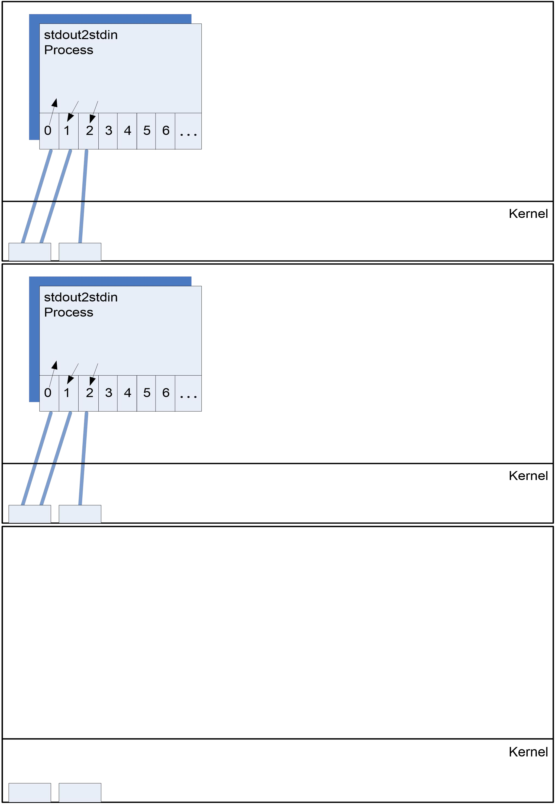

Slide 12
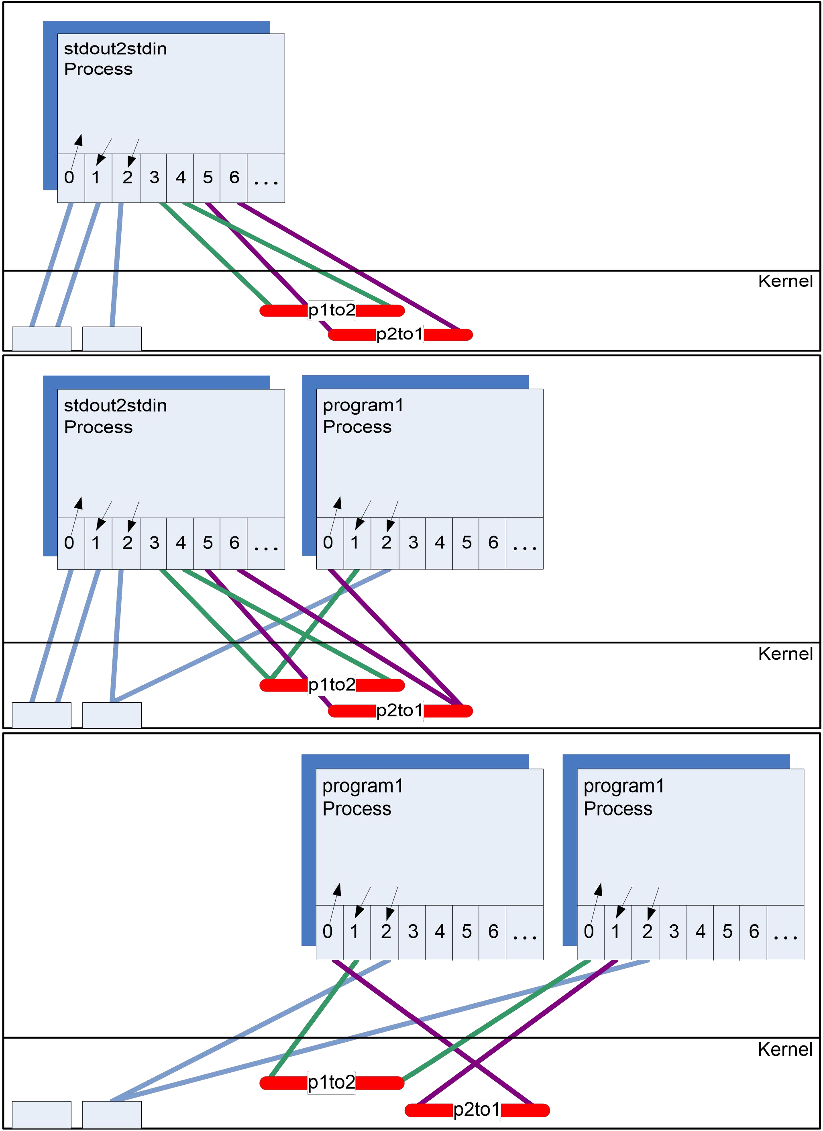

Slide 13
In process states, under what conditions do the following occur: running to ready, running to waiting, and waiting to ready?
1) Running to Ready
A transition from Running state to Ready state can happen only in case the OS uses a preemptive scheduler. Some examples of preemptive scheduling algorithms are
Round Robin Scheduling Algorithm
Preemptive Priority Based Scheduling Algorithm
Shortest Remaining Job First Algorithm
In each of the above algorithms the scheduler can select another process to RUN, while some process is already running on the Processor. In such a situation the Running process is said to be "PREEMPTED" and moved from Running state to Ready queue
Note: The transition from Running to Ready is the differentiating factor between the state diagrams of a Preemptive and Non Preemptive Operating System
2) Running to Waiting
This can occur when a running process is blocked due to one of the following reasons
Process need to perform I/O operation
Waiting for some event to occur such as a non busy waiting semaphore
3) Waiting to Ready
The I/O operation or event for which the process was waiting gets completed

