Slide 1
TTDD: A Two-tier Data Dissemination Model for Large-scale Wireless Sensor Networks
Haiyun Luo
Fan Ye, Jerry Cheng
Songwu Lu, Lixia Zhang
UCLA CS Dept.

Slide 2
Outline
Data dissemination to mobile sinks
Two-tier query and data forwarding
Performance evaluation
Related work
Conclusion

Slide 3

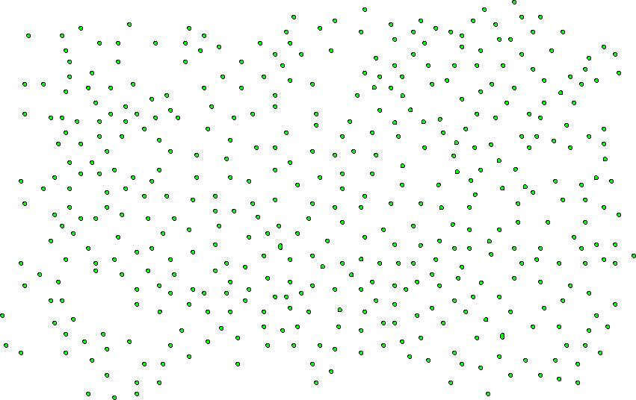
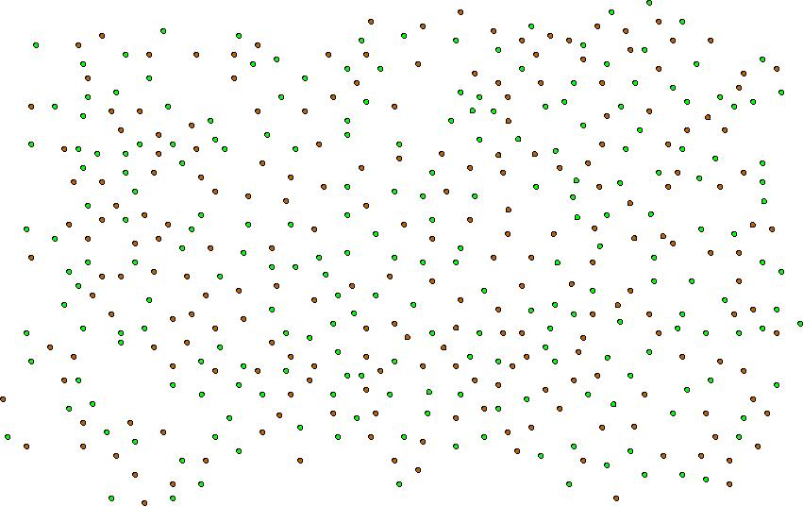



Sensor Network Model
Sink
Stimulus
Source
Sink

Slide 4
Mobile Sink
Excessive Power
Consumption
Increased Wireless
Transmission
Collisions
State Maintenance
Overhead

Slide 5
Challenges
Battery powered sensor nodes
Communication via wireless links
  Bandwidth constraint
  Load balancing
Ad-hoc deployment in large scale
  Fully distributed w/o global knowledge
  Large numbers of sources and sinks
Unexpected sensor node failures
Sink mobility
  No a-priori knowledge of sink movement

Slide 6
Goal, Idea
Efficient and scalable data dissemination from multiple sources to multiple, mobile sinks
Two-tier forwarding model
  Source proactively builds a grid structure
  Localize impact of sink mobility on data forwarding
  A small set of sensor node maintains forwarding state

Slide 7
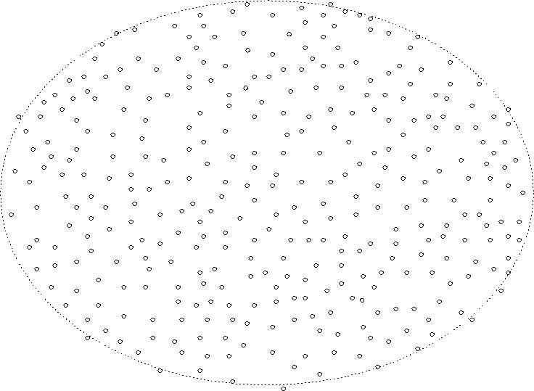
TTDD Basics
Dissemination Node
Data Announcement
Source
Data
Sink
Immediate
Dissemination
Node
Query

Slide 8
TTDD Mobile Sinks
Dissemination Node
Data Announcement
Trajectory
Forwarding
Source
Immediate
Dissemination
Node
Data
Sink
Immediate
Dissemination
Node
Trajectory
Forwarding

Slide 9
TTDD Multiple Mobile Sinks
Dissemination Node
Data Announcement
Trajectory
Forwarding
Source
Immediate
Dissemination
Node
Data
Source

Slide 10
Grid Maintenance
Issues:
  Handle unexpected dissemination node failures
  Efficiency
Solutions:
  Source sets the Grid Lifetime in Data Announcement
  DN replication: each DN recruits several sensor nodes from its one-hop neighbor, replicates the location of the upstream DN
  DN failure detected and replaced on-demand by on-going query and data flows

Slide 11
Grid Maintenance
Dissemination Node
Source
X
Immediate
Dissemination
Node
Data

Slide 12
Grid Maintenance (cont’d)
Dissemination Node
Source
X
Immediate
Dissemination
Node
Data

Slide 13
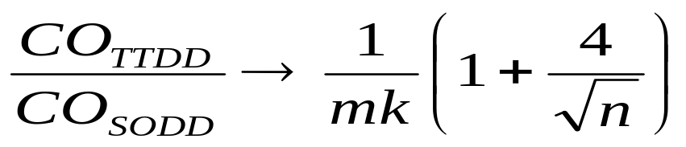
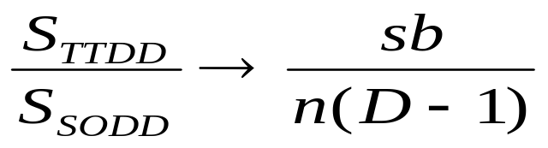
Performance Evaluation
Compare with sink-oriented data dissemination approaches
  Communication overhead
  State maintenance complexity

Slide 14
Ns-2 Simulation
Metrics
  Energy consumption, delay, success rate
Impacts of
  Cell size
  Number of sources and sinks
  Sink mobility
  Node failure rates

Slide 15
Related Work
SPIN (Mobicom 1999)
  Data dissemination to all sensor nodes
Directed Diffusion, DRP, GRAB (2000)
  Flat dissemination structure, stationary sinks
GAF (Mobicom 2001)
  Turn off redundant nodes in MANET
  Pre-defined grid, cell size determined by radio
Ad hoc network clustering
  Node mobility causes high infrastructure maintenance overhead

Slide 16
Conclusion
TTDD: two-tier data dissemination Model
  Exploit sensor nodes being stationary and location-aware
  Construct & maintain a grid structure with low overhead
Proactive sources
  Localize sink mobility impact
Infrastructure-approach in stationary sensor networks
  Efficiency & effectiveness in supporting mobile sinks

