Slide 1
Lecture 10
Resource Allocation and Deadlock

Slide 2
Previously …
We have seen how threads may be synchronized with each others by condition variable to execute the desired portion of code.
We have seen how the powerful tools, called semaphores, are implemented as locks and condition variable.
Notes:
We have also seen how condition variables may be used to check whether a condition is true before continuing its execution

Slide 3
Resource Allocation
Resource allocation is a common requirement in operating systems
Many resources need to be allocated dynamically, e.g. memory, printers, etc.
Resource allocation introduces the issues of:
  Mutual Exclusion – when a resource can only be used by one process (or thread) at a time
  Starvation – a process (or thread) may be “locked out” by other processes (or threads) and prevented from acquiring a resource
  Deadlock – two or more processes (or threads) may wait infinitely for a resource held by the other
In this lecture, we will use the term “process” rather than “thread”

Slide 4
Deadlock
A set of blocked processes each holding a resource and waiting to acquire a resource held by another process in the set
  Example
    Semaphores A and B, each initialized to 0
  P0 P1
sem_wait(A); sem_wait(B)
sem_post(B); sem_post(A)

Slide 5
Deadlock Conditions
Deadlock can arise if four conditions happen simultaneously
  Mutual Exclusion: only one process at a time can use a resource
  No Preemption: a resource can only be released voluntarily by the process holding it, after that process has completed its task
  Hold and Wait: a process holding at least one resource is waiting to acquire additional resources held by other processes
  Circular Wait: there exists a set {P₀, P₁, …, P_{n}} of waiting processes such that P₀ is waiting for a resource that is held by P₁, P₁ is waiting for a resource that is held by P₂, … , P_{n–1} is waiting for a resource that is held by P_{n}, and P_{n} is waiting for a resource that is held by P₀

Slide 6
Resources
Resource types R₁, R₂, . . ., R_{m}
    CPU, memory space, I/O devices
Each resource type R_{i} has W_{i} instances
A resource can be utilized by each processes as follows:
  requested (acquiring)
  used (holding)
  released
sem_wait(A);
sem_post(A);

Slide 7
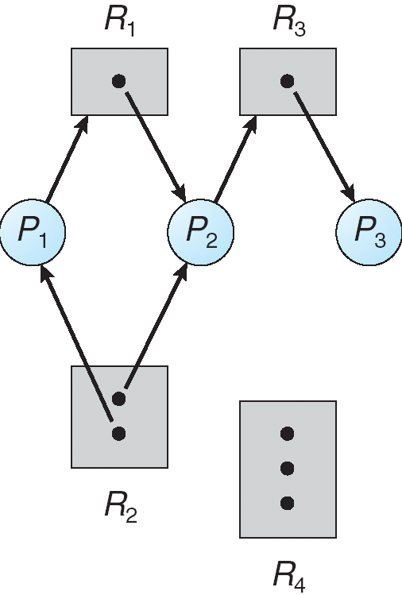
Resource Allocation Graph
A set of vertices V and
a set of edges E
  V is partitioned into two types:
    P = {P₁, P₂, …, P_{n}}, the set consisting
    of all the processes in the system
    R = {R₁, R₂, …, R_{m}}, the set consisting of all resource types in the system
  E is partitioned into two types:
    Request edge – directed edge P_{i} → R_{j}
    Assignment edge – directed edge R_{j} → P_{i}

Slide 8
Resource Allocation Graph
Process
Resource Type with 4 instances
P_{i} requests instance of R_{j}
P_{i} is using an instance of R_{j}
P_{i}
R_{j}
P_{i}
R_{j}

Slide 9
Deadlock?
  Mutual Exclusion:
  No Preemption:
  Hold and Wait:
  Circular Wait:

Slide 10
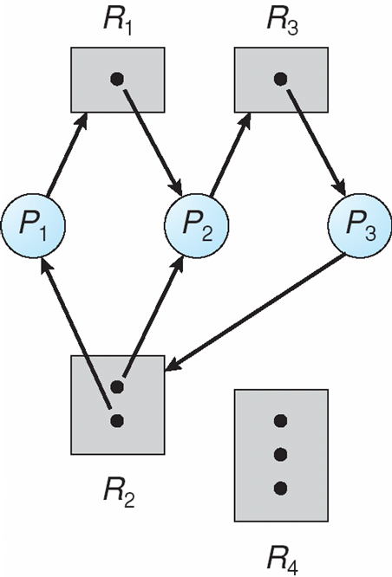
Graph With Deadlock
  Mutual Exclusion:
  No Preemption:
  Hold and Wait:
  Circular Wait:

Slide 11
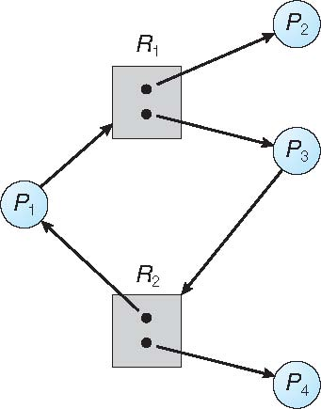
Graph With Cycle But No Deadlock
If graph contains no cycles ⇒ no deadlock
If graph contains a cycle ⇒
  If only one instance per resource type, then deadlock
  If several instances per resource type, possibility of deadlock

Slide 12
Deadlock Management
Deadlock Prevention
  Design the system in such a way that deadlocks can never occur
Deadlock Avoidance
  Allow the possibility of deadlock but avoid it before it occurs
Deadlock Detection and Recovery
  Allow the possibility of deadlock, determine if deadlock has occurred and which processes and resources are involved
  After detection, clear the problem, allow processes to complete and resources to be reused (may require terminating processes)
Ignore the Problem
  Pretend that deadlocks never occur (some systems do this)

Slide 13
(1) Deadlock Prevention
Limit the ways, a request can be made to ensure that one of the four conditions for deadlock does not happen.
Notes:
Deadlock can arise if four conditions hold simultaneously

Slide 14
Recall: Deadlock Conditions
Mutual Exclusion: only one process at a time can use a resource
No Preemption: a resource can only be released voluntarily by the process holding it, after that process has completed its task
Hold and Wait: a process holding at least one resource is waiting to acquire additional resources held by other processes
Circular Wait: there exists a set {P₀, P₁, …, P_{n}} of waiting processes such that P₀ is waiting for a resource that is held by P₁, P₁ is waiting for a resource that is held by P₂, … , P_{n–1} is waiting for a resource that is held by P_{n}, and P_{n} is waiting for a resource that is held by P₀

Slide 15
Deadlock Prevention: Circular Wait
Impose a total ordering of all resources types and require that each process requests resources in increasing order of resource type
If a resource of type j is held, process can only request resources of types > j
  Example: Semaphores A and B, each initialized to 1
  P0 P1
sem_wait(A); sem_wait(B)
sem_post(B); sem_post(A)
  Example: The Dining Philosophers
    Require that each philosopher requests forks in increasing order of fork number

Slide 16
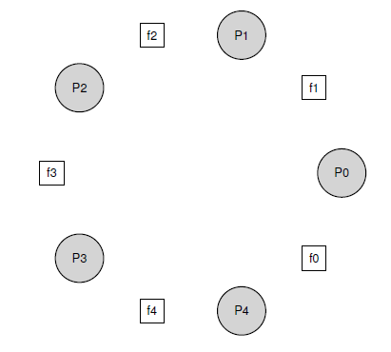
The Dining Philosophers
fork
Philosophers either think or eat
When eat, they need two forks
while (1)
{
think();
getforks(p);
eat();
putforks(p);
}
Philosopher
Write the routines getforks(p) and putforks(p) such that there is no deadlock,
no philosopher starves, and as many philosophers can eat at the same time
as possible
Notes:
Assume there are five “philosophers” sitting around a table
Between each pair of philosophers is a single fork (and thus, five total)
The philosophers each have times when they think, and don’t need any forks, and times when they eat
In order to eat, a philosopher needs two forks, both the one on their left and the one on their right
The contention for these forks, and the synchronization problems that ensue, are what makes this interesting

Slide 17
Dining Philosophers, Deadlock
sem_t left(int p) { return p; }
sem_t right(int p) { return (p + 1) % 5; }
void getforks(p) {
sem_wait(forks[left(p)]);
sem_wait(forks[right(p)]);
}
void putforks(p) {
sem_post(forks[left(p)]);
sem_post(forks[right(p)]);
}
A circular wait occurs if each philosopher picks up the fork to the left and then waits to pick up the fork to the right
Notes:
A number of philosophers is 5

Slide 18
Dining Philosophers, No Deadlock
sem_t left(int p) { return p; }
sem_t right(int p) { return (p + 1) % 5; }
void getforks(p) {
if (p == 4) {
sem_wait(forks[right(p)]);
sem_wait(forks[left(p)]);
} else {
sem_wait(forks[left(p)]);
sem_wait(forks[right(p)]);
}
}
void putforks(p) {
sem_post(forks[left(p)]);
sem_post(forks[right(p)]);
}
If philosopher 4 picks up the fork to the right first , no circular wait occurs as each philosopher requests forks in the same order

Slide 19
Deadlock Prevention: Hold and Wait
Prevent this condition by acquiring all resources at once
Use a semaphore “Prevention” to ensure that this is done atomically
This has the problem of low resource utilization and starvation is possible
sem_wait(Prevention);
sem_wait(R1); // acquire resource R1
sem_wait(R2); // acquire resource R2
...
sem_post(Prevention);

Slide 20
Deadlock Prevention: No Preemption
If a process that holds some resources requests another resource that cannot be immediately allocated, then all resources currently held are released
This can be done by using trylock() (or trywait() on semaphores) to acquire the second or subsequent resource
do {
sem_wait(R1); // acquire R1
flag = sem_trywait(R2); // try to acquire R2
if (flag != 0) { // failed to acquire R2
sem_post(R1); // release R1
yield(); // or random delay
}
} while (flag != 0)
...
Notes:
One new problem does arise, however: livelock. It is possible that two threads could both
be repeatedly attempting this sequence and repeatedly failing to acquire both locks.
solutions to the livelock problem, for example, one could add a random delay before looping back

Slide 21
Deadlock Prevention: Mutual Exclusion
We know this is difficult, because the code we wish to run does indeed have critical sections.
  Some resources may be sharable and do not need mutual exclusion
  Using wait-free locking
    Not use explicit locking, there is called wait-free technique. (require powerful h/w instruction)

Slide 22
(2) Deadlock Avoidance
Requires that the system has some additional information available
  The deadlock avoidance algorithm dynamically examines the resource allocation state to ensure that there can never be a circular wait condition
  Resource allocation state is defined by the number of available and allocated resources, and the maximum demands of the processes
  Simplest and most useful model requires that each process declare the maximum number of resources’ instance of each type that it may need

Slide 23
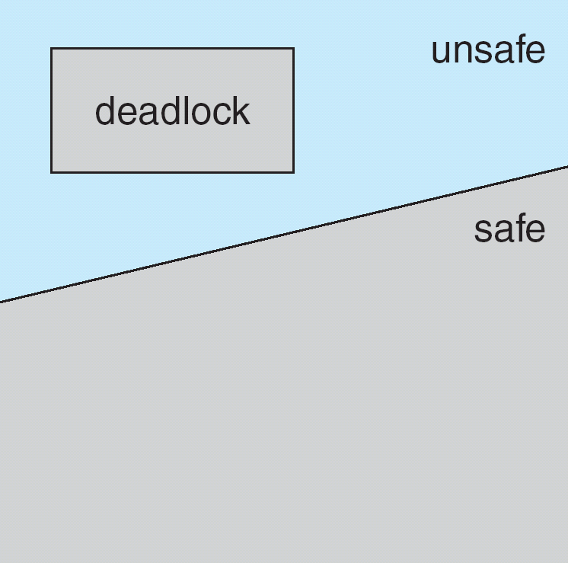
Safe, Unsafe, Deadlock State
If a system is in safe state ⇒ no deadlocks
If a system is in unsafe state ⇒ possibility of deadlock
Avoidance ⇒ ensure that a system will never enter an unsafe state

Slide 24
Safe State
When a process requests an available resource, system must decide if immediate allocation leaves the system in a safe state
  A safe state if one where there exists a sequence <P₁, P₂, …, P_{n}> of all processes such that for each P_{i}, the resources that P_{i} can still request can be satisfied by currently available resources + resources held by all the P_{j}, with j < i
That is:
  If P_{i} resource needs are not immediately available, then P_{i} can wait until all P_{j} have finished
  When all P_{j} have finished, P_{i} can obtain needed resources, execute, return allocated resources, and finish
  When P_{i} is finished, P_{i +1} can obtain its needed resources, and so on

Slide 25
Banker’s Algorithm
Used for deadlock avoidance when there are multiple instances of each resource type
Safety Algorithm
  Used to check whether the system is in a safe state
Resource Request Algorithm
  Used to determine if a request can be granted
    If requested resources are not available, process must wait
    If requested resources are available, “pretend” to allocate them and check whether the system is in safe state
    If unsafe, process must wait, and the old state is restored
Notes:
For details, see Chapter 7 of Silberschatz “Operating System Concepts”:
http://codex.cs.yale.edu/avi/os-book/OS9/slide-dir/

Slide 26
Example
Suppose there is a single resource type, with 10 instances
  At a particular time, the resource allocation state is as follows:
  If P4 asks for one more instance, does this lead to a safe or unsafe state?
  If P3 asks for one more instance, does this lead to a safe or unsafe state?
 | Allocation | Max | Need
P1 | 1 | 6 | 5
P2 | 1 | 5 | 4
P3 | 2 | 4 | 2
P4 | 4 | 7 | 3
Need =
Max – Allocation
  Available =
  2 instances

Slide 27
Example
  If P4 asks for one more instance, does this lead to a safe or unsafe state?
  “Pretend” to allocate request – the state changes to:
  The request from P4 is unsafe, as for all P_{i}, Need_{i} > Available
  If all P_{i} request the number of instances they still need, deadlock will occur – therefore request is not granted
 | Allocation | Max | Need
P1 | 1 | 6 | 5
P2 | 1 | 5 | 4
P3 | 2 | 4 | 2
P4 | 5 | 7 | 2
  Available =
  1 instance

Slide 28
Example
  If P3 asks for one more instance, does this lead to a safe or unsafe state?
  “Pretend” to allocate request – the state changes to:
  If all P_{i} request the number of instances they still need, the sequence <P3, P2, P1, P4> satisfies safety requirement
  The request from P3 is safe – therefore request is granted
 | Allocation | Max | Need
P1 | 1 | 6 | 5
P2 | 1 | 5 | 4
P3 | 3 | 4 | 1
P4 | 4 | 7 | 3
  Available =
  1 instance

Slide 29
Avoidance Graph
Used for deadlock avoidance when there is only one instance of each resource type
  Claim edge P_{i} → R_{j} represented by a dashed line indicates that process P_{i} may need a resource R_{j}
  Claim edge converts to request edge when the process requests a resource
  Request edge converts to an assignment(used) edge when the resource is allocated to the process
  When a resource is released by a process, assignment edge reconverts to a claim edge
  Resources must be claimed in advance

Slide 30
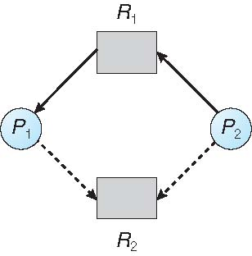
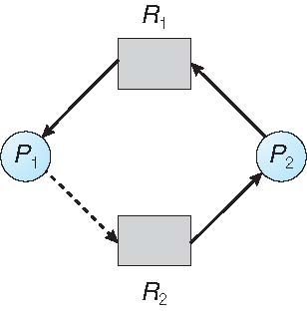
Resource Allocation Graph
Safe State – No Cycle
Unsafe State – Cycle
A request can be granted only if converting the request edge to an assignment edge does not result in a cycle in the graph
  Request by P₁ for R₂ can be granted
  Request by P₂ for R₂ cannot be granted

Slide 31
(3) Deadlock Detection and Recovery
Allow system to enter deadlock state
  Instead of preventing or avoiding deadlock, we allow deadlock to occur
Detection algorithm
  Execute a deadlock detection algorithm periodically to check for deadlocks
Recovery scheme
  If there is a deadlock, take some action to recover

Slide 32
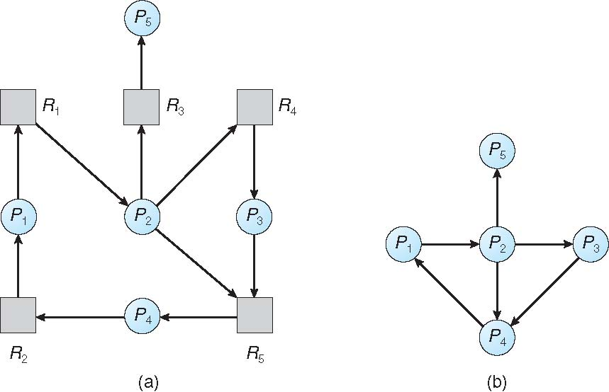
Wait-For Graph
If only one instance of each resource type, we maintain a Wait-For graph
Nodes are processes
P_{i} → P_{j} if P_{i} is waiting for P_{j}
Resource Allocation Graph
Corresponding Wait-For Graph

Slide 33
Deadlock Detection
If only one instance of each resource type
  Periodically invoke an algorithm that searches for a cycle in the Wait-For graph – if there is a cycle, there is a deadlock
  An algorithm to detect a cycle in a graph requires O(n²) operations, where n is the number of vertices in the graph
If multiple instances of each resource type, a more general algorithm is required
  A general algorithm to detect deadlock requires O(m×n²) operations, where m is the number of resources types and n is the number of processes
Notes:
For details, see Chapter 7 of Silberschatz: http://codex.cs.yale.edu/avi/os-book/OS9/slide-dir/

Slide 34
Deadlock Recovery
Terminate all deadlocked processes, or
Terminate one process at a time until the deadlock cycle is eliminated
In which order should we choose to terminate?
  Priority of the process
  How long process has computed, and how much longer to completion
  Resources the process has used
  Resources process needs to complete
  How many processes will need to be terminated?
  Is process interactive or batch?

Slide 35
Summary
Concurrency exists between different processes and different threads of the same process
Critical Sections (e.g. accessing shared resources or shared data) need to be executed with mutual exclusion
Locks and Condition Variables may be used by threads for mutual exclusion and synchronization
Semaphores may be used by threads or processes for mutual exclusion and synchronization
    Resource Allocation may lead to deadlock where two or more processes (or threads) may wait indefinitely for a resource held by the other

