Slide 1
Lecture 9
Condition Variables and Semaphores

Slide 2
Previously …
We have seen how locks may be used to execute critical sections of code with mutual exclusion, so avoiding race conditions
We have seen how locks may be implemented using:
  Some hardware support (in the form of a more powerful instruction)
  Some operating system support and a queue
We have also seen how to check a condition is true/false before continuing its execution, in spinning wait.
Notes:
We have also seen how condition variables may be used to check whether a condition is true before continuing its execution

Slide 3
Condition Variables

Slide 4
Threads Synchronization
Lock is not the only primitive needed in concurrent programs
There are many cases where a thread wishes to check whether a condition is true before continuing its execution
A parent thread might check whether a child thread has completed before continuing
There are 2 questions
  How does a child indicate that it is done?
  How does a parent wait for a child?

Slide 5
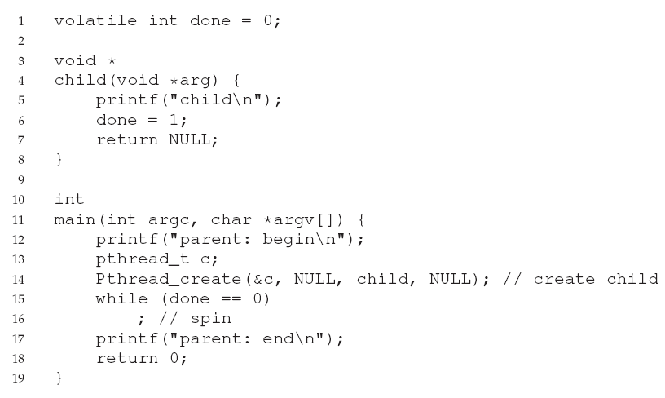
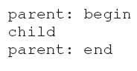
Spinning until ‘true’
Desired output
inefficient as the parent spins
and wastes CPU time

Slide 6
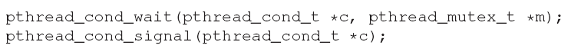
Condition Variable
A condition variable is an explicit queue that threads can put themselves on when some state of execution is not as desired (Waiting on the condition)
Some other thread, when it changes the said state, can then wake the waiting threads allowing them to continue (Signaling on the condition)

Slide 7
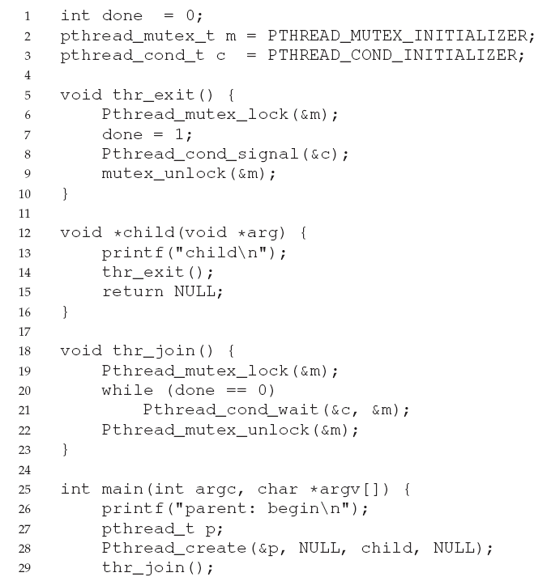
CODING TIP: ALWAYS HOLD
THE LOCK WHILE SIGNALING

Slide 8
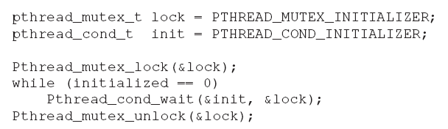
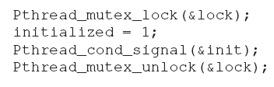
Note
A thread checks to see if the variable initialized has yet been set to something other than zero
If not, the thread simply calls the wait routine in order to sleep until some other thread wakes it
The wait call, in addition to putting the calling thread to sleep, releases the lock
When signaling (as well as when modifying the global variable initialized), we always make sure that we hold the lock

Slide 9
After Wait()
wait() takes a mutex as a parameter; it assumes that this mutex is locked when wait() is called.
wait() will
  Release the lock and put the calling thread to sleep
  When the thread wakes up (after some other thread has signaled it) …
  it must re-acquire the lock before returning to the caller

Slide 10
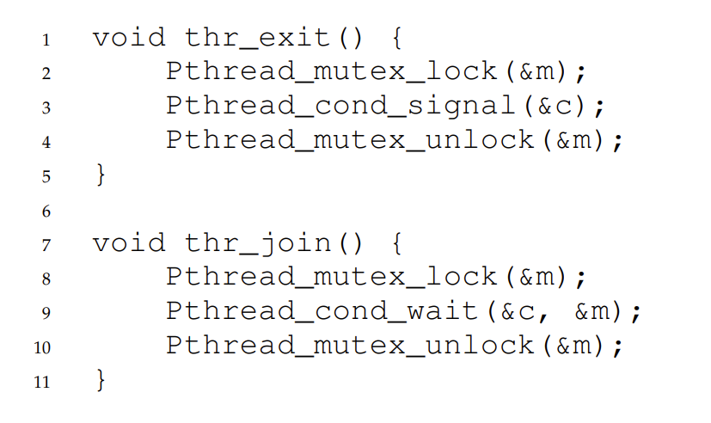
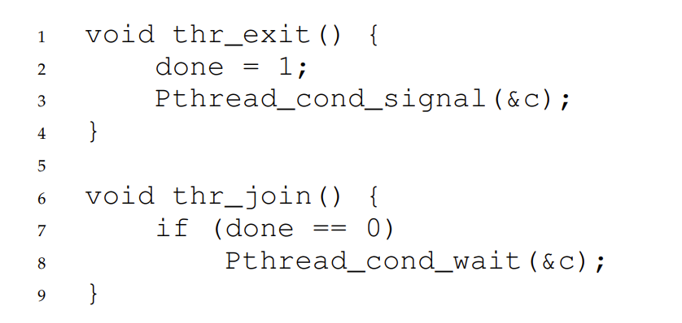
(1)
(2)

Slide 11
Producer/Consumer
One or more Producer threads and one or more Consumer threads
  Producers produce data items and wish to put them in a buffer
  Consumers get data items out of the buffer and consume the data in some way
Examples:
  A multi-threaded web server – a producer puts requests into the buffer and consumer threads get and process them
  Unix pipe: grep foo file.txt | wc –l (grep is the producer and wc the consumer)
The bounded buffer is a shared resource and requires synchronized access to it

Slide 12
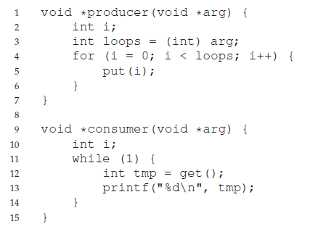
Producer and Consumer Code
puts an integer into the shared buffer
‘loops’ number of times
gets the data out of that shared
buffer (forever)

Slide 13
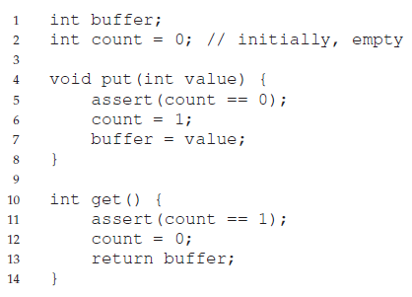
This Buffer (Just a Single int) with basic actions: Put and Get
Assume buffer is empty
Mark it as ‘full’
Take the data and make the
buffer empty again
Notes:
The conditions for this should be obvious
Only put data into the buffer when count is zero (i.e. when the buffer is empty)
Only get data from the buffer when count is one (i.e. when the buffer is full)
If we write the synchronization code such that a producer puts data into a full buffer, or a consumer gets data from an empty one, we have done something wrong (and in this code, an assertion will fire)

Slide 15
Need Condition Variables
The put() and get() functions have critical sections within them
  put() updates the buffer and get() reads from it
  Eg. two producers might try to update the buffer at the same time and an item could be lost
  Race conditions must be prevented
But putting a lock around the critical section alone does not work
We also need condition variables
Let’s see how …

Slide 16
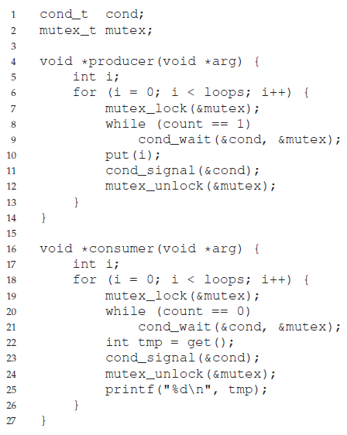

Slide 17
Scenario with
two consumers (Tc1 and Tc2)
and a producer (Tp)
If Tc1 and Tc2 run first, what
might be a possible sequence
of events?

Slide 18
Problem
What is the problem with this code?
  Suppose the two consumers run first (Tc1 and Tc2), and both go to sleep (line 21) as the buffer is empty
  Then, the producer runs, puts a value in the buffer, wakes one of the consumers (say Tc1), and goes to sleep
  Tc1 then runs (returning from wait() at line 21), re-checks the condition (line 20), finds the buffer is full, and gets the value (line 22)
  This consumer then signals on the condition, waking one of the threads that is sleeping
  However, which thread should be woken?

Slide 19
This is a Bug
All three threads are left sleeping
  Because the consumer has emptied the buffer, it clearly should wake the producer
  However, if it wakes the consumer Tc2 (definitely possible depending on how the wait queue is managed), we have a problem
  Specifically, the consumer Tc2 will wake up and find the buffer empty (line 20), and go back to sleep (line 21)
  The producer Tp, which has a value to put into the buffer, is left sleeping
  The other consumer thread, Tc1, also goes back to sleep

Slide 20
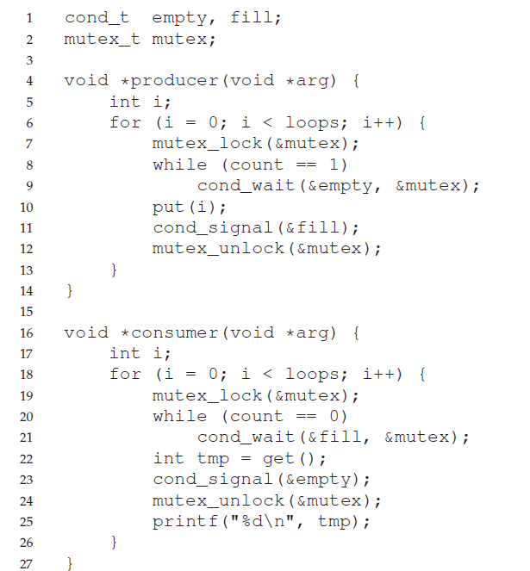
Solution
Use two condition variables in order to
properly signal which type of thread
should wake up when the state of
the system changes
Notes:
In the code above, producer threads wait on the condition empty, and signal fill
Conversely, consumer threads wait on fill and signal empty
By doing so, the problem above is avoided by design: a consumer can never accidentally wake a consumer, and a producer can never accidentally wake a producer

Slide 21
Use While (not If)
Why do we use while and not if to check the condition?
  Suppose we have two consumers (Tc1 and Tc2) as before
  Tc1 runs and goes to sleep (line 21) as the buffer is empty
  Tc2 is ready, but does not yet run
  Then, the producer runs, puts a value in the buffer, wakes Tc1, and goes to sleep
  Before Tc1 returns from the wait() and reacquires the lock, Tc2 runs, finds an item in the buffer and consumes it
  Then Tc1 returns from the wait() at line 21 – using if would allow it to get an item from an empty buffer
Using while is always correct – using if does not always work

Slide 22
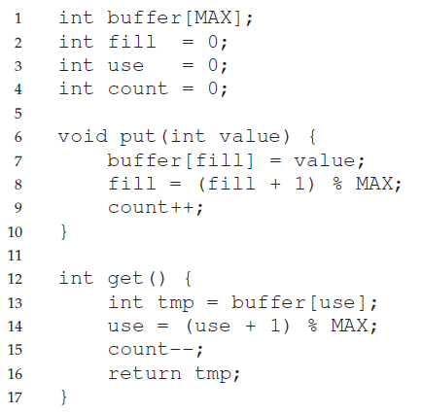
Final Put and Get
Circular Buffer
The single int has been extended into a circular buffer of size MAX
fill is the input pointer
use is the output pointer

Slide 23
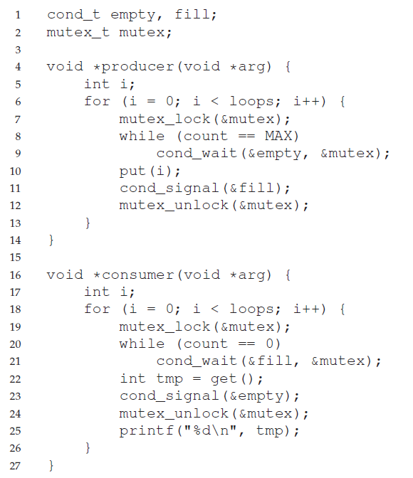
Final Producer/
Consumer

Slide 24
Semaphores

Slide 25
Introduction
We have seen that we need both locks and condition variables to solve a broad range of relevant and interesting concurrency problems
  Locks can be used to ensure mutual exclusion
  Condition variables can be used for synchronize
Now … we can actually use semaphores as both locks and condition variables

Slide 26
Definition
A semaphore is as an object with an integer value that we can manipulate with two routines
In the POSIX standard, these are called
  sem_wait()
  sem_post()
The initial value of the semaphore determines its behavior
  sem_init() is also needed

Slide 27
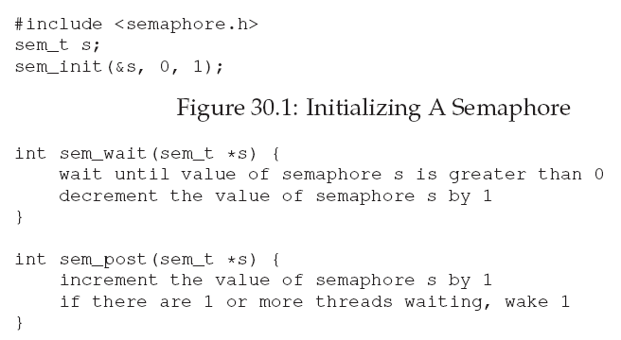
How it Works
0 indicates semaphore shared between threads in same process
s is initialized to a value of 1
Returns immediately or causes the caller to wait for a subsequent post
Does not ever suspend the
caller, just wakes a waiting thread
Notes:
sem_wait may return right away because the value of the semaphore was 1 or higher when the process called sem_wait()
Multiple calling threads may call sem_wait(), and thus all be queued waiting to be woken – Once woken, the waiting thread will then decrement the value of the semaphore and return to the user
sem_post never suspend the caller, it simply increments the value of the semaphore and then, if there is a thread waiting to be woken, wakes one of them

Slide 28
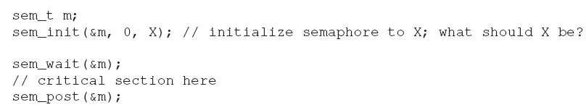
Binary Semaphores
Binary Semaphore can be used as a lock
Two threads are trying to enter their critical sections
  Suppose one thread holds the lock, i.e. it has called sem wait(), but not yet called sem post()
  If another thread tries to enter the critical section it will find that the value of the semaphore is 0, and thus wait
Notes:
The value X should be 1 to implement a binary semaphores or lock – The value of the semaphore simply alternates between 1 and 0
Two threads (thread A and B) are trying to enter their critical sections
Suppose thread A holds the lock (i.e. it has called sem wait(), but not yet called sem post()), and another thread (thread B) tries to enter the critical section by calling sem wait()
Thread A will find that the value of the semaphore is 0, and thus wait (putting itself to sleep and releasing the CPU)
When thread A runs again, it will eventually call sem post(), incrementing the value of the semaphore back to 1, and then wake the waiting thread B, which will then be able to acquire the lock for itself

Slide 29
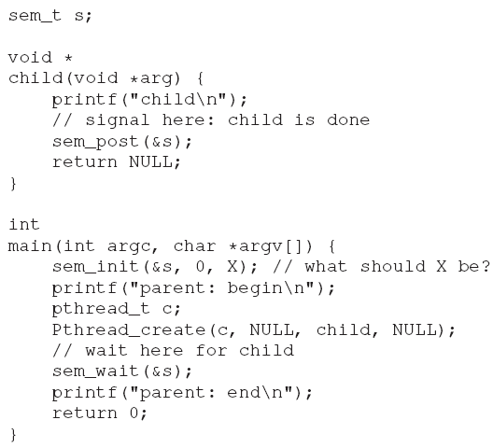
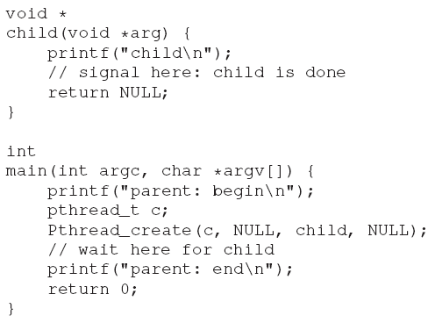
Semaphore as Condition Variable
Semaphores are also useful when a thread wants to halt its own progress waiting for something to change
Parent waits for its
child to complete
What should the initial value of this
semaphore be?
Notes:
Parent waits for its child to complete
The parent simply calls sem wait() to wait for the condition and the child sem post() to signal the condition
What should be the initial value of the semaphore?
The answer is that the value of the semaphore should be set to 0
Assume that the parent creates the child but the child has not run yet
In this case, the parent will call sem wait() before the child has called sem post(), and thus we’d like the parent to wait for the child to run
When the child finally runs, it will call sem post(), incrementing the value to 1 and waking the parent, which will then return from sem wait() and complete the program
The second case occurs when the child runs to completion before the parent gets a chance to call sem wait()
In this case, the child will first call sem post(), incrementing the value of the semaphore from 0 to 1
When the parent gets a chance to run, it will call sem wait() and find the value of the semaphore to be 1 – the parent will decrement the value and return from sem wait() without waiting

Slide 30
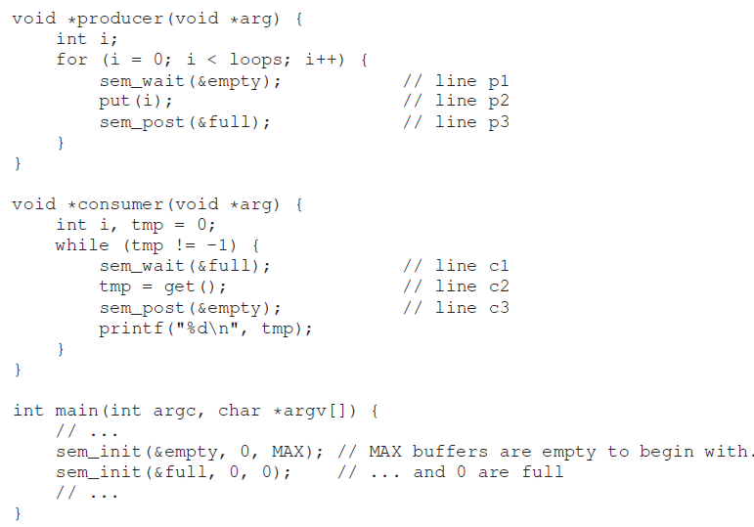
Semaphore on
Producer/Consumer

Slide 31
Introduces Two Semaphores, empty and full
Suppose first we have a single int buffer (i.e. MAX = 1)
Assume the consumer gets to run first – thus, the consumer will call sem_wait(&full)
Because full was initialized to the value 0, the call will block the consumer and wait for another thread to call sem_post() on the semaphore
Assume the producer then runs – it will call sem wait(&empty), but will continue, because empty was initialized to the value MAX (in this case, 1)
Thus, empty will be decremented to 0 and the producer will put a data value into the buffer
The producer will then call sem post(&full), changing the value of the full semaphore from 0 to 1 and waking the consumer

Slide 32
Producer/Consumer Problem
We now have a race condition
Producer waits for a buffer slot to become empty in order to put data into it
put(i) and get() are done without locks
Race condition may occur
Consumer similarly waits for a buffer slot to become filled before using it
How can locks be added ?
Notes:
Suppose that MAX is greater than 1 (say MAX = 10) and that there are multiple producers and multiple consumers – We now have a race condition

Slide 33

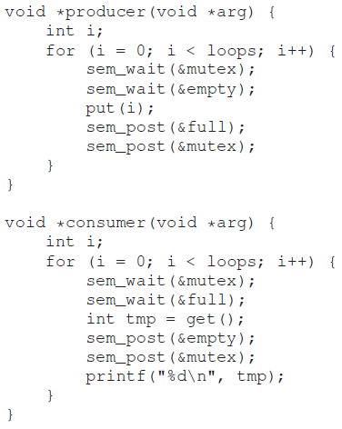
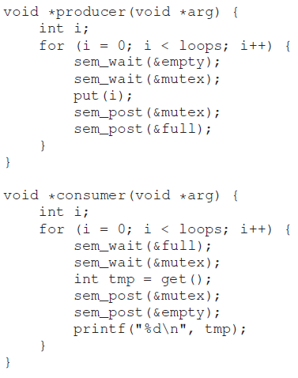
Add Mutex Locks
Think of a scenario that may cause
deadlock from this code
How do we fix it ?
Notes:
Imagine two threads, one producer and one consumer
The consumer gets to run first – it acquires the mutex , and then calls sem wait() on the full semaphore
Because there is no data yet, this call causes the consumer to block, but the consumer still holds the lock
A producer then runs – unfortunately, the first thing it does is call sem wait() on the binary mutex semaphore and waits because the lock is already held
There is a simple cycle here – the consumer holds the mutex and is waiting for the someone to signal full
The producer could signal full but is waiting for the mutex – thus, the producer and consumer are each stuck waiting for each other: a classic deadlock

Slide 34
Deadlock Occur
Two threads are one producer (Tp1) and one consumer (Tc1)
Tc1 gets to run first – it acquires the mutex , and then calls sem wait() on the full semaphore
Because there is no data yet, this call causes Tc1 to sleep, but the consumer still holds the lock
Tp1 then runs – unfortunately, the first thing it does is call sem wait() on the binary mutex semaphore and waits because the lock is already held
There is a simple cycle here – the consumer holds the mutex and is waiting for the someone to signal full
The producer could signal full but is waiting for the mutex – thus, the producer and consumer are each stuck waiting for each other: a classic deadlock

Slide 35
void *producer(void *arg) {
int i;
for (i = 0; i < loops; i++) {
sem_wait(&empty);
sem_wait(&mutex);
put(i);
sem_post(&mutex);
sem_post(&full);
}
}
void *consumer(void *arg) {
int i;
for (i = 0; i < loops; i++) {
sem_wait(&full);
sem_wait(&mutex);
int tmp = get();
sem_post(&mutex);
sem_post(&empty);
printf("%d\n", tmp);
}
}
Solution –
Reduce the Scope of the Lock

Slide 36
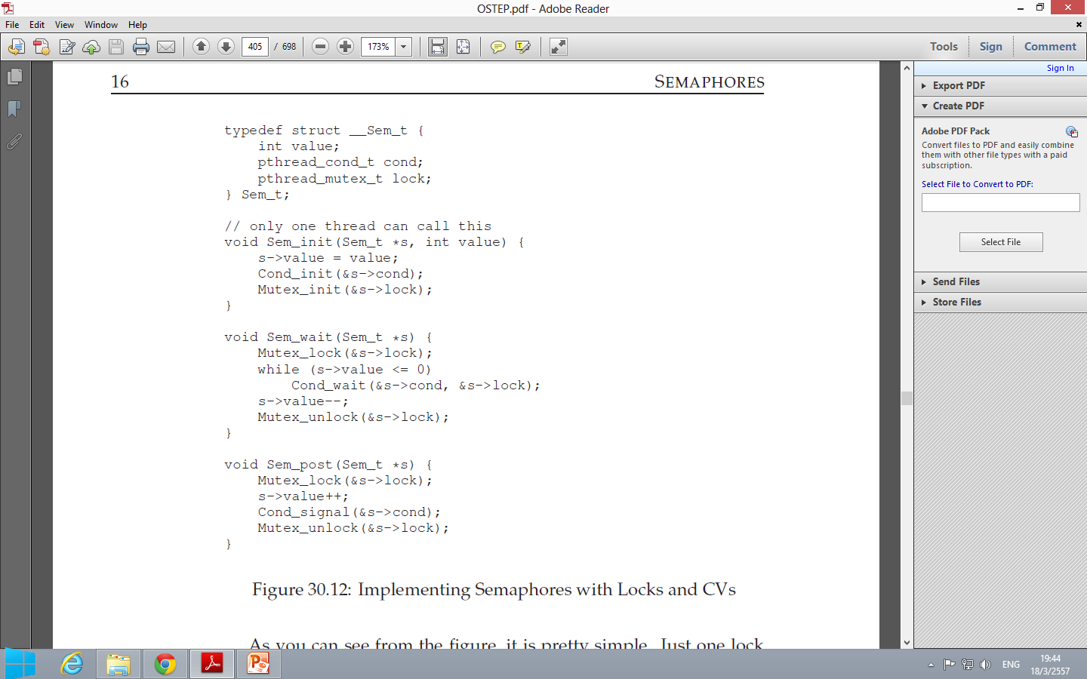
How to Implement a Semaphore
Notes:
Just one lock and one condition variable, plus a state variable to track the value of the semaphore, is all you need.

