Slide 1
Lecture 8
Locks Mechanism

Slide 2
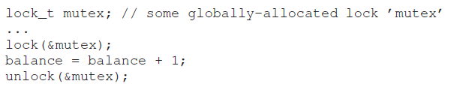
Previously
A multi-threaded process has more than one point of execution.
More than one threads want to access the share variable at the same time.
Race condition occurs. Critical sections need to define. Off cause, guarantee mutual exclusion is our goal.
Introduce Lock/Unlock function
  Programmers annotate source code with locks
  Putting them around critical sections to ensure atomicity
Notes:
Locks provide some minimal amount of control over scheduling to programmers.
In general, we view threads as entities created by the programmer but scheduled by the OS, in any fashion that the OS chooses. Locks yield some of that control back to the programmer; by putting a lock around a section of code, the programmer can guarantee that no more than a single thread can ever be active within that code. Thus locks help transform the chaos that is traditional OS scheduling into a more controlled activity.

Slide 3
Locks
Mechanism
  acquired, i.e. exactly one thread holds the lock
  available (free), i.e. no thread holds the lock
A lock variable holds the state of the lock at any instant in time
The name that the POSIX library uses for a lock is a mutex, as it is used to provide mutual exclusion between threads
Next … how should we build a lock?
  Can we build a purely software lock?
  What hardware support is needed?
  What OS support?

Slide 4
Evaluating Lock Implementation
Mutual Exclusion: the lock should prevent multiple threads from executing a critical section at the same time
Absence of Deadlock: if two or more threads are trying to enter their critical sections, at least one will succeed
Fairness: each thread trying to acquire the lock should get a fair chance at acquiring it
Performance: the time overheads added by using the lock
  Overhead of acquiring lock when if no other thread wants to free it
  Overhead of acquiring lock when there is contention for the lock

Slide 5
Recall The Code
From Last Week
static volatile int counter = 0;
void *mythread(void *arg)
{
printf("%s: begin\n", (char *) arg);
int i;
for (i = 0; i < 1e7; i++) {
counter = counter + 1;
}
printf("%s: done\n", (char *) arg);
return NULL;
}
int main(int argc, char *argv[])
{
pthread_t T0, T1;
printf("main: begin (counter = %d)\n", counter);
pthread_create(&T0, NULL, mythread, "A");
pthread_create(&T1, NULL, mythread, "B");
// join waits for the threads to finish
pthread_join(T0, NULL);
pthread_join(T1, NULL);
printf("main: done with both (counter = %d)\n", counter);
return 0;
}

Slide 6
Review Uncontrolled Scheduling
Accessing shared data needs careful control because of the possible interleaving of threads
  Two threads each increment a shared variable, counter
Thread 1 Thread 2
load counter load counter
add 1 add 1
store counter store counter
Many possible interleavings, including:
load counter
add 1
load counter
store counter
add 1
store counter
Incorrect answer !!

Slide 7
Controlling Interrupts
This was an early approach to implementing locks
  The OS ensures code inside the critical section is not interrupted, and thus executes as if it were atomic
  void lock() { disableInterrupts(); }
  void unlock() { enableInterrupts(); }
This is a simple approach but has many disadvantages
  It allows any thread to perform a privileged operation (turning interrupts on and off) which is very risky – the thread may not enable interrupts again
  The approach does not work on multi-core or multiprocessors
Notes:
A greedy program could call lock() at the beginning of its execution and thus monopolize the processor – worse, an errant or malicious program could call lock() and go into an endless loop
In this latter case, the OS will never regain control of the system, and the only way to address the problem is to restart the system
If multiple threads are running on different CPUs, and each try to enter the same critical section, it does not matter whether interrupts are disabled – threads will be able to run on other processors, and thus could enter the critical section
The solution is sometimes used within the OS kernel itself to guarantee atomicity when accessing its own data structures
It is inefficient when compared to normal instruction execution as code that masks/unmasks interrupts is generally slower

Slide 8
Software Test and Set
A purely software attempt at implementing a lock
typedef struct lock_t { int flag; } lock_t;
void init(lock_t *mutex) {
// 0 -> lock is available, 1 -> held
mutex->flag = 0;
}
void lock(lock_t *mutex) {
while (mutex->flag == 1); // TEST flag and spin-wait
mutex->flag = 1; // now SET it!
}
void unlock(lock_t *mutex) {
mutex->flag = 0;
}
What about Correctness and Performance ???
Notes:
Use a simple flag to indicate whether a thread holds the lock
A thread that wants to enter its critical section will call lock(), which tests whether the flag is equal to 1
If the flag is 0, it sets the flag to 1 to indicate that the thread now holds the lock
On leaving the critical section, the thread calls unlock() and clears the flag, indicating that the lock is no longer held
If another thread happens to call lock() while that first thread is in the critical section, it will simply spin-wait in the while loop for that thread to call unlock() and clear the flag
Once that first thread does so, the waiting thread will fall out of the while loop, set the flag to 1 for itself, and proceed into the critical section

Slide 9
Note Area for Online Teaching
void init(lock_t *mutex) {
mutex->flag = 0;
}
void lock(lock_t *mutex) {
while (mutex->flag == 1);
mutex->flag = 1;
}
void unlock(lock_t *mutex) {
mutex->flag = 0;
}
lock_t mu;
…
init(&mu);
…
lock(&mu);
counter=counter+1;
unlock(&mu);
…

Slide 10
What about Performance
Spin-waiting wastes time waiting for another thread to release the lock
On a single processor, the thread that holds the lock cannot even run (at least, not until a context switch occurs)!
Thus, as we move forward and develop more sophisticated solutions, we should also consider ways to avoid this kind of waste

Slide 11
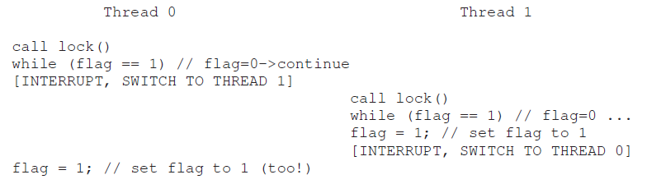
What about Correctness
Unlikely but possible
Both threads can enter the critical section at the same time – no mutual exclusion

Slide 12
Hardware Support for Locking
Although there are purely software solutions to locking (e.g. Peterson’s algorithm), some hardware support can provide a simpler and better solution
The hardware support generally takes the form of a primitive instruction that is guaranteed by the hardware to execute atomically
Examples provided on different architectures include:
  Test-and-Set
  Compare-and-Swap
  Fetch-and-Add
  Load-Linked and Store-Conditional
  etc.

Slide 13
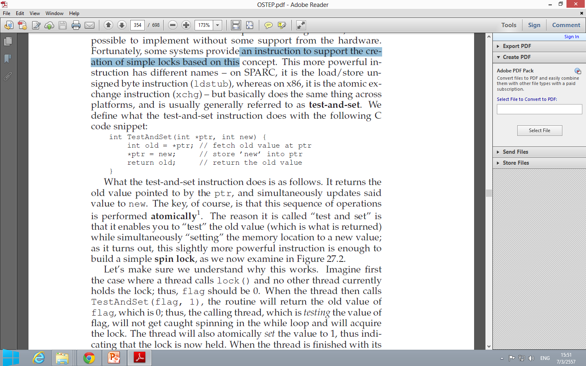
Test-and-Set
(Hardware Support for Locking)
A Test-and-Set instruction is added to support the creation of locks based on spin-wait
It returns the old value in the location pointed to by ptr, and simultaneously updates the location to the new value
The key is that this sequence of operations is performed atomically
Next … how to use the Test-and-Set instruction to build a lock
Notes:
The reason it is called “Test and Set” is that it enables you to “test” the old value (which is what is returned) while simultaneously “setting” the memory location to a new value

Slide 14
typedef struct __lock_t {
int flag;
} lock_t;
void init(lock_t *lock) {
// 0 indicates lock is available, 1 that it is held
lock->flag = 0;
}
void lock(lock_t *lock) {
while (TestAndSet(&lock->flag, 1) == 1); // spin-lock
}
void unlock(lock_t *lock) {
lock->flag = 0;
}
Test-and-set is an atomic instruction
This is called “spin lock” spins using CPU cycles, until the lock becomes available.
As long as the lock is held by another thread, TestAndSet() will repeatedly return 1
By making both the test (of the old value of the lock) and set (of the new value) a single atomic operation, we can ensure that only one thread acquires the lock
Notes:
As long as the lock is held by another thread, TestAndSet() will repeatedly return 1, and thus this thread will spin and spin until the lock is finally released
When the flag is finally set to 0 by some other thread, this thread will call TestAndSet() again, which will now return 0 while atomically setting the value to 1 and thus acquire the lock and enter the critical section
By making both the test (of the old value of the lock) and set (of the new value) a single atomic operation, we can ensure that only one thread acquires the lock
Thus we can build a successful mutual exclusion primitive!
You may also now understand why this type of lock is usually referred to as a spin lock
It is the simplest type of lock to build, and simply spins, using CPU cycles, until the lock becomes available
To work correctly on a single processor, it requires a preemptive scheduler (i.e. one that will interrupt a thread via a timer, in order to run a different thread, from time to time)
Without preemption, spin locks don’t make much sense on a single CPU, as a thread spinning on a CPU will never relinquish it

Slide 15
Evaluating Test-and-Set
Correctness?
  Mutual Exclusion is guaranteed and Deadlock cannot occur
Performance?
  On a single processor, performance overheads can be quite painful
  On multi-core or multiprocessor, spin locks work reasonably well
Fairness?
  Cannot guarantee that a waiting thread will ever enter the critical section
  A thread spinning may spin forever….starvation
Spinning to wait for a lock held on another processor
doesn’t waste many cycles
Notes:
You may also now understand why this type of lock is usually referred to as a spin lock. It is the simplest type of lock to build, and simply spins, using CPU cycles, until the lock becomes available. To work correctly on a single processor, it requires a preemptive scheduler (i.e., one that will interrupt a thread via a timer, in order to run a different thread, from time to time). Without preemption, spin locks don’t make sense on a single CPU, as a thread spinning on a CPU will never relinquish it.
Single CPU – imagine the case where the thread holding the lock is pre-empted within a critical section
The scheduler might then run every other thread (imagine there are N−1 others), each of which tries to acquire the lock
In this case, each of those threads will spin for the duration of a time-slice before giving up the CPU, which is quite a waste of CPU cycles
Multiple CPU – imagine Thread A on processor 1 and Thread B on processor 2, both contending for a lock
If Thread A (processor 1) gets the lock, and then Thread B tries to, B will spin (on processor 2)
However, presumably the critical section is short, and thus soon the lock becomes available, and is acquired by Thread B
Spinning to wait for a lock held on another processor doesn’t waste many cycles in this case, and thus can be quite effective

Slide 16
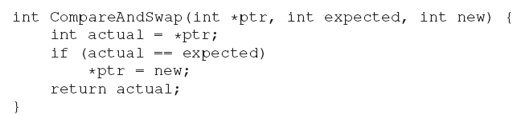
Compare-and-Swap (1)
Another hardware primitive is the Compare-and-Swap instruction
It tests whether the value at the location pointed to by ptr is equal to an expected value
  If so, it updates the memory location pointed to by ptr with the new value
  If not, it does nothing
Again this sequence of operations is performed atomically
old
old
old

Slide 17
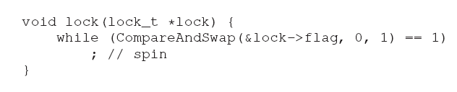
Compare-and-Swap (2)
In both cases the actual value at the memory location is returned allowing the code calling Compare-and-Swap to know whether it succeeded or not
A lock can be built in a similar way to that with Test-and-Set
The rest of the code is the same as the Test-and-Set example
Notes:
This code works similarly to Test-and-Set – it simply checks if the flag is 0 and if so, atomically swaps in a 1 thus acquiring the lock
Threads that try to acquire the lock while it is held will continue spinning until the lock is finally released
Compare-and-swap is a more powerful instruction than Test-and-Set
Test-and-Set will return the old value and set the new value always
Compare-and-Swap will check if the old value is equal to the expected value and only set the value to the new one if it is
For implementing a lock, they are the same, but Compare-and-Swap may be used for some other purposes

Slide 18
Compare-and-Swap (3)
Compare-and-swap is a more powerful instruction than Test-and-Set
Test-and-Set will return the old value and set the new value always
Compare-and-Swap will check if the old value is equal to the expected value and only set the value to the new one if it is.
For implementing a lock, they are the same, but Compare-and-Swap may be used for some other purposes.

Slide 19
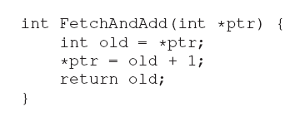
Fetch-and-Add (1)
Fetch-and-Add atomically increments a value at the location pointed to by ptr, while returning the old value at that location
Fetch-and-Add can be used to build a more interesting ticket lock
When a thread wishes to acquire a lock, it first does an atomic Fetch-and-Add on the ticket value; that value is now considered this thread’s “turn” (myturn)
The globally shared lock->turn is then used to determine which thread’s turn it is

Slide 20
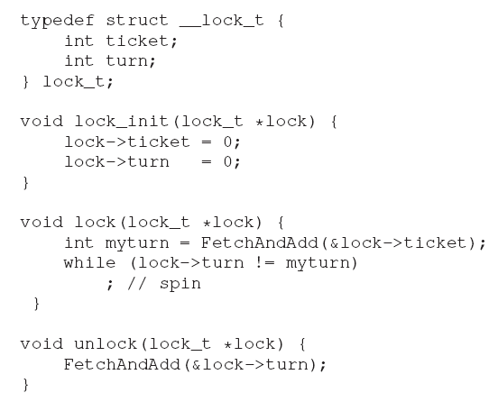
Fetch-and-Add (2)
Get a queue ticket
Wait for a turn
Now, it’s somebody else turn

Slide 21
Note Area for Online Teaching
void init(lock_t *mu) {
mu->ticket = 0;
mu->turn = 0;
}
void lock(lock_t *mu) {
int myturn = FetchAndAdd(&mu->ticket);
while (mu->turn != myturn);
}
void unlock(lock_t *mutex) {
FetchAndAdd(&mu->turn);
}
lock_t mu;
…
init(&mu);
…
lock(&mu);
counter=counter+1;
unlock*(&mu);
…

Slide 22
Fetch-and-Add (3)
When (myturn == turn) for a given thread, it is that thread’s turn to enter the critical section
Unlock is accomplished simply by incrementing the turn such that the next waiting thread (if there is one) can now enter the critical section
This method ensures progress for all threads
Once a thread is assigned its ticket value, it will be scheduled at some point in the future
In previous methods, no such guarantee existed

Slide 23
So Much Spinning
Hardware-based locks are simple and they work, but … they are inefficient with so much spinning
Threads can waste an entire time slice doing nothing but checking a value
  If a context switch occurs in a critical section, the value will never change until another context switch occurs
With N threads contending for a lock, N−1 time slices may be wasted
How can we develop a lock that does not needlessly waste time spinning on the CPU?
Hardware support alone cannot solve the problem – we’ll need OS support too!

Slide 24
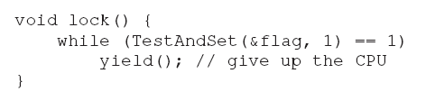
Yield (1)
When a thread is going to spin, instead it gives up the CPU to another thread
An operating system primitive yield() can be called when a thread wants to give up the CPU
Yield ()
  Moves the caller from the running state to the ready state
  And thus allows another thread to run

Slide 25
Yield (2)
What if there are many threads contending for a lock repeatedly?
If one thread acquires the lock and is preempted before releasing it, the other N–1 threads will each call lock(), find the lock held, and yield the CPU
Each of the N–1 threads will execute this run-and-yield pattern until the thread holding the lock gets to run again
There are still plenty of waste cycles
And … the starvation problem still exists with some cases
Notes:
Think about the example with two threads on one CPU – in this case, our yield-based approach works quite well
If a thread happens to call lock() and find the lock held, it will simply yield the CPU, and thus the other thread will run and finish its critical section
With many threads, the scheduler determines which thread runs next – if the scheduler makes a bad choice, a thread that runs must either spin waiting for the lock (our first approach), or yield the CPU immediately (our second approach)
Either way, there is potential for waste and no prevention of starvation

Slide 26
Using Queues: Sleep instead of Spin
Explicitly exert some control over who gets to acquire the lock next
To do this, we need a little more OS support, as well as a queue (keep track of which threads are waiting to enter the lock)
For simplicity, Solaris’s support is considered
  park() to put a calling thread to sleep
  unpark(threadID) to wake a particular
Put a caller to sleep if it tries to acquire a held lock and wakes it when the lock is free

Slide 27
Basic Idea
Lock: A thread checks a lock
  If free, takes the lock and enters the critical section
  If not, sleeps in a queue – Someone else will give it the lock later on
Unlock: A Thread unlocks the critical section
  If the waiting queue is empty, releases the lock
  If not, pass the lock to the next thread in the queue
  The next thread will be woken up with the lock and can proceed into the critical section

Slide 28
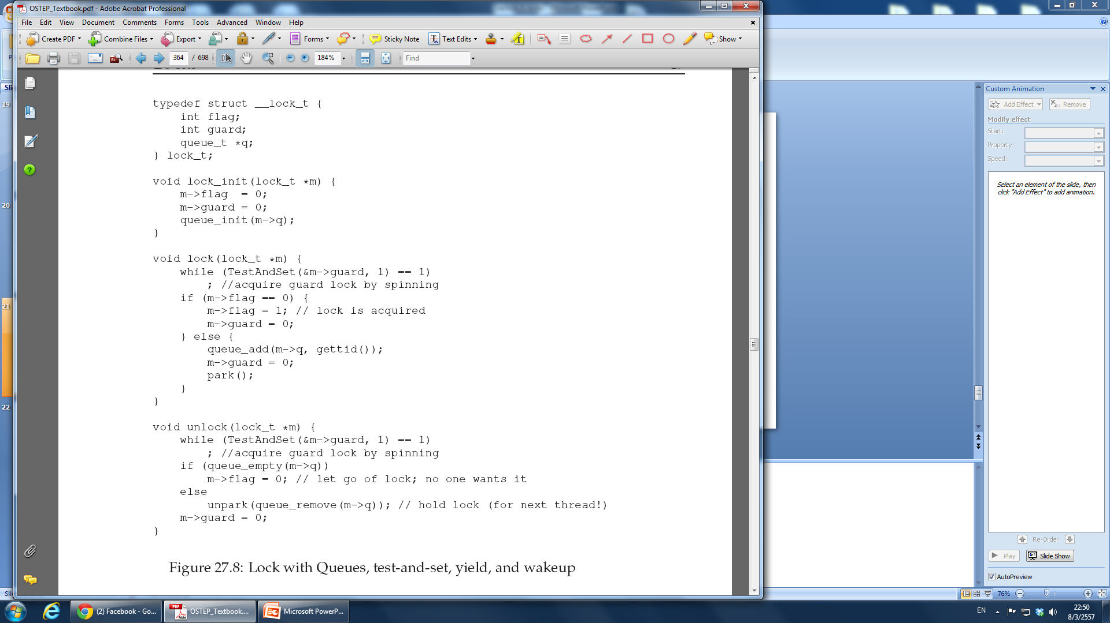
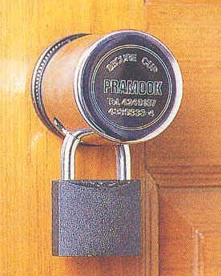
Why the ‘guard’ ?
How about Starvation ?
Queue help control who get the lock next
….avoid starvation
This has to be a mini critical section
But a much smaller section in
comparison to user-defined critical
Section … less spinning time
Enter the queue
sleep
This has to
be a mini
critical
section
Notes:
Combine the old test-and-set idea with an explicit queue of lock waiters to make a more efficient lock.
Second, we use a queue to help control who gets the lock next and thus avoid starvation.
You might notice how the guard is used, basically as a spin-lock around the flag and queue manipulations the lock is using.
This approach thus doesn’t avoid spin-waiting entirely; a thread might be interrupted while acquiring or releasing the lock, and thus cause other threads to spin-wait for this one to run again.
However, the time spent spinning is quite limited (just a few instructions inside the lock and unlock code, instead of the user-defined critical section), and thus this approach may be a reasonable one.
Second, you might notice that in lock(), when a thread can not acquire the lock (it is already held), we are careful to add ourselves to a queue (by calling the gettid() call to get the thread ID of the current thread), set guard to 0, and yield the CPU.
the flag does not get set back to 0 when another thread gets woken up. Why is this? Well, it is not an error, but rather a necessity! When a thread is woken up, it will be as if it is returning from park(); however, it does not hold the guard at that point in the code and thus cannot even try to set the flag to 1. Thus, we just pass the lock directly from the thread releasing the lock to the next thread acquiring it; flag is not set to 0 in-between.

Slide 29
A thread will be about to park, assuming that it
should sleep until the lock is no longer held
What if there is thread-switch at that time to another thread?
If switch to the thread holding the lock …
If that thread then releases the lock (instead of passing the lock to a thread in the queue
The subsequent park by the first thread would potentially sleep forever
This scenario has a lot of ‘if’, but it certainly is possible
that the race condition occurs – ‘waiting race’

Slide 30
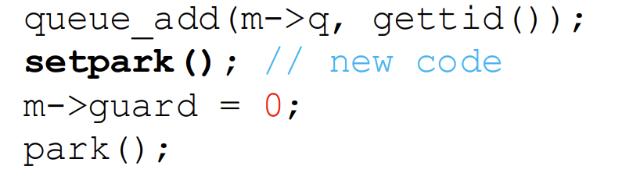
Waiting Race
Solaris solves this problem by adding a third system call: setpark()
By calling this routine, a thread can indicate it is about to park
If the thread happens to be interrupted and another thread calls unpark before park is actually called, the subsequent park returns immediately instead of sleeping
A different solution could pass the guard into the kernel
  the kernel could take precautions to atomically release the lock
  dequeue the running thread
Modify the ‘lock’

Slide 31
Different OS, Different Support
Linux provides something called a futex which is similar to the Solaris interface but provides a bit more in-kernel functionality
Two-phase lock: Spinning can be useful if not for too long
  In the first phase, the lock spins for a while, hoping that it can acquire the lock
  If the lock is not acquired during the first spin phase, a second phase is entered, where the caller is put to sleep, and only woken up when the lock becomes free later
Notes:
fast userspace mutex: Linux contributors from IBM in 2002

Slide 32
A Lock Needs …
Some hardware support (in the form of a more powerful instruction)
Some operating system support
  park() and unpark() primitives on Solaris
  futex on Linux
The details differ for each OS
The exact code to perform such locking is usually highly tuned

