Slide 1

Soviet_Architecture_DataBase
SADB
web project made as structured storage of data about soviet type architecture all across the world​ There will be information about soviet housebuilding series and their specific types
1

Slide 2
A large number of libraries were used for the project (Required installation)
SERVER PART (FLASK's modules) - Flask, flask-wtf, flask-login, flask-restful
System – OS, HashLib
DataBase – SQLalchemy
LIST_OF_LIBRARIES
MANY_LIBRARY
2

Slide 3
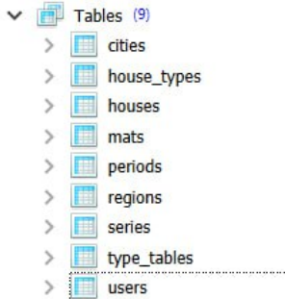
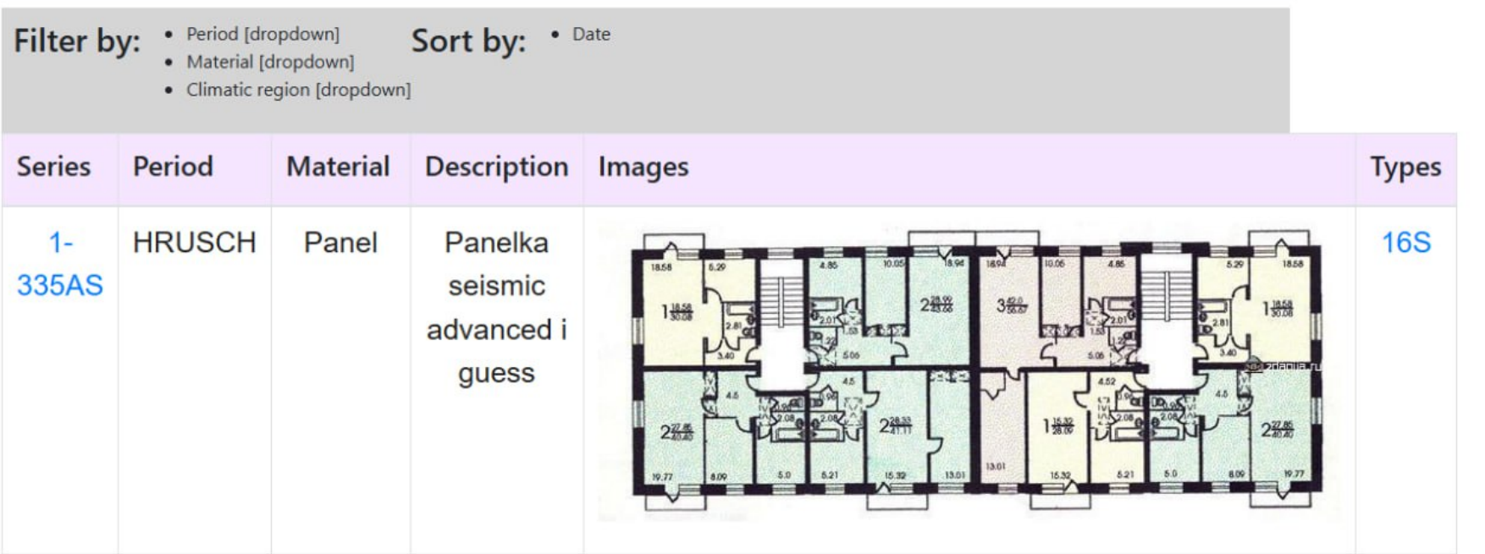
The aim of the project is to collect, store and organize historically accurate information about the architecture of the Soviet Union.
COMPLEX OF DATABASES AND USER's VIEW OF IT
HISTORICAL_ACCURACY
3

Slide 4
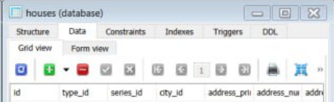



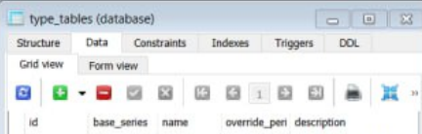
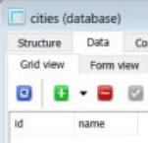
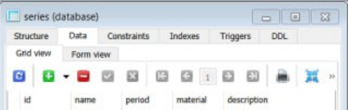
A variety of interconnected databases were used to simplify and streamline data storage.
DATA_SYSTEM
4

Slide 5
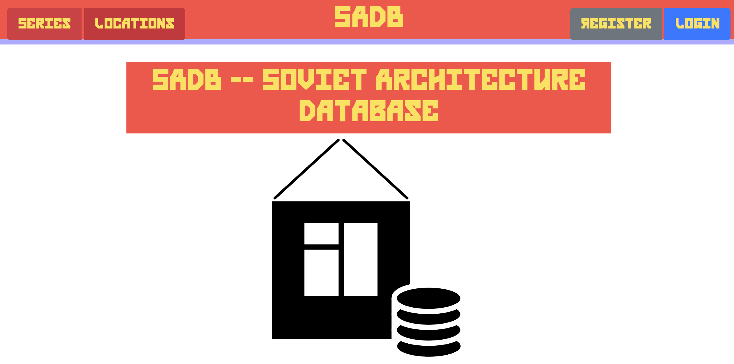
User-friendly_and_stylized
MAIN_PAGE
The interface was created similar to the style of the Soviet Union, while remaining user-friendly.

