Slide 1

Pharmacy Inventory
Software Design
Prof. Nelson Medinilla
Members:
Laura M. Zapata
Pairsa Ghazi
Jorge E. González O.
Madrid, 04 June 2012
Notes:
0

Slide 2
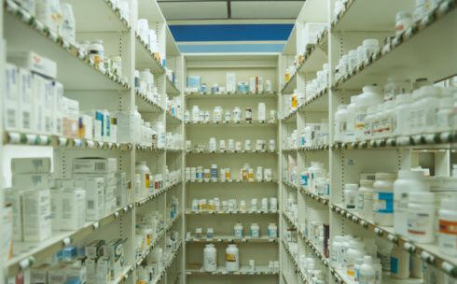
Overview
Pharmacy Inventory
Use Case
Class Diagrams
Sequence Diagrams
Product Demonstration
Conclusions

Slide 3
1. Pharmacy Inventory
Pharmacy Inventory is essential to the profitability of your pharmacy.
Don’t let profit sit on your shelves or expensive brand name drugs go out of date due to improper inventory levels.
Too much inventory is a major cause for insufficient cash flow. especially in the case of the wholesaler and rent payables.
Some Benefits:
Better cash flow finding the right balance between Inventory Turns
Good customer service to establish proper inventory levels
Good relationship with suppliers
Good return on investment
Accurate prediction of future needs of inventory.

Slide 4
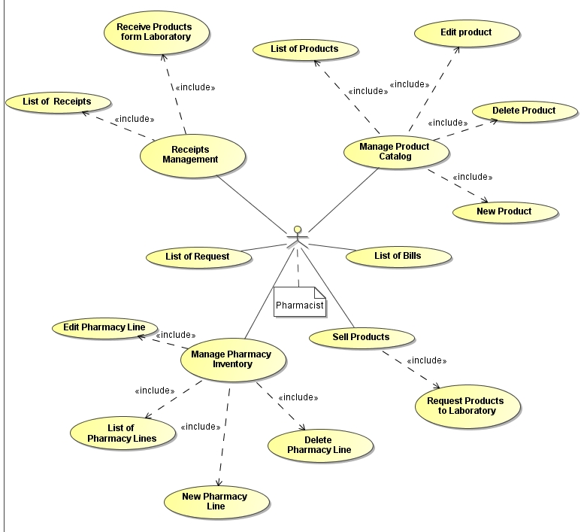
2. General Use Case
Use Case

Slide 5
3.1 Class Diagram (April 20)
Request
Laboratory
Collection
1
1
1..*
1
1
0..*
Request Line
Product
Price
1
0..1
1
1
1
0..*
Item
Location
1

Slide 6
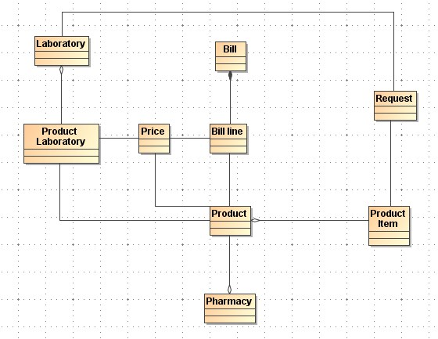
3.2 Class Diagram (May 16)

Slide 7
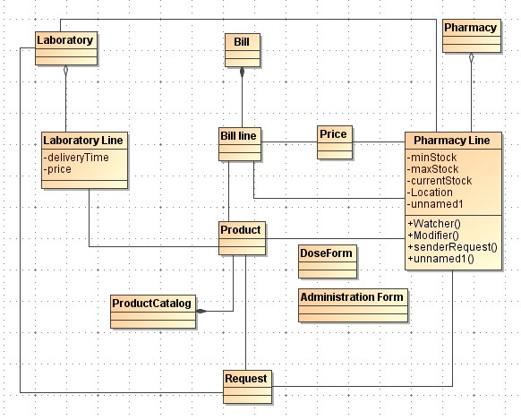
3.3 Class Diagram (May 20)

Slide 8
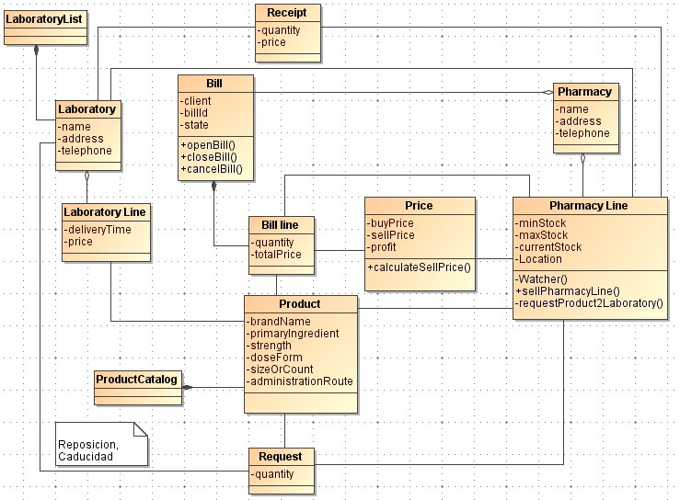
3.4 Class Diagram (May 23)

Slide 9
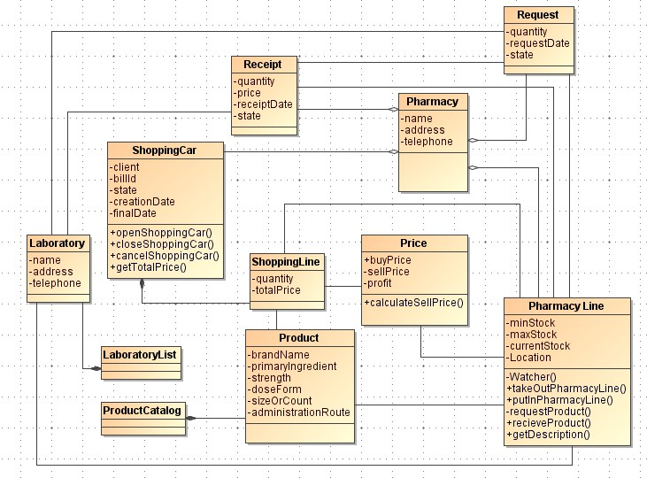
3.5 Class Diagram (May 27)

Slide 10
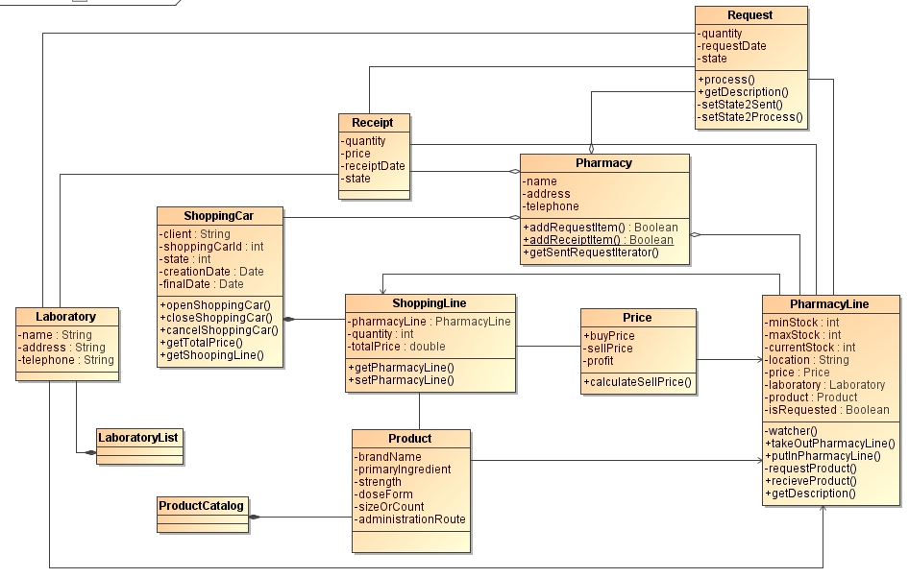
3.6 Class Diagram (June 3)

Slide 11
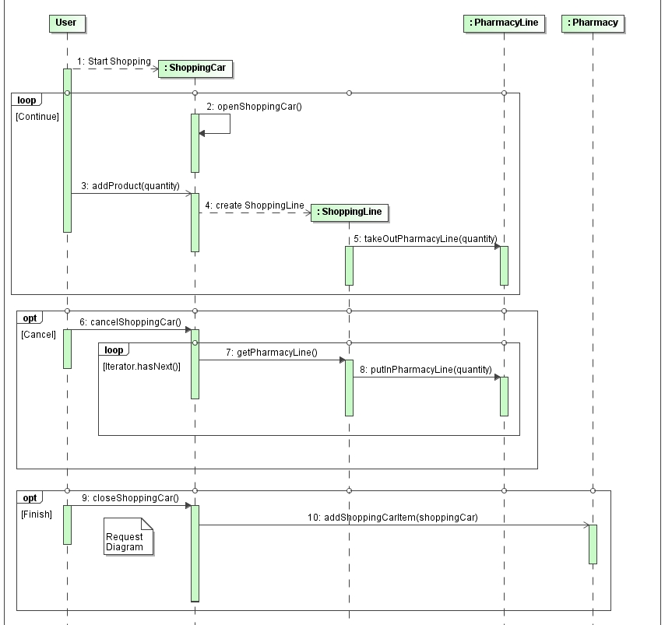
4.1 Sequence Diagram – Shopping Car

Slide 12
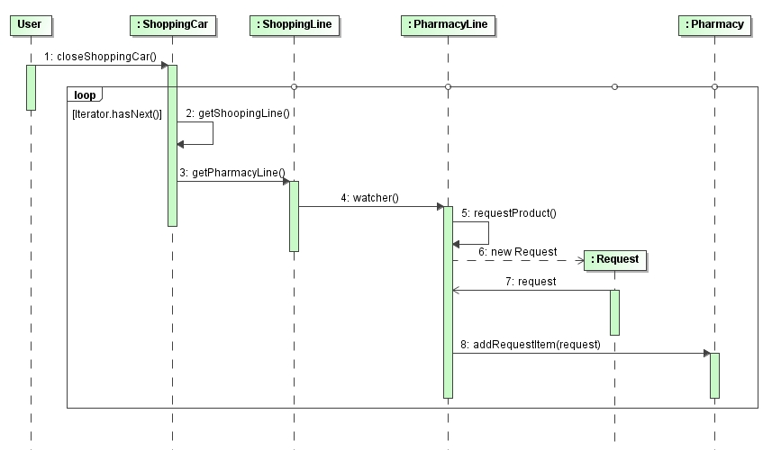
4.2 Sequence Diagram – Request

Slide 13
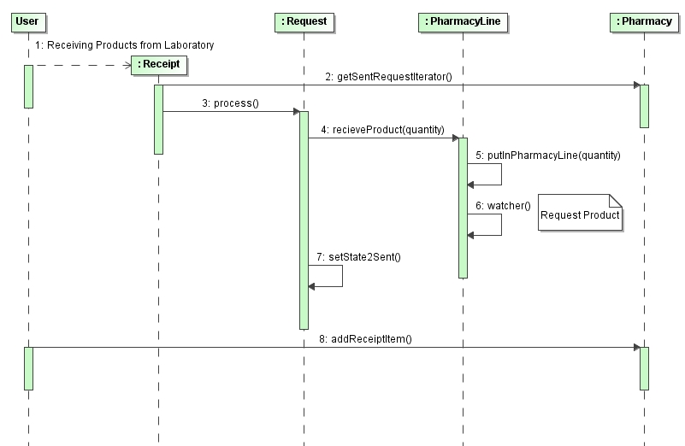
4.3 Sequence Diagram – Receipt

Slide 14

5. Product Demonstration

Slide 15
5. Conclusions
Difficulty in change the paradigm form Object Based Design to Object Oriented Design. The most difficult thing was unlearning the previous paradigm.
We obtain better results (modularity) if we design the Class Model first than Data Model
Software Design is the base of any software artifact; If we don’t have a good design probably we’ll have problem in the future related with scalability, maintainability, testability and even security.

Slide 16
Thank You
Questions ?

