Slide 1
Website
Created using iThoughts[...]

Slide 2
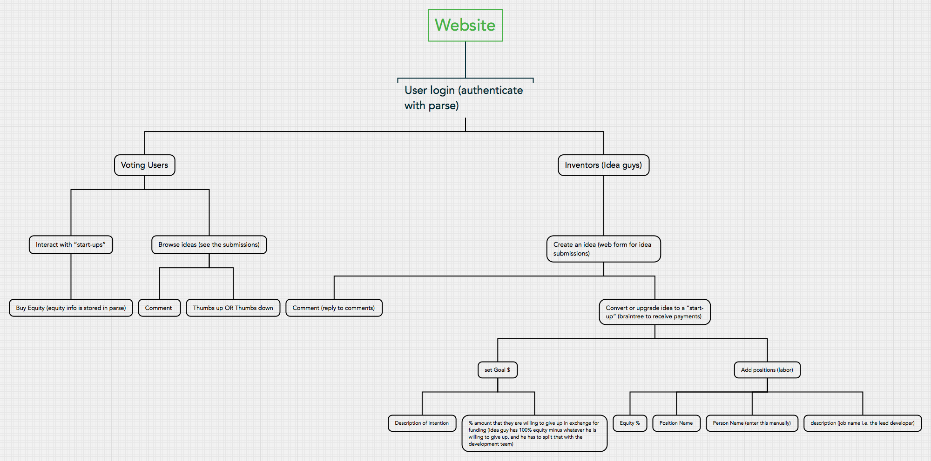
Website
Notes:
Created using iThoughts

Slide 3
User login (authenticate with parse)
Voting Users
Interact with “start-ups”
Buy Equity (equity info is stored in parse)
Browse ideas (see the submissions)
Comment
Thumbs up OR Thumbs down

Slide 4
User login (authenticate with parse)
Inventors (Idea guys)
Create an idea (web form for idea submissions)
Comment (reply to comments)
Convert or upgrade idea to a “start-up” (braintree to receive payments)
set Goal $
Add positions (labor)

Slide 5
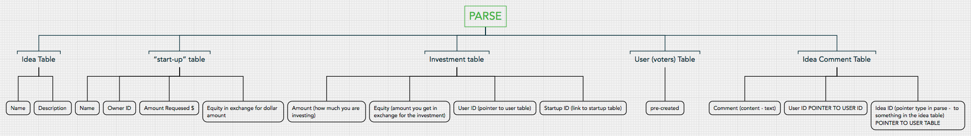
PARSE
Notes:
Created using iThoughts

Slide 6
Idea Table
Name
Description

Slide 7
“start-up” table
Name
Owner ID
Amount Requesed $
Equity in exchange for dollar amount

Slide 8
Investment table
Amount (how much you are investing)
Equity (amount you get in exchange for the investment)
User ID (pointer to user table)
Startup ID (link to startup table)

Slide 9
User (voters) Table
pre-created

Slide 10
Idea Comment Table
Comment (content - text)
User ID POINTER TO USER ID
Idea ID (pointer type in parse - to something in the idea table) POINTER TO USER TABLE

