Slide 1
UNIT :SMA2175- COMPUTER PROGRAMMING I
TITLE: ASSIGNMENT 1
GROUP MEMBERS
JERRY KICHE | ENE211-0261/2021
ELI LEKAKENY | ENE211-0047/2021
LATIFAH MORRID | ENE211-0023/2021
ALVIN ISRAEL | ENE211-0249/2021
ENDRIAN MWANGI | ENE211-0011/2021
VICTOR MOSES | ENE211-0049/2021

Slide 2
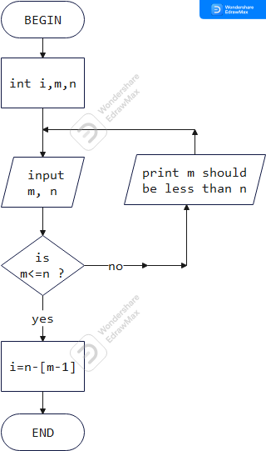
Algorithm to output the number of integers between two numbers:
Pseudocode:
START
INITIALIZE i, m, n
INPUT m, n
IF (m<=n)
i=n-(m-1)
ELSE
print(“m should be less than n”)
ENDIF
STOP

Slide 3
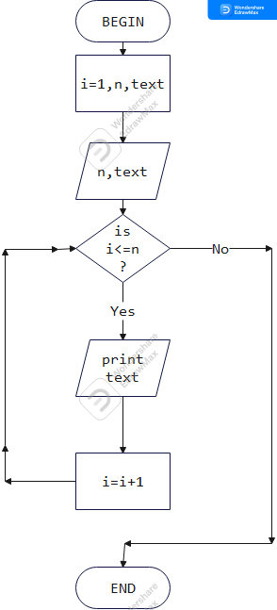
Algorithm to print a text n number of times
START
INITIALIZE i, n, text
SET i =1
INPUT n, text
FOR (i=1, i<=n, i++)
OUTPUT text
ENDFOR
STOP
START
INITIALIZE i, n, text
INPUT n, text
FOR i=1 to n
OUTPUT text
ENDFOR
STOP

Slide 4
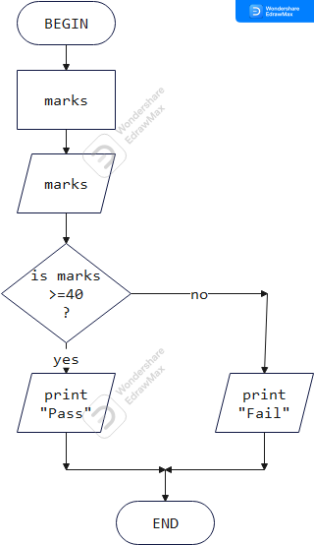
Algorithm to implement a grading system
START
INITIALIZE marks
INPUT marks
IF marks>=40
print(“Pass”)
ELSE
print(“Fail”)
ENDIF
STOP

