Slide 1
DSFPT04A Phase 3
Telecommunication Project
Laban Kariuki

Slide 2
Content
Overview
Business Understanding
Data Understanding
Modeling
Evaluation
Recommendation
Next steps
A breakdown

Slide 3
Overview

Slide 4
A model to help predict the likelihood of a subscriber churning from our services based available data.

Slide 5
Business Understanding

Slide 6

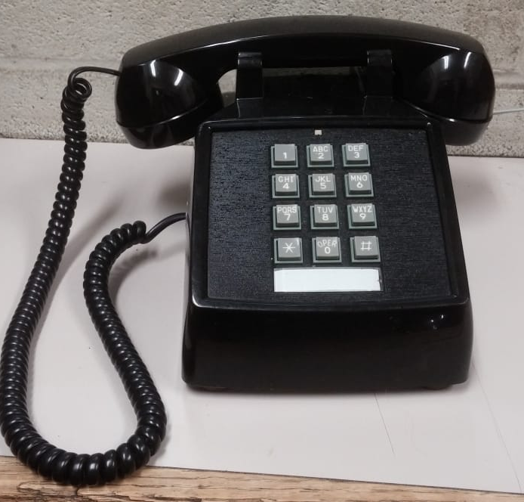
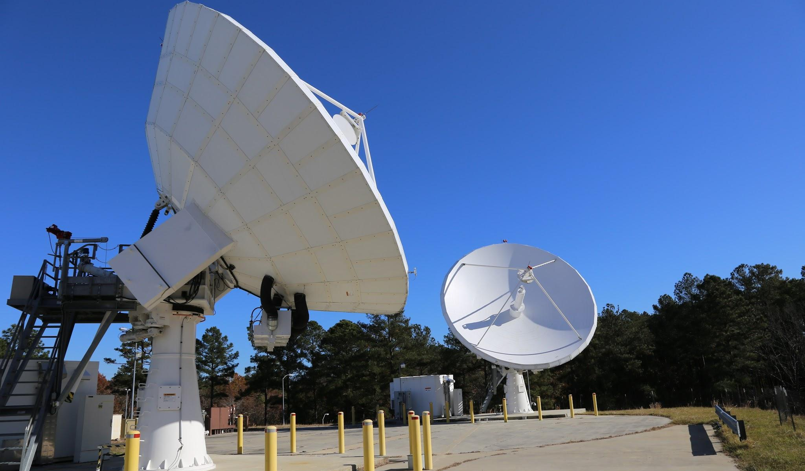
Objectives
The telecommunication company is looking to identify the likelihood of customers abandoning its services
It is more ideal to focus on customers who will be with the company in the foreseeable future than those who will end up leaving
By identifying staying customers, resources can thereafter be spent on retention

Slide 7
Data Understanding

Slide 8
Syria Telecoms Company Customer Data
Source and nature of the data
The data has been sourced from Syria Telecommunications Company. It is composed of details relating to
Phone calls duration
Day and night
Phone calls charges
Day and night
The available types in the data
A review of the data reveals the existence of different types of data:
Characters
Numerics
Booleans
Floats and
Objects
There was no need to drop any features or records. The data was clean.

Slide 9
Modelling

Slide 10
Options taken
Models used for prediction
Initial model used the lot transformation
Later improved by doing a one hot encoding
Concluded with the bias variance trade off.
Results of the models
Poor predictor of the likelihood of a customer churning
Also a poor predictor of the likelihood of our model
Promising results that could use better or more improved accuracy

Slide 11
Evaluation

Slide 12
Outcome
Results of the models
Initial model used the lot transformation
Later improved by doing a one hot encoding
Finally fit the model with K-Fold cross validation
Improvements made on the models
Poor predictor of the likelihood of a customer churning
Also a poor predictor of the likelihood of our model
Promising results that could use better or more improved accuracy

Slide 13
Recommendations

Slide 14
Key Pickings
The takeout
Our model demonstrated a great deal of underfitting for the most part.
Unfortunately, our K-Fold cross validation did not help reduce the bias.
This is indicating of the majority of the features not being adequate to give a prediction as intended.
Recommendations
Additional records of the same data be used for the analysis
Different data source be utilized.
Reduction in the number of features excluding categorical data

Slide 15
Next Steps

Slide 16
Going forward
Proposal
Data sourcing from similar industry sources with a similar nature of data
Consider utilizing different features in the model.
Consider using fewer features and switching them across models for optimal results
Expectation
Multiple data sources are available
Nature of features may vary but a few will be similar
It might be important to consider extrapolating this model to other types of organizations as well.
Other models need also be utilized for purposes of establishing the one that best fits our expectation

Slide 17
Conclusion
It is important for us to make use of all the models at our disposal. Although this particular project only utilized two, should time allow, more models can be considered in a bid to establish the one that best fits our data.

Slide 18
Thank You

Slide 19


The prediction

