Slide 1
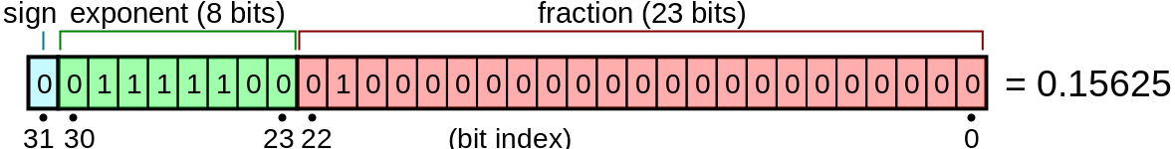
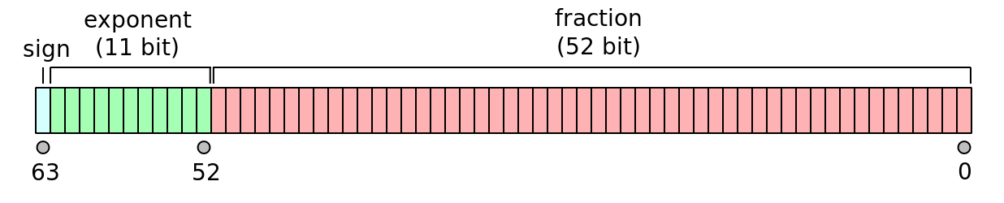
Digital Computers
Digital computers – numbers are represented by several voltages in “binary code”
 | 128 | 64 | 32 | 16 | 8 | 4 | 2 | 1
bit | 0 | 0 | 1 | 1 | 0 | 0 | 1 | 1
voltage | 0V | 0V | 3V | 3V | 0V | 0V | 3V | 3V
51 in 8-bit binary code is 00110011
Single precision floating-point variable – 32 bits or 4 bytes
Double precision floating-point variable – 64 bits or 8 bytes
https://en.wikipedia.org/

Slide 2
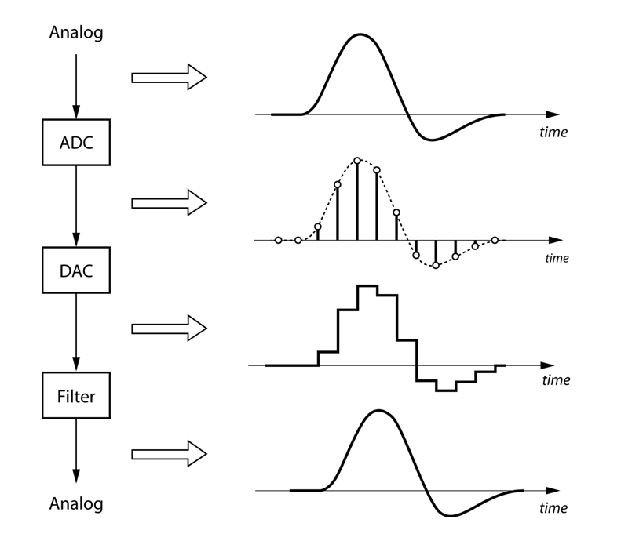
Digital Data Aquisition
A/D – analog to digital converter (i.e. LabQuest)
Continuous Analog
Discrete Digital
https://nutaq.com
D/A – digital to analog converter (i.e. an iPod)
Discrete Digital
“Continuous” Analog

Slide 3
Sampling Frequency and Nyquist Criterion
Quality of a digital signal depends on the Sampling Frequency f_{S}
Discrete Digital
“Continuous” Analog
Nyquist Criterion – The maximum frequency component that can be resolved is half the sampling frequency

Slide 4
Sampling Frequency
Engineering Trade-off:
high quality data
Large f_{s}
large data files
low quality data
Small f_{s}
small data files

Slide 5
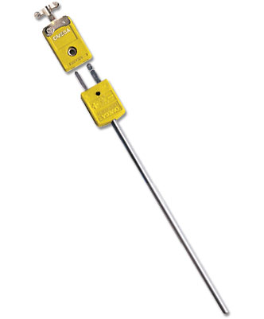
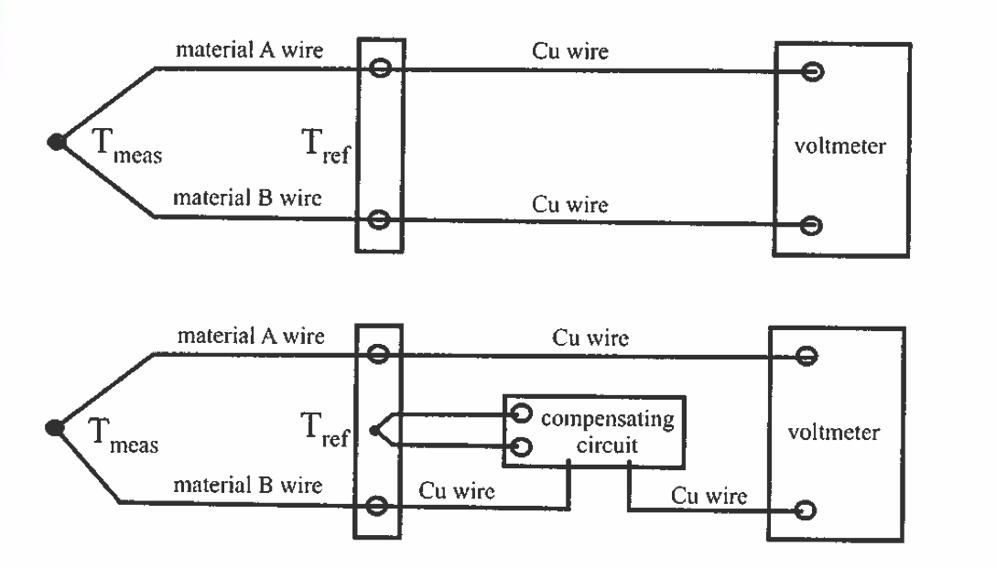

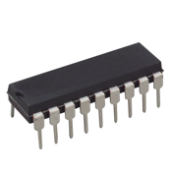
A10 - Thermocouple
Two different metals form a junction – Seebeck or Thermoelectric effect
Thermocouple “type” refers to what metals it uses (Type K, Type J, etc.)
1% accuracy over a wide a temperature range!
Omega.com
Fig. 4.18
IC chip to amplify and linearize the output such that V = (10 mV/C)*T

Slide 6

A10 - 1st Order Response
Response to an “impulse”
Thermocouple (TC)
“1st order response”

Slide 7
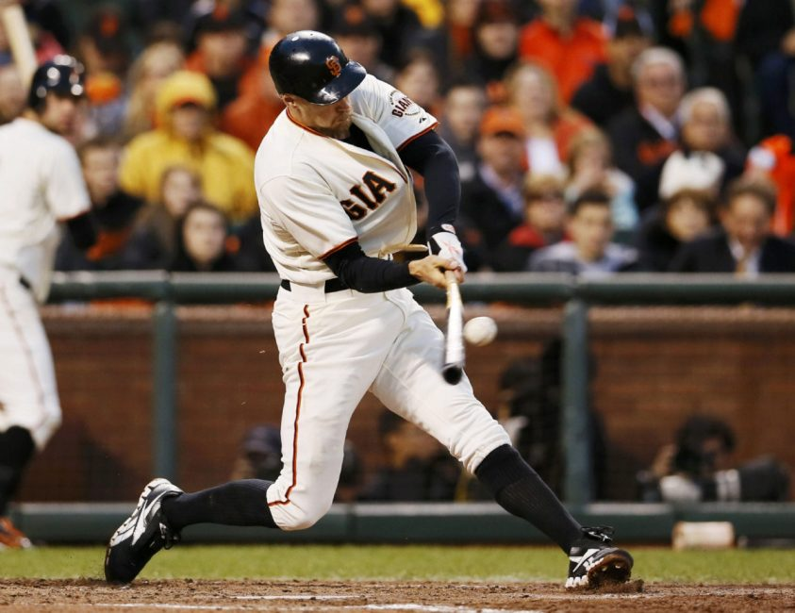
A10 - Cantilever Vibrations
Baseball bat undergoes cantilever vibrations after striking a ball.

Slide 8
Fourier Transform
“Spectral Density”
AMPLITUDE vs. FREQUENCY
AMPLITUDE vs. TIME
FFT
PHASE vs. FREQUENCY

