Slide 1
AME20216 - Lab I L12 – Transient Signals

Slide 2
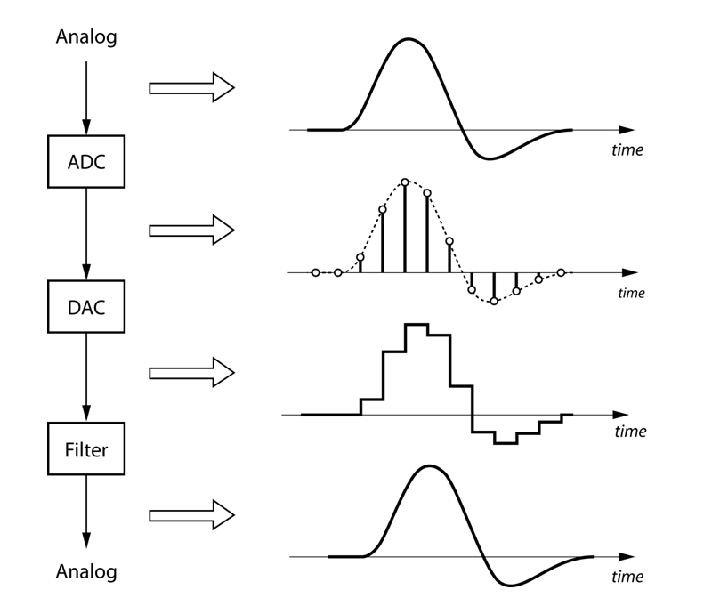
Sampling Frequency and Nyquist Criterion
Quality of a digital signal depends on the Sampling Frequency f_{S}
Discrete Digital
“Continuous” Analog
Nyquist Criterion – The maximum frequency component that can be resolved is half the sampling frequency

Slide 3
Sampling Frequency
Engineering Trade-off:
high quality data
Large f_{s}
large data files
low quality data
Small f_{s}
small data files

Slide 4
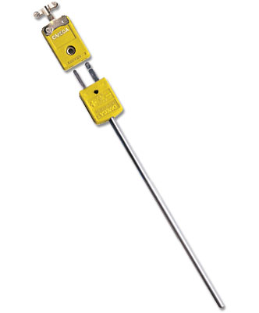
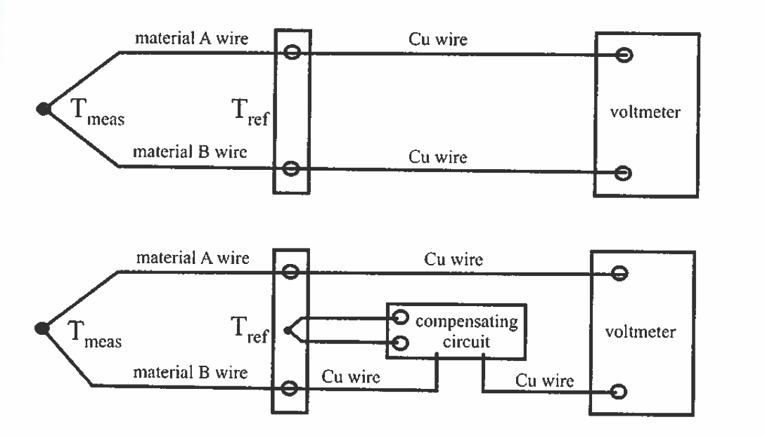

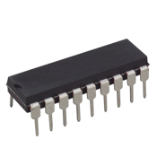
A10 - Thermocouple
Two different metals form a junction – Seebeck or Thermoelectric effect
Thermocouple “type” refers to what metals it uses (Type K, Type J, etc.)
1% accuracy over a wide a temperature range!
Omega.com
Fig. 4.18
IC chip to amplify and linearize the output such that V = (10 mV/C)*T

Slide 5
A10 - 1st Order Response
Thermocouple (TC)
“1st order response”
Response to an “impulse”

Slide 6
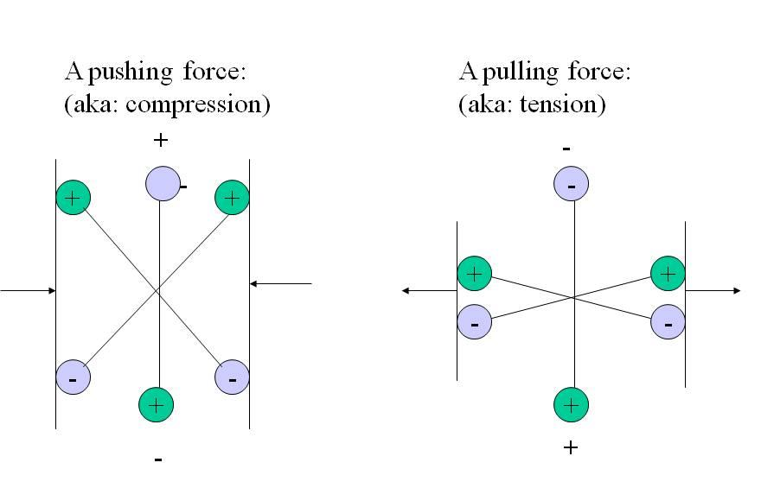
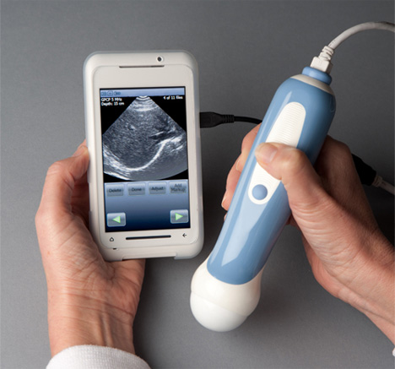
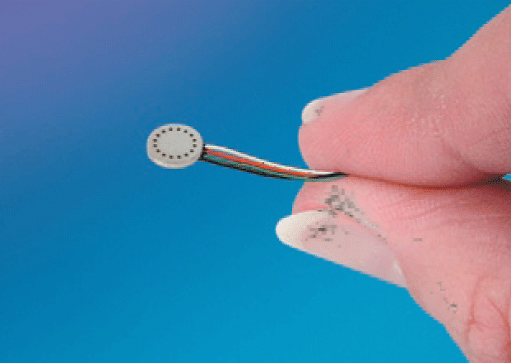
A10 - Piezoelectric Pressure Transducer
Piezoelectric crystals produce a voltage when deformed
voltage
Pressure
+
+
+
+
-
-
-
-
Kulite Sensors - DC
Ultrasound - AC

Slide 7
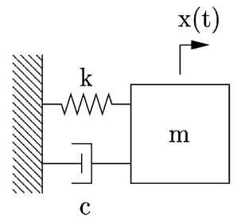
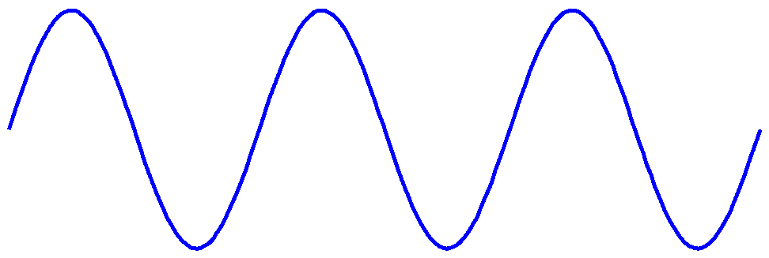
A10 - Piezoelectric Pressure Transducer
Function generator
Oscilloscope
Piezo
Transmitter
Piezo
Receiver
Acoustic
waves

Slide 8
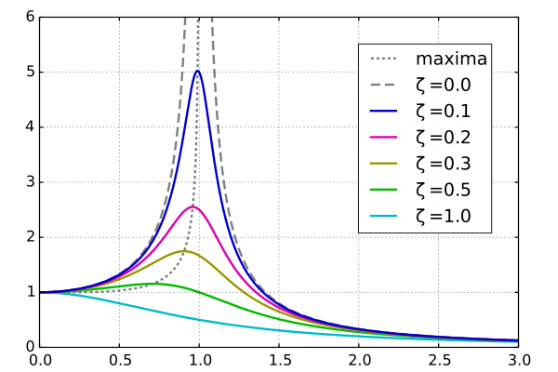
A10 - 2nd Order Response
2 important parameters: resonance frequency ω₀ and damping ratio ζ
Driven response, amplitude vs. freq.
Damping ratio
ζ < 1 underdamped
ζ = 1 critically damped
ζ > 1 overdamped
ω/ω₀

