Slide 1

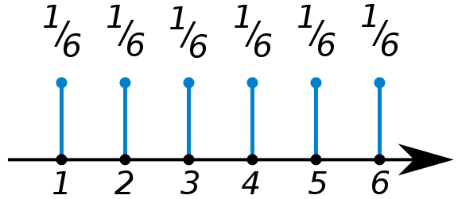
Discrete Probability Distributions
P(n) – Probability of observing the nth discrete value
P(n) =
n =
Normalization
Mean or “expected value”
<n> = 3.5

Slide 2

Binomial Distribution
Probability an event A occurs v_{A} times out of N trials, given the prob. of seeing it once is P(A).
N= 60
N= 600
P(A)=1/6
P(A)=1/6

Slide 3
Measuring Probability – Poisson Statistics
“Counting” experiments.
Uncertainty in Measured Probability
Measured Probability
N= 60
N= 600
P(A)=1/6
P(A)=1/6
“Statistical Convergence”

Slide 4



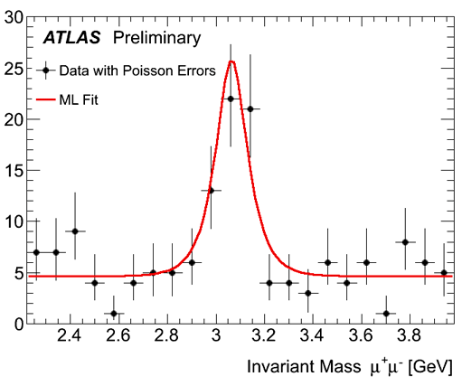
Measuring Probability – Poisson Statistics
“Counting” experiments.
http://www.bbc.com/news/world-us-canada-43818752

Slide 5
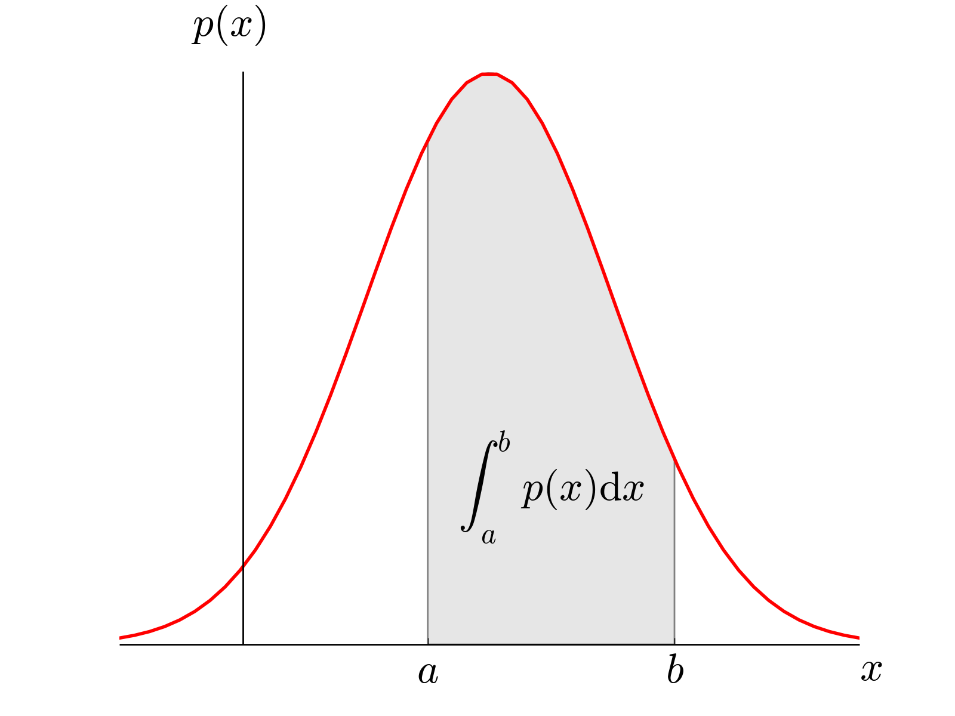
Continuous Probability Distributions
ρ(x) – Probability Density Function
Probability x is between a and b:

Slide 6
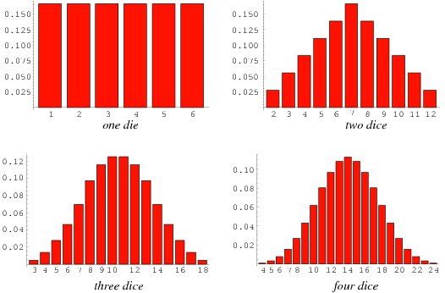
Central Limit Theorem
http://mathworld.wolfram.com/Dice.html

Slide 7
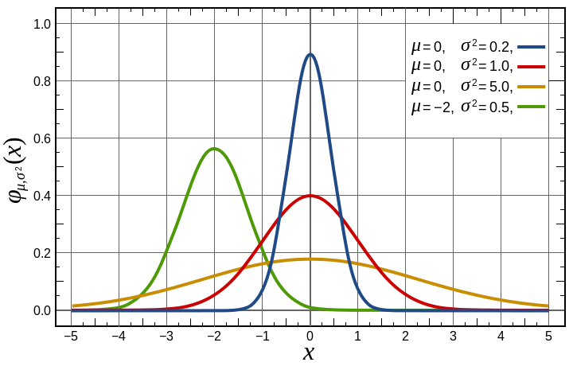
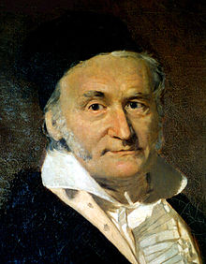
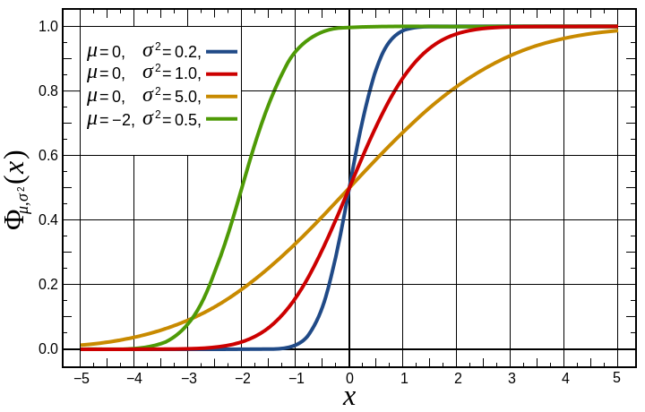
Gaussian Distribution
Gaussian PDF
Central Limit Theorem – For large N, most distributions become Gaussian
Gaussian CDF
Carl Friedrich Gauss (1777-1855)

Slide 8
Measuring Probability
Poisson Statistics
Discrete “Counting” experiments.
Continuous Distributions
Determine and standard deviation to “curve fit” histogram with PDF
Measured Probability

Slide 9


Product Safety
People’s lives are in your hands!
United Airlines Flight 811
Aloha Airlines Flight 243
Insufficient locking mechanism on cargo bay door of Boeing 747.
Rupture in fuselage roof of Boeing 737.

Slide 10
Ethical Handling of Data
When is it OK to throw out data?
Value is physically impossible
Equipment incorrectly set up or malfunctions
True statistical outlier -> Grubbs’ Test

Slide 11
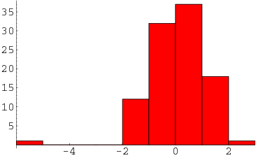
Ethical Handling of Data
Why might it be unethical to throw out data?
What are some legitimate reasons to disregard data?
Outliers ➔ Grubbs’ Test
True outlier if:
For N > 50
http://mathworld.wolfram.com/Outlier.html

Slide 12
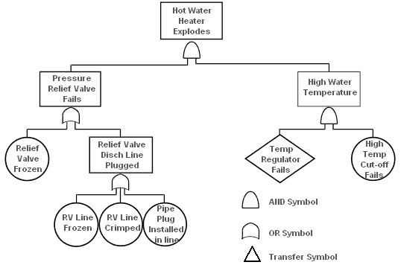
Probability and Statistics in Engineering

Slide 13
Other Courses in Probability
AME50561 – Reliability in Engineering (Ovaert)
ACMS10145 – Stats for Business I
ACMS20340 – Statistics for Life Sciences
ACMS30530 – Intro to Probability
ACMS30540 – Mathematical Statistics
ACMS30600 – Stat Methods & Data Analysis
ACMS37020 – Projects in Actuarial Science
ACMS40875 – Stat Methods in Data Mining
MATH40210 – Basic Combinatorics
PHYS70152 - Intro to Network Science

