Slide 1
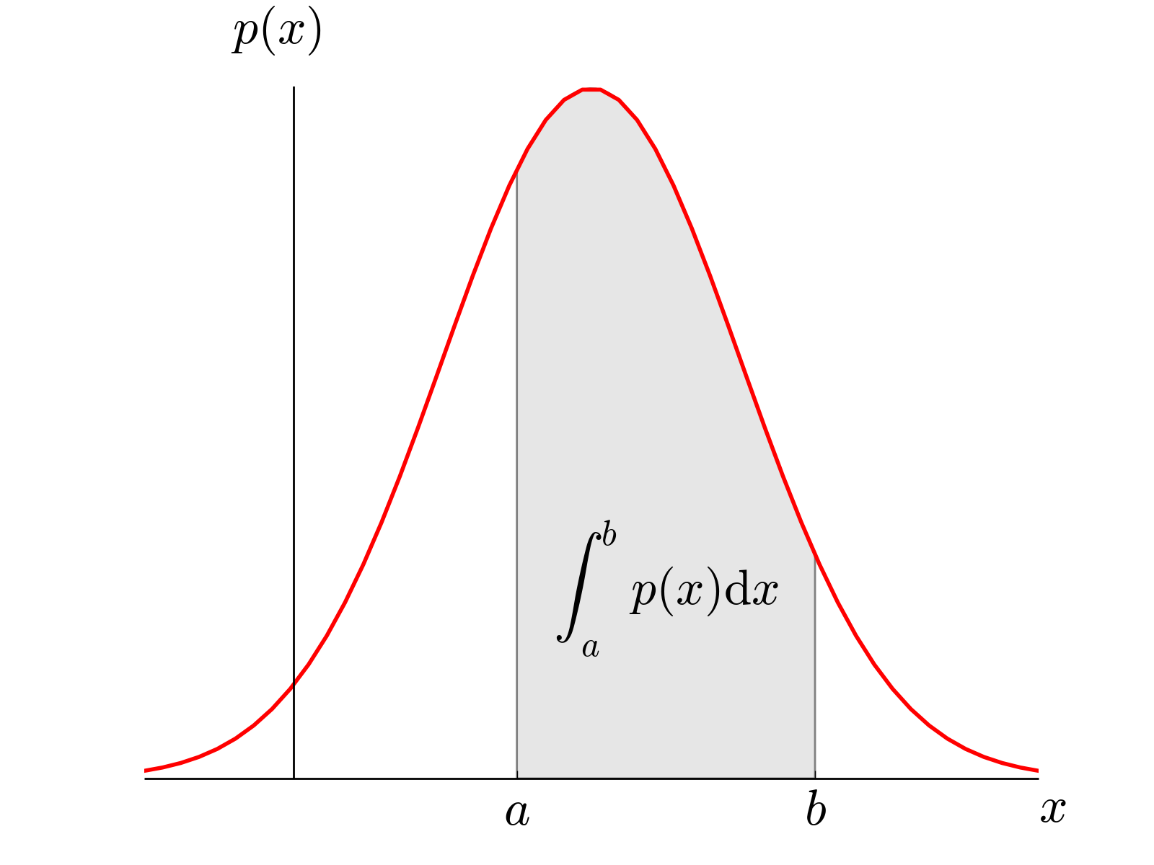
Continuous Probability Distributions
ρ(x) – Probability Density Function
Normalization
Mean or “expected value”

Slide 2
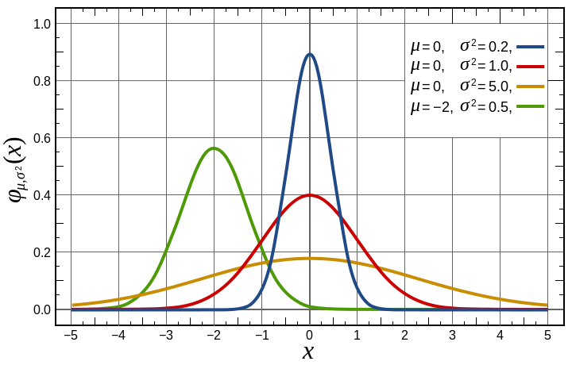
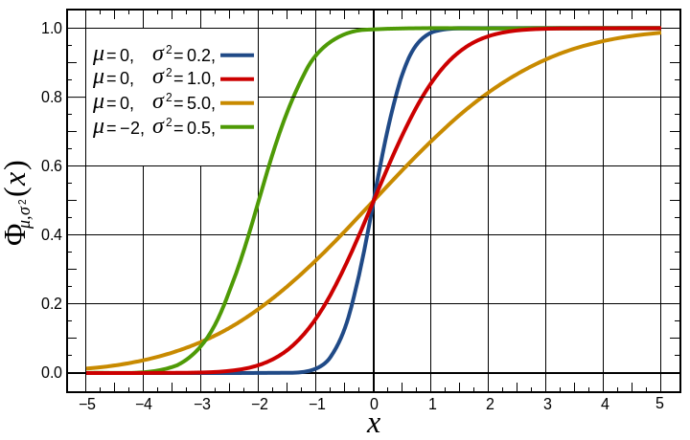
Gaussian Distribution
Central Limit Theorem – For large N, most distributions become Gaussian
Gaussian PDF
Gaussian CDF

Slide 3
Probability Density Functions
Calculate mean and standard deviation.
➔Use CDF or z-table to compute probability.
We are essentially “curve fitting” the discrete histogram with a continuous PDF.

Slide 4

Measuring Probability
Poisson Statistics
Discrete “Counting” experiments.
Continuous Distributions
Determine and standard deviation to “curve fit” histogram with PDF
Measured Probability

Slide 5
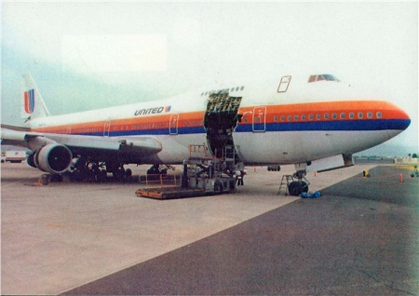

Product Safety
People’s lives are in your hands!
United Airlines Flight 811
Aloha Airlines Flight 243
Insufficient locking mechanism on cargo bay door of Boeing 747.
Rupture in fuselage roof of Boeing 737.

Slide 6
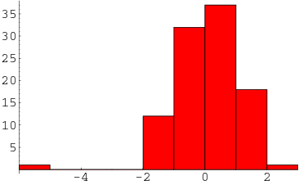
Ethical Handling of Data
Why might it be unethical to throw out data?
What are some legitimate reasons to disregard data?
Outliers ➔ Grubbs’ Test
True outlier if:
For N > 50
http://mathworld.wolfram.com/Outlier.html

Slide 7
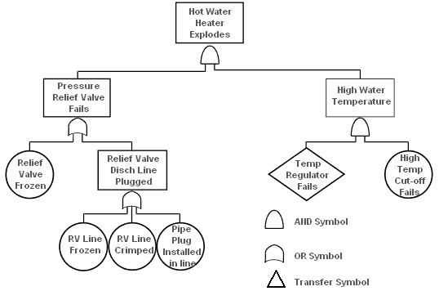
Probability and Statistics in Engineering

Slide 8
Other Courses in Probability
AME50561 – Reliability in Engineering (Ovaert)
ACMS10145 – Stats for Business I
ACMS20340 – Statistics for Life Sciences
ACMS30530 – Intro to Probability
ACMS30540 – Mathematical Statistics
ACMS30600 – Stat Methods & Data Analysis
ACMS37020 – Projects in Actuarial Science
ACMS40875 – Stat Methods in Data Mining
MATH40210 – Basic Combinatorics
PHYS70152 - Intro to Network Science

