Slide 1
AME20216 - Lab I A2 – Galileo’s Inclined Plane

Slide 2

A1 – Meterstick Measurements

Slide 3
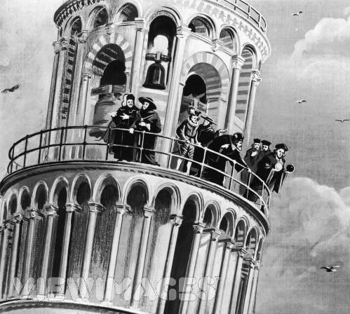
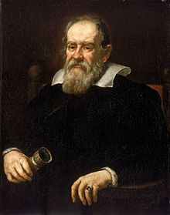
Gravity
Galileo Galilei 1564 - 1642
Apollo 15 Feather vs. Hammer
Inclined Plane

Slide 4
A2 – Galileo’s Inclined Plane
Galileo empirically found that
x
θ

Slide 5
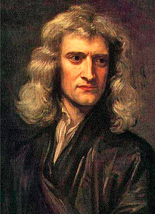
Interpreting Data
Sir Isaac Newton 1642 - 1747
According to Newtonian physics for a ball rolling down an inclined plane:

Slide 6
A2 – Galileo’s Inclined Plane
Measure time t to roll distance x.

Slide 7
A2 – Galileo’s Inclined Plane

Slide 8
A2 – Extrapolating g

Slide 9
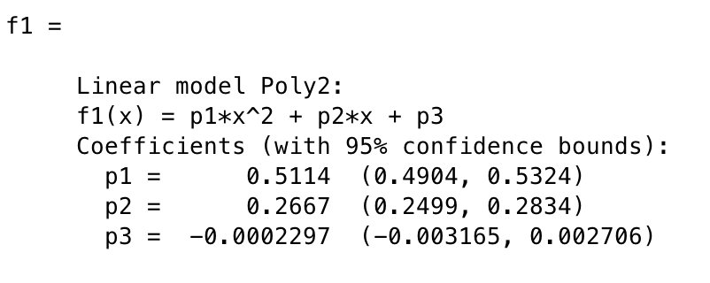
A2 – Using “fit()” command
θ = 8.1°
Uncertainty in p1
Uncertainty in g
0.5324 m/s²
10.6320 m/s²
0.5114 m/s²
10.2121 m/s²
g = 10.2 ± 0.4 m/s²
0.4904 m/s²
9.7933 m/s²

