Slide 1
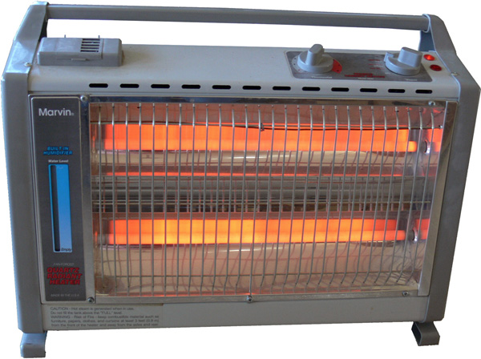
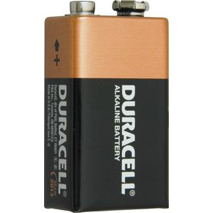
Non-ideal Power Supply
Power supplies and batteries have an “internal resistance” or “output impedance” that limits the amount of current it can output.

Slide 2
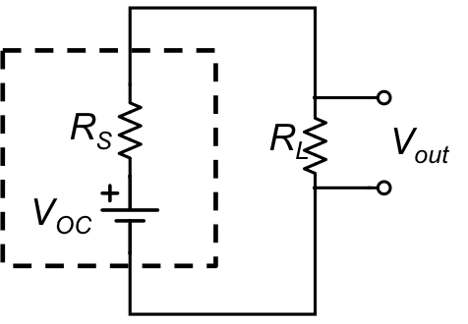
Non-ideal Power Supply
Power supplies and batteries have an “internal resistance” or “output impedance” that limits the amount of current it can output.
Voltage “Droop”

Slide 3
Non-ideal Power Supply
Power output depends on load resistance R_{L}
q_{L}
Max power occurs when
R_{L} = R_{S}
“Impedance matching”
R_{L}

Slide 4
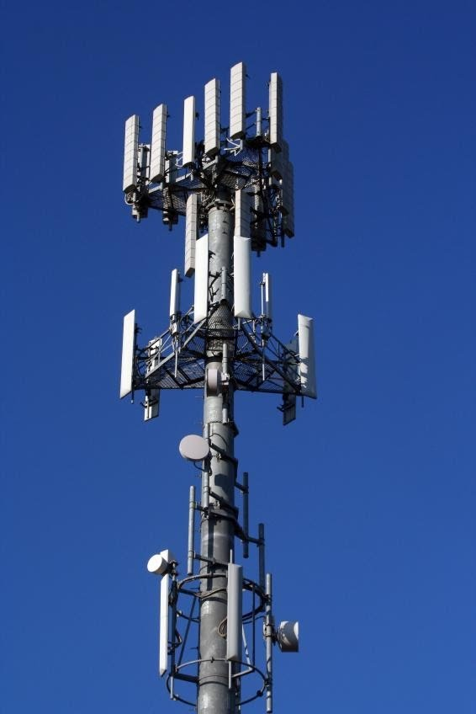
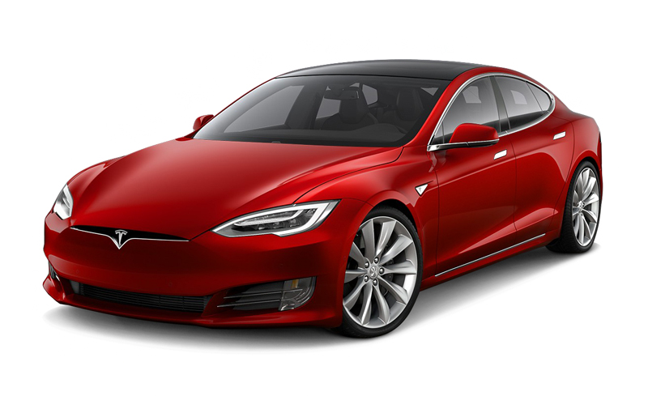
Impedance Matching
Max power always occurs when load resistance matches internal resistance of power supply.

