Slide 1
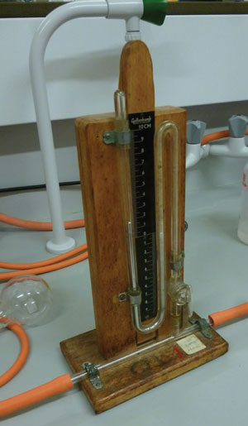
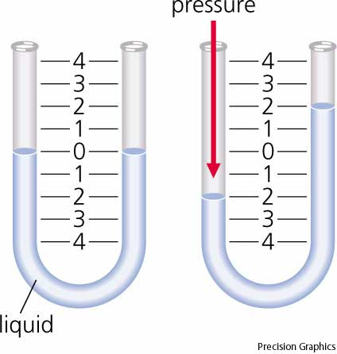
Manometer
Measures pressure

Slide 2
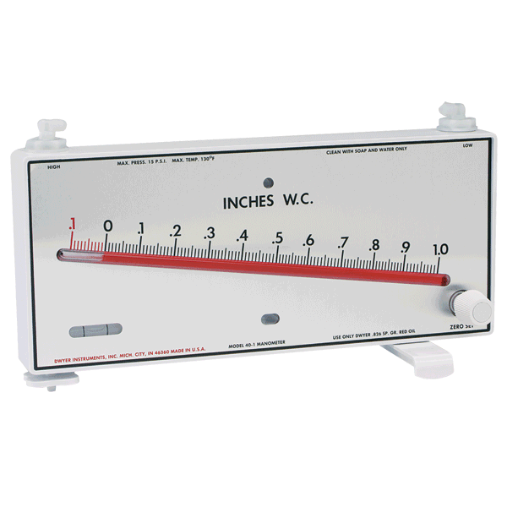
Sensitivity
U-tube Manometer
Less sensitive
Greater range
Inclined Manometer
More sensitive
Less range
http://www.dwyer-inst.com

Slide 3
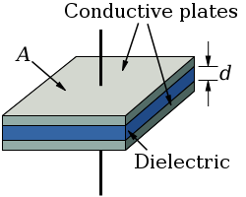
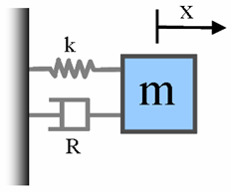
Capacitive Sensors
h
h
Spring mass system
Hook’s law
Accelerometer
Pressure
www.mathworks.com

Slide 4
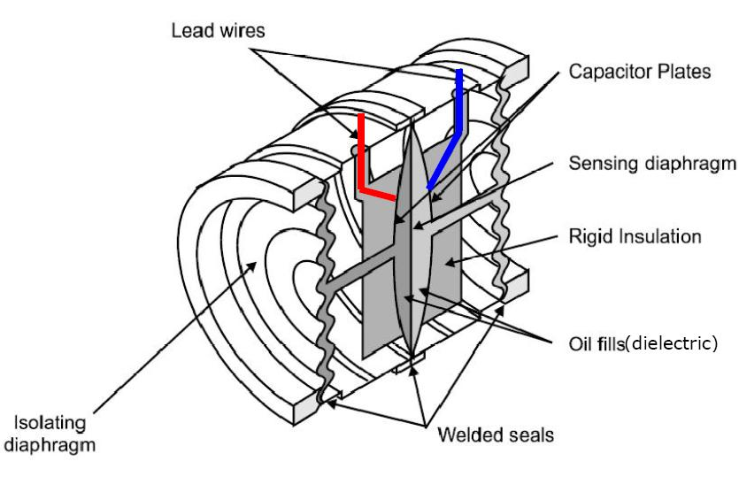
Capacitive Pressure Transducer
Pressure pushes capacitor plates closer together
Capacitive presssure sensor
C_{OUT}
Capacitance-to-voltage IC chip
V_{OUT}

Slide 5
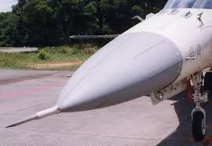
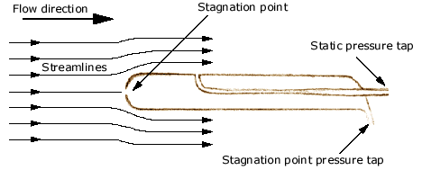
Pitot Static Probe
Measures fluid velocity u using Bernoulli’s law

Slide 6
Calibration

