Slide 1
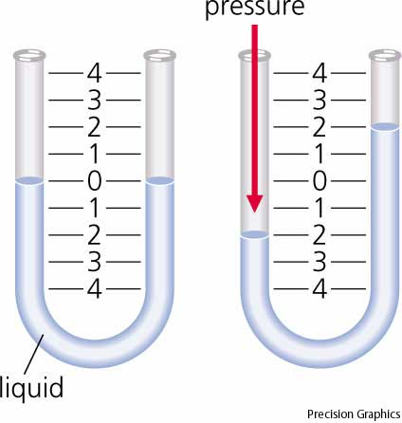
Transducer
Converts a physical stimulus to a length or voltage
Manometer
Pressure
Length
Capacitive Pressure Sensor
Pressure
Voltage
Analog sensor – outputs a voltage

Slide 2
Alternating Current

Slide 3
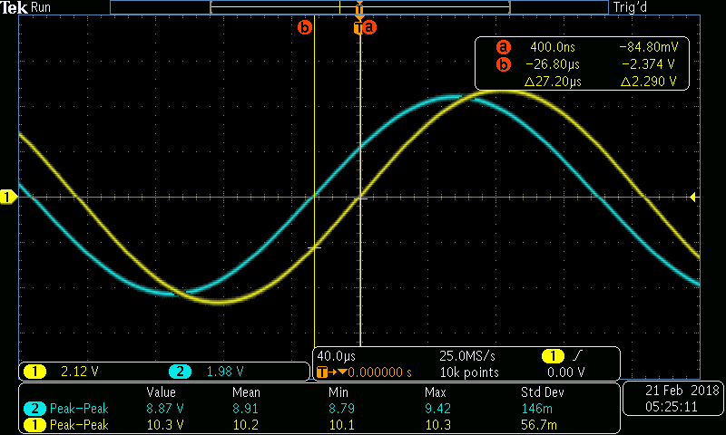
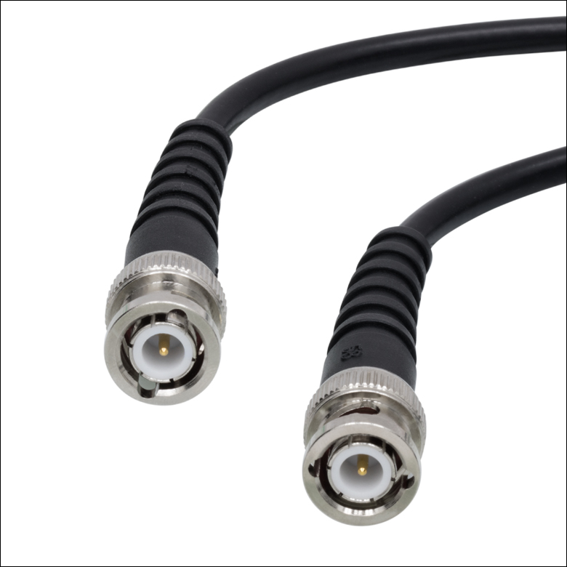
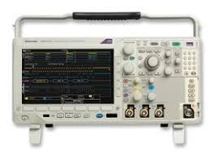
A5 – Electronics II
Oscilloscope
Coaxial Cable

