Slide 1
AME20216 - Lab I Continuous Probability Distributions

Slide 2
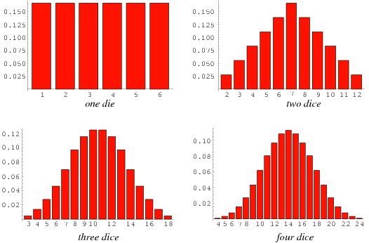
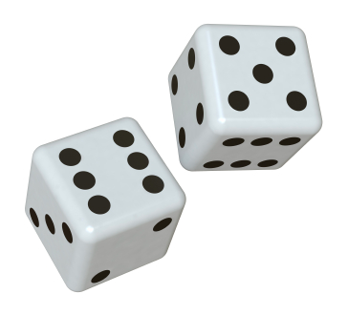
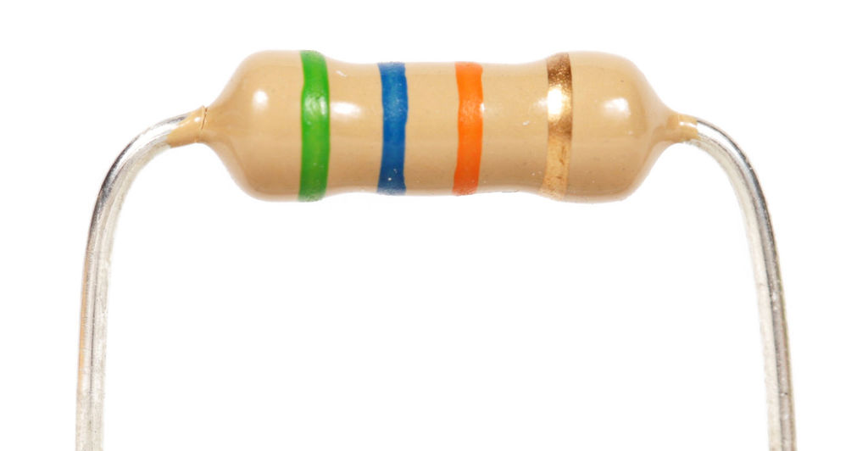
A12 – Monte Carlo Night!
Pair of Dice
Manufactured Resistors

Slide 3
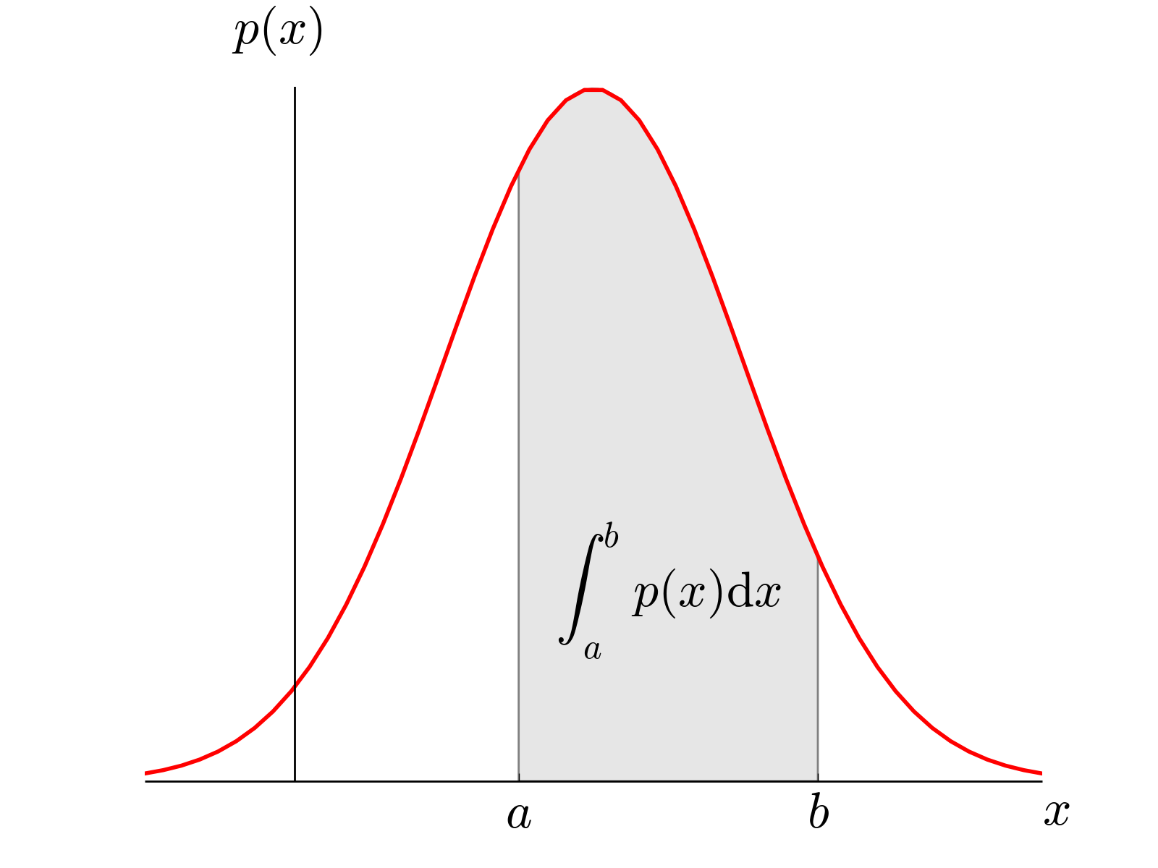
Continuous Probability Distributions
ρ(x) – Probability Density Function
Probability x is between a and b:

Slide 4
Central Limit Theorem
http://mathworld.wolfram.com/Dice.html

Slide 5
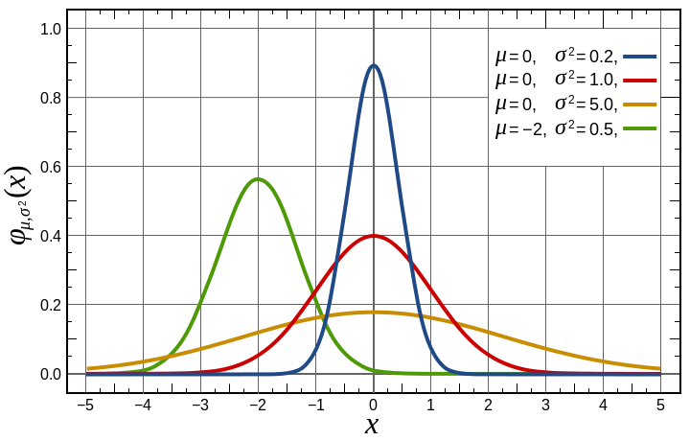
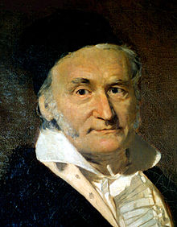
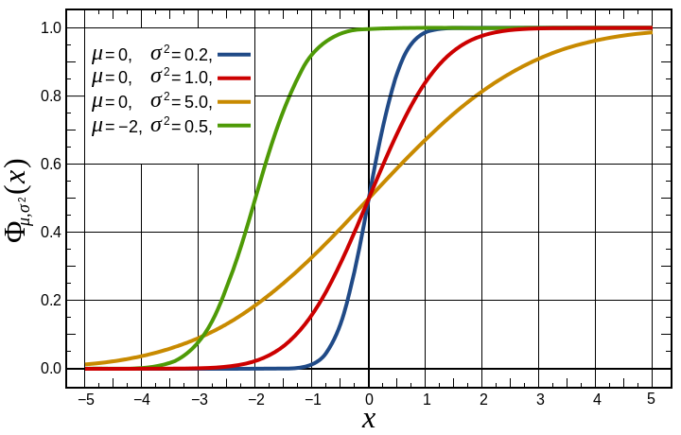
Gaussian Distribution
Gaussian PDF
Central Limit Theorem – For large N, most distributions become Gaussian
Gaussian CDF
Carl Friedrich Gauss (1777-1855)

Slide 6
Gaussian Distribution
Central Limit Theorem – For large N, most distributions become Gaussian
Gaussian PDF
Gaussian CDF

Slide 7
Z-table

