Slide 1

AME20216 – Lab I
Lab Overview
Fall 2017

Slide 2
Basic Expectations
Be Present (physically and mentally)
Attendance is Mandatory
Un-excused absence => No credit
For credit => Contact TA and obtain a University Excused Absence Form
– Late arrivals (to Lab)
– No outside work
– No cell phones
Early is on time, on time is late
50% penalty on Lab Notebook
Be Prepared
Complete the Pre-lab quizzes.
Try to bring a flash drive.
Ask questions about the lab procedure if anything is unclear.

Slide 3

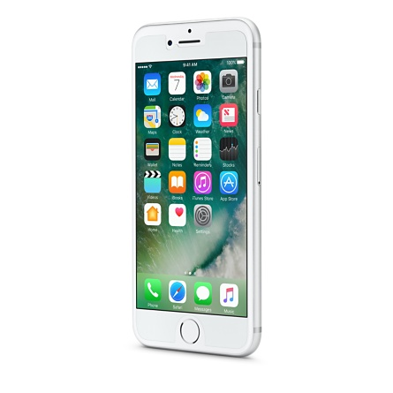
NO CELL PHONES IN LAB!

Slide 4
Basic Expectations
Be Respectful
Pay attention to directions from the Instructors
NO CELL PHONES
Follow directions when they are given
Treat equipment with care!
Be aware of what you are doing
DO NOT perform an exercise until you are exactly sure what you are doing (i.e. be deliberate)
Be Safe
Failure to follow safety guidelines results in ejection from lab, and no credit for assignment.
Why?

Slide 5


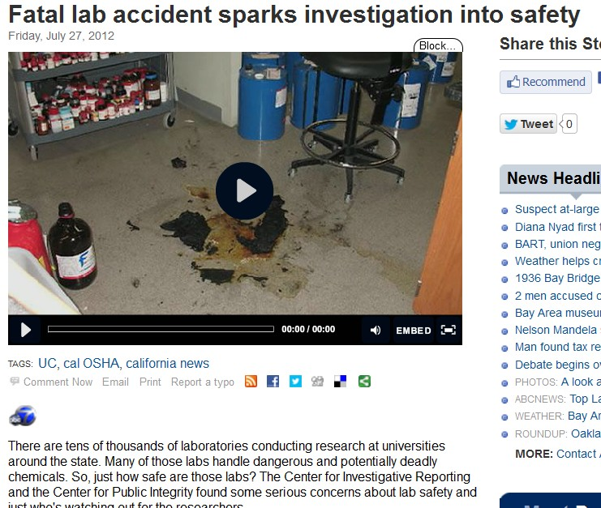

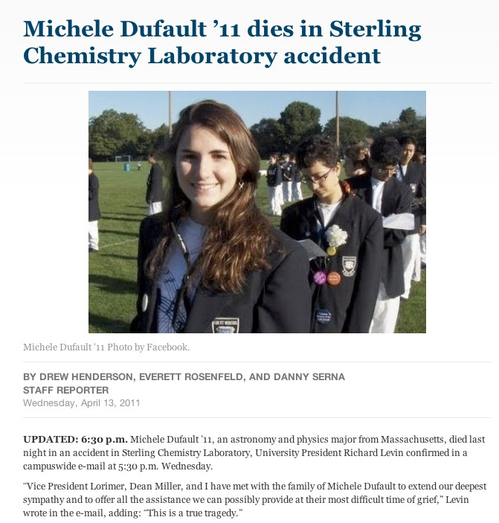




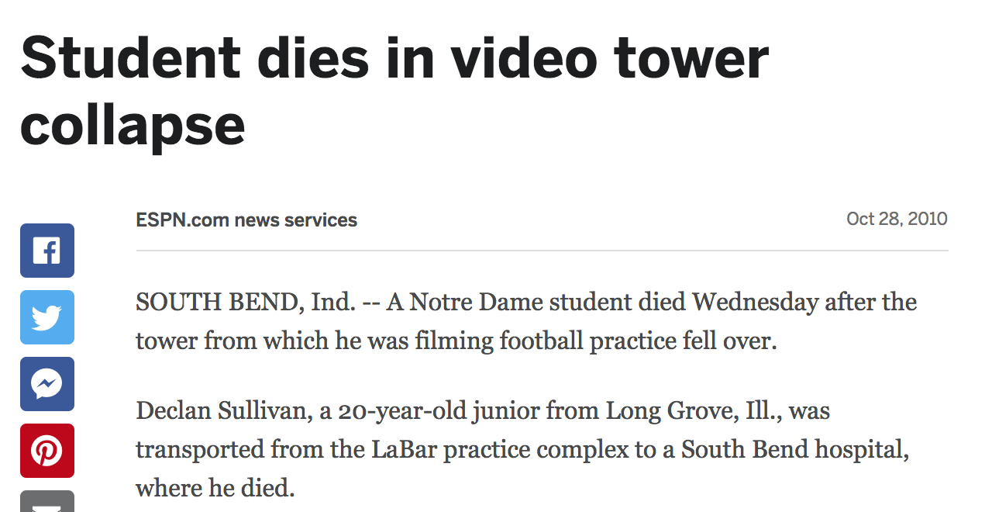
Lab Safety: Motivation

Slide 6

Lab Safety:
Ground Rules
Safety is priority #1 for everyone in the lab.
No Food/Beverage
No Horseplay
No Headphones
No Cell Phones
Pay attention: Do not be careless
Only use areas of the lab designated for AME20216
Be aware of your surroundings
– Carelessness with equipment can hurt you and your neighbors
If you are not 100% sure what you are doing is right or safe, STOP, and ASK for help!

Slide 7
Lab Safety:
B14 Lab Safety and PPE Documentation
Notebook on Counter Top
Personal Protective Equipment (PPE)
Safety Glasses
Emergency Action Plan
Fire
Tornado
Chemical Spill Kit
Floor-Dry
Absorbative Blanket

Slide 8
Lab Safety
Laboratory Dress Code
Closed toed shoes
[No Flip-flops], you will be made to
change prior to beginning a lab
Avoid excessively baggy clothing
Use hair ties
Keep long hair up/away from face & equipment
Remove (or tape down) loose jewelry
Hazard for lasers, machinery w/ moving parts, etc.
Vision-correction:
Use your most recent prescription glasses/contacts.

Slide 9
Course Structure
Total of 12 Lab Exercises (A1- A12)
Pre-Lab Lecture
Thursday before Lab
Content: Lab handouts and materials
75% of total grade is lab
Pre-Lab Quiz (10 %)
Lab Notebooks (10%)
2 Lab Reports (20 %)
Lab Plots and Deliverables (30%)
Lab Final (5%)
All lab work is done in Groups of 2, but deliverables are turned in individually

Slide 10
Lab Calendar

Slide 11

Lab Notebooks
Lab notebooks must be signed by the TA or instructor before the end of lab.
Guidelines can be found on the course website.
This Notebook is the official one, and is the only one you should use.

Slide 12
Lab Reports and Deliverables
Deliverables can be found at the end of every lab handout.
Deliverables must be turned in the following week at the beginning of lab.
A score sheet for the particular lab must be attached to the deliverables. A one point deduction will be applied for failure to do so.
Error analysis. A deduction will be applied for any use of the term “human error”.

Slide 13
Policies
BOTH the Lab TA and Prof. Rumbach should be included on all emails to ensure an accurate and prompt response
Regrade requests must be made within a week of receiving the graded assignment.
Regrade requests should be made in office hours or at the end of lab.
Late assignments will receive a deduction of 30% off each working day that they are late.
There will be no extensions or make-up quizzes for the lab for computer malfunctions. It is the student’s responsibility to know how to use Sakai.

Slide 14
Academic Honesty
Academic Dishonesty: Claiming work as your own when it is someone else’s. This includes:
Copying exams/quizzes
Copying text from another student’s report
Copying figures from another student’s report
Using another student’s Matlab code
Posting answers to websites like chegg.com or scribd.com
Allowing your partner to do all the laboratory work
These will not be tolerated!
Violators will be handed over to the Dean!

Slide 15
2 Lab Reports
Sample Lab Report
Writing Guidelines
(From Dunn, Ch 12)
Format for Submission
Use Technical Memo template - Dunn (pg. 447)
6 Pages, double-spaced (Appendices are typically not necessary)
References and footnotes single spaced 1” Margins
All reports must be type written, including equations.
NO CODE ATTACHED
Content
Write in 3rd person, past tense
Proper grammar is required.
Active voice is best. (link)
Do not use contractions
No superfluous tables or figures
Do not re-iterate the experimental procedure Abbreviations must be Defined in Text (DIT) Numbers & Units: Dunn 12.2.3
Date: 05/01/1962
To: U.S. D.O.D. Nuclear Research Committee
From: Dr. R. B. Banner Subject: Gamma Ray Research
Summary
This should be one paragraph that summarizes the important results and states the significant conclusions. When writing this section, assume that this may be the only part of the technical memo that actually is read. Include the most important numerical values you determined.
Findings
This part covers in more detail what was summarized above. Enough information must be provided such that an engineer at your level could critically evaluate the approach and methods and understand how you arrived at the results and conclusions, without your providing any information beyond what is written. Only the most important figures and tables need to be included here.
Conclusions
This section needs to tie everything together and state what the big take-away should be.
References
Student, N.O.D., and S.A.M. College. 2010. Measurements through a hard semester. J Heat Mass Transfer 11:548-556.
M.A. Saad. 1992. Compressible Fluid Flow. 2nd ed. New Jersey: Prentice Hall Inc.
Appendices
These addenda contain supplementary material, such as detailed derivations or calculations. They are not meant to contain a record of everything that was done on the memo’s subject. Include only what is needed to support material presented in the body of the memo. Do not place the results here and then refer to them from the memo.
Acronyms/abbreviations must be spelled out on first use.
Define all variables used in equations. (e.g. is V volume or volts)

Slide 16
Technical Memos: Schematics
Schematics…
Have descriptive captions BELOW the schematic with brief descriptions of what is being depicted
A white or transparent background WITHOUT a border
Parts should be labelled with what they represent
Schematics can be made on any design software (creo, powerpoint, and other illustration software) but put some time into the design.
Do not just take a screen shot of a creo model.
Sill TJ & von Recum HA. Biomaterials (2008)
Figure x: Schematic of electrospinning. An electric field is applied to a polymer solution being ejected at a constant rate in the direction of a grounded target. The polymer solution is carried through air by an electric field to become fine fibers that are deposited on a rotating and/or translating mandrel to produce a fibrous mesh.

Slide 17


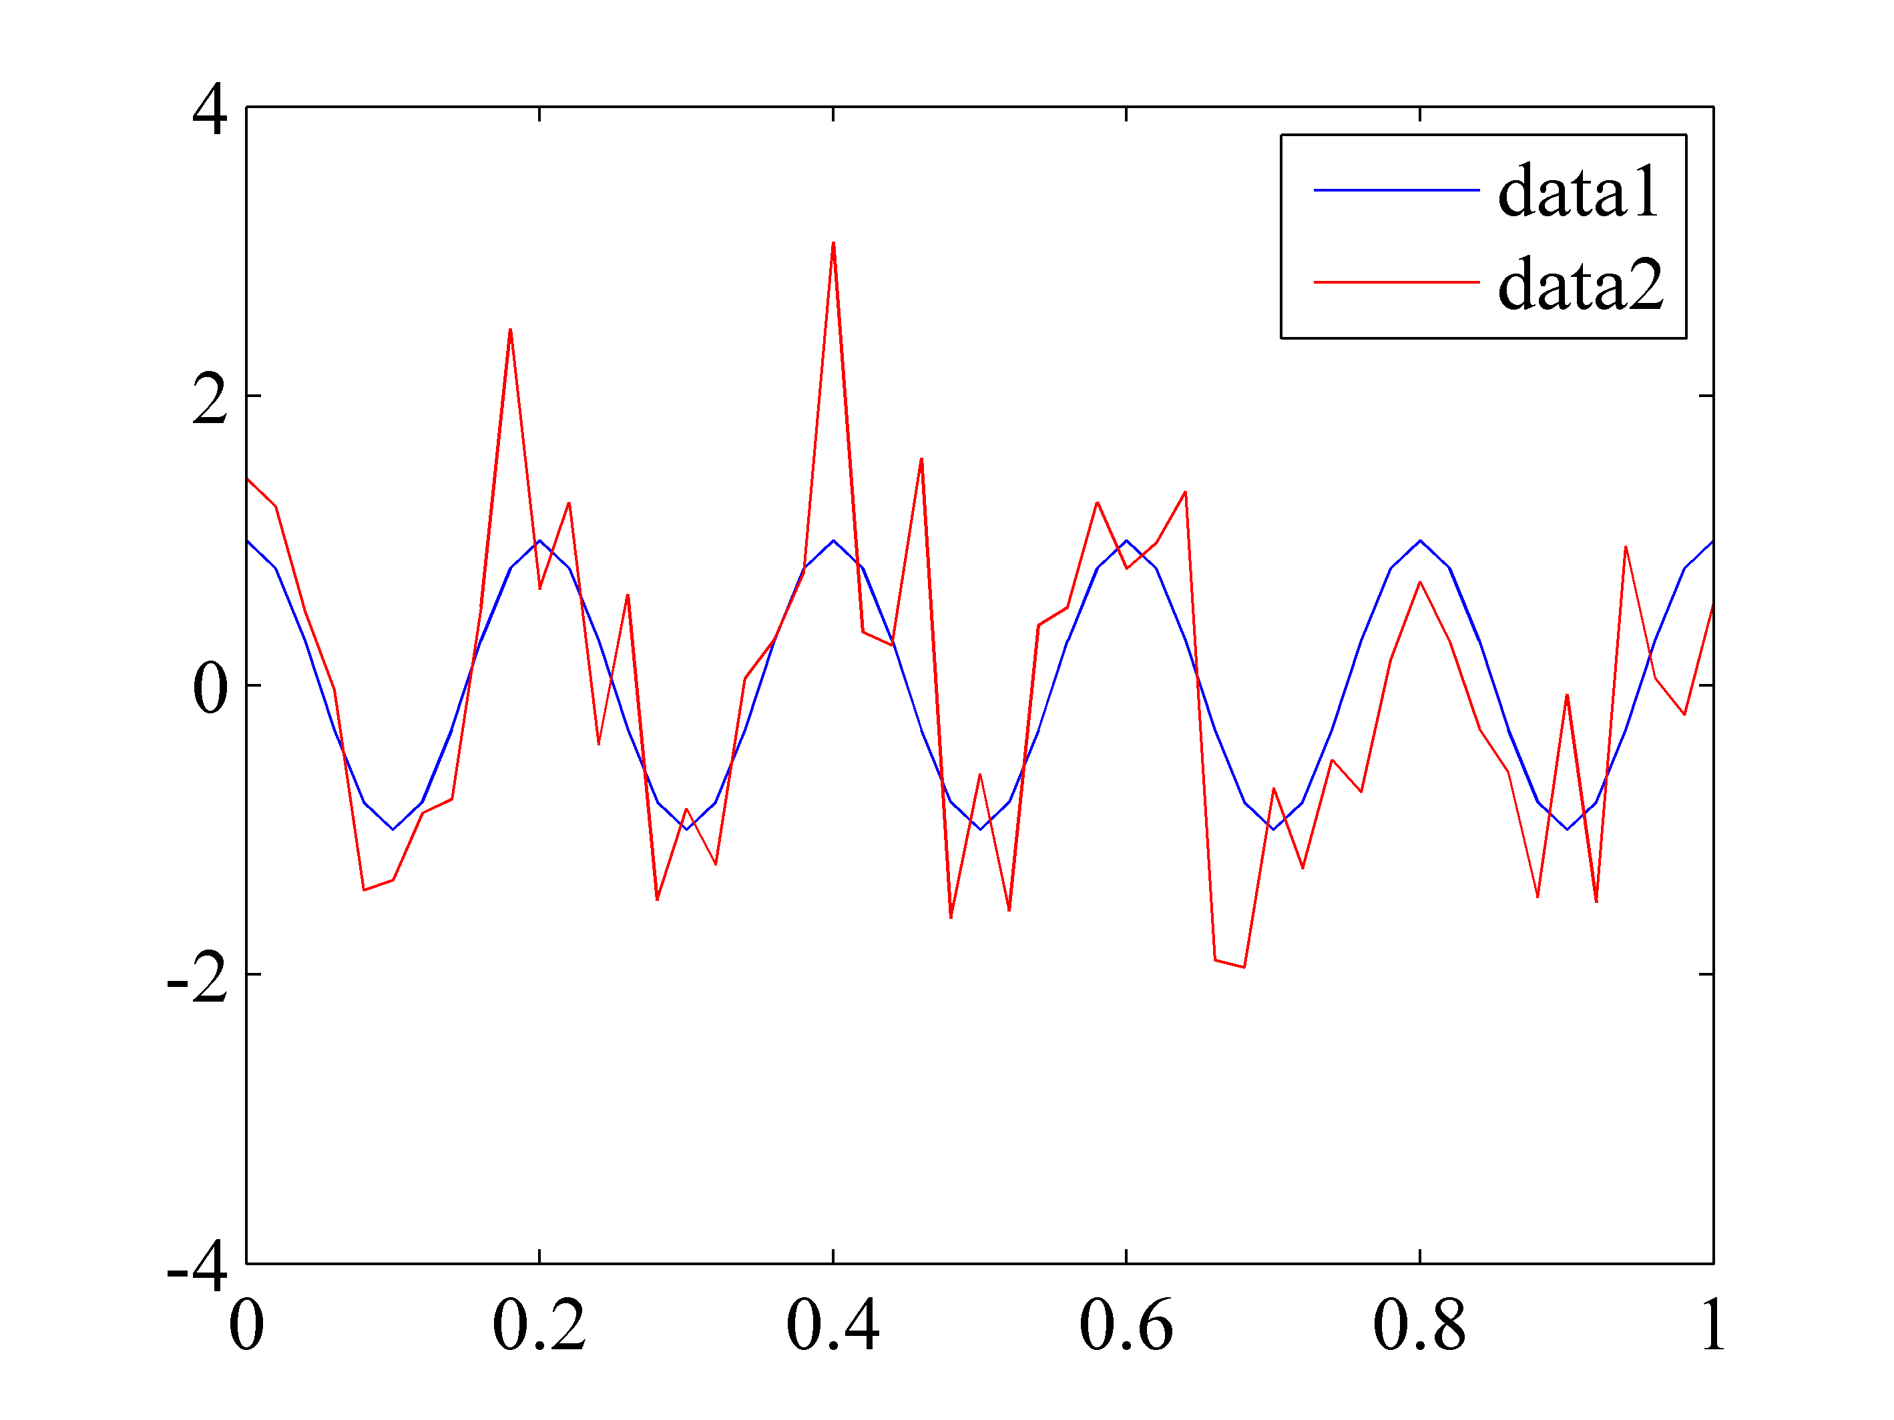
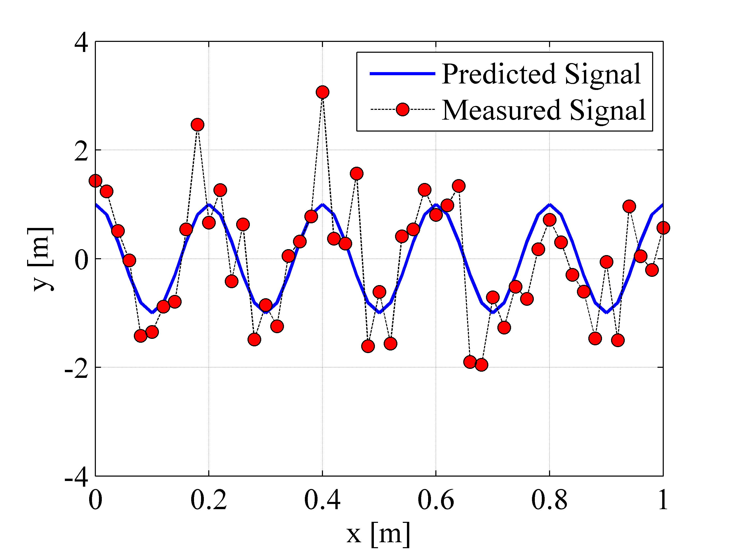



Technical Memos: Figures
Plot continuous functions as continuous lines Plot discrete data points as points
Figures should have…
White/clear background
NO Border (ie excel default)
Legends
Axis labels
No Title
Figure captions (below)
Should have large axis labels
Make legends and titles large
I(amps)
t(secs)
Figure. Comparison of theory and experiment.
Figure 1. Comparison of system output predicted from equation (3) and experimental measurement.
Figure numbers, captions, axis labels, and units are required on
all figures included in technical memos
MatLab is preferred over Excel. Mathworks file exchange: ExportFig.
Figures must be legible. May have two that are side-by-side.

Slide 18
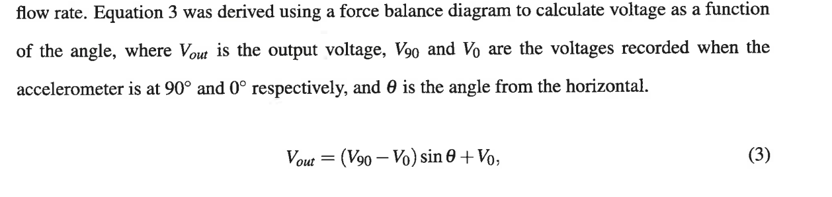
Technical Memos: Tables & Equations
Equations should have…
An identifying number to the right that is referenced in text, i.e. Eq. (2)
Variables should be defined in text
Include line fit equations in text and describe variables.
Make sure equations are separated from the body of Text by empty lines on the top and bottom

Slide 19
Technical Memos: Tables
Tables should have…
Table captions ABOVE the table
Both table and figure captions should be descriptive
Units should be given if applicable
Tables and figures should contribute to understanding your results

