Slide 1

DANDY STUFF
Stuffed animal shop

Slide 2
Team
Quân(Daniel)
Chinh
Khanh

Slide 3
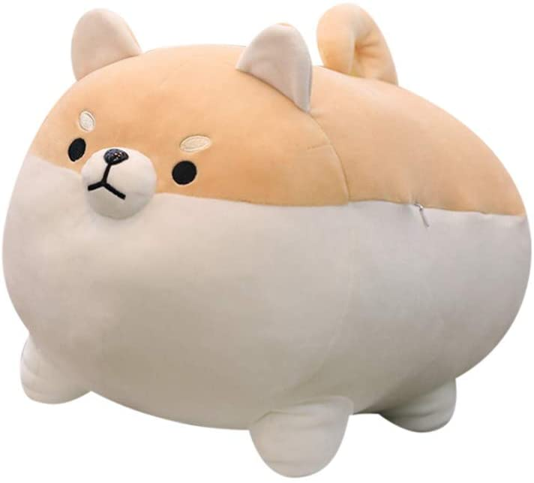
Presentation:
Introduction
About us and the website
Website’s Home Page
Website’s Contact
Development Process
Coding
Hosting

Slide 4
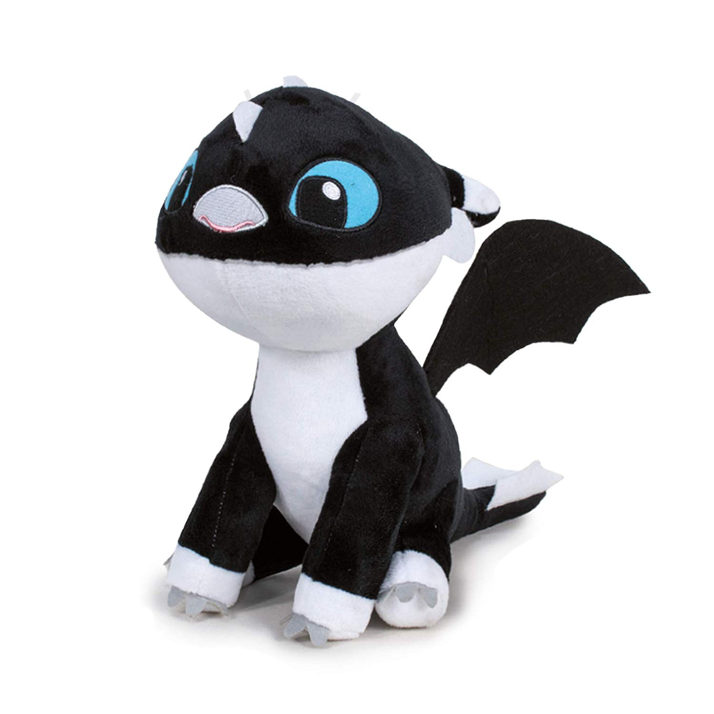
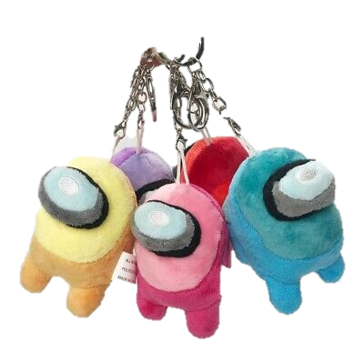
Introduction
About us the website
Dandy Stuff was started from our love of animals and animal toys, especially stuffed animals.
But it seems like a lot of places only carry stuffed dogs, cats, and bears - not the more unusual ones that we like to collect. The more unusual it is, the more we like it.
That's where the idea for Dandy Stuff was born. We want to offer only the best quality stuffed animals that are super cuddly, fun, unique, and “dandy”.
Besides stuffed animals, we’ve expanded our shop to have a variety of adorable and unique keychains made out of smaller stuffed animals!

Slide 5
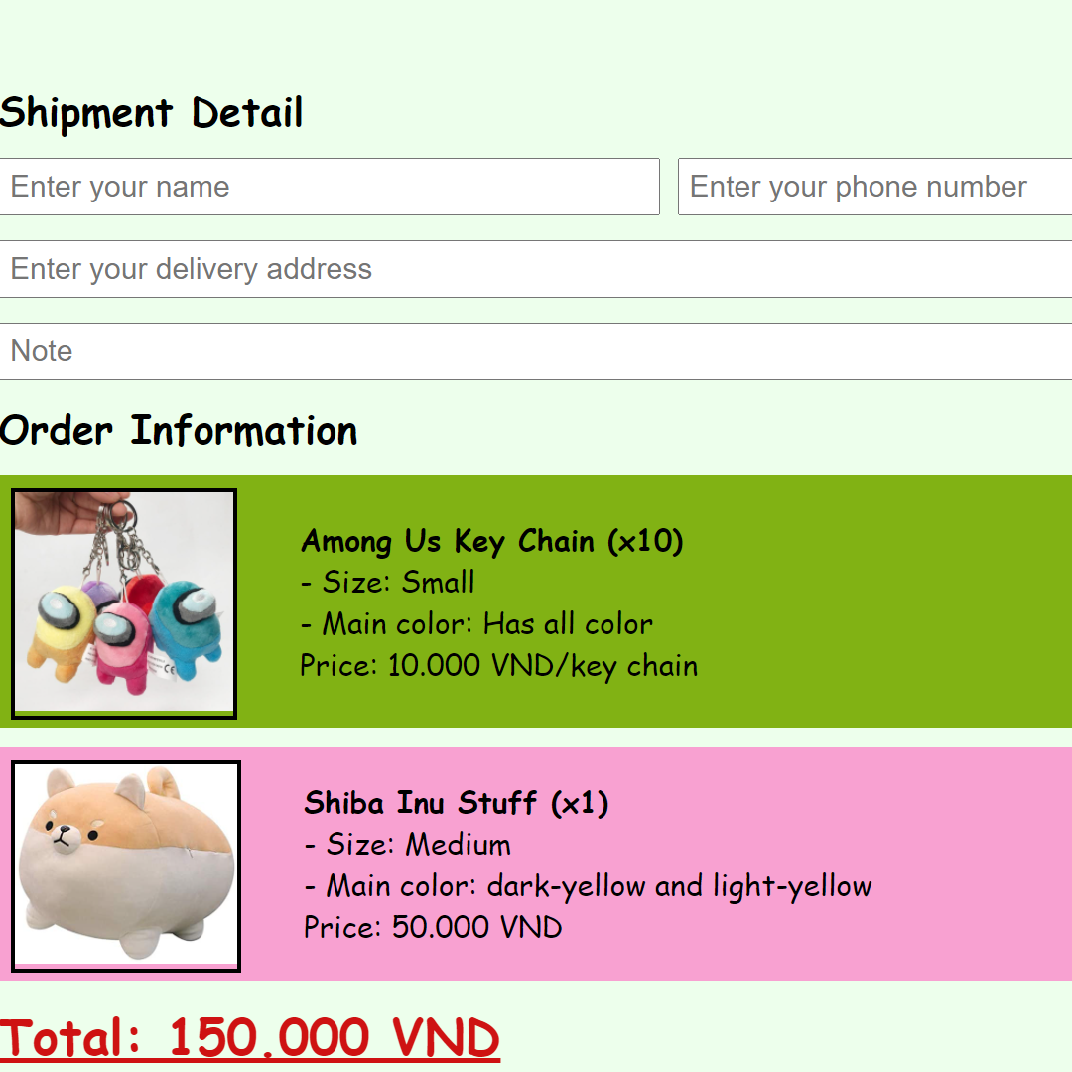
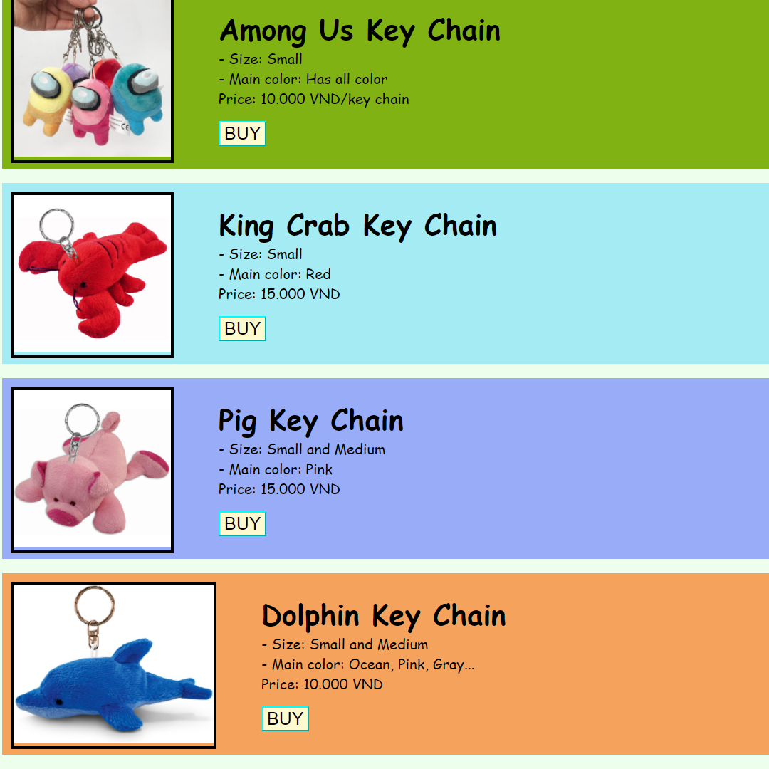
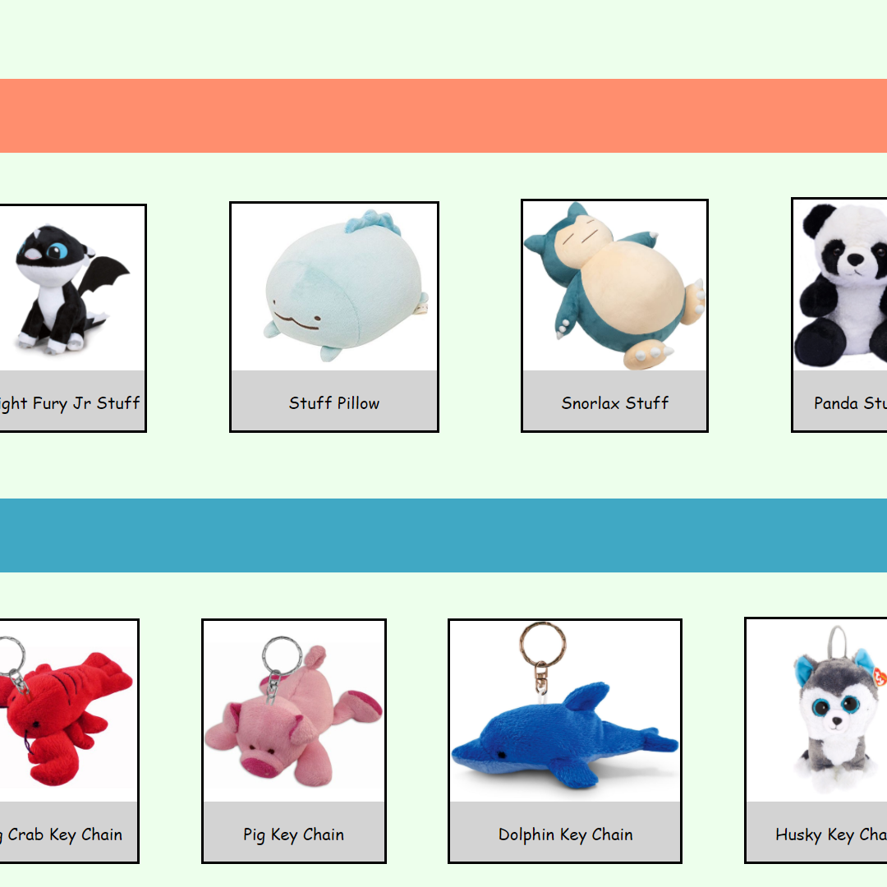
Home page
On the website’s Home Page, you can browse through all of our recent products and look at their designs.
If you want to learn more about them, you can go to the “Stuff” or “Keychains” tabs to learn about each item.
While on the Home Page, you can search for an item you want with the search bar, or check your Cart to see which items you have selected and buy them.

Slide 6
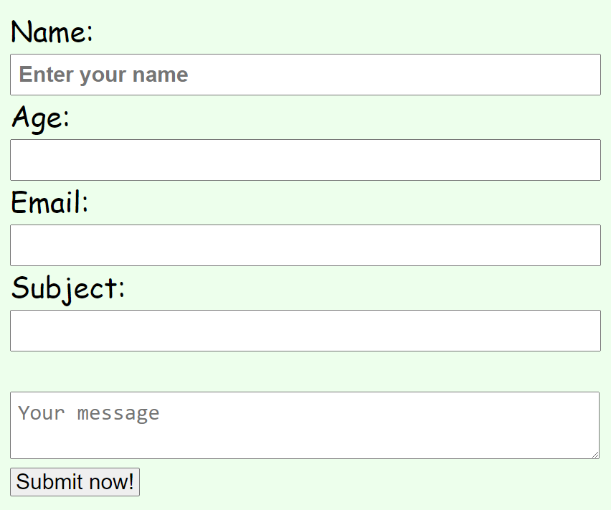
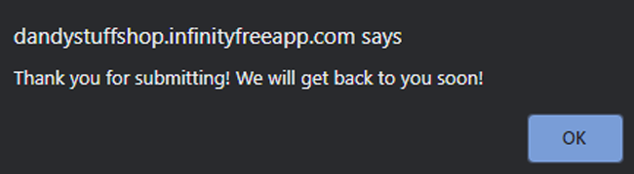
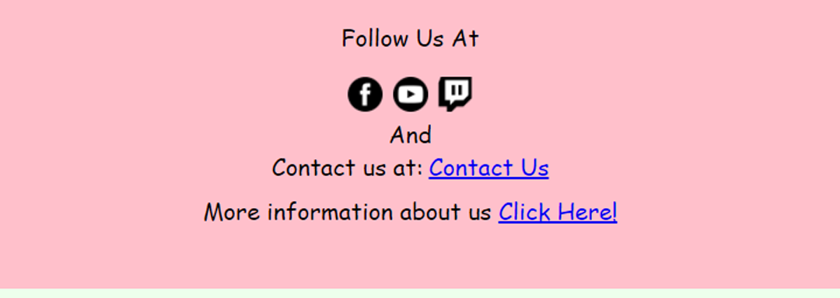
Contact us If you have any questions or idea for us, contact us through our website with 3 easy steps:
1. Contact page
2. Fill in the form
3. Submit
At the bottom of every page on our website, there will be a footer with a “Contact us” text, click it and it will take you to the Contact page.
Fill in the required details such as your name, age, email, and your message to us.
Press submit and you’ll be notified that your message has been sent. We’ll get back to you as soon as we see it.

Slide 7
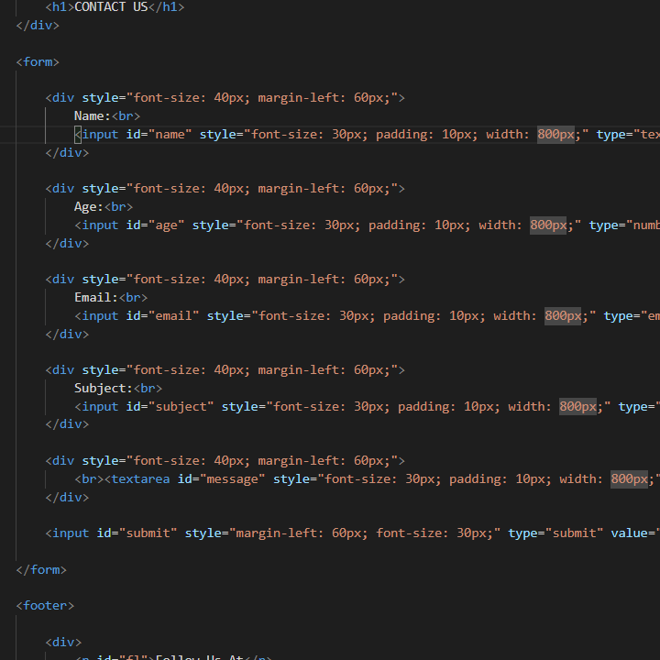
Development Process

Slide 8
Timeline
Idea
We like stuffed animals
Check other similar websites for idea/design/code
Check older lessons for code
Coding
Use tables to make images and text line up instead of using position/float.
1 column for image,
1 column for texts.
Bug Fixes
We had some problems with the body overlapping with the footer, so we use a table to fix it
We had to put each image into a div because we couldn’t get all the images to be inline in 1 single div.
Footer/Font were too big/small when designing the site on mobile so we had to fix a lot of things
Finalizing
Hosting
Finally, we polish up the site, edit the Mobile pages, fix font and image sizes. And fix up some box’s width
Upload to infinityfree.net
Push everything on Git hub

Slide 9
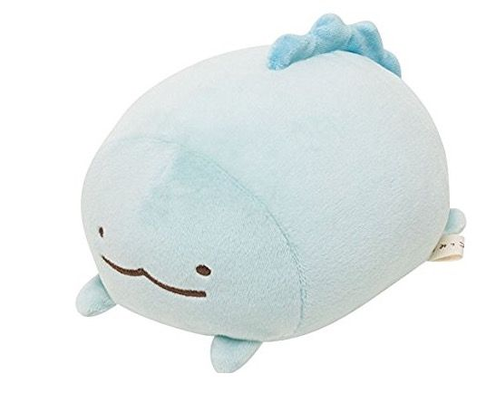
THANK YOU
FOR LISTENING

