Slide 1
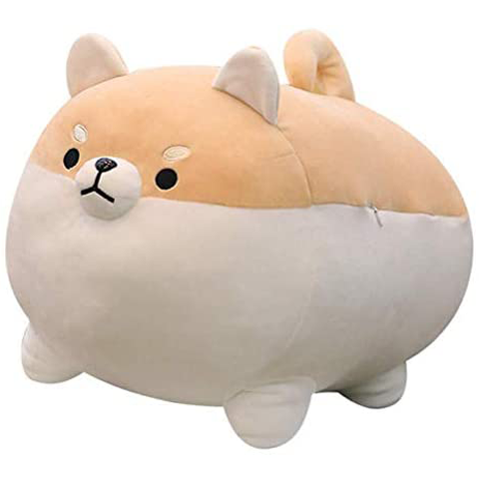
DANDY STUFF
Stuffed animal shop

Slide 2
Team members
Quân(Daniel)
Khanh

Slide 3
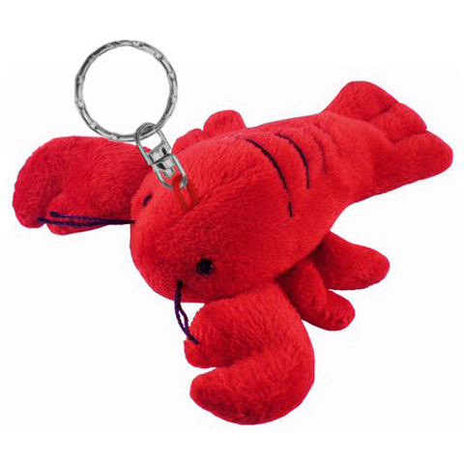
Presentation:
User Experience
Updates to the website
Shopping Process
Development Process
Coding
Techniques

Slide 4
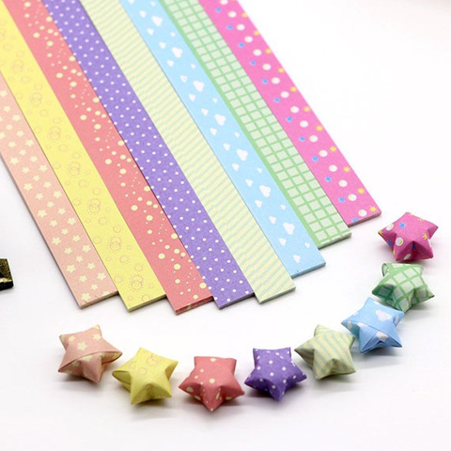
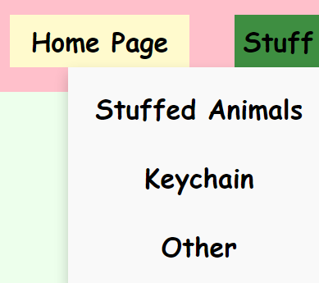
User Experience
Updates to the Website
More products were added in, including Glitters, Origami, Stickers, ...
A dropdown menu is added for easy navigation on desktop and mobile, containing the 3 categories of products: Stuffed animals, Keychain, and Other.
Redesigned the pages to all be more consistent with each other. Some images, text, and paragraphs were different sizes.

Slide 5
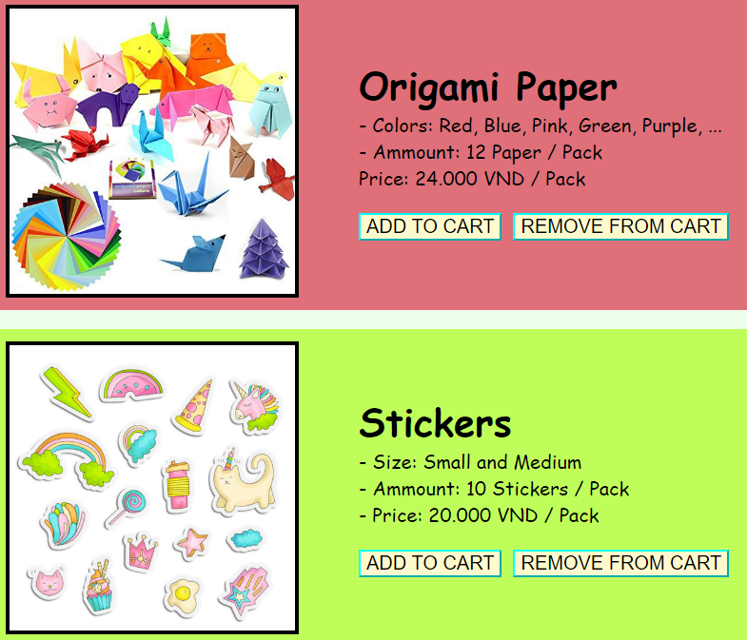
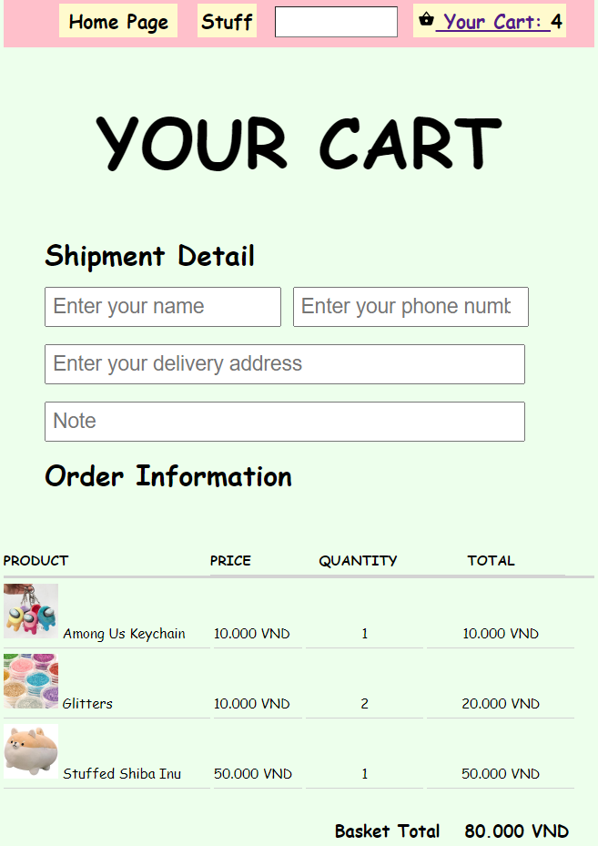
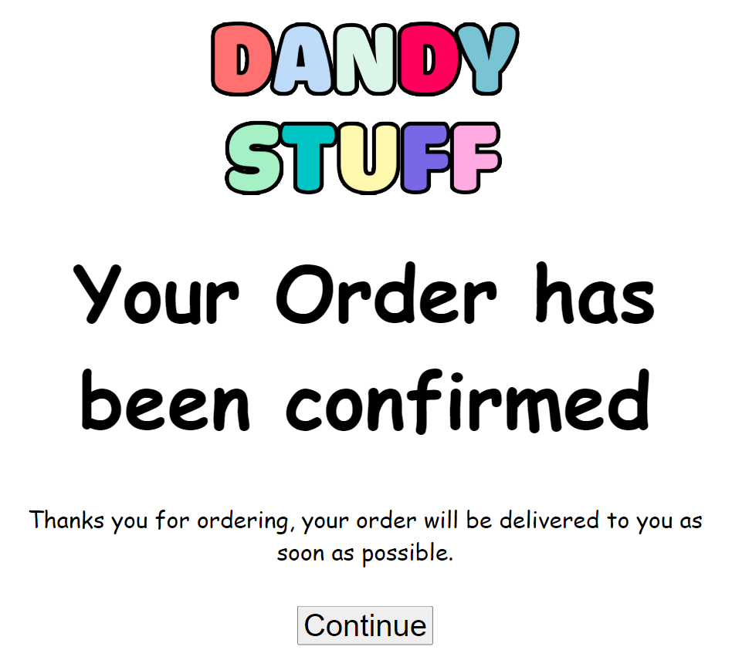
Shopping Process
You can add an item to the cart by picking any item from the 3 categories, and hitting the "Add to cart" button.
The cart will update and display the number of items inside it next to the "Your Cart" button.
When you go to the cart page, it will display which items are currently inside with the quantity and prices displayed.
If you want to remove an item from the cart, you can go to the item's page and hit the "Remove from cart" button, it will update the Cart page as well.
Once you're done, you can fill in the shipping details and click the "Confirm" button, it will take you to a page and say your order has been confirmed. After that, Clicking the "Continue" button will take you back to the Home Page.

Slide 6
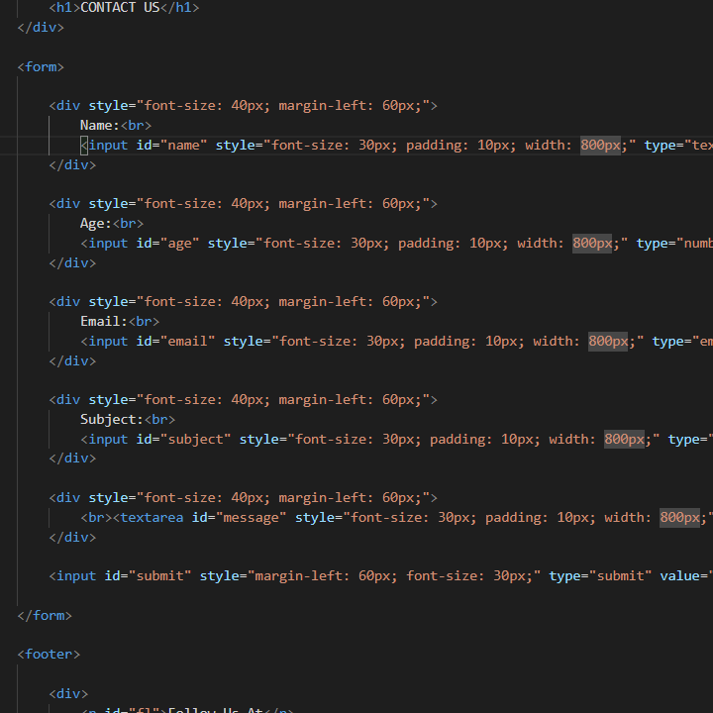
Development Process

Slide 7
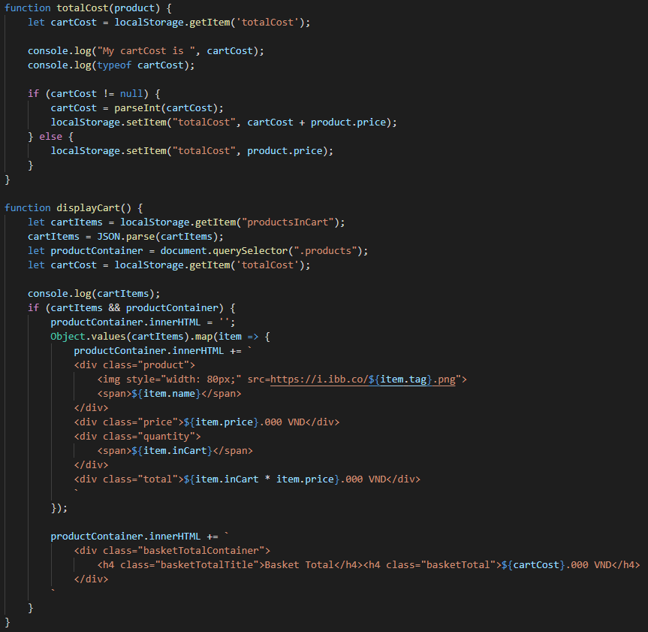
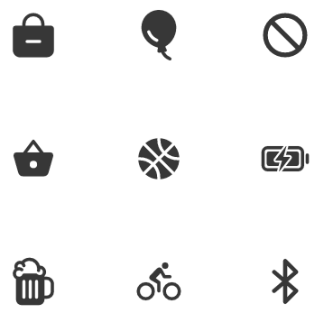
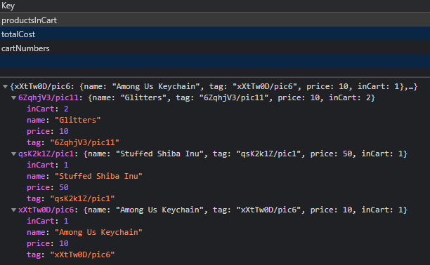
Coding & Techniques
1. Local Storage
2. Working with
Local storage
3. Importing Icon
We had a lot of problem dealing with an online database so we chose to do local storage to do our “Cart” page
Importing an icon using a script, instead of using an image for our Cart.
Importing an icon using a script, instead of using an image for our Cart.

Slide 8
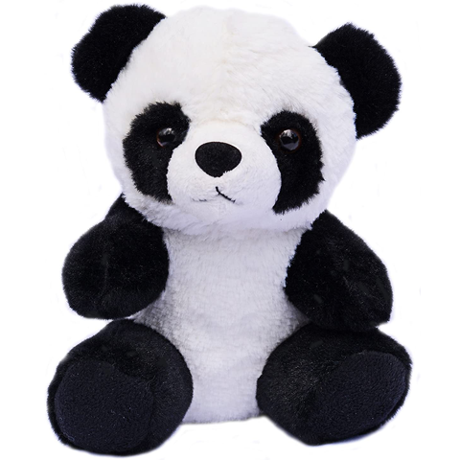
THANK YOU
FOR LISTENING

