Slide 1
Avant – Sell Your Content
Tony Lockhart
Nadine Hernandez
Daniel Valverde
Isaac Motley

Slide 2
Overall Application Concept
A marketplace for artists to sell their content.

Slide 3
Motivation for Avant
We want a place for artists to easily be able to host their art without having to build a website. With the intention to sell.

Slide 4

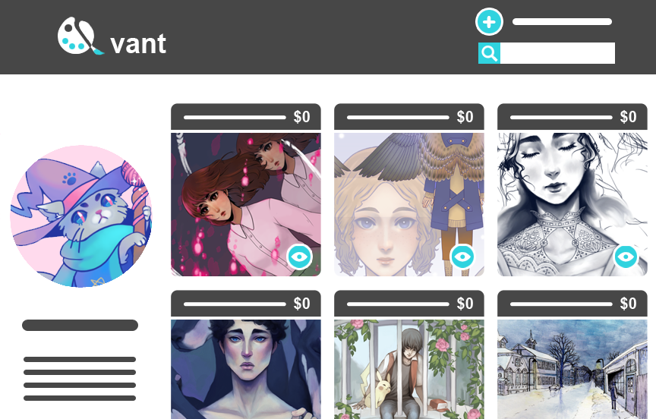
Design Process
We tried to stay modular so that we would have the least amount of people stepping on each others toes.
approximately 15 minute standups every day
Daniel (login (authentication), using passport, express-sessions)
Nadine (frontend design and implementation/handlebars)
Tony (sequelize integration of routes, db, views, and authentication)
Isaac (github repo, travis, and MVC folder structure, Powerpoint, testing)

Slide 5
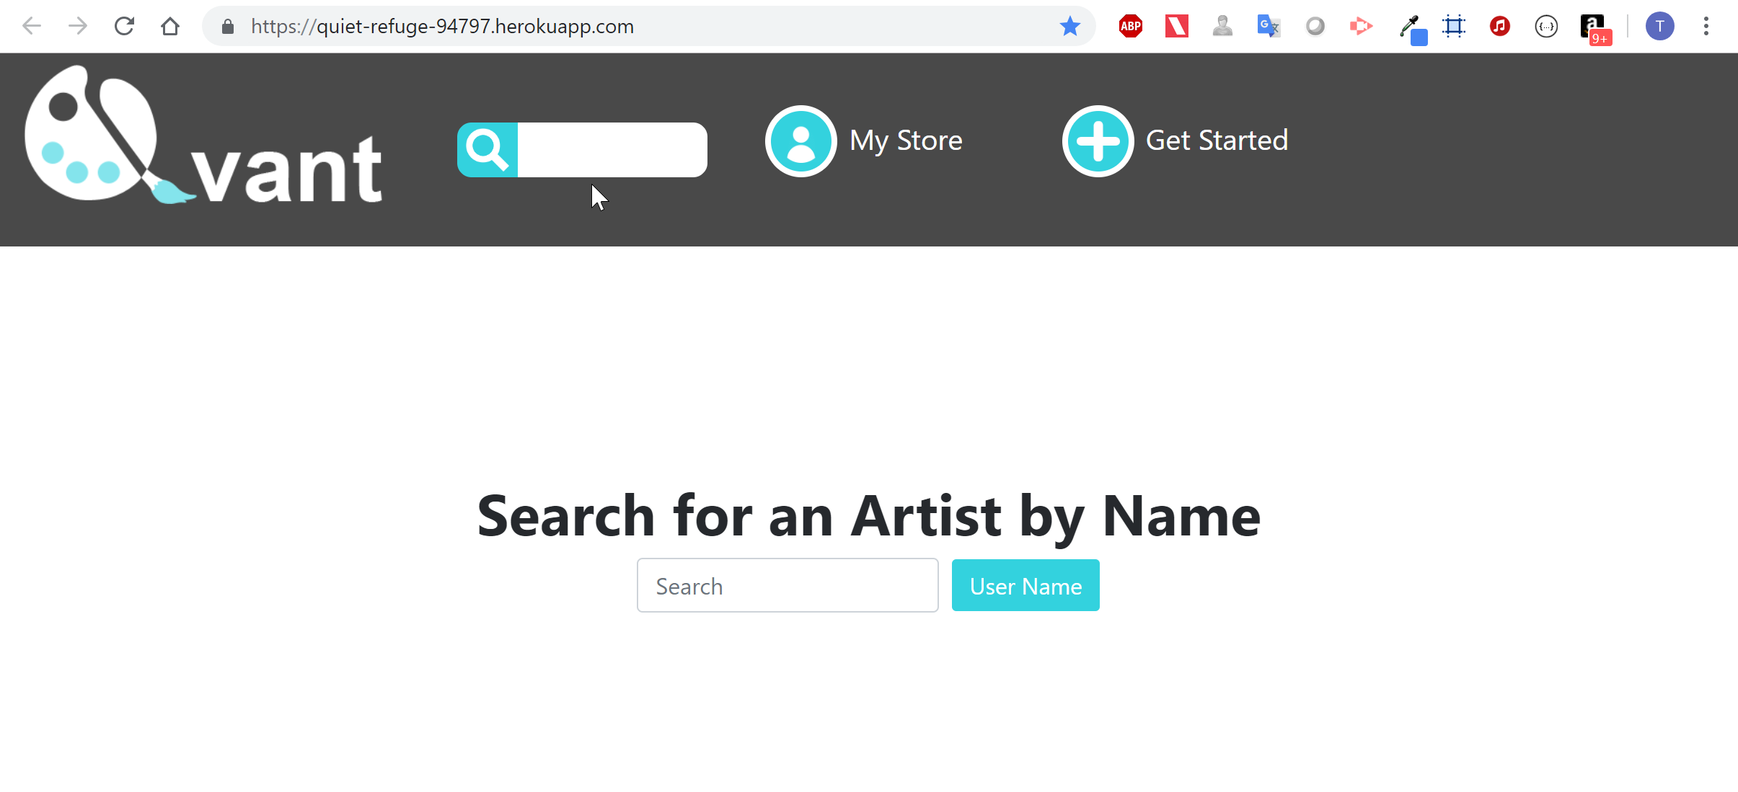
Demo

Slide 6
Express and Node.js Web Server
Avant Web Server
Built with the Express Web Application Framework.
Express provides the middleware between the app and the web server.

Slide 7
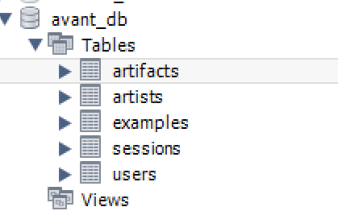
MySQL Database with Sequelize ORM
Avant Database Structure
Functions:
Authenticate Users:
User Registration
User Login
Store Artist Info
Profiles
Listings
Retrieve Artist Info
Search by Artist Name
Display Artist Store

Slide 8
Avant Get Put & Post Requests
GET Requests
Read and retrieve artist listings
Authenticate existing users
PUT Requests
Update Artist profile information
POST Requests
Add user profiles and listings
Register new users

Slide 9
Deployed to Heroku
Heroku
Platform as a service that allows customers to develop, run, and manage applications without maintaining infrastructure.
Avant URL:
https://quiet-refuge-94797.herokuapp.com

Slide 10
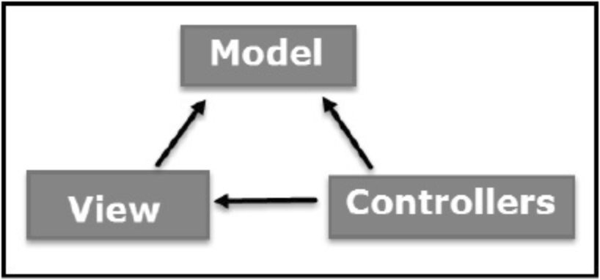
MVC Framework
Models - Data models were defined using Sequelize
Views - Frontend views were built using Handlebars
Controllers - Routing is performed using Express and JavaScript

Slide 11
Secured Database Credentials
dotEnv keeps database credentials secure:
By loading credentials from environment variables

Slide 12
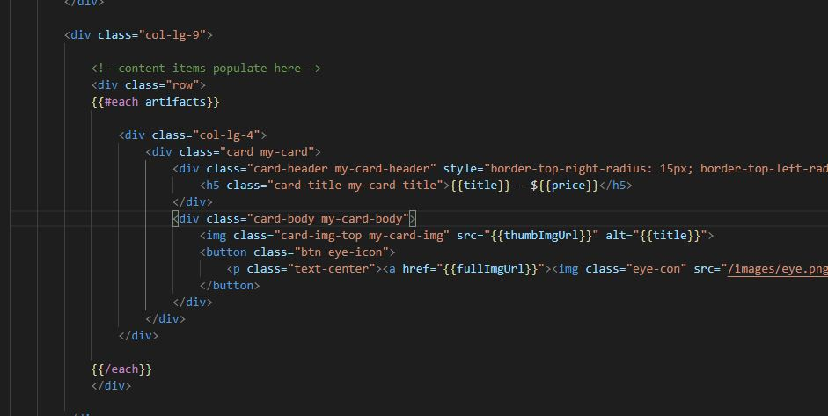

Polished frontend
Bootstrap framework
Mobile responsive with additional media queries
Unified modern styling

Slide 13
Coding Standards
ESLint: A linting utility to allow developers to find syntax errors in JavaScript code without having to execute it, as well as adhering to a standard way of coding set by the developer or developers using it
Prettier: An opinionated code formatter with support for several different languages that removes all original styling and ensures that all outputted code conforms to a consistent style

Slide 14
Libraries and packages
Express-session: This module creates a database to save session data.
Passport: Passport is Express compatible authentication middleware for Node.js. Passport’s goal in life is to authenticate requests, which it does through an extensible set of plugins known as strategies.
Connect-flash: Flash is a special package used in association with Session used for storing messages. Messages are written to the flash and cleared after being displayed to the user. This ensures that messages are available to the next page that is rendered.

Slide 15
Authentication (nice to have)
Using passport and express-sessions we incorporated authentication

Slide 16
Handlebars (nice to have)
Shared header throughout pages
Each store-front page populates in a predictable format with individual artist information to create the experience of a personalized site.

Slide 17
Future development
Artist contact form that will send the artist an email.
Integration of messages APIs like twillio for instant messaging.
Buyer content request form.
Image upload feature.
Security to prevent images from being copied and used without permission.
Ability to log out
Encrypted passwords
Passport Facebook Oauth authentication
Process Payments using Stripe

