Slide 1
MongoDB
An Introduction

Slide 2
What’s MongoDB?
A schema-less database
Non-relational database
Stores data as JSON
Stores hierarchical data

Slide 3
SQL vs NoSQL (Why MongoDB?)
SQL | NoSQL
Rigid Structure | Schema less
Stores entries as rows | Each entry is a document(JSON)
Tables | Collections
Columns | Keys
Data fetched using SQL | Object Oriented access

Slide 4
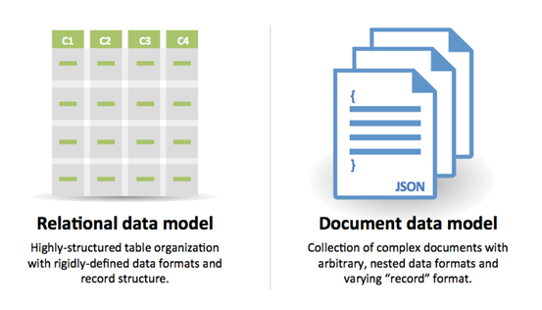

Slide 5
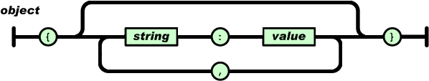
What’s JSON?
A way of representing data.
Consists of key-value pairs and arrays.
Supports hierarchical data.
{‘name’: ‘anirudh’}
{‘name’: ‘anirudh’, age: 19}
{‘name’: ‘anirudh’, age: 19, ‘pet’: {‘name’: tazo, ‘breed’: ‘Japanese Spitz’}
{‘name’: ‘anirudh’, ‘subjects’: [‘English’, ‘Maths’, ‘History’]}

Slide 6
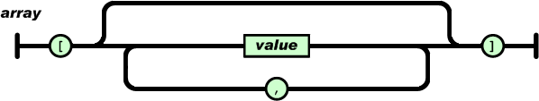
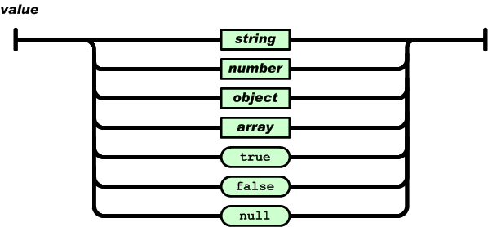

Slide 7
Installing MongoDB
Download mongodb https://fastdl.mongodb.org/linux/mongodb-linux-i686-3.0.5.tgz
tar -zxvf ~/Downloads/mongodb-linux-i686-3.0.5.tgz
mkdir ~/mongodb
cp -a ~/mongodb-linux-i686-3.0.5/. ~/mongodb
sudo mkdir -p /data/db
sudo chown -R $(whoami) /data
cd ~/mongodb/bin
./mongod
Open another terminal window
~/mongodb/bin/mongo

Slide 8
MongoDB Shell - Basic Operations
db | Shows the name of the currently active database
show dbs | Show a list of all available databases
use dbname | Makes the database mentioned after use keyword active
show collections | Shows all the collections present in the currently active database
db.col_name.insert(document) | Insert the JSON document inside the ‘col_name’ collection
db.col_name.find() | List all documents in the ‘col_name’ collection

Slide 9
MongoDB Shell - Basic Operations
db.col_name.find(SEL_CRITERIA) | List all documents that match the selection criteria
db.col_name.update(SEL_CRITERIA, $set: {NEW_DATA}) | Modify data or add new data to an existing document that matches the SEL_CRITERIA
db.col_name.update(SEL_CRITERIA, $set: {NEW_DATA}, {multi: true}) | Modify data or add new data to all documents that matches the SEL_CRITERIA
db.col_name.remove() | Remove all documents in a collection
db.col_name.remove(SEL_CRITERIA) | Remove all documents in a collection that match the SEL_CRITERIA

Slide 10
Example
> use library
switched to db library
> db
library
> db.books.insert({"title": "Harry Potter", "author": "JK Rowling", "part": 3, "publisher": "Bloomsbury"})
WriteResult({ "nInserted" : 1 })
> db.books.find()
{ "_id" : ObjectId("55cb530b4ec394ab29d49353"), "title" : "Harry Potter", "author" : "JK Rowling", "part" : 3, "publisher" : "Bloomsbury" }
> db.books.insert({title: "The Hunger Games", author: "Suzanne Collins"})
WriteResult({ "nInserted" : 1 }

Slide 11
Example
PRETTY
> db.books.find().pretty()
{
"_id" : ObjectId("55cb530b4ec394ab29d49353"),
"title" : "Harry Potter",
"author" : "JK Rowling",
"part" : 3,
"publisher" : "Bloomsbury"
}
{
"_id" : ObjectId("55cb55cecb58e0459b8def7b"),
"title" : "The Hunger Games",
"author" : "Suzanne Collins"
}
$exists
> db.books.find({part: {$exists: true}})
{ "_id" : ObjectId("55cb530b4ec394ab29d49353"), "title" : "Harry Potter", "author" : "JK Rowling", "part" : 3, "publisher" : "Bloomsbury" }

Slide 12
Example
> db.books.find({title: "Harry Potter"})
{ "_id" : ObjectId("55cb530b4ec394ab29d49353"), "title" : "Harry Potter", "author" : "JK Rowling", "part" : 3, "publisher" : "Bloomsbury" }
$set
> db.books.update({title: "Harry Potter"},{$set: {copies_sold: 123456}})
WriteResult({ "nMatched" : 1, "nUpserted" : 0, "nModified" : 1 })
> db.books.find({title: "Harry Potter"}).pretty()
{
"_id" : ObjectId("55cb530b4ec394ab29d49353"),
"title" : "Harry Potter",
"author" : "JK Rowling",
"part" : 3,
"publisher" : "Bloomsbury",
"copies_sold" : 123456
}
> db.books.update({title: "The Hunger Games"}, {$set: {copies_sold: 654321}})
WriteResult({ "nMatched" : 1, "nUpserted" : 0, "nModified" : 1 })
$gt
> db.books.find({copies_sold: {$gt: 234567}})
{ "_id" : ObjectId("55cb55cecb58e0459b8def7b"), "title" : "The Hunger Games", "author" : "Suzanne Collins", "copies_sold" : 654321 }

Slide 13
Example
AND
> db.books.find({title: "Harry Potter", part: 3})
{ "_id" : ObjectId("55cb530b4ec394ab29d49353"), "title" : "Harry Potter", "author" : "JK Rowling", "part" : 3, "publisher" : "Bloomsbury", "copies_sold" : 123456 }
$or
> db.books.find({$or:[{title: "Harry Potter"}, {author: "Suzanne Collins"}]})
{ "_id" : ObjectId("55cb55cecb58e0459b8def7b"), "title" : "The Hunger Games", "author" : "Suzanne Collins", "copies_sold" : 654321 }
{ "_id" : ObjectId("55cb530b4ec394ab29d49353"), "title" : "Harry Potter", "author" : "JK Rowling", "part" : 3, "publisher" : "Bloomsbury", "copies_sold" : 123456 }
> db.books.remove({title: "Harry Potter"})
WriteResult({ "nRemoved" : 1 })
> db.books.find()
{ "_id" : ObjectId("55cb55cecb58e0459b8def7b"), "title" : "The Hunger Games", "author" : "Suzanne Collins", "copies_sold" : 654321 }

Slide 14
Query Operators
Operation | Syntax | Example
Equality | {<key>:<value>} | db.mycol.find({"by":"tutorials point"}).pretty()
Less Than | {<key>:{$lt:<value>}} | db.mycol.find({"likes":{$lt:50}}).pretty()
Less Than Equals | {<key>:{$lte:<value>}} | db.mycol.find({"likes":{$lte:50}}).pretty()
Greater Than | {<key>:{$gt:<value>}} | db.mycol.find({"likes":{$gt:50}}).pretty()
Greater Than Equals | {<key>:{$gte:<value>}} | db.mycol.find({"likes":{$gte:50}}).pretty()
Not Equals | {<key>:{$ne:<value>}} | db.mycol.find({"likes":{$ne:50}}).pretty()

