Slide 1

An Introduction

Slide 2

Preface

Slide 3
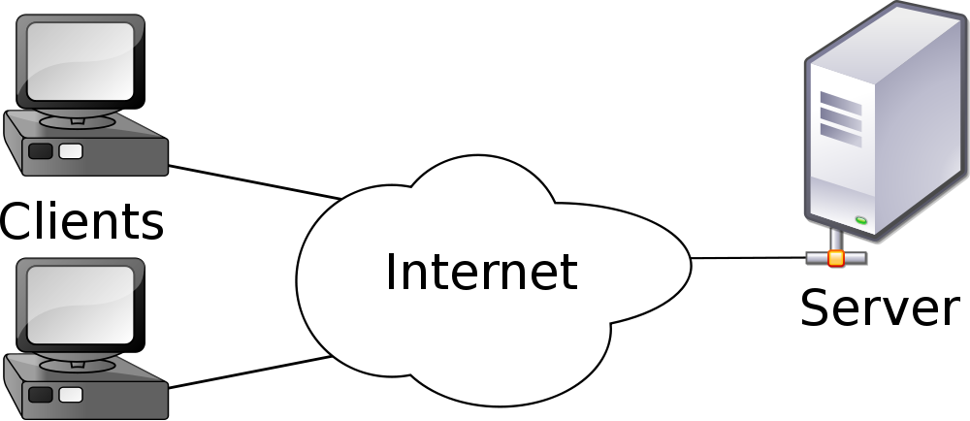
Client-Server Model

Slide 4
Request - Response Trace
CGI
Pre-processor
DB Server
Request
Client
Web Server
Response
Server OS
Server

Slide 5
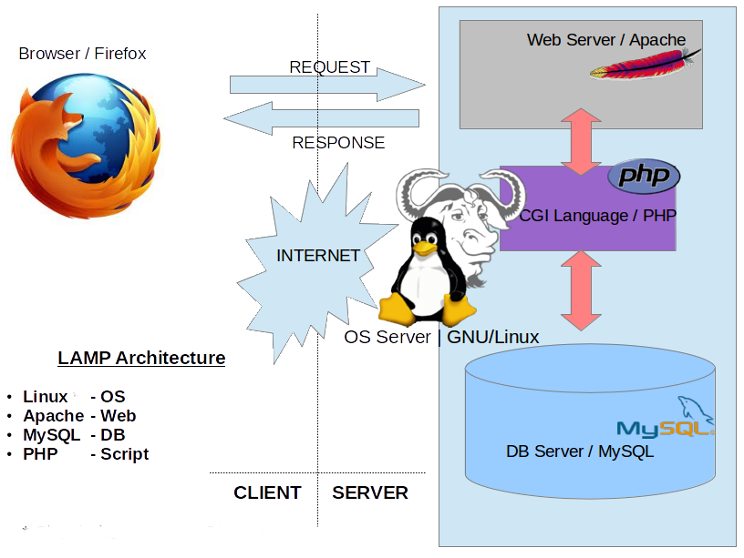
Web Architecture

Slide 6
QUIZ – I
Log on to
www.testmoz.com/545188

Slide 7
Databases

Slide 8
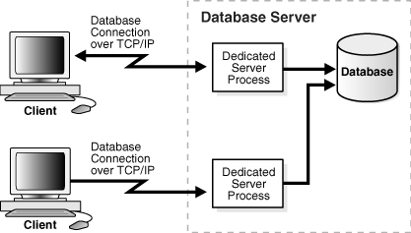
What is a Database ?

Slide 9
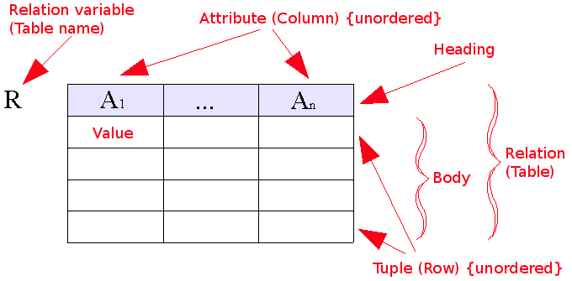
Relational Model And SQL

Slide 10

SQL vs NoSQL

Slide 11
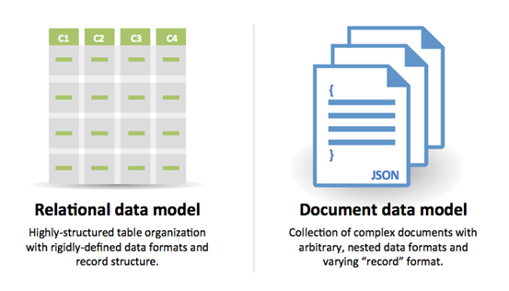
1.Data Storage

Slide 12
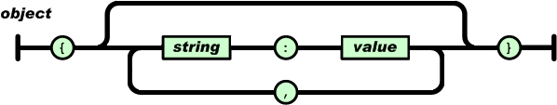
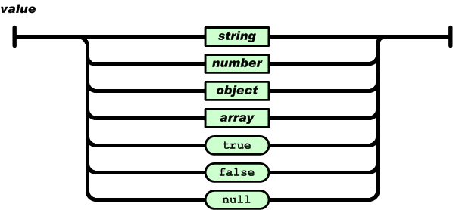
Javascript aside : What is JSON ?

Slide 13
JSON (Example)
var me = {
name : “flintstone”
age : 20
height : 5.7 subjects : [‘ML’, ‘DBMS’, ‘CN’ ]
isMale : true
}

Slide 14
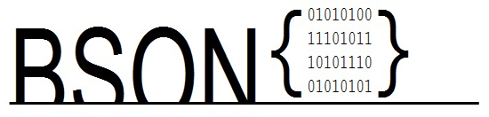
Why BSON ?

Slide 15
2.Schema
ID | Rice | Wheat | Onions | Tomato
1 | 10 | (NULL) | 10 | 5
2 | 20 | 20 | (NULL) | (NULL)

Slide 16
{
id : 1 ,
rice : 10 ,
onions : 10 ,
tomatoes : 5
} ,
{
id : 2 ,
rice : 10 ,
wheat : 10
}

Slide 17
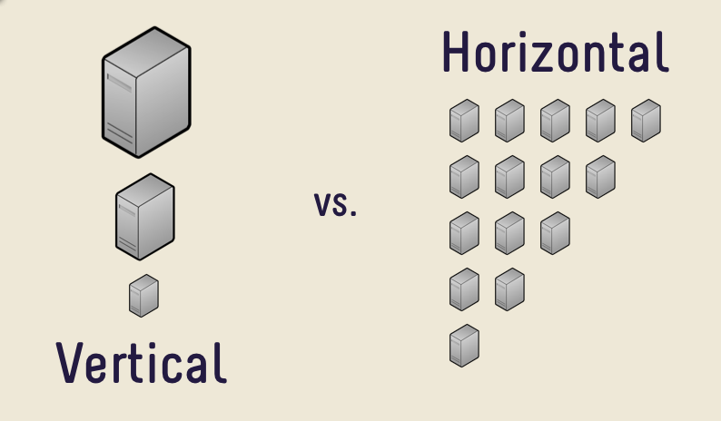
3.Scalability

Slide 18
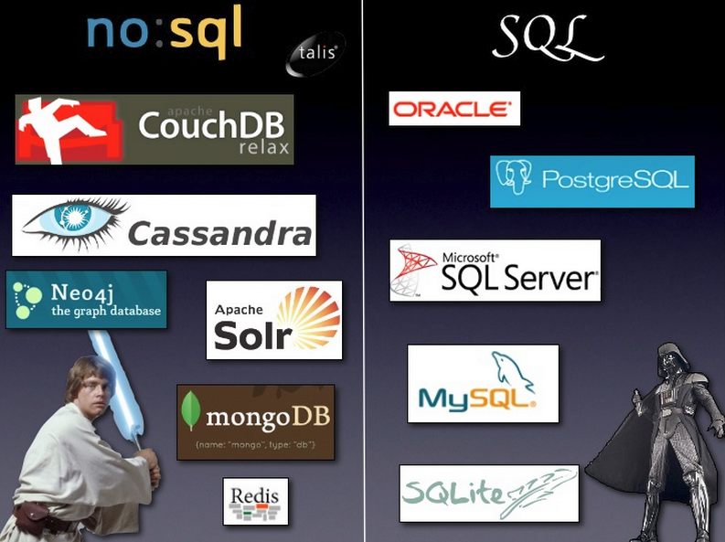
Examples

Slide 19
MongoDB
Most popular NoSQL language
Written in C++
OpenSource
Horizontally Scalable
Document Model

Slide 20
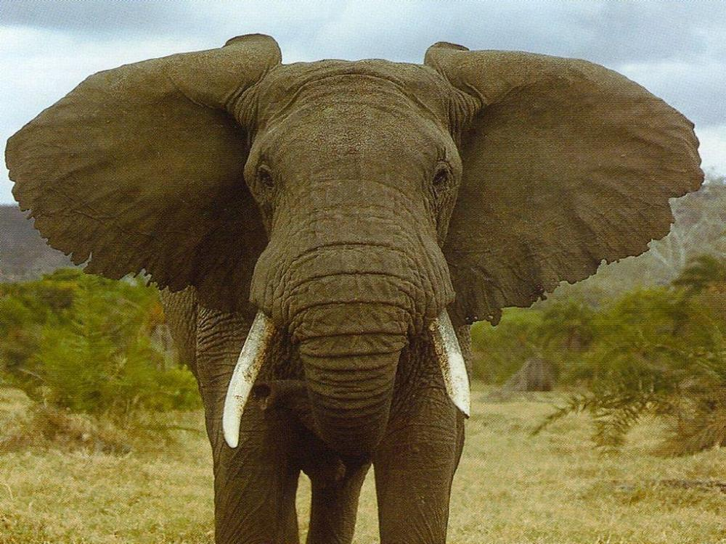
HUMONGOUS DataBase

Slide 21
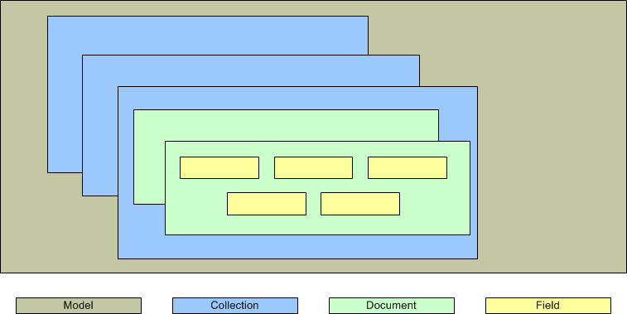
Document Model

Slide 22
Document Model
SERVER - HOST MACHINE - X
DATABASE - A
DATABASE - B
DOC
DOC
COLLECTION-1
COLLECTION-1

Slide 23
RDBMS vs MongoDB
RDBMS | MongoDB
Database | Database
Table | Collection
Tuple/Row | Document
Column | Field

Slide 24
RDBMS vs MongoDB
Database Server and Client
Mysqld/Oracle | mongod
mysql/sqlplus | mongo

Slide 25
Quiz - II
Log on to
www.testmoz.com/545200

Slide 26
Installing Mongo DB
Run the mongodb.exe file
Create a folder named ‘data’ in C Drive
Add folder within ‘data’ name ‘db’
Install robomongo (optional)
Set the correct port (default)
Done

Slide 27

Basic Operations

Slide 28
1.Creating a Database
Syntax : use DATABASE_NAME
Example: use first_db

Slide 29
2.Listing Databases
Show dbs

Slide 30
3. Adding Collections
Syntax:
db.createCollection(“Collection_Name”)
Example:
db.createCollection(“first_collection”)

Slide 31
4.Inserting Documents
Syntax:
db.COLLECTION_NAME.insert(document)
Example
db.first_collection.insert({name:”flintstone”})

Slide 32
5.Adding More Documents
Syntax:
db.COLLECTION_NAME.insert(
[
{name:”flint” , age:20},
{name: “Lexi” , age : 5},
{name : “Drew”}
]
)

Slide 33
6.Querying
Syntax:
db.COLLECTION_NAME.find()
db.mycol.find().pretty()

Slide 34
Operation | Syntax | Example
Equality | {<key>:<value>} | db.mycol.find({"name":"flint”}).pretty()
Less Than | {<key>:{$lt:<value>}} | db.mycol.find({"age":{$lt:25}}).pretty()
Less Than Equals | {<key>:{$lte:<value>}} | db.mycol.find({"age":{$lte:15}}).pretty()
Greater Than | {<key>:{$gt:<value>}} | db.mycol.find({"age":{$gt:10}}).pretty()
Greater Than Equals | {<key>:{$gte:<value>}} | db.mycol.find({"age":{$gte:20}}).pretty()
Not Equals | {<key>:{$ne:<value>}} | db.mycol.find({"age":{$ne:30}}).pretty()

Slide 35
7.Update
Syntax:
db.COLLECTION_NAME.update(SELECTIOIN_CRITERIA, UPDATED_DATA)
Example:
db.first_collection().update( {name: “Drew”},{ $set:{
name : “Andrew”} })

Slide 36
8.Remove a Document
Syntax
db.COLLECTION_NAME.remove(“parameter_list”)
Example
db.first_collection.remove({name: “Andrew” })

Slide 37
9.Removing a collection
Syntax
db.COLLECTION_NAME.drop()

Slide 38
10.Dropping a Datbase
Syntax:
db.dropDatabase()

Slide 39
Exercise – I

Slide 40
You are in-charge of handling the database of an e-commerce website . You are required to ----
Create a main database
Create collections for Clothing , Electronics , Furniture
Each document in a collection must contain details of Name ,Price , Manufacturer & Availability
Optionally , details of Discounts , Size and Colour may be present
It is later found that two products are unavailable and must be removed .
An electronics manufacturer X hiked the cost of there products . Increase the cost of all products form that manufacturer by 10%
Query all products that have discount of 30% or above
DONE !

