Slide 1


Slide 2
Chapter 4
Enhanced Entity-Relationship and UML Modeling

Slide 3
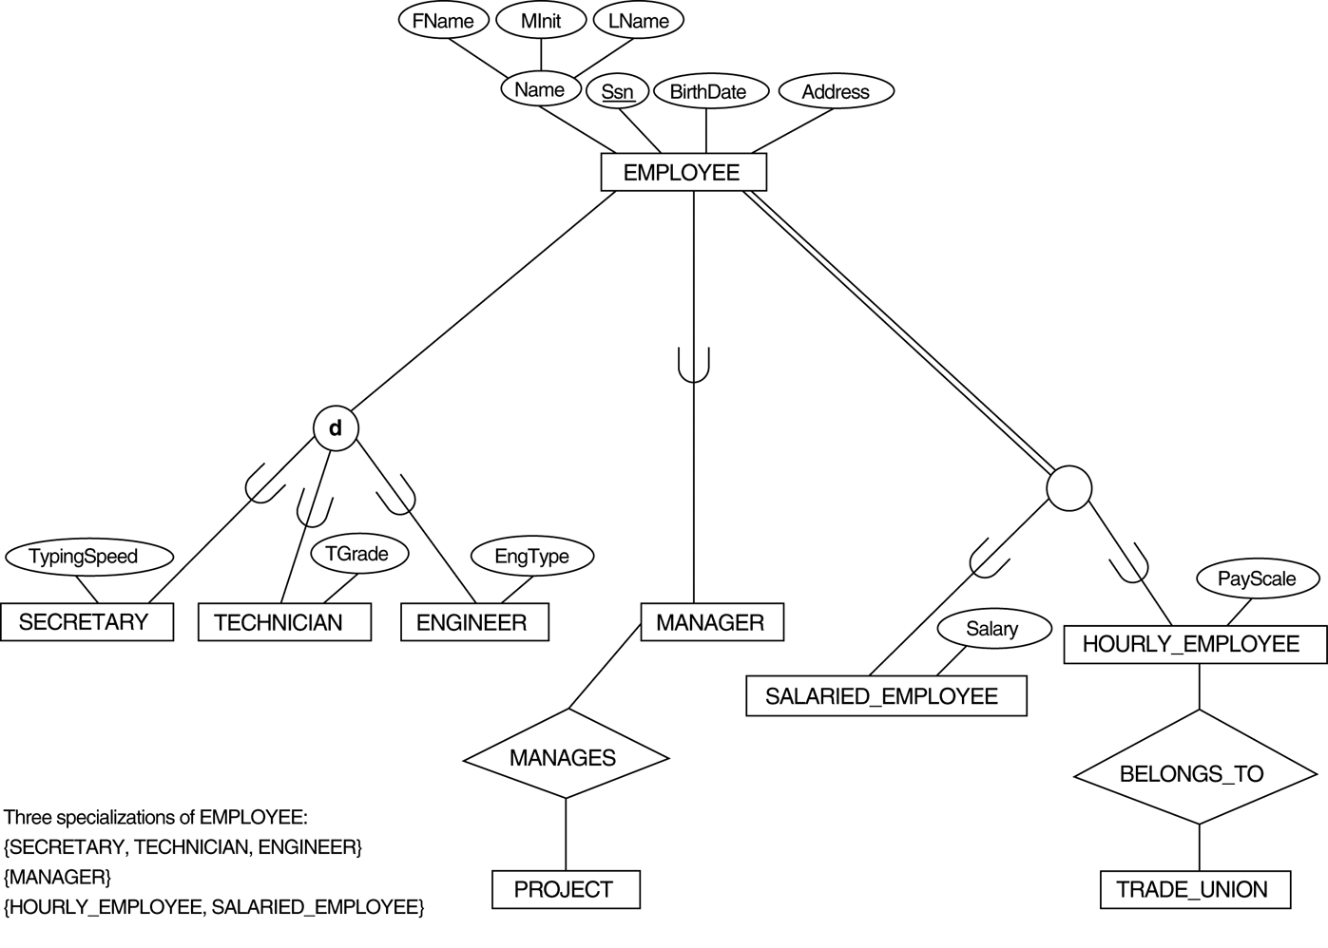
FIGURE 4.1
EER diagram notation to represent subclasses and specialization.

Slide 4
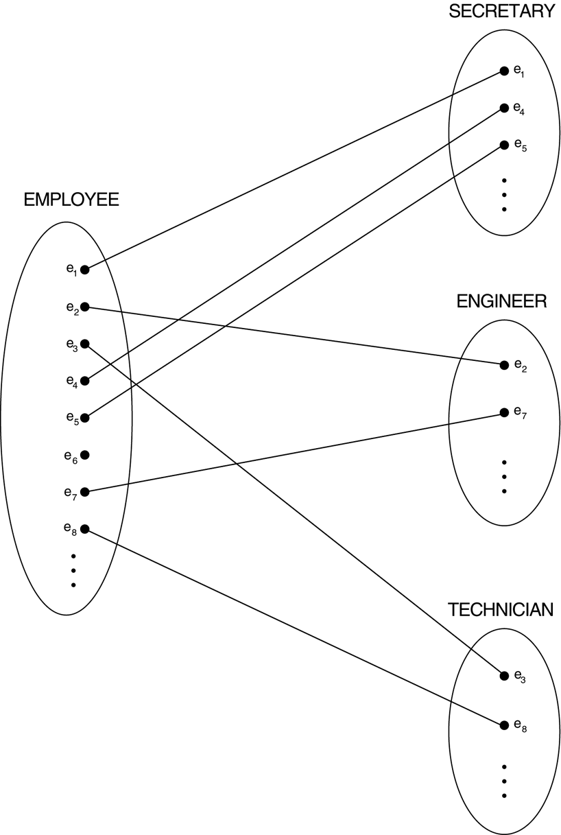
FIGURE 4.2
Instances of a specialization.

Slide 5
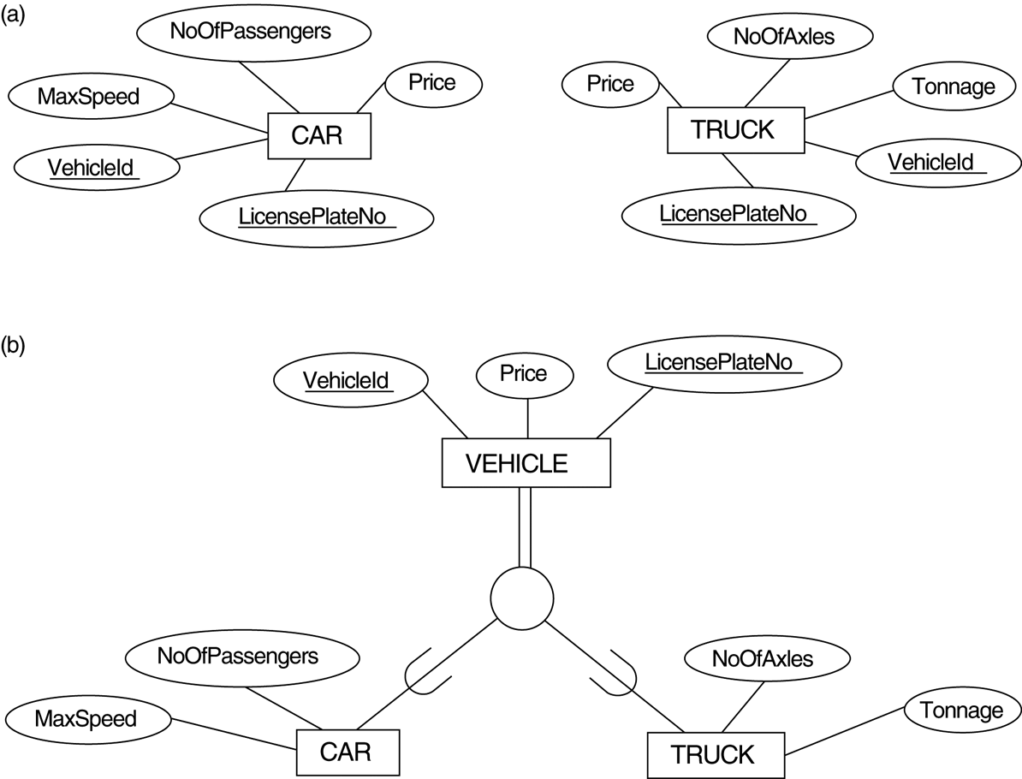
FIGURE 4.3
Generalization. (a) Two entity types, CAR and TRUCK. (b) Generalizing CAR and TRUCK into the superclass VEHICLE.

Slide 6

FIGURE 4.4
EER diagram notation for an attribute-defined specialization on JobType.

Slide 7

FIGURE 4.5
EER diagram notation for an overlapping (nondisjoint) specialization.

Slide 8
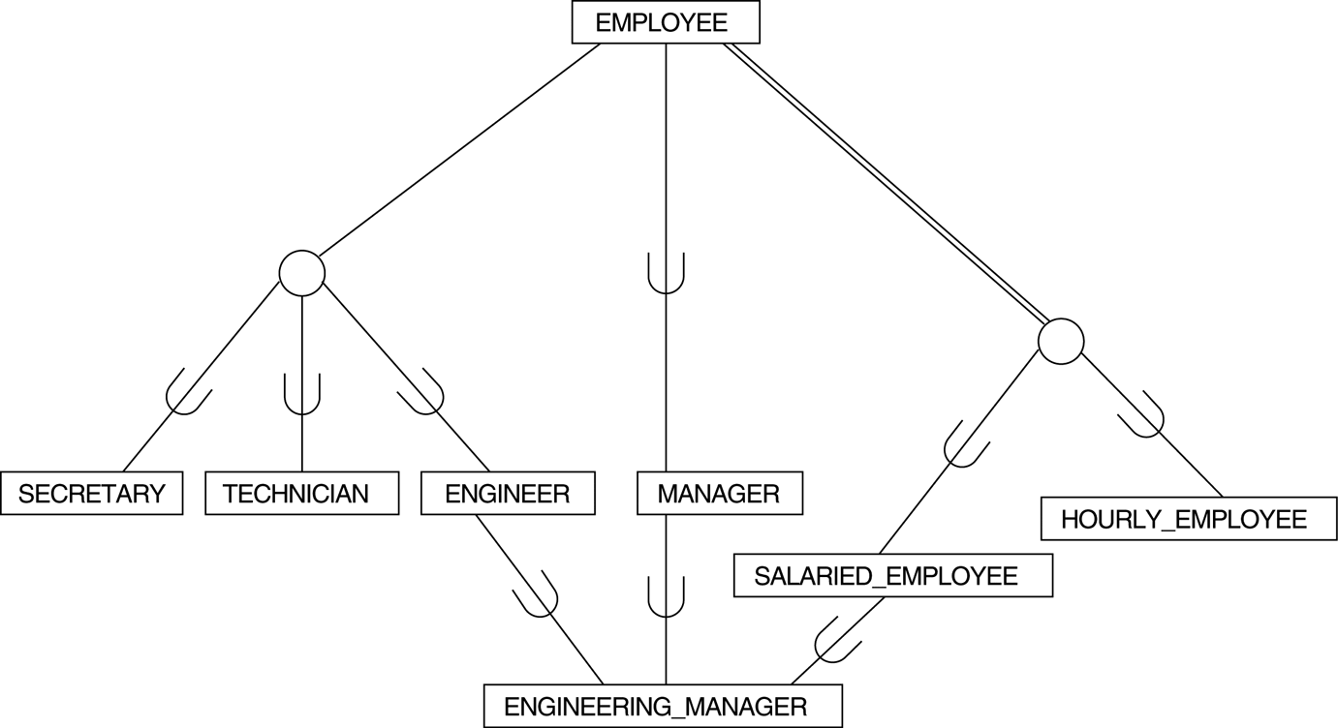
FIGURE 4.6
A specialization lattice with shared subclass ENGINEERING_MANAGER.

Slide 9

FIGURE 4.7
A specialization lattice with multiple inheritance for a UNIVERSITY database.

Slide 10

FIGURE 4.8
Two categories (union types): OWNER and REGISTERED_VEHICLE.

Slide 11
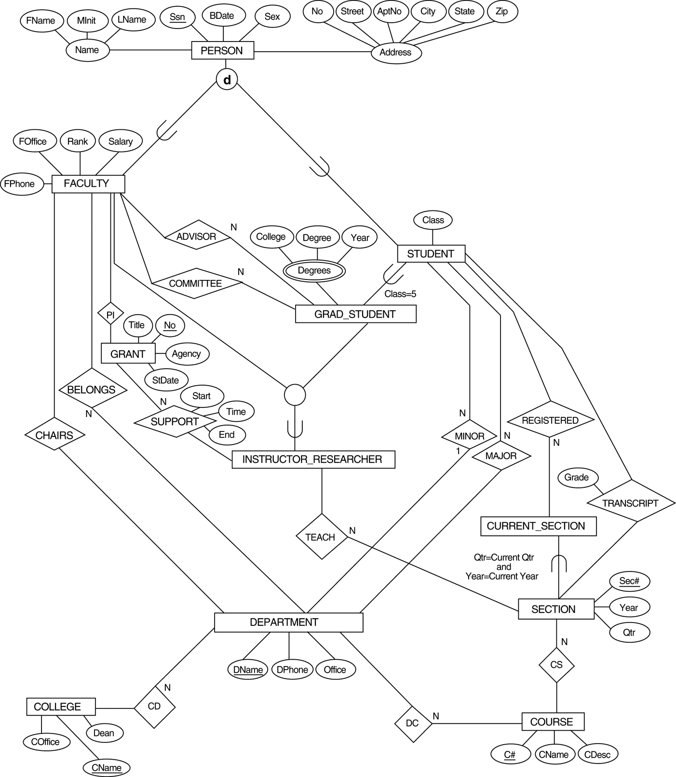
FIGURE 4.9
An EER conceptual schema for a UNIVERSITY database.

Slide 12
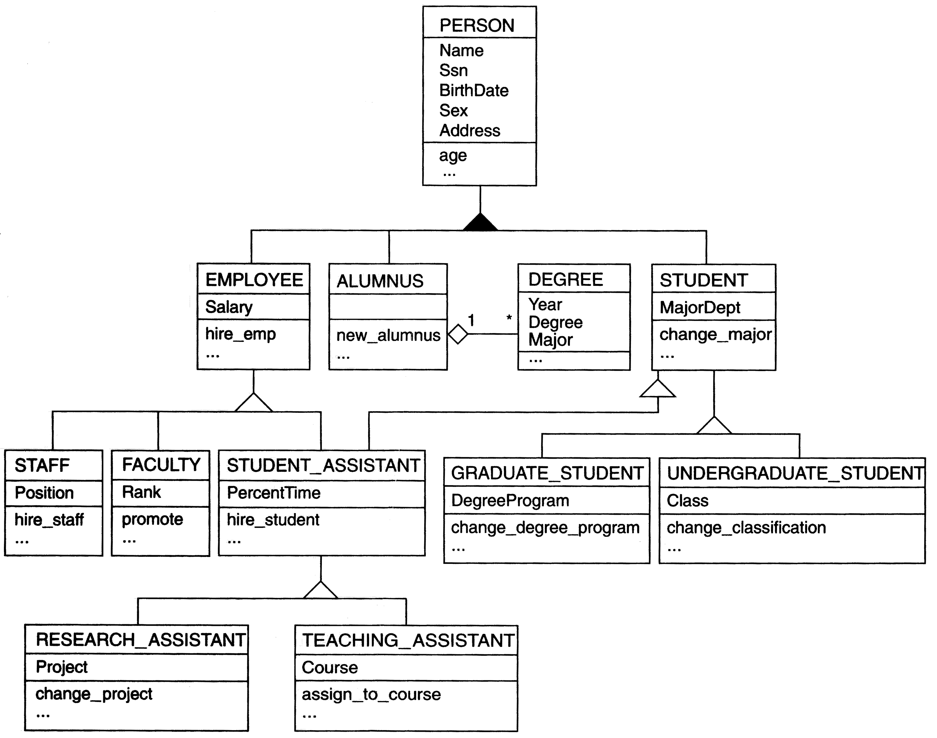
FIGURE 4.10
A UML class diagram corresponding to the EER diagram in Figure 4.7, illustrating UML notation for specialization/ generalization.

Slide 13
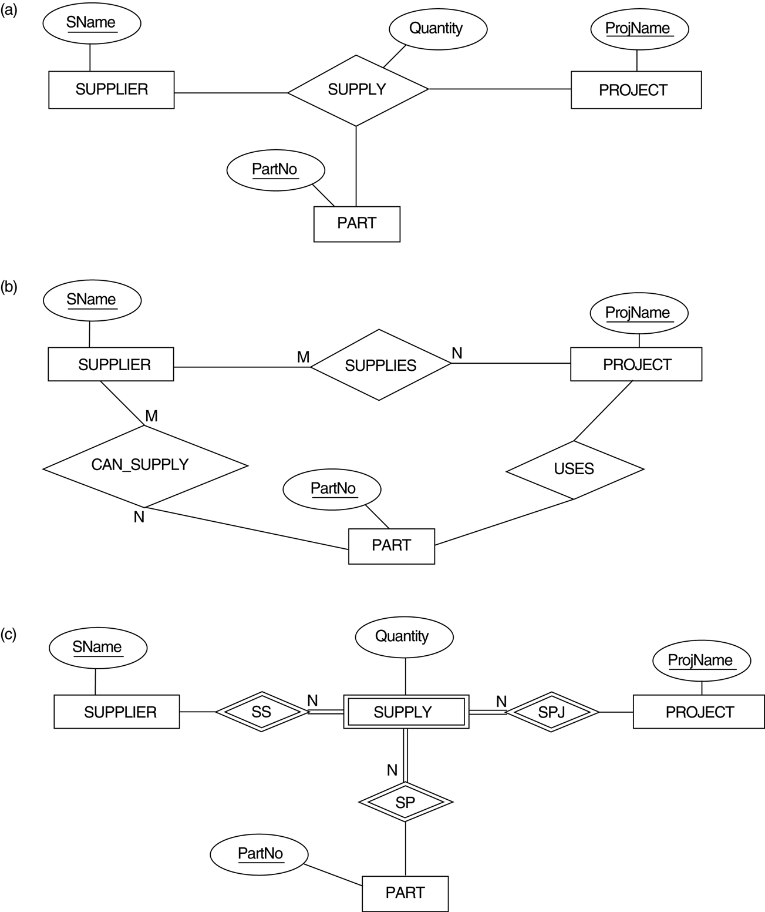
FIGURE 4.11
Ternary relationship types. (a) The SUPPLY relationship. (b) Three binary relationships not equivalent to SUPPLY. (c) SUPPLY represented as a weak entity type.

Slide 14
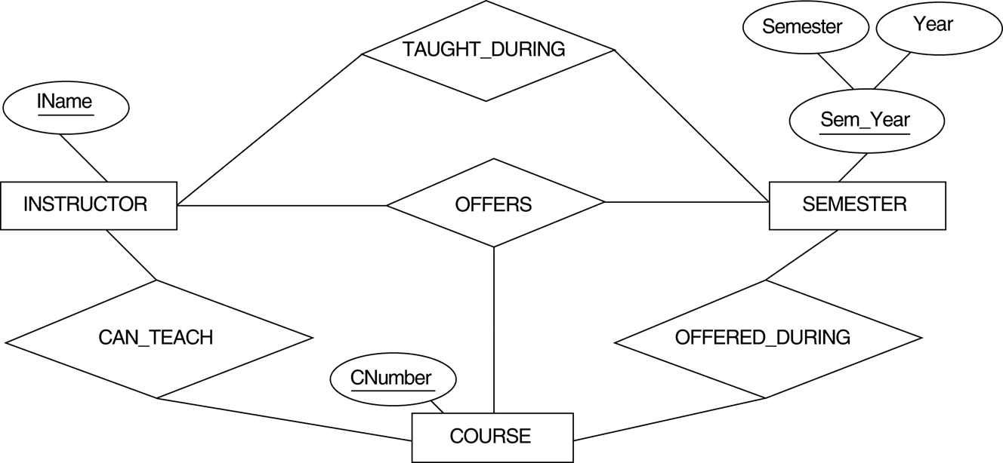
FIGURE 4.12
Another example of ternary versus binary relationship types.

Slide 15
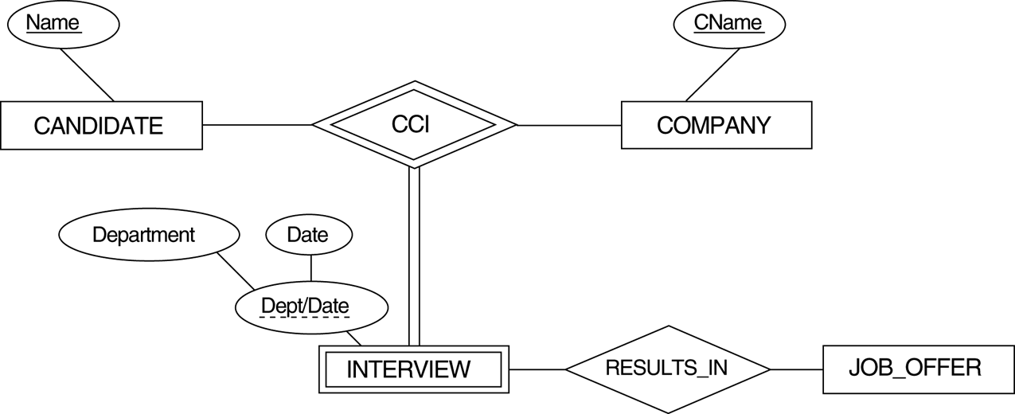
FIGURE 4.13
A weak entity type INTERVIEW with a ternary identifying relationship type.

Slide 16
FIGURE 4.13
A weak entity type INTERVIEW with a ternary identifying relationship type.

Slide 17
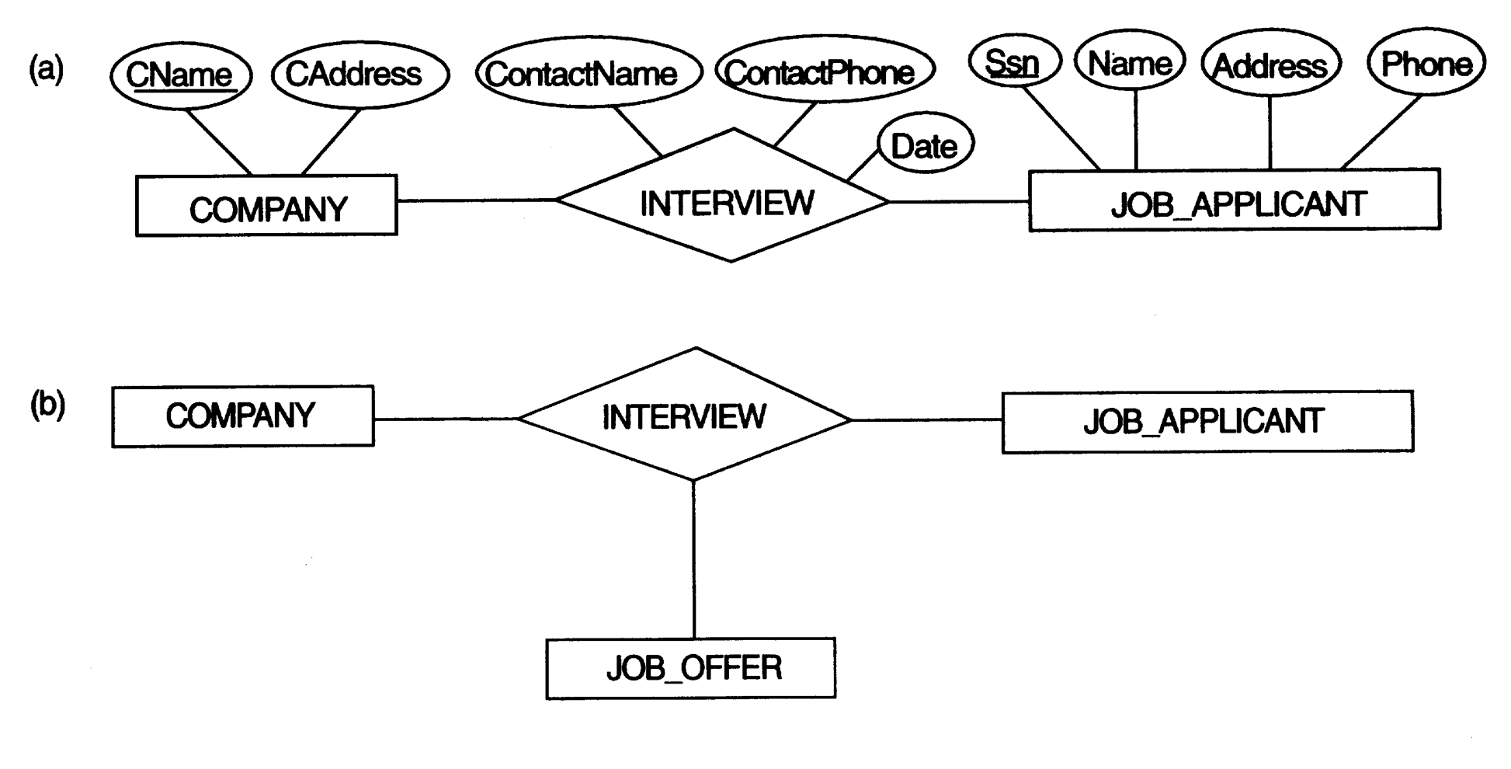
FIGURE 4.14a,b
Aggregation. (a) The relationship type INTERVIEW.
(b) Including JOB_OFFER in a ternary relationship type (incorrect).

Slide 18
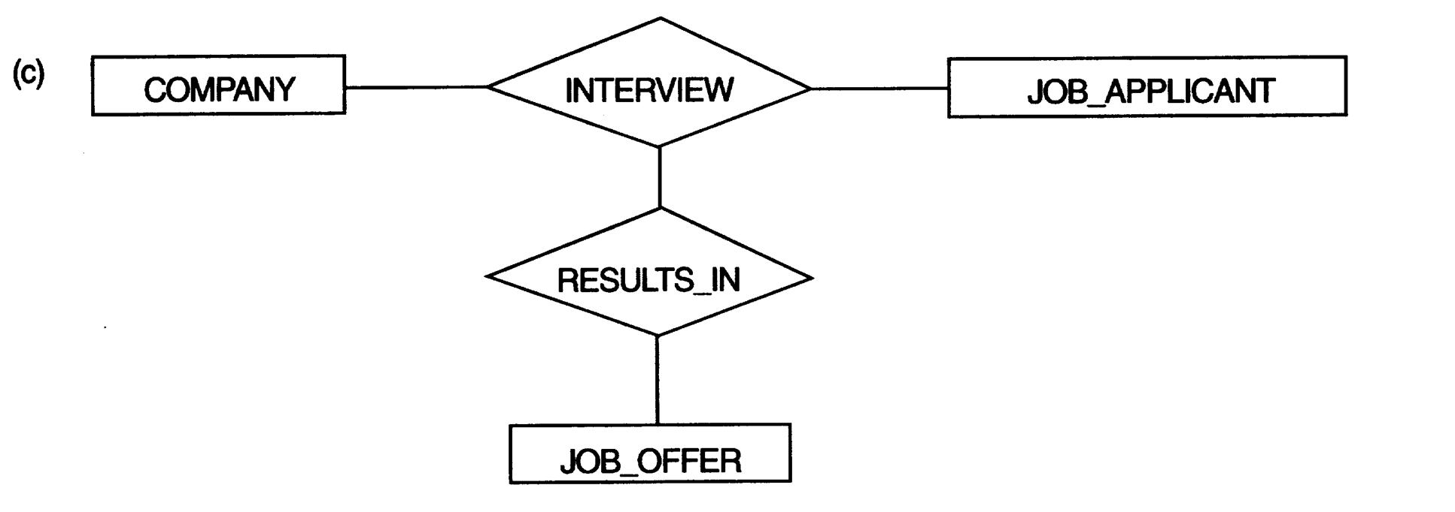
FIGURE 4.14c
Aggregation. (c) Having the RESULTS_IN relationship participate in other relationships (generally not allowed in ER).

Slide 19
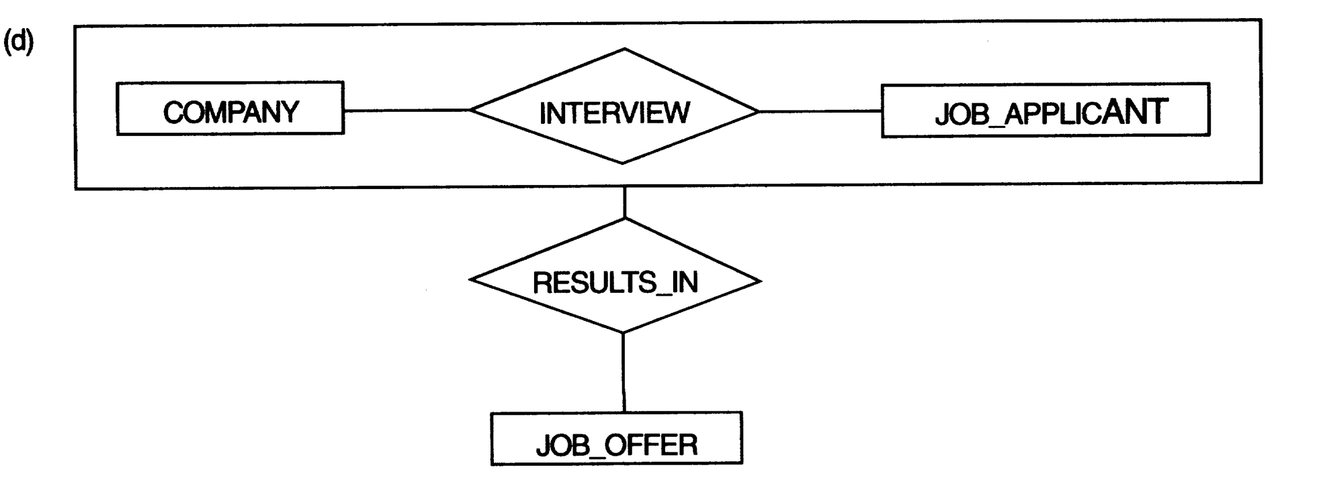
FIGURE 4.14d
Aggregation. (d) Using aggregation and a composite (molecular) object (generally not allowed in ER).

Slide 20
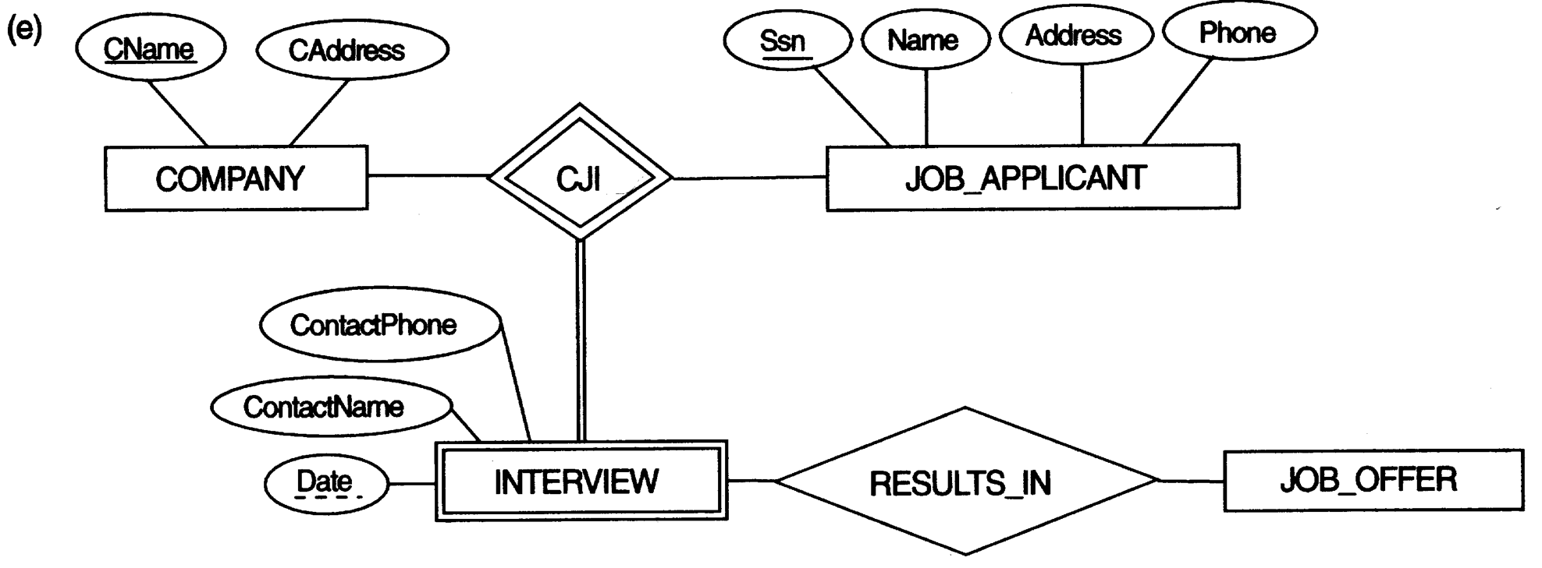
FIGURE 4.14e
Aggregation. (e) Correct representation in ER.

Slide 21
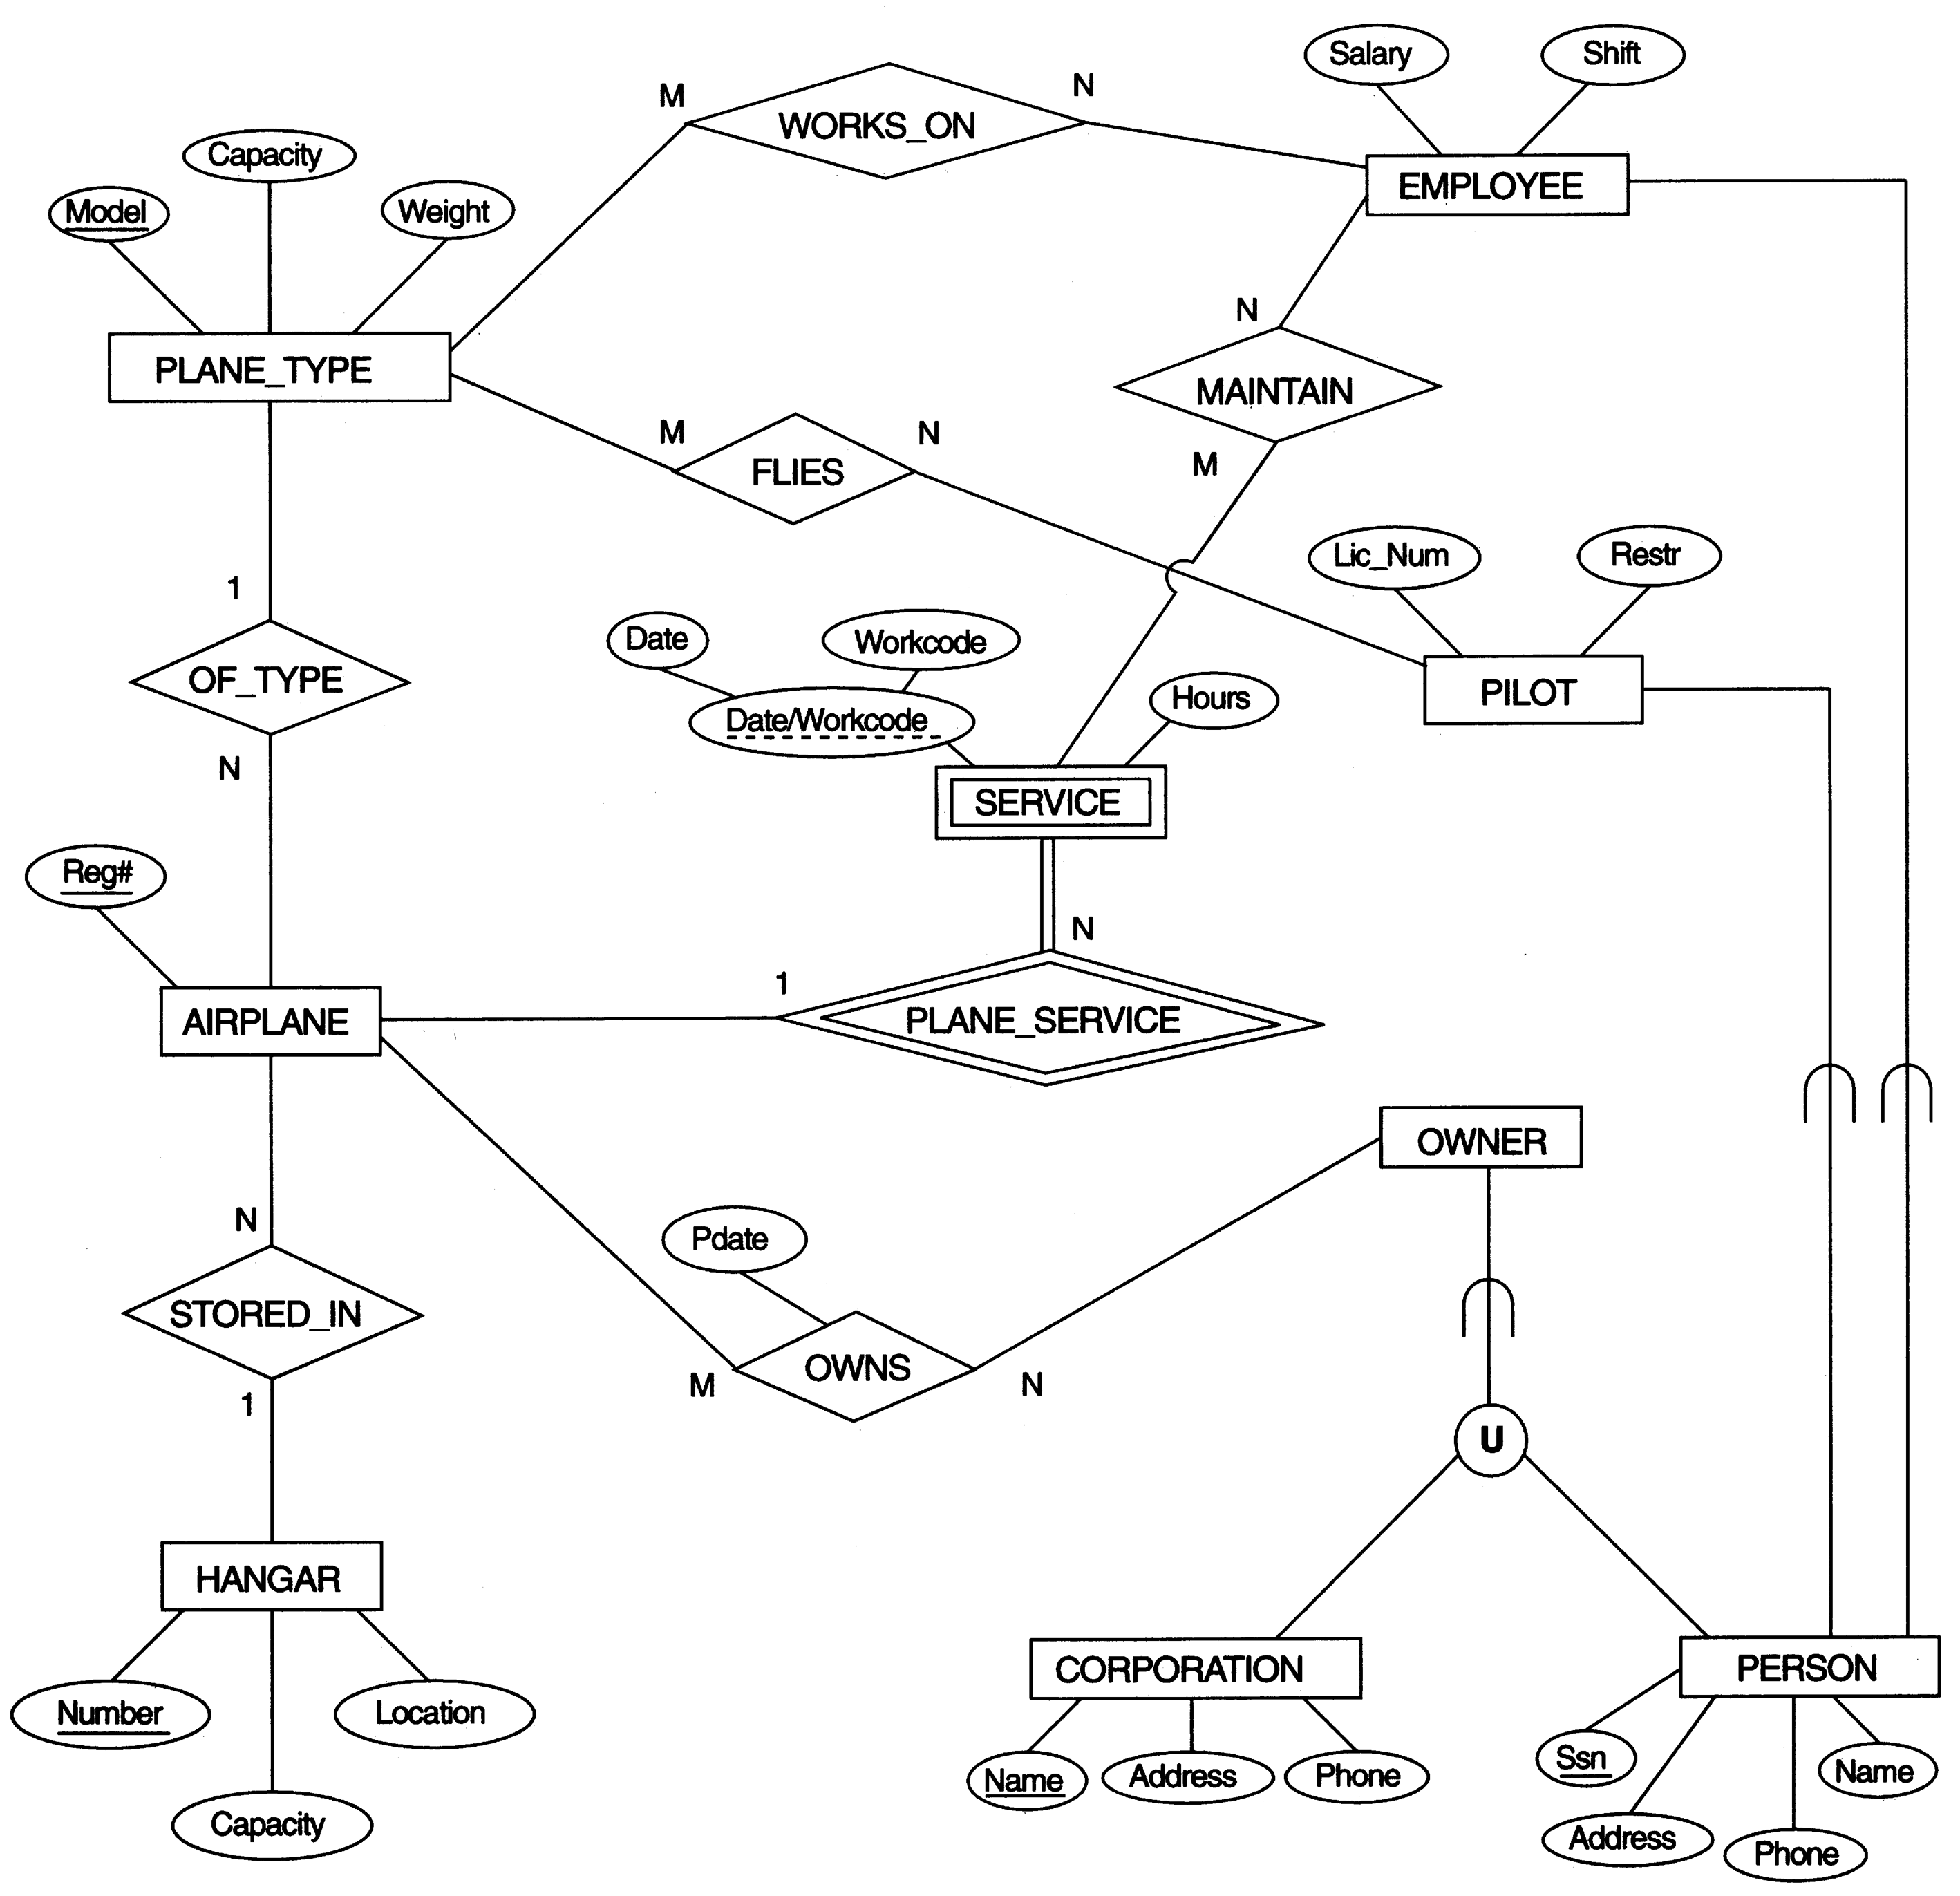
FIGURE 4.15
EER schema for a SMALL AIRPORT database.

