Slide 1

Chapter 5
The Relational Data Model and Relational Database Constraints

Slide 2
Chapter Outline
Relational Model Concepts
Relational Model Constraints and Relational Database Schemas
Update Operations and Dealing with Constraint Violations
Notes:
The RM was first introduced by Dr. Ted Codd of IBM research in 1970 in a classic paper, and attracted immediate attention to its simplicity and mathematical foundation.
The model users the concept of a mathematical relation – which looks somewhat like a table of values – as its basic building block, and has its theoretical basis in set theory and first-order predicate logic.
The first commercial implementations of the RM became available in early 80s, such as the Oracle DBMS and the SQL/DS system on the MVS OS by IBM.
Current popular relational DBMS include DB2 and Informix Dynamic Server (from IBM), Oracle and RDB (from oracle), and SQL server and Access (from Microsoft), mySQL.
In this chapter, we concentrate on describing the basic principles of the RM of data.

Slide 3
Relational Model Concepts
The relational Model of Data is based on the concept of a Relation.
The model was first proposed by Dr. T.F. Codd of IBM in 1970 in the following paper:
"A Relational Model for Large Shared Data Banks," Communications of the ACM, June 1970.
The above paper caused a major revolution in the field of Database management and earned Ted Codd the coveted ACM Turing Award.
Notes:
The relational Model of Data is based on the concept of a Relation.
A Relation is a mathematical concept based on the ideas of sets.
The strength of the relational approach to data management comes from the formal foundation provided by the theory of relations.

Slide 4
Informal Definitions
RELATION: A table of values
  A relation may be thought of as a set of rows.
  Each row represents a fact that corresponds to a real-world entity or relationship.
  Each row has a value of an item or set of items that uniquely identifies that row in the table.
  Each column typically is called by its column name or column header or attribute name.

Slide 5
Informal Definitions
Key of a Relation:
  Each row has a value of a data item (or set of items) that uniquely identifies that row in the table
    Called the key
  In the STUDENT table, SSN is the key
  Sometimes row-ids or sequential numbers are assigned as keys to identify the rows in a table
    Called artificial key or surrogate key

Slide 6
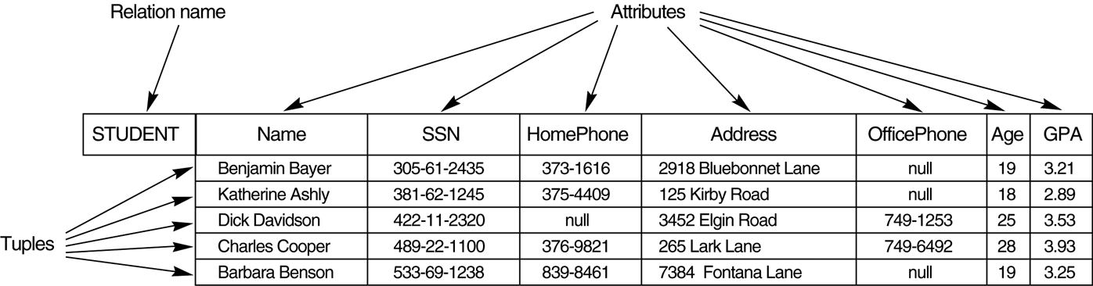
Example - Figure 5.1

Slide 7
Formal definitions
The Schema (or description) of a Relation:
  Denoted by R(A1, A2, .....An)
  R is the name of the relation
  The attributes of the relation are A1, A2, ..., An
Example:
CUSTOMER (Cust-id, Cust-name, Address, Phone#)
  CUSTOMER is the relation name
  Defined over the four attributes: Cust-id, Cust-name, Address, Phone#
Each attribute has a domain or a set of valid values.
  For example, the domain of Cust-id is 6 digit numbers.

Slide 8
Formal definitions
A row is called a tuple, which is an ordered set of values
A column header is called an attribute
  Each attribute value is derived from an appropriate domain.
The table is called a relation.
  A relation can be regarded as a set of tuples (rows).
The data type describing the types of values an attribute can have is represented by a domain of possible values.
Each row in the CUSTOMER table is a 4-tuple and consists of four values, for example.
<632895, "John Smith", "101 Main St. Atlanta, GA 30332", "(404) 894-2000">
A relation is a set of such tuples (rows).

Slide 9
Formal Definitions
A domain has a logical definition.
Example: “USA_phone_numbers” are the set of 10 digit phone numbers valid in the U.S.
A domain also has a data-type or a format defined for it.
  For example, the USA_phone_numbers may have a format: (ddd)-ddd-dddd where each d is a decimal digit.
  Dates have various formats such as month, date, year or yyyy-mm-dd, or dd mm,yyyy etc.

Slide 10
Formal Definitions
The relation is formed over the cartesian product of the sets; each set has values from a domain
The Cartesian product of two sets A and B is defined to be the set of all pairs (a, b) where a∈A and b∈B . It is denoted A×B , and is called the Cartesian product

Slide 11
An Example of Cartesian Product
R
S
A | B
a1 | b1
a2 | b2
X | Y
x1 | y1
x2 | y2
R
S
R × S
A | B
X | Y
A | B | C | D
a1 | b1
x1 | y1
a1 | b1 | x1 | x2
a1 | b1
x2 | y2
a1 | b1 | x2 | y2
a2 | b2
x1 | y1
a2 | b2 | x1 | y1
a2 | b2
x2 | y2
a2 | b2 | x2 | y2

Slide 12
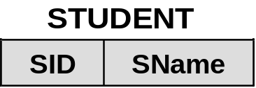
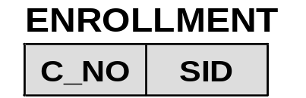
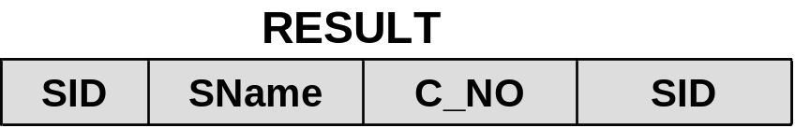
An Example of Cartesian Product
STUDENT
ENROLLMENT
SID | SName
111 | Williams
222 | Johnes
C_NO | SID
1000 | 111
2000 | 222
STUDENT × ENROLLMENT
111 | Williams
1000 | 111
111 | Williams | 1000 | 111
111 | Williams
2000 | 222
111 | Williams | 2000 | 222
222 | Johns
1000 | 111
222 | Johns | 1000 | 111
222 | Johns
2000 | 222
222 | Johns | 2000 | 222

Slide 13
Formal Definitions
The degree of a relation is the number of attributes n of its relation schema.
A relation schema R of degree n is denoted by
R(A1 , A2 , …, An )
The domain of Ai is denoted by dom(Ai).

Slide 14
DEFINITION SUMMARY
Informal Terms | Formal Terms
Table | Relation
Column | Attribute/Domain
Row | Tuple
Values in a column | Domain
Table Definition | Schema of a Relation
Populated Table | Extension

Slide 15
Characteristics of Relations
Ordering of tuples in a relation r(R):
  The tuples are not considered to be ordered, even though they appear to be in the tabular form.
Ordering of attributes in a relation schema R (and of values within each tuple):
  We will consider the attributes in R(A₁, A₂, ..., A_{n}) and the values in t=<v₁, v₂, ..., v_{n}> to be ordered .
Values in a tuple: All values are considered atomic (indivisible). A special null value is used to represent values that are unknown or inapplicable to certain tuples.

Slide 16
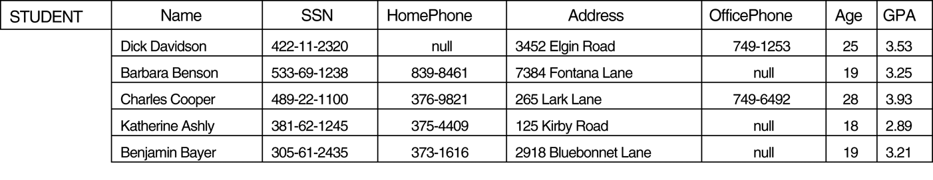
CHARACTERISTICS OF RELATIONS- Figure 5.2

Slide 17
Relational Integrity Constraints
Constraints are conditions that must hold on all valid relation states.
There are three main types of constraints in the relational model:
  Key constraints
  Entity integrity constraints
  Referential integrity constraints
Another implicit constraint is the domain constraint
  Every value in a tuple must be from the domain of its attribute (or it could be null, if allowed for that attribute)

Slide 18
Key Constraints
Superkey of R: Is a set of attributes SK of R with the following condition:
  No two tuples in any valid relation state r(R) will have the same value for SK
  That is, for any distinct tuples t1 and t2 in r(R), t1[SK] ≠ t2[SK]
  This condition must hold in any valid state r(R)
Key of R:
  A "minimal" superkey
  That is, a key is a superkey K such that removal of any attribute from K results in a set of attributes that is not a superkey (does not possess the superkey uniqueness property)

Slide 19
Key Constraints (continued)
Example: Consider the CAR relation schema:
  CAR(State, Reg#, SerialNo, Make, Model, Year)
  CAR has two keys:
    Key1 = {State, Reg#}
    Key2 = {SerialNo}
  Both are also superkeys of CAR
  {SerialNo, Make} is a superkey but not a key.
In general:
  Any key is a superkey (but not vice versa)
  Any set of attributes that includes a key is a superkey
  A minimal superkey is also a key

Slide 20
Key Constraints (continued)
If a relation has several candidate keys, one is chosen arbitrarily to be the primary key.
  The primary key attributes are underlined.
Example: Consider the CAR relation schema:
  CAR(State, Reg#, SerialNo, Make, Model, Year)
  We chose SerialNo as the primary key
The primary key value is used to uniquely identify each tuple in a relation and provides the tuple identity
Also used to reference the tuple from another tuple
  General rule: Choose as primary key the smallest of the candidate keys (in terms of size)
  Not always applicable – choice is sometimes subjective

Slide 21

CAR table with two candidate keys – LicenseNumber chosen as Primary Key

Slide 22
Relational Databases and Relational Database Schemas
Relational Database Schema:
  A set S of relation schemas that belong to the same database.
  S is the name of the whole database schema
  S = {R1, R2, ..., Rn}
  R1, R2, …, Rn are the names of the individual relation schemas within the database S
Following slide shows a COMPANY database schema with 6 relation schemas

Slide 23

Schema Diagram for the COMPANY Relational Database Schema

Slide 24
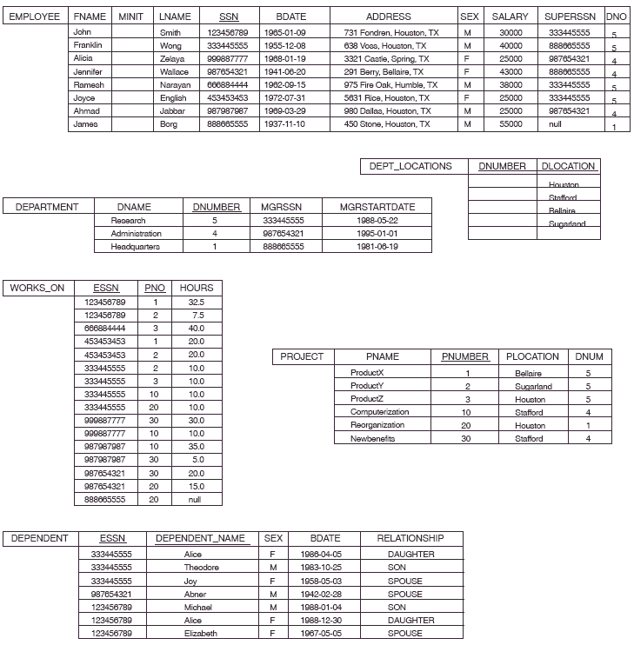
Figure 5.6 One possible database state for the COMPANY relational database schema

Slide 25
Entity Integrity
Entity Integrity:
  The primary key attributes PK of each relation schema R in S cannot have null values in any tuple of r(R).
    This is because primary key values are used to identify the individual tuples.
    t[PK] ≠ null for any tuple t in r(R)
    If PK has several attributes, null is not allowed in any of these attributes
  Note: Other attributes of R may be constrained to disallow null values, even though they are not members of the primary key.
Notes:
This is because primary key values are used to identify the individual tuples.

Slide 26
Referential Integrity
A constraint involving two relations.
Used to specify a relationship among tuples in two relations: the referencing relation and the referenced relation.
Tuples in the referencing relation R₁ have attributes FK (called foreign key attributes) that reference the primary key attributes PK of the referenced relation R₂. A tuple t₁ in R₁ is said to reference a tuple t₂ in R₂ if t₁[FK] = t₂[PK].
A referential integrity constraint can be displayed in a relational database schema as a directed arc from R₁.FK to R₂.PK

Slide 27
Displaying a relational database schema and its constraints
Each relation schema can be displayed as a row of attribute names
The name of the relation is written above the attribute names
The primary key attribute (or attributes) will be underlined
A foreign key (referential integrity) constraints is displayed as a directed arc (arrow) from the foreign key attributes to the referenced table
  Can also point the primary key of the referenced relation for clarity
Next slide shows the COMPANY relational schema diagram

Slide 28


Slide 29
Referential Integrity Constraint
The value in the foreign key column (or columns) FK of the referencing relation R1 can be either:
  a value of an existing primary key value of a corresponding primary key PK in the referenced relation R2, or
  a null.
In case (2), the FK in R1 should not be a part of its own primary key.
Example:
<"John”, “L”,, “Smith", 111222333, 1965-10-21, "101 Main St. Atlanta, GA 30332", M, 42000, 444555666, NULL>
<“Mary”, “J”,, “Burton", 111111111, 1972-1-18, “23 Maple St. Atlanta, GA 30310", F, 35000, NULL, 3>

Slide 30
Other Types of Constraints
Semantic Integrity Constraints:
  based on application semantics and cannot be expressed by the model per se
  Example: “the max. no. of hours per employee for all projects he or she works on is 56 hrs per week”
A constraint specification language may have to be used to express these
SQL-99 allows triggers and ASSERTIONS to express for some of these

Slide 31
Populated database state
Each relation will have many tuples in its current relation state
The relational database state is a union of all the individual relation states
Whenever the database is changed, a new state arises
Basic operations for changing the database:
  INSERT a new tuple in a relation
  DELETE an existing tuple from a relation
  MODIFY an attribute of an existing tuple
Next slide shows an example state for the COMPANY database

Slide 32

Populated database state for COMPANY

Slide 33
Update Operations on Relations
INSERT a tuple.
DELETE a tuple.
MODIFY a tuple.
Integrity constraints should not be violated by the update operations.
Several update operations may have to be grouped together.
Updates may propagate to cause other updates automatically. This may be necessary to maintain integrity constraints.

Slide 34
Update Operations on Relations
In case of integrity violation, several actions can be taken:
  Cancel the operation that causes the violation (RESTRICT or REJECT option)
  Perform the operation but inform the user of the violation
  Trigger additional updates so the violation is corrected (CASCADE option, SET NULL option)
  Execute a user-specified error-correction routine

Slide 35
Possible violations for each operation
INSERT may violate any of the constraints:
  Domain constraint:
    if one of the attribute values provided for the new tuple is not of the specified attribute domain
  Key constraint:
    if the value of a key attribute in the new tuple already exists in another tuple in the relation
  Referential integrity:
    if a foreign key value in the new tuple references a primary key value that does not exist in the referenced relation
  Entity integrity:
    if the primary key value is null in the new tuple

Slide 36
Possible violations for each operation
DELETE may violate only referential integrity:
  If the primary key value of the tuple being deleted is referenced from other tuples in the database
    Can be remedied by several actions: RESTRICT, CASCADE, SET NULL (see Chapter 8 for more details)
      RESTRICT option: reject the deletion
      CASCADE option: propagate the new primary key value into the foreign keys of the referencing tuples
      SET NULL option: set the foreign keys of the referencing tuples to NULL
  One of the above options must be specified during database design for each foreign key constraint

Slide 37
Possible violations for each operation
UPDATE may violate domain constraint and NOT NULL constraint on an attribute being modified
Any of the other constraints may also be violated, depending on the attribute being updated:
  Updating the primary key (PK):
    Similar to a DELETE followed by an INSERT
    Need to specify similar options to DELETE
  Updating a foreign key (FK):
    May violate referential integrity
  Updating an ordinary attribute (neither PK nor FK):
    Can only violate domain constraints

Slide 38
Summary
Presented Relational Model Concepts
  Definitions
  Characteristics of relations
Discussed Relational Model Constraints and Relational Database Schemas
  Domain constraints
  Key constraints
  Entity integrity
  Referential integrity
Described the Relational Update Operations and Dealing with Constraint Violations

Slide 39
In-Class Exercise
(Taken from Exercise 5.15)
Consider the following relations for a database that keeps track of student enrollment in courses and the books adopted for each course:
STUDENT(SSN, Name, Major, Bdate)
COURSE(Course#, Cname, Dept)
ENROLL(SSN, Course#, Quarter, Grade)
BOOK_ADOPTION(Course#, Quarter, Book_ISBN)
TEXT(Book_ISBN, Book_Title, Publisher, Author)
Draw a relational schema diagram specifying the foreign keys for this schema.

